Slide 1
How fashion influences the modern world

Slide 2
Global Fashion Trends
helloSustainable materials will dominate the industry
Personalized clothing through 3D printing will rise
Virtual try-on and augmented reality will enhance shopping
Eco-friendly production methods will become the norm

Slide 3

Global Fashion Trends
Sustainable clothing is gaining popularity
Luxury brands are incorporating streetwear
Athleisure wear continues to influence
Digital platforms are shaping fashion choices

Slide 4
Fashion Media Impact
Management positions in various departments
Sales and marketing roles with growth potential
Information technology and software development opportunities
Research and development positions for innovation and advancement

Slide 5
Runway Show Influence
Runway Show Influence
Fashion trends are set by designers
Influences consumer purchasing decisions
Impacts beauty and cosmetic industry

Slide 6
Career Opportunities Available
Management positions in various departments
Sales and marketing roles with growth potential
Information technology and software development opportunities
Research and development positions for innovation and advancement

Slide 7
Fashion Media Impact
Management positions in various departments
Sales and marketing roles with growth potential
Information technology and software development opportunities
Research and development positions for innovation and advancement

Slide 8
Digital Fashion Boom
Fashion industry contributes to GDP growth
Employment opportunities in design and manufacturing
Textile exports generate significant revenue
Sustainable fashion practices reduce environmental costs

Slide 9
Sustainable Fashion Rise
Increased consumer awareness of environmental impact
Growing demand for eco friendly clothing
Reduced waste through recycling and upcycling
Ethical production practices gaining prominence

Slide 10
Fashion Technology Advances
Digital printing enables precise designs
Laser cutting improves fabric precision
Smart fabrics integrate wearable technology
Virtual try-on enhances customer experience

Slide 11
Consumer Behavior Study
Consumer motivation and decision making
Product knowledge and preference formation
Impact of external factors on purchasing behavior
Cultural and social influences on consumer choices

Slide 12
Cultural Exchange Through
Artistic collaborations
Music festivals
Educational programs
Language classes

Slide 13
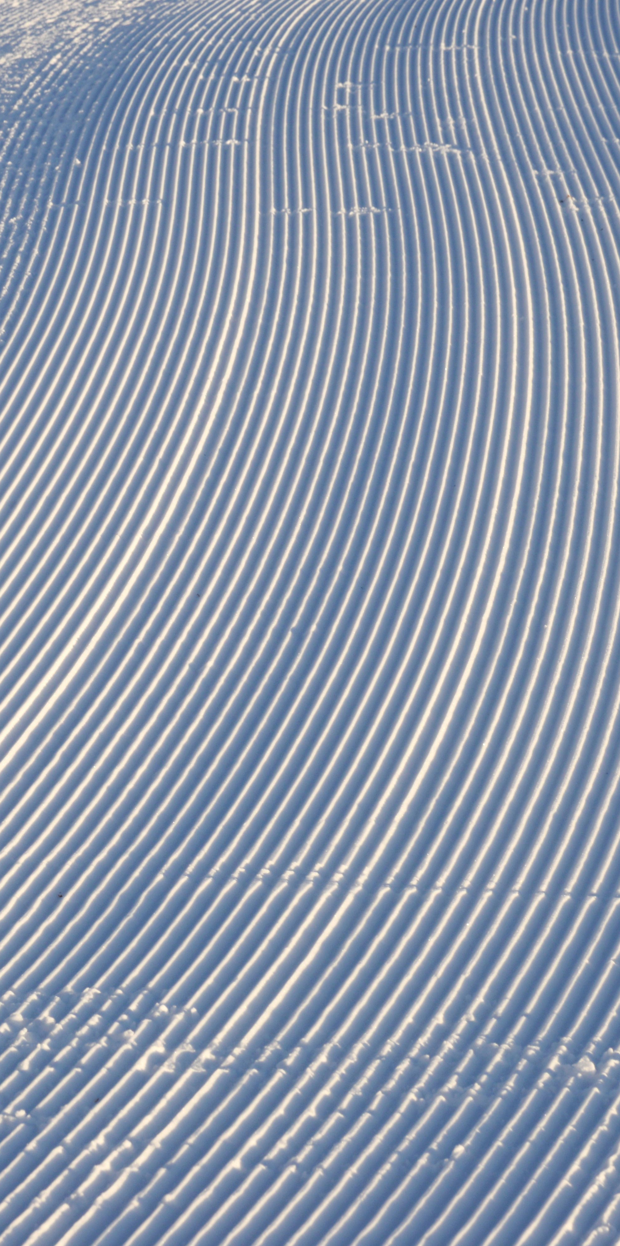
Fashion Economic Impact
Fashion industry contributes to GDP growth
Employment opportunities in design and manufacturing
Textile exports generate significant revenue
Sustainable fashion practices reduce environmental costs

Slide 14

Fashion Marketing Strategies
Brand positioning to target specific demographics
Influencer partnerships to increase brand awareness
Social media campaigns to engage with customers
Digital advertising to reach a wider audience

Slide 15
Cultural Exchange Through
Artistic collaborations
Music festivals
Educational programs
Language classes

Slide 16
Digital Fashion Boom
Fashion industry contributes to GDP growth
Employment opportunities in design and manufacturing
Textile exports generate significant revenue
Sustainable fashion practices reduce environmental costs

Slide 17
Fashion Media Impact
Management positions in various departments
Sales and marketing roles with growth potential
Information technology and software development opportunities
Research and development positions for innovation and advancement

Slide 18
Cultural Exchange Through
Artistic collaborations
Music festivals
Educational programs
Language classes

Slide 19
Global Fashion Trends
helloSustainable materials will dominate the industry
Personalized clothing through 3D printing will rise
Virtual try-on and augmented reality will enhance shopping
Eco-friendly production methods will become the norm

Slide 20
Future Fashion Predictions
Sustainable materials will dominate the industry
Personalized clothing through 3D printing will rise
Virtual try-on and augmented reality will enhance shopping
Eco-friendly production methods will become the norm

Slide 21
Thank you

