Slide 1
Finance Pipeline
Dev. : Sadiya Shaikh

Slide 2
Project at a Glance
AI-powered Wealth Relationship Manager assistant
Combines financial news, client portfolio data and meeting information
Produces personalized market outlooks, RM talking points and sector signals
Built around a deterministic multi-stage workflow with LLM-powered components
Digital Wealth RM Assistant • 2/20

Slide 3
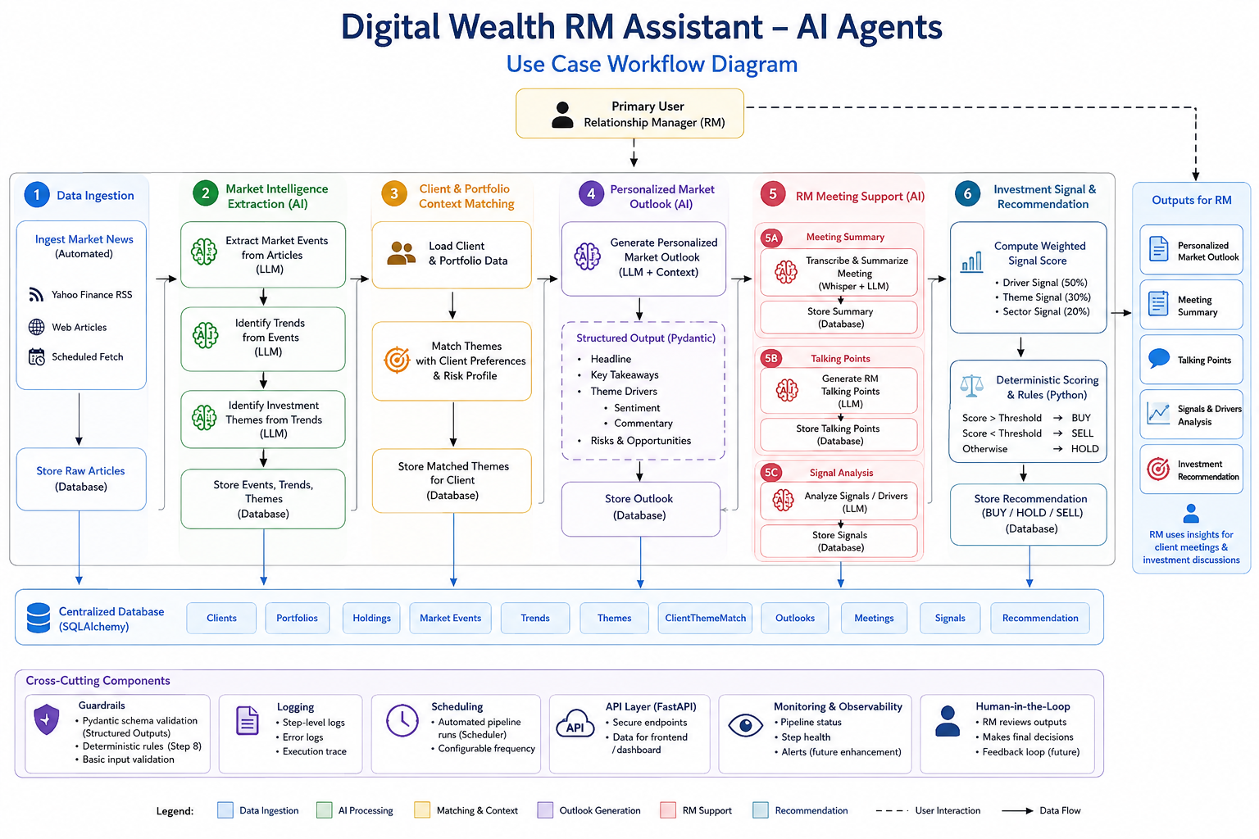

Slide 4
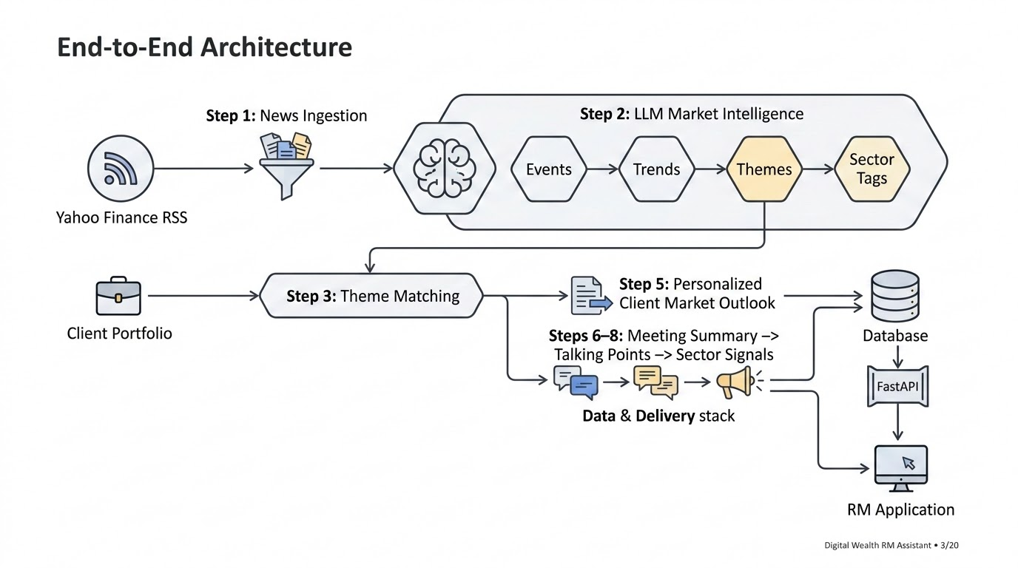

Slide 5
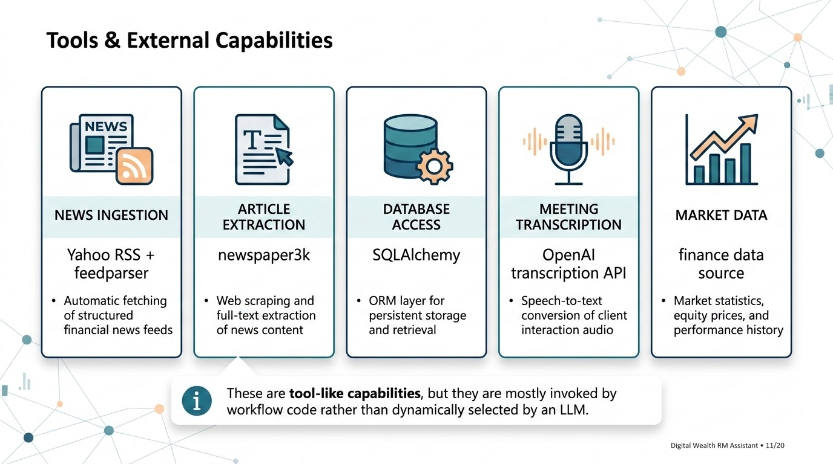

Slide 6
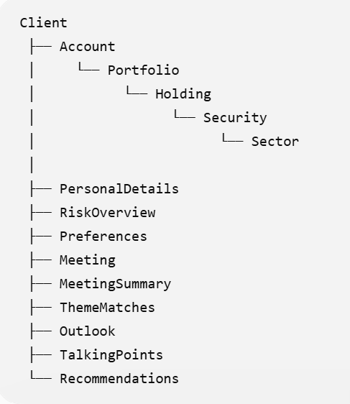
DB Design

Slide 7
Visual of storing Actual data
ARTICLE 42: "NVIDIA Beats Q4 Earnings, Fed Signals Rate Cut"
│
├─ EVENT 100: "NVIDIA beats earnings" (EARNINGS)
│ ├─ links to TREND 1000 (score: 0.95) → THEME 500: "AI Revolution"
│ │ ├─ Semiconductors (+Positive, 0.95)
│ │ └─ Energy (-Negative, 0.70)
│ │
│ └─ links to TREND 1001 (score: 0.3) → THEME 501: "Monetary Tightening"
│
└─ EVENT 101: "Fed signals rate cut" (MACRO)
└─ links to TREND 1001 (score: 0.92) → THEME 501: "Monetary Tightening"

Slide 8
Model + Harness
Model: OpenAI GPT models accessed through LangChain
LLM use cases: news analysis, outlook generation, meeting summarization, talking points and signals
Harness: custom combination of pipeline.py + LangChain + SQLAlchemy + FastAPI + scheduler
The project uses a lightweight custom orchestration layer rather than a dedicated autonomous-agent harness
Digital Wealth RM Assistant • 4/20

Slide 9
Prompts & System Instructions
Step 2 uses task-specific prompts for event extraction, trend clustering, themes and sector/sentiment tagging
Step 5 prompt combines client, portfolio, matched-theme and news context to generate an outlook
Steps 6–8 use specialized prompts for meeting and RM workflows
Current prompts combine role/instructions/context/task; a future improvement is explicit separation of system, developer, user and output instructions
Digital Wealth RM Assistant • 5/20

Slide 10
State & Memory
Persistent state is stored in the relational database through SQLAlchemy
Pipeline state flows through entities such as NewsArticle → MarketEvent → Trend → Theme → ClientThemeMatch
Client, portfolio, holdings, preferences, meetings and generated outputs persist across runs
This is persistent application memory—not conversational agent memory or vector memory
Digital Wealth RM Assistant • 6/20

Slide 11
Guardrails & Structured Output
Pydantic schemas constrain and validate LLM responses
Structured outputs make AI results usable by downstream database/API layers
Deterministic Step 8 scoring rules reduce unrestricted LLM control over signals
Current guardrails are basic; missing areas include prompt-injection protection, PII checks, hallucination validation and stronger financial-safety controls
Digital Wealth RM Assistant • 7/20

Slide 12
Middleware & Retries
FastAPI provides the application/API layer, but sophisticated agent middleware is not currently a major part of the design
Current exception handling is not equivalent to robust retry
Important improvement: retry failed LLM calls with exponential backoff
Track processing_status, retry_count, last_error and processed_at
Do not mark an article as successfully processed when an LLM stage fails
Digital Wealth RM Assistant • 8/20

Slide 13
Logging & Observability
Python logging provides basic execution/error visibility
Current logging is closer to application logs than full LLM observability
Recommended trace fields: trace_id, client_id, step, model, prompt version, latency, tokens, retries, validation status and errors
Future: centralized traces, cost monitoring and LLM evaluation
Digital Wealth RM Assistant • 9/20

Slide 14
Agent Loop vs Workflow
Current architecture is primarily a deterministic workflow: Step 1 → Step 2 → Step 3 → Step 5 → Steps 6–8
A true agent loop is Model → Tool → Result/State → Model → … → Final response
The current system does not let an LLM dynamically choose the next step
For finance, deterministic orchestration can be preferable because it improves control and auditability
Digital Wealth RM Assistant • 10/20

Slide 15
Context Engineering
One of the strongest parts of the project
Step 5 does not send a generic 'give me a market outlook' request
It assembles relevant client context: portfolio + holdings + risk/preferences + matched themes + relevant news
Context is narrowed through the relational chain from client/theme matches back to relevant market information
This enables personalized rather than generic LLM output
Digital Wealth RM Assistant • 12/20

Slide 16
RAG / Retrieval
The project does not implement classic vector RAG
No primary flow of chunking → embeddings → vector database → similarity search
Instead it uses relational/database-driven retrieval
Example: Client → ClientThemeMatch → Theme → Trend → MarketEvent → NewsArticle → LLM
Accurately describe this as database-driven contextual retrieval or RAG-like retrieval, not traditional vector RAG
Digital Wealth RM Assistant • 13/20

Slide 17
Multi-Agent Assessment
The repository contains multiple specialized AI stages
Market intelligence extraction
Client outlook generation
Meeting summarization
Talking-point generation
Recommendation/signal generation
Technically, these are closer to specialized AI workflow components than fully autonomous agents
Digital Wealth RM Assistant • 14/20

Slide 18
Human-in-the-Loop
AI generates market outlooks, talking points and signals
The Relationship Manager consumes the outputs and makes the final decision
Current human-in-the-loop behavior is implicit rather than a formal approval workflow
Recommended: require explicit RM review before any strong investment action or recommendation is surfaced as actionable
Digital Wealth RM Assistant • 15/20

Slide 19
Final Summary
Model: GPT via LangChain
Harness: custom pipeline + LangChain + DB + API
Prompts: specialized per AI task
State: relational database
Memory: persistent client/business data
Guardrails: structured outputs + deterministic rules
Tools: news, database, transcription, market data
Context engineering: portfolio + themes + relevant news
Agent loop: limited; mostly deterministic workflow
Main next step: production-grade reliability, security, observability and evaluation
Digital Wealth RM Assistant • 20/20

Slide 20
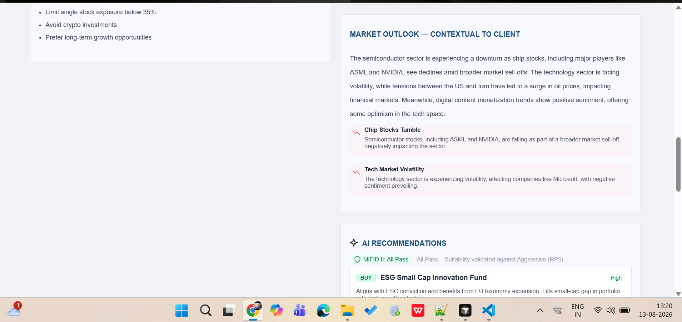

Slide 21
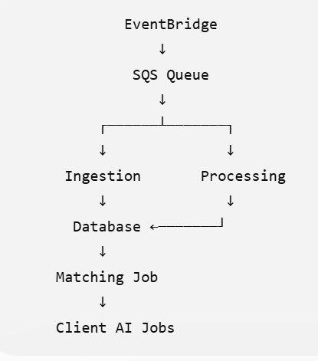
right now it is tightly coupled we can make it like

