Slide 1
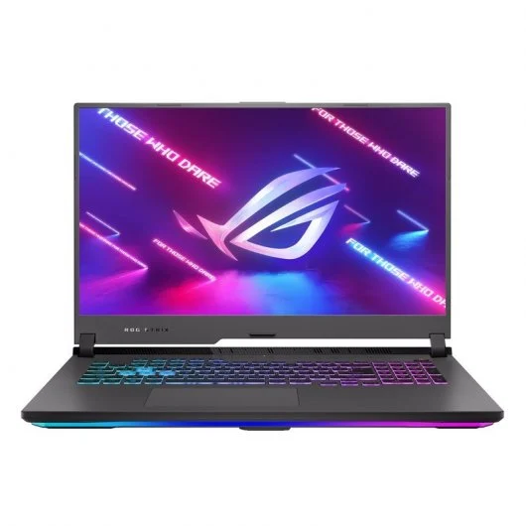
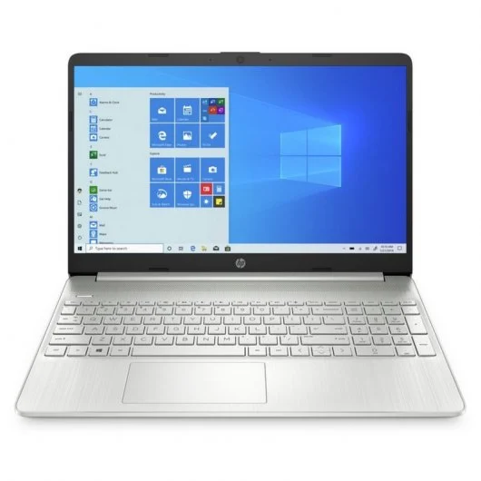
Asus ROG Strix G17 G713IC-HX011
AMD Ryzen 7 4800H/16GB/1TB SSD/RTX 3050/17.3"
999€
HP 15s-fq4028ns Intel Core i5-1155G7/16GB/512GB SSD/15.6"
649€
PVP749€
PVP1399€

