Slide 1
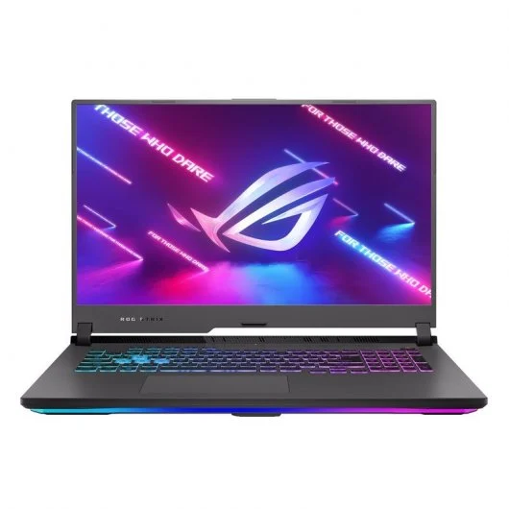
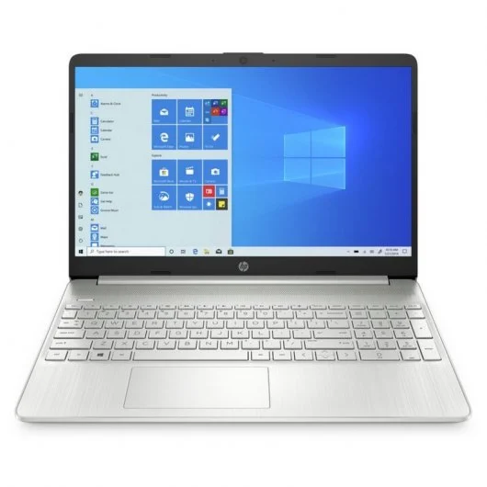
HP 15s-fq4028ns
Intel Core i5-1155G7/16GB/512GB SSD/15.6"
649€
Asus ROG Strix G17 G713IC-HX011
AMD Ryzen 7 4800H/16GB/1TB SSD/RTX 3050/17.3"
999€
PVP749€
PVP1399€
HP 15s | Asus ROG Strix G17
Processor Intel Core i5-1155G7 | Processor AMD Ryzen 7 4800H
16GB RAM | 16GB RAM
Memory 512GB SSD | Memory 1TB SSD
15.6 inches Screen | 17.3 inches Screen
This one meets all my needs and the price is more affordable | It has amazing properties but it is a bit expensive

