Slide 1
PreFlowd Prediction and Prevention of Flood through pre-Flood water diversion to water-crisis areas
Template for Master Plan for Effective-Decision Making

Slide 2
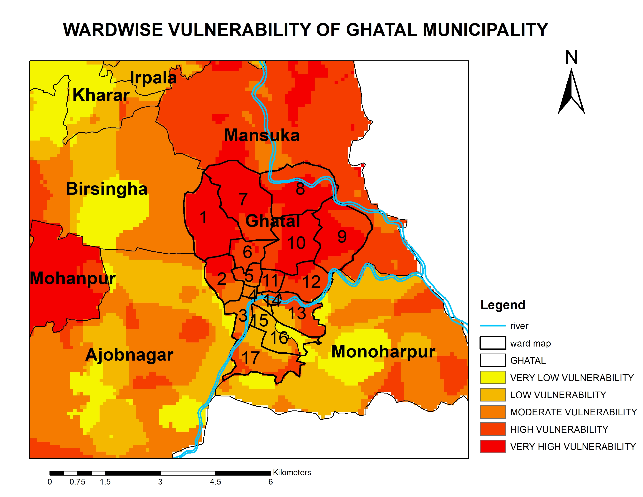
Problem statement
Ghatal (or, Dwarekeshar /Shilabati Basin) used to face floods every year
The flood height reaches 5 ft on the left bank of Shilabati
The waterlogging condition persists for 15-30 days

Slide 3
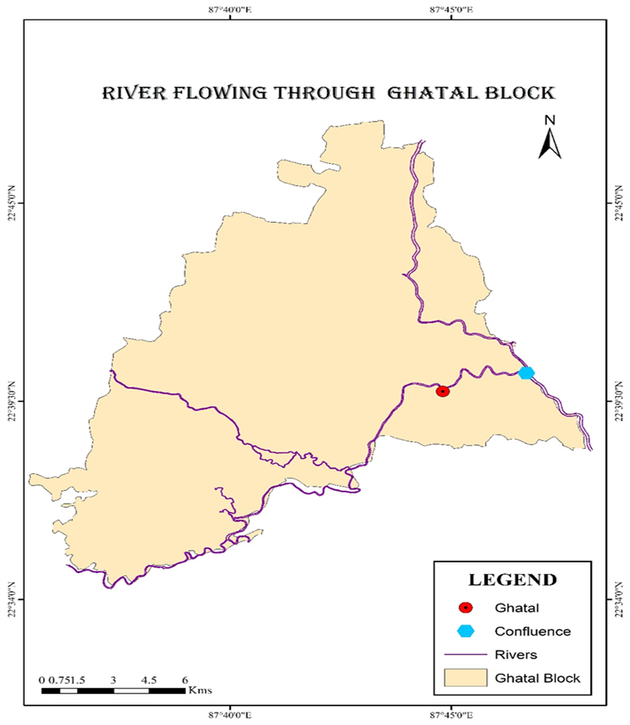
The Shilabati River (also known as Shilai) originates near Chak Gopalpur village of Hura block in the Purulia district of the Indian state of West Bengal.
It flows almost southeasterly through the districts of Bankura and Paschim Medinipur.
The Shilabati joins the Dwarakeswar near Ghatal and afterward is known as Rupnarayan.
It finally joins the Hooghly River, which empties into the Bay of Bengal.

Slide 4
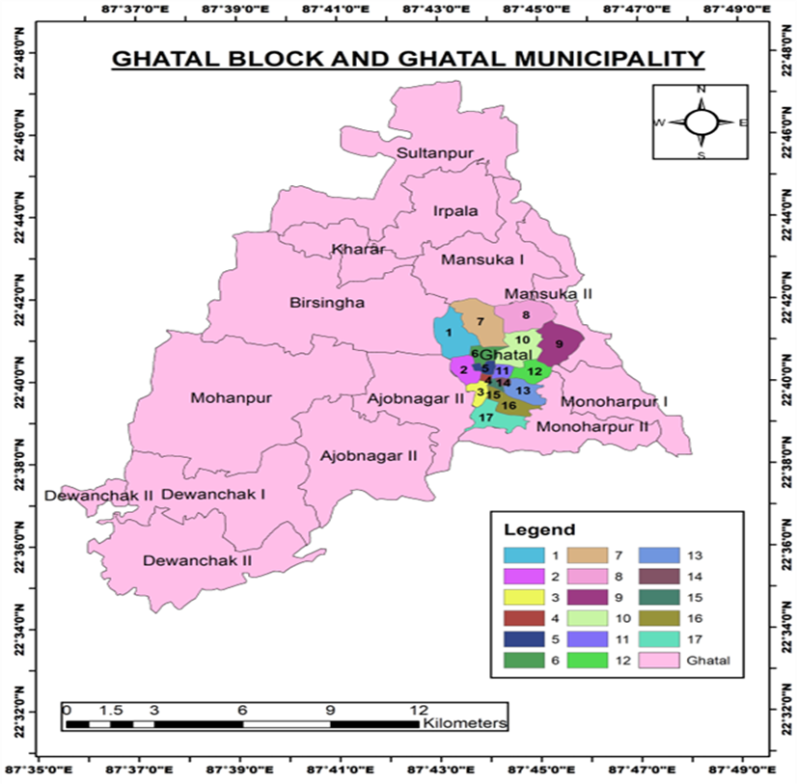
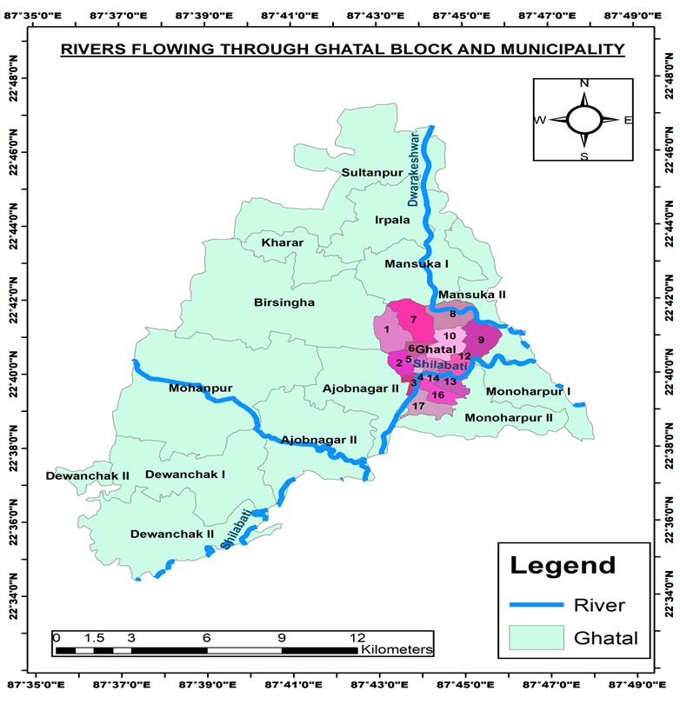

Slide 5
STRENGTHS Maximum people have their own house funded by government Boats for transportation are available throughout the year | WEAKNESS Overflow of Shilabati river. Topography of the area is uneven
OPPORTUNITIES Many works are being carried on the Ghatal region, so there is always a chance of improvement of the policies and developmental plans. Ghatal Master Plan | CHALLENGES No work on the Ghatal circuit embankment has been done since the British period. Since it is entirely a rural area, the poverty level is high.

Slide 6
Expected Process Flow
Flood Prediction
Prevention Mechanism
Expected Solutions
Artificial Structural:
Check and Simulate consequences of our Manual/Intelligent Intervention
Precautions:
Inputs Required
New Diversion
Old reconnection by restoration
Natural:
Embankments and Dams
Plantation embankments
DEM of a specific Watershed
Precipitation over the Watershed
Water ph control to prevent heavy metal present under the river bed from coming out
Discharge data
Field verification
Detention Basin
Upstream watershed management structures
Check:
Possibility of establishing the measures

Slide 7
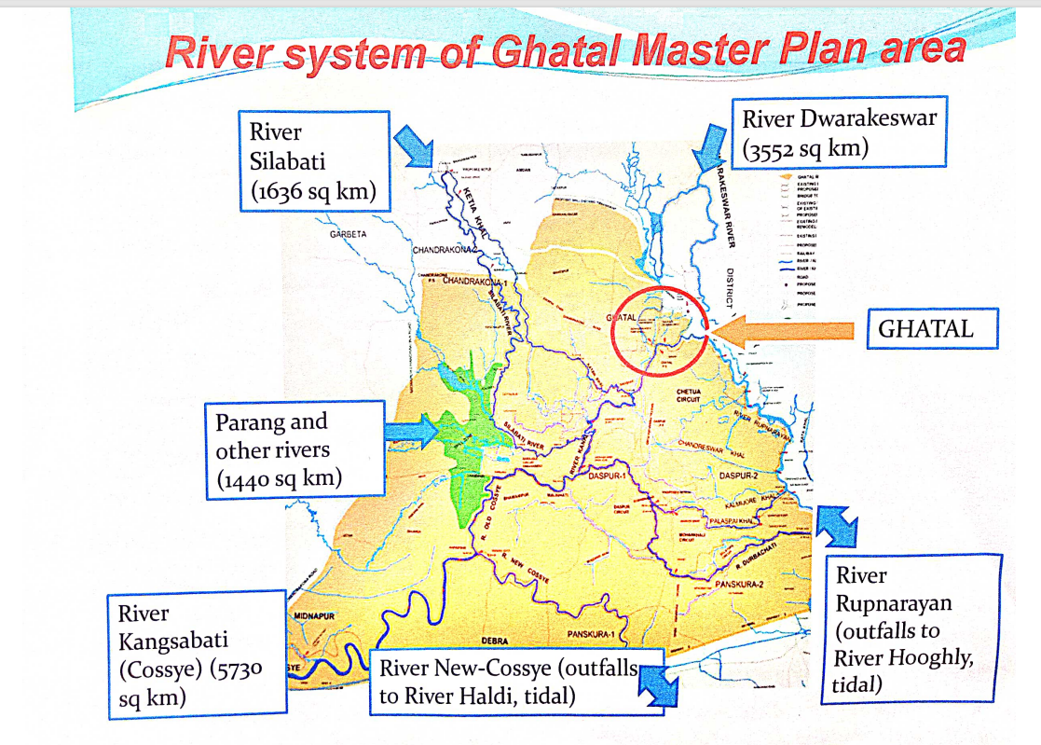
Evolving on the previous Master Plans
Source : Irrigation and waterways department

Slide 8
Simultaneous Processes
Water Crisis Area Prediction
Priority for historically drought affected areas
Spatial Flood Prediction
Use spatio-temporal Temperature, Humidity, Precipitation, Water Discharge and Digital Elevation Model
Simulation for Time based Pro-Active Intelligent Interventions

Slide 9
Start
Use input parameters for simultaneous processing
Simulate consequences of the solution with updated Decision Inputs
Either Flood or Drought Predicted. Severity check (Impact Assessment). Is intelligent human intervention necessary and required?
Flood Prediction (Algo & Simulation)
Drought Prediction (Algo & Simulation)
NO: Continue Simulation where left off till simulation accuracy dies down.
This essentially creates a Decision Tree with each Decision Node giving rise to new possibilities of managing the river flow. Each Node is a predicted problem of Flood or Drought and the Edges originating from a Node refers to the different solution strategies suggested by the Algorithm as well as the possibility of no Intelligent action (i.e. positive or negative consequences of the ignorance).
Store the Timestamped Environmental States for each Simulation (Example: Original Simulation, 1st Intervention Simulation, 2nd Intervention Simulation which is an alternate solution of the original problem, 1-1 Simulation (it refers to if after the 1st Intervention, an after-effect needs to be managed, which is done through the subtree 1 intervention)
YES
PreFlowd Algorithm finds multiple solutions (i.e. decisions of previous water diversion over different times at places from where the pre-flood water is coming from). Each of these possible solutions are stored (in an array) and the outcome of each solution is further simulated using the updated inputs which were changed due to human decision.
The best pathway to choose for the intelligent intervention would be based on:
Minimum Cumulative Impact Assessment (may be weighted with accuracy of the Simulations as it degrades with Time)
Closeness of the chosen intervention (i.e. Environmental Parameters) with the pathway of no-intervention, essentially mapping out a different trajectory of reaching similar and safe environmental states through minimal human intervention
End

Slide 10
Team Members
Name | Designation | Email
Santanu Banerjee | MS in Operation Research from Department of Industrial and Systems Engineering in IIT Kharagpur | sanerji9@gmail.com
Papia Das | M. Sc in GeoInformatics from Adamas University | papiad984@gmail.com
Ranajit Adhikari | Masters in GeoSpatial from Burdwan University | adhikariranajit60@gmail.com
Manisha Baral | Assistant Professor, Adamas University | manisha.baral26@gmail.com
Kasturi Mukherjee | Associate Professor, Adamas University | mukherjee.kasturi86@gmail.com

