Slide 1
Prediction and Prevention of Flood through pre-Flood water diversion to water-crisis areas

Slide 2



ABOUT THE PROJECT
DATA
MODEL
PRODUCT
We have collected layers of data for the specific concerned watershed of Ghatal
We believe with the help of advanced prediction tools, natural disasters like floods can be predicted and prevented by taking multiple strategic steps back-in-time
The final algorithm-and-code is under development

Slide 3
Strategic water diversion for foresightful solutions at diverse timescales and geographical locations
State the problem in one in one sentence
RESEARCH GAP
COSTS INVOLVED for:
Based on Literature reviews, we find that algorithm development for flood prevention is poorly dealt with as yet. Ming 2020 (https://doi.org/10.1029/2019WR025583) talks about DEM alteration but does not implement it.
Acquiring precision data
Implementability of results based on surveys
Strategic canal infrastructure development for enforcement of suggested solutions
USERS
USABILITY
Governments and decision makers for diverting pre-flood water through separate channels
Specific training of the Neural Networks wrt. concerned watersheds or solution-implementation areas (which ever is larger) must be done. As a future vision, a worldwide integrated NN could be developed which would be able to suggest optimal measures.

Slide 4
SOLUTION
CLOSE THE GAP
We are using a Convolutional Long Short Term Memory based Neural Network to train the acquired layered datasets.
TARGET AUDIENCE
People affected by floods to get relief
COST SAVINGS
Depends on the affected areas and the impact of the flood. Implementation would require separate budget allocation for each watershed.
EASY TO USE
User Interface is yet to be designed, as yet we are focused on a single watershed case study.
Product
PreFlowd water diversion suggestion system (under development)

Slide 5
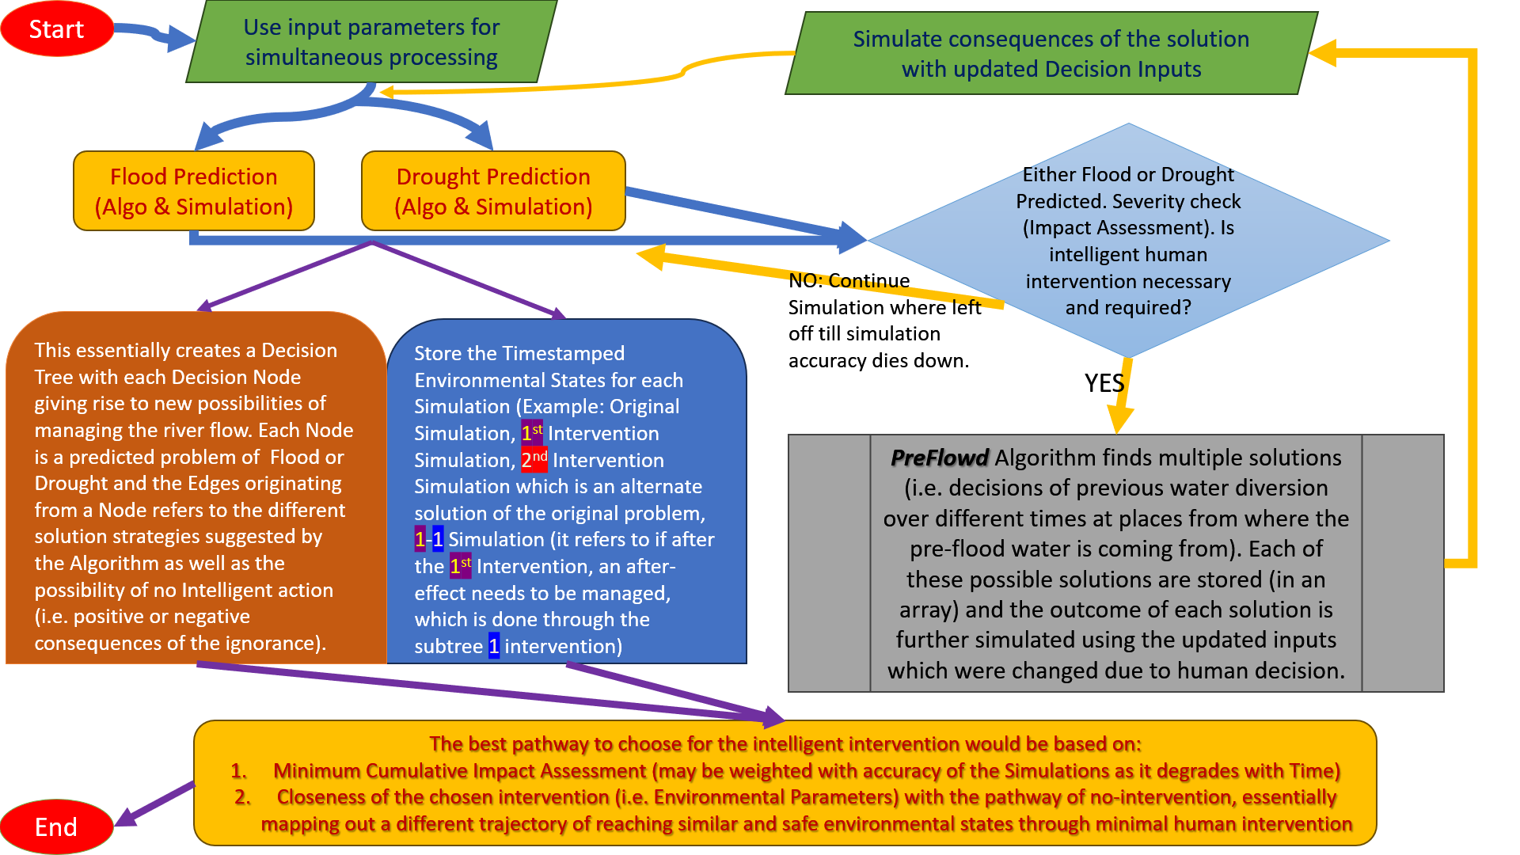
The overall architecture and logic flow of the Convolutional LSTM under development

Slide 6
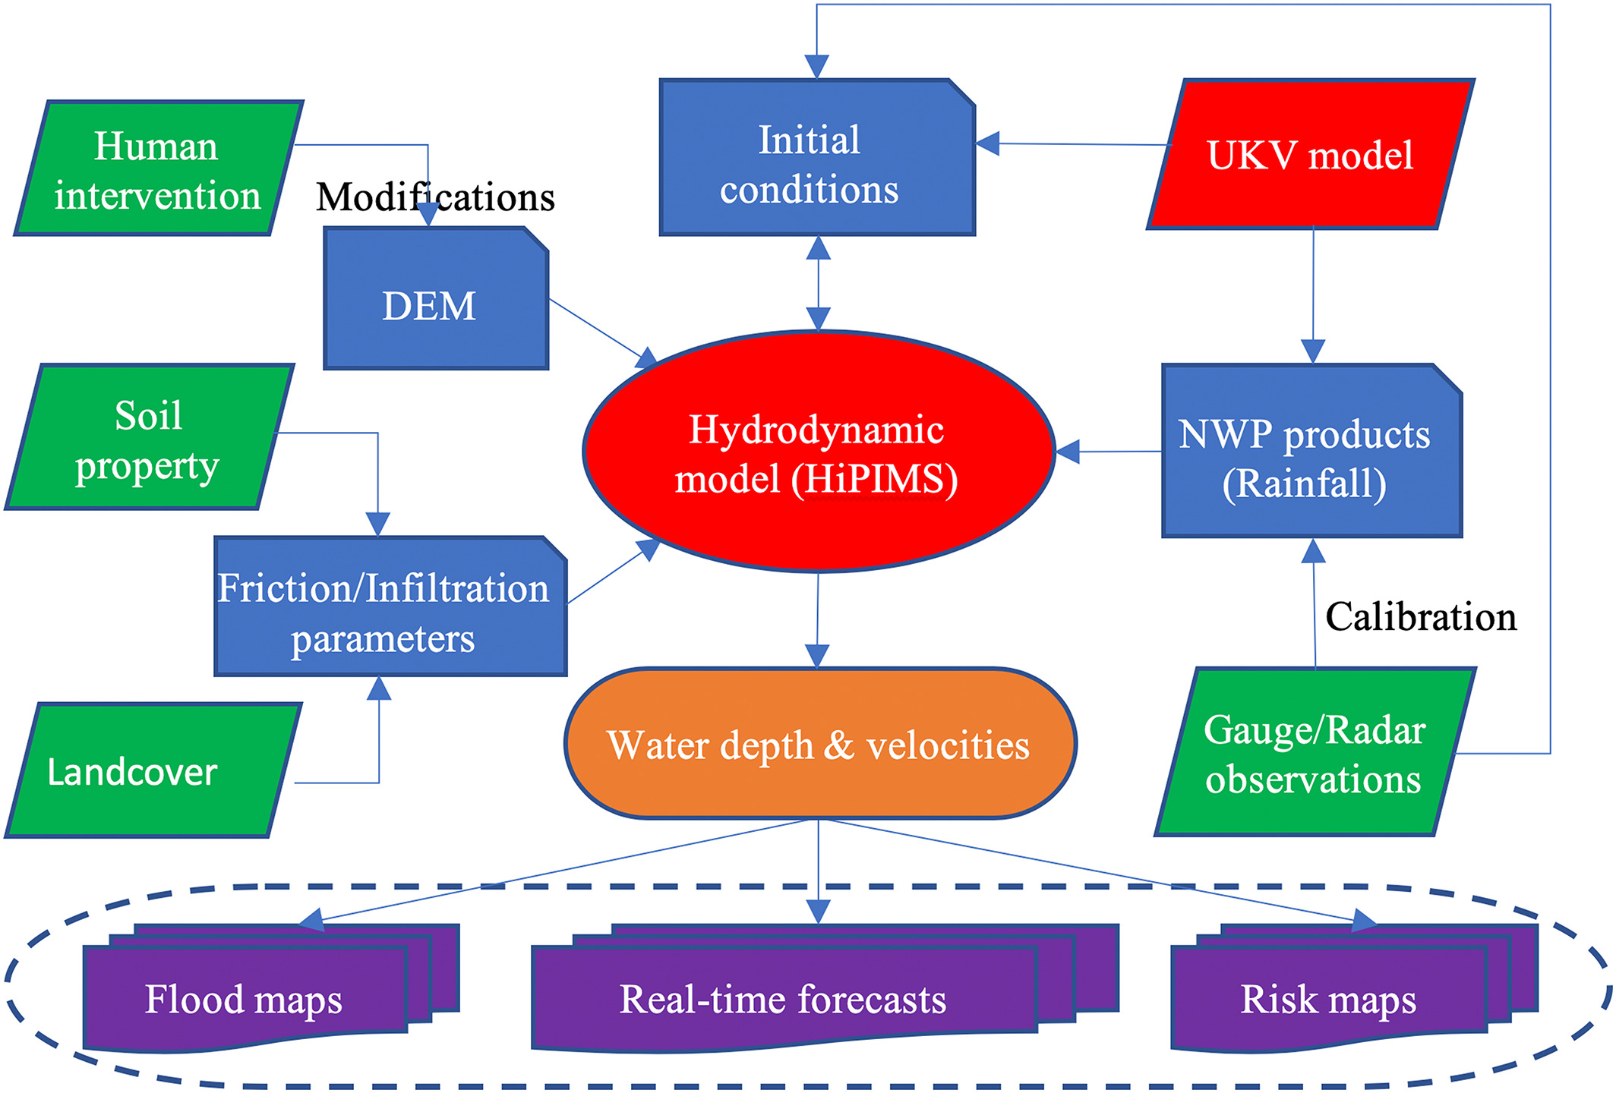
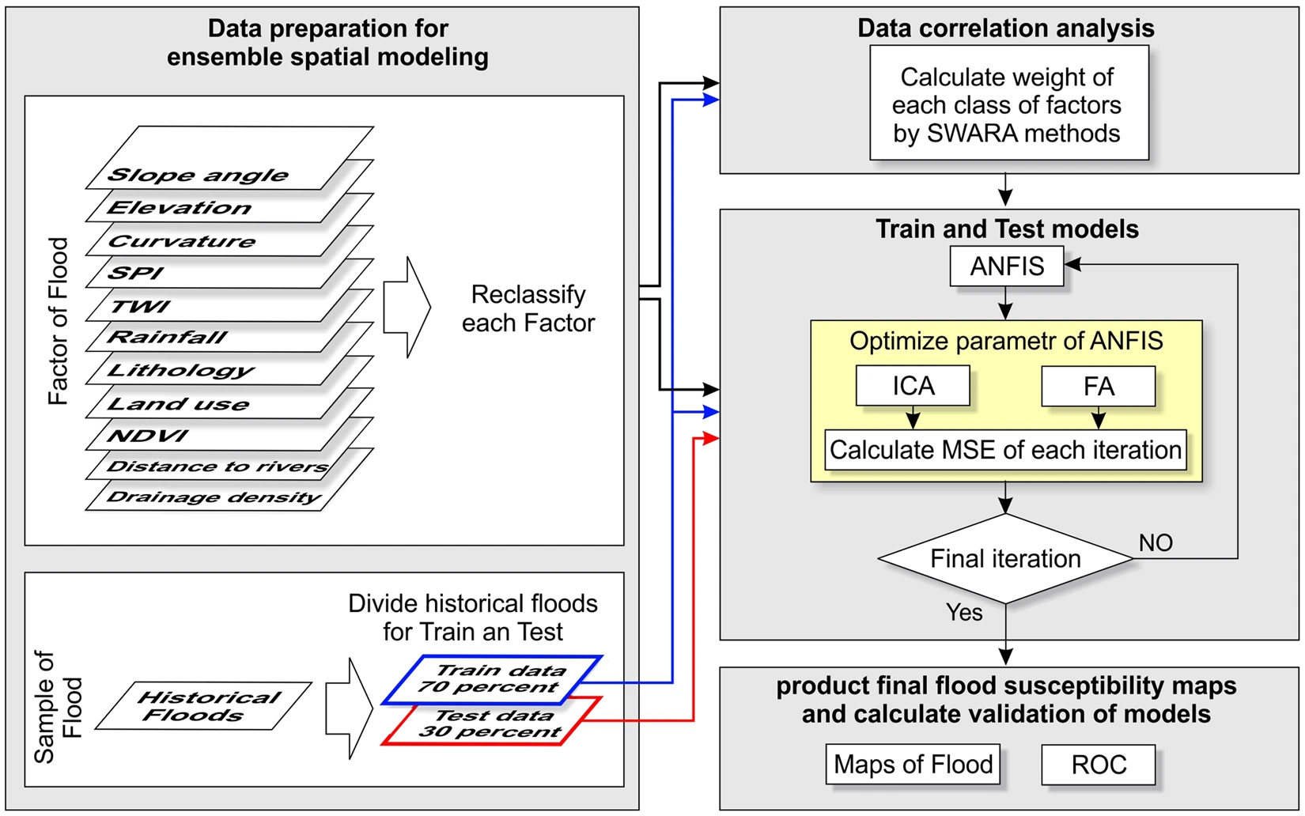
Literature Review
Ming 2020 (https://doi.org/10.1029/2019WR025583) Fig.1
suggests Human Intervention possibilities
Bui 2018 (https://doi.org/10.1029/2019WR025583) Fig.8
suggests the different layers as factors for Flood forecasting.
We consider a few of these factors to train the Conv-LSTM.

Slide 7
MAJOR CHALLENGES/DRWABACK
2
3
A pre-flood water-diversion system is an essential to be trained accurately, therefore deeper expert collaboration is sought
NO
COMPETITORS
Data Acquiring and refinement is a time-taking & mammoth task
Obtainable market
Necessary intervention
Decision Support System

Slide 8
ONE-YEAR ACTION PLAN
Working Algorithm Deployment
Sept-Oct 2023
2023
JAN
FEB
MAR
APR
MAY
JUN
JUL
AUG
SEP
OCT
NOV
DEC
2024
JAN
FEB
MAR
APR
MAY
JUN
JUL
AUG
SEP
OCT
NOV
DEC
Test with Government
Regional launch
Feedback based on usage and results
Feb 2024
July 2024
Dec 2024

Slide 9
Team
Santanu Banerjee (MS Operations Research, IITKGP)
Papia Das (MSc GeoInformatics, Adamas University)
Ranajit Adhikari (Masters in GeoSpatial, Burdwan University)
Manisha Baral (Assistant Professor, Adamas University)
Kasturi Mukherjee (Associate Professor, Adamas University)

Slide 10
THANK YOU

