Slide 1

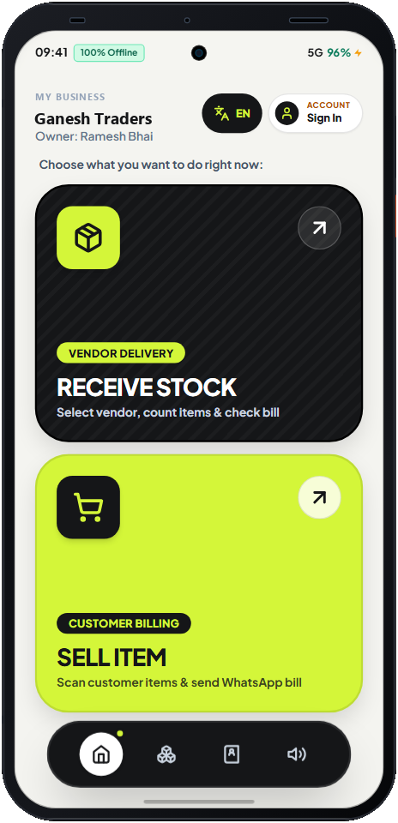
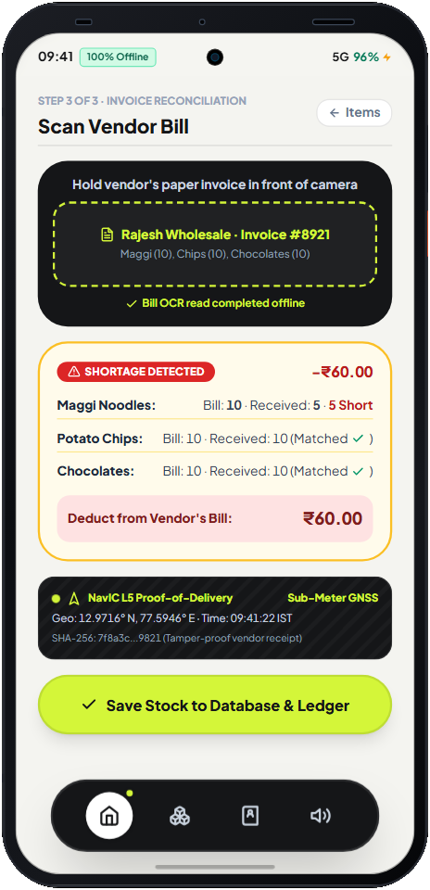

2026 · GRAND FINALE
Bengaluru · 9–11 October
Great ideas don't need desks.
KOUNTER
Offline AI loss-prevention for India's shops, godowns and factory stores — powered entirely by the iQOO 15.
TEAM
HoloTrio
Sanskar Tiwari · Team Leader
Shambhavi Patil · Member
Kanishka Salgude · Member
TRACK · PRODUCTIVITY
100% ON-DEVICE
Notes:
Kounter by Team HoloTrio for the iQOO Hackathon 2026 Grand Finale, Bengaluru. Primary track: Productivity; technical anchor: Open Innovation (local models, zero cloud).

Slide 2





THE PROBLEM
Stock leaks money every morning.
A distributor drops 30–50 crates during the rush. The bill says 24 Maggi; only 20 arrived. Ramesh finds out days later — or never.
Short deliveries
No time to count every packet while serving customers
Expired sales
63M+
₹8–15K
₹5–10K
Old stock hides at the back; return window passes
small businesses (MSMEs) in India
lost per shop / month to short deliveries
lost per shop / month to expired stock
Cold-chain spoilage
Freezers fail during power cuts; dairy curdles
Existing apps record only what the shopkeeper types. Nobody verifies what physically arrived.
Language & typing barrier
SaaS apps need English, typing and internet
iQOO HACKATHON 2026 · TEAM HOLOTRIO · KOUNTER
02
Notes:
Figures from our research docs (docs/01_pitch/master.md). Combined leakage ₹13K–25K per shop per month.

Slide 3




THE SOLUTION
One phone. Four catches. Zero internet.
Delivery Catch
Cold-Chain Guardian
NFC vendor check-in, one ultrawide photo, on-device YOLO counts every packet and matches it against the OCR'd bill.
When dairy or ice-cream is logged, the IR blaster pulses the counter freezer into super-freeze.
Bill 24 · Got 20 · Vendor owes ₹56
Physical actuation, no smart plug
Expiry Guard
Hindi Voice Soundbox
Periscope macro reads dot-matrix expiry stamps at intake; an expired scan at checkout is blocked with a haptic buzz.
Ask “Rajesh ne kitna kam maal diya?” — on-device speech AI answers aloud through the stereo speakers.
RED · SALE BLOCKED
Speaks Hindi & English
iQOO HACKATHON 2026 · TEAM HOLOTRIO · KOUNTER
03

Slide 4

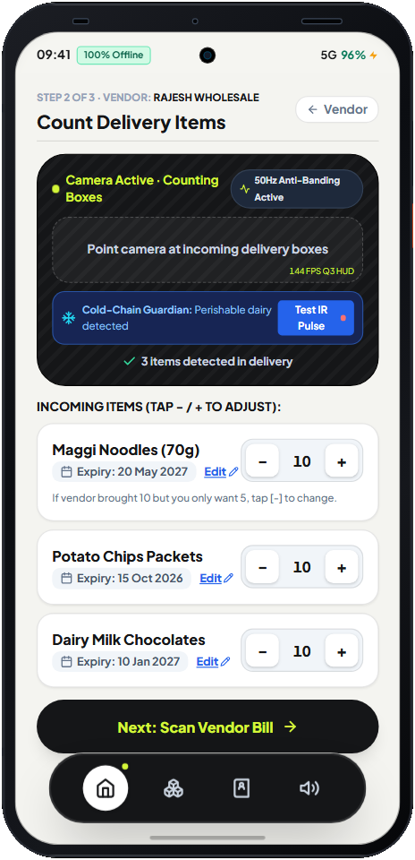
THE APP · LIVE PROTOTYPE
Receive stock in three taps.
01
02
03
Pick a job
Count the delivery
Check the bill
Two giant buttons: Receive Stock or Sell Item. Built for owners who don't type.
Camera counts boxes, reads expiry dates and flags perishables for the freezer.
OCR reads the invoice; shortages are priced and stamped with NavIC proof-of-delivery.
Screens captured from prototype/kounter_ui.html
iQOO HACKATHON 2026 · TEAM HOLOTRIO · KOUNTER
04

Slide 5
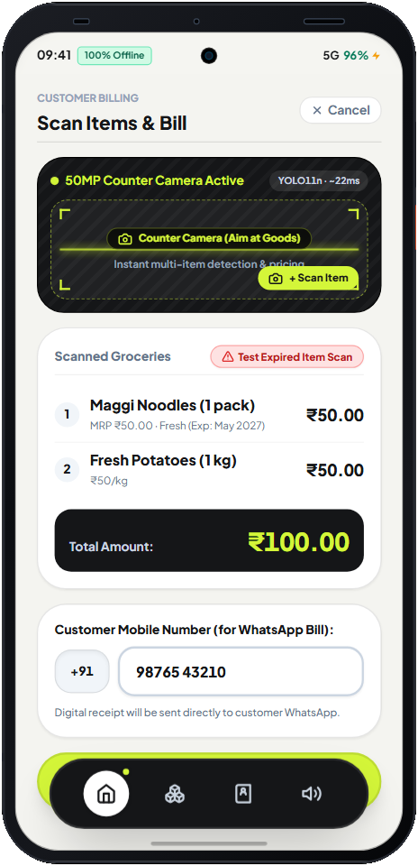
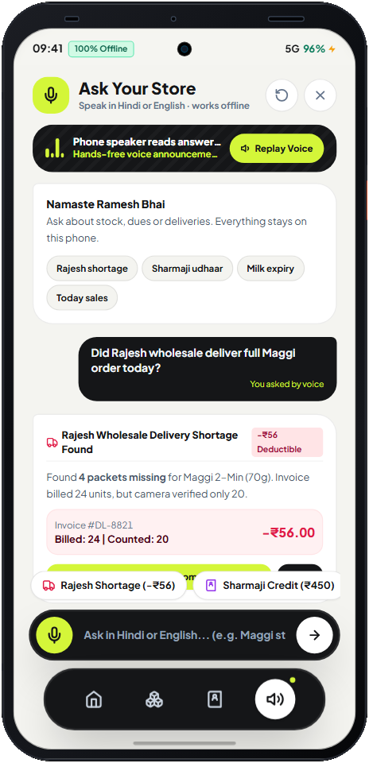




AT THE COUNTER
Sell safely. Ask in Hindi.
Multi-item scan billing
YOLO11n on the NPU identifies several items in one frame; the WhatsApp bill goes to the customer.
Expired item? Sale blocked
Distinct X-axis haptic pattern cuts through an 80 dB bazaar where beeps get lost.
Built-in Kounter Soundbox
Answers are read aloud on the stereo speakers — replaces a ₹125/month rented soundbox.
Everything stays on the phone
Works in Airplane Mode. Vendor margins and khata never leave the device.
iQOO HACKATHON 2026 · TEAM HOLOTRIO · KOUNTER
05

Slide 6












HARDWARE WE USE · iQOO 15
Every sensor has a job.
Snapdragon 8 Elite Gen 5
Supercomputing Chip Q3
50 MP Ultrawide
50 MP 3x Periscope
Hexagon NPU runs vision, OCR, speech and intent models in parallel
144 Hz AR bounding-box HUD without stealing NPU time
Whole delivery counter in one frame for counting
Telemacro reads tiny dot-matrix expiry dates
Color Spectrum Sensor
IR Blaster
NFC
NavIC L5 GNSS
Kills 50 Hz tube-light banding & foil glare
Pulses freezers / ACs via ConsumerIrManager
One-tap vendor check-in with a card or badge
Geo-stamped proof-of-delivery receipts
X-axis Linear Haptics
Dual Stereo Speakers
7000 mAh + Vapour Chamber
3D Ultrasonic Fingerprint
Distinct buzz patterns for shortage & expiry
Loud Hindi answers — a built-in soundbox
12-hour counter shift through power cuts
Locks margins & vendor ledgers; works with wet hands
Why iQOO 15? IR blaster, periscope telemacro, NavIC L5 and the Q3 chip together are what make this impossible on a generic phone or in the cloud.
iQOO HACKATHON 2026 · TEAM HOLOTRIO · KOUNTER
06

Slide 7






HARDWARE WE USE · DEMO KIT
What we bring to the finale.
15
Laptop + iQOO Office Kit
NFC tags (NTAG215 cards)
The only compute device in the Red Light phase. All AI runs here.
Green Light phase: customer-facing bill screen, loss dashboard, Excel/Tally export
One card per mock distributor for tap-to-check-in
SoC
Snapdragon 8 Elite Gen 5 + Q3
IR receiver + LED board
Real FMCG props
Memory
12 / 16 GB RAM
Benchtop stand-in for a freezer — lights up when the phone pulses it
Maggi, chips, chocolates & a dairy pack with one expired batch
OS
OriginOS 6 · Android 16
Display
6.85" 2K AMOLED · 144 Hz
Cameras
50 MP main · ultrawide · 3x periscope
Printed vendor invoices
Tube-light / LED lamp
Battery
7000 mAh · 100 W
Deliberately over-billed (24 vs 20) to trigger the shortage catch
Shows flicker-free capture under real shop lighting
iQOO HACKATHON 2026 · TEAM HOLOTRIO · KOUNTER
07

Slide 8
ON-DEVICE AI STACK
Photo in, verdict out — in under 250 ms.
NFC tap
›
Photo ×2
›
YOLO11n
›
PaddleOCR
›
Reconcile
›
Verdict
vendor check-in
ultrawide + bill
INT8 · ~22 ms
mobile v4 · ~65 ms
fuzzy match > 0.82
haptic + voice + IR
INPUTS
50 MP Ultrawide · 3x Telemacro · Color Spectrum · Mic · NFC · NavIC L5
HEXAGON NPU
YOLO11n detection · PaddleOCR / ML Kit · Whisper-small STT · Laya 322M intent
Q3 CHIP
144 Hz AR overlay of bounding boxes on the live camera feed
CORE ENGINE
Kotlin + Jetpack Compose + C++ NDK · Room/SQLite ledger · ConsumerIrManager
OFFICE KIT
Presentation API customer screen · ledger sync · .xlsx export
Lime = our software · Orange = iQOO 15 hardware
iQOO HACKATHON 2026 · TEAM HOLOTRIO · KOUNTER
08

Slide 9


HACKATHON FORMAT FIT
Phone-first. Laptop when it helps.
RED LIGHT
GREEN LIGHT
Phone only
Phone + laptop via Office Kit
Full audit, counting and OCR on the iQOO 15
SQLite ledger, haptics, IR and voice agent
Runs in Airplane Mode — Wi-Fi and cellular off
Customer-facing bill on the laptop screen; cost margins stay hidden
Loss-prevention dashboard with vendor reliability scores
One-click day-end Excel / Tally export for GST
iQOO HACKATHON 2026 · TEAM HOLOTRIO · KOUNTER
09

Slide 10
HOW WE SCORE AGAINST THE RUBRIC
Built for how the jury judges.
30%
End product quality
JURY
Works end-to-end offline; a two-button UI a shopkeeper keeps using daily
20%
Novelty & impact
JURY
Verifies physical deliveries, not typed ones — ₹13–25K/month back per shop
15%
Creative phone use
DEVICE DATA
Two camera lenses, voice, NPU, IR, NFC, NavIC and haptics in the core loop
15%
Technical depth
JURY
Parallel INT8 models on Hexagon NPU + Q3 HUD; Kotlin / C++ NDK, Room DB
10%
Office Kit usage
DEVICE DATA
Customer bill screen, dashboard sync and Excel export on the laptop
10%
Demo & presentation
JURY
Live Airplane-Mode demo with real props: shortage, IR, blocked sale, voice
Rubric from iqoo.reskilll.com: 75% jury panel · 25% HackTracker device data.
iQOO HACKATHON 2026 · TEAM HOLOTRIO · KOUNTER
10

Slide 11
IMPACT
Money back in Ramesh's pocket.
₹13–25K
< 250 ms
₹0
₹125
leakage we target per shop, per month
photo-to-verdict, fully offline
cloud cost — no API calls, no data plan
saved monthly by replacing a rented soundbox
Midpoints of our researched ranges; the “after” bars are our target, to be validated in pilot shops.
Built for owners with basic literacy: icons, Hindi voice, one-photo workflows.
iQOO HACKATHON 2026 · TEAM HOLOTRIO · KOUNTER
11

Slide 12
48-HOUR EXECUTION PLAN · FRI EVENING → SUN EVENING
How we build it at the finale.
0–12 h
12–22 h
22–32 h
32–40 h
40–48 h
Core app
Sensors
Voice & haptics
Office Kit
Demo polish
Android scaffold, Camera2 dual-lens, SQLite schema, YOLO11n + OCR on device
Colour-spectrum anti-banding, IR transmitter, NFC tap-in, NavIC geotag
Whisper STT, Laya intent → SQL, custom haptic waveforms
Customer display via Presentation API, dashboard, Excel export
Props, lighting calibration, 3–5 minute pitch rehearsal
Already done: clickable prototype of every screen + showcase website.
iQOO HACKATHON 2026 · TEAM HOLOTRIO · KOUNTER
12

Slide 13
KOUNTER
Every delivery counted.
Every rupee protected.
Offline. On-device. Built on the iQOO 15.
Thank you
TEAM HOLOTRIO
Sanskar Tiwari (Leader) · Shambhavi Patil · Kanishka Salgude
iQOO Hackathon 2026 · Grand Finale · Bengaluru · 9–11 Oct

