Slide 1

SMART INDIA HACKATHON 2026
SUDARSHAN
Enterprise Android Banking Malware Analysis and Fraud Intelligence Platform
Bridging the intelligence translation gap from raw Android bytecode to court-admissible, deterministic fraud verdicts and explainable SOC intelligence.
DETERMINISTIC VERDICT
0 to 100 FRS
Mathematical risk engine; AI never computes raw score
AGENTIC EXPLORATION
5-Level Perception
Automated bypass of OTP, login, and anti-analysis traps
VIDE BRAND DEFENSE
4-Axis Detection
Identifies cloned Indian bank apps prior to credential theft
ENTERPRISE READY
2,841 Tests Passing
Tested across 165 test suites with 100% pass rate
Target Focus: Protecting Indian Banking Infrastructure (Bank of India, SBI, PNB, ICICI, HDFC) from Android Trojans

Slide 2

PROBLEM DEFINITION
The Problem: The Mobile Threat Intelligence Translation Gap
Why conventional malware tools fail against modern Android banking trojans and leave SOC teams blind
1. Deceptive Payloads & Evasion
Banking trojans (Drinik, Xenomorph, Hydra, Anubis) use dynamic DEX loading, reflection, and encrypted strings. Static analysis sees only generic packers, missing malicious runtime logic entirely.
2. The Intelligence Translation Gap
Raw tooling emits thousands of disjointed events (SMS permissions, Accessibility flags, socket connections). SOC analysts are overwhelmed and lack the causal link proving fraud intent.
3. Uncontrolled AI Hallucination
Generic LLMs used in security tools invent CVEs, fabricate risk scores, and hallucinate behaviors. Financial compliance requires deterministic, court-admissible mathematical proof.
EXECUTION COMPARISON : TRADITIONAL TOOLS VS. SUDARSHAN ARCHITECTURE
Analysis Dimension
Conventional Sandbox / AV Tools
SUDARSHAN Enterprise Platform
Operational Impact
Static Analysis
Decompilation dumps and raw permission counts
VIDE 4-Axis Visual Impersonation and auto-repaired AST
Catches fake bank lookalikes immediately
Dynamic Sandbox
Blind 30s timeout; fails on OTP/login screens
5-Level Agentic Explorer with synthetic credential dispatch
Achieves deep multi-screen state exploration
Telemetry Correlation
Isolated event logs requiring manual grep
Causal Workflow Reconstruction with MITRE ATT&CK mapping
Reconstructs complete fraud attack sequences
Scoring Authority
Subjective CVSS or hallucinated AI scores
Deterministic Fraud Risk Score (FRS 0-100) with 4 Safety Floors
Court-admissible, fully auditable risk metric
SOC Integration
Unstructured JSON reports; slow triage
Evidence-grounded RAG Dossiers and STIX 2.1 / MISP feeds
Accelerates incident triage from hours to minutes
SUDARSHAN : Enterprise Android Banking Malware Analysis and Fraud Intelligence Platform
Slide 2 of 15

Slide 3
PLATFORM PILLARS
What is SUDARSHAN? The Four-Pillar Convergence
A purpose-built fraud intelligence platform translating raw artifacts into court-admissible banking defense
PILLAR 1
PILLAR 2
PILLAR 3
PILLAR 4
Multi-Source Evidence Extraction
Deep Dynamic Exploration
Deterministic Risk Authority
Evidence-Constrained Intelligence
- Dual-Engine Static Analysis: MobSF rules + Androguard AST decomposition
- APK Structure Repair: Auto-heals corrupted ZIP headers and manifests
- VIDE Impersonation Engine: Detects fake Indian banking app lookalikes
- IOC Reputation Feeds: 24h cached VT, AlienVault OTX, AbuseIPDB lookup
- PID-Accurate Early Hooking: Injects Frida bundle prior to native library init
- 5-Level Perception Loop: XML hierarchy, Activity state, Frida, Logcat, Vision
- Autonomous Obstacle Dispatcher: Auto-fills OTPs, pins, and login forms
- Anti-Analysis Evasion Bypasses: Transparent stubs mask tracerpid and root
- Mathematical FRS Engine: 0-100 score combining STEI, BFCI v2, and Impact
- 4 Non-Bypassable Safety Floors: Enforces minimum risk for stealth and evasion
- CH27 Fraud Triad Escalation: Cloned layout + Cert mismatch + Accessibility
- Absolute Zero AI Risk Bias: Code-level rule authority governs final verdict
- Google Gemini 2.5 Flash RAG: Natural language explanation strictly on indexed facts
- 3-State Circuit Breaker: Instant fallback if API limits or errors occur
- Automated Investigation Dossier: 7-section structured executive report
- Enterprise SOC Export: STIX 2.1 bundles, MISP feeds, and signed evidence JSON
SUDARSHAN : Enterprise Android Banking Malware Analysis and Fraud Intelligence Platform
Slide 3 of 15

Slide 4
SYSTEM ARCHITECTURE
Complete System Architecture
Modular, strictly bounded, and tamper-resistant architecture engineered for high-throughput banking SOCs
1. Presentation & Analyst Experience
React 18 / Vite SPA
Clean White/Blue Theme
Tailwind CSS + Lucide
Responsive UI System
Role-Based Access
Admin / SOC Lead / Analyst
Evidence Registry
Searchable finding tables
2. API Gateway & Orchestration Core
FastAPI Gateway (:8000)
Strict CORS & Rate Limiting
JWT Auth Engine
Stateless analyst sessions
Durable Queue & Workers
Resilient async batching
SQLite WAL Store
Forensic persistence
3. Dual-Engine Analysis Foundation
Static Decompilation
Androguard + MobSF rules
VIDE Engine
AST, Color & String Matching
Android AVD Sandbox
Hardened emulator container
Frida Dynamic Bundle
Early PID hook instrumentation
4. Intelligence & Correlation Engine
Runtime Event Bus
High-speed telemetry broker
Threat Correlator
VT, OTX, AbuseIPDB (24h TTL)
Workflow Reconstructor
Causal attack chain builder
MITRE ATT&CK Mapping
Mobile fraud technique tags
5. Deterministic Scoring & AI Explanation
STEI Engine
5-axis static exposure
BFCI v2 Engine
7 behavioral fraud axes
4 Safety Floors
Stealth & evasion bounds
Gemini 2.5 Flash RAG
Evidence-constrained narrative
SUDARSHAN : Enterprise Android Banking Malware Analysis and Fraud Intelligence Platform
Slide 4 of 15

Slide 5
ANALYSIS PIPELINE
End-to-End Analysis Pipeline: From APK to Court-Admissible Verdict
Six sequential, strictly bounded analysis stages executing with automated failovers and complete auditability
STAGE 01
STAGE 02
STAGE 03
STAGE 04
STAGE 05
STAGE 06
Intake & Header Repair
Static Decompilation & VIDE
Dynamic Detonation
Deep Agentic Exploration
Causal Workflow Reconstruction
Deterministic Scoring & RAG
Validates APK structure, hashes SHA-256, extracts signing certificates, and auto-heals corrupted central directories.
Decompiles DEX bytecode into smali and Java AST. VIDE detects visual brand cloning across 10 protected Indian banks.
Boots APK in instrumented Android sandbox. Injects Frida banking trojan bundle at spawn time before anti-root loads.
5-level perception loop navigates UI barriers, automatically bypassing login screens, OTP prompts, and permission dialogs.
Correlates raw runtime events through causal chain rules into an end-to-end multi-stage fraud attack sequence.
FRS calculator enforces 4 safety floors. Gemini 2.5 Flash RAG synthesizes an evidence-grounded threat dossier.
CORE ENGINES:
zipfile, androguard, apktool
CORE ENGINES:
Androguard, MobSF, RapidFuzz
CORE ENGINES:
Android AVD, ADB, Frida hook bundle
CORE ENGINES:
Agentic Explorer, OCR vision
CORE ENGINES:
WorkflowReconstructor, MITRE ATT&CK
CORE ENGINES:
RiskEngine, Gemini 2.5 Flash
SUDARSHAN : Enterprise Android Banking Malware Analysis and Fraud Intelligence Platform
Slide 5 of 15

Slide 6
STATIC INTELLIGENCE & VIDE
Static Threat Intelligence & Visual Impersonation (VIDE)
Unmasking fake banking apps, credential stealers, and phishing overlays prior to sandbox execution
STATIC DECOMPILATION & THREAT SCORING
VIDE: VISUAL IMPERSONATION DETECTION ENGINE
- Resilient Header Repair
Auto-repairs manipulated APK ZIP headers, truncated manifests, and obfuscated string pools used to crash standard analysis tools.
1. Layout View AST Distance (Threshold: 0.20)
Decompiles layout XML into an Abstract Syntax Tree. Compares view hierarchy structures against official banking templates.
- DEX & Smali AST Analysis
Parses classes, methods, and reflection calls; identifies hidden dynamic DEX loaders, native dropper binaries, and packing signatures.
2. CIEDE2000 Color Vector Distance
Calculates perceptual color difference Delta-E across dominant palette vectors to detect fake banking theme color clones.
- Permission & Component Profiling
Flags 127 high-risk Android permissions (Accessibility, System Alert Window, Read/Send SMS, Query All Packages) and hidden receivers.
3. RapidFuzz String Similarity (Threshold: 82.0)
Token-based string matching detects typosquatting and deceptive brand names across app labels and package identifiers.
- External Threat Feeds (24h Cache)
Hashes, domains, and IP endpoints are correlated against VirusTotal, AlienVault OTX, and AbuseIPDB with SQLite caching to conserve quota.
4. Protected Signer Registry (10 Indian Banks)
Maintains cryptographically verified SHA-256 signer certificates for Bank of India, SBI, PNB, ICICI, HDFC, Axis, and others.
- STEI Calculation (0 to 100)
Combines Credential Theft (60%), Banking Targeting (20%), Permission Risk (10%), Obfuscation (5%), and Infrastructure Risk (5%).
CRITICAL DETECTION OUTCOME :
Visual clone match (>0.85) + Signer Certificate Mismatch activates CH27 Fraud Triad escalation (FRS >= 95).
SUDARSHAN : Enterprise Android Banking Malware Analysis and Fraud Intelligence Platform
Slide 6 of 15

Slide 7
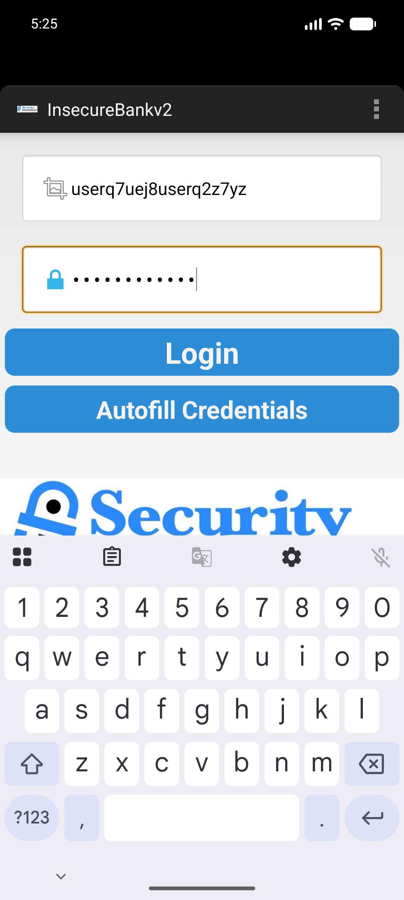
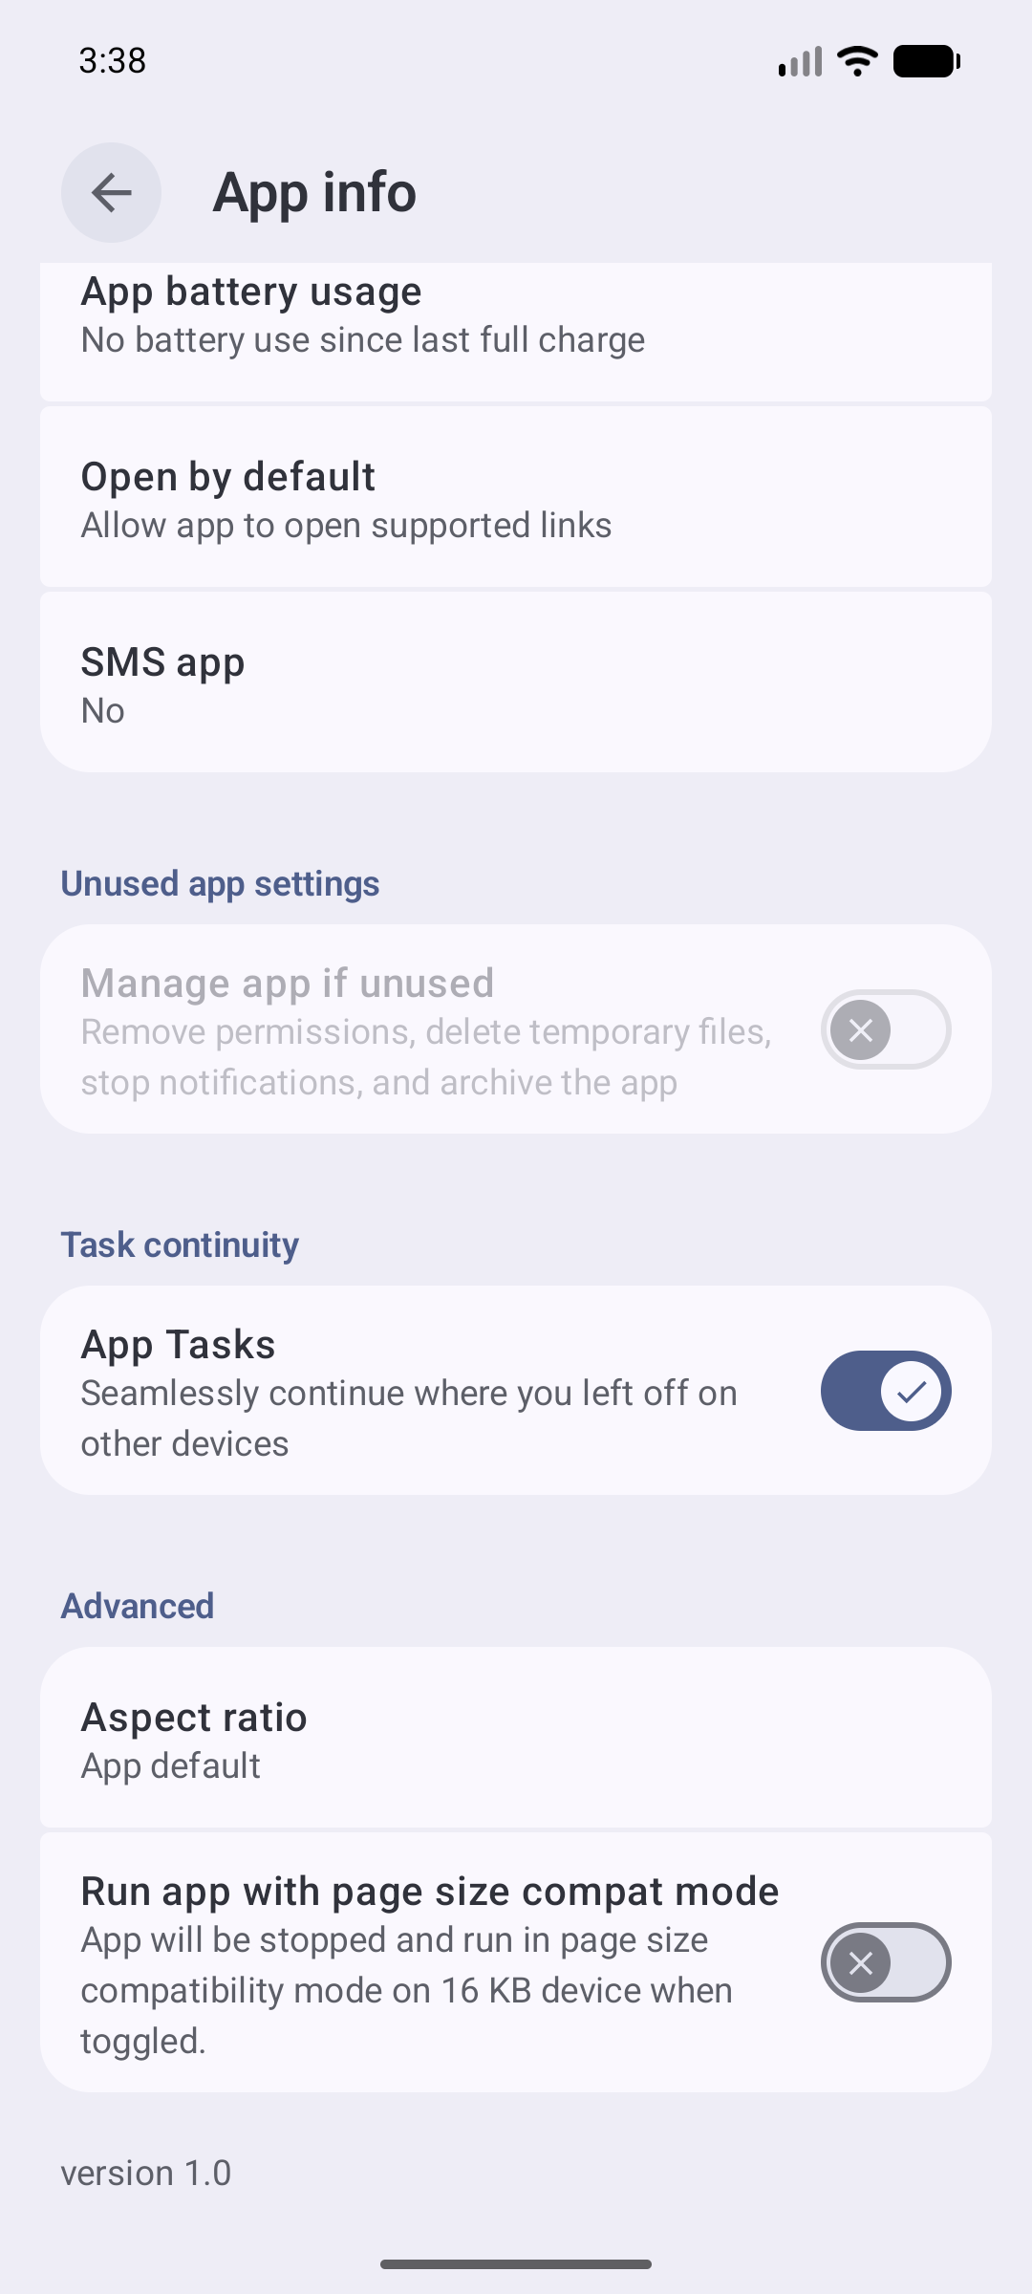
DYNAMIC DETONATION
Dynamic Analysis & Deep Agentic Exploration
Autonomous sandbox execution powered by PID-accurate early hooking and 5-level perception navigation
SANDBOX ORCHESTRATION & FRIDA INSTRUMENTATION
REAL SANDBOX RUNTIME CAPTURE
- Early PID Hook Injection (banking_trojan.bundle.js)
Frida attaches at process spawn time prior to native library initialization, neutralizing anti-analysis routines that attempt to terminate the app upon detecting ptrace or frida-server.
- ART Runtime Deoptimization & Universal SSL Bypass
Deoptimizes JIT-compiled methods to ensure all sensitive banking API calls trigger hooks; neutralizes certificate pinning across OkHttp3, TrustManager, and Conscrypt.
- 5-Level Perception Hierarchy Loop
Level 1: Native Accessibility XML hierarchy dump (sub-second UI parsing)
Level 2: Activity Manager state and focused window detection
Level 3: Frida method invocation hooks and dynamic event interception
Level 4: Real-time Android Window Manager and Logcat error telemetry
Level 5: Computer Vision / OCR fallback when views are obfuscated or rendered in WebViews
- Directed Screen Graph Exploration
Maintains a state transition graph of discovered screens to eliminate infinite loops; dynamically schedules interactions to maximize code coverage within a 130s adaptive budget.
Screen 1: Bank Login Form
(Automated test credentials)
Screen 2: Permission Trap
(Accessibility abuse bypass)
SUDARSHAN : Enterprise Android Banking Malware Analysis and Fraud Intelligence Platform
Slide 7 of 15

Slide 8
OBSTACLE NAVIGATION
Handling Real-World Banking App Obstacles
Automated perception and dispatch mechanisms breaking through complex barriers that stall traditional sandboxes
Login & Credential Gates
OTP & SMS 2FA Prompts
Custom M-PIN & Number Pads
Challenge: Banking malware pauses execution until user inputs valid credentials.
SUDARSHAN Solution: Synthetic Credential Dispatcher detects input fields and injects plausible test identities, triggering subsequent fraud logic.
Challenge: App stalls waiting for an incoming carrier SMS verification code.
SUDARSHAN Solution: Virtual SMS Gateway simulates incoming OTP messages via ADB, directly firing the malware's SMS interception receivers.
Challenge: Scrambled on-screen custom PIN keypads prevent text input injection.
SUDARSHAN Solution: OCR coordinate mapper detects numeric keypad bounding boxes and coordinates randomized tap sequences.
Runtime Permission Dialogs
Phishing Overlays & WebViews
Anti-Analysis & Sandbox Checks
Challenge: System popups block app until user grants Accessibility or SMS access.
SUDARSHAN Solution: Auto-Grant Dispatcher monitors system dialog windows and programmatically clicks 'Allow' or activates accessibility services.
Challenge: Trojan hides malicious payload inside an overlay WebView or sub-domain.
SUDARSHAN Solution: Multi-Window Monitor intercepts TYPE_APPLICATION_OVERLAY, extracts rendered HTML, and captures phishing form targets.
Challenge: Malware detects emulator files (qemu, build props), root (su), or Frida.
SUDARSHAN Solution: Stealth Frida Stubs spoof device fingerprint, hide open ports, and mask tracerpid, ensuring malware executes fully.
SUDARSHAN : Enterprise Android Banking Malware Analysis and Fraud Intelligence Platform
Slide 8 of 15

Slide 9
WORKFLOW RECONSTRUCTION
From Runtime Events to Fraud Intelligence: Causal Workflow Reconstruction
Converting thousands of disjointed hook logs into coherent, causal banking fraud attack sequences
THE RECONSTRUCTION ADVANTAGE : SINGLE INDICATOR VS. COMPLETE ATTACK CHAIN
Conventional sandboxes output disconnected event logs: an SMS read event, an accessibility flag, a socket send. In isolation, any one event could be benign. SUDARSHAN's WorkflowReconstructor engine correlates events across time and causal dependencies, proving malicious attack progression with mathematical confidence.
STAGE 1: SERVICE ACTIVATION
STAGE 2: OVERLAY PHISHING
STAGE 3: 2FA INTERCEPTION
STAGE 4: C2 EXFILTRATION
Accessibility Hijack
MITRE ATT&CK: T1417 (Input Capture)
Fake Banking Surface
MITRE ATT&CK: T1411 (Overlay Phishing)
SMS OTP Theft
MITRE ATT&CK: T1412 (SMS Capture)
Credential Transmission
MITRE ATT&CK: T1437 (C2 Protocol)
App tricks user or auto-clicks to enable Accessibility Service; starts monitoring window content.
Detects launch of genuine banking app; immediately draws full-screen fake login overlay on top.
Intercepts incoming SMS broadcast, suppresses notification, extracts 6-digit OTP from message text.
Transmits harvested login credentials, OTP, and device identity to malicious C2 server over HTTPS.
SUDARSHAN : Enterprise Android Banking Malware Analysis and Fraud Intelligence Platform
Slide 9 of 15

Slide 10
RISK ENGINE
Deterministic Risk Engine: Mathematical Authority
Guaranteed, auditable, and court-admissible risk scoring where AI is prohibited from computing verdicts
FRAUD RISK SCORE (FRS) FORMULA
NON-BYPASSABLE SAFETY FLOORS & FRAUD TRIAD
FRS = 0.25*STEI + 0.35*BFCI + 0.20*Correlation + 0.20*BankingImpact
1. Visibility Safety Floor (Min FRS: 60)
If app hides launcher icon or operates stealthily without user visibility, score cannot drop below 60.
- STEI (Static Threat Exposure Index)
0.60*CT + 0.20*BT + 0.10*PR + 0.05*OB + 0.05*IR
Weights credential theft and targeting over generic permissions.
2. Static Evidence Floor (Min FRS: 70)
Verified banking trojan signatures or hardcoded phishing overlays guarantee High/Critical risk floor.
- BFCI v2 (Behavioral Confidence Index)
7 behavioral axes: Accessibility (0.315), SMS Intercept (0.225), Overlay Phishing (0.180), Bank Target (0.090), Code Exec (0.100), Network (0.045), Persistence (0.045).
3. Evasion Safety Floor (Min FRS: 65)
Active anti-analysis, ptrace detection, or environment tampering enforces minimum suspicious floor.
4. Execution Assertions Floor (Min FRS: 85)
Observed credential scraping or overlay injection forces score to minimum 85 regardless of other weights.
- Threat Correlation Score
External IP/Domain/Hash matches from VT, AlienVault OTX, AbuseIPDB.
- Targeted Banking Impact Score
Direct targeting of Indian financial entities (BOI, SBI, UPI protocols).
THE CH27 ON-DEVICE FRAUD TRIAD ESCALATION :
High Visual Clone (>0.85) + Signer Cert Mismatch + Accessibility Abuse (BIND_ACCESSIBILITY_SERVICE)
==> Immediate Hard Escalation to FRS >= 95 (CRITICAL RISK)
SUDARSHAN : Enterprise Android Banking Malware Analysis and Fraud Intelligence Platform
Slide 10 of 15

Slide 11
AI INVESTIGATION BOUNDARY
AI + RAG + Evidence-Constrained Analysis
Leveraging Google Gemini 2.5 Flash for rapid incident investigation without ever touching deterministic risk scoring
STRICT ARCHITECTURAL AI BOUNDARY
7-SECTION STRUCTURED INVESTIGATION DOSSIER
- AI is an Explainability Engine, NEVER a Calculator
Gemini 2.5 Flash synthesizes technical findings into natural language explanations. It has zero authority to calculate, modify, or override the deterministic FRS score or risk band.
Section 1: Executive Fraud Summary
Plain-English verdict narrative summarizing malware intent, impact, and confidence level.
Section 2: Malware Family Attribution
Correlates behavioral signatures with known banking families (Hydra, Anubis, Xenomorph).
- Evidence-Constrained RAG Pipeline
The LLM context window is populated exclusively with structured, verified evidence records from SQLite EvidenceStore. It answers only from indexed facts, citing exact Record IDs.
Section 3: Behavioral Attack Timeline
Step-by-step chronological progression of actions executed in the sandbox.
Section 4: Targeted Financial Entities
Explicit list of Indian banks, UPI packages, and payment apps targeted for credential theft.
- 3-State Circuit Breaker Resilience
State 1: Normal (Live Gemini Flash streaming)
State 2: Degraded (Rate limit or timeout detected)
State 3: Tripped (Instant failover to deterministic rule narrative template; zero downtime)
Section 5: Compromised Permissions & Data
Inventory of stolen SMS tokens, Accessibility screen scrapes, and contact dumps.
Section 6: Actionable SOC Recommendations
Clear guidance: Quarantine app, revoke user sessions, block C2 IPs, push MDM blacklist.
- Prompt Injection Defense
Sanitizes all untrusted strings extracted from APK manifests, activity labels, and certificate metadata to prevent indirect prompt injection attacks.
Section 7: Verifiable Evidence Citations
Every single statement links directly to an immutable forensic EvidenceRecord hash.
SUDARSHAN : Enterprise Android Banking Malware Analysis and Fraud Intelligence Platform
Slide 11 of 15

Slide 12
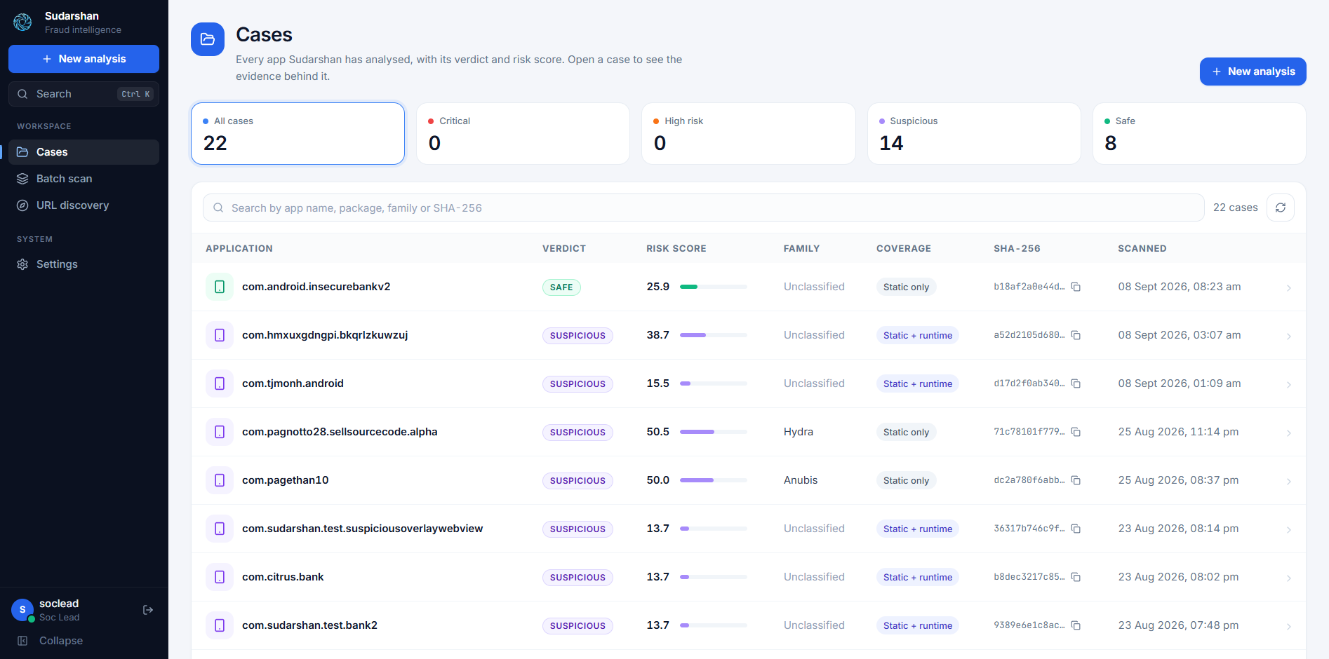
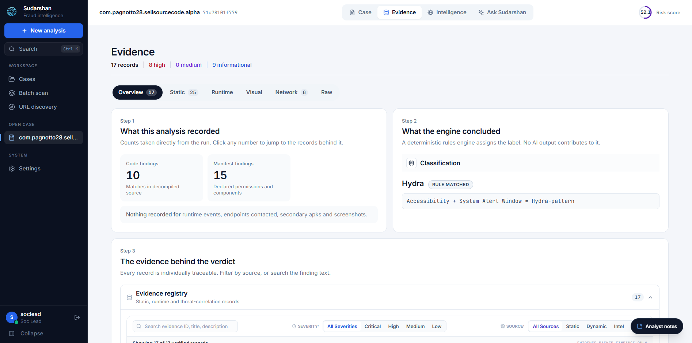
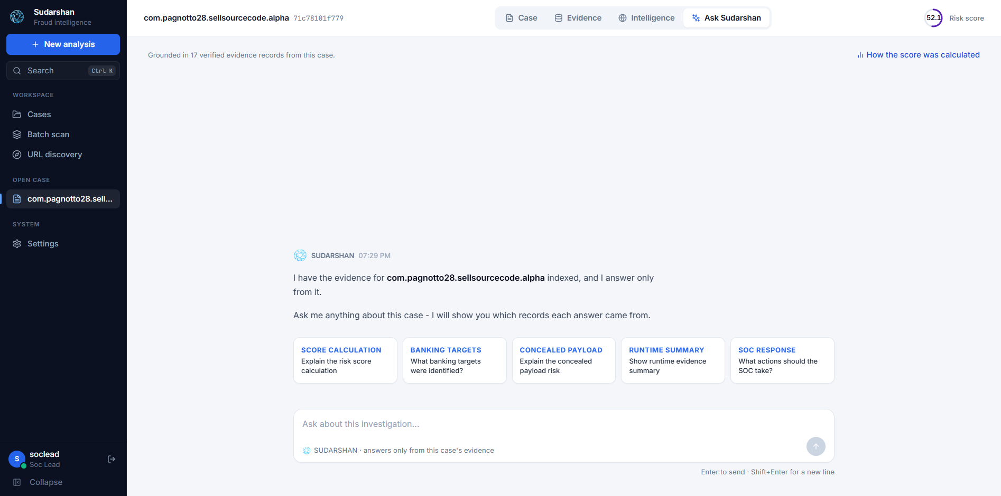
ANALYST INTERFACE
Real Frontend & Analyst Experience
Live production UI from the SUDARSHAN console: high-speed triage, auditable evidence, and grounded AI chat
CASE REGISTRY & RISK BANDS
TRACEABLE EVIDENCE REGISTRY
GROUNDED ANALYST INVESTIGATION ASSISTANT
SUDARSHAN's interactive chat allows tier-1 analysts to query complex technical findings in plain English.
- Grounded strictly in the 17 verified evidence records for this case.
- Quick prompt chips: Explain score calculation, identify banking targets, reveal concealed payloads, and recommend SOC actions.
- Transparent verification: Every answer cites the underlying evidence ID.
SUDARSHAN : Enterprise Android Banking Malware Analysis and Fraud Intelligence Platform
Slide 12 of 15

Slide 13
ENTERPRISE OPERATIONS
Enterprise SOC, Security and Scalability
Built for high-volume banking operations: hardened container isolation, granular RBAC, and high throughput
1. Sandbox & Container Containment
2. Granular 3-Tier RBAC Control
3. Durable Queue & Batch Intake
4. SOC Interoperability & Export Standards
- Isolated Docker network boundaries preventing external network contamination.
- Read-only root filesystem with ephemeral tmpfs storage for malware detonation.
- Dedicated ADB bridge daemon ensuring zero cross-container process leakage.
- Automated environment teardown restoring clean baseline AVD images after each run.
- Administrator: System configuration, worker queue monitoring, user provisioning.
- SOC Lead: Verdict override authority, analyst case assignment, threat export.
- Security Analyst: Case investigation, artifact inspection, grounded AI chat.
- Stateless JWT tokens with strict revocation lists and audit trail logging.
- Enterprise batch scan worker capable of processing 500+ APK portfolios.
- Persistent SQLite WAL database surviving unexpected worker restarts.
- Automatic job deduplication preventing redundant analysis of duplicate hashes.
- Configurable analysis worker pools (5 parallel durable workers standard).
- STIX 2.1 Threat Intelligence Bundles for SIEM/SOAR automated ingestion.
- MISP Event Sharing JSON formats for cross-institutional fraud intelligence.
- Court-Admissible Threat Dossiers in standalone signed HTML / PDF formats.
- Persistent IOC cache with 24h TTL reducing external API consumption by 85%.
SUDARSHAN : Enterprise Android Banking Malware Analysis and Fraud Intelligence Platform
Slide 13 of 15

Slide 14
STATUS & ROADMAP
Current Implementation Status vs. Future Roadmap
Disciplined engineering: verified working capabilities today versus strategic expansion milestones
VERIFIED IMPLEMENTED CAPABILITIES (TODAY)
STRATEGIC FUTURE EXPANSION (ROADMAP)
- 2,841 Automated Tests Passing (100%)
Verified across 165 test suites covering static, dynamic, risk, and API modules.
- Distributed Kubernetes Cluster Orchestration
Dynamic on-demand pod scaling across enterprise cloud infrastructures for 10,000+ daily APK scans.
- Dual-Engine Static Analysis & Header Repair
Auto-repairs corrupted APKs; decomposes DEX smali and parses 127 Android permissions.
- Bare-Metal Physical Device Farm Integration
Hardware-in-the-loop testing on real Android phones to counter advanced ARM-specific hardware rootkits.
- VIDE Visual Impersonation Engine
Tested and active across 10 protected Indian institutions (BOI, SBI, ICICI, HDFC, etc.).
- Dynamic Sandbox with Frida Early Hooking
PID-accurate injection, SSL pinning bypass, and transparent anti-analysis evasion.
- Multi-Bank Inter-Institutional Threat Mesh
Decentralized zero-day threat sharing network linking public and private Indian financial institutions.
- 5-Level Perception Loop & Obstacle Dispatcher
Automated bypass of OTP prompts, permission dialogs, and simulated login forms.
- Automated SIEM & MDM Policy Generation
Auto-compilation of YARA rules, SIEM Sigma detection signatures, and real-time MDM push policies.
- Deterministic Risk Authority (FRS & 4 Floors)
Pure code-level scoring authority; AI strictly prohibited from computing verdicts.
- Advanced OCR Vision Transformer Upgrades
Integration of lightweight on-device vision models for sub-second recognition of scrambled numeric keypads.
- Full React 18 / Vite Analyst Dashboard
Interactive Case Registry, Evidence Tables, Threat Intel, and Grounded Gemini RAG.
SUDARSHAN : Enterprise Android Banking Malware Analysis and Fraud Intelligence Platform
Slide 14 of 15

Slide 15
CONCLUSION & STRATEGIC VALUE
SUDARSHAN : The Definitive Banking Threat Shield
Transforming mobile banking defense from disjointed bytecode alerts into court-admissible, deterministic fraud protection.
Zero AI Hallucination in Scoring
Deterministic mathematical scoring (FRS 0-100) and 4 non-bypassable safety floors guarantee 100% predictable, auditable, and court-admissible verdicts.
Deep Autonomous Exploration
5-level perception hierarchy and synthetic dispatchers break through complex OTP, login, and anti-analysis barriers without human intervention.
Proactive VIDE Brand Defense
Unmasks fake Indian banking app lookalikes before user credentials ever leave the device by analyzing layout AST, color vectors, and certificate keys.
Production Tested & SOC Ready
2,841 passing automated tests, hardened container containment, granular RBAC, and standard STIX 2.1 feeds ready for enterprise deployment.
SUDARSHAN : Defending India's Digital Financial Ecosystem | Smart India Hackathon 2026

