Slide 1




SUDARSHAN
From APKs to fraud intelligence.
Android banking malware analysis that turns a suspicious app into evidence-backed, deterministically scored fraud intelligence.
APK
EVIDENCE
INTELLIGENCE
suspicious app
static, runtime, network
scored and explained
SUDARSHAN
01 / 15

Slide 2







THE PROBLEM
Raw signals are not intelligence.
A banking trojan shows up as scattered events that each look harmless. An analyst still has to connect them.
WHAT A SANDBOX HANDS YOU
WHAT AN ANALYST NEEDS
BIND_ACCESSIBILITY_SERVICE
Accessibility service activated
RECEIVE_SMS
Overlay drawn over the bank app
TYPE_APPLICATION_OVERLAY
Now what?
DexClassLoader
Each event alone could be benign.
SMS OTP intercepted
Socket.connect
Data sent to a remote server
SYSTEM_ALERT_WINDOW
QUERY_ALL_PACKAGES
FULL_ACCOUNT_TAKEOVER
Evasion packing hides the real logic
Volume thousands of events with no causal link
Trust a model-generated score cannot be audited
SUDARSHAN
02 / 15

Slide 3








THE SOLUTION
SUDARSHAN connects the evidence.
Four independent lenses feed one evidence model. Fixed formulas, not a model, decide the risk.
6
STATIC
code, manifest, VIDE
automated pipeline stages
DYNAMIC
7
instrumented run
EVIDENCE
+ CORRELATION
DETERMINISTIC
RISK ENGINE
weighted behavioural axes
NETWORK
10
ANALYST
proxied traffic
Indian bank baselines
VISUAL
0
screens, lookalikes
AI explains
reads evidence only
No path from AI
to the score
AI inputs to the risk score
SUDARSHAN
03 / 15

Slide 4


SYSTEM ARCHITECTURE
How SUDARSHAN is built.
ANALYST CONSOLE
React 18 + Vite case, evidence, intel, Ask Sudarshan
FOLLOW THE APK
API GATEWAY
FastAPI :8000 JWT · 3-tier RBAC · rate limits · audit log
1
Enters through the authenticated gateway
1
ORCHESTRATION
Job queue · batch worker case store on SQLite or PostgreSQL
2
2
Queued and handed to the engine
ANALYSIS ENGINE :8001 · internal token · not exposed to host
3
Decompiled, then run inside the sandbox
STATIC
DYNAMIC
NETWORK
THREAT INTEL
3
Androguard · APKTool
JADX · VIDE · YARA
Android guest · Frida 17
explorer · ADB gateway
mitmproxy sidecar
HAR · C2 signatures
VirusTotal · OTX
AbuseIPDB · 24 h cache
4
Normalised into tagged evidence
SANDBOX BOUNDARY
EVIDENCE
Event bus → evidence store → workflow reconstructor → MITRE ATT&CK
4
5
Scored by fixed formulas
RISK ENGINE
Deterministic STEI · BFCI v2 · FRS 0-100 · safety floors
5
6
Explained by AI, decided by the analyst
AI INVESTIGATION
Gemini 2.5 Flash RAG reads evidence, cannot write the score
6
SUDARSHAN
04 / 15

Slide 5






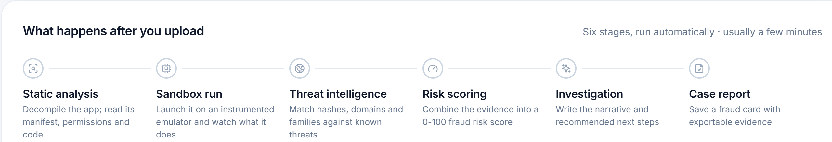
END-TO-END PIPELINE
One APK. Six stages. One scored case file.
Every stage runs automatically and writes to the same evidence record.
01
02
03
04
05
06
ANALYST
APK
Static analysis
Sandbox run
Threat intelligence
Risk scoring
Investigation
Case report
Decompile; read manifest, permissions, code
Instrumented emulator records behaviour
Match hashes, domains and families
Combine evidence into a 0-100 score
Narrative and recommended next steps
Fraud card with exportable evidence
STEI · VIDE
hook events
IOC matches
FRS + band
grounded AI
PDF · STIX 2.1
IN THE REAL CONSOLE
The same six stages drive the live progress view
Status comes from the backend job, so the analyst sees where each APK is.
SUDARSHAN
05 / 15

Slide 6





STATIC THREAT INTELLIGENCE
Read the APK before it ever runs.
Decompilers and matchers turn bytecode into scored indicators. VIDE flags lookalike bank apps.
Androguard
Manifest, permissions, components, entropy
STEI Static Threat Evaluation Index
CT 0.60
BT 0.20
APKTool 2.10
Resources, smali, layout XML
CT credential theft · BT banking targeting · PR permissions 0.10 · OB obfuscation 0.05 · IR infrastructure 0.05
VIDE four independent axes
APK
JADX 1.5.1
Java source, fraud-pattern scan
auto-repaired
Layout AST
CIEDE2000 colour
tree distance 0.20
per-swatch ΔE
VIDE
Visual impersonation of bank apps
Fuzzy strings
Signer registry
RapidFuzz 82.0
fail-closed
CH27 fraud triad clone confidence > 0.85 + signer mismatch + accessibility service → FRS ≥ 95, Critical
SUDARSHAN
06 / 15

Slide 7





DYNAMIC ANALYSIS
Observe what the APK actually does.
Static indicators become actionable when runtime behaviour confirms them.
ISOLATED SANDBOX fails closed
RELIABLE OBSERVATION
FRIDA 17 MONITORS
Exact-PID attach
ANDROID GUEST
Accessibility
Waits for a stable process before monitoring.
SMS
ART deoptimisation gate
Sample under test
Overlay
RUNTIME
EVENT BUS
typed, with severity
Compiled methods route through monitored paths.
Code loading
AVD · Genymotion · device
Five-step launch ladder
Network
Records which launch method succeeded.
Persistence
→ evidence store
mitmproxy
HAR capture
Honest outcomes
An empty run is reported as inconclusive, not safe.
SUDARSHAN
07 / 15

Slide 8




AGENTIC DEEP EXPLORATION
Walk through the app like a real user.
Fraud logic sits behind login, OTP and permission screens. A fixed timer never reaches it.
FIVE-LEVEL PERCEPTION
L1
UI XML dump
bounds, IDs, view tree
CLASSIFY
17 screen types
L2
Activity state
foreground package
SCREEN
GRAPH
loop detection
L3
Frida events
overlay, accessibility
PERCEIVE
PLAN + ACT
fuse all five levels
15-stage goal graph
L4
Logcat
crashes, denials
L5
Vision fallback
OCR when UI is canvas
VERIFY
before / after diff
SCREENS IT HANDLES
BANKING_LOGIN
OTP_ENTRY
PERMISSION_REQUEST
KYC_UPDATE
DEVICE_ADMIN
UPDATE_PROMPT
Forms are filled from a synthetic victim profile, never real customer data.
SUDARSHAN
08 / 15

Slide 9

WORKFLOW RECONSTRUCTION
From scattered events to a fraud workflow.
Rules link events by type and time into causal stages, each tied to its evidence records.
OBSERVED EVENT TYPES
AccessibilityService connected
STAGE 1
STAGE 2
STAGE 3
STAGE 4
Accessibility Service Activation
Phishing Overlay Deployment
SMS / OTP Interception
C2 Network Communication
AccessibilityEvent received
WindowManager.addView
T1417
T1411
T1412
T1623
SMS_RECEIVED broadcast
SmsManager.sendTextMessage
OkHttpClient request
FULL_ACCOUNT_TAKEOVER
Socket.connect
Composite sequence emitted by the reconstructor. Others it can name:
DexClassLoader init
OTP_THEFT_CHAIN
OVERLAY_PHISHING_CHAIN
DROPPER_CHAIN
10
MITRE ATT&CK for Mobile techniques mapped
Every stage keeps the IDs of the records behind it
SUDARSHAN
09 / 15

Slide 10
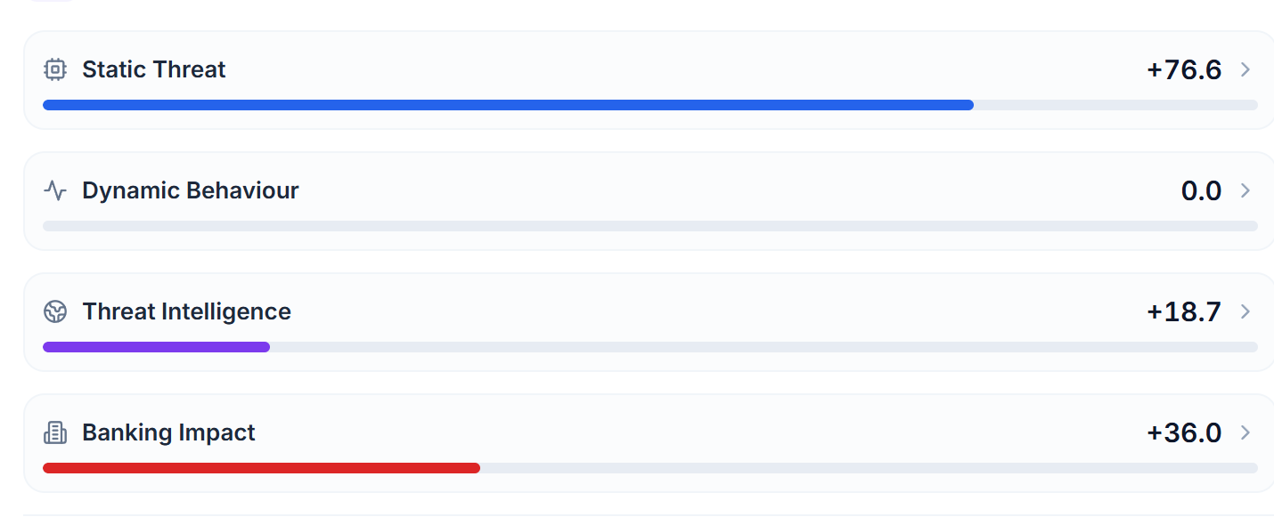
DETERMINISTIC RISK ENGINE
Evidence in. One auditable number out.
Fixed weights and fixed floors. Identical evidence always yields an identical verdict.
BFCI v2
×0.35
FRS Fraud Risk Score, 0 to 100
runtime behaviour
real case 55.5
STEI
×0.25
static threat
RISK ENGINE
Safe
Low
Medium
High
Critical
Correlation
no model in the scoring path
0
20
40
60
80
100
×0.20
threat intel
SAFETY FLOORS AND ESCALATION
Banking impact
×0.20
Visibility floor
Static-evidence floor
Evasion floor
targeted banks
Execution assertions
CH27 triad ≥ 95
REAL CASE IN THE CONSOLE
Each axis opens the findings that moved it.
ANALYST DECISION
A SOC lead can record a verdict with a reason. It is stored beside the engine score, never over it.
SUDARSHAN
10 / 15

Slide 11






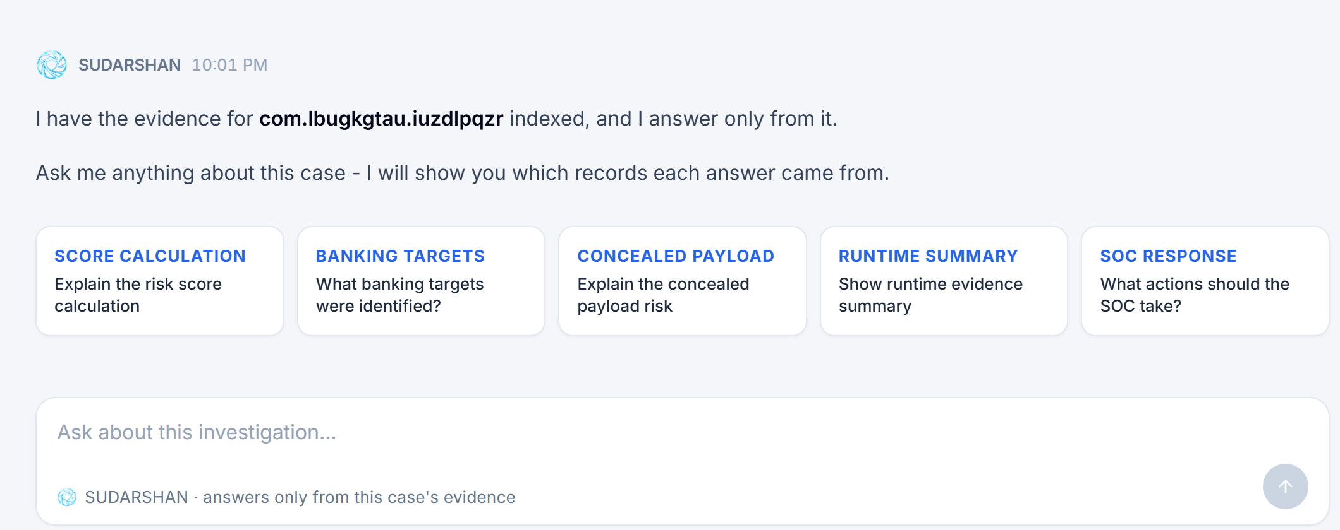
AI INVESTIGATION
AI explains the evidence. It never scores it.
Gemini answers only from this case’s evidence records, and nothing it says reaches the score.
Evidence store
Sanitiser
Case graph
Gemini 2.5 Flash
Grounded answer
verified records
strips injected text
per SHA-256
bounded prompt
cites record IDs
No write path
Model output cannot reach the scoring functions.
ASK SUDARSHAN, REAL CONSOLE
RISK ENGINE
IF THE MODEL IS UNAVAILABLE
AVAILABLE
DEGRADED
OPEN
Template narrative from engine output
The case report still completes with no AI at all.
SUDARSHAN
11 / 15

Slide 12
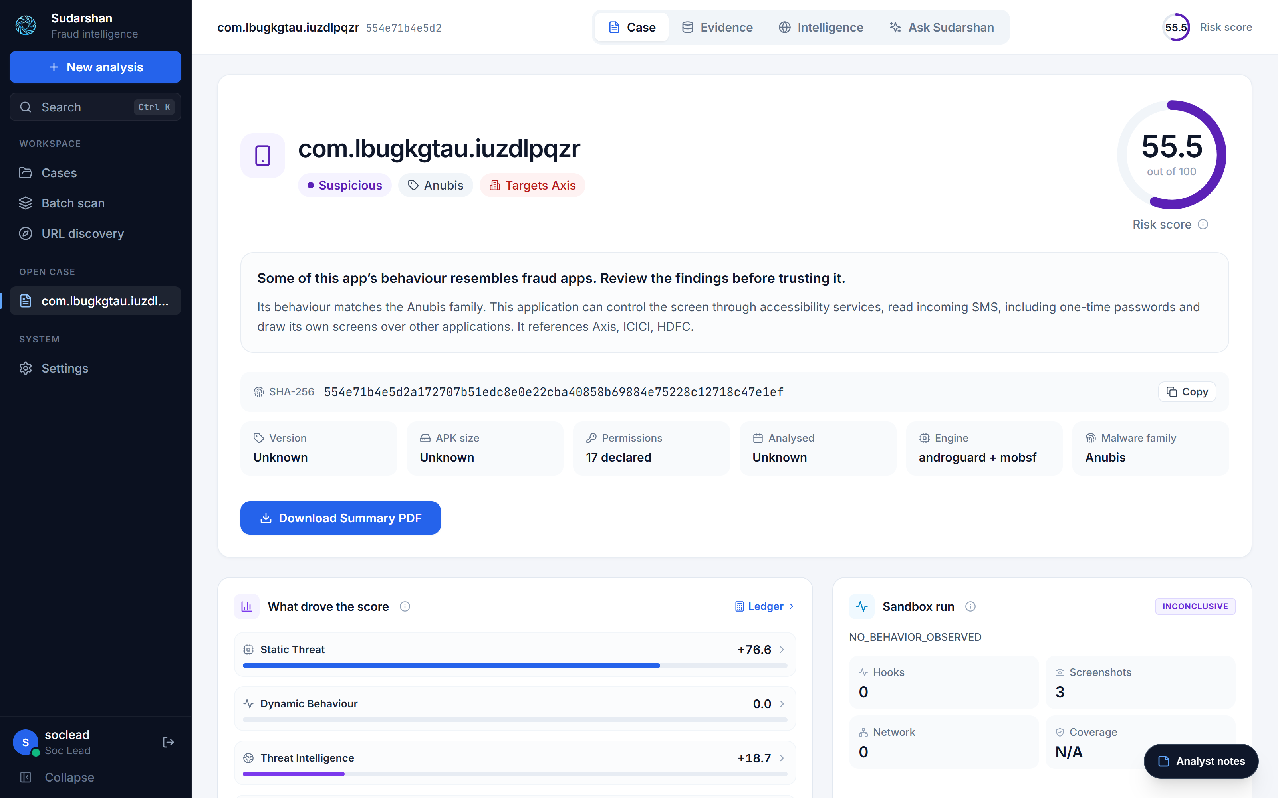
ANALYST CONSOLE
What the analyst actually sees.
REAL CASE, LOCAL CONSOLE
Anubis-family sample referencing Axis, ICICI and HDFC.
1
2
1
Risk score
55.5 out of 100, from the deterministic engine.
2
Family + target
Anubis rule match. Targets Axis.
3
Score drivers
Static +76.6, threat intel +18.7, dynamic 0.0.
3
4
4
Sandbox run
Marked inconclusive. No behaviour is invented.
Captured 28 Sep 2026
SUDARSHAN
12 / 15

Slide 13
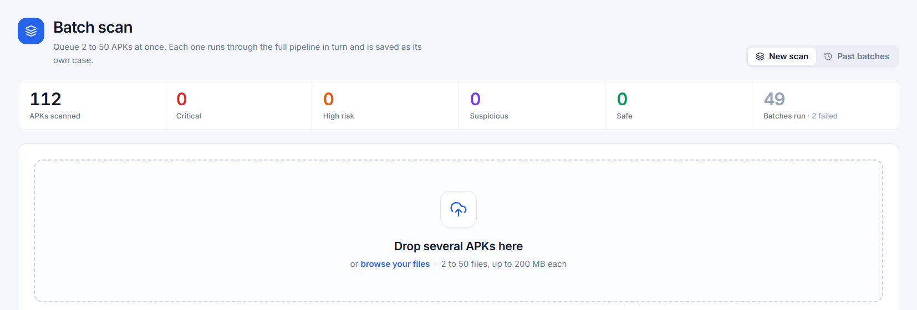

ENTERPRISE READINESS
Built to sit inside a bank SOC.
Layered containment around a hostile sample, and exports that plug into existing tools.
ACCESS
BATCH INTAKE
JWT sessions · RBAC: analyst, soc_lead, admin · lockout · rate limits · audit and export ledger
SERVICES
Internal service token · read-only root filesystem · all capabilities dropped · seccomp
SANDBOX
2 to 50 APKs per batch · FIFO · pause, resume, cancel, retry
Containment fails closed · ADB gateway choke point · dynamic runs off by default at the gateway
SOC EXPORTS
SAMPLE UNDER TEST
STIX 2.1
IOC CSV / TXT
YARA rules
Suricata / Snort
MITRE JSON
PDF dossier
Next for scale: PostgreSQL plus an external broker for horizontal workers (planned).
SUDARSHAN
13 / 15

Slide 14

STATUS AND ROADMAP
Working today. Clear path to scale.
Implemented features are covered by automated tests. Planned items are labelled as planned.
TODAY
2,841
IMPLEMENTED
PLANNED
Static analysis, APK repair, VIDE
Horizontal workers on PostgreSQL + broker
automated tests collected
0 failures · 28 skipped where a live sandbox is required
Frida 17 sandbox with exact-PID attach
Cloud device providers (Corellium, Waydroid)
Five-level perception explorer
Automatic second-stage payload re-analysis
165
Workflow reconstruction + ATT&CK
Bank baseline corpus beyond 10 institutions
test files across backend and engine
Deterministic FRS, floors, CH27
Family discovery beyond known families
Grounded Gemini RAG with fallback
Inter-bank IOC sharing over STIX feeds
Console, batch scan, STIX 2.1 export
SUDARSHAN
14 / 15

Slide 15



THE COMPLETE SYSTEM
STATIC
DYNAMIC
NETWORK
APK
VISUAL
EVIDENCE
CORRELATION
FRAUD
WORKFLOW
DETERMINISTIC
RISK
AI-ASSISTED
INTELLIGENCE
SOC
ACTION
SUDARSHAN
From suspicious APK to actionable fraud intelligence.
Evidence-backed · deterministically scored · explained for the analyst
SUDARSHAN
15 / 15

