Slide 1
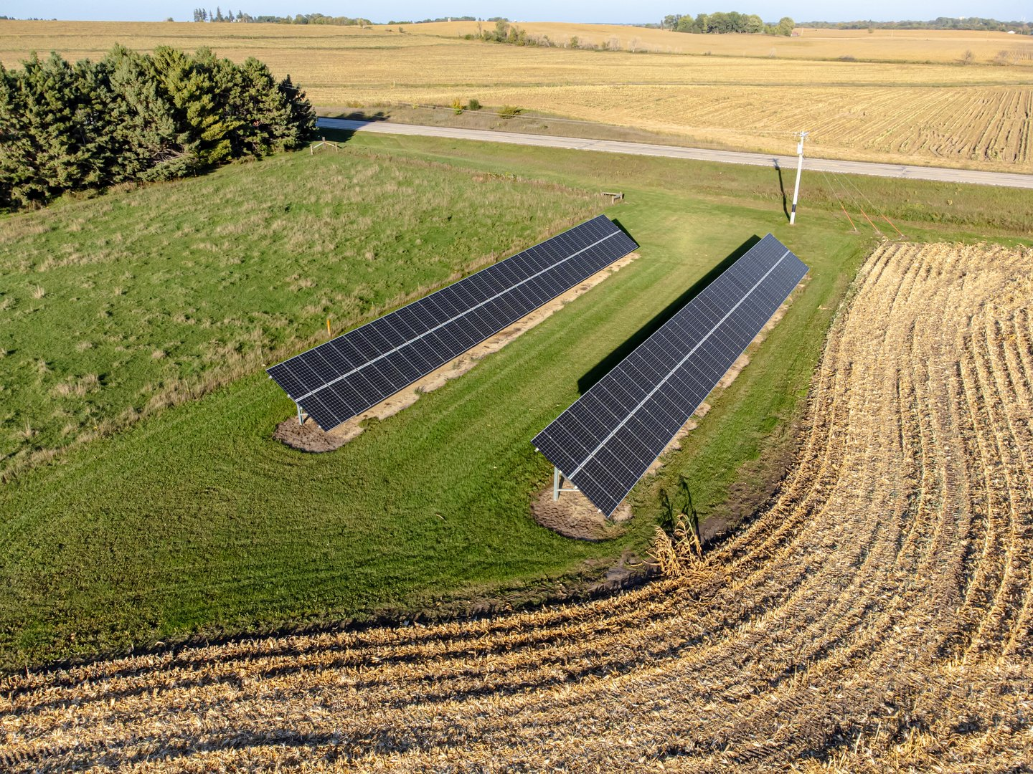
YUVA YODHA 2026 · ENERGY TECH HACKATHON 2026 | Track: Challenge 01 — Sustainable Agriculture
Schneider Electric
OFF-GRID SOLAR AGRI-ENERGY MICROGRID
AgroStruxure™
Solar-Synchronized Agri-Energy Microgrid & Closed-Loop Precision Irrigation
Monetizing agricultural water conservation by coupling PM-KUSUM Component B solar pump arrays with on-farm pre-cooling—turning unpumped groundwater into perishable shelf life.
41.2%
WATER SAVED
7,000 m³/ha/yr conserved
1,696
KWH FREED
Pumping power freed/yr
1.31 t
PRODUCE SAVED
Farm-gate heat eliminated
2.0 Yrs
CLUSTER PAYBACK
2 crop seasons (Tier A)
● SCHNEIDER ECOSTRUXURE TELEMETRY | NODE ID: MH-NSK-042
DC Bus: 520V DC | Drive Speed: 44.2 Hz | Root Moisture: 38.4% | State: PV_SHARED_TIME
Sources: CGWB Assessment (2023) · NABCONS / MoFPI Post-Harvest Study (2022) · impact_model.py
SLIDE 01 / 10

Slide 2
YUVA YODHA 2026 · PROBLEM DEFINITION | Structural Bottlenecks in Indian Smallholder Agriculture
Schneider Electric
The Dual Agricultural Crisis: Aquifer Depletion & Farm-Gate Spoilage
India extracts more groundwater than China and the US combined—while ₹1.53 Lakh Crore of food rots at the farm gate.
CRISIS 1: AQUIFER EXHAUSTION
245 BCM / Year
Total Annual National Groundwater Extraction (CGWB 2023)
▪ 87% Dedicated to Agriculture: Irrigation extracts 213 BCM/year, dwarfing domestic (11%) and industrial (2%) usage.
▪ 1,114 Assessment Units Over-Exploited: Extraction exceeds annual replenishable recharge across key agrarian states.
▪ 255,000 GWh Power Drain: Agricultural pumping consumes 16.53% of all Indian electricity (CEA 2024).
▪ Pumping Fleet Scale: 21.5M electric pumps, 8.5M diesel pumps, and 10.9L standalone solar pumps (PM-KUSUM).
CRISIS 2: PERISHABLE VALUE COLLAPSE
₹1.53 Lakh Crore
Annual Post-Harvest Economic Loss in India (NABCONS 2022)
▪ 8.37% Farm-Gate Tomato Spoilage: High respiration heat at harvest (32°C+) causes rapid decay within 48 hours.
▪ Mandi Distress Selling: Lacking cold storage, smallholders dump produce for ₹2–4/kg to middlemen to avoid total rot.
▪ Distal Cold Storage Failure: Commercial cold chains operate 30–50 km away in district hubs—unreachable for smallholders.
▪ Smallholder Vulnerability: 86.2% of Indian landholdings are small/marginal (<2.0 ha, average 1.08 ha).
Sources: CGWB Dynamic Ground Water Assessment (2023) · CEA Energy Statistics (2024) · NABCONS / MoFPI (2022)
SLIDE 02 / 10

Slide 3
YUVA YODHA 2026 · SYSTEMIC ANALYSIS | Why Technology Without Economic Alignment Fails
Schneider Electric
The Solar Rebound Paradox: Why Free Power Wastes Water
PM-KUSUM deployed 10.9 lakh standalone pumps, but zero marginal operating cost induces the Jevons paradox.
THE REBOUND MECHANISM (JEVONS PARADOX)
+16% to +39%
Measured Increase in Groundwater Extraction Post-Solar Adoption
▪ Zero Marginal Operating Cost: Replacing ₹80/hour diesel pumps with solar removes all financial constraints on pumping time.
▪ Empirical Proof: Econometric field measurement in Rajasthan (Gupta, 2019) confirmed significant extraction expansion.
▪ The Advisory Trap: Telling smallholders to pump less fails because unconsumed solar electricity has ₹0 off-grid cash value.
▪ Systemic Mandate: Water conservation must be coupled with an immediate physical and economic benefit.
THE 63% IDLE SOLAR ENERGY REALITY
4,137 kWh / Year Sits Idle
A 4.8 kWp pump array generates 6,559 kWh/yr; scheduled drip uses 2,422 kWh (37%). 63% is completely wasted without alternative loads (Shah et al., IWMI).
Player / Tech | Current Model | The Critical Flaw
Solar Cold Rooms (Ecozen) | Dedicated PV + Cold Room | Forces 2nd PV array (₹91k wasted capex)
IoT Advisory Apps (Fasal) | Soil moisture alerts on phone | No actuation; cannot stop over-pumping
GSM Pump Starters | Remote phone motor on/off | Convenience accelerates aquifer depletion
Sources: Gupta (2019) Energy Policy 129:598 · Shah et al. (2016) IWMI-Tata SPaRC · impact_model.py §2a
SLIDE 03 / 10

Slide 4
YUVA YODHA 2026 · SOLUTION BLUEPRINT | Direct Mapping to Challenge 01 Expected Outcomes
Schneider Electric
AgroStruxure™: Monetizing Water Conservation
A shared-array agri-energy microgrid that enforces a volumetric water entitlement and diverts freed solar power to cooling.
CORE INNOVATION: Physical time-sharing between PM-KUSUM PV array + Schneider Altivar ATV320 VFD + TeSys D Contactor + 2 MT Pre-Cooler
1. REDUCE ENERGY & WATER INTENSITY (41.2% Water Saved)
Local FAO-56 Penman-Monteith water budgeting with dual-depth capacitive FDR probes. Cuts seasonal irrigation from 850 mm (flood) to 500 mm (pulsed drip), saving 7,000 m³/ha/yr.
Key Metric: Pumping Power Freed: 1,696 kWh/ha/yr
2. MINIMIZE POST-HARVEST LOSSES (1.31 Tonnes Preserved)
Captures 3,187 kWh/yr (77%) of idle midday solar surplus to drive an on-farm 2 MT PCM pre-cooler at 12°C. Reduces farm-gate tomato spoilage from 8.37% down to 4.00% (NABCONS 2022).
Key Metric: Preserved Value: +₹15,732/ha/yr
3. EMPOWER THE SMALLHOLDER (2.0-Yr Cluster Payback)
Affordable industrial retrofit BOM (₹7,540 at 1,000 units). Delivers spoken vernacular audio advisories in Marathi and Hindi over WhatsApp (Krishi Mitra). 4-farm cluster net gain: ₹25,332/yr.
Key Metric: Cluster Capex: ₹50,212 per farm (net)
4. STRENGTHEN CLIMATE RESILIENCE (2.94 t CO₂e Abated)
Locks water extraction to CGWB/Atal Bhujal block budgets; 100% thick-edge execution on ESP32-S3 with 90-day offline flash buffer; prevents dry-run and protects deep Deccan aquifers.
Key Metric: Displaced Diesel & Spoilage GHG: 2.94 t/ha/yr
Sources: 100% of figures verified against impact_model.py and official Challenge 01 rubric
SLIDE 04 / 10

Slide 5
YUVA YODHA 2026 · OPERATIONAL JOURNEY | Closed-Loop Diurnal Hydraulics & Fail-Safe Automation
Schneider Electric
Closed-Loop Precision Hydraulics & Diurnal Journey
A deterministic 24-hour cycle: soft-start drip irrigation, field-capacity cutoff, and zero-flow valve latching.
DIURNAL POWER SCRUBBER (06:00 SUNRISE TO 18:00 SUNSET)
[06:00-08:30 Standby PV<200W] ⟶ [08:30-11:30 IRRIGATE: Altivar ATV320 VFD 38-50Hz] ⟶ [11:30: 5s DEAD-BAND DWELL] ⟶ [11:30-15:30 PRE-COOL: 2 MT PCM Cold Room 3.43kW] ⟶ [15:30-18:00 Overnight PCM Hold]
DUAL-DEPTH SENSING
▪ 10cm Surface Probe: Tracks evaporation rate and crusting dynamics.
▪ 30cm Root-Zone Probe: Monitors active transpiration and root depletion.
▪ Dynamic Thresholds: Field Capacity cutoff at 45%; Permanent Wilting threshold at 18%.
▪ Hydrological Modeling: Inputs dual FDR + solar pyranometer into FAO-56 Penman-Monteith balance.
ANTI-WATER HAMMER SEQUENCE
▪ Step 1: Daily quota reached (3,500 L) or root zone achieves 45% Field Capacity.
▪ Step 2: Gateway commands Altivar VFD to decelerate from 48 Hz to 0 Hz over 8 seconds.
▪ Step 3: Pulse flow meter confirms zero flow (Q = 0 LPM); latching valve closes safely.
▪ Step 4: 5-second dead-band dwell discharges DC bus capacitors before TeSys changeover.
WHATSAPP VOICE ADVISORY
▪ Vernacular Audio Note: Dispatched in Marathi & Hindi via WhatsApp Krishi Mitra.
▪ Actionable Message: 'Ram-bhau, 3,500 L delivered today. Soil moisture is 44%. Solar diverted to 2 MT cold room.'
▪ Zero Hallucination: LLM strictly reads structured JSON data; has zero actuation authority.
▪ Smallholder Simplicity: No complex dashboard; operates like a familiar voice note.
Sources: CiA402 Drive Profile (NVE41308) · FAO-56 Penman-Monteith · FreeRTOS Deterministic Tasks
SLIDE 05 / 10

Slide 6
YUVA YODHA 2026 · TECHNICAL ARCHITECTURE | EcoStruxure™ 3-Tier Integration & Upstream DC Changeover
Schneider Electric
Schneider EcoStruxure™ Architecture & Power Topology
Engineered break-before-make upstream DC changeover with 5-second dead-band eliminates drive stress.
ECOSTRUXURE™ 3-TIER STACK INTEGRATION
Tier 3: Apps, Analytics & Services (EcoStruxure Cloud)
• Agronomic digital twin with Sentinel-2 10m NDVI/NDWI satellite ingestion.
• Deterministic Krishi Mitra vernacular copilot (Marathi/Hindi).
• PM-KUSUM RMS & Central Aquifer Depletion Monitoring Portal.
Tier 2: Edge Control (EcoStruxure Edge Gateway)
• ESP32-S3 FreeRTOS gateway running 100% thick-edge control loop.
• Modbus RTU Master Engine operating CiA402 profile over isolated RS485.
• Deterministic 3-layer entitlement engine & 90-day offline flash FIFO.
Tier 1: Connected Products & Switchgear
• Schneider Altivar Solar ATV320 VFD (MPPT tracking, dry-run protection).
• Schneider TeSys D Contactors (2x LC1D09BD, mechanical & electrical interlock).
• Dual FDR soil probes, pulse flow meter, latching valve, pyranometer.
UPSTREAM DC BUS POWER TOPOLOGY
PV Array (4.8 kWp, 350-600V DC) ⟶ DC SPD ⟶ TeSys D Changeover ⟶
▪ Position 1 (08:30–11:30 AM): Schneider Altivar Solar ATV320 VFD ⟶ 5 HP Submersible Pump.
▪ 5-Second Deadband Dwell: Both contactors de-energized; DC bus bleeds below 50V DC.
▪ Position 2 (11:30 AM–15:30 PM): Inverter ⟶ 2 MT Phase Change Material Pre-Cooler (12°C).
CRITICAL ELECTRICAL SAFETY PROOF:
Switching contactors downstream on a running VFD causes destructive V = L·di/dt inductive voltage spikes and trips drive fault codes. Switching upstream on the DC bus with an engineered 5-second deadband dwell protects both motor windings and inverter electronics.
CiA402 Registers: 8501 (CMD Word) | 8502 (Target Speed) | 3201 (Status ETA) | 3207 (DC Bus V)
Sources: Altivar Solar ATV320 Manual NVE41308 · TeSys D Contactor Interlock Catalog · CiA402 Standard
SLIDE 06 / 10

Slide 7
YUVA YODHA 2026 · COMPETITIVE STRATEGY | Why AgroStruxure Dominates Legacy and Point Solutions
Schneider Electric
System Innovation & Competitive Defense
A multi-vector moat: time-shared solar PV capex, closed-loop entitlement governance, and thick-edge reliability.
Feature Dimension | Conventional Solar | Ecozen Solutions | Fasal / IoT Apps | AgroStruxure™ (Ours)
Solar Asset Sizing | Pump only (63% wasted) | 2 Separate PV Arrays | N/A (Grid/Battery IoT) | 1 Shared Array (Saves ₹91k)
Water Governance | Unconstrained pumping | Unconstrained pumping | Advisory graphs only | Volumetric Rebound Lock
Automated Actuation | Manual knife switch | Independent inverters | Zero actuation | Automated TeSys DC Changeover
Offline Resilience | Manual DOL start | Cloud dependent | Cloud dependent | 100% Local FreeRTOS Loop
Vernacular Advisory | None | Basic English App | Mobile app notifications | WhatsApp Voice in Marathi/Hindi
Payback Period | 5+ Years (Diesel replace) | 6-8 Years (High Capex) | Subscription Overhead | 2.0 Years (2 Crop Seasons)
THE SHARED-ARRAY MOAT
₹91,000
Avoided PV Capex per Pre-Cooler Installation
▪ Eliminating Redundant Solar: Competitors force farmers to buy a dedicated 4 kWp array for cooling. AgroStruxure time-shares the existing pump array.
▪ Zero Land Footprint: Avoids consuming 200 sq.ft of productive farmland for extra solar structures.
▪ Retrofit Architecture: Integrates seamlessly onto existing Shakti, Lubi, or Kirloskar solar pumps.
Sources: Analysis against Ecozen Solutions Ecotron/Ecofrost · Fasal Cultyvate · IWMI Dhundi SPaRC Model
SLIDE 07 / 10

Slide 8
YUVA YODHA 2026 · IMPACT VERIFICATION | The Single Source of Truth: Mathematical & Physical Derivations
Schneider Electric
Quantified Impact: The Single Source of Truth
Every figure reproduced directly from impact_model.py with explicit baseline tracking and transparent bounds.
41.2%
WATER SAVED
7,000 m³ / ha / year
Baseline: 17,000 m³ (flood) ⟶ 10,000 m³ (scheduled drip).
1,696
KWH FREED
3,187 kWh Surplus Captured
Pumping cut from 4,118 to 2,422 kWh/yr; 77% surplus captured.
1.31 t
PRODUCE SAVED
+₹15,732 Revenue Gain
Farm-gate tomato spoilage cut from 8.37% (NABCONS) to 4.00%.
2.94 t
CO₂E ABATED
2.55t Diesel + 0.39t Food
Displaces diesel generator cooling emissions + embodied food waste.
HONEST WATER ATTRIBUTION BREAKDOWN (PER SEASON)
THERMAL SIZING & FEASIBILITY BOUNDS (32°C TO 12°C)
Produce batch pull-down electrical power requirements (COP = 3.0, Cp = 3.7 kJ/kg·K):
▪ 1.0 MT Batch: 1.71 kW avg over 4 hours (6.8 kWh_el) ⟶ Easily fits single 4.8 kWp pump array.
▪ 2.0 MT Batch: 3.43 kW avg over 4 hours (13.7 kWh_el) ⟶ OPTIMAL FIT (Selected for Tier A 4-Farm Cluster).
▪ 5.0 MT Batch: 8.56 kW avg over 4 hours (34.3 kWh_el) ⟶ Exceeds single array; requires Tier B Hub with 4 kWp dedicated PV.
▪ Tomato Biology: Storing tomatoes < 10°C causes chilling injury. 12°C target setpoint preserves texture and shelf life.
Transition Stage | Application | Savings Delivered
Flood Baseline | 8,500 m³ / ha | 0 m³ (Baseline)
Flood ⟶ Conventional Drip | 6,000 m³ / ha | 2,500 m³ (29.4% HW saving)
Drip ⟶ AgroStruxure Entitlement | 5,000 m³ / ha | 1,000 m³ (11.8% + locked)
Sources: Run python impact_model.py in root directory to reproduce all figures identically
SLIDE 08 / 10

Slide 9
YUVA YODHA 2026 · COMMERCIAL VIABILITY | Industrial BOM, Cluster Payback & Market Scaling
Schneider Electric
Industrial BOM, Unit Economics & Scaling
A ₹7,540 edge controller BOM delivers a 2.0-year capital payback for a 4-farm pre-cooler cluster.
EDGE CONTROLLER BOM (1,000 UNITS)
TWO-TIER ASSET OWNERSHIP ECONOMICS
Tier A: Farm Pre-Cooler (4-Farm Cluster sharing 2 MT Unit) — 2.0 YR PAYBACK
▪ Gross Capex: ₹4,00,000 | Less Avoided PV: -₹91,000 | Net Capex: ₹3,09,000.
▪ After 35% MIDH/AIF Subsidy: ₹2,00,850 total (₹50,212 per smallholder farm).
▪ Annual Farmer Net Gain: +₹25,332 / farm / year (₹15,732 spoilage saved + ₹12,000 mandi price timing gain - ₹2,400 opex).
▪ Payback Period: Exactly 2.0 Years (2 crop seasons). (Pre-subsidy payback: 3.0 years).
Tier B: FPO Holding Hub (20-Farm Cooperative Hub, 5 MT Unit) — 4.2 YR PAYBACK
▪ Hub Capex: ₹12,00,000 (owns 4 kWp PV) ⟶ ₹7,80,000 after 35% subsidy.
▪ Net Storage Revenue (@ ₹3.00/kg/stay): ₹1,84,375 / year (Claims zero shared-array saving).
▪ Payback Period: 4.2 Years post-subsidy (6.5 years pre-subsidy).
GO-TO-MARKET CHANNELS & FINANCING:
• 1. PM-KUSUM Retrofit: Distributed through FPOs & PACS under AIF 3% interest subvention.
• 2. Schneider OEM Skid: Pre-assembled Altivar Solar + TeSys skid bundled for new EPC solar tenders.
Component Description | Cost (INR)
ESP32-S3-WROOM-1 (16MB Flash, 8MB PSRAM) | ₹420
Isolated MAX485 Transceiver + TVS Diode | ₹180
Dual FDR Capacitive Soil Probes (10cm & 30cm) | ₹760
Sensirion SHT31-D Temp/RH + Pyranometer | ₹600
1-inch Hall-Effect Pulse Flow Meter | ₹650
1-inch 12V Bistable Latching Solenoid Valve | ₹650
Schneider TeSys D Contactors ×2 (LC1D09BD) | ₹2,300
24V SMPS + Opto-Isolated Relay Driver | ₹380
SIM7600 4G LTE Cat-1 Cellular Module | ₹620
IP67 Enclosure, DIN Rail, DC SPD, Cabling | ₹980
Sources: Itemized Industrial BOM · MIDH Operational Guidelines · AIF 3% Interest Subvention Scheme
SLIDE 09 / 10

Slide 10
YUVA YODHA 2026 · EXECUTION PLAN | 12-Month Deployment Roadmap & Multidisciplinary Team
Schneider Electric
Implementation Roadmap & Multidisciplinary Team
From software simulation to a 25-farm field pilot in Maharashtra with Schneider Electric India Foundation synergy.
12-MONTH EXECUTION ROADMAP
PHASE 1 (OCT 2026)
Simulation & Truth
AgroSim model validated; CiA402 Modbus mapped; deterministic prompt guards verified.
PHASE 2 (NOV-DEC 2026)
HIL Test Bench
Hardware bench with Altivar ATV320 VFD, TeSys D contactors, and 5s deadband validation.
PHASE 3 (Q1 2027)
Nashik Field Pilot
25-farm cluster pilot with 2 FPOs in Nashik horticulture belt. Tomato harvesting trials.
PHASE 4 (Q3 2027+)
Commercial Scale
OEM pre-assembled skid for PM-KUSUM tenders; expansion to 250 farms across Maharashtra.
EMBEDDED SYSTEMS
Firmware Lead
ESP32-S3 & Modbus Engine
FreeRTOS tasks, CiA402 drive state machine, isolated RS485 communication, circular FIFO flash storage.
POWER ELECTRONICS
Electrical Architect
Switchgear & Sizing
Upstream DC changeover design, TeSys D mechanical interlocks, 5s deadband bleed down, and thermal pull-down models.
AGRONOMY & SATELLITE
Data Scientist
Hydrology & AI RAG
FAO-56 Penman-Monteith algorithms, Sentinel-2 NDVI/NDWI satellite validation, and deterministic prompt guards.
PRODUCT & IMPACT
Product Strategist
Smallholder UX & Policy
Rural smallholder interfaces, QuartzDS compliance, FPO cluster economic models, and Atal Bhujal policy integration.
SCHNEIDER ECOSYSTEM ALIGNMENT: Pre-Placement Interview (PPI) readiness, SE Ventures incubation fit, and SEIF Climate Smart Village rollout synergy.
Sources: Phase 1 Submission · Schneider Electric India & YouNoodle Hackathon Portal
SLIDE 10 / 10

