Slide 1
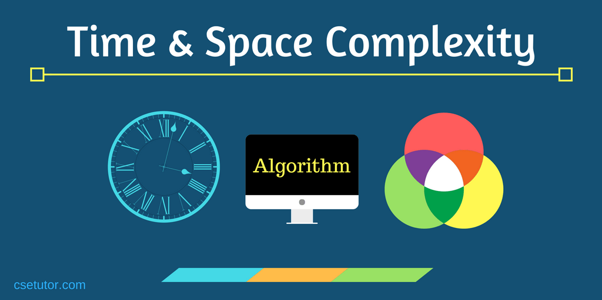

Slide 2
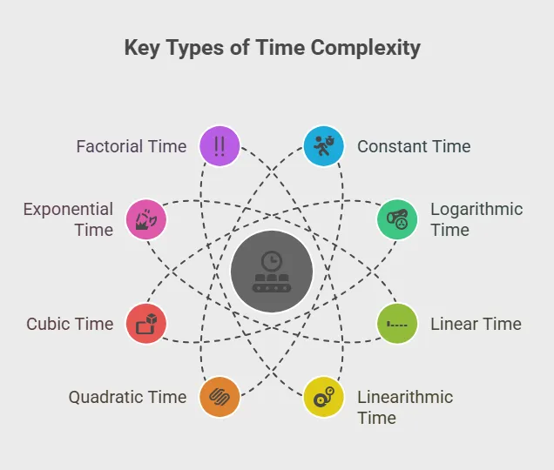

Slide 3
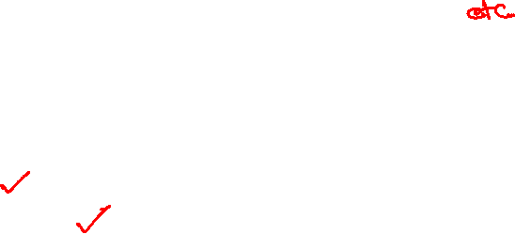
Asymptotic Analysis
1. What is Asymptotic Analysis?
Asymptotic Analysis is the theoretical and mathematical way of measuring how an algorithm grows as input size increases.
Key Ideas
It measures the order of growth of running time or memory.
It does not depend on machine, compiler, or programming language.
We can analyze an algorithm without implementing it.
It focuses on:
Cost (operations performed)
Time (running time as input grows)

Slide 4
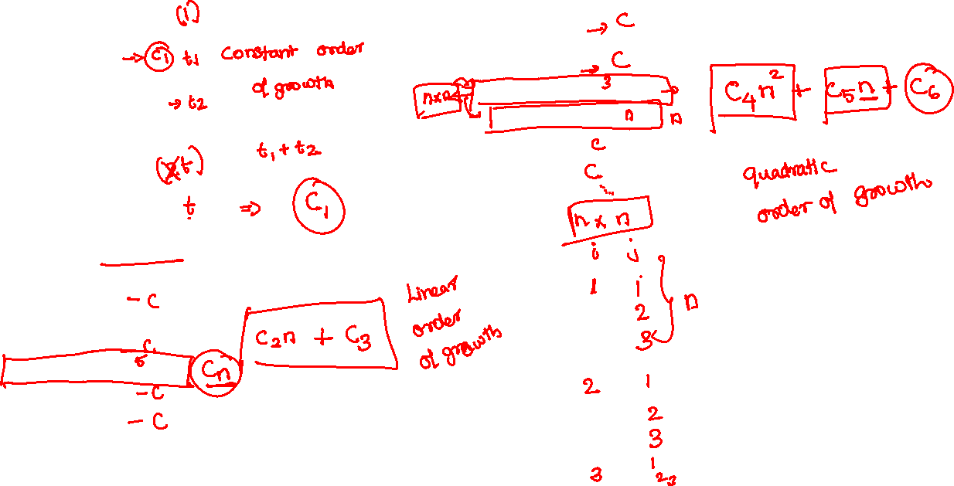
Function 1 — Formula Based
Function 3 — Nested Loop
int fun3(int n)
{
int sum = 0;
for (int i = 1; i <= n; i++)
for (int j = 1; j <= i; j++)
sum++;
return sum;
}
int fun1(int n)
{
return n * (n + 1) / 2;
}
Function 2 — Single Loop
int fun2(int n)
{
int sum = 0;
for (int i = 1; i <= n; i++)
sum = sum + i;
return sum;
}

Slide 5
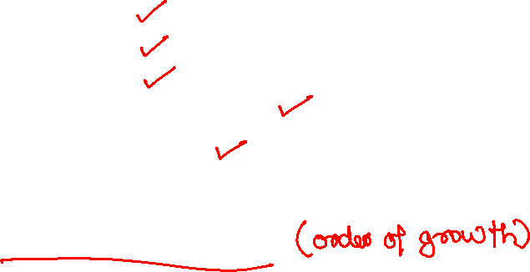
Time Taken by a Program
Depends on many factors:
Input size
Hardware
Compiler
Programming language
Algorithm design
Asymptotic analysis removes system factors and focuses only on growth with input size.

Slide 6
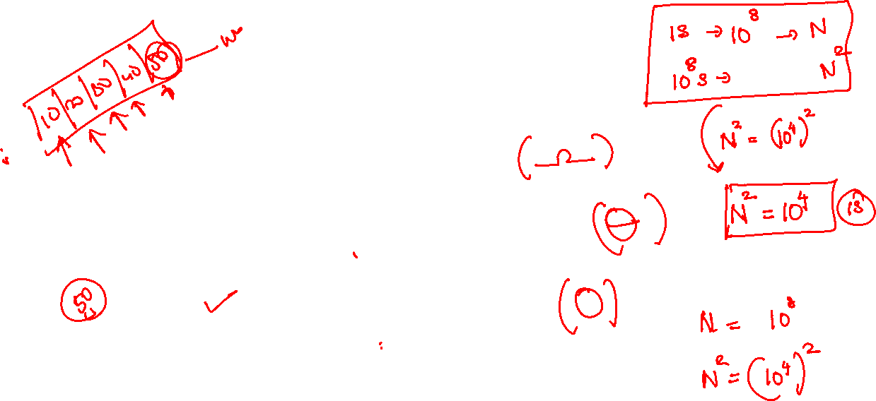
Best Case,
Average Case,
Worst Case

Slide 7
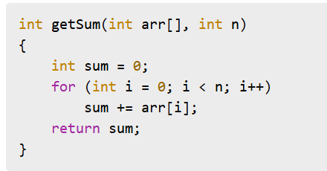
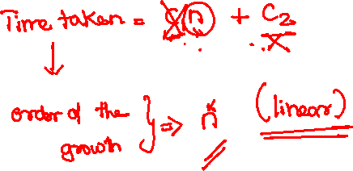
Example 1 — Same Order for All Inputs

Slide 8
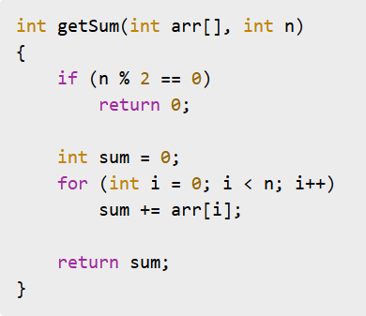
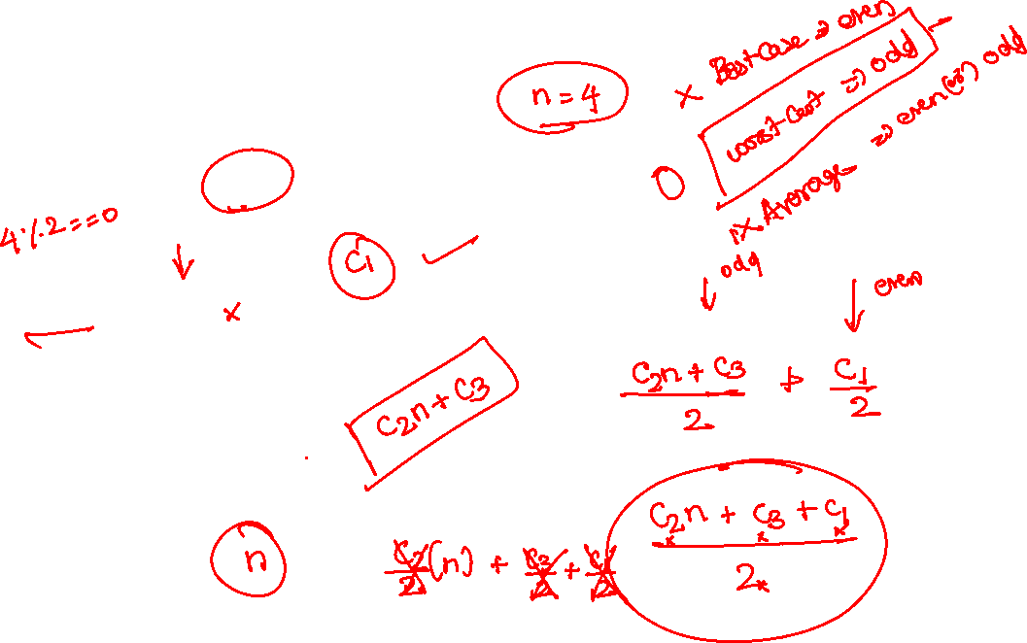
Example 2 — Multiple Orders of Growth

Slide 9

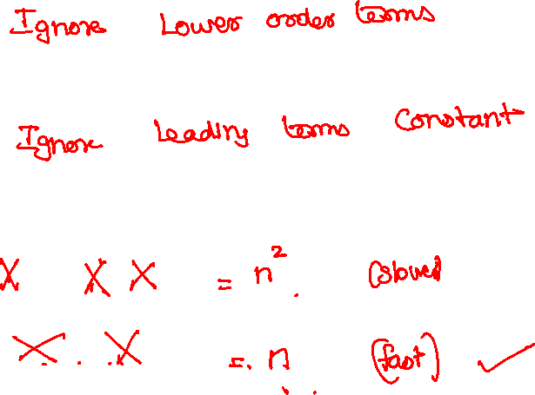
Direct Way to Find Order of Growth
f(n) = 2n² + n + 6
g(n) = 100n + 3

Slide 10
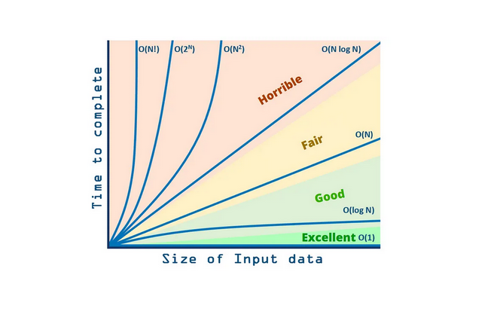
Comparing Common Growth Rates
Constant < log log n < log n < √n < n < n log n < n² < n³ < n⁴ < 2ⁿ < nⁿ

Slide 11
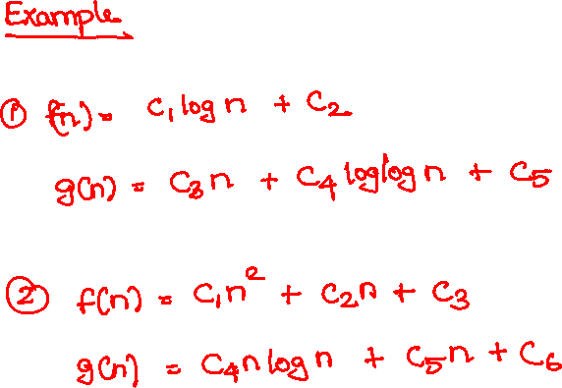
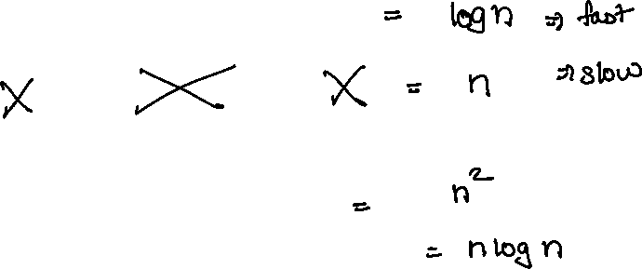

Slide 12
Asymptotic Notations
Mathematical tools to represent growth of functions.
Three Popular Notations
1. Big O (O) — Upper Bound
Maximum time an algorithm can take
2. Theta (Θ) — Tight Bound
Exact order of growth
3. Omega (Ω) — Lower Bound
Minimum time required

Slide 13
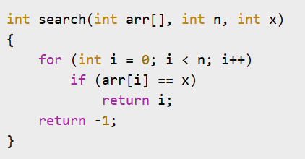
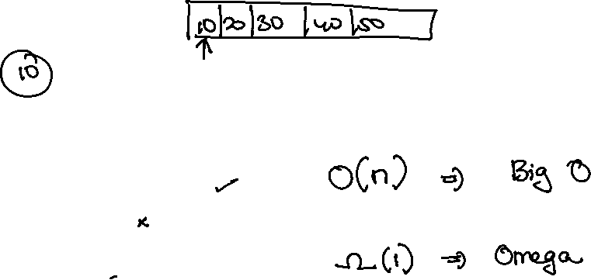

Slide 14
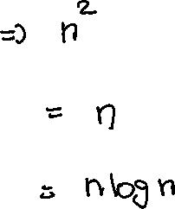
Big O — Direct Method
Ignore lower order terms
Ignore leading terms constants
3n² + 5n + 6
3n + 10 log n + 3
n log n + n

Slide 15
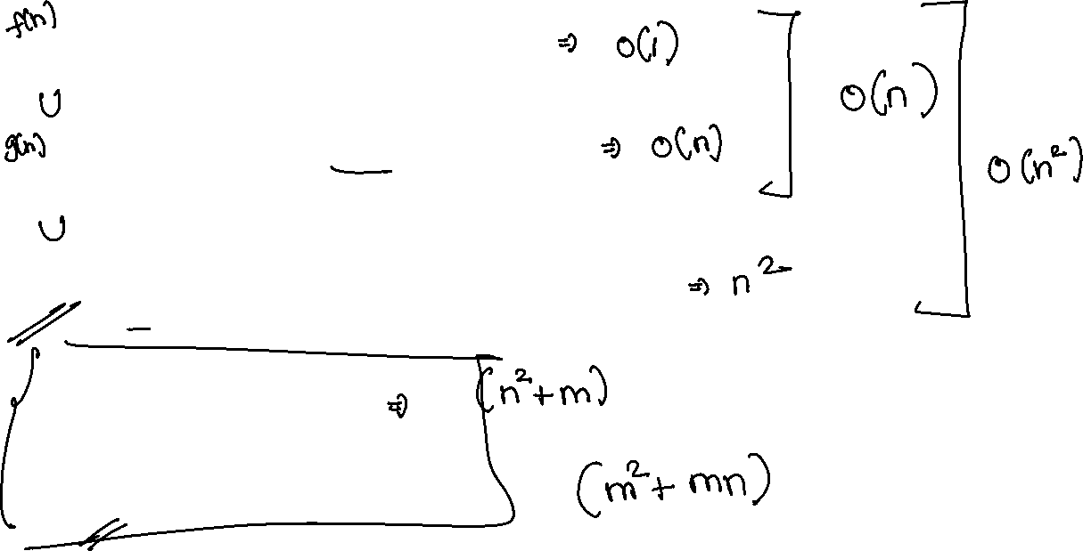
{100, 2000, 10⁵}
{n/4, 2n+3, n/100, log n, n+10000}
{n²+n, 2n², n²+1000n, n²+n log n, n²/1000}
100n² + 1000m + n
1000m² + 200mn + 30m + 20n

Slide 16

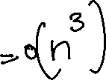
Big-O Notation — Upper Bound
Represents the maximum time an algorithm can take.
Worst-case growth rate.

Slide 17
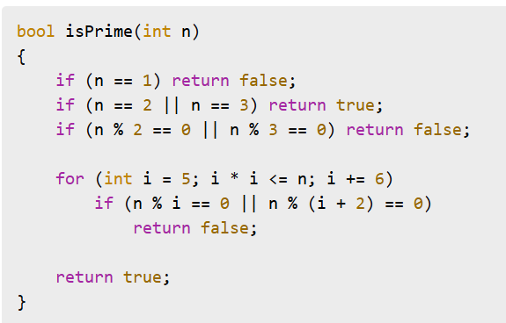
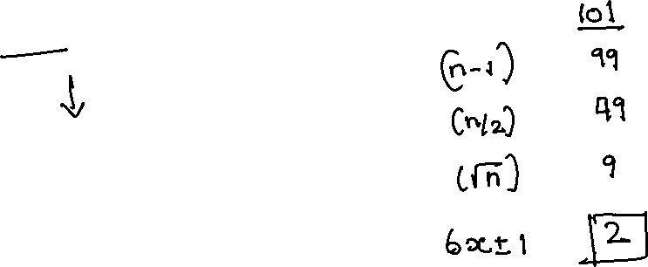
Application — Prime Check

Slide 18


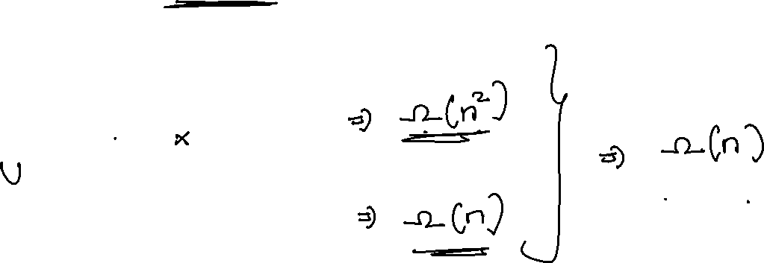
Omega (Ω) Notation — Lower Bound
Represents the minimum time required.
Best-case growth rate.

Slide 19
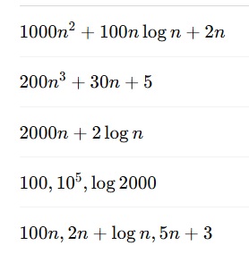
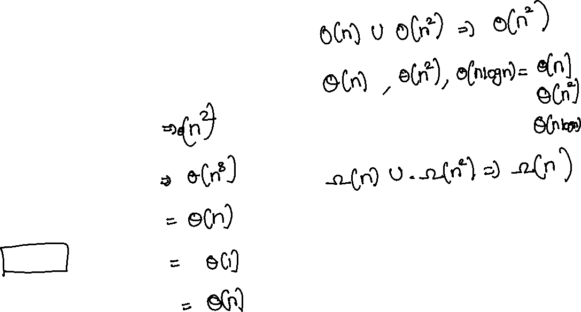
Theta (Θ) Notation — Exact Bound
Tight bound (both upper & lower bound)
Exact order of growth

Slide 20
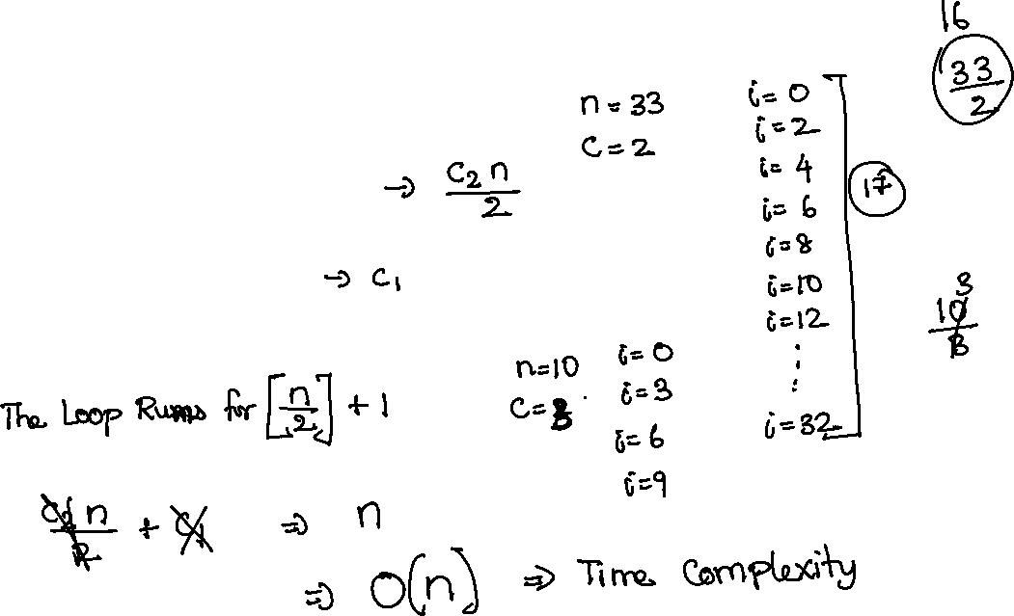
Example 1 — Increment by Constant
for (int i = 0; i < n; i = i + c)
{
// constant work
}

Slide 21
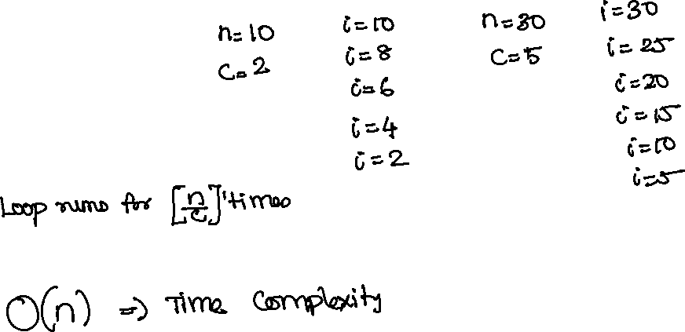
Example 2 — Decrement by Constant
for (int i = n; i > 0; i = i - c)
{
// constant work
}

Slide 22
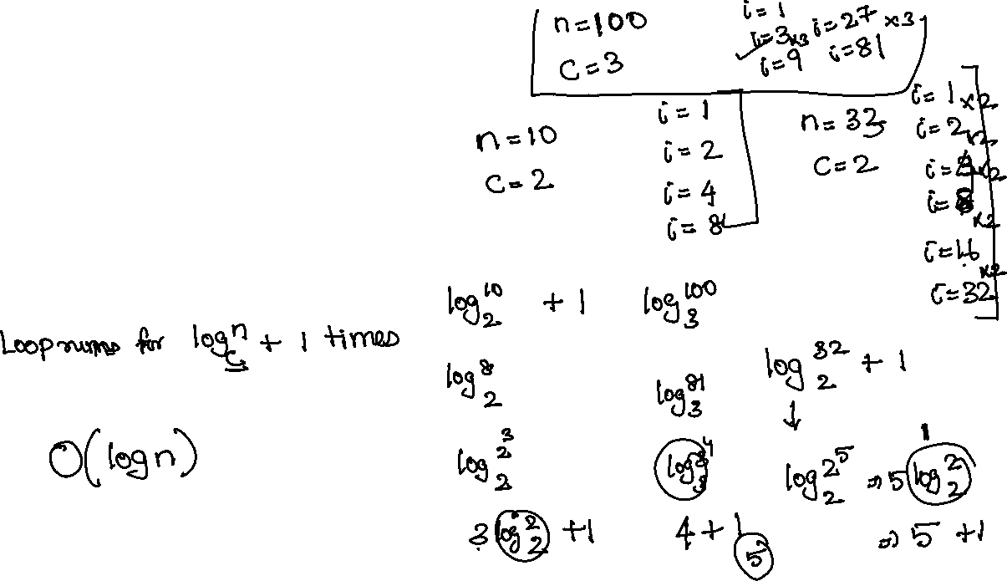
Example 3 — Multiply by Constant
for (int i = 1; i < n; i = i * c)
{
// constant work
}

Slide 23
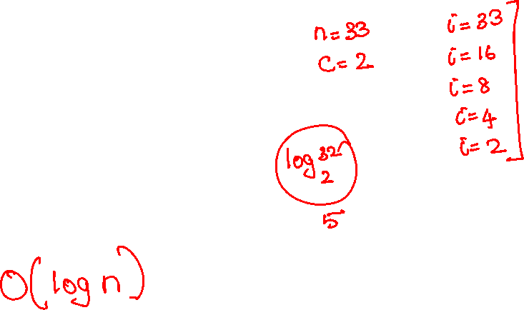
Example 4 — Divide by Constant
for (int i = n; i > 1; i = i / c)
{
// constant work
}

Slide 24
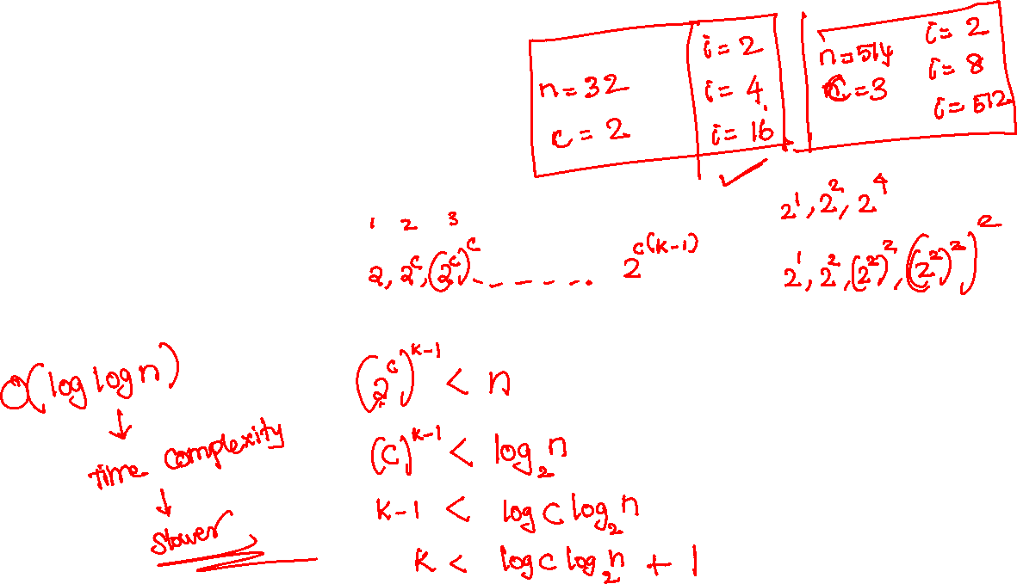
Example 5 — Power Growth Loop
for (int i = 2; i < n; i = pow(i, c))
{
// constant work
}

Slide 25
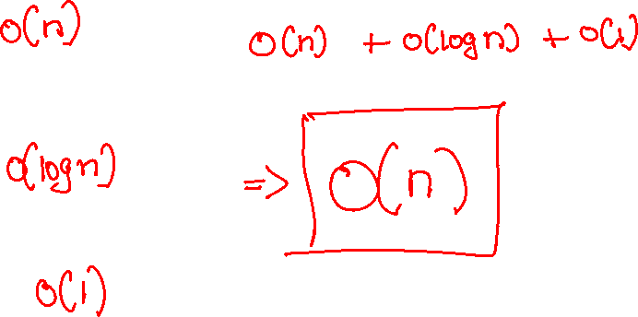
Analysis of Multiple Loops
Case 1 — Subsequent Loops (One after another)
for (i=0; i<n; i++)
{
}
for (i=1; i<n; i=i*2)
{
}
for (i=1; i<100; i++)
{
}

Slide 26
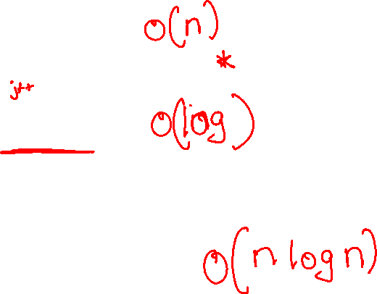
Case 2 — Nested Loops
for (i=0; i<n; i++)
{
for (j=1; j<n; j=j*2)
{
}
}

Slide 27
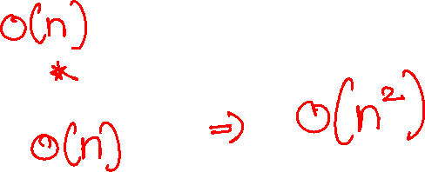
Case 3 — Nested Linear Loops
for (i=0; i<n; i++)
{
for (j=0; j<n; j++)
{
}
}

Slide 28
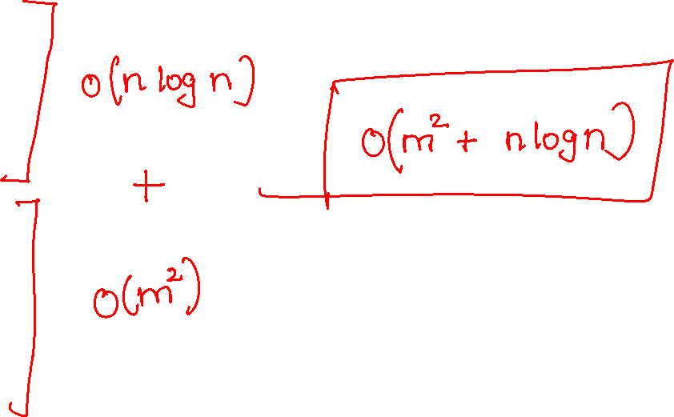
Case 4 — Mixed Nested + Separate
for (i=0; i<n; i++)
{
for (j=1; j<n; j=j*2)
{
}
}
for (i=0; i<m; i++)
{
for (j=0; j<m; j++)
{
}
}

Slide 29
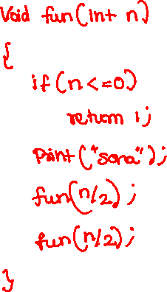
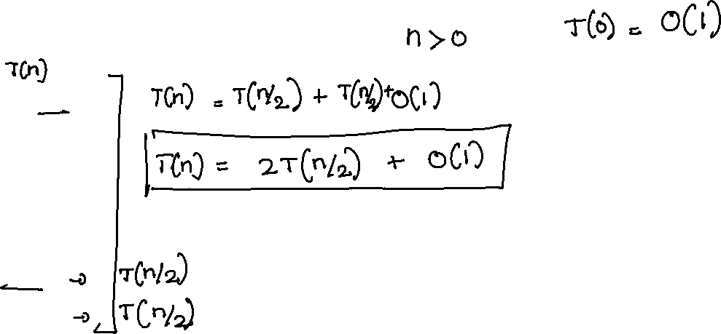
Analysis of Recursion
Example 1 — Two Equal Subproblems

Slide 30
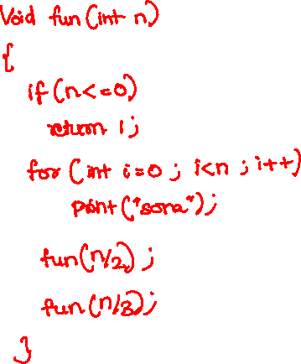
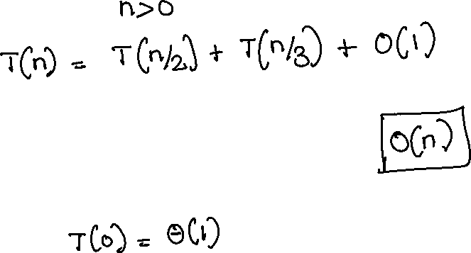
Example 2 — UnEqual Subproblems

Slide 31
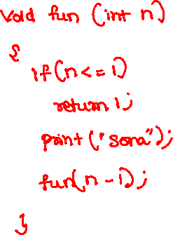
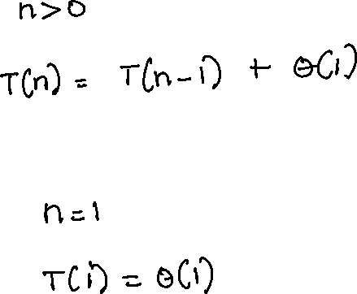
Example 3 — Linear Recursion

Slide 32
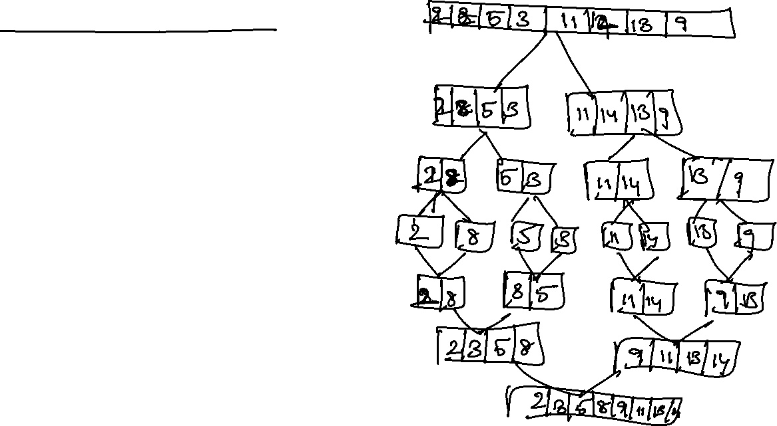
Recursion Tree Method
Steps:
Draw recursion tree
Root = non-recursive work
Children = recursive calls
Expand until base case
Add work at each level

Slide 33
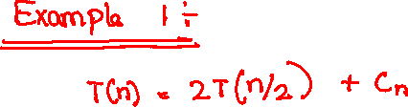
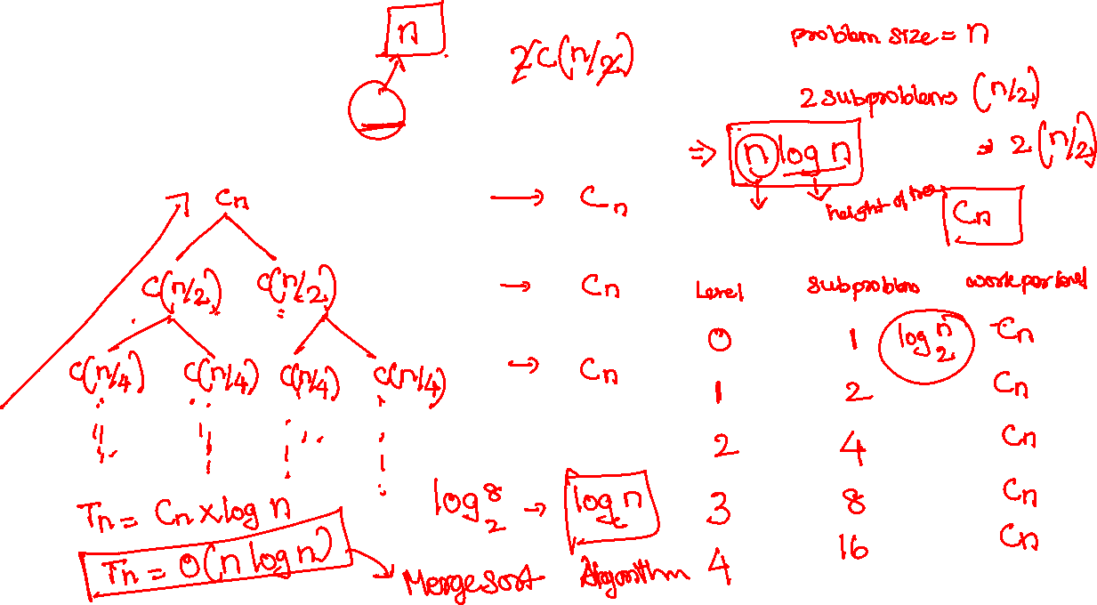

Slide 34
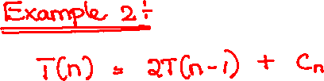
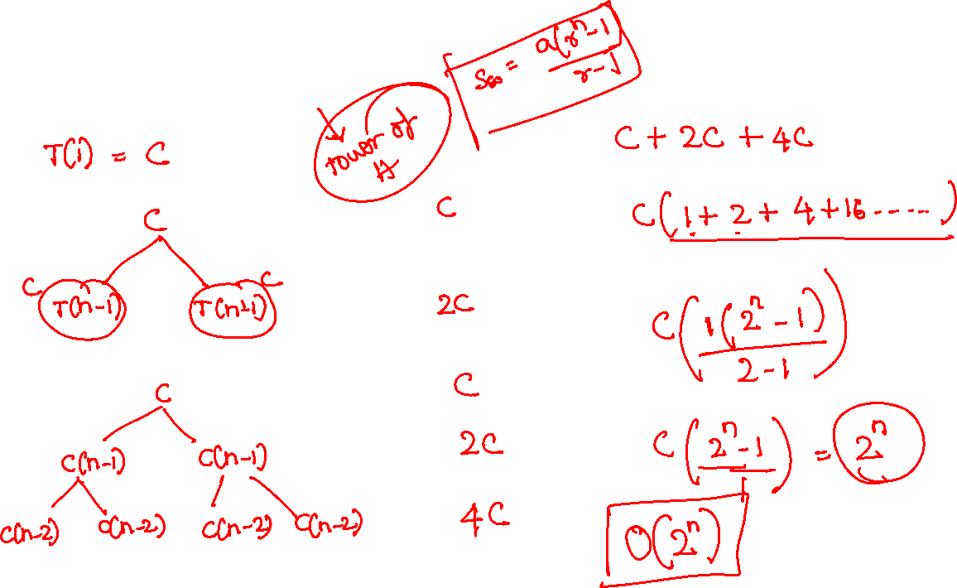

Slide 35
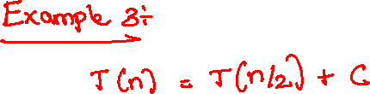
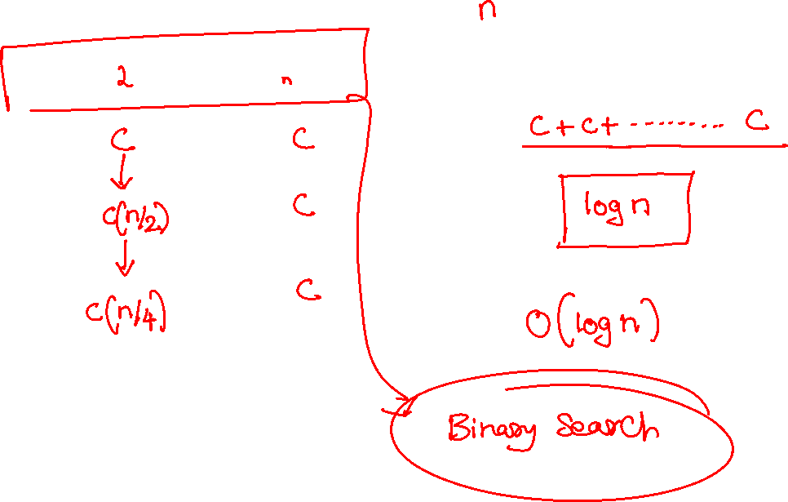

Slide 36
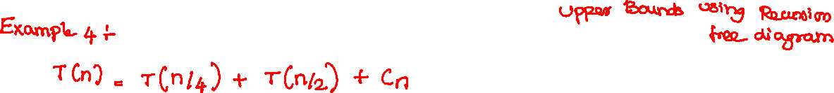
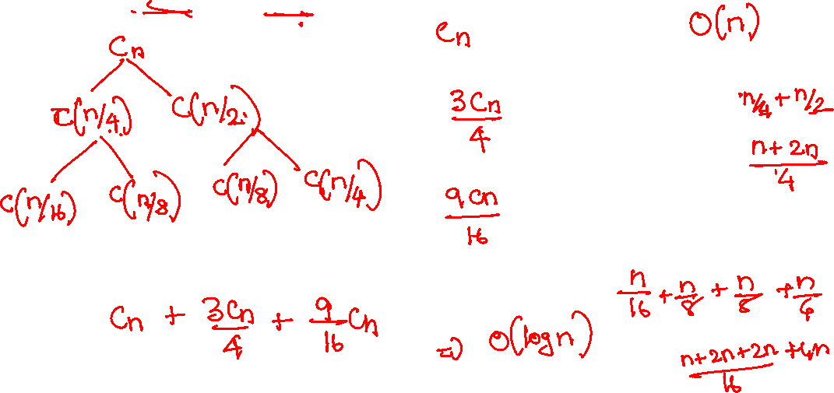

Slide 37
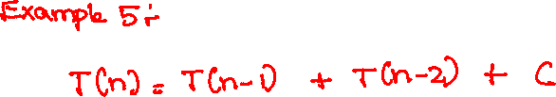
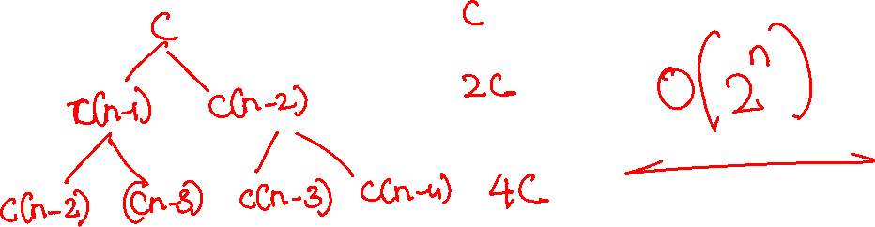

Slide 38
Pattern | Complexity
Single loop (linear) | O(n)
Loop × loop | O(n²)
Loop × log loop | O(n log n)
Divide by 2 each step | O(log n)
Double recursion (n/2, n/2) | O(n)
Merge sort | O(n log n)
Binary search | O(log n)
Power growth loop | O(log log n)

Slide 39


Slide 40


Slide 41


Slide 42


Slide 43



Slide 44



Slide 45



Slide 46


Slide 47



