Slide 1
Business Performance Report
Prepared by:Samudika Jagodage

Slide 2
Time Period Start: 1/8/2016 End: 31/1/2017 Countries: Germany, France, Portugal, Spain, Rest of the World Key Measures Total Revenue = Total Sports Revenue + Total Casino Revenue Total Customers Total Signups Total Deposit Amount Product-Level Metrics Revenue and customers by: Sports Casino
Data set Overview

Slide 3
KPI Snapshot
KPI | Value
Total Revenue | $124,241K
Total Casino Revenue | $99,710K
Total Sports Revenue | $24,531K
Total Deposit Amount | $324,574K
Total Customers | 6,767K
Total Signups | 407K

Slide 4
Trend Analysis

Slide 5
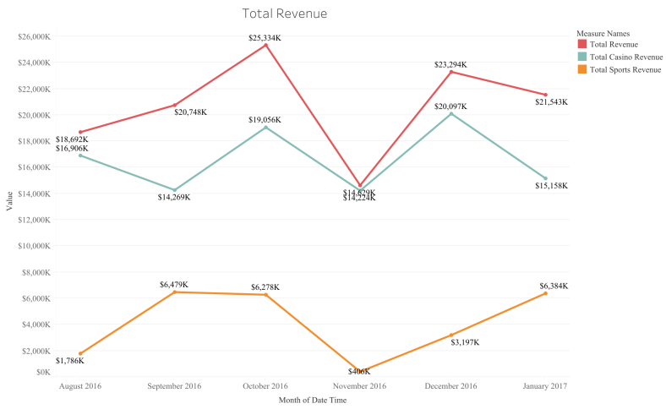
Product Wise Revenue
Sudden decline in Nov 2016 driven by declines in both sportsbook and casino.
Strong recovery in Dec 2016, with growth across both segments.
Revenue dropped again in Jan 2017, mainly due to a fall in casino performance.

Slide 6
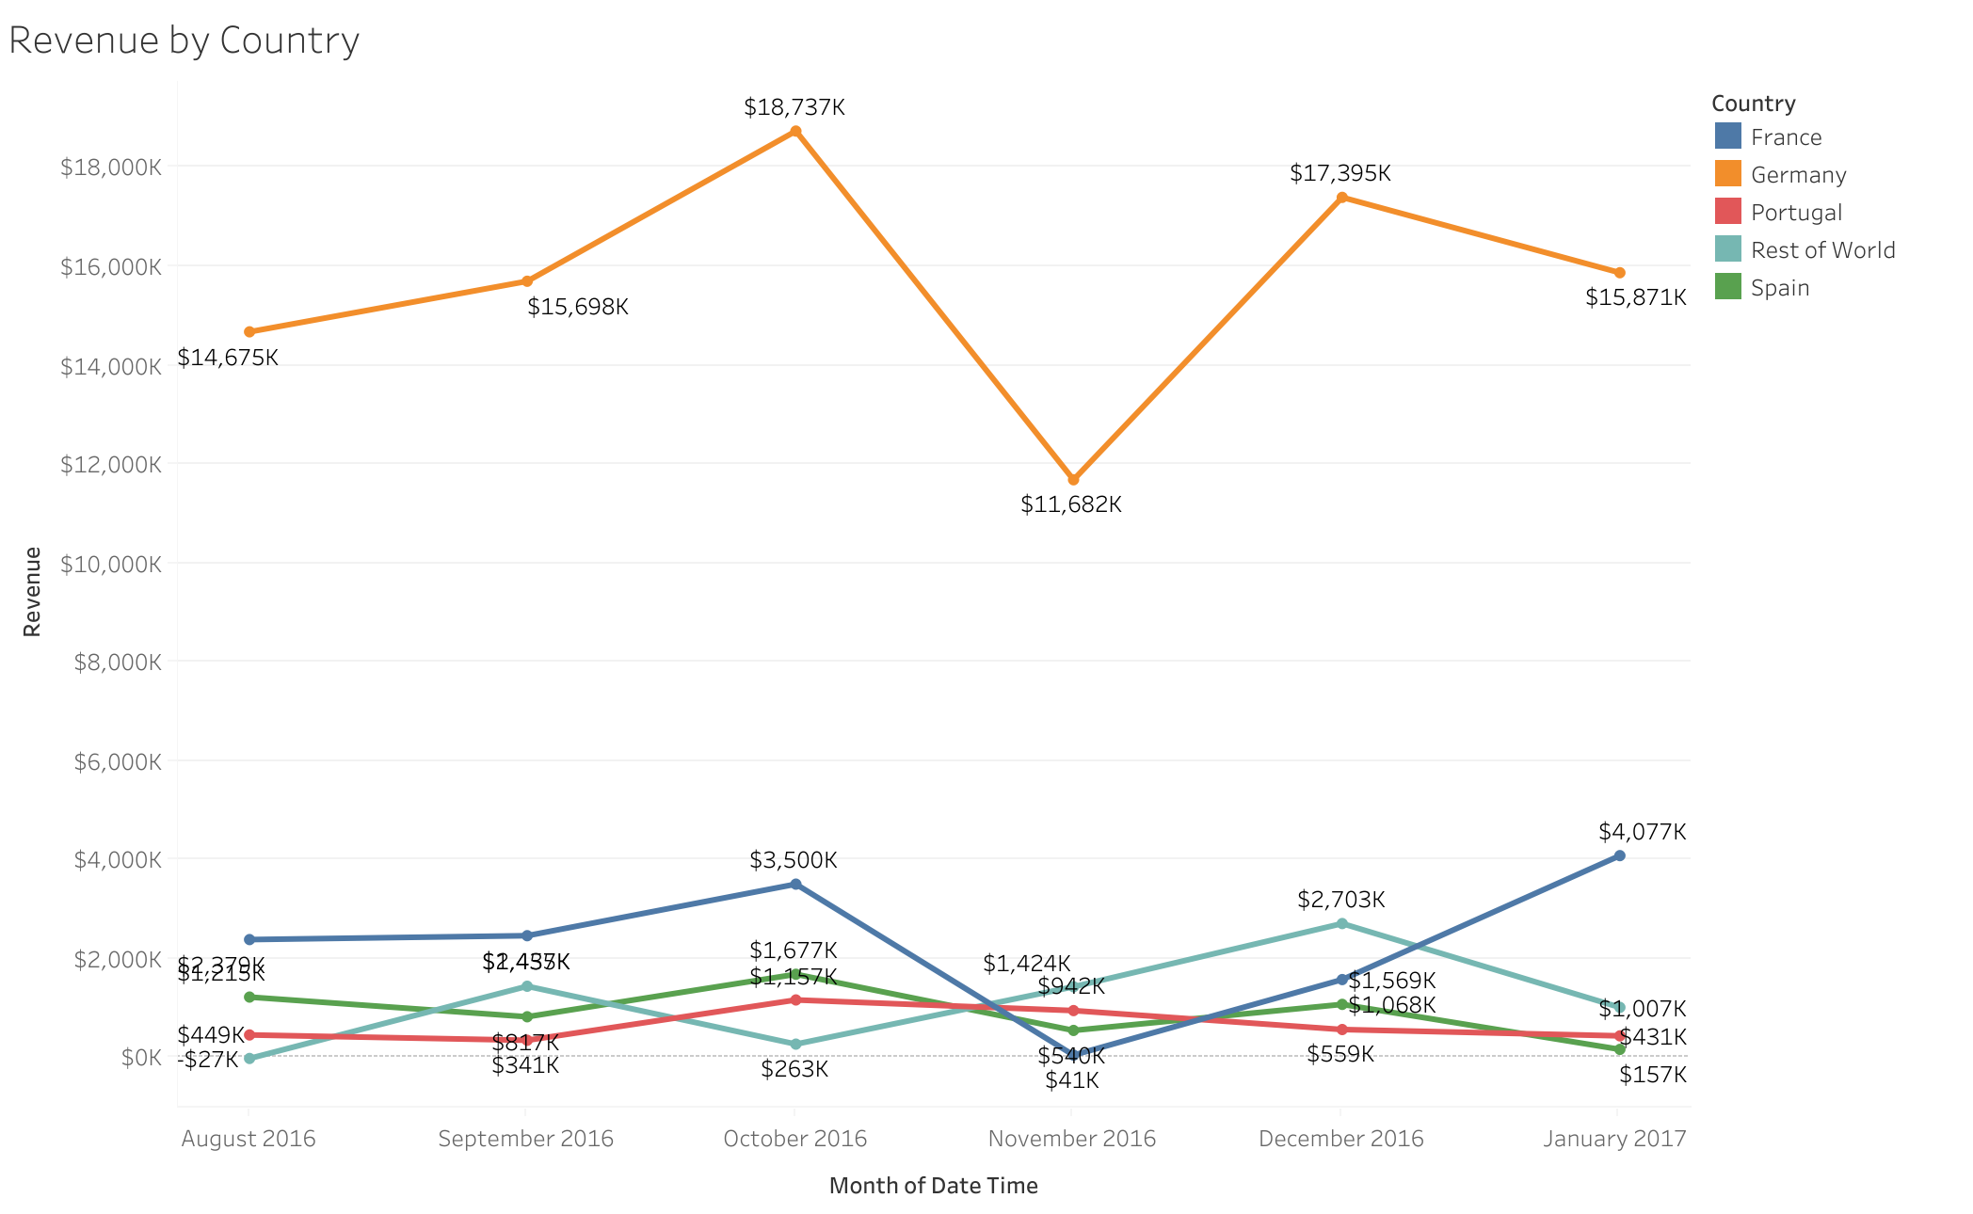
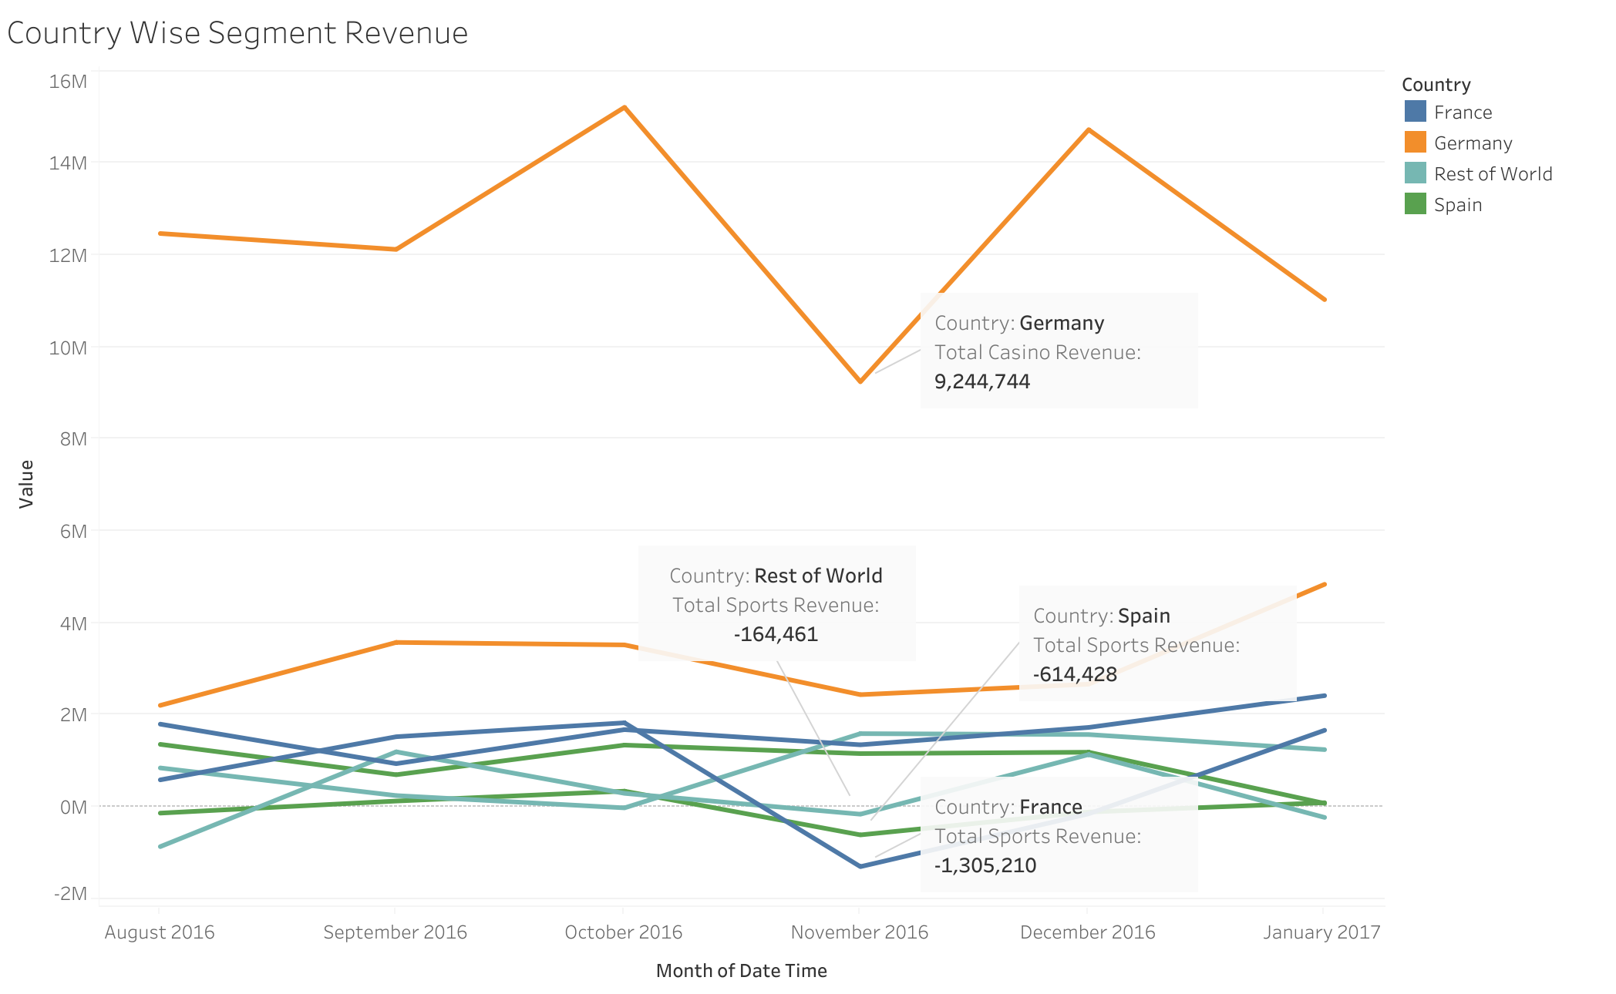
Country Wise Revenue
Nov 2016 Total revenue declined, primarily due to decreases in Germany and France
Portugal and Spain showed a consistent declining trend throughout this period.
January 2017 Revenue drop was mainly driven by Germany and Countries in the rest of the world

Slide 7
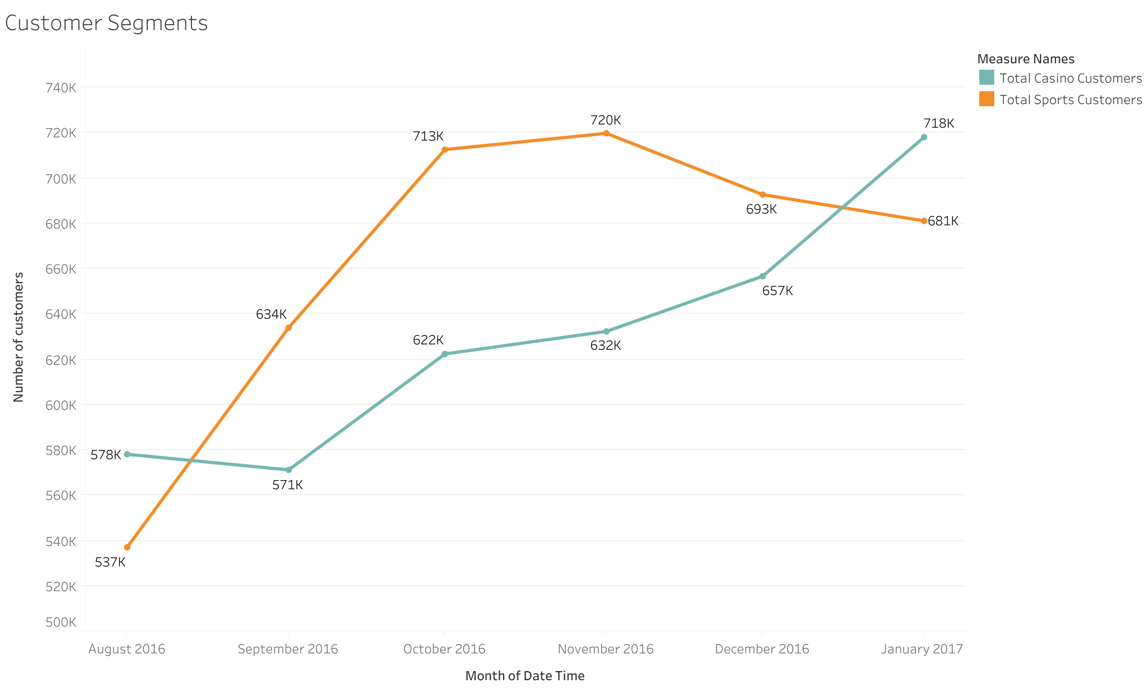
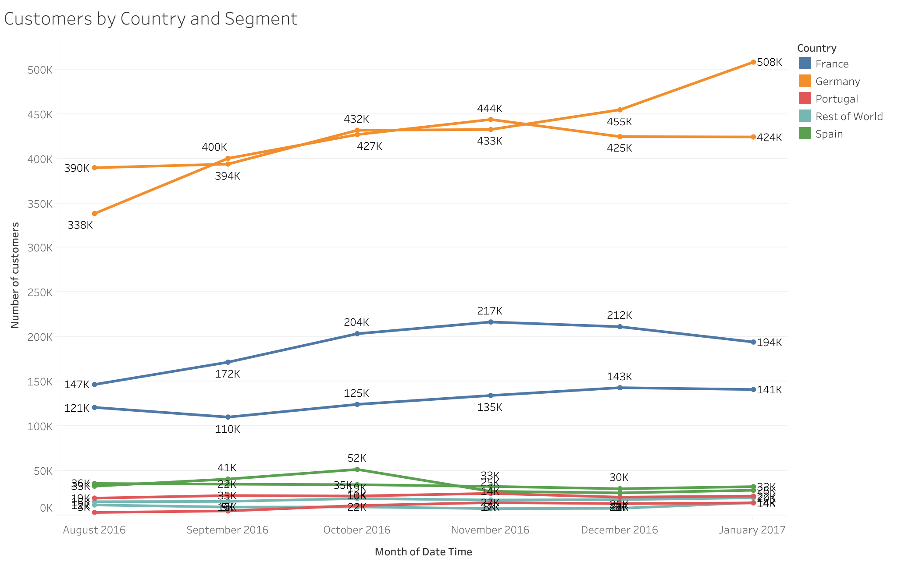
Customers by Country and Segment
November 2016 Casino and sportsbook customer numbers remained stable, so there might not be an impact on revenue from customers
Number of customers show gradual increase over the period (There's only slight drop of sportsbook customers in December 2016, January 2017)
Germany and France: Despite an increase in the number of customers, Casino revenue declined in November

Slide 8
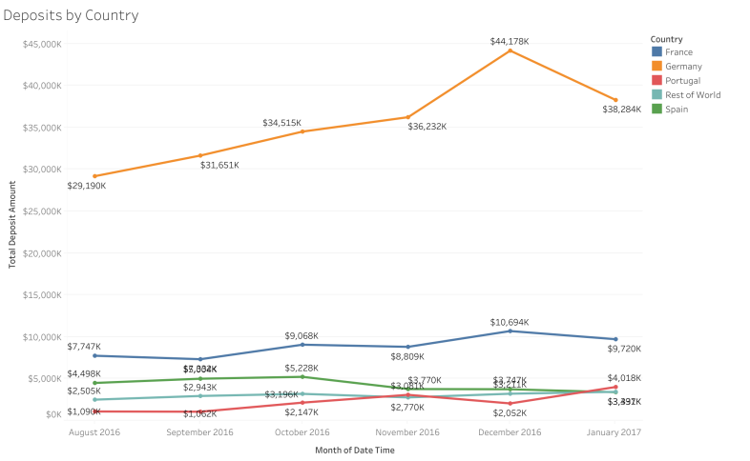
Country Wise Deposit Trend Analysis
Germany’s deposits increased in December. This might have a contribution to increase of revenue
In January, deposits decreased slightly, this might have lead to the minor drop in revenue.
However, the revenue decline in November was not driven by deposits, indicating other factors influenced the decrease.

Slide 9
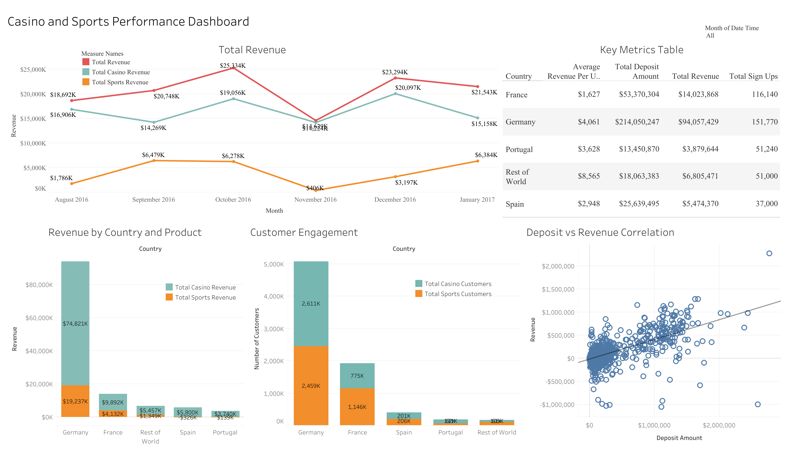

Slide 10
THANK YOU

