Slide 1
Russian Cuisine in NY City
Coursera project

Slide 2
Table of Contents
Description of Business problem
Description of data
Methodology
Results

Slide 3
Business Problem
As many as 800 languages are spoken in New York, making it the most linguistically diverse city in the world.
With that cultural diversity, there are multiple Russian eateries and restaurants in NY.
Estimating the opportunity to open a new restaurant, we have to find what competition level is in this business and where the most popular Russian restaurant is in NY.

Slide 4
Description of data
New York city data
List of Russian restaurants in NY city (Foursquare API)
GeoSpace data

Slide 5
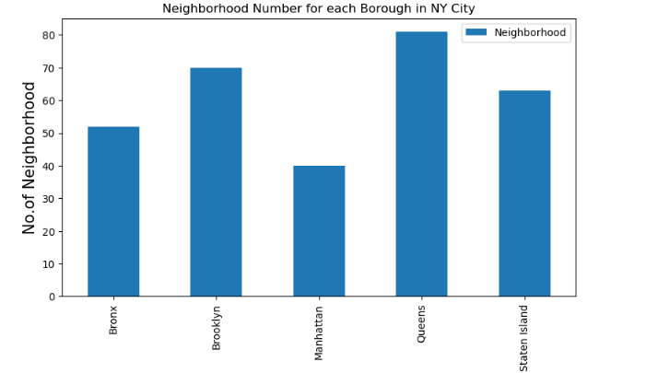
Methodology
Analyzing the data, we get the list of boroughs and neighborhoods in NY

Slide 6
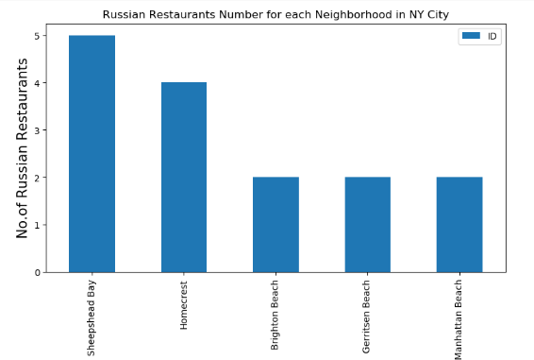
Explore how may Russian restaurants are in each neighborhood

Slide 7
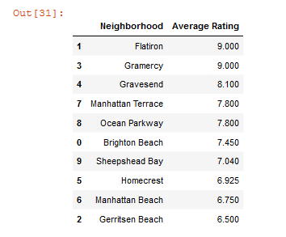
List of top-rated Russian restaurants

Slide 8
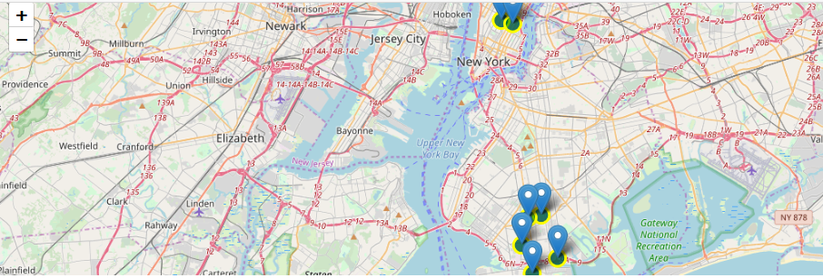
Top Russian restaurants locations in NY
Results: Brooklyn is a NY borough with the highest competition among Russian restaurants

Slide 9
Thank you!

