Slide 1
“Evolution and Performance” in [ Computer Organization and Assembly Language ] Lecture-03 Usman Nasim

Slide 2
[ Brief History of Computers ]
Reducing Distance between Components
Decreasing Component Size
Increasing Memory Size
Increasing Processor Speed
Changing Organization of the Processor
“pipelining and parallel execution techniques”
“what’s the benefit of it????”
Balancing the performance of various elements

Slide 3
To Balance out the Mismatch between Elements,
the Design must handle with the Evolving Factors:
Performance improvement in various components differ greatly from one type of element to another.
New application and new peripherals constantly change the nature of the demand on the system w.r.t. instruction profile and data access patterns.

Slide 4
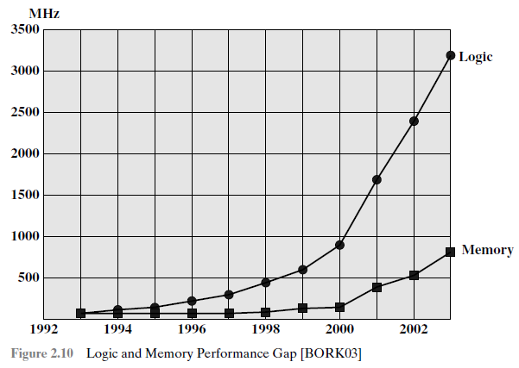

Slide 5
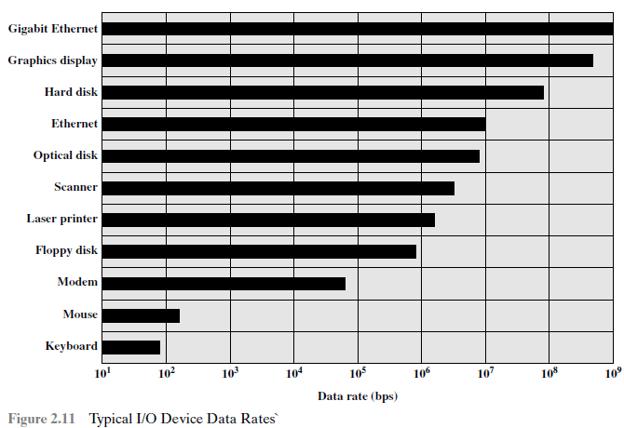

Slide 6
Processor Performance
Increase in Hardware Speed of Processor.
(by shrinking size of logic gates, hence reducing propagation delay)
An increase in Clock Rate.
(causes operations to execute more rapidly)

Slide 7
Improvement in Chip Organization and Architecture
Cache Capacity (1, 2 or 3 levels), w.r.t Size and Speed
Instruction execution logic become more complex by introducing parallel processing (pipelining and superscalar).
Placing Multiple Processors on a Single Chip, called Multicore, with large shared Cache.

Slide 8
Intel x86 Architecture Evolution
8080 (8-bit) | Pentium (Parallel Processing) | Core (2 Processors on a Single Chip)
8086 (16-bit) | Pentium Pro (More Powerful) | Core 2 (64-bit)
80286 (Enabled 16-bit Memory Addressing) | Pentium II (MMX Technology) | Core 2 Quad (4 Processors on a Single Chip)
80386 (32-bit, Multi-tasking) | Pentium III (3D Graphics SW)
80486 (Instruction Pipelining, Math Coprocessor) | Pentium 4 (Enhancements for Multimedia)

Slide 9
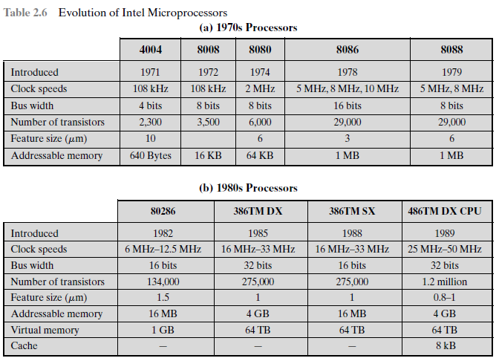

Slide 10
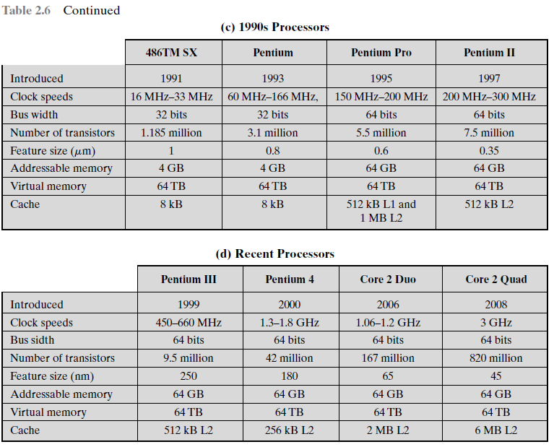

Slide 11
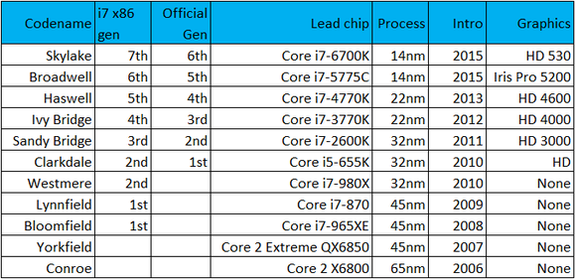

Slide 12
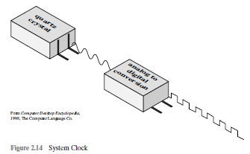
Clock Speed/Rate
“Rate of pulses”
e.g., 1GHz processor, how many pulses per second???

Slide 13

Instruction Execution Rate
Avg. Cycle Per Instruction:
CPI_{i} : Number of cycles required for instruction type i
I_{i} : Number of executed instructions of type i for a given program
I_{c} : Instruction count for a program as the number of machine instructions executed for that program
Processor Time to execute a given program:
𝜏 is constant cycle time and 𝜏 = 1/f, where f is the processor clock frequency.

Slide 14
1 GHz processor with CPI=1
1 billion instructions per second (1 billion clocks per second/cpi)
4 GHz processor with CPI=8
0.5 billion instructions per second

Slide 15
Clock Speed & Instructions per Second
Execution of an
instruction involves: Fetching,
Decoding,
Loading and Storing data
Performing arithmetic and logical operations
Deduction: Simple clock speed is not an accurate/true measure of different Processors’ Performance, hence requiring complex assessment mechanism. (Why???)

Slide 16
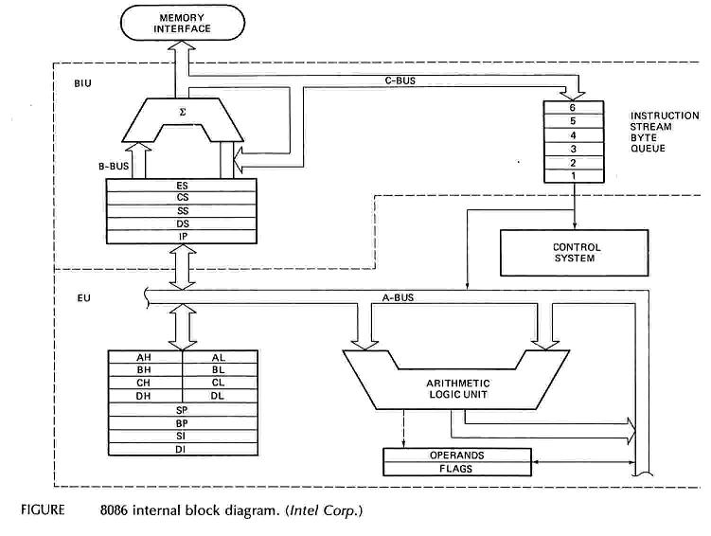
Intel 8086 Internal Architecture

