Slide 1
“Evolution and Performance” in [ Computer Organization and Assembly Language ] Lecture-04 M. M. Yasin myasin@ciitsahiwal.edu.pk

Slide 2
“Complex Instruction Set Computers (CISCs)”
e.g., Intel x86 Architecture…used for Non-Embedded Systems
(..used in mainframes, supercomputers, general purpose systems)
“Reduced Instruction Set Computers (RISCs)”
e.g., ARM Architecture…used for Embedded Systems
(..one of the most powerful and best-designed RISC based systems)

Slide 3
Embedded System
“Combination of hardware and software to perform
specific and dedicated task”
e.g., Digital Clock, Automated open/close Door System,
Other examples given in Table 2.7 in the Textbook on Page 65
Embedded System have a wide range of Requirements and Constraints based on the Applications.
Usually these Constraints dictate HW/SW Operations.
e.g., Speed, Precision, Time-Duration

Slide 4
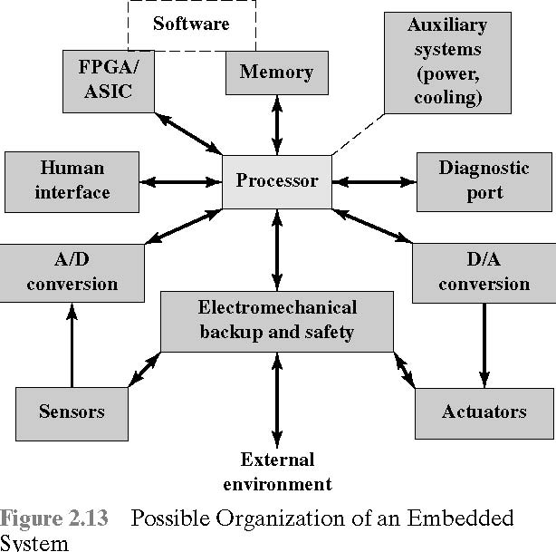

Slide 5
ARM Evolution
“Stands for Acorn RISC Machine, family of RISC-based microprocessors and microcontrollers, designed by ARM Inc.”
The Company “doesn’t make” but instead Designs
and licenses them to the Manufacturers (VLSI Technology).

Slide 6
ARM Evolution
Later a new company was organized, with Acorn, VLSI and Apple, known as ARM Limited.
The Acorn RISC Machine became the Advanced RISC Machine.
The company dropped the designation Advanced RISC Machine in the late 1990s. It is now simply known as the ARM Architecture.

Slide 7
More About ARM Chips…
Low Cost
Small Size
High Speed
Low Power Consumption
Being used in a large variety of Consumer Products.
e.g., Handheld Devices, Games, Phones, Apple’s iPhone and iPod, Real-Time Systems, Secure Applications like SIM Cards

Slide 8
…More About ARM Chips
ARM processors are designed to meet the needs of three system categories:
Embedded real-time systems: Systems for storage, automotive body and power-train, industrial, and networking applications.
Application platforms: Devices running open operating systems including Linux, Palm OS, Symbian OS, and Windows CE in wireless, consumer enter­tainment and digital imaging applications.
Secure applications: Smart cards, SIM cards, and payment terminals.

Slide 9
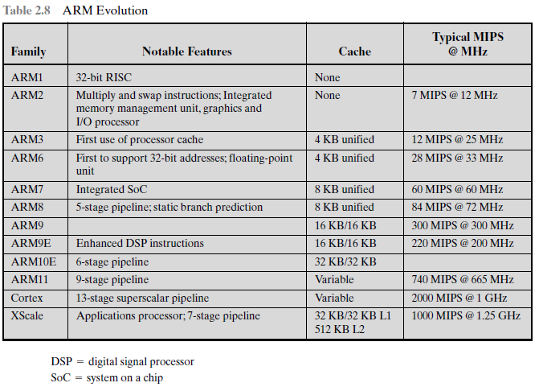

Slide 10
[ Performance Assessment ]
Key Parameters in Evaluation Criteria
Size
Cost
Security
Reliability
Performance
Energy Saving and Power Consumption
Note: Evaluation Criteria may vary among systems that are designed for different applications.

Slide 11
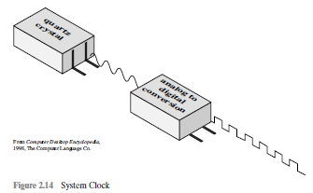
Clock Speed/Rate
“Rate of pulses”
e.g., 1GHz processor, how many pulses per second???

Slide 12
Clock Speed & Instructions per Second
Execution of an
instruction involves: Fetching,
Decoding,
Loading and Storing data
Performing arithmetic and logical operations
Deduction: Simple clock speed is not an accurate/true measure of different Processors’ Performance, hence requiring complex assessment mechanism. (Why???)

Slide 13

Instruction Execution Rate
Avg. Cycle Per Instruction:
CPI_{i} : Number of cycles required for instruction type i
I_{i} : Number of executed instructions of type i for a given program
I_{c} : Instruction count for a program as the number of machine instructions executed for that program
Processor Time to execute a given program:
𝜏 is constant cycle time and 𝜏 = 1/f, where f is the processor clock frequency.

Slide 14
Since Instruction Execution involves Processor Cycle Time as well as Memory Cycle Time
and these aren't equal,
therefore need to refine the above relation.
p: Number of processor cycles needed to decode/execute an instruction
m: Number of memory references needed
k: Ratio b/w memory and processor cycle time

Slide 15
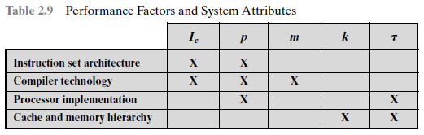
Above five performance factors are influenced/affected by below four system attributes:
Instruction Set Design
How effective the Compiler is in producing an efficient machine language program
Processor Implementation
Cache and Memory Hierarchy

