Slide 1
“Computer Function & Interconnection” in [ Computer Organization and Assembly Language ] Lecture-10, 11, 12 M. M. Yasin myasin@ciitsahiwal.edu.pk

Slide 2
“A Top-Level View of Computer Function and Interconnection”
The functional behavior of the system consists of the exchange of data and control signals among these computer components.
This exchange of data/control among computer components/modules is done through a communication channel/medium.

Slide 3
“Bus Interconnection”
It's a communication pathway or channel that connects 2 or more devices/components.
A bus consists of multiple communication lines. Each line can carry a binary signal ( 0 or 1). For example, an 8-bit data can be transmitted over 8 bus lines.
Since multiple devices are connected to the bus, therefore the key characteristics of a bus is a shared transmission medium.

Slide 4
“Topics Covered”
Classification of Buses w.r.t. their Function.
Operation of the Bus.
Basic Elements of Bus Design.
Different Available Buses and their Usage/Performance.

Slide 5
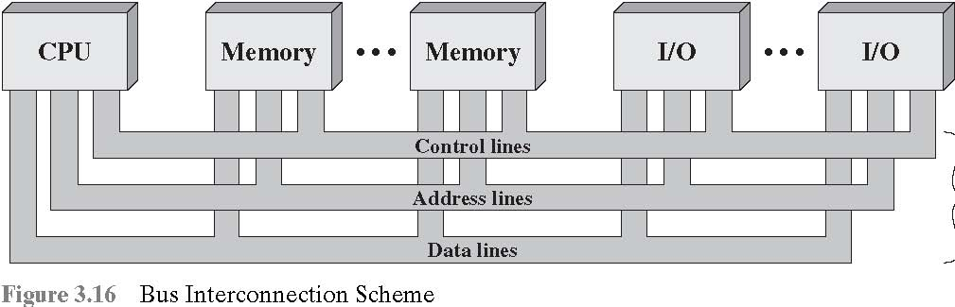
“Bus Interconnection”
Any bus can be classified into three functional groups:
Data Lines
Address Lines
Control Lines

Slide 6
“(1) Data Lines/Bus”
The data lines provide a path for moving data among system modules, also called as “data bus”.
The data bus may consist of 32, 64, 128, or even more separate lines, known as the width of the data bus.
The width of the data bus is a key factor in determining overall system performance. How???
the width of the data bus is a fundamental factor in determining system performance. It affects data transfer rates, memory access efficiency, instruction fetching, I/O operations, parallel processing, overall bandwidth, and scalability. Wider data buses generally lead to better performance, especially in data-intensive and high-speed applications.

Slide 7
“(2) Address Lines/Bus”
Used to designate the source or destination of the data on the data bus. For example, if the processor wishes to read a word (8, 16, or 32 bits) of data from memory, it puts the address of the desired word on the address lines.
The width of the address bus determines…???

Slide 8
“(2) Address Lines/Bus”
Furthermore, the address lines are generally used to address I/O ports. Typically, the higher-order bits are used to select a particular module on the bus, and the lower-order bits select a memory location or I/O port within the module.
For example, on an 8-bit address bus, address 01111111 and below might reference locations in a memory module (module 0) with 128 words of memory, and address 10000000 and above refer to devices attached to an I/O module (module 1).

Slide 9
“(3) Control Lines/Bus”
Used to control the use of the data and address lines. Because the data/address lines are shared by all components.
Control signals transmit both Command and Timing information among system modules.
Timing signals indicate the validity of data and address information.
Command signals specify operations to be performed.

Slide 10
“(3) Control Lines/Bus”
Typical control lines include:
Memory write: Causes data on the bus to be written into the addressed location
Memory read: Causes data from the addressed location to be placed on the bus
I/O write: Causes data on the bus to be output to the addressed I/O port
I/O read: Causes data from the addressed I/O port to be placed on the bus
Transfer ACK: Indicates that data have been accepted from or placed on the bus

Slide 11
“(3) Control Lines/Bus”
Bus request: Indicates that a module needs to gain control of the bus
Bus grant: Indicates that a requesting module has been granted control of the bus
Interrupt request: Indicates that an interrupt is pending
Interrupt ACK: Acknowledges that the pending interrupt has been recognized
Clock: Is used to synchronize operations
Reset: Initializes all modules

Slide 12
“Operation of the Bus”
If one module wishes to send data to another, it must:
obtain the use of the bus
transfer data via the bus.
If one module wishes to request data from another module, it must:
obtain the use of the bus
transfer a request to the other module over the appropriate control and address lines. It must then wait for that second module to send the data.

Slide 13
“Multiple-Bus Hierarchies”
If a great number of devices are connected to the bus, performance will suffer. There are two main causes:
In general, the more devices attached to the bus, the greater the bus length and hence the greater the propagation delay.
The bus may become a bottleneck as the total data transfer demand approaches the capacity of the bus. This problem can be solved by:
increasing the data rate that the bus can carry.
using wider buses.
However, because the data rates generated by attached devices (e.g., graphics and video controllers, network interfaces) are growing rapidly, therefore need multiple buses.

Slide 14
“Elements of Bus Design”
A variety of bus implementations exist, a few basic design elements are as follows:
Bus Type
Method of Arbitration
Timing
Bus Width
Data Transfer Type

Slide 15
“Elements of Bus Design”
Bus Type: Bus lines can be separated into two generic types:
Dedicated, (2) Multiplexed.
Dedicated: A dedicated bus line is permanently assigned either to one or a number of computer components.
An example of functional dedication is the use of separate dedicated address and data lines, which is common on many buses.

Slide 16
“Elements of Bus Design”
Multiplexed: Same set of lines are used for both address and data information using an Address Valid control line.
At the beginning of a data transfer, the address is placed on the bus and the Address Valid line is activated. At this point, each module has a specified period of time to copy the address and determine if it is the addressed module. The address is then removed from the bus, and the same bus connections are used for the subsequent read or write data transfer.
Advantages: ???
Disadvantages: ???

Slide 17
“Elements of Bus Design”
Physical Dedication: It refers to the use of multiple buses, each of which connects only a subset of modules.
For example, the use of an I/O bus to interconnect all I/O modules. This bus is then connected to the main bus through some type of I/O adapter module.
Advantage: High throughput, because there is less bus conflict.
Disadvantage: Increased size and cost of the system.

Slide 18
“Elements of Bus Design”
Method of Arbitration: Since more than one module may need control of the bus and only one unit/module at a time can successfully transmit over the bus, therefore some method of arbitration/negotiation is needed. The various methods can be classified into two classes/schemes.
(1) Centralized (2) Distributed
Centralized: A single hardware device is responsible for allocating time on the bus, called Bus Controller/Arbiter.
Distributed: Each module contains access control logic and modules act together to share the bus.

Slide 19
“Elements of Bus Design”
Timing: It refers to the way in which events are coordinated on the bus. It can be either:
(1) Synchronous (2) Asynchronous
Synchronous: Occurrence of events on the bus is determined by the clock.
Asynchronous: Occurrence of one event on a bus follows and depends on the occurrence of a previous event.

Slide 20
“Elements of Bus Design”
Bus Width: The data bus may consist of 32, 64, 128, or even more separate lines, known as Bus Width.
Note-1:
The wider the data bus, the greater the number of bits transferred at one time. i.e., greater performance.
Note-2:
The width of the address bus has an impact on system capacity. i.e., greater range of locations.

Slide 21
“Elements of Bus Design”
Data Transfer Type: Bus supports various data transfer types.
In case of multiplexed address/data bus, the bus is first used for specifying the address and then for transferring the data.
In the case of dedicated address and data buses, the address is put on the address bus and remains there while the data are put on the data bus
There are other combinations operations that some buses allow. For example, read-modify-write operation, read-after-write, block data transfer.

Slide 22
“Different Available Buses and their Usage/Performance”
PC Parallel Port. The original PC parallel port was unidirectional (towards the printer) and was capable of about 10 KB/sec.
Enhanced Parallel Port (EPP) achieves transfer speeds of between 500 KB/sec and 2 MB/sec and is targeted at CD-ROMs, tapes and hard drives.
Industry Standard Architecture (ISA) bus. This bus architecture was developed by IBM for the PCs. It is still in wide use where high performance is not necessary. Performance is 3 Mbps at 16 bits.

Slide 23
“Different Available Buses and their Usage/Performance”
SCSI (Small Computer System Interface). The original SCSI 1 introduced an 8 bit parallel bus that was able to do Asynchronous transfers at 1.5 MegaBytes/sec and Synchronous transfers up to 5 MB/sec. It is used to connect peripherals and computers such as hard disks, tape devices, port expanders, CD-ROMs, CD-R units, scanners, and many other devices. Other versions are: FAST-SCSI, WIDE-SCSI, ULTRA-SCSI.
IDE (Integrated Drive Electronics), developed by Compaq and Western Digital, is a standard for connecting disk drives in a common way to PC motherboards. In today's IDE configurations, multiple devices can share the IDE controller.

Slide 24
“Different Available Buses and their Usage/Performance”
Universal Serial Bus. USB standard is for connecting keyboards, monitors, input devices, and digital cameras over a 12-Mbps bus network.
Designed to simplify the connection of peripheral devices, provide increased I/O capacity, and provide maximum flexibility for the continued evolution of the PC.
USB replaced PC's keyboard, serial, and parallel connections with a simple jack architecture, with auto detection capabilities to know when a device is attached or unattached.

Slide 25
“Different Available Buses and their Usage/Performance”
FireWire. The IEEE-1394 standard, known as FireWire, is a serial SCSI-bus standard supporting transfer rates from 100 to 400 MBps, expanding eventually up to 1.6 Gbps (gigabits per second) or faster.

Slide 26
“Different Available Buses and their Usage/Performance”
Fire Wire vs. USB. Both are emerging technologies that offer a new method of connecting multiple peripherals to a computer. Both permit peripherals to be added to or disconnected from a computer without the need to reboot. Both use thin, flexible cables which employ simple, durable connectors.
Although 1394 and USB cables may look nearly the same, the amount of data flowing through them is quite different. Firewire offers a data transfer rate that is over 16 times faster than USB.

Slide 27
“Different Available Buses and their Usage/Performance”
Bluetooth. The technology is for wireless communication of data and voice. It is based on a low-cost short-range radio link, built for stationary and mobile communication environments.
It allows for the replacement of the many cables that connect one device to another with one universal short-range radio link.

Slide 28
“Peripheral Component Interconnect (PCI)”
PCI. The peripheral component interconnect (PCI) is a popular high-bandwidth, processor-independent bus that can function as a peripheral bus.
Compared with other common bus specifications, PCI delivers better system performance for high-speed I/O subsystems (e.g., graphic display adapters, network interface controllers, disk controllers…).
The current standard allows the use of up to 64 data lines at 4.224 Gbps.
PCI requires very few chips to implement and supports other buses attached to the PCI bus.

Slide 29
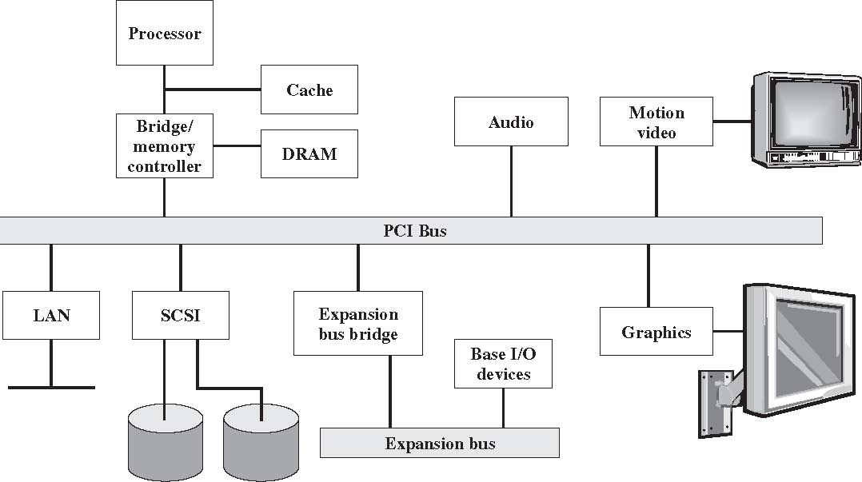
“Peripheral Component Interconnect (PCI)”
Figure 3.22 Typical Desktop System

