Slide 1
“Cache Memory” in [ Computer Organization and Assembly Language ] Lecture-22, 23 M. M. Yasin myasin@ciitsahiwal.edu.pk

Slide 2
“Computer Memory System”
Computer memory is organized into a hierarchy:
At the highest level (closest to the processor), are the processor Registers.
Next comes one or more levels of Cache. When multiple levels are used, they are denoted L1, L2, and so on.
Next comes Main Memory, which is usually made out of dynamic random-access memory (DRAM).
All of these are considered internal to the computer system.
The hierarchy continues with external memory, with the next level typically being a fixed Hard Disk,
and one or more levels below that consisting of removable media such as Optical Disks and Tape.

Slide 3
“Computer Memory System”
Register
Cache
Main Memory
Hard Disk
Optical Disk and Tape
Note: It would be nice to use only the fastest memory, but because that is the most expensive memory, we trade off access time for cost by using more of the slower memory.
(frequency of access
by the processor)
decreases
(cost/bit)
decreases
(capacity)
increases
(access time)
increases

Slide 4
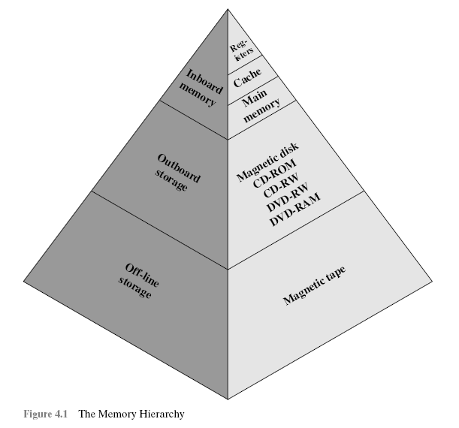
The key to the success of this organization is:
“decreasing frequency of access
by the processor”.

Slide 5
“Computer Memory System”
Few Characteristics of Memory:
Capacity
Internal: bytes/words
External: bytes
Unit of Transfer
Internal: No. of lines in/out of Memory. i.e., 64, 128
External: Blocks
Method of Accessing
Sequential → Tapes
Direct → Disks
Random → Main Memory and some Cache
Associative → some Cache

Slide 6
“Computer Memory System”
Sequential:
Memory is organized into units of data, called records. Access must be made in a specific linear sequence.
Direct:
Individual blocks or records have a unique address based on physical location. Access is accomplished by direct access to reach a general vicinity plus sequential searching, counting, or waiting to reach the final location.

Slide 7
“Computer Memory System”
Random Access:
Each addressable location in memory has a unique, physically
wired-in addressing mechanism. Thus, any location can be selected at random and directly addressed and accessed.
Associative:
This is a random access type of memory that enables one to make a comparison of desired bit locations within a word for a specified match. Thus, a word is retrieved based on a portion of its contents rather than its address. As with ordinary random-access memory, each location has its own addressing mechanism, and retrieval time is constant independent of location.

Slide 8
“Cache Memory Principles”
Cache memory is intended to give memory speed approaching that of the fastest memories available, and at the same time provide a large memory size at the price of less expensive memories.
The cache contains a copy of portions of main memory.
When the processor attempts to read a word of memory, a check is made to determine if the word is in the cache. If so, the word is delivered to the processor.
If not, a block of main memory, consisting of some fixed number of words, is read into the cache and then the word is delivered to the processor.

Slide 9
“Cache Memory Principles”
Because of the phenomenon of locality of reference,
when a block of data is fetched into the cache to satisfy a single memory reference, it is likely that there will be future references to that same memory location or to other words in the block.
Figure 4.3b depicts the use of multiple levels of cache. The L2 cache is slower and typically larger than the L1 cache, and the L3 cache is slower and typically larger than the L2 cache.

Slide 10
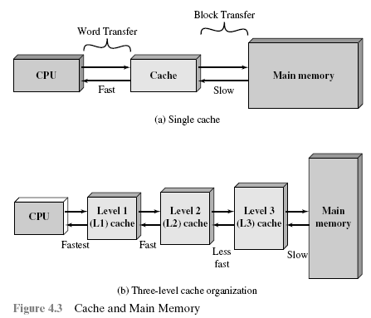

Slide 11
“Few Elements of Cache Design”
(1) Cache Size
We would like the size of the cache to be
small enough so that the overall average cost per bit is close to that of main memory alone and
large enough so that the overall average access time is close to that of the cache alone.
The larger the cache, the larger the number of gates involved in addressing the cache. The result is that large caches tend to be slightly slower than small ones.

Slide 12
“Few Elements of Cache Design”
(2) Number of Caches
When caches were originally introduced, the typical system had a single cache. More recently, the use of multiple caches has become the norm.
Two aspects of this design issue concern the number of levels of caches and the use of unified versus split caches.
(1) Multilevel Cache: As logic density has increased, it has become possible to have a cache on the same chip as the processor: the on-chip cache. Compared with a cache reachable via an external bus, the on-chip cache reduces the processor’s external bus activity and therefore speeds up execution times and increases overall system performance.

Slide 13
“Few Elements of Cache Design”
The inclusion of an off-chip or external cache is still desirable. Now a days, designs include both on-chip and external caches. The simplest such organization is known as a two-level cache, with the internal cache designated as level 1 (L1) and the external cache designated as level 2 (L2).
The reason for including an L2 cache is the following:
If there is no L2 cache and the processor makes an access request for a memory location not in the L1 cache, then the processor must access Main Memory across the bus. Due to the typically slow bus speed and slow memory access time, this results in poor performance. On the other hand, if an L2 cache is used, then frequently the missing information can be quickly retrieved.

Slide 14
“Few Elements of Cache Design”
With the increasing availability of on-chip area available for cache, recent microprocessors have moved the L2 cache onto the processor chip and added an L3 cache.
Originally, the L3 cache was accessible over the external bus. More recently, most microprocessors have incorporated an on-chip L3 cache.
In either case, there appears to be a performance advantage to adding the third level.

Slide 15
“Few Elements of Cache Design”
(2) Unified versus Split Cache: Initially, on-chip cache used to store references to both data and instructions.
More recently, it has become common to split the cache into two: one dedicated to instructions and one dedicated to data. These two caches both exist at the same level, typically as two L1 caches.
When the processor attempts to fetch an instruction from main memory, it first consults the instruction L1 cache, and when the processor attempts to fetch data from main memory, it first consults the data L1 cache.

Slide 16
“Few Elements of Cache Design”
There are two potential advantages of a unified cache:
For a given cache size, a unified cache has a higher hit rate than split caches because it balances the load between instruction and data fetches automatically. That is, if an execution pattern involves many more instruction fetches than data fetches, then the cache will tend to fill up with instructions, and if an execution pattern involves relatively more data fetches, the opposite will occur.
Only one cache needs to be designed and implemented.

Slide 17
“Few Elements of Cache Design”
Key advantage of split cache is:
It eliminates the dispute for the cache between the instruction fetch/decode unit and the execution unit.
Detail: When the execution unit performs a memory access to load and store data, the request is submitted to the unified cache. If, at the same time, the instruction pre-fetcher issues a read request to the cache for an instruction, that request will be temporarily blocked so that the cache can service the execution unit first, enabling it to complete the currently executing instruction.
This cache contention can degrade performance by interfering with efficient use of the instruction pipeline. The split cache structure overcomes this difficulty.

Slide 18
“Few Elements of Cache Design”
Despite these advantages, the trend is toward split caches, particularly for superscalar machines such as the Pentium and PowerPC, which emphasize parallel instructions execution and the pre-fetching of predicted future instructions.

