Slide 1


RoadSafe
Analytics

Slide 2

Project Overview
Objective: Analyze the US Accidents (2016–2022) dataset to uncover key patterns and risk factors.
Dataset: Over 4 million accident records sourced from Kaggle.
Focus Areas:
Data cleaning & preprocessing
Exploratory data analysis
Visualization of trends & hotspots
Goal: Deliver insights to support road-safety improvements.

Slide 3



AGENDA
Announcement
TARGET
Tools
Study road accident data to find patterns and causes.
Use Python to analyze and understand the data.
Dataset: US Accidents from Kaggle.
Goal: Help improve road safety with insights.
Clean and prepare accident data.
Study accidents by time, location, weather, and road.
Show patterns with charts and graphs give insights for safety and policies.
Make a report and presentation.
Python
Pandas
Matplotlib
Seaborn
Google Colab Jupyter Notebook
US Accidents
Dataset (Kaggle)

Slide 4
PROJECT WORKFLOW
Project Initialization
Data Cleaning & Preprocessing
Univariate Analysis
Bivariate & Multivariate Analysis
Geospatial Analysis
Insight Extraction
Hypothesis Testing
Final Visualization & Interpretation
Documentation & Presentation

Slide 5
Impact & Beneficiaries of RoadSafe Analytics
Why It’s Useful Helps identify accident trends and risk factors. Provides data-driven insights to improve road safety. Supports better decision-making for safety measures and infrastructure. | Where It’s Applicable Government & Transportation Departments: for policy planning and resource allocation. Urban Planners: to design safer roads and intersections. Emergency Services: to anticipate high-risk areas and improve response times. Insurance & Research Organizations: for risk assessment and awareness campaigns. | Who Benefits Commuters & Drivers: safer travel and reduced accident risk. City Authorities: better data for road safety initiatives. Healthcare Systems: fewer severe injuries reduces emergency load. Policy Makers: evidence-based policies for road safety.

Slide 6

Project Initialization
📍 Step 1: Defined project scope, objectives & outcomes ⬇ 📍 Step 2: Acquired dataset & reviewed schema ⬇ 📍 Step 3: Calculated preliminary descriptive stats ⬇ 📍 Step 4: Detected missing values, duplicates & outliers

Slide 7

Handle Missing data
Datetime Transformation
Outlier Treatment
Categorical Encoding
Duplicate Removal
Data Cleaning and Preprocessing
Dropped columns with excessive missing values; imputed others (median/mode). | Converted timestamps; derived features (Hour, Weekday, Month). | Encoded variables for analysis and modeling. | Detected and handled unrealistic values (e.g., negative durations). | Identified and removed duplicate records.

Slide 8
Univariate Analysis
Univariate analysis helps explore the distribution of individual variables in the dataset.
1️⃣ Accident Severity (⚠️) Shows how accidents are spread across different severity levels (minor, moderate, severe, fatal). | 2️⃣ Time of Day (⏰) Identifies peak accident times: morning, afternoon, evening, or night. | 3️⃣ Day of Week (📅) Compares accident counts across weekdays and weekends (Monday–Sunday).
4️⃣ Month (🗓) Tracks accident trends across the year to spot seasonal patterns. | 5️⃣ Weather Conditions (🌤) Reveals impact of weather (clear, rain, fog, snow, etc.) on accidents. | 6️⃣ Road Type (🛣) Determines if accidents occur more on highways, city roads, or rural roads.
📊 Visualization Methods: Histograms, bar charts, and pie charts used for distribution analysis.

Slide 9

Bivariate and Multivariate Analysis
Bivariate Analysis: Examines relationships between two variables to identify trends, correlations, or differences (e.g., Severity vs Visibility). Multivariate Analysis: Explores interactions among three or more variables to find patterns, clusters, or influences (e.g., Severity vs Visibility vs Weather). Purpose & Visualization: Helps understand relationships and patterns; commonly visualized using scatter plots, box plots, heatmaps, and pair plots.

Slide 10
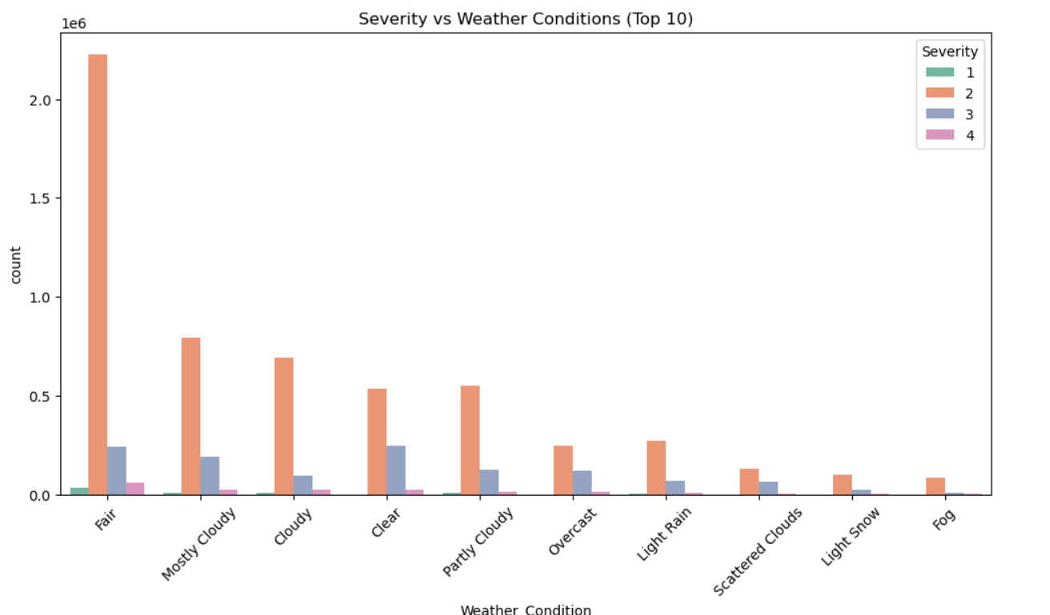
Severity vs Weather Conditions
Most accidents, including severe ones, occur during fair and clear weather, likely due to higher traffic volumes in these conditions.
Bad weather conditions like rain, fog, and snow are associated with a higher proportion of severe accidents, but the total number remains much lower compared to clear weather.
Human and traffic factors cause most accidents, not just extreme weather.

Slide 11
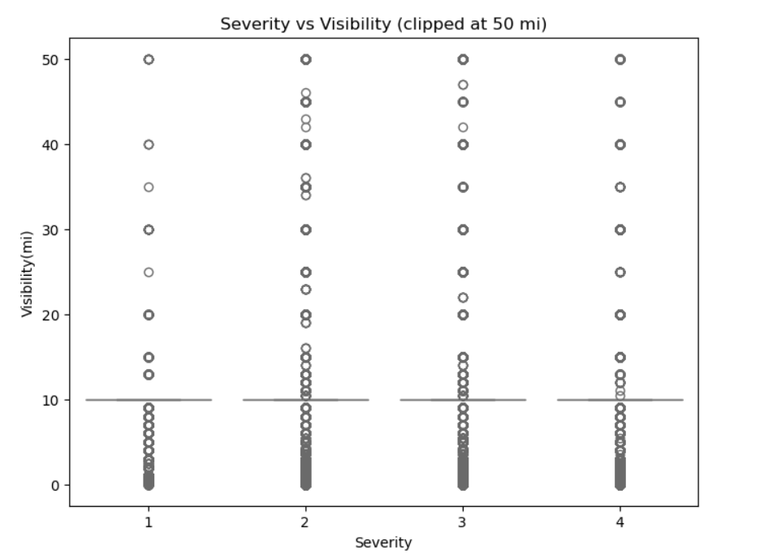
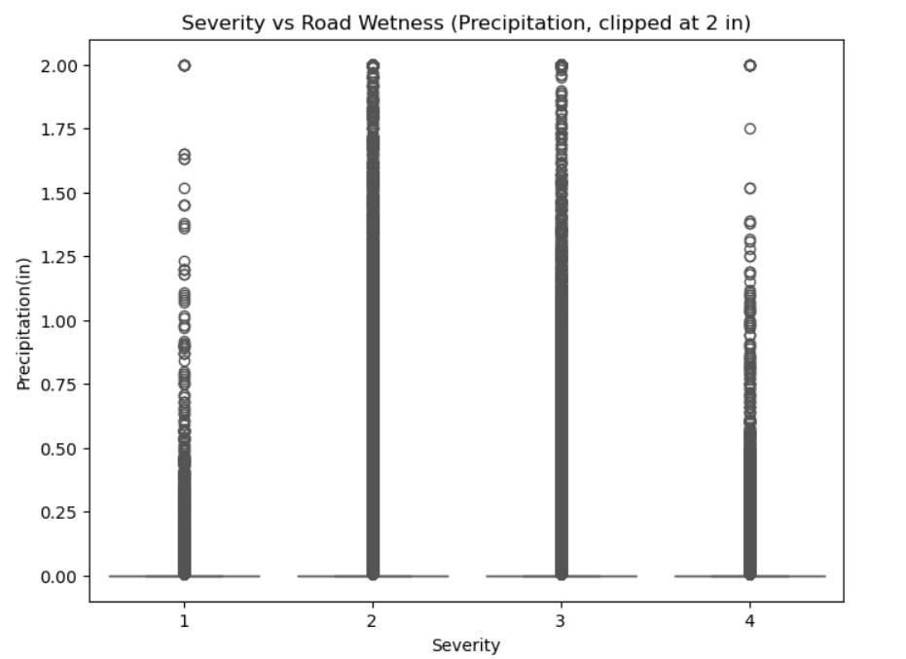
Severity vs Visibility
Most accidents, including severe ones, occur under normal visibility and dry road conditions, likely because these conditions are most common.
Extremely low visibility and high precipitation (wet roads) are associated with certain severe accidents, but such situations are much less frequent in the data.
Neither poor visibility nor high road wetness alone show a strong correlation with accident severity, suggesting that these environmental factors are not the main drivers of severe accidents.

Slide 12
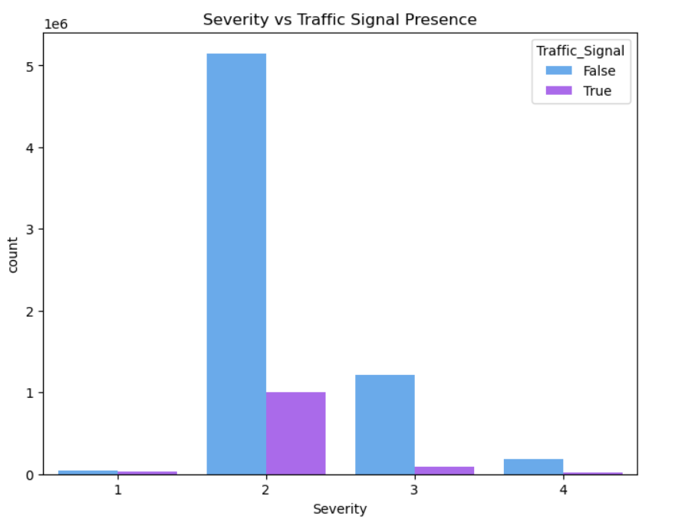
Severity vs Traffic Features
Most accidents occur at locations without traffic signals, with severity 2 being the most common outcome in both signalized and non-signalized spots.
The presence of a traffic signal does not show a strong effect on the occurrence of severe accidents; severe cases (3 and 4) are proportionally rare regardless of signal presence.
This indicates that while traffic signals are important for control, other factors likely play a bigger role in determining accident severity.

Slide 13
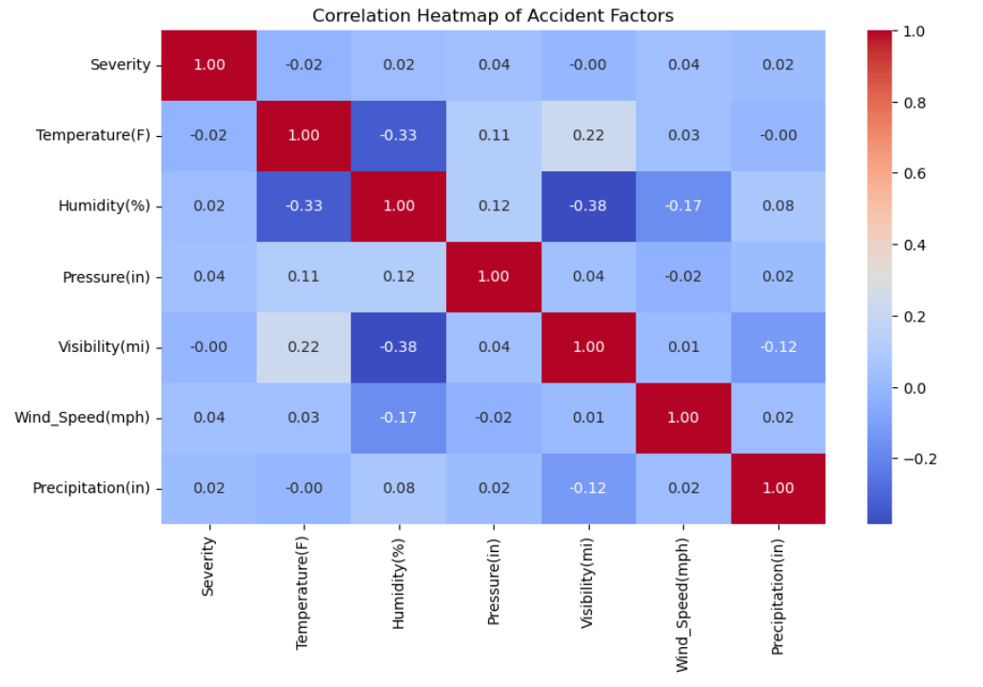
Correlation Heatmap
Accident severity shows very weak correlation with weather and road factors like temperature, humidity, visibility, wind speed, and precipitation.
No single environmental factor strongly predicts accident severity.
This suggests severity is influenced more by other factors such as human behavior and traffic conditions than by these individual weather variables.

Slide 14
Bivariate & multivariate analysis reveals how factors interact with accident severity.
Adverse weather, low visibility, junctions, and congestion increase severity risk.
Correlation heatmap shows severity depends on multiple interacting factors, not just one.
Builds on univariate analysis and prepares for advanced modeling with multiple predictors.

Slide 15

Goal: Identify accident hotspots using latitude & longitude data.
Nationwide Patterns: Dense clusters on East Coast, California, Texas, Florida.
Top Cities: Miami (142K), Los Angeles (79K), Orlando (74K), Dallas (50K), Houston (46K).
Key Takeaway: Accidents highly concentrated in urban centres and highways.
Geospatial and Location-Based Analysis

Slide 16
Insight Extraction and Hypothesis Testing
Q1: Time of Day → No significant variation
Q2: Rain vs Fog → Rain accidents more severe (p < 0.05)
Q3: Visibility vs Severity → Weak correlation (not significant)
Key Takeaway: Weather (especially rain) impacts severity more than time or visibility.

Slide 17
Final Visualization and Interpretation
Accident Frequency → Balanced across day, fewer at night
Rain vs Fog → Rain shows higher severity
Visibility → Weak effect on severity
Heatmap → Severity depends on multiple interacting factors
Key Takeaway: Severity is multi-factorial, not driven by one variable

Slide 18
THANKYOU

