Slide 1
CS-336: Embedded Systems
AVR Assembly
Slight modification of slides shared by Dr. Rehan Ahmed
Instructor: Asra Abid Siddiqui [asiddiqui.phd20seecs@seecs.edu.pk]

Slide 2
Modeling Finite State Machines
Some More Assembly Instructions …

Slide 3
Subtraction
SUB Rd, Rs
  Rd = Rd – Rs
Example:
  SUB R25, R9
    R25 = R25 - R9
  SUB R17, R30
    R17 = R17 - R30
CPU
ALU
R0
R1
R2
…
SREG:
H
N
Z
I
T
S
V
C
R15
R16
R17
PC
…
Instruction decoder
R30
R31
Instruction Register
registers

Slide 4
Increment and Decrement
INC Rd
  Rd = Rd + 1
Example:
  INC R25
    R25 = R25 + 1
DEC Rd
  Rd = Rd - 1
Example:
  DEC R23
    R23 = R23 - 1
CPU
ALU
R0
R1
R2
…
SREG:
H
N
Z
I
T
S
V
C
R15
R16
R17
PC
…
Instruction decoder
R30
R31
Instruction Register
registers

Slide 5
Modeling Finite State Machines
AVR Memory Space
Two Kinds of Memory Spaces:
Code Memory
Data Memory

Slide 6
AVR Data Memory

Slide 7
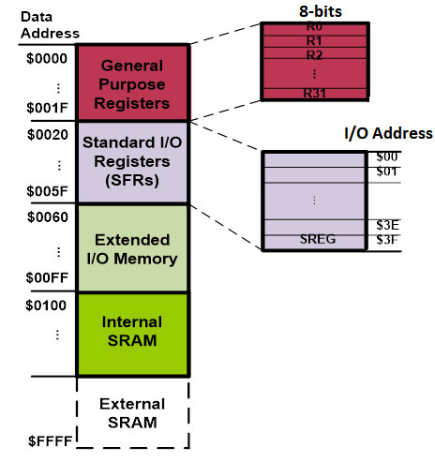
AVR Data Memory: Data Memory Space
Data memory composed of:
GPRs
I/O Memory
Internal data SRAM

Slide 8
Data Address Space
Data memory composed of:
GPRs
I/O Memory
Internal data SRAM

Slide 9
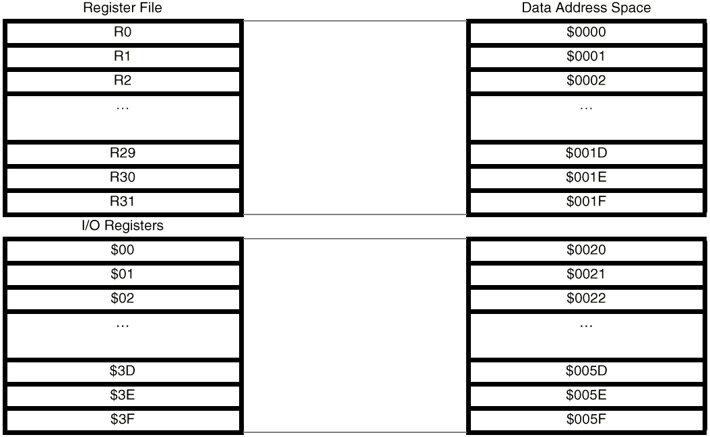
AVR Data Memory Space: GPRs
GPRs:
  Take 32 bytes of data memory
  Address location $00 - $1F (always)

Slide 10
AVR Data Memory Space: I/O Memory
I/O Memory (SFR):
    Dedicated to specific functions such as:
      Status register
      Timers
      Serial communication etc.
    I/O Memory locations depend on the number of pins and peripheral functions supported by a device
      At least all the families have 64 bytes
I/O Registers

Slide 11
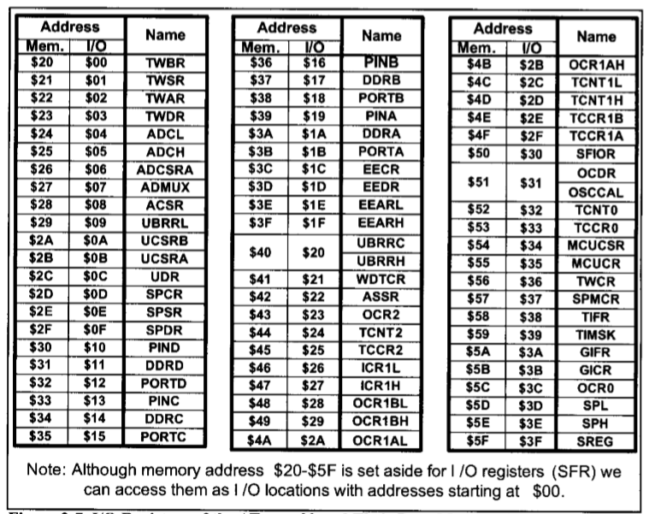
AVR Data Memory Space: I/O Memory

Slide 12
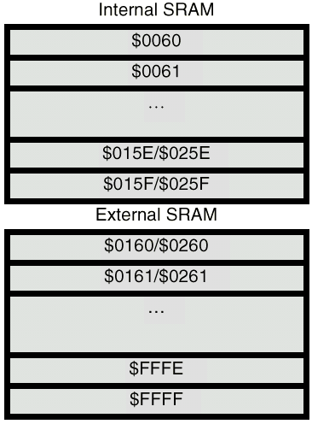
AVR Data Memory Space: Internal SRAM
Internal SRAM:
  aka Scratch Pad memory
    Used for storing data and parameters

Slide 13
Data Address Space
Example: Add contents of location 0x90 to contents of location 0x95 and store the result in location 0x313.
Example: Store 0x53 into the SPH register. The address of SPH is 0x5E
Example: What does the following instruction do?
LDS R20,2
LDS (Load direct from data space)
STS (Store direct to data space)
Example: Write a program that stores 55 into location 0x80 of RAM.
Example: Write a program that copies the contents of location 0x80 of RAM into location 0x81.
Solution:
LDS R20, 0x90 ;R20 = [0x90]
LDS R21, 0x95 ;R21 = [0x95]
ADD R20, R21 ;R20 = R20 + R21
STS 0x313, R20 ;[0x313] = R20
LDS Rd, addr ;Rd = [addr]
STS addr,Rd ;[addr]=Rd
Solution:
LDI R20, 0x53 ;R20 = 0x53
STS 0x5E, R20 ;SPH = R20
Solution:
LDI R20, 55 ;R20 = 55
STS 0x80, R20 ;[0x80] = R20 = 55
Answer:
It copies the contents of R2 into R20; as 2 is the address of R2.
Example:
LDS R1, 0x60
Example:
STS 0x60,R15 ; [0x60] = R15
Solution:
LDS R20, 0x80 ;R20 = [0x80]
STS 0x81, R20 ;[0x81] = R20 = [0x80]

Slide 14
Solution:
LDS R20, 0x53 ;R20 = 0x53
STS 0x5E, R20 ;SPH = R20

Slide 15
Data Address Space
Example: Write a program that adds the contents of the PINC I/O register to the contents of PIND and stores the result in location 0x90 of the SRAM
IN (IN from IO location)
Using Names of I/O registers
OUT (OUT to I/O location)
IN Rd,IOaddress ;Rd = [addr]
Solution:
IN R20,PINC ;R20 = PINC
IN R21,PIND ;R21 = PIND
ADD R20,R21 ;R20 = R20 + R21
STS 0x90,R20 ;[0x90] = R20
Example:
OUT SPH,R12 ;OUT 0x3E,R12
IN R15,SREG ;IN R15,0x3F
OUT IOAddr,Rd ;[addr]=Rd
Example:
IN R1, 0x3F ;R1 = SREG
IN R17,0x3E ;R17 = SPH
Example:
OUT 0x3F,R12 ;SREG = R12
OUT 0x3E,R15 ;SPH = R15

Slide 16
Reading Assignment
The AVR Microcontroller and Embedded Systems: Using Assembly and C by Mazidi et al., Prentice Hall
  Chapter 2: 2.1-2.3

Slide 17

THANK YOU

