Slide 1





PIONEERING IDEAS IN MANAGEMENT

Slide 2
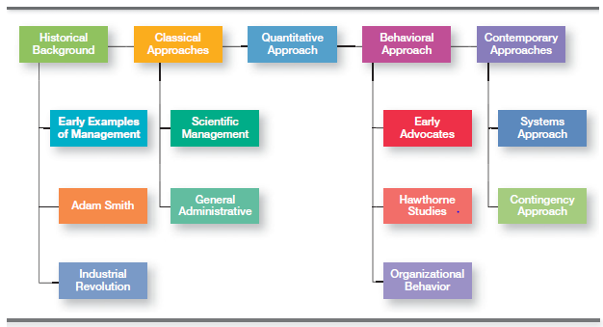
MAJOR APPROACHES to MANAGEMENT

Slide 3
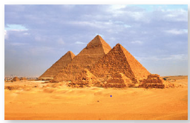
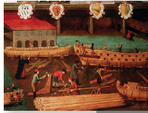
Historical Background
The Egyptian pyramids and the Great Wall of China are proof that projects of
tremendous scope, employing tens of thousands of people, were completed in ancient times.
Another example of early management can be found in the city of Venice, which
was a major economic and trade center in the 1400s.

Slide 4


Historical Background
In 1776, Adam Smith published The Wealth of Nations, in which he argued
the economic advantages that organizations and society would gain from the division of labor (or job specialization)
Starting in the late eighteenth century when machine power was substituted for human power, a point in history known as the industrial revolution, it became more economical to manufacture goods in factories rather than at home.

Slide 5
The classical viewpoint
This viewpoint emphasises efficiently managing work and organisations.
It comprises three different management approaches:
Scientific
administrative
bureaucratic management.

Slide 6
Classical theorists
Scientific management
Frederick W. Taylor, Frank and Lillian Gilbreth, Henry Gantt
Administrative management
Henri Fayol, Chester Barnard
Bureaucratic management
Max Weber

Slide 7
Scientific Management
Scientific management is an approach in classical management theory focusing on the scientific study of work methods to improve worker efficiency.

Slide 8
Scientific Management
Frederick W. Taylor
Four principles of ‘scientific management:
Scientifically study each part of a job and develop “the one best way” of doing it.
Scientifically select and then train, teach, and develop the worker.
Co-operate with workers to ensure they use the proper method in accordance with the principles of the science.
Divide work and responsibility between workers and managers.

Slide 9
Scientific Management
Frank and Lillian Gilbreth
  Time and motion studies
  Human implications of Scientific Management
  As parents of 12 children, the Gilbreths ran their household using scientific management principles and techniques.
  Cheaper by the Dozen
  Bricklaying experiments, number of motions in laying exterior brick from 18 to about 5, and in laying interior brick from 18 to 2 --- more productive and less fatigued
  Microchronometer---worker’s hand-and-body motions, devised a classification scheme to label 17 basic hand motions (search, grasp, hold

Slide 10
Administrative Management
‘Approach focused on principles for managers to co-ordinate organisations’ internal activities.’

Slide 11
Administrative Management
Organising
Planning
Commanding
Henri Fayol
Controlling
Co-ordinating

Slide 12
Administrative Management
Henri Fayol’s ‘Principles of Management’
Division of work
Authority
Discipline
Unity of command
Unity of direction
Primacy of general interest
Remuneration

Slide 13
Administrative Management
Centralization
Scalar chain
Order
Equity
Stability of tenure of personnel.
Initiative
Esprit de corps

Slide 14
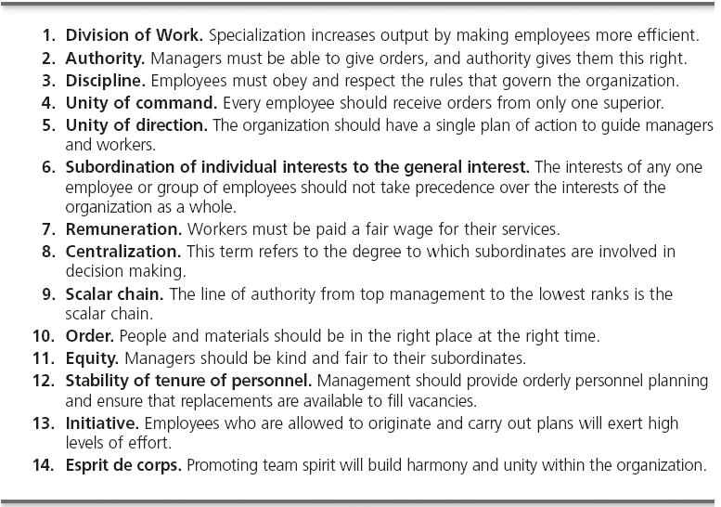
Administrative Management

Slide 15
Bureaucratic Management
A form of organization characterized by division of labor, a clearly defined hierarchy, detailed rules and regulations, and impersonal relationships.

Slide 16
Bureaucratic Management
Weber’s Ideal Bureaucracy
Specialisation of labour
Formal rules and procedures
Impersonality
Well-defined hierarchy
Career advancement on merit

Slide 17
QUANTITATIVE MANAGEMENT VIEWPOINT
Focused on mathematics, statistics and information aids supporting managerial decision making and organisational effectiveness.

Slide 18
Quantitative Management
Management science
‘Approach aimed at increasing decision effectiveness through use of sophisticated mathematical models and statistical methods.’ Also called Operations Research (OR).
Operations management
‘Function or field of expertise primarily responsible for managing production and delivery of an organisation’s products and services.’
Management information systems
‘Field of management focused on designing and implementing computer-based information systems for use by management.’

Slide 19
Behavioural Viewpoint
Emphasising the importance of trying to understand the effect of different factors on human behaviour in organizations.
Organizational behavior (OB)
(motivating, leading, building trust, working with a team, managing conflict,)

Slide 20
Behavioural Viewpoint
The Hawthorne studies
Series of studies carried out from late 1920s to early 1930s
Western Electric’s Hawthorne (Chicago) plant
Major researcher: Harvard psychologist Elton Mayo
Example: Illumination studies… lighting levels
Numerous experiments in the redesign of jobs, changes in workday and workweek length, introduction of rest periods, and individual versus group wage plans.
Provided the foundation for our current theories of motivation, leadership, group behavior and development, and numerous other behavioral approaches.

Slide 21
Contemporary Viewpoints
Systems theory
‘Approach based on the idea that organisations can be
visualised as systems.’
System: set of interrelated and interdependent parts operating as a whole to pursue a common goals.
Open systems: interact continually with environment.
(takes in inputs (resources) from the environment and transforms or processes these resources into outputs that are distributed into the environment. The organization is “open” to and interacts with its environment.)
Closed systems: does not interact with environment, gets little feedback.

Slide 22
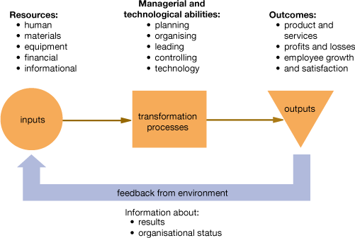
Systems view of organisations

Slide 23
Contemporary Viewpoints
Contingency theory
‘Viewpoint arguing that appropriate managerial action depends on the particular parameters of the situation.’
No universal rules (contrast with classical theories)
The challenge for managers is to match the correct techniques and decisions to the circumstances.
“if, …… then.”

