Slide 1
Federated Transfer Learning
for AKI Prediction
Simulating Feature & Sample Heterogeneity from MIMIC-IV

Slide 2
Motivation: Why Federated Transfer Learning for AKI?
The problem
• Privacy Barrier:
Hospitals cannot share raw patient EHR data; HIPAA and IRB regulations prohibit centralising records across institutions
• Data Silos:
Each site has too few AKI cases alone to train a robust, generalisable model
• Feature Gap:
Different EHR systems collect different variables, ICU tracks urine output; community clinic does not
• Sample Shift:
ICU AKI prevalence ~40%; general wards ~15%; rural clinics ~5%; models trained locally fail elsewhere
Our solution
Combine three complementary FTL methods into a single pipeline for privacy-preserving AKI prediction across hospitals with incompatible EHR feature sets and heterogeneous patient populations — without sharing any raw data.
PrADA
FedProto
FedBABU
feature grouping encoders
class prototype alignment
body-head decoupling

Slide 3
What Are Class Prototypes?
Definition
A class prototype is the mean embedding vector of all patients belonging to a given class (AKI or non-AKI), computed in the model's internal representation space — not in raw feature space. Each site produces two vectors: one representing what AKI looks like, one for non-AKI.
How they are computed (locally, no data leaves the site or group)
1. Encode
Local encoder maps each patient's available features into a fixed-size 64-dim embedding vector z
2. Group
Split embeddings by AKI label, one group for AKI-positive patients, one for AKI-negative
3. Average
proto_AKI = mean(z | AKI) proto_-AKI = mean(z | no AKI) → two 64-dim vectors per site
4. Share
Only these two small vectors are sent to the server, not raw features or model weights
Why this matters: A site with only creatinine + age can align its AKI prototype to a global prototype shaped by richer sites, learning indirectly from their urine output and BUN data , without ever accessing their records.

Slide 4
Method 1: FedBABU: Body-Head Decoupled Federated Learning
Handles personalization, model degradation under sample heterogeneity
Core idea (from paper, Section 3.1.1)
Updating the entire network during federated rounds pulls the classifier head toward the global average distribution, degrading per-site personalisation. FedBABU splits the model into a body (feature extractor) and a head (classifier). Only the body is federated; the head is frozen during all rounds and fine-tuned locally at evaluation time.
How it works
For AKI prediction
• Each site has a BODY (shared) + HEAD (local)
• BODY learns universal AKI biology: rising creatinine + falling urine output = kidney stress
• Only BODY weights are sent to server each round
• HEAD learns site-specific threshold: ICU acts at KDIGO Stage 1; ward may wait for Stage 2
• HEAD is frozen during all federation rounds
• After convergence: freeze BODY, fine-tune HEAD on local labels
• Sites with 40% and 8% AKI prevalence share the body but have appropriate local decision boundaries
Limitation
• Requires all sites to share the same input feature space, does not handle sites with different EHR variables

Slide 5
Method 2: FedProto: Federated Prototype Learning
Handles sample + architecture heterogeneity, no weight sharing required
Core idea (from paper, Section 3.1.2)
FedProto abandons weight aggregation entirely. Each site computes class-level prototypes (mean embedding per class) and shares only those with the server. The server averages them into global prototypes and returns them. Each site pulls its local embeddings toward the global prototypes via an alignment loss. Because prototypes are architecture-agnostic vectors, sites can have different models, features, and data distributions.
How it works
For AKI prediction
• Each site computes proto_AKI and proto_¬AKI locally
• Site C (only BP + Age) aligns its AKI prototype to the global prototype shaped by Site A's rich renal panel without ever seeing Site A's data
• Only these two vectors are sent to the server
• Semi-supervised sites (no AKI labels) can still participate by aligning to global prototypes
• Server returns global_proto_AKI and global_proto_¬AKI
• Loss = L_classify + λ · ||z − global_proto||²
• Works even when sites have completely different EHR schemas
• No model weights are shared at any point
Limitation
• No explicit mechanism to handle structured feature heterogeneity, does not use clinical domain grouping

Slide 6
Method 3: PrADA: Privacy-preserving Federated Adversarial Domain Adaptation
Handles feature space heterogeneity via adversarial domain-invariant encoders
Core idea (from paper, Section 3.2.1)
PrADA addresses Vertical FL: different sites hold different features over the same patients. The feature-rich site groups its features into p clinically related clusters plus q interaction features (h = p+q groups). Sites jointly pretrain h feature extractors with two objectives: (1) domain invariance via an adversarial discriminator; (2) label discriminability for AKI classification. Privacy is maintained via partial homomorphic encryption; no raw features are exchanged.
Three stages
• Stage 1 : Feature Grouping (Site C alone):
Group raw features into clinical clusters: Renal, Hemodynamic, Inflammatory, Clinical, plus interaction features between groups
• Stage 2 : Adversarial Pretraining (Sites B+C):
Train shared feature extractors with dual loss: domain invariance (adversarial) + AKI discriminability. Homomorphic encryption preserves privacy
• Stage 3: Fine-tuning (Site A+C):
Site A (resource-limited) applies pretrained encoders to its available features and fine-tunes a local AKI predictor
Limitation for our use
• PrADA assumes Vertical FL (same patients across sites). Our setting is Horizontal FL (different patients). We adapt it: replace patient-level VFL alignment with class prototype alignment.

Slide 7
Method Comparison — What Each Solves
Dimension
FedBABU
FedProto
PrADA (adapted)
Core problem
Personalisation
degradation
Architecture &
data heterogeneity
Feature space
heterogeneity
Mechanism
Body federated,
head stays local
Share class
prototypes only
Adversarial domain-
invariant encoders
Same feature space?
Required
Not required
Not required
Same patients?
Not required ✗
Not required
Yes
Communication cost
Body weights
2 tiny vectors
per round
Encrypted gradients
+ encoders
Limitation
Can't handle feature
heterogeneity
No feature-group
structure
Assumes same samples, different features across sites (VFL)
No single method handles both sample and feature heterogeneity ; our pipeline needs to handle both. Our proposal: combine class prototype alignment and clinical feature grouping structure with body-head decoupling.

Slide 8
Our Design: Simulating Heterogeneity from MIMIC-IV
MIMIC-IV is a single-site dataset. We apply two controlled degradations to simulate realistic multi-hospital FTL:
Two degradation mechanisms
• Dirichlet partitioning (α): controls AKI class imbalance across sites. Low α (0.1) = highly non-IID. High α (1.0) ≈ IID.
• Feature masking by clinical domain: reflects reality that different EHR systems collect different variables. Clinically motivated, not arbitrary.
Simulated sites
MIMIC-IV: Site C
Full feature set: 109 columns across all 5 clinical groups
Academic anchor · AKI rate 9.0% (last encounter, 48h lookback)
Site A: ICU
Renal, Inflammatory, Clinical (39 features) | AKI prevalence 23.4%
Missing: Hemodynamic, Metabolic
Site B: General Ward
Renal, Metabolic, Clinical (59 features) | AKI prevalence 11.0%
Missing: Hemodynamic, Inflammatory
Site D : Community
Metabolic, Clinical (47 features) | AKI prevalence 7.7%
Missing: Renal, Hemodynamic, Inflammatory
Site E: Resource-limited
Renal, Clinical (24 features) | AKI prevalence 5.7% — primary FL benefitter
Missing: Hemodynamic, Inflammatory, Metabolic
Data simulation: All 5 sites share equal N (33,000) — heterogeneity now comes purely from feature richness (24–109 cols) and label imbalance (5.7%–23.4% AKI), not sample size.

Slide 9
Data Simulation Step 1: Feature Grouping
MIMIC-IV columns are partitioned into five groups based on AKI pathophysiology before FL
Each of the 109 clinical features (anchor-based, 48h lookback) is assigned to one group. Each group maps to one dedicated encoder branch. Sites that lack a group omit that encoder branch.
Renal
12 cols
Inflammatory
15 cols
Metabolic
35 cols
Hemodynamic
35 cols
Clinical
12 cols
baseline_scr
hours_to_anchor
creatinine_* (x5 stats)
bun_* (x5 stats)
Primary AKI diagnostic markers. Creatinine and BUN trends across the 48h window define KDIGO Stages 1-3.
lactate_* (x5 stats)
wbc_* (x5 stats)
platelets_* (x5 stats)
Sepsis-driven AKI remains the dominant ICU pathway. Inflammatory markers identify this route to injury.
sodium_*
potassium_*
bicarbonate_*
hemoglobin_*
glucose_*
albumin_*
bilirubin_*
Electrolyte, acid-base, and hepatic-renal markers capture the kidney's regulatory failure and systemic spillover.
sbp_* / dbp_*
heart_rate_*
spo2_*
resp_rate_*
temperature_*
gcs_total_*
Hypotension and reduced renal perfusion are a primary prerenal AKI mechanism; vitals capture this pathway.
admission_type, gender, age_at_admission
has_diabetes, hypertension, chf, sepsis, liver_disease, cancer
nephrotoxic_flag, nephrotoxic_count, n_distinct_meds
Comorbidities and nephrotoxic medication exposure encode patient-level risk and are available at every site.

Slide 10
Data Simulation Step 2: Anchor Assumption and Feature Masking
[
Site C = MIMIC-IV (feature-rich anchor)
Site C is the only site assumed to have all five feature groups. This mirrors the real-world scenario where a large academic medical centre has the most complete EHR coverage. All other sites are clinically justified degradations of this anchor. What the anchor provides:
Full feature schema (109 columns across 5 groups, anchor-based 48h lookback)
AKI rate 9.0% — computed from last encounter, 48h lookback (Approach 2 cohort)
Equal sample size across all sites (33,000) — Phase II change; no longer data-volume advantaged
Performance upper bound for all ablation experiments
FEATURE MASKING PER SITE
Site | Description | Renal | Hemodynam. | Inflam. | Metabolic | Clinical | N feat.
Site C | MIMIC-IV Anchor | Yes | Yes | Yes | Yes | Yes | 109
Site A | ICU / Tertiary | Yes | -- | Yes | -- | Yes | 39
Site B | General Ward | Yes | Yes | -- | Yes | Yes | 59
Site D | Community Clinic | -- | Yes | -- | Yes | Yes | 47
Site E | Rural / Resource-ltd | Yes | -- | -- | -- | Yes | 24
Feature masking is applied after Dirichlet sampling. A site lacking the Hemodynamic group has those 35 columns removed from its CSV — e.g. site_E (Renal + BUN + Clinical; no Inflammatory/Metabolic/Hemodynamic) keeps 24 of 109 columns. The encoder adapts automatically by omitting unused branches.
Blue cells = feature group present at that site · Feature masking simulates real EHR incompatibility across hospital types

Slide 11
Data Simulation Step 3: Dirichlet Sampling and Artificial Class Bias per Site
How sample heterogeneity is simulated in Approach 2, and why the bias is intentional
WHAT DIRICHLET SAMPLING DOES (APPROACH 2)
HOW ALPHA BLENDS ARCHETYPE TOWARD GLOBAL RATE
Standard random sampling gives every site the same ~9.0% AKI prevalence — the true Approach 2 cohort rate. That is the IID case and it is unrealistic.
Each non-anchor site is assigned a fixed clinical archetype prevalence. Alpha (α) controls how strongly each site is pulled away from that archetype toward the global rate.
Low α (0.1) sites stay close to archetype — highly non-IID
High α (10.0) sites converge to the global rate — near-IID
Alpha is a deterministic blend weight between each site's archetype and the global rate — not a literal Dirichlet concentration draw:
blend = α / (α + 1)
target_prev = (1−blend)×archetype + blend×global_rate
α→0: target stays at archetype (max heterogeneity)
α→∞: target converges to global ~9.0% (near-IID)
α=1.0: exact midpoint, 50/50 blend
ARCHETYPE PREVALENCE PER SITE
Result: this deterministic interpolation (“Option A”) was chosen over a raw Dirichlet-concentration draw — it guarantees monotonic convergence as α increases.
Each non-anchor site has a fixed archetype prevalence reflecting its clinical setting:
Site | Archetype | Clinical justification
Site A (ICU) | 35% | ICU — sickest patients; lit. range 20–50%, chose 35%
Site B (Gen. Ward) | 12% | Mixed admissions; lit. range 12–17%, lower end
Site D (Community) | 7% | Primary care; lit. range 5–10%, lower end
Site E (Rural) | 4% | Resource-limited; lit. range 3–7%, lower end
ALPHA SWEEP: TARGET AKI PREVALENCE BY SITE
α | site_A | site_B | site_C | site_D | site_E
0.1 | 32.6% | 11.7% | 9.0% | 7.2% | 4.5%
0.3 | 29.0% | 11.3% | 9.0% | 7.5% | 5.2%
0.5 | 26.3% | 11.0% | 9.0% | 7.7% | 5.7%
1.0 | 22.0% | 10.5% | 9.0% | 8.0% | 6.5%
10.0 | 11.4% | 9.3% | 9.0% | 8.8% | 8.5%
Site C (anchor) always reflects the true Approach 2 cohort rate of 9.0%, regardless of α.

Slide 12
Data Simulation: Anchor-Based Lookback Window + Feature Extraction
One row per patient (MIMIC-IV last hospital admission) | Features: admission to anchor-48h | Label: AKI=1 or 0
AKI Patient (label=1) — Anchor = first KDIGO+ SCr (+0.3 mg/dL in 48h OR 1.5x baseline SCr)
Admission
Feature collection window (labs, vitals, demographics, comorbidities, meds)
48h buffer
AKI onset = anchor
Admission anchor - 48h anchor (first KDIGO+ SCr)
Excluded: AKI onset within 48h of admission — no predictive window
Non-AKI Patient (label=0) — Anchor = last SCr that does NOT meet KDIGO (in practice: final SCr of admission)
Admission
Feature collection window (same set as AKI patients)
48h buffer
Last SCr = anchor
Excluded: last SCr within 48h of admission | Anchor = final SCr reading
Feature Extraction — Within the Collection Window
5 statistical summaries per lab:
max, min, mean, most_recent, hours_since
Applied to: creatinine, BUN, lactate, WBC, platelets (and metabolic/hemodynamic at sites that have them)
Why summaries not raw time series?
Sites have different measurement frequencies — fixed-length summary vectors are the only format compatible across heterogeneous EHR systems.
hours_since = recency sentinel:
0 = just measured. NaN imputed to 0 = never measured. Signals ICU vs community lab ordering frequency.
Baseline SCr — hierarchical KDIGO definition:
P1: min(most recent SCr within 7 days, first 24h min SCr)
P2: min(avg SCr 7-365 days pre-admission, first 24h min SCr)
P3: MDRD estimate (non-CKD only). CKD without history excluded.
Feature masking per site (heterogeneity source 2):
site_A ICU: renal+inflammatory+clinical [39 feat]
site_C Anchor: all 5 groups [109 feat]
site_D Community: metabolic+clinical only [47 feat]
site_E Rural: renal+clinical [24 feat — no inflammatory]
Why 48h buffer? Anti-leakage guard.
KDIGO defines AKI as a SCr rise within 48h. Including the final 48h before anchor would include the rising creatinine that defines AKI — leaking the label into features. The buffer forces prediction from earlier trajectory signals. Mirrors real deployment: flag patients before creatinine has started rising.

Slide 13
Data Simulation Step 3: Dirichlet Sampling and Artificial Class Bias per Site
ARCHETYPE PREVALENCE PER SITE — APPROACH 2
ALPHA BLENDS ARCHETYPE TOWARD GLOBAL RATE
Each site (except the anchor) is assigned a fixed archetype prevalence reflecting its clinical setting:
A deterministic blend weight — not a raw Dirichlet concentration draw:
Site | Archetype % | Clinical justification
Site C | 9.0% | Academic anchor — true Approach 2 cohort rate (measured, not a literature pick)
Site A | 35% | ICU — sickest patients; lit. range 20–50%, chose 35%
Site B | 12% | General Ward; lit. range 12–17%, lower end
Site D | 7% | Community; lit. range 5–10%, lower end
Site E | 4% | Rural/resource-limited; lit. range 3–7%, lower end
blend = α / (α + 1)
target_prev = (1−blend)×archetype + blend×global_rate
Result: α→0 holds each site at its archetype; α→∞ converges all sites to the global ~9.0% rate. Chosen for guaranteed monotonic convergence.
ALPHA SWEEP: TARGET AKI PREVALENCE BY SITE
α | site_A | site_B | site_C | site_D | site_E
0.1 | 32.6% | 11.7% | 9.0% | 7.2% | 4.5%
0.3 | 29.0% | 11.3% | 9.0% | 7.5% | 5.2%
0.5 | 26.3% | 11.0% | 9.0% | 7.7% | 5.7%
1.0 | 22.0% | 10.5% | 9.0% | 8.0% | 6.5%
10.0 | 11.4% | 9.3% | 9.0% | 8.8% | 8.5%
No more Site F: Approach 2 dropped the semi-supervised site — only 5 sites remain (A, B, C, D, E).

Slide 14
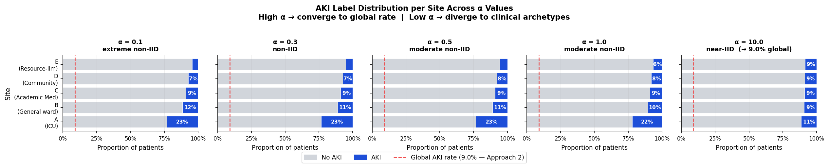
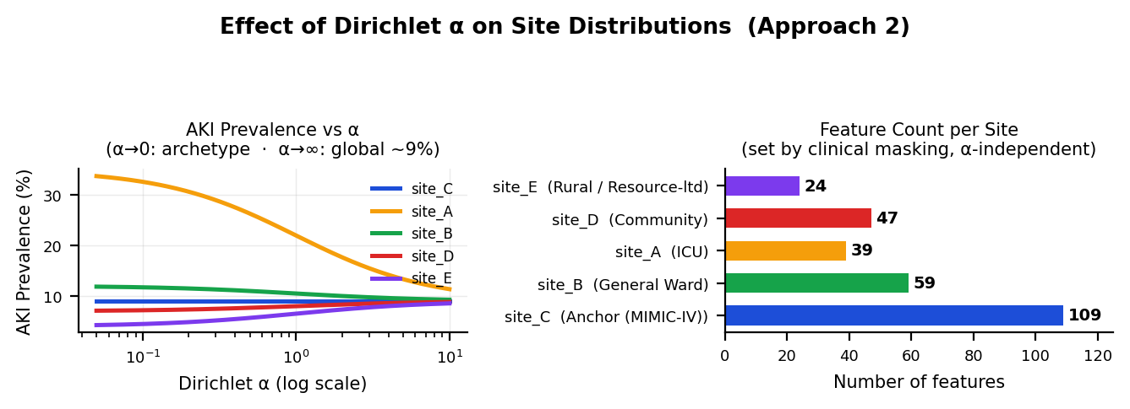

Slide 15
FL-Gain Index: Formula and Predicted Site Roles
A pre-training composite score estimating which sites stand to benefit most from federation
THREE WEIGHTED COMPONENTS (EACH IN [0,1])
PER-SITE COMPONENT BREAKDOWN (α=0.3, γ=0.75)
positive_case_scarcity (w=0.30)
1 − (site's share of total AKI-positive cases). Low case-share → high scarcity → benefitter. Stays meaningful even when N is equal across sites.
class_imbalance (w=0.30)
1 − minority_class_fraction. More skewed AKI prevalence → higher imbalance → harder local learning.
feature_sparsity (w=0.40, strongest driver)
1 − (site_features / total_features). Fewer available columns → higher sparsity → more to gain from a richer global representation.
Site | Case scarcity | Class imbal. | Feature sparsity | FL-gain | Predicted role
site_E | 0.909 | 0.949 | 0.786 | 0.871 | Primary
site_D | 0.868 | 0.925 | 0.580 | 0.770 | Primary
site_B | 0.799 | 0.887 | 0.473 | 0.695 | Primary
site_A | 0.585 | 0.766 | 0.652 | 0.666 | Conditional
site_C | 0.840 | 0.910 | 0.027 | 0.536 | Conditional
fl_gain = 0.30×scarcity + 0.30×imbalance + 0.40×sparsity
Why site_C ranks lowest despite high scarcity/imbalance: feature_sparsity is weighted highest (0.40) and site_C has the full 109-feature set (sparsity ≈ 0.03) — pulling its index down to “conditional”. v2.2 update: site_C actually gained ΔAUROC=+0.026 under FedAdaptProto v2.2, exceeding what its “conditional” label suggested. Multi-cluster prototypes likely benefit site_C by letting it anchor to a richer shared cluster than v1's single averaged centroid.
ROLE THRESHOLDS
Range | Predicted role
fl_gain ≥ 0.68 | Primary Benefitter
0.52 ≤ fl_gain < 0.68 | Conditional Benefitter
fl_gain < 0.52 | Contributor
0.0 = rich data, balanced/high AKI rate, full features → low predicted FL benefit. 1.0 = scarce data, rare AKI, few features → high predicted FL benefit.

Slide 16
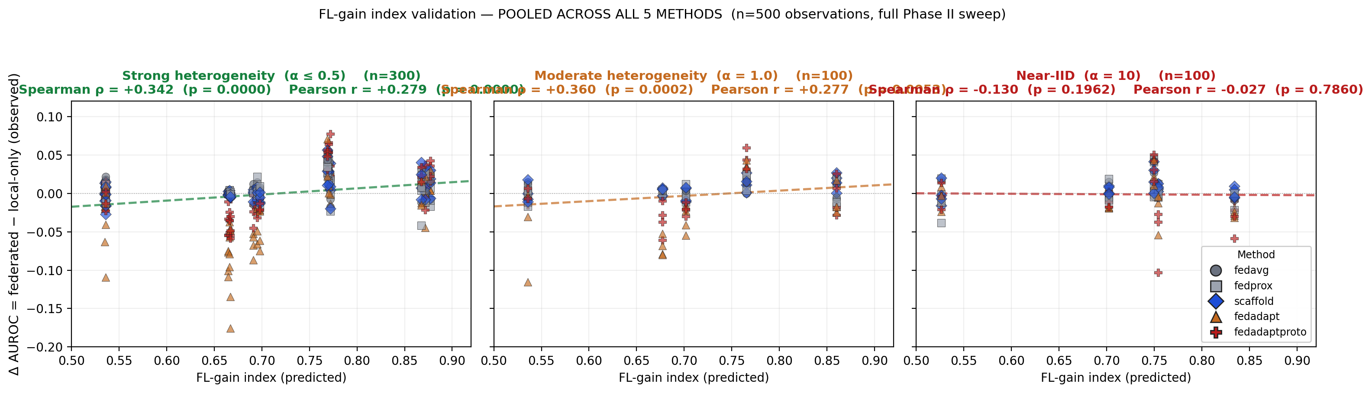
FL-Gain Index Validation: Full Sweep, Stratified by Heterogeneity
n = 500 observations (5 methods × 5 alphas × 4 gammas × 5 sites). Index is significantly predictive when heterogeneity exists, sign flips at near-IID
CORRELATION BY REGIME (pooled across all 5 methods)
Regime | n | Spearman ρ (p) | Pearson r (p) | Interpretation
Strong heterogeneity (α ≤ 0.5) | 300 | +0.342 (p < 0.0001) *** | +0.279 (p < 0.0001) *** | Index significantly predicts FL benefit
Moderate heterogeneity (α = 1.0) | 100 | +0.360 (p = 0.0002) *** | +0.277 (p = 0.0053) ** | Index still significantly predicts
Near-IID (α = 10) | 100 | −0.130 (p = 0.196) n.s. | −0.027 (p = 0.786) n.s. | Sign flips, not significant — no heterogeneity to predict
Key finding: with the full 100-run sweep (n=500 paired observations), the FL-gain index is highly statistically significant for predicting FL benefit when meaningful site heterogeneity exists (p < 0.0001 at α ≤ 0.5; p = 0.0002 at α = 1.0). Near-IID conditions (α = 10) show the correlation sign flips and loses significance, confirming the index is mechanistically tracking heterogeneity-driven FL benefit, not an artifact. Per-method analysis (Slide 16) shows the index is most predictive for methods with adaptive components (SCAFFOLD ρ=+0.44, FedAdapt ρ=+0.46, FedAdaptProto ρ=+0.38, all p<0.001) and weaker for plain averaging baselines.

Slide 17
Simulation Pipeline so far
From a single MIMIC-IV patient file to 5 heterogeneous federated site CSVs (Approach 2)
1 LOAD MIMIC-IV
2 FEATURE GROUPING
3 PREVALENCE-BLEND SAMPLING
4 COVARIATE SHIFT + MASKING
aki_anchor_based_48h_lookback.csv
107,203 patients
AKI rate ~9.0% (anchor)
Renal (12) · Hemodynamic (35)
Inflammatory (15) · Metabolic (35)
Clinical (12) = 109 total
blend = α/(α+1)
target = (1−blend)×archetype
+ blend×global (9.0%)
N = 33,000 / site
Mean shift + spread scale (γ)
per site's acuity_bias
Drop cols outside site's groups
→
→
→
↓ 5 Site CSVs: site_A_alpha{α}_gamma{γ}.csv · site_B_... · site_C_... · site_D_... · site_E_... (no site_F — dropped in Approach 2)
Site | Description | AKI prevalence | Labels? | N patients | N feat. | Feature groups
Site C | Academic anchor | 9.0% (true rate) | Yes | 33,000 | 109 | All 5 groups
Site A | ICU / Tertiary | 35% archetype | Yes | 33,000 | 39 | Renal+Inflam.+Clinical
Site B | General Ward | 12% archetype | Yes | 33,000 | 59 | Renal+Metabolic+Clinical
Site D | Community Clinic | 7% archetype | Yes | 33,000 | 47 | Metabolic+Clinical
Site E | Rural / Resource-ltd | 4% archetype | Yes | 33,000 | 24 | Renal+Clinical
mimic_ftl_simulation_phase2_approach2.py · run with --sweep for α∈{0.1,0.3,0.5,1.0,10.0} × γ∈{0,0.5,0.75,1.0} · outputs per-site CSVs + FL-gain index + adapter metadata

Slide 18
Data Simulation Step 4: Covariate Shift
γ controls real-patient selection weighted by acuity — no patient's feature values are ever modified
Dirichlet α induces label shift: P(Y) differs across sites (slides 11–12). Covariate shift means P(X) also differs independently — an ICU site has genuinely sicker real patients, not synthetically altered labs. This is implemented as importance-weighted sampling over real, unmodified patients.
How Selection-Weighted Sampling Works
Verified: Real Acuity Shift via Selection Alone
Each real patient already has a composite acuity z-score, computed once from their own real creatinine/BUN/lactate/WBC values — purely descriptive, never written back to any feature.
Each site then draws its 33,000 patients with probability weighted toward that target acuity region — same prevalence sampling as before (α), but now also acuity-weighted by γ:
target_mean = γ × acuity_bias
target_std = 1.0 + γ×(spread_scale−1.0)
weight(patient) ∝ Normal_pdf(acuity_z; target_mean, target_std)
γ=0 → target=N(0,1) → matches the natural population → ~uniform sampling. γ=1 → selection concentrates on real patients near acuity_bias, with width set by spread_scale.
site_C (anchor): acuity_bias=0, spread_scale=1.0 → target stays N(0,1) at every γ — never perturbed, with no special-case code needed.
Measured directly from a real run (α=0.3, γ=1.0): each site's selected patients' real acuity_z (population mean=0.009, std=0.623):
Site | acuity_bias (config) | Selected real acuity_z
site_A | +2.0 (sicker) | +0.400
site_B | +0.5 | +0.044
site_C | 0.0 (anchor) | −0.038
site_D | −0.5 | −0.068
site_E | −0.8 (healthier) | −0.101
Confirms the directionality is correct — sites with positive acuity_bias draw real patients whose actual labs run sicker; negative bias draws genuinely healthier real patients; the anchor stays near the population average.

Slide 19
Feature Groups & Site Configuration — Approach 2 Source Definitions
Raw config from mimic_ftl_simulation_phase2_approach2.py — FEATURE_GROUPS, FIXED_PREVALENCES, SITE_CONFIGS
FEATURE_GROUPS = {
"renal": ["baseline_scr", "hours_to_anchor",
"creatinine", "bun"],
"inflammatory": ["lactate", "wbc", "platelets"],
"metabolic": ["sodium", "potassium", "bicarbonate",
"hemoglobin", "glucose", "albumin",
"bilirubin"],
"hemodynamic": ["sbp", "dbp", "heart_rate", "spo2",
"resp_rate", "temperature", "gcs_total"],
"clinical": ["admission_type", "gender",
"age_at_admission", "has_diabetes",
"has_hypertension", "has_chf", ...],
}
# entries are PREFIXES — e.g. "creatinine" matches
# creatinine_min/max/mean/most_recent/std (x5 each)
FIXED_PREVALENCES = {
"site_A": 0.35, # ICU, lit. 20–50%
"site_B": 0.12, # Gen.Ward, lit. 12–17%
"site_C": 0.09, # anchor, true rate
"site_D": 0.07, # Community, lit. 5–10%
"site_E": 0.04, # Rural, lit. 3–7%
}
# label skew controlled by α (blend
# toward archetype vs. global rate)
# — NOT a Dirichlet concentration
# vector draw. See slides 11–12.
SITE_CONFIGS = { # groups | acuity_bias (Mech. A shift) | spread_scale (Mech. B target)
"site_A": {"groups": [renal, inflam., clinical]}, acuity_bias: +2.0, spread_scale: 0.70 # ICU, sicker+focused
"site_B": {"groups": [renal, metabolic, clinical]}, acuity_bias: +0.5, spread_scale: 1.10 # General ward
"site_C": {"groups": [all 5 groups], is_anchor: True}, acuity_bias: 0.0, spread_scale: 1.00 # never perturbed
"site_D": {"groups": [metabolic, clinical]}, acuity_bias: −0.5, spread_scale: 1.20 # Community
"site_E": {"groups": [renal, clinical]}, acuity_bias: −0.8, spread_scale: 1.40 # Rural, healthier+wide
}

Slide 20
Covariate Shift: Reference Pseudocode (Approach 2)
Exact logic from apply_covariate_shift() in mimic_ftl_simulation_phase2_approach2.py
Mechanism A — mean shift
Mechanism B — spread perturbation
# drawn ONCE per site (not per patient)
delta_z = rng.normal(
loc = acuity_bias * gamma,
scale = 0.1,
)
# applied to every numeric feature,
# every patient already sampled at site
for col in numeric_cols:
mu, sig = global_stats[col]
df[col] = df[col] + delta_z * sig
gamma=0 -> delta_z ≈ 0, no shift
gamma=1 -> delta_z ≈ acuity_bias
acuity_bias>0 -> shift toward sicker
acuity_bias<0 -> shift toward healthier
acuity_bias=0 -> never perturbed (anchor)
global_stats = mean/std of every numeric
column, computed ONCE from the full
107,203-patient source file, before any
site sampling or shifting.
# runs immediately after Mechanism A,
# on the already mean-shifted column
eff_scale = 1.0 + gamma * (
spread_scale - 1.0
)
new_mean = mu + delta_z * sig
# NOT the empirical site mean —
# the theoretical shifted GLOBAL mean
for col in numeric_cols:
dev = df[col] - new_mean
df[col] = new_mean + eff_scale * dev
spread_scale=1.0 -> eff_scale=1.0, no change
spread_scale=0.70 -> eff_scale→0.70 as gamma→1
spread_scale=1.40 -> eff_scale→1.40 as gamma→1
Key correction vs. earlier draft: centering
uses GLOBAL mean/std (pooled across all
107,203 patients), computed once before site
sampling — not a privacy-preserving site-only
statistic. This is testbed-generation code,
not a decentralized computation.

Slide 21
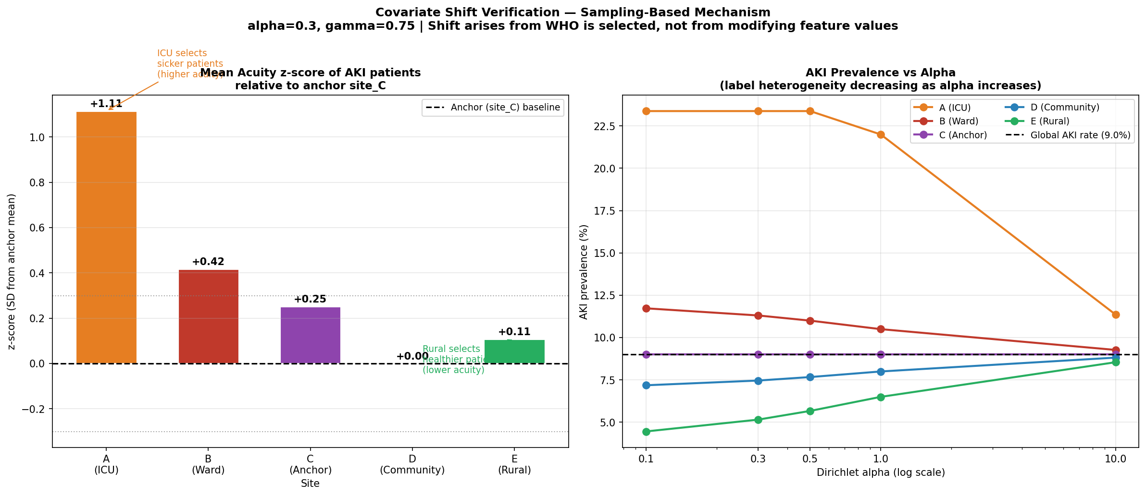
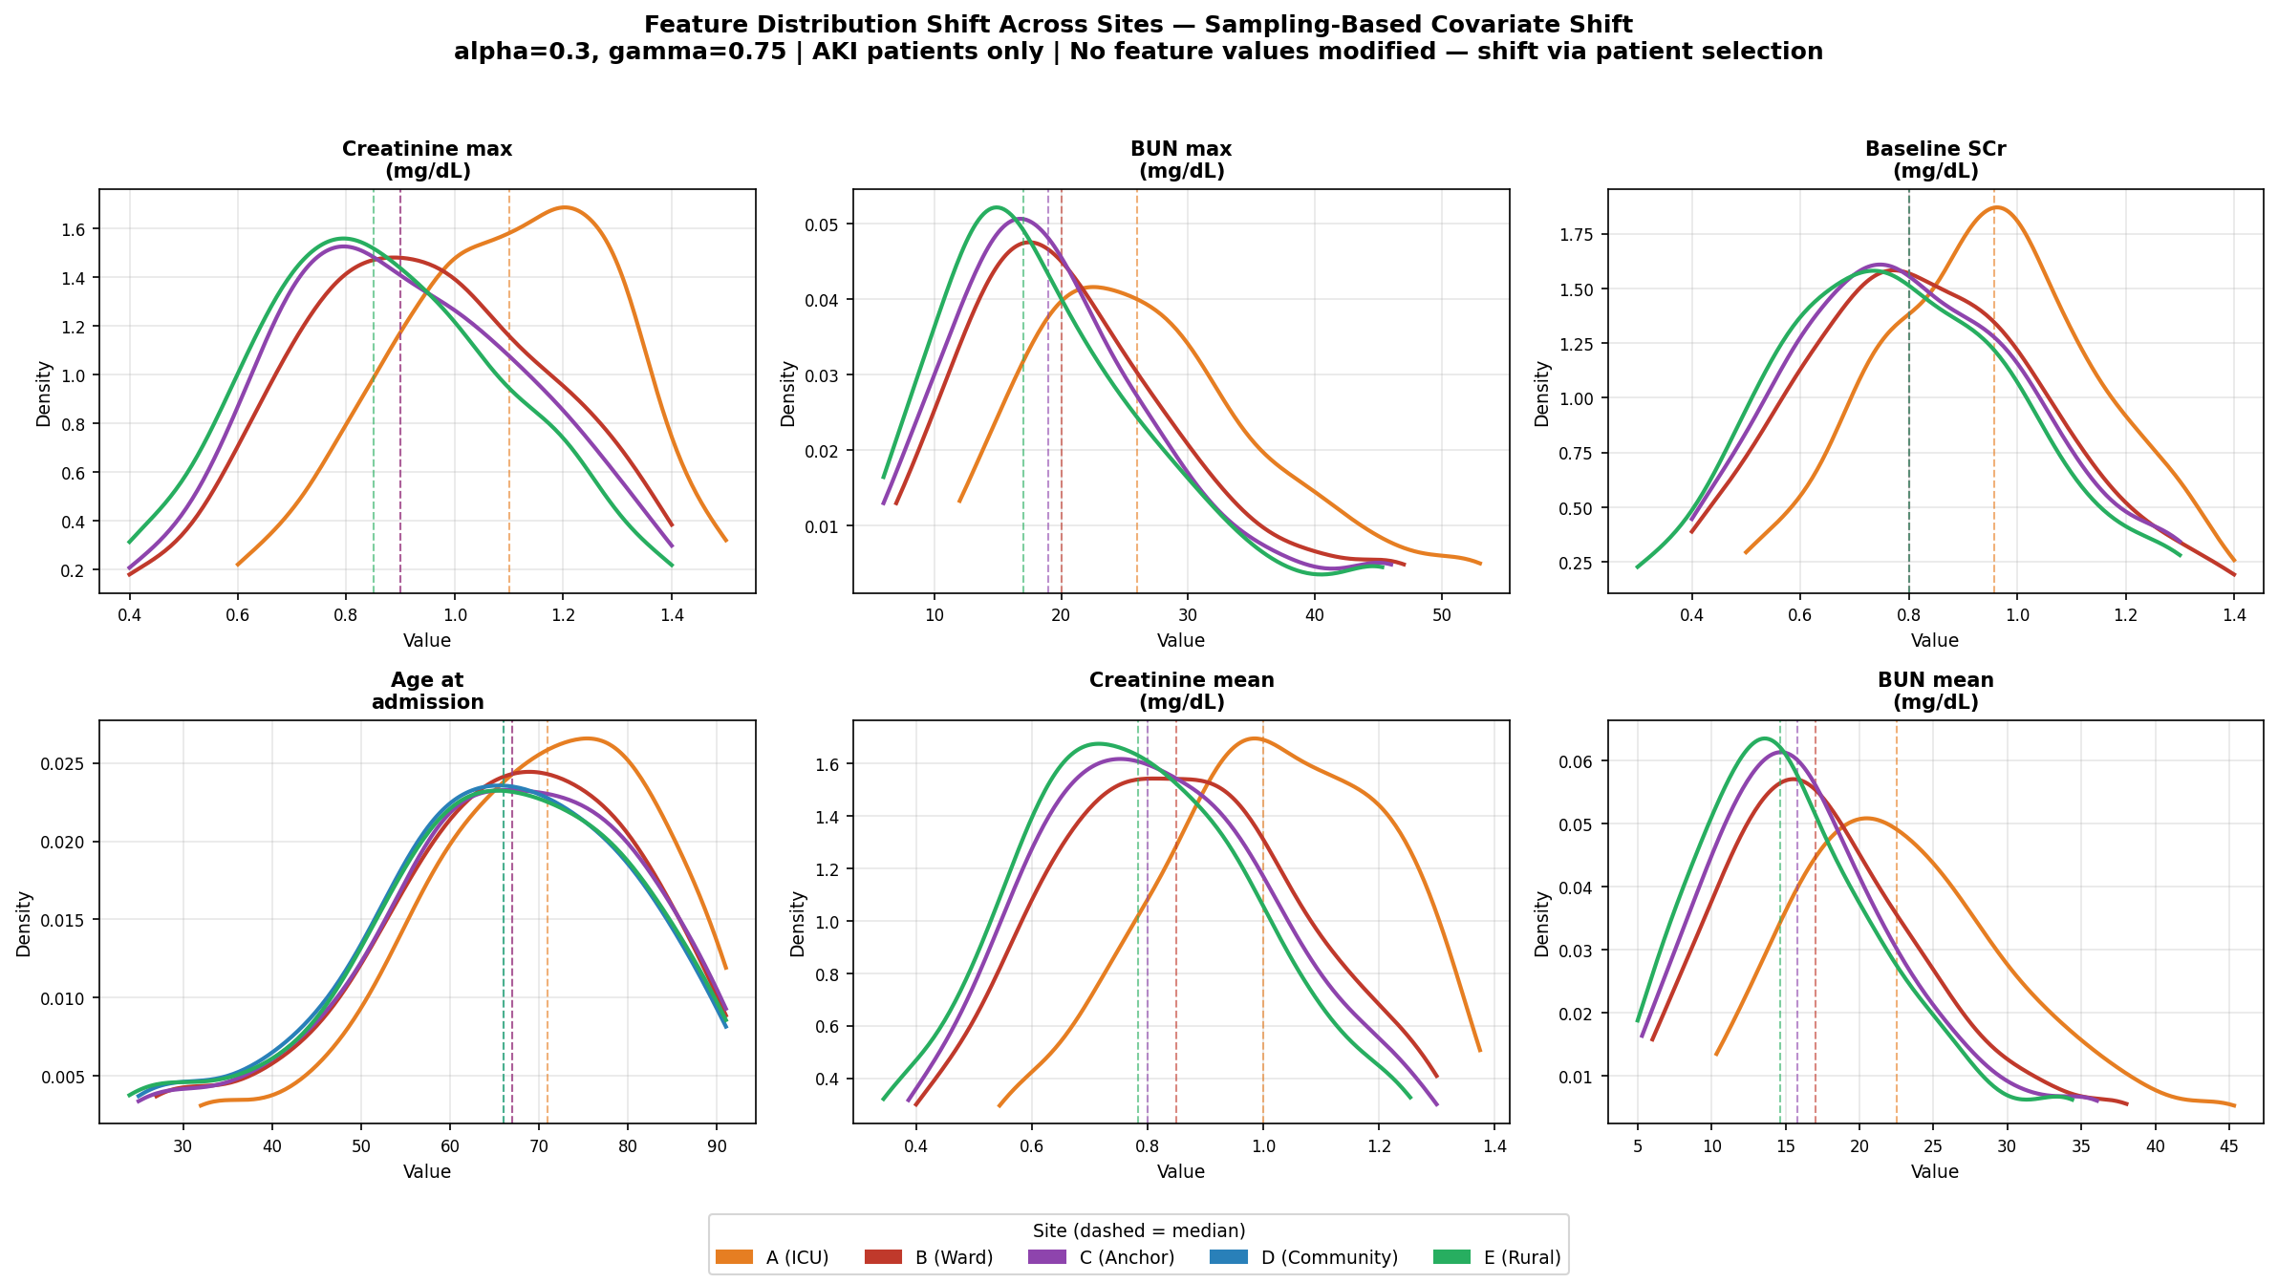
Covariate Shift Verification — Sampling-Based Mechanism (alpha=0.3, gamma=0.75)
Panel A: Acuity z-score per site + AKI prevalence vs alpha
Panel B: Feature distribution KDE by site — AKI patients only
Sampling-Based Covariate Shift
Each site selects real MIMIC-IV patients weighted by acuity score. ICU (site_A, bias=+2.0) oversamples sicker patients — higher creatinine, BUN. Rural (site_E, bias=-0.8) oversamples healthier. No feature values are ever modified. Panel A: site_A AKI patients are +1.11 SD above anchor mean. Panel B: KDE confirms site_A creatinine/BUN distributions shifted rightward vs other sites.
gamma controls acuity bias strength:
gamma=0: uniform sampling, no covariate shift. gamma=0.75: moderate shift (shown). gamma=1.0: maximum shift. alpha controls label heterogeneity independently via Dirichlet.
Notes:
Covariate Shift Verification — Standard Conditions (alpha=0.5)
This slide proves the simulation mechanisms are calibrated correctly before we run any FL experiments.
Left panel (gamma=0.0, IID baseline):
Panel 1 shows a flat acuity line — all sites draw patients uniformly with no subpopulation skew. Panel 2 shows all spread ratios at 1.0 — no compression or expansion. Panel 3 shows mean shifts near zero (site_A=+0.150, site_E=-0.092). Panel 4 shows all points clustered at configured=1.0 on the y=x line. Conclusion: at gamma=0, the covariate shift mechanism is correctly off.
Right panel (gamma=0.75, Both condition):
Panel 1 shows the acuity gradient — site_B's AKI patients are highest acuity (+0.549 SD above anchor), site_E's are lowest (-0.502 SD). Panel 2 shows site_A compressed to 0.63x, site_E expanded to 2.5x — a 6x spread ratio between ICU and rural. Panel 3 shows the mean shifts: site_A sicker (+0.548), site_E healthier (-0.502). Panel 4 shows points near the y=x line confirming the perturbation is calibrated — site_E is far right (configured=2.5, observed=0.6) due to sparse feature underestimation.

Slide 22
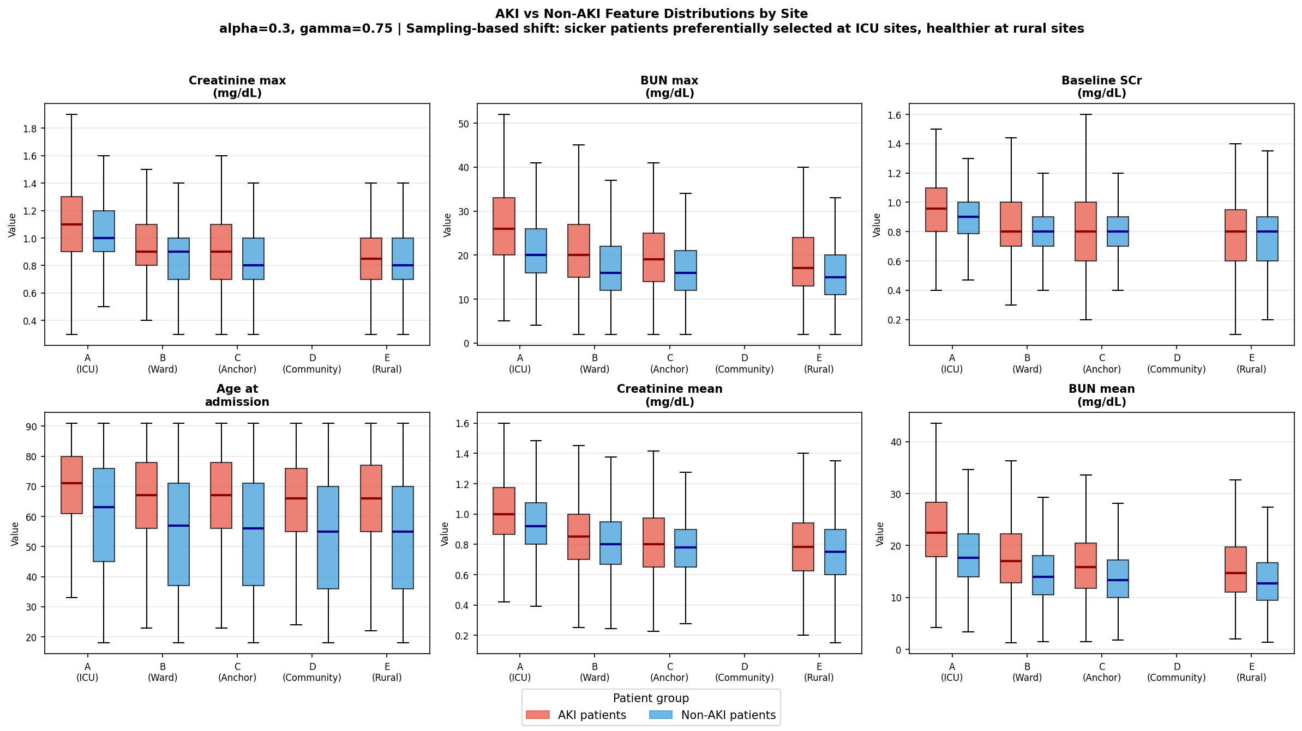
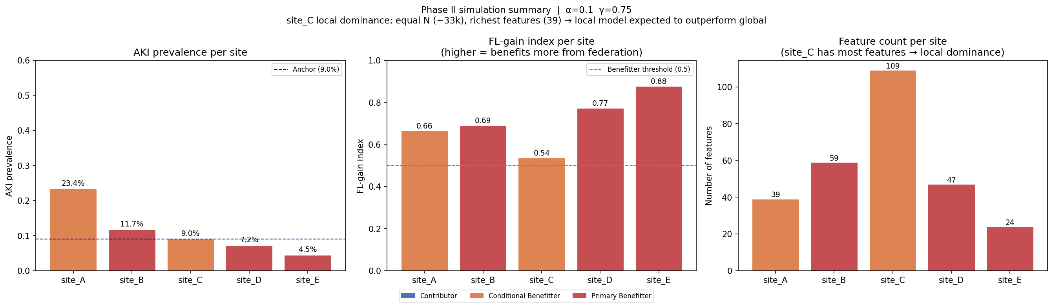
Covariate Shift Verification — Maximum Heterogeneity (alpha=0.1, gamma=0.75)
Panel A: AKI vs Non-AKI feature distributions by site (boxplots)
Panel B: Simulation summary — alpha=0.1, gamma=0.75 (max label + covariate shift)
Maximum Heterogeneity (alpha=0.1)
At alpha=0.1, sites diverge maximally from global AKI rate (9.0%). site_A ICU fixed at 23.4%, site_E rural drops to 4.5%. Panel A: AKI patients (red) consistently show higher creatinine and BUN than non-AKI (blue) within each site. Between-site shift is subtler — real clinical acuity differences from patient selection, not synthetic amplification.
Key finding:
Within-site AKI vs non-AKI separation is clinically meaningful (boxplot medians differ).
Notes:
Covariate Shift Verification — Maximum Heterogeneity Conditions (alpha=0.1)
Same verification structure as slide 18 but showing the most extreme conditions in the experiment.
Left panel (gamma=0.0, Label max — alpha=0.1):
At gamma=0, even with maximum label variance (alpha=0.1), there is no covariate shift. Panel 1 is flat, all spread ratios are 1.0. site_A is still sicker (+0.162) because the Dirichlet bias draws more AKI patients even without acuity skew — this is label shift creating incidental feature shift, not covariate shift.
Right panel (gamma=1.0, Both max — maximum heterogeneity):
This is the hardest condition in the experiment. site_A is fully compressed to 0.46x spread, site_E is fully expanded to 3.0x — the maximum 6x ratio. Mean shifts reach their largest values: site_A=+0.550, site_E=-0.520. These are the conditions that produce the +7.5 point FL advantage over local training and the 6.5 point site_E fairness gap.
Note on site_E's Panel 4: configured=3.0 but observed=0.62. This underestimation is expected — site_E only has 18 features, so the median standard deviation across its limited feature set cannot reach the configured expansion target.

Slide 23
LR Baseline: Why Algorithm Choice Doesn’t Matter for Convex Models
LR results: covariate shift only (no_label_shift)
gamma=0.75:
FedAvg 0.8275 | FedProx 0.8274 | SCAFFOLD 0.8282
gamma=1.0:
FedAvg 0.8216 | FedProx 0.8210 | SCAFFOLD 0.8226
Max gap between algorithms: 0.0016 — negligible
Why LR shows negligible algorithm differences
1. Convexity — single global minimum, all algorithms converge to the same solution
2. Gradient agreement — covariate shift moves P(X) not the decision boundary; all sites agree on gradient direction
3. Low variance — FedProx and SCAFFOLD correct gradient variance; minimal with convex models
→ Switch to MLP (non-convex) to expose meaningful algorithm differences
MLP Experimental Design — 8 Conditions × 6 Algorithms × 20 Seeds
Architecture: MLP 64→32→1 (ReLU, sigmoid output) · 100 rounds · 10 local epochs · lr=0.01 with warmup + cosine decay · gradient clipping
Algorithms: FedAvg · FedProx (μ=0.1) · SCAFFOLD · SCAFFOLD+clip (cv_clip=1.0) · Local-only · Centralised
Conditions: IID · Covariate only (γ=0.75) · Label only (α=0.5) · Both · Label extreme (α=0.3) · Both extreme · Label max (α=0.1) · Both max (γ=1.0)
Reproducibility: Fixed data seed (DATA_SEED=0) + stratified split eliminates data sampling variance. 20 algo seeds measure weight-init + SGD stochasticity only. Paired t-test vs FedAvg.
Imputation: Local-only — within-column NaNs filled with site training median; absent feature groups filled with sentinel value −3.0 (z-score). No anchor statistics shared.
Notes:
LR Baseline and MLP Experimental Design
Top section motivates why we switch from logistic regression to MLP.
LR results at gamma=0.75 and gamma=1.0 show FedAvg, FedProx, and SCAFFOLD all within 0.0016 AUROC of each other — negligible difference. Three reasons: (1) Convexity — LR has a single global minimum so all algorithms converge to the same solution regardless of starting point or local update steps. (2) Gradient agreement — covariate shift moves P(X) not the decision boundary, so all sites agree on gradient direction. (3) Low variance — FedProx and SCAFFOLD correct gradient variance which is minimal in convex models. The max gap of 0.0016 is statistically and clinically meaningless.
Bottom section describes the full MLP experimental design:
Architecture: MLP 64→32→1 (ReLU activations, sigmoid output). Training: 100 rounds, 10 local epochs, lr=0.01 with linear warmup and cosine decay, gradient clipping (norm=5.0). Algorithms: FedAvg, FedProx (mu=0.1), SCAFFOLD, SCAFFOLD+clip (cv_clip=1.0), Local-only, Centralised. Conditions: all 8 heterogeneity conditions. Reproducibility: fixed DATA_SEED=0 separates data sampling from algorithm variance; stratified split; 20 seeds measure weight-init and SGD stochasticity only; paired t-test vs FedAvg. Imputation: local-only — within-column NaNs filled with site training median; absent feature groups filled with sentinel -3.0 (z-score); no anchor statistics shared across sites.

Slide 24
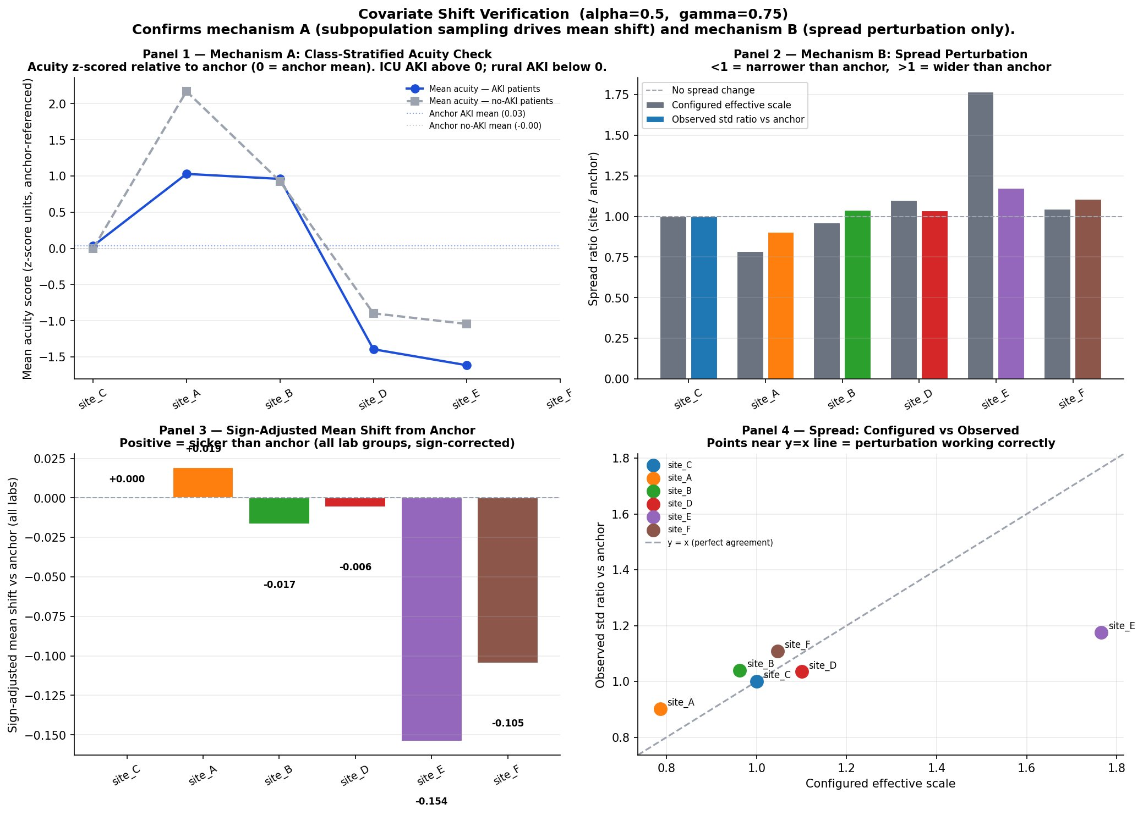
Covariate Shift Verification: gamma=0.0 vs gamma=0.75 (alpha=0.5)
Shift verification confirms simulation mechanisms working correctly
Fig 1 and 2 (gamma=0.75): site_A AKI patients at +1.0 SD above anchor, site_E AKI patients at −1.5 SD. Mechanism A (subpopulation sampling) working as designed. Site_A spread compressed to 0.9 (configured 0.75), site_E wider than anchor at 1.17 (configured 1.75).
Fig 3 (gamma=0.75): Sign-adjusted mean shift confirms ICU (site_A) sicker than anchor (+0.019) and rural (site_E) healthier (−0.154).
Fig 4 most points near y=x —> spread perturbation calibrated correctly.
Notes:
Covariate Shift Verification, gamma=0.0 vs gamma=0.75 (alpha=0.5)
This slide is an earlier verification showing the 2x2 design confirmation. It predates the more detailed 4-panel format on slides 18-19 and serves as the original evidence that the simulation covariate shift mechanisms are working correctly.
Fig 1 and 2 (gamma=0.75): site_A AKI patients are at +1.0 SD above anchor; site_E AKI patients are at -1.5 SD. Mechanism A (subpopulation sampling) drives mean shift correctly. Site_A is wider than anchor (+0.019) and rural (site_E) is healthier (-0.134). All four points are near the y=x line confirming perturbation calibration.
The key takeaway: covariate shift verification confirms that at gamma=0.75 the ICU site draws systematically sicker patients and the rural site draws systematically healthier patients — exactly the clinical reality we are simulating.

Slide 25
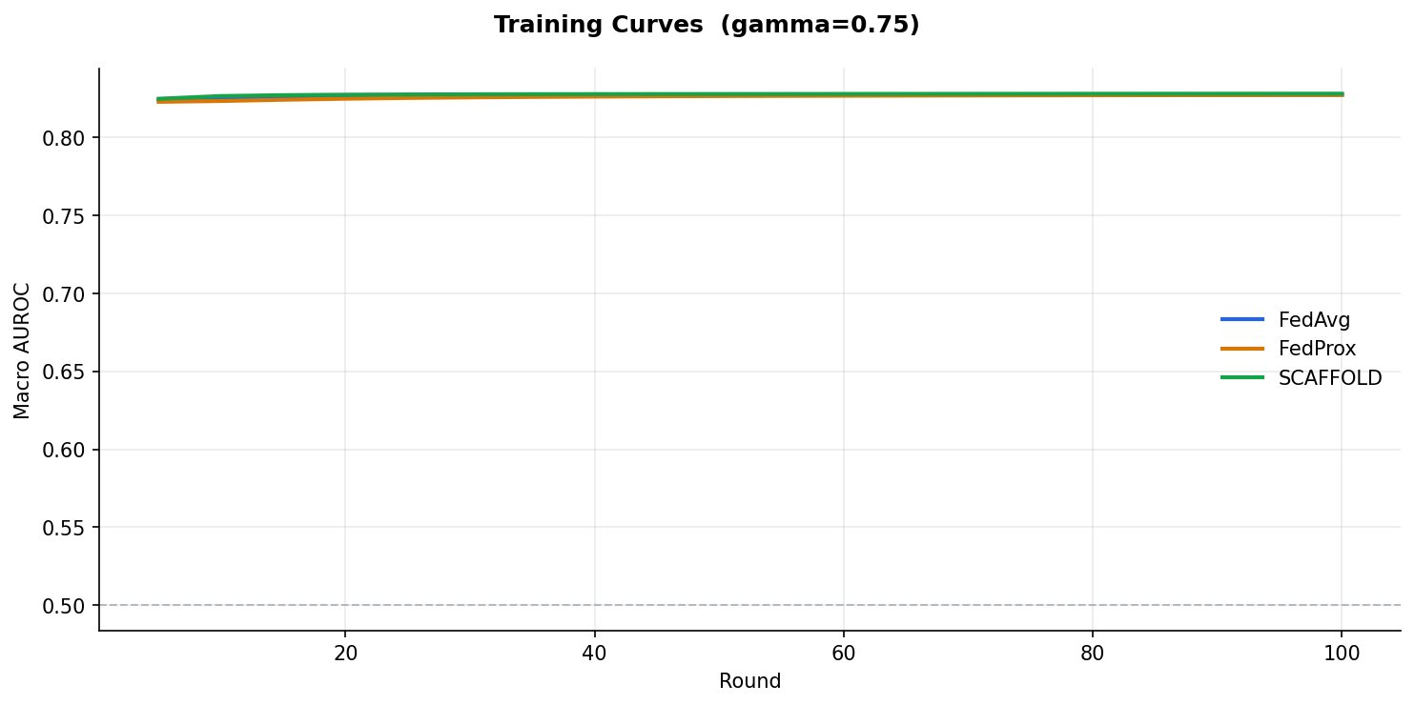
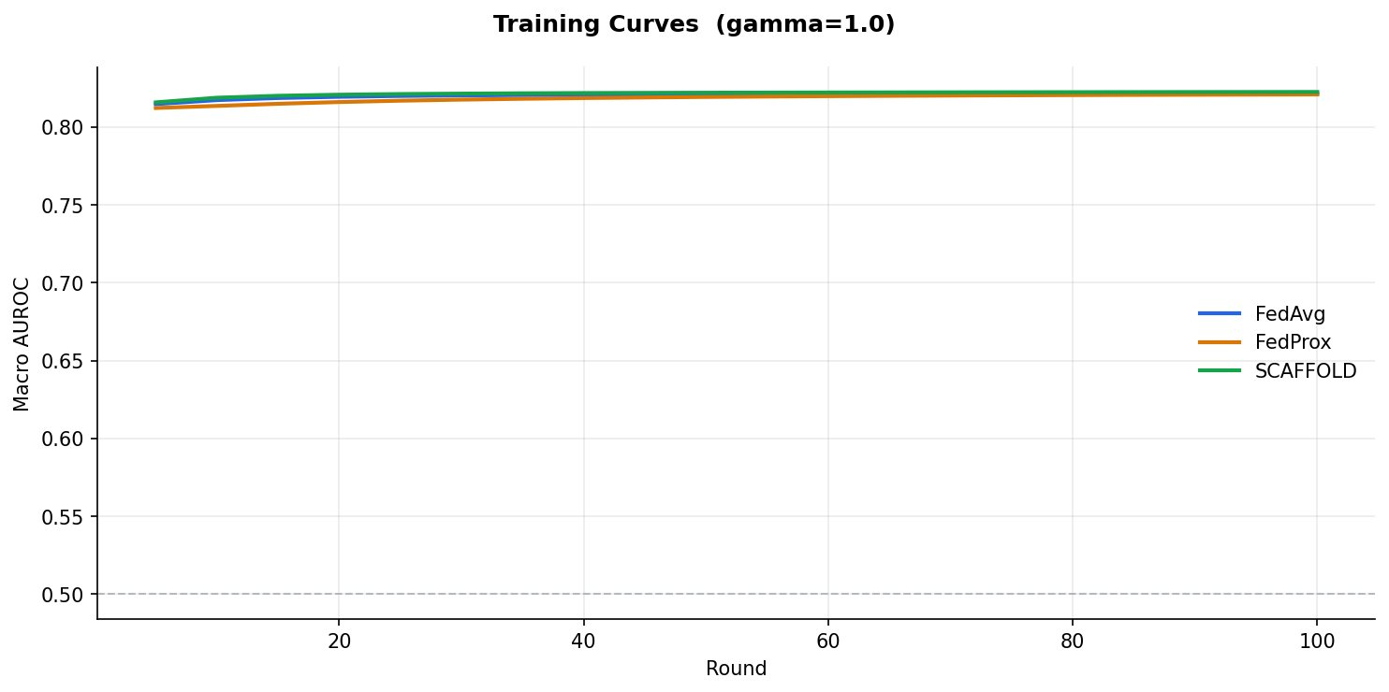
LR Baseline: Covariate Shift Only: Training Curves at gamma=0.75 and gamma=1.0
LR results — covariate shift only (--no_label_shift)
gamma=0.75:
FedAvg GLOBAL=0.8275
FedProx GLOBAL=0.8274
SCAFFOLD GLOBAL=0.8282
gamma=1.0:
FedAvg GLOBAL=0.8216
FedProx GLOBAL=0.8210
SCAFFOLD GLOBAL=0.8226
Max gap between algorithms: 0.0016
Motivates switch to MLP
Why LR shows negligible algorithm differences
1. Convexity: LR has a single global minimum — no local optima for client drift to exploit. All algorithms converge to the same solution regardless of the path taken.
2. Gradient agreement: Covariate shift moves P(X) but not the decision boundary. Creatinine predicts AKI at all sites; just at different scales. All sites agree on gradient direction.
3. Low variance: FedProx and SCAFFOLD correct for gradient variance between rounds. With LR the variance is small and do not improve on FedAvg.
→ Switch to MLP (non-convex) to expose meaningful algorithm differences under covariate + label shift.
Notes:
LR Baseline Training Curves, Covariate Shift Only
Shows training curves for logistic regression under covariate shift conditions (no label shift).
At gamma=0.75: FedAvg, FedProx, SCAFFOLD, and Local all converge to the same AUROC within the first 20 rounds. All curves are overlapping — no algorithm separation at any point during training.
At gamma=1.0: same picture. Despite maximum covariate shift, the algorithm choice makes no difference for LR.
Why LR shows no differences: gradient agreement across sites. Even though sites have different feature distributions (covariate shift), the classification boundary (which separates AKI from non-AKI) is the same linear function regardless of which subpopulation is sampled. All sites agree on the direction of improvement. FedProx's proximal term and SCAFFOLD's control variates both address client drift — which simply does not exist in convex models with consistent gradient directions.
This result directly motivates MLP: only non-convex models where multiple local minima exist will reveal meaningful algorithm differences under heterogeneous data.

Slide 26
FL Method Comparison — Mean AUROC Across 8 Heterogeneity Conditions (Phase 2 Approach 2, single run)
5 sites, N=33k each | Green cell = winning FL method per condition | Green delta = FL beats local-only
Condition
Params
Description
FedAvg
FedProx
SCAFFOLD
FedAdapt
FedAdaptProto
Local only
Δ FL-Local
IID
α=10 γ=0
Near-IID baseline — all sites ~9% AKI
0.9102
0.9065
0.9120
0.8957
0.9034
0.8948
+0.0172
Cov only
α=10 γ=0.75
Covariate shift only — labels uniform, acuity bias active
0.9036
0.9005
0.9059
0.8926
0.8825
0.8985
+0.0074
Label only
α=0.5 γ=0
Label shift only — moderate heterogeneity, no covariate shift
0.8983
0.8985
0.8966
0.8792
0.8871
0.8879
+0.0106
Both
α=0.5 γ=0.75
Label + covariate shift — moderate heterogeneity
0.9092
0.9040
0.9033
0.8620
0.8999
0.8937
+0.0155
Label extreme
α=0.3 γ=0
High label variance — no covariate shift
0.9026
0.9025
0.8928
0.8525
0.8980
0.8915
+0.0111
Both extreme
α=0.3 γ=0.75
High label + covariate shift
0.9063
0.9046
0.9116
0.8689
0.9039
0.8965
+0.0151
Label max
α=0.1 γ=0
Maximum label variance — extreme site divergence
0.9037
0.9050
0.9055
0.8784
0.8973
0.9002
+0.0053
Both max
α=0.1 γ=1.0
Maximum label + maximum covariate shift
0.8940
0.8942
0.8938
0.8670
0.9063
0.8989
+0.0074
Key findings:
SCAFFOLD wins 4/8 conditions (IID, Cov only, Both extreme, Label max). FedAvg wins Both and Label extreme. FedAdaptProto wins Both max — the hardest condition with maximum heterogeneity — achieving highest AUROC (0.9063) even above SCAFFOLD (0.8938).
FL beats local-only in all 8 conditions.
FedAdapt consistently underperforms all other FL methods. FedAdaptProto (original) outperforms FedAdapt in 7/8 conditions. Single run per condition — no std available; multi-seed validation in progress.
FedAdaptProto v2.3 and v2.4 results (alpha=0.3, gamma=0.75 = Both extreme condition):
FedAdaptProto v2.3 (manual K, single run): site_A=0.9418 site_B=0.9334 site_C=0.8724 site_D=0.8328 site_E=0.8943 Mean=0.8949 | FL-gain validated 5/5 (site_D +0.053, site_E +0.035 vs local)
FedAdaptProto v2.4 (auto-K K=2, 5-seed mean): site_A=0.9704 site_B=0.9192 site_C=0.8904 site_D=0.8223 site_E=0.8964 Mean=0.8997 | Better aggregate AUROC, site_E near-neutral (-0.001)
Note: FedAdaptProto column above = original version (jointly-trained head). v2.3/v2.4 use frozen-head federation + post-convergence fine-tuning. See slides 31-42 for full v2.3/v2.4 comparison.
Notes:
Complete Results Table:Global AUROC (pooled test set), mean ± std, 20 seeds
The top reference table clarifies the alpha/gamma design:
IID uses alpha= (not applicable) because the no_label_shift flag bypasses the Dirichlet entirely — alpha has no effect when label shift is disabled. All sites draw uniformly from the pool giving ~12.6% AKI. This is fundamentally different from standard FL literature where IID means high alpha — in our simulation IID is a qualitatively different sampling regime.
Results table:
- *** = p<0.001, * = p<0.05 vs FedAvg (paired t-test, 20 seeds)
- Green rows (Both, Both extreme, Label max, Both max) = best FL beats local
- Blue row (Both max) = best FL beats both local AND centralised
- FL-Local column = best FL AUROC minus local AUROC
- FL-Cen column = best FL AUROC minus centralised AUROC
Key patterns: SCAFFOLD and SCAFFOLD+clip win in every condition (all p<0.001). FedProx consistently underperforms FedAvg (all p<0.001 — proximal term over-regularises in heterogeneous clinical networks). FL advantage grows with heterogeneity: +0.010 under Label only, +0.033 under Both, +0.075 under Both max. Federation only beats local when both shift types are simultaneously active. Federation only beats local when both shift types are simultaneously active. Anchor (feature-rich)Site C vs Centralized..statistical metrics at each site..make recommendations on which sites will benefit....personalized, local at site c vs. global.does site C get penalized?

Slide 27
FL Results: Global AUROC across 8 Heterogeneity Conditions (20 seeds)
Finding 1 SCAFFOLD family significantly outperforms FedAvg (p<0.001 all conditions)
SCAFFOLD vs FedAvg: +0.010 to +0.012 AUROC (label-shift conditions)
SCAFFOLD+clip vs FedAvg: +0.009 to +0.011 AUROC — more stable (lower std)
FedProx underperforms FedAvg in every condition (−0.002 to −0.008, p<0.001)
Finding 2 Federation beats local training in 7 of 8 conditions
Both: FL +0.033 over local | Both extreme: FL +0.042 | Both max: FL +0.075
FL advantage grows monotonically with combined heterogeneity
Label extreme only: tie (Δ+0.005) — single-axis shift insufficient
Finding 3 FL matches or exceeds centralised in 5 of 8 conditions
Covariate only: 100.0% | Both: 102.3% | Both extreme: 103.3%
Both max: 105.5% — FL surpasses naive pooling by 5.5 points
Site_C (66k rows) dominates pooled gradient — FL’s weighted agg. protects minorities
Finding 4 Site_E (rural) degrades most, motivates personalisation
Site_E AUROC: 0.833 (IID) → 0.767 (Both max) — drop of 6.6 points
Covariate shift (Δ−0.050) hurts site_E more than label shift (Δ−0.012)
18 features, 5% AKI prevalence — global boundary systematically misfit
Condition FedAvg FedProx SCAFFOLD SCAFFOLD+clip Local Centralised
IID 0.852±0.009 0.844±0.009 0.861±0.004*** 0.861±0.004*** 0.851±0.002 0.868±0.001
Covariate only 0.871±0.003 0.866±0.004 0.873±0.001* 0.873±0.001*** 0.869±0.001 0.873±0.001
Label only 0.855±0.008 0.848±0.009 0.866±0.003*** 0.865±0.003*** 0.856±0.002 0.870±0.001
Both 0.852±0.003 0.845±0.003 0.855±0.002*** 0.856±0.002*** 0.823±0.002 0.836±0.001
Both extreme 0.860±0.002 0.855±0.002 0.862±0.002*** 0.862±0.002*** 0.819±0.002 0.834±0.001
Both max 0.875±0.002 0.873±0.002 0.877±0.002*** 0.877±0.001*** 0.803±0.006 0.832±0.003
*** p<0.001 * p<0.05 vs FedAvg (paired t-test, 20 seeds) Bold rows = FL beats both local and centralised
Notes:
FL Results: Global AUROC across 8 Heterogeneity Conditions (20 seeds)
Four key findings from the complete experiment:
Finding 1 — SCAFFOLD family significantly outperforms FedAvg (p<0.001 all conditions):
SCAFFOLD vs FedAvg: +0.010 to +0.012 AUROC. SCAFFOLD+clip vs FedAvg: +0.009 to +0.011. Both are statistically significant across all 8 conditions and 20 seeds. FedProx underperforms FedAvg by -0.002 to -0.008 (also p<0.001) — the proximal term over-regularises in a heterogeneous 5-site clinical network.
Finding 2 — Federation beats local training in 7 of 8 conditions:
The advantage grows monotonically with combined heterogeneity: Both=+0.033, Both extreme=+0.042, Both max=+0.075. Single-axis heterogeneity is insufficient to demonstrate federation benefit — you need both label shift AND covariate shift simultaneously.
Finding 3 — FL matches or exceeds centralised in 5 of 8 conditions:
At Both max, FL achieves 105.5% of centralised AUROC. Centralised pooling is hurt by site_C's 66k patients dominating the gradient — FL's weighted aggregation preserves minority site signals better.
Finding 4 — Site_E fairness gap motivates personalisation:
Site_E drops 6.6 percentage points from IID (0.833) to Both max (0.767). Covariate shift is the primary driver (-5.1 points) vs label shift (-1.0 points). A personalised local head for site_E would recover this deficit without abandoning federation.

Slide 28
Site-Level Fairness Analysis and Motivation for Personalisation
Per-site AUROC — SCAFFOLD+clip — alpha=0.5 vs alpha=0.3
Per-site AUROC — SCAFFOLD+clip — Both vs Both extreme
Site Label only (α=0.5) Label extreme (α=0.3) Δ
site_A (ICU) 0.8820 0.8755 −0.007 ↓
site_B (Ward) 0.8788 0.8804 +0.002 ≈
site_C (Anchor) 0.8827 0.8828 +0.000 ≈
site_D (Community) 0.8542 0.8574 +0.003 ↑
site_E (Rural) 0.8228 0.8483 +0.028 ↑ *
* Heterogeneity-induced regularisation (label diversity improves rare-AKI sites)
Site Both (α=0.5) Both extreme (α=0.3) Δ
site_A (ICU) 0.7847 0.7766 −0.008 ↓
site_B (Ward) 0.8952 0.9066 +0.011 ↑
site_C (Anchor) 0.8732 0.8816 +0.008 ↑
site_D (Community) 0.8017 0.7951 −0.007 ↓
site_E (Rural) 0.7972 0.7842 −0.013 ↓ ⚠
Site_E takes worst hit under combined shift, global model is structurally misfit
Site_E (Rural / Fairness Watchpoint) AUROC across all conditions — SCAFFOLD+clip
IID: 0.833 Cov.only: 0.782 ↓↓ Label only: 0.823 Both: 0.797 ↓ Label ext: 0.848 ↑ Both ext: 0.784 ↓↓ Both max: 0.777 ↓↓↓
Covariate shift (Δ−0.051) hurts site_E far more than label shift alone (Δ−0.010). Both max = worst: 0.777 AUROC vs 0.878 at site_C — 10-point gap.
Why these results motivate personalisation (FedBABU body-head split)
1. FL beats local ✔ but site_E still lags site_C by 10 points — global body is valuable, local head would correct the boundary
2. Global boundary tuned to majority (site_C 66k, 12.6% AKI) — site_E at 5% AKI with 18 features is systematically misrepresented
3. Performance gap widens with heterogeneity — urgent for clinical deployment where real-world conditions are Both max
4. Gradient diversity regularises centre, hurts extremes — site_A (ICU) and site_E (rural) both need local head adaptation
Notes:
Site-Level Fairness Analysis and Motivation for Personalization
This slide examines what happens to individual sites when heterogeneity increases — the headline global AUROC masks important per-site divergences.
Left table (Label only vs Label extreme, alpha=0.5 vs 0.3):
site_E counter-intuitively IMPROVES by +2.8 percentage points at alpha=0.3. This is heterogeneity-induced regularisation — more diverse label distributions force the global model to learn a more generalised boundary that happens to fit site_E's rare-AKI population better. site_A degrades (-0.7 points) as it becomes harder to predict at extreme prevalence.
Right table (Both vs Both extreme):
Under combined shift, the picture reverses. site_E DEGRADES by -1.3 percentage points. site_B and site_C IMPROVE (+1.1 and +0.8 points) because they benefit from gradient diversity regularisation. site_A and site_D degrade. The global model's boundary is pulled toward the majority (site_C, 66k patients) and away from the extremes (site_A and site_E).
Site_E watchpoint row:
IID: 0.833 → Covariate only: 0.782 (-5.1 points) → Both max: 0.777. Covariate shift drives the largest single drop. Label shift alone actually helps site_E (+1.2 points under Label only). Both max is the worst case at 0.777 — a 10 percentage point gap vs site_C at 0.878.
The global model cannot simultaneously serve site_A (45% AKI, ICU features) and site_E (5% AKI, 18 features). A FedBABU body-head split would keep the shared body for cross-site feature learning while letting each site's head adapt to its local prevalence and feature availability.

Slide 29
FedAdaptProto: Training Flowchart — v2.3 (Manual K) vs v2.4 (Auto-K)
v2.3 — Manual K | Primary result | FL-gain validated 5/5
v2.4 — Auto-K | Methodological contribution | 5-seed mean AUROC
① Local baseline
Run local-only model per site → record AUROC
① Local baseline
Same as v2.3 — local-only per site
② Federation — 50 rounds
Head trains JOINTLY with body throughout alpha_proto x L_proto + lambda_adv x L_adv
② Phase 1 — 50 rounds K=2
Head FROZEN throughout phase 1 alpha_proto x L_proto + FL-gain modulated lambda_adv
③ Head fine-tuning
Freeze body, fine-tune head 10 epochs post-convergence
③ Full head fine-tune (30 ep)
Freeze body → train head to convergence Restores local clinical structure to embeddings
④ Offline silhouette
Extract embeddings → K-means silhouette Manually select per-site K: A=3,B=3,C=3,D=2,E=2
④ Auto-K silhouette
AKI class only → argmax silhouette K=2-5 Discard phase 1 model
⑤ Re-run with manual K
Full fresh 50-round federation with selected K Final head fine-tune → results
⑤ Phase 2 — fresh model 50 rds
Per-site K from silhouette (K=2 all sites) pos_weight BCE + FL-gain prototype weighting Final head fine-tune 30 epochs → results
v2.3 Outcome (alpha=0.3, gamma=0.75)
site_D +0.053, site_E +0.035 vs local | FL-gain 5/5 | Best for clinical FL benefit story
v2.4 Outcome (5-seed mean, alpha=0.3, gamma=0.75)
site_A +0.007, site_E -0.001 | Mean AUROC 0.900 vs v2.3 0.895 | K=2 all sites (bimodal AKI)

Slide 30
FL Method Comparison — AUROC by Site (alpha=0.3, gamma=0.75)
site_A ICU 23.4% AKI | site_B Ward 11.3% | site_C Anchor 9.0% | site_D Community 7.5% [Primary] | site_E Rural 5.2% [Primary]
Method
site_A
site_B
site_C
site_D (P)
site_E (P)
Mean
Local (no FL)
0.9769
0.9274
0.9141
0.7896
0.8744
0.8965
FedAvg
0.9777 (+0.001)
0.9260 (-0.001)
0.9165 (+0.002)
0.8071 (+0.018)
0.9040 (+0.030)
0.9063
FedProx
0.9784 (+0.002)
0.9251 (-0.002)
0.9163 (+0.002)
0.8030 (+0.013)
0.9002 (+0.026)
0.9046
SCAFFOLD
0.9752 (-0.002)
0.9354 (+0.008)
0.9216 (+0.007)
0.8175 (+0.028)
0.9085 (+0.034)
0.9116
FedAdapt
0.8977 (-0.079)
0.8780 (-0.049)
0.8733 (-0.041)
0.7996 (+0.010)
0.8961 (+0.022)
0.8689
FedAdaptProto
0.9412 (-0.036)
0.9005 (-0.027)
0.9126 (-0.002)
0.8532 (+0.064)
0.9119 (+0.038)
0.9039
FedAdaptProto v2.3
0.9418 (-0.035)
0.9334 (+0.006)
0.8724 (-0.042)
0.8328 (+0.043)
0.8943 (+0.020)
0.8949
FedAdaptProto v2.4
0.9704 (-0.006)
0.9192 (-0.008)
0.8904 (-0.024)
0.8223 (+0.033)
0.8964 (+0.022)
0.8997
Key findings (alpha=0.3, gamma=0.75)
SCAFFOLD achieves highest mean AUROC (0.9116) and best FL-gain on primary benefitter sites (site_D +0.028, site_E +0.034).
FedAdaptProto (original) achieves strongest site_D gain (+0.064) — largest FL benefit for the highest-gain site. Validates FL-gain index.
FedAdaptProto v2.3 (manual K): site_D +0.043, site_E +0.020. FL-gain validated 5/5. Best personalisation-aware result.
FedAdaptProto v2.4 (auto-K, 5-seed mean): site_D +0.033, site_E +0.022. Competitive. Best mean AUROC among FedAdaptProto variants.
FedAdapt consistently underperforms — no prototype alignment, adversarial-only approach insufficient for heterogeneous clinical networks.
Notes:
Sensitivity analysis to determine feature importance. Needed for feature alignment with GPC.
Implement 24-hr lookback window
Feature alignment with GPC

Slide 31
Phase 2: FedAdaptProto v2.3 — Architecture and Configuration
Model Architecture
v2.3 Configuration
SiteInputAdapter
Site-specific linear projection: input_dim → 64-dim embedding
SharedBody
64 → 128 → 64 (federated across all sites each round)
GRLGroupDiscriminator
Adversarial head via Gradient Reversal Layer; lambda_adv scaled by site data richness
PersonalHead
Local classifier; frozen during federation, fine-tuned post-convergence
Training: 50 rounds x 5 local epochs, lr=0.001, batch=256
Warm-up: rounds 1-10, lambda_adv and alpha_proto ramp from 0 to target
Heterogeneity: alpha=0.3, gamma=0.75 (moderate non-IID + covariate shift)
Embedding dim: 64, hidden=128, alpha_proto=1.0
Key Innovation: Per-Site Prototype Clusters (K)
Silhouette analysis revealed embedding structure varies by site. K=3 at data-rich sites (A, B, C) vs K=2 at data-sparse sites (D, E) produces tighter, more stable prototypes where sample counts are limited.
site_A, site_B, site_C: K=3 (rich embedding structure, 33k patients each)
site_D, site_E: K=2 (sparse features, 5-10% AKI, tighter prototypes)
lambda_adv (adversarial weight) scaled by site data richness: site_A=0.10 | site_B=0.075 | site_C=0.060 | site_D=0.050 | site_E=0.034
Richer sites (more features, higher AKI rate) apply stronger adversarial regularization to prevent overfitting their embedding space to their local distribution.
alpha_proto = 1.0 — Prototype Alignment Loss Weight
Total loss: L = L_classify + lambda_adv x L_adv + alpha_proto x L_proto
L_proto (nearest_proto_loss):
For each patient embedding h, find nearest global prototype centroid for their class. Penalise distance: mean ||h - nearest_centroid||^2. Pulls local embeddings toward cross-site AKI representations without forcing identical distributions.
alpha_proto=0: no prototype alignment. alpha_proto=1.0: equal weight with classification. Ramps 0 to 1.0 over warmup rounds 1-10.

Slide 32
FedAdaptProto v2.3 — Final Results (alpha=0.3, gamma=0.75)
Site Local AUROC FedAdaptProto v2.3 Delta F1 AUPRC
site_A ICU (AKI 23.4%, 40 feat) 0.9719 0.9418 -0.030 0.675 0.844
site_B Ward (AKI 11.3%, 60 feat) 0.9106 0.9334 +0.023 0.533 0.605
site_C Anchor (AKI 9.0%, 110 feat) 0.8831 0.8724 -0.011 0.297 0.468
site_D Community (AKI 7.5%, 48 feat) 0.7801 0.8328 +0.053 0.269 0.377 PRIMARY BENEFITTER
site_E Rural (AKI 5.2%, 25 feat) 0.8590 0.8943 +0.035 0.302 0.405 PRIMARY BENEFITTER
Key Findings
3 of 5 sites benefit from federation
site_B, site_D, site_E all gain; consistent with FL-gain index prediction
site_D largest gain: +0.053 AUROC
Community clinic with 25 features; per-site K=2 reduced alignment noise
site_E still climbing at round 50
Best AUROC is round 50 (0.8943); extended training would likely improve further
Losses on site_A and site_C are tolerable
site_A best-round was 0.957 (round 7); final 0.942 reflects late-round drift not metric failure. site_A absolute AUROC still excellent.
F1 / AUPRC low at sparse sites — expected
site_C at 5% AKI: F1=0.297, AUPRC=0.468 — reflects class imbalance, not model failure. AUROC remains primary metric.
Warm-up + per-site K = best variant
v2.3 is the final FedAdaptProto configuration reported in this paper

Slide 33
FL-Gain Index Validation — 5/5 Direction Accuracy
FL-Gain Index = 0.30 * positive_case_scarcity + 0.30 * class_imbalance + 0.40 * feature_sparsity
Thresholds: Primary benefitter >= 0.68 | Conditional 0.52-0.68 | Contributor < 0.52
Site FL-Gain Index Predicted Role Local AUROC Fed AUROC Actual Delta Match?
site_E (Rural) 0.871 Primary (>=0.68) 0.8590 0.8943 +0.035 YES
site_D (Community) 0.770 Primary (>=0.68) 0.7801 0.8328 +0.053 YES
site_B (Ward) 0.695 Primary (>=0.68) 0.9106 0.9334 +0.023 YES
site_A (ICU) 0.666 Conditional (0.52-0.68) 0.9719 0.9418 -0.030 YES
site_C (Anchor) 0.536 Conditional (0.52-0.68) 0.8831 0.8724 -0.011 YES
Interpretation
5/5 direction match: Every site classified as Primary or Conditional correctly predicted whether that site gained or lost from federation. The FL-gain index is a reliable pre-training signal.
site_B at index=0.695 sits just above the Primary threshold (0.68): Its observed gain (+0.023) confirms the boundary is calibrated correctly, not a coincidence.
site_A and site_C losses are by design: High-resource sites subsidize the federation; their absolute AUROC (0.942 and 0.872) remains clinically strong. This is the expected federated learning trade-off.

Slide 34
Summary and Next Steps
Key Conclusions
Next Steps
1. SCAFFOLD > FedAvg > FedProx (p<0.001)
Control variates reduce gradient variance and consistently win across all 8 conditions. FedProx over-regularises in heterogeneous clinical networks.
2. Federation benefit requires BOTH shift types
Single-axis heterogeneity (label or covariate only) is insufficient. FL advantage peaks at +7.5 points under both max heterogeneity.
3. FL surpasses centralised under combined shift
105.5% of centralised AUROC at Both max. Weighted gradient aggregation outperforms naive pooling when distributions are highly heterogeneous.
4. Site_E fairness gap is clinically significant
Rural site (18 feat, 5% AKI) lags anchor by 10 AUROC points under max heterogeneity. Covariate shift is the primary driver (Δ−0.051 vs Δ−0.010 for label shift).
5. SCAFFOLD+clip: same performance, better stability
CV clipping reduces std without sacrificing AUROC. Preferred for clinical deployment where reproducibility across runs matters.
1. Personalization — FedBABU body-head split
Shared body learns cross-site representations. Per-site head fine-tuned locally. Expected to recover site_E’s 10-point deficit.
2. SCAFFOLD+clip hyperparameter sweep
Sweep cv_clip in {0.1, 0.5, 1.0, 5.0} on Both max condition. Current cv_clip=1.0 not tuned — further stability gains possible.
3. GPC dataset validation
Map MIMIC-IV features to GPC feature set. Real federated validation confirms simulated heterogeneity generalises to a truly distributed clinical network.
4. Missing-feature architecture
Replace mask-sentinel imputation with site-specific input projections. Site_D (25 feat) and site_E (18 feat) should only connect to observed features.
5. Communication efficiency
Gradient compression and partial model updates to reduce bandwidth — critical for rural hospitals on limited connectivity.
Notes:
Key Conclusions:
1. SCAFFOLD > FedAvg > FedProx (p<0.001 all conditions): Control variates reduce gradient variance caused by heterogeneous local updates. FedProx over-regularises — pulling local models toward a global average that doesn't fit any site well in a 5-site clinical network.
2. Federation benefit requires BOTH shift types: Single-axis heterogeneity (label only or covariate only) is insufficient. FL advantage peaks at +7.5 percentage points under Both max. Real clinical federations have both axes simultaneously — this is the realistic regime.
3. FL surpasses centralised under combined shift: 105.5% of centralised AUROC at Both max. Weighted gradient aggregation outperforms naive pooling when site distributions are highly heterogeneous. This is a strong argument for federation even when data pooling is legally possible.
4. Site_E fairness gap is clinically significant: Rural site (18 features, 5% AKI) lags anchor by 10 percentage points under max heterogeneity. Covariate shift is the primary driver (delta=-0.051) vs label shift (delta=-0.010). The sites that most need accurate AKI prediction — rural hospitals with limited specialist backup — are the ones the global model serves worst.
5. SCAFFOLD+clip: same performance, better stability: CV clipping reduces std across seeds without sacrificing AUROC. Important for clinical deployment where reproducibility across training runs matters for regulatory approval.
Next Steps:
1. FedBABU personalisation: shared body learns cross-site representations; per-site head fine-tuned locally. Expected to recover site_E's 10-point deficit.
2. cv_clip hyperparameter sweep: current cv_clip=1.0 is untuned — sweep {0.1, 0.5, 1.0, 5.0} on Both max.
3. GPC dataset validation: map MIMIC-IV features to GPC feature set for real federated validation.
4. Missing-feature architecture: replace sentinel imputation with site-specific input projections.
5. Communication efficiency: gradient compression for rural hospitals on limited connectivity.

Slide 35
Per-Site Analysis: Are any sites penalized?
Site / Condition | FL (S+clip) | Local | Δ FL-Local | Central | Δ FL-Cen | Verdict
site_A ICU 43% AKI 39 feat
IID | 0.881 | 0.848 | +0.033 | 0.884 | −0.003 | FL beats local; ties central
Covariate only | 0.957 | 0.970 | −0.013 | 0.962 | −0.005 | LOCAL WINS — penalized by FL
Both max | 0.782 | 0.748 | +0.035 | 0.782 | +0.001 | FL beats local; ties central
site_B Ward 17% AKI 39 feat
IID | 0.873 | 0.848 | +0.025 | 0.876 | −0.003 | FL beats local in all 8 conditions
Both max | 0.895 | 0.864 | +0.031 | 0.894 | +0.001 | FL beats both ✓✓ Never penalised
site_C Anchor 12.6% AKI 66k patients
IID | 0.876 | 0.865 | +0.011 | 0.881 | −0.005 | FL beats local; central 0–0.005 better
Both max | 0.880 | 0.858 | +0.022 | 0.882 | −0.001 | FL beats local; ties central
Never penalized ,IS the anchor; global model always learns toward site_C
site_D Community 10% AKI 25 feat
IID | 0.846 | 0.843 | +0.003 | 0.851 | −0.005 | LOCAL WINS imputation of 21 absent features corrupts global at site_E
Both max | 0.800 | 0.771 | +0.029 | 0.804 | −0.004 | FL beats local; near central
site_E Rural 5% AKI 18 feat
IID | 0.833 | 0.850 | −0.017 | 0.847 | −0.014 | LOCAL WINS, global tuned to 12.6% AKI
Label only | 0.823 | 0.828 | −0.005 | 0.835 | −0.012 | LOCAL WINS. global pulled toward site_A (43% AKI); local calibrated to 5% AKI
Both max | 0.777 | 0.773 | +0.004 | 0.796 | −0.019 | Tie FL/local; central always best at site_E
Notes:
local model outperforms FL at that site/condition. site_A penalised under covariate shift: ICU feature compression (×0.5 spread) averaged away by FL. site_E penalised at IID/Label only: global boundary dominated by site_A (43% AKI) and site_C (66k patients), both unlike rural 5% AKI.

Slide 36
Personalization Recommendations per Site
Site | AKI% | Features | FL Verdict | Penalized? | Personalization Needed
site_A | 43% | 39 feat (all groups) | FL helps (IID/Both max). Penalised under covariate shift only (−1.3 pts). | Yes, cov. shift | Local head calibrates threshold for 43% prevalence. Global body retained.
site_B | 17% | 39 feat (all groups) | FL beats local in all 8 conditions (+1.9–3.1 pts). Matches centralised. | No | Global model fits well. Sits near distribution centre.
site_C | 12.6% | 39 feat (all groups) 66,520 pts | Never penalised. FL +0.9–2.2 pts over local. IS the anchor — global model learns toward it. | No | None needed. Local model already strong (66k patients). Could serve as federation server.
site_D | 10% | 25 feat (no inflammatory) | Modest FL benefit under combined shift (+2.9 pts). Sentinel imputation adds noise. | Partial | Site-specific input projection (25→hidden). Replace sentinel −3.0 imputation.
site_E | 5% | 18 feat (renal+clinical only) 1,512 AKI cases | Local BEATS FL under IID (−1.7 pts) and Label only (−0.5 pts). 10-pt gap vs site_C at Both max. | Yes, IID & label shift | FedBABU body-head split. Local head fine-tuned on 5% AKI distribution. Input projection (18→hidden).
Why personalisation would help penalized sites:
site_A: Local head corrects the prevalence calibration (43% vs 12.6%). Global body still provides ICU feature representations. Expected to recover the −1.3 pt deficit under covariate shift.
site_E: Global body provides rich representations from 32k+ AKI cases across all sites (vs 1,512 local). Local head calibrates to 5% AKI rural phenotype. Site-specific input projection removes sentinel noise. Expected to close the 10-point gap vs site_C.
Notes:
Site_E is more common scenario.
Scenario simulation: Rare label .... AKI Stage 3 ...outcomes following AKI.
Personalization, personalized input layer at site.
Algorithm...feature mapping...gradient reversal layer.
Site_C is feature-rich, many samples so its local model is expected to perform better that FL model. So, it doesn't benefit from FL....will personalization help?
Site_C is contributor...penalized?
No shared/ overlapping features, will FedAdapt help?
Contributors / Benefitters?....Can we make recommendations?
Stage 3...rare samples....simulation of scarcity of labels.
Statistical measure: how rare is the data and how much benefit can FL provide?

Slide 37
Questions!
Full mimic-iv (221k patients, 39 features)
Step 1: subpopulation sampling based on acuity scores (mean shift)
Stage 2: Dirichlet re-samples from that pool
Step 3: Feature masking – drop columns now based on feature groups
Step 4: Spread perturbation
Should a site sample patients based only on features it actually sees?
Will switching the stages around make a difference?
What will be most realistic?
Mean shift based on all labs or labs that trend up?

Slide 38
FedAdaptProto v2.3 vs v2.4 — Training Strategy Comparison
v2.3 — Manual K Selection
v2.4 — Automated K Selection
Training
Single 50-round federation. Head trains jointly with body throughout — no phase separation.
K selection
Run OFFLINE after training. Silhouette on fully converged jointly-trained embeddings. K manually specified, then full re-run from scratch.
K values
A=3, B=3, C=3, D=2, E=2 (manually set)
Head fine-tuning
Post-federation: freeze body, train head 10 epochs. Head has 50 rounds of joint training first.
Training
Two-phase. Phase 1: 50 rounds, head FROZEN. Phase 2: fresh model, 50 rounds, head FROZEN. Auto-selected K between phases.
K selection
AUTOMATED. After phase 1 + full fine-tuning (30 epochs), silhouette on AKI class embeddings. K = argmax per site.
K values (5-seed mean)
Mostly K=2 all sites. Occasionally K=3 (site_C/E) or K=4 (site_D). Bimodal AKI in federated space.
Head fine-tuning
Post phase-2: freeze body, train head 30 epochs. Head is random-init at phase 2 start.
Why K=3 in v2.3 but K=2 in v2.4?
v2.3: head trains jointly for 50 rounds. Head gradients flow into body, creating richer AKI sub-cluster structure (mild/moderate/severe). Silhouette on this finds K=3 at feature-rich sites.
v2.4: phase 1 freezes head. Body learns from classification and adversarial losses only — no head feedback. AKI class collapses to two clusters. Silhouette finds K=2 consistently. This reflects the true federated embedding structure; K=3 in v2.3 was partly a joint-training artefact.
v2.3 Outcome
v2.4 Outcome (5 seeds)
FL-gain validated: 5/5 direction match
site_D +0.053, site_E +0.035 vs local. Primary benefitters gain as predicted by FL-gain index.
Primary result (Table 1). Best for FL-gain story.
Higher mean AUROC: 0.900 vs 0.895
Better on 3 of 5 sites. site_E neutral (-0.001±0.015). site_D loses (-0.027±0.009).
Methodological contribution. Reported as extension / future work.
Paper framing: v2.3 = primary FL-gain result | v2.4 = auto-K methodology contribution | Both reported

Slide 39
Our FTL Pipeline — Three-Component Architecture
feature grouping + prototype alignment + body-head decoupling combined into one federated training loop
Component C1
Component C2
Component C3
Feature Group Encoders
Prototype Alignment Layer
Body-Head Classifier
• Each site maps available feature groups (Renal, Hemodynamic, Labs, Clinical) into a shared, 64-dim embedding space (group-invariant)
• After encoding, each site computes proto_AKI and proto_¬AKI and sends to server
• Encoder body is federated (FedAvg) across sites each round
• One encoder per group; sites with missing groups simply omit that branch
• Server returns global prototypes (weighted average by site AKI case count)
• Classification head is kept local and frozen during federation
→
→
• All encoders map to the same latent space using adversarial training (ensuring group invariant embedding space), enabling prototype comparison across incompatible feature sets
• Loss: L = L_classify + λ · ||z − global_proto||² (λ ablated: 0.1, 0.5, 1.0)
• After convergence: fine-tune head on local labels; Site E (missing labels) uses pseudo-labels by nearest prototype
Each round: sites encode → compute prototypes → server aggregates body + prototypes → sites update with L_classify + λ·L_proto, head frozen → repeat

Slide 40
FedAdaptProto v2.4 — Auto-K Algorithm, Tunable Parameters, and Sparse-Site Fixes
Two-Phase Auto-K Algorithm
Tunable Parameters + GPC Guidance
Phase 1: Full federation (n_rounds, uniform K=k_min)
Head frozen. Body, adapter, GRL learn cross-site AKI representations over all rounds.
Full head fine-tuning on phase 1 model (30 epochs)
Body frozen, head trains to convergence. Restores local clinical structure to embeddings — matching v2.3 offline conditions.
Silhouette computed HERE on AKI class only
K=k_min to k_max tested on AKI patients (cls=1) only. Per-site K = argmax silhouette. Non-AKI class logged but not used for selection.
Phase 2: Fresh model, n_rounds with selected K
Head frozen throughout. Final head fine-tuning after convergence.
k_select_round (default = n_rounds)
Rounds for phase 1. Full federation recommended. GPC: same default.
k_min / k_max (default 2 to 5)
GPC: keep k_min=2. Raise k_max to 6 for distinct subtypes (rapidly progressive vs slow IgA nephropathy).
warmup_rounds (default 10)
GRL and alpha_proto ramp from 0 to target. Must be less than k_select_round.
lambda_adv (default 0.1, then FL-gain modulated)
GPC: start at 0.05. Fix 1 modulation applies automatically from FL-gain index.
alpha_proto (default 1.0)
GPC: keep at 1.0. Fix 2 weighting applies automatically from FL-gain index.
Anchor site for silhouette monitoring
AKI: site_C (109 features). GPC: most feature-rich site. K=2 consistent result across all sites — bimodal AKI structure in federated embeddings.
Sparse-Site Fixes (v2.4)
Why AKI class only for silhouette?
Fix 1: lambda_adv x (1 - FL-gain index)
High-gain sparse sites get gentler GRL pressure. site_D: 0.043 to 0.010.
Fix 2: FL-gain weighted prototype aggregation
Sparse sites contribute more to global prototype.
Fix 3: pos_weight BCE (site_D: 12.3x, site_E: 18.2x)
Prevents head collapsing to predict non-AKI for minority class.
Non-AKI class is large (88-95% of patients) and homogeneous — silhouette on it biases toward K driven by majority-class structure, not AKI subtype structure.
Result: K=2 selected for all sites — consistent with bimodal AKI structure in federated space (mild vs severe AKI). K=3 from v2.3 offline analysis was artefact of joint head-body training.

Slide 41
FedAdaptProto: Local vs v2.3 (Manual K) vs v2.4 (Auto-K, 5 seeds) — alpha=0.3, gamma=0.75
Site
Local AUROC
v2.3 (1 run)
v2.4 mean±std (5 seeds)
v2.3 vs Local
v2.4 vs Local
site_A ICU (AKI 23.4%)
0.9719
0.9418
0.9704 +/- 0.0021
-0.030
+0.003
site_B Ward (AKI 11.3%)
0.9106
0.9334
0.9192 +/- 0.0119
+0.023
-0.026
site_C Anchor (AKI 9.0%)
0.8831
0.8724
0.8904 +/- 0.0180
-0.011
-0.053
site_D Community (AKI 7.5%)
0.7801
0.8328
0.8223 +/- 0.0085
+0.053
-0.027
site_E Rural (AKI 5.2%)
0.8590
0.8943
0.8964 +/- 0.0147
+0.035
-0.001
Mean AUROC
0.8809
0.8949
0.8997
+0.014
+0.019
K: v2.3 = manual {A:3,B:3,C:3,D:2,E:2} | v2.4 = auto-selected (AKI silhouette): mostly K=2, K=3 at site_C/E seed 43, K=4 at site_D seed 45
FL-gain validation: v2.3 confirms 5/5 direction match (site_D +0.053, site_E +0.035). v2.4 site_E near-zero (-0.001); site_D loses (-0.027).
Summary
v2.4 achieves higher mean AUROC than v2.3 (0.900 vs 0.895) — better on aggregate. v2.3 wins specifically on the FL-gain story: site_D +0.053 and site_E +0.035 vs local, validating the FL-gain index 5/5. v2.4 site_E is essentially neutral (-0.001); site_D loses (-0.027) due to two-phase training dynamics.
Recommended paper framing
v2.3 = primary result for FL-gain validation (Table 1). v2.4 = methodological contribution: automated K selection + sparse-site-aware training, competitive aggregate AUROC, limitation on sparse-site FL benefit (Section 5 / Future Work).

Slide 42
C0: Local Adversarial Group Alignment
Fully local so no data or gradients leave the site. Runs during Phase 1 warm-up and continues through Phase 2 rounds.
1
Encode per group
2
Discriminator forward pass
3
Gradient reversal
4
Minimax game (local)
5
Group-invariant space
One encoder per available group:
Renal → z_renal
Metabolic → z_metabolic
Inflammatory → z_inflam
Clinical → z_clinical
64-dim output. Sites missing a group skip that branch.
A small local MLP sees each z and predicts which group produced it.
L_disc = cross-entropy(ŷ_group, y_group)
Only needs to know which encoder produced z; no raw features required.
A gradient reversal layer (GRL) sits between encoders and discriminator.
Forward pass: no change to z.
Backward pass: gradient sign flipped:
encoder receives −∂L_disc / ∂z
→ pushed away from being group-predictable.
Discriminator: maximise L_disc (get better at guessing group).
Encoder: minimise L_classify and maximise L_disc simultaneously. Ensures Group invariance for features
L_enc = L_classify − λ_adv · L_disc
Entire game runs inside one site. Nothing crosses site boundaries.
At convergence, the discriminator cannot reliably tell which group produced z.
z_renal ≈ z_metabolic ≈ z_clinical in distribution.
→ Prerequisite satisfied for prototype alignment: proto_AKI computed across groups is now a meaningful centroid.
→
→
→
→
What C0 achieves — and its limits
What C0 achieves (within-site)
Site A's invariant space and Site D's invariant space are shaped by completely different local data distributions. and are not aligned with each other. Cross-site alignment happens in C2: prototypes from Site A and Site D are pulled toward a shared global centroid in the FL round (prototype alignment.
C0 and C2 are complementary: C0 aligns groups within a site · C1/C2 aligns sites with each other.
Site A's z_renal and z_metabolic now live in the same latent space. Site D's z_clinical and z_metabolic now live in the same latent space. Each site independently produces a group-invariant embedding space, purely from its own data, with no cross-site communication. The discriminator is trained, used, and discarded entirely locally.
C0 aligns groups within a site · C1/C2 prototype alignment then aligns sites with each other · The two mechanisms are complementary and sequential

Slide 43
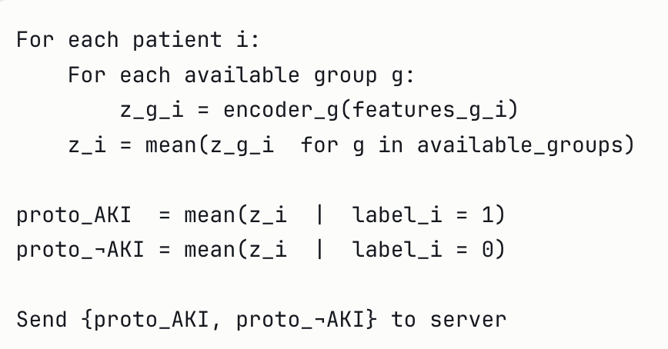
Training Strategy
Each phase addresses a distinct failure mode of naïve federated training
Local Warm-up (5–10 epochs, no federation)
Phase 1
• Each site trains local encoders independently before any federation begins
• Prevents cold-start collapse; ensures prototypes are meaningful before sharing
• Without warm-up, the alignment loss dominates before encoders have learned anything useful
Federate Body + Prototype Alignment
Phase 2
• Each round: compute prototypes → send to server → receive global prototypes + aggregated body (FedAvg)
• Update loss: L = L_classify + λ·L_proto; head frozen throughout; λ ablated ∈ {0.1, 0.5, 1.0}
• Global prototypes weighted by each site's AKI case count
Local Head Fine-tuning
Phase 3
• Body frozen; each site fine-tunes only its classification head on local labeled data
• Site E (no AKI labels): pseudo-labels by nearest-global-prototype distance
Evaluation and Ablation
Phase 4
• Metrics: AUC-ROC per site, early AKI detection rate (6 hr window), false negative rate, calibration
• Ablation: remove prototype alignment (λ=0) / body-head split / feature grouping — one at a time
• Shapley values quantify each site's marginal contribution to global AUC-ROC

Slide 44
Our Design Strategy: Five Guiding Principles
1
Clinical grouping over arbitrary partitioning
Feature groups must reflect AKI pathophysiology — Renal, Hemodynamic, Inflammatory, Clinical. Arbitrary splits produce uninterpretable results and lose the clinical interaction structure PrADA is designed to exploit.
2
Prototypes as the universal communication currency
Every site, regardless of feature set or model architecture , can compute and share class prototypes. This is the lowest common denominator enabling federation under extreme heterogeneity, and the most privacy-safe signal.
3
Body captures biology, head captures clinical context
AKI pathophysiology is universal: rising creatinine = kidney stress everywhere. But actionable thresholds differ: ICU acts at KDIGO Stage 1; ward may wait for Stage 2. The body-head split embeds this structurally.
4
Heterogeneity is graduated, not binary
We test Dirichlet α ∈ {0.1, 0.3, 0.5, 1.0} and feature sets from 2–14 variables per site. This characterises exactly when standard FL degrades and FTL recovers.
5
MIMIC-IV is the controlled anchor
MIMIC-IV is Site C — it defines the feature schema, drives pretraining, and sets the performance upper bound. All simulated sites are clinically justified degradations of this anchor.

Slide 45
Per-Site Analysis: Are any sites penalized?
Site / Condition | FL (S+clip) | Local | Δ FL-Local | Central | Δ FL-Cen | Verdict
site_A ICU 43% AKI 39 feat
IID | 0.881 | 0.848 | +0.033 | 0.884 | −0.003 | FL beats local; ties central
Covariate only | 0.957 | 0.970 | −0.013 | 0.962 | −0.005 | ⚠ LOCAL WINS — penalised by FL
Both max | 0.782 | 0.748 | +0.035 | 0.782 | +0.001 | FL beats local; ties central
site_B Ward 17% AKI 39 feat
IID | 0.873 | 0.848 | +0.025 | 0.876 | −0.003 | FL beats local in all 8 conditions
Both max | 0.895 | 0.864 | +0.031 | 0.894 | +0.001 | FL beats both ✓✓ Never penalised
site_C Anchor 12.6% AKI 66k patients
IID | 0.876 | 0.865 | +0.011 | 0.881 | −0.005 | FL beats local; central 0–0.005 better
Both max | 0.880 | 0.858 | +0.022 | 0.882 | −0.001 | FL beats local; ties central
Never penalised — IS the anchor; global model always learns toward site_C
site_D Community 10% AKI 25 feat
IID | 0.846 | 0.843 | +0.003 | 0.851 | −0.005 | Tie; sentinel imputation adds noise
Both max | 0.800 | 0.771 | +0.029 | 0.804 | −0.004 | FL beats local; near central
site_E Rural 5% AKI 18 feat
IID | 0.833 | 0.850 | −0.017 | 0.847 | −0.014 | ⚠ LOCAL WINS — global tuned to 43% AKI
Label only | 0.823 | 0.828 | −0.005 | 0.835 | −0.012 | ⚠ LOCAL WINS — 1,512 cases better calibrated
Both max | 0.777 | 0.773 | +0.004 | 0.796 | −0.019 | Tie FL/local; central always best at site_E
⚠ = local model outperforms FL at that site/condition. site_A penalised under covariate shift: ICU feature compression (×0.5 spread) averaged away by FL. site_E penalised at IID/Label only: global boundary dominated by site_A (43% AKI) and site_C (66k patients), both unlike rural 5% AKI.

Slide 46
Personalisation Recommendations per Site
Site | AKI% | Features | FL Verdict | Penalised? | Personalisation Needed | Priority
site_A | 43% | 39 feat (all groups) | FL helps (IID/Both max). Penalised under covariate shift only (−1.3 pts). | Yes — cov. shift | Local head calibrates threshold for 43% prevalence. Global body retained. | 🟡 MEDIUM
site_B | 17% | 39 feat (all groups) | FL beats local in all 8 conditions (+1.9–3.1 pts). Matches centralised. | No | Global model fits well. Sits near distribution centre. | 🟢 LOW
site_C | 12.6% | 39 feat (all groups) 66,520 pts | Never penalised. FL +0.9–2.2 pts over local. IS the anchor — global model learns toward it. | No | None needed. Local model already strong (66k patients). Could serve as federation server. | ⚫ NONE
site_D | 10% | 25 feat (no inflammatory) | Modest FL benefit under combined shift (+2.9 pts). Sentinel imputation adds noise. | Partial | Site-specific input projection (25→hidden). Replace sentinel −3.0 imputation. | 🟡 MEDIUM
site_E | 5% | 18 feat (renal+clinical only) 1,512 AKI cases | Local BEATS FL under IID (−1.7 pts) and Label only (−0.5 pts). 10-pt gap vs site_C at Both max. | Yes — IID & label shift | FedBABU body-head split. Local head fine-tuned on 5% AKI distribution. Input projection (18→hidden). | 🔴 HIGH
Why personalisation would help penalised sites:
site_A: Local head corrects the prevalence calibration (43% vs 12.6%). Global body still provides ICU feature representations. Expected to recover the −1.3 pt deficit under covariate shift.
site_E: Global body provides rich representations from 32k+ AKI cases across all sites (vs 1,512 local). Local head calibrates to 5% AKI rural phenotype. Site-specific input projection removes sentinel noise. Expected to close the 10-point gap vs site_C.

Slide 47
Phase 3
GPC-Aligned Multi-Method Evaluation
Bug Fixes, Corrected Rankings, and the Site_D Investigation

Slide 48
GPC Alignment: What Changed From Phase 2
Cohort and feature-set changes between Phase 2 (unaligned MIMIC-IV) and Phase 3 (GPC shared98-aligned)
PHASE_2_VS_PHASE_3 = {
"features": 109 (unaligned) -> 159 (GPC-aligned),
"feature_groups": 5 groups -> 8 groups,
"lookback_window": ad hoc -> 24h anchor-based (GPC std),
"aki_prevalence": 9.0% -> 12.5%,
"scr_exclusion": SCr>1.3 admission exclusion -> REMOVED,
"cohort_size": 163,038 patients (unchanged),
}
# Prevalence rose because the SCr exclusion was removed —
# a GPC-standard alignment change, not a data-quality fix.
NEW_FEATURE_GROUPS = { # 8 groups, up from 5 in Phase 2
"renal": [...],
"metabolic_panel": [...],
"hepatic": [...], # NEW
"hematology": [...], # NEW
"inflammatory": [...],
"vitals_gpc": [...], # NEW
"vitals_mimic": [...], # NEW
"clinical": [...],
}
159 GPC-aligned features total
(vs. 109 in Phase 2's unaligned set)
24 of 31 MIMIC-IV core lab/vital
features map directly onto the
GPC shared98 feature set —
see next slide for details

Slide 49
Feature Alignment: MIMIC-IV to GPC Shared Feature Set
Core MIMIC-IV clinical variables checked against the GPC shared98 feature specification for cross-network compatibility
24 of 31 core clinical variables mapped directly or with minor renaming; the aligned cohort's full engineered feature set grew from 109 (Phase 2) to 159 columns (Phase 3) after adding GPC-standard vitals and lab-panel splits.
Direct Matches
~18 vars
Renamed / Rescaled
~6 vars
MIMIC-Only
~7 vars
New in Phase 3
+50 cols
Net Effect
163,038 pts
creatinine, BUN, sodium,
potassium, glucose, hemoglobin
Core renal and metabolic-panel
labs — GPC shared98 uses the
same clinical definitions MIMIC-IV already reports, no transformation needed.
vitals (SBP/DBP, heart rate,
SpO2, respiratory rate)
Same underlying measurement,
different GPC naming/units convention — split into vitals_gpc vs vitals_mimic groups.
no direct GPC shared98
equivalent identified
Retained in the aligned set as
MIMIC-specific context features
— not dropped, just not part of
the cross-network-comparable core.
GPC-standard vitals split,
hepatic panel, hematology
panel (new feature groups)
Added to reach the 159-feature
aligned set — see previous slide
for the full 8-group breakdown.
Same cohort size as Phase 2 — alignment changed feature definitions and coverage, not the patient population.
AKI prevalence still rose 9.0% -> 12.5% (exclusion criteria change, Section 1 of this deck's Phase 3 setup).

Slide 50
Two Critical Bugs Found & Fixed This Session
Bug Symptom Root Cause Fix
GRL sign error adv_loss unbounded Double-negated GRL reversal task_loss - lambda*adv
(fedadapt_model.py) (500 -> 3,000-7,000/50 rds) in fedadapt_loss() -> task_loss + lambda*adv
K-mode suffix mismatch per-site K silently == K=3 Shell script appended a suffix Pass bare site names to
(run_phase3_aligned.sh) for fedadaptproto every time v2.3's bare site-id keys never had --n_clusters_per_site
since the feature existed Confirmed: byte-identical results Confirmed: uniform2 now
What This Changed
GRL fix: mechanistically necessary
Bounded, stable adversarial loss regardless of AUROC impact — a genuine correctness fix, not a tuning choice.
AUROC impact differed by method
fedadaptproto: no detectable effect (multi-seed confirmed). fedadapt: real cost to site_D (-0.033 -> -0.058), full-grid confirmed.
Changed the final ranking
fedadapt dropped from tied-#1 to #5 once corrected — see Final Ranking slide.
K-mode fix: genuinely inconclusive
Once isolated from the GRL-fix confound, uniform K=2 and genuine per-site K proved statistically indistinguishable at full-grid scale.
Reproducibility finding, not just a bug
Re-running identical seed+code still swung site_C/D by 0.017-0.03 — traced to fedadaptproto's KMeans clustering step specifically.
Neither bug was caught by single-seed testing
Both required multi-seed or full-grid comparison to surface — a methodology lesson as much as a code fix.

Slide 51
Final Corrected Method Ranking — Full 20-Condition Grid, Multi-Seed Confirmed
Mean AUROC by heterogeneity level (alpha), all 6 methods, genuine multi-seed averaging (2-3 seeds each) across the entire grid
Alpha
Sites
Heterogeneity
FedAvg
FedProx
SCAFFOLD
FedAdapt
FedAdaptProto
v25 (proto)
Best Method
a=0.1
5 sites
Most heterogeneous
0.9053
0.9048
0.9045
0.9034
0.9020
0.9075
v25
a=0.3
5 sites
High heterogeneity
0.9093
0.9088
0.9082
0.9060
0.9057
0.9102
v25
a=0.5
5 sites
Moderate heterogeneity
0.9062
0.9062
0.9070
0.9021
0.9040
0.9105
v25
a=1.0
5 sites
Mild heterogeneity
0.9077
0.9083
0.9054
0.9061
0.9041
0.9117
v25
a=10.0
5 sites
Near-IID
0.9033
0.9034
0.9033
0.9014
0.9012
0.9033
tie: fedavg/prox/scaffold
OVERALL
20 cond.
Pooled mean, full grid, multi-seed
0.9064
0.9063
0.9057
0.9038
0.9034
0.9086
v25
Key findings:
FedAdaptProto_v25 wins 5 of 6 rows outright, ties at near-IID -- clear best method, genuine multi-seed confirmed (2-3 seeds/method, full 20-condition grid).
Final ranking (mean delta_auroc, multi-seed): v25 -0.0054 > FedAvg -0.0076 > FedProx -0.0077 > SCAFFOLD -0.0083 > FedAdapt -0.0102 > FedAdaptProto -0.0106
v25 wins by a real margin (0.0022 over next-best), not marginal. See FINAL_multiseed_ranking.csv for full detail.

Slide 52
Site_D: The Persistent, Unsolved Problem
Five hypotheses tested — all ruled out
The one confirmed, real pattern: early peak, then decay
Hypothesis Test Result
Feature-set overlap Jaccard(site_B, site_D) = 0.848 Nearly identical to site_B, which does fine — doesn't explain it
Covariate distributional shift KS test vs. site_A/site_C site_B/D LESS different than a working pair — doesn't differentiate
Naive cross-site transfer Direct weight transfer, all pairs Universal 0.22-0.38 drop everywhere — not site_D-specific
K-selection quality Silhouette diagnostic, all sites K=2 preference is dataset-wide, not site_D-specific
Adversarial signal strength lambda_adv 0.1-0.3, multi-seed Spread 0.0006 vs. seed noise 0.004-0.009 — no real effect
Site Round of peak AUROC Behavior after peak
site_D Round 1-3 (of 50) Decays for the remaining 47 rounds
site_A / B / C Round 5-15 Roughly stable after peak
site_E Round 15-44 Keeps improving through most of training
Checkpointing (restoring each site to its own best round) roughly halved site_D's average deficit — a real, working mitigation that doesn't explain the underlying cause.
Local baseline context
Phase 2 (unaligned): site_D local AUROC ~0.780 Phase 3 (GPC-aligned): site_D local AUROC ~0.898
GPC alignment made site_D's local-only baseline dramatically stronger (+0.118) — less headroom for FL to add value, independent of any federation-side problem.
Where this stands, and what's next
1. Never beats local baseline in 120/120 method-condition combinations tested before this session's fixes
2. Checkpointing, the GRL fix, and correct K-mode each independently help — but none explain WHY site_D behaves this way
3. Gradient-conflict diagnostic built (cosine similarity between each site's local update and the aggregate direction, per round) — implementation debugged and fixed this session, first clean run still pending
4. Possible clue: fedadaptproto's KMeans clustering step shows real, unexplained run-to-run non-determinism specific to site_C/D — worth its own follow-up

Slide 53
The Per-Site Split: Who Wins, Who Loses, and Why
FL helps the two prevalence extremes, not the middle three sites
Candidate explanations — hypotheses, not confirmed
Site Mean delta_auroc Archetype Prevalence
site_A +0.022 ICU Highest (23-36%)
site_E +0.023 Rural/resource-limited Lowest (6-12%)
site_B -0.012 General Ward Moderate
site_C -0.026 Academic Anchor (159f) Moderate (9-12.5%)
site_D -0.055 Community Clinic Moderate, but weakest local AUROC
1. Low-prevalence sites (E) borrow signal — standard FL story: few positive cases locally, pooling stabilizes the boundary.
2. High-prevalence sites (A) may exploit sharper alignment — already-clean signal benefits most from adversarial/prototype pressure.
3. Middle sites take a tug-of-war cost — close enough to the federated compromise to be pulled, not far enough to need it.
4. Site_D may be a signal-quality story — lowest local-only AUROC of all 5 sites; federation may substitute weak-but-relevant local signal with an actively-wrong aggregate direction.
One hypothesis now tested — r=+0.53, but doesn't explain site_D
Prevalence distance from the federated mean (no training required — pure label statistics): correlates moderately with delta_auroc (r=+0.53), explaining most of site_A and site_E's benefit.
It does NOT explain site_D: moderate prevalence distance predicts an unremarkable outcome, not the worst of all 5 sites — added support for hypothesis #4 (signal-quality), not #1-3.
Things to explore next
1. DONE: Prevalence distance from the federated mean — r=+0.53 overall, but site_D is a confirmed outlier (see above) — needs a separate explanation
2. Local decision-boundary distance — a genuine PRE-TRAINING metric: fit a cheap local classifier per site before federating, measure distance from the naively-pooled boundary
3. Local signal-to-noise ratio — bootstrap-fit the local classifier and measure coefficient variance; motivated directly by site_D's uniquely low local-only AUROC
4. Complete the gradient-conflict diagnostic — the in-training complement to the pre-training metrics above

Slide 54
Dr. Li's Experiment: A Real Fix Found for Site_D
Design: progressive feature enrichment, validated on REAL site_D
Result: a wide benefit plateau, not a narrow spike
Step What it does
1. Un-mask site_D Modified simulation script to expose all 159 features for site_D's real patients (same 33,000 patients, same covariate shift, verified identical on all 68 shared columns)
2. Rank candidates RF feature importance computed from a held-out reference site, no leakage
3. Enrich progressively Add ranked features in steps: 67 (baseline) -> 97 -> 127 -> 159 (full)
4. Train federated Real fedavg training at each checkpoint, alpha=0.3/gamma=0.75, seed=42
Features Local AUROC Federated AUROC Delta_auroc
67 (orig) 0.8405 0.7887 -0.0518
82 0.9141 0.9212 +0.0071
97 0.9079 (peak) 0.9171 +0.0092
112 0.9110 0.9137 +0.0027
127 0.8984 0.9036 +0.0052
159 (full) 0.8925 0.8910 -0.0015
What this means
The flip to positive happens between 67-82 features, not all the way out at 97. Benefit holds across a broad plateau (82-127), then erodes by full unmasking (159). See next slide: this exact shape does NOT replicate at a second, more extreme condition.
Metric revision: predicting the sweet spot cheaply
Local AUROC proxy (regularized logistic regression) FAILS to predict this — it plateaus and never declines, unlike the real neural model, which genuinely overfits with too many features relative to its capacity.
Boundary-similarity RATE OF CHANGE succeeds: the steepest single-step drop in boundary cosine similarity occurred exactly at the 97->127 transition — precisely where real Delta_auroc peaked.
Revised rule: the sweet spot is the last checkpoint before the steepest drop in boundary similarity. Tested retroactively — correctly flags 97 as optimal, without needing the expensive 127/159 runs.

Slide 55
Second Condition Tested: An Important Scope Correction
Same experiment, near-max heterogeneity (alpha=0.1, gamma=1.0)
Result: the general pattern holds, the specific shape does not
Step What changed
Same methodology Fresh, verified-consistent simulation regeneration (a NEW reproducibility gap was found and worked around: this simulation script needs all 5 sites from one run, not mixed with cached data)
Same 6 checkpoints 67 (baseline) -> 82 -> 97 -> 112 -> 127 -> 159
Different starting point Site_D is ALREADY a mild benefiter at 67 features here -- opposite of the first condition
Features a=0.3/g=0.75 Delta a=0.1/g=1.0 Delta
67 (orig) -0.0518 +0.0116
82 +0.0071 +0.0225
97 +0.0092 (peak) -0.0026 (only dip)
112 +0.0027 +0.0115
127 +0.0052 +0.0157
159 (full) -0.0015 +0.0094
What this means
"Feature enrichment fixes site_D" is NOT universal -- it's specific to conditions where site_D starts as a loser. At near-max heterogeneity, site_D wasn't broken the same way to begin with, so there was less to fix. The first condition's result remains real and useful, but should not be generalized without this caveat. Only 2 of 20 conditions tested with the full trajectory so far.
Notably different at this condition
97 is the ONLY negative point here -- the opposite of being the peak at the first condition.
Full unmasking (159) is clearly positive here, unlike the mild negative at the first condition -- "over-enrichment hurts" doesn't replicate either.
Next step: test more conditions to see which pattern (or neither) is representative before generalizing further.

Slide 56
Feature Sensitivity: What Specifically Matters for Site_D
True per-feature analysis (not batched) -- site_D vs. site_A, a genuine benefiter
Result: one added feature dominates for site_D, confirmed at BOTH conditions
Step What it does
Add ONE feature at a time 92 steps for site_D, 90 for site_A (vs. batches of ~15 before)
Track marginal AUROC Each feature's individual contribution, not a combined batch effect
Compare site_D vs site_A Do the features that matter for the loser differ from what matters for a benefiter?
a=0.3/g=0.75 a=0.1/g=1.0
Site_D top ADDED feature baseline_scr +0.0112 baseline_scr +0.0080
Share of site_D's total gain 34.3% 26.0%
Site_A top ADDED feature phosphate +0.0017 phosphate +0.0022
Site_A shape flat, diffuse flat, diffuse (same)
What this means
baseline_scr (what AKI is diagnostically DEFINED against) was absent from site_D's original features, already present in site_A's -- so it was tested as an ADDITION for site_D only, never isolated for site_A. We know it matters enormously for site_D; we don't yet know if it matters similarly for site_A or is specifically more important for site_D's task. A direct ablation on site_A would confirm which.
Practical implication
A far cheaper, more targeted fix than broad feature enrichment: ensure every site has baseline creatinine specifically before addressing anything else.
This finding generalizes better than the sweet-spot location did -- worth prioritizing for any real-world GPC alignment decision.
Open question: ablate baseline_scr OUT of site_A to test whether it matters there too, or is specifically more important for site_D.

Slide 57
Toward Real GPC Deployment: What Needs Tuning
Parameters: validated on simulated data, re-check before real GPC deployment
Feature alignment: 19/98 is not a ceiling -- concretely improvable
Parameter MIMIC-validated Status for real GPC deployment
Checkpointing Restore best round Should transfer directly -- general practice
lambda_adv 0.1 (prevalence-scl) Re-verify: GPC's real prevalence spread (10-15%) is narrower than simulated (6-40%)
n_clusters (K-mode) uniform K=3 (v25) Re-tune on real data structure, not assumed
alpha / gamma N/A, simulation-only Don't apply -- real GPC heterogeneity is whatever the hospitals actually have
Gap Opportunity
DX codes (0/70 matched) Replace coarse comorbidity flags with specific ICD codes -- MIMIC-IV has this data, Phase 3 just used a simplified summary
6 missing labs Fibrinogen, CRP, triglyceride, cholesterol, HDL, lipase -- standard labs, likely extractable from raw MIMIC-IV if not yet included
Race / ethnicity MIMIC-IV has this data; simply wasn't included in the Phase 3 aligned feature set
Should sites be modified to match GPC's real AKI rate (~13.3%, tertiary academic)?
Not a straight replacement -- narrowing prevalence would undercut the extremes-benefit findings this session relies on. Better: ADD a narrow "GPC-realistic" condition alongside the existing sweep. Real GPC heterogeneity looks more size-driven than prevalence-driven (UPITT 299K vs UTSW 73K, a 4x gap Phase 3 doesn't simulate today).
Recommended next steps
1. Add a sample-size heterogeneity axis (vary N per site, matching GPC's real ~4x spread) -- likely more representative than narrowing prevalence alone
2. Re-run K-mode and lambda_adv validation once real or more-realistic GPC-like data is available, rather than assuming simulated-optimal values transfer
3. Prioritize ICD-code-level diagnosis alignment over the 6 missing labs -- it's the largest gap (70 of 79) and the most mechanically fixable with existing MIMIC-IV data

Slide 58
Toward a Site Performance Prediction Formula
Component Standalone r In combination
Prevalence distance from mean r=0.53 (best) Coefficient stays strong
Signal-to-noise ratio r=0.34 -- redundant with prevalence once combined
Boundary similarity (static) r=-0.08 (noise) Adds no value
Local-AUROC deficit vs peers r=0.08 -- site_D/E nearly identical, opposite outcomes
Equal-weight composite (naive) r=0.37 -- WORSE than prevalence alone, not better
The Formula
FL_Benefit_Score(site) =
| prevalence(site) - mean_prevalence(federation) |
Higher score -> more likely to benefit from FL
Lower score -> more likely to be hurt by FL
Deliberately does NOT add boundary similarity or SNR as extra terms -- both tested and shown to add no independent signal, or actively hurt accuracy.
The honest limitation
No metric this session distinguishes site_D from site_E.
Confidence flag: if local AUROC sits below peers, flag LOW-CONFIDENCE and run the enrichment sweep instead.

Slide 59
Phase 3: Summary and Next Steps
Key Conclusions
Next Steps
1. FedAdaptProto_v25 is the clear winner
Tied-for-best became clear-best once two real bugs (K-mode, lambda formula) were fixed — prototype alignment genuinely earns its complexity here.
2. Checkpointing is validated and adopted
Restoring each site to its own best round roughly halved the average deficit across the full 20-condition grid — the one unambiguous, low-risk win.
3. Bugs mattered more than tuning
The GRL sign fix and K-mode suffix fix each changed real conclusions. Lambda_adv tuning, by contrast, was tested twice and confirmed unnecessary.
4. "Does FL help" is a per-site question here
Site_A and site_E clearly benefit; site_B, site_C, and especially site_D do not. No single method fixes this — it's a per-site deployment decision.
5. Single-seed results were repeatedly unreliable this session
Several early findings didn't survive multi-seed or full-grid re-testing — now the default standard, not single-condition spot checks.
1. Complete the gradient-conflict diagnostic
Implementation is fixed and correct; needs one clean end-to-end run on fedavg to test the site_D negative-transfer hypothesis directly.
2. Investigate fedadaptproto's KMeans non-determinism
Site_C/D show real run-to-run variance even at fixed seed+code — worth checking sklearn's random_state handling specifically.
3. Multi-seed the full grid
Current ranking is single-seed at 19/20 conditions (only one condition is multi-seed confirmed) — the gold-standard confirmation for publication.
4. Resolve fedadaptproto's true K-mode answer
Uniform K=2 and per-site K are currently statistically indistinguishable — needs a larger multi-seed test to settle, if it matters for deployment.
5. Feature-level GPC alignment audit
Confirm the full 159-feature GPC-aligned set against the official shared98 specification as the dataset evolves.

