Slide 1
ENSE 400 Project Progress Vlog 3
Humane Transport
Clark Inocalla, Kelly Holtzman, Mansi Patel, Sana Khan
December 14, 2020

Slide 2

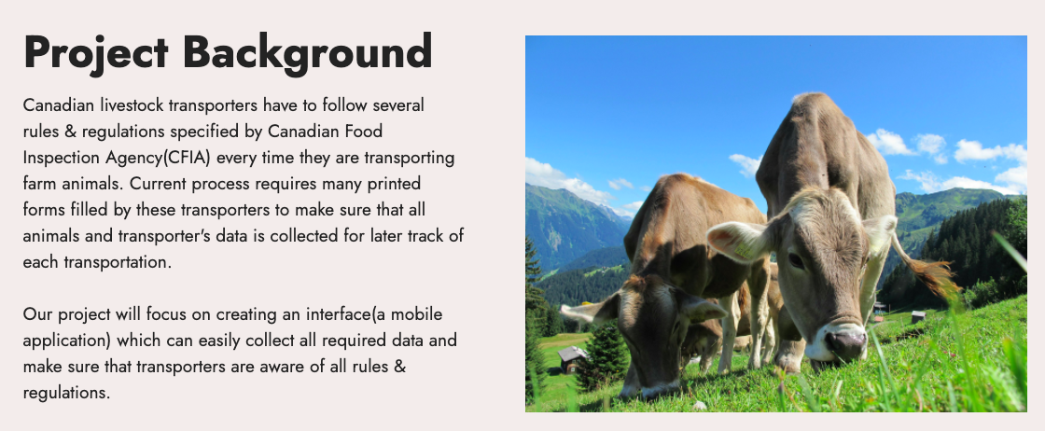

Slide 3
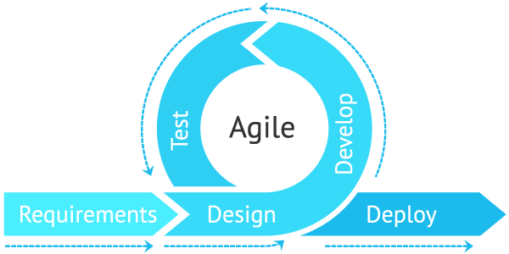
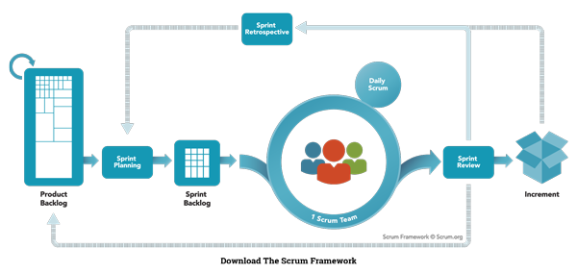
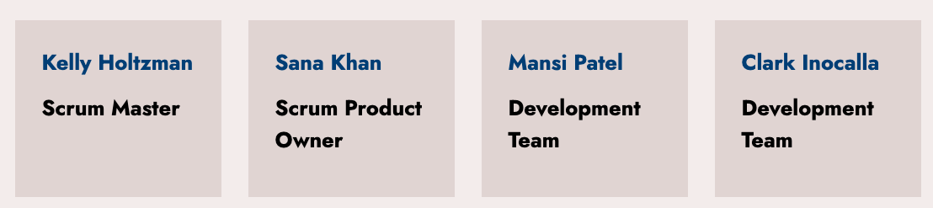
Agile Scrum
Team
Responsibilities
We’re following the traditional method of daily scrums, Sprint review/retrospective, and backlog refinement

Slide 4
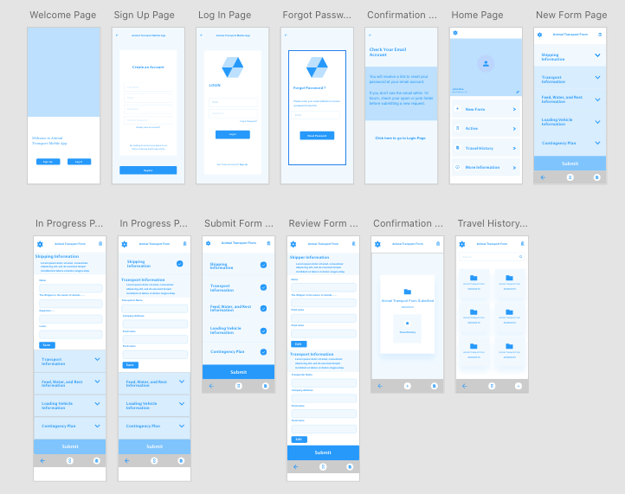
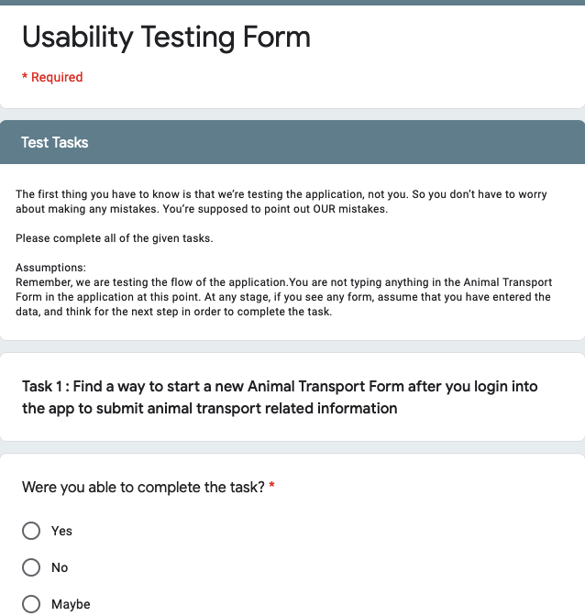
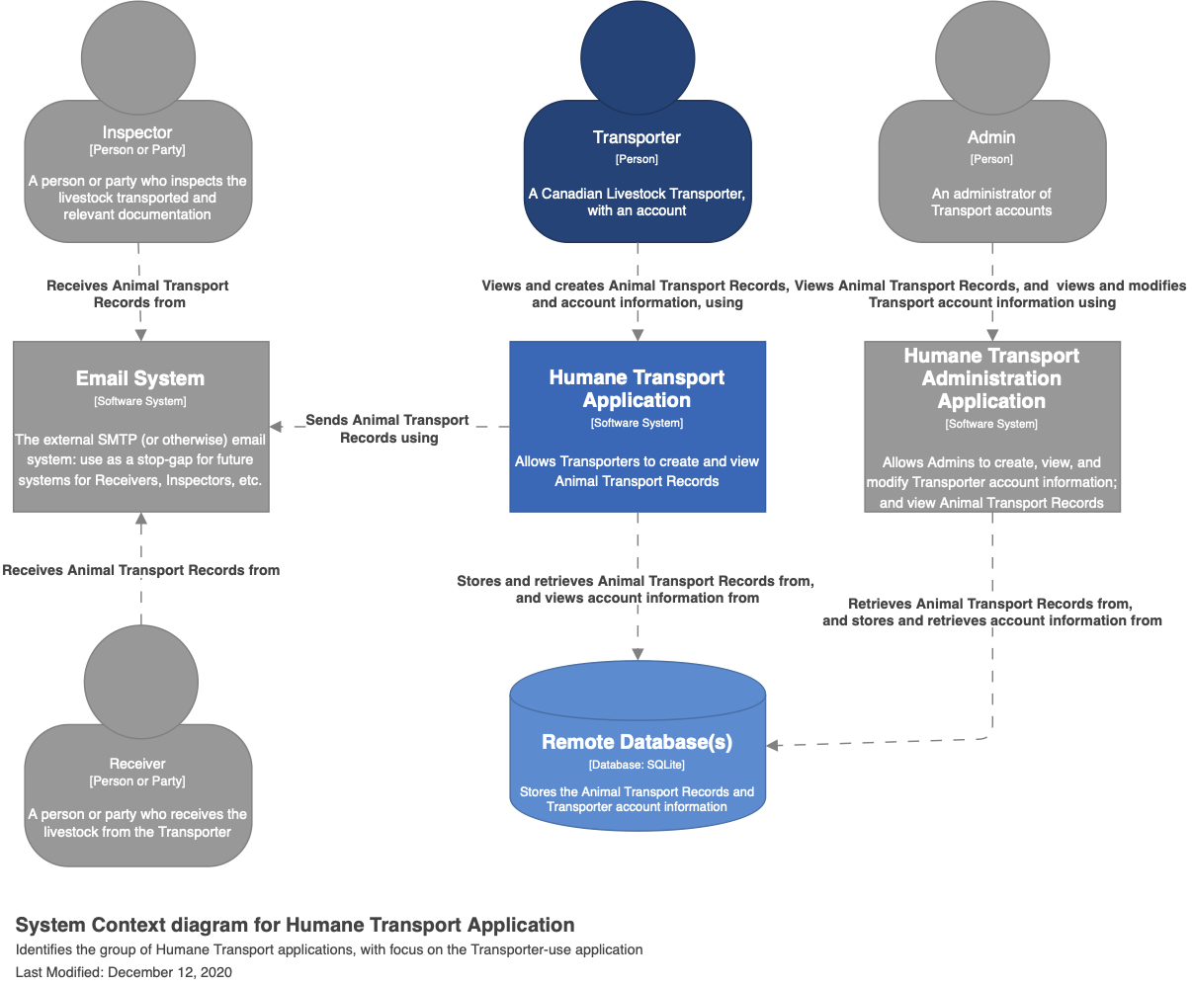
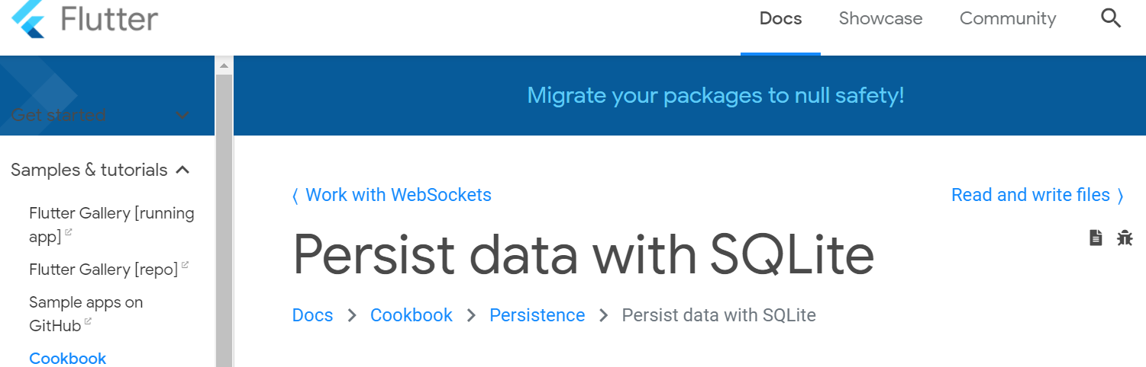
Sprint 3 Overview
Ends Dec 14, 2020
In this Sprint we prepared further for developing software next semester:
Designing GUI Prototypes for client-testing
Developing a GUI Testing Form(at)
Designing our high-to-mid-level Client-Server Architecture
Investigating Database Interface APIs
Had meetings with our mentor and another group developing a similar software system

Slide 5
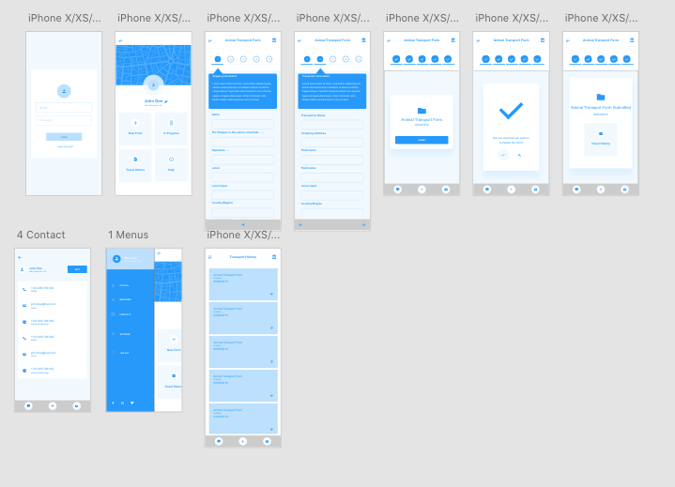
Continued
Mid-Fi
Generation
Mid-Fi
Design#1
Reviewed the first Mid-fi with the team members
Generated the second Mid-Fi design based the feedback provided by the team members
Testing both the design with client and will the adopt the best rated design
Mid-Fi
Design#2

Slide 6
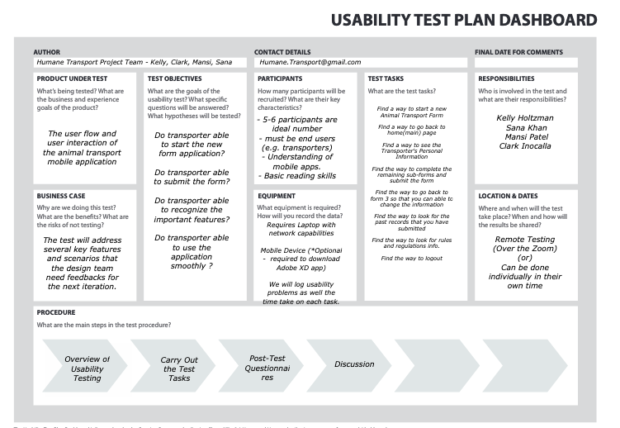
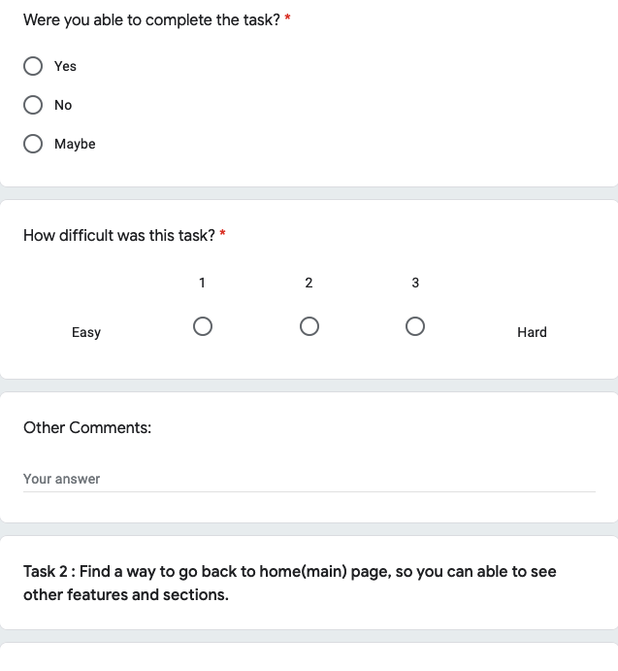
GUI Prototype Testing Forms
Usability Test Plan Dashboard
includes Test Objectives, Equipment details, Test Tasks, Location & Date, Testing Procedure
Usability Test Forms

Slide 7
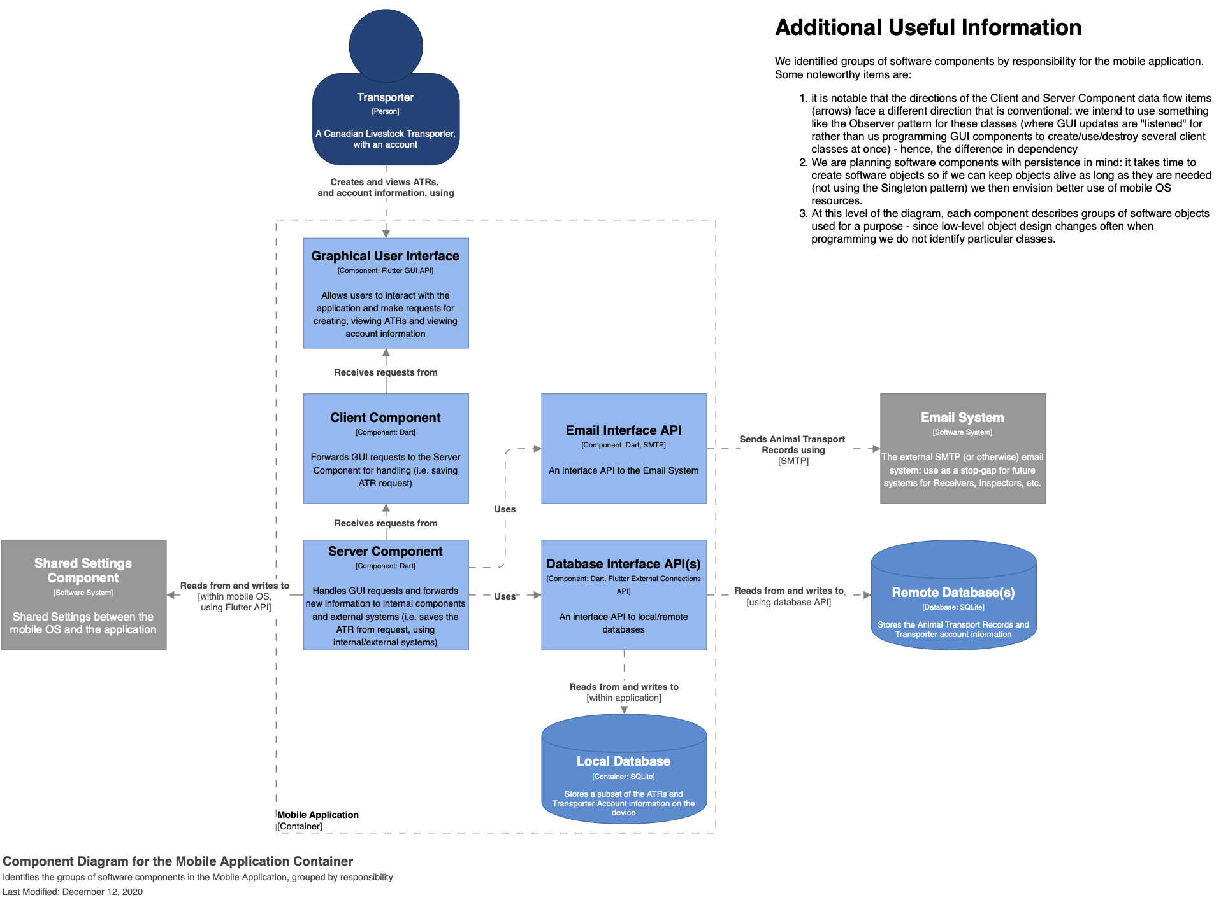
Client/Server Architecture Design Draft(s)
Using the C4 Model for diagramming
Drawings available on GitHub at time of writing (see open Pull Requests)
We identified where our application fits among external systems we’re using
We outlined the major responsibilities (and software components) our mobile application will have
Including:
System Context
Mobile Application Context
Client/Server Components

Slide 8
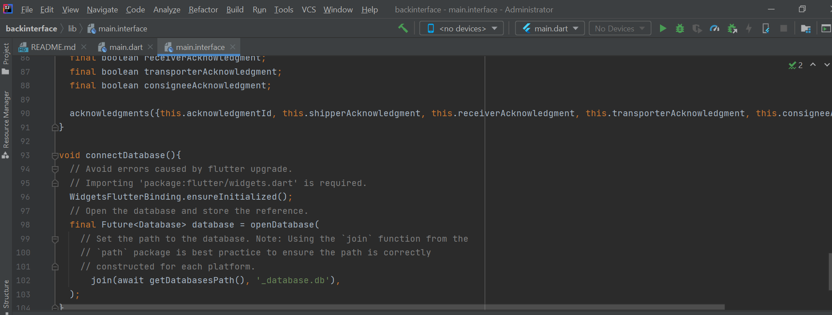
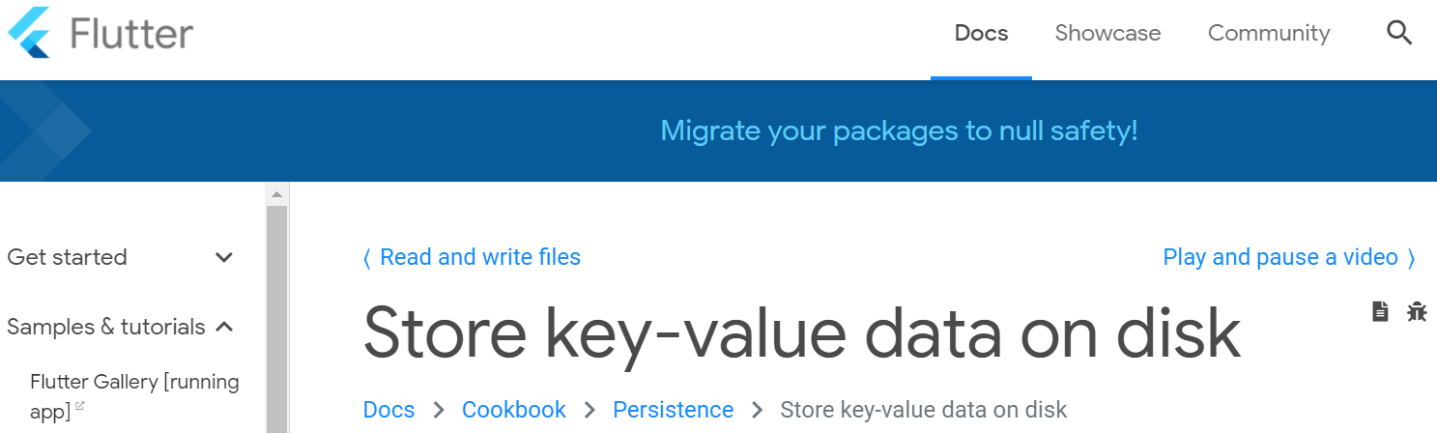
Database(s) Interface Investigation and Design

Slide 9

Mentor and Livestock Services Saskatchewan Meetings and What We Learned
LSS Meeting
Identified general issues faced with current e-manifest system developed by LSS
Missing form data
No data service at remote locations
Database interface needs to be adoptable for multiple database.
Project Discussion
More investigation on flutter framework
Investigation on software testing
We decided to split our back-end and front-end design discussion between mentors i.e. Karim and Tim

Slide 10
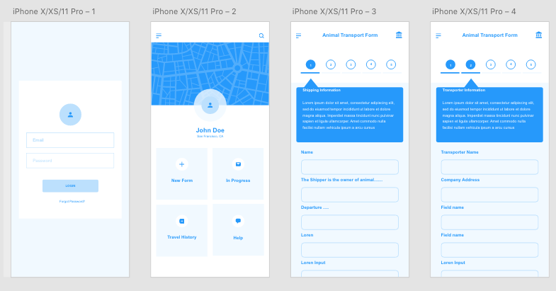
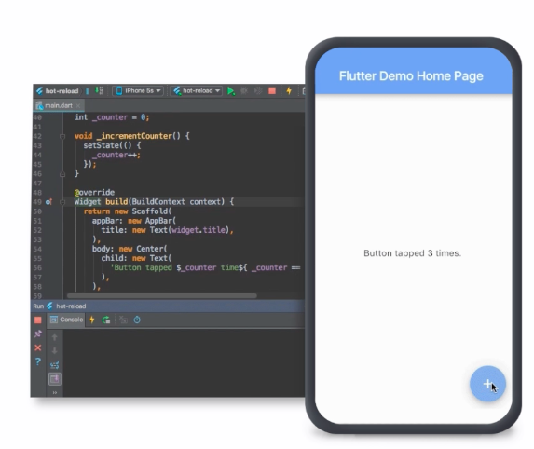
Sprint 4 Outlook
Starts Dec 21, 2020
Prototype testing with the client, generating HiFi
Investigate further Flutter/Dart language options and features
Setup Flutter Multi-platform project*
*May include GUI-side programming if client testing is done earlier than expected

Slide 11
Group Reflection
Open discussion for the meeting
Does the team feel "on track"?
What progress does the team particularly feel good about?
What barriers does the team feel is a current impediment to success?
What help does the team require to move positively forward?
Other questions or concerns?
?

Slide 12
Image References
Agile Scrum Framework. https://www.scrum.org/resources/what-is-scrum
Livestock Services Saskatchewan
https://lssc.ca/

