Slide 1
ENSE 400 Project Progress Vlog
Humane Transport
Clark Inocalla, Kelly Holtzman, Mansi Patel, Sana Khan
October 19, 2020

Slide 2


Project
Details
We’re designing and developing a proof-of-concept mobile application to replace present Canadian animal transportation records.
The existing manifests are in part controlled by the CFIA.
We’re not affiliated with nor endorsed by the CFIA.

Slide 3
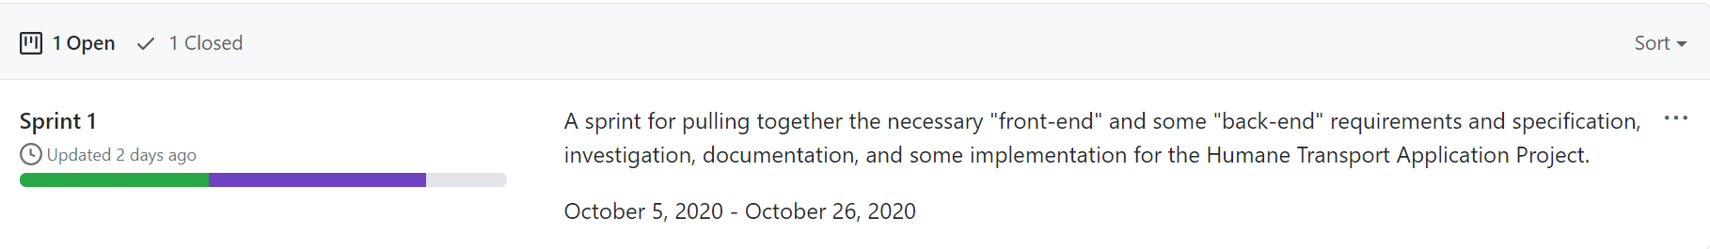
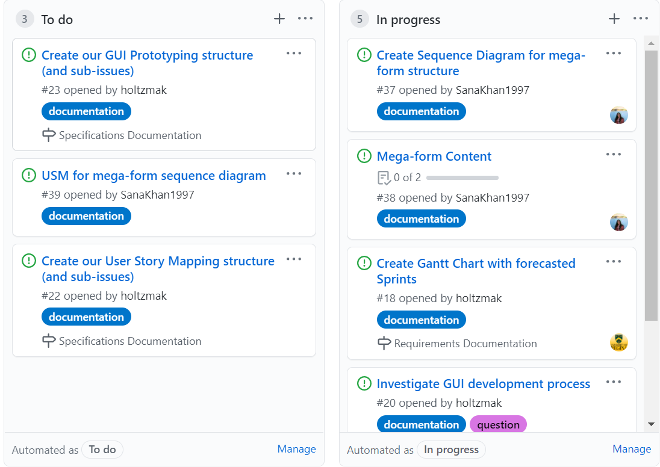
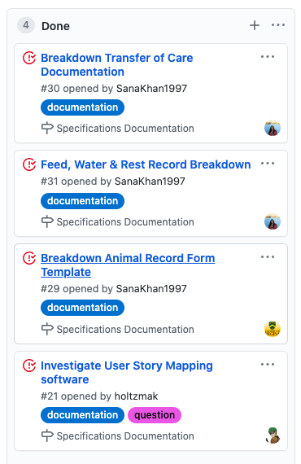
Sprint 1 Progress
There are several ongoing investigations:
CFIA Forms/Document Breakdown
Multiplatform Project base!
3. Database for App

Slide 4
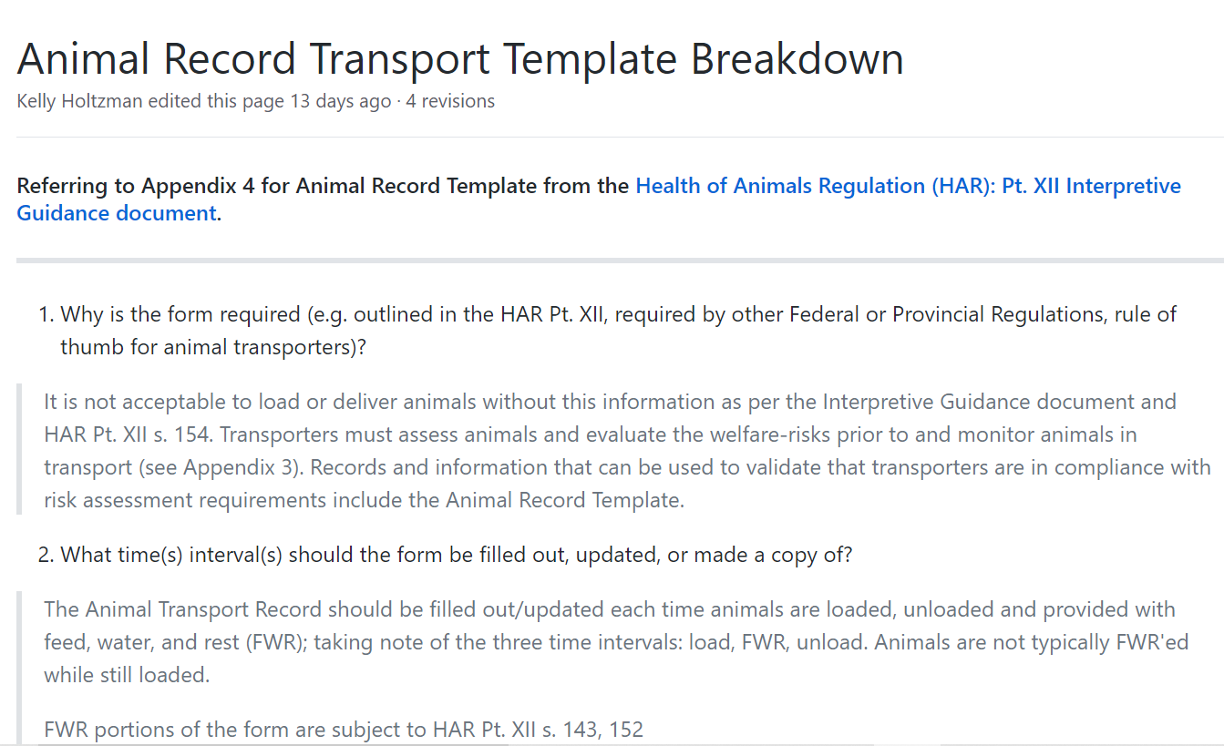
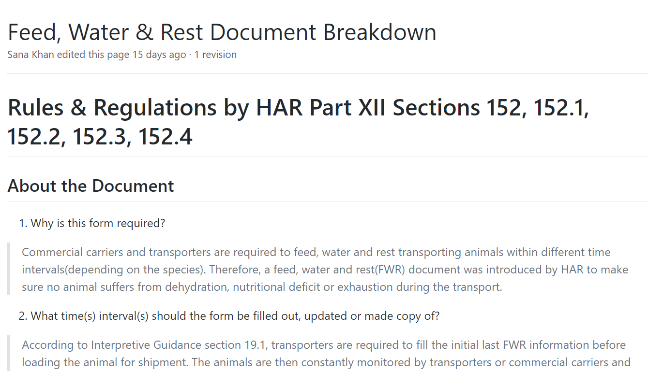
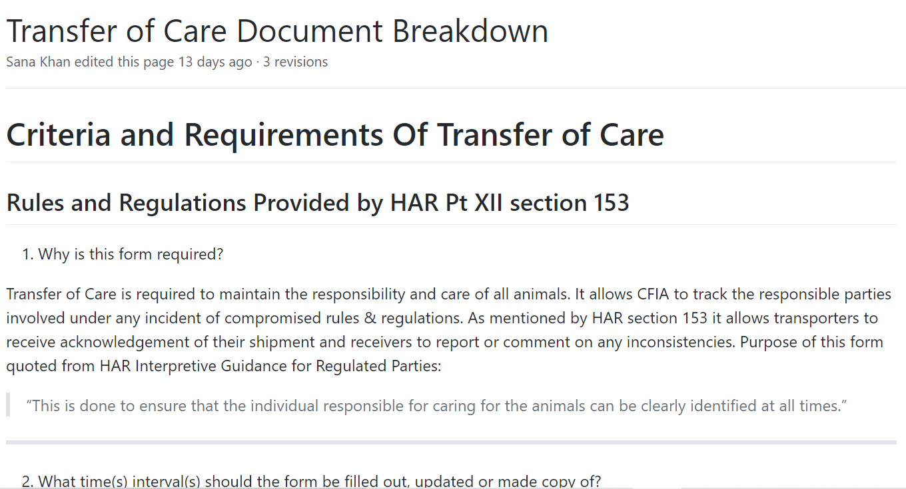
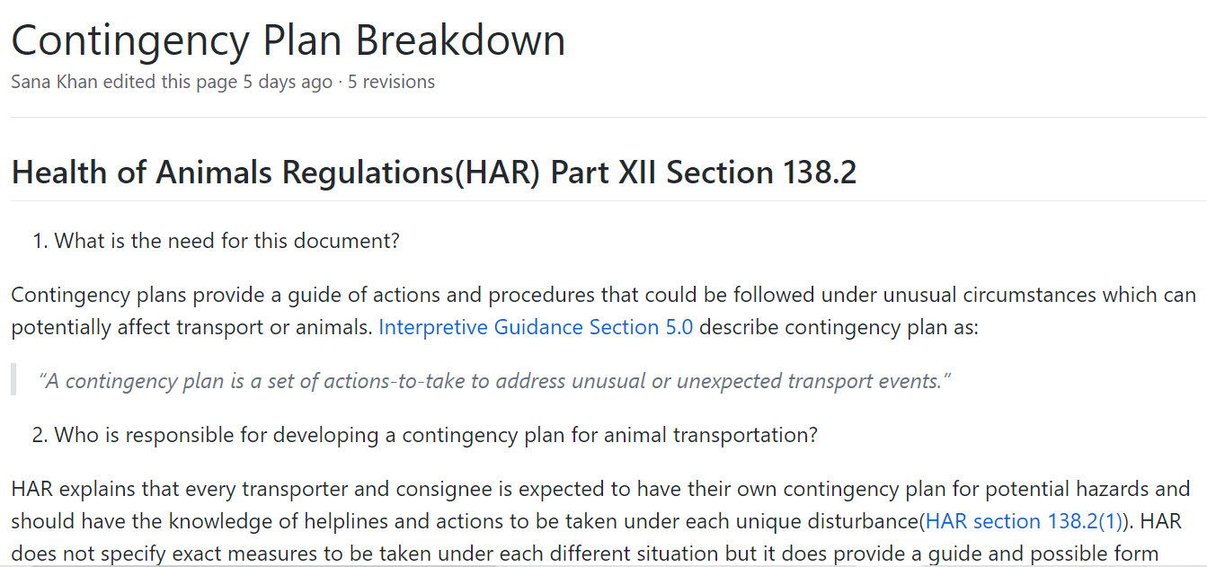
Form/Document Breakdown
Available templates, rules & regulations and form elements of each document
Animal Transport Record
Feed, Water and Rest Form
Transfer of Care
Contingency Plan
Document breakdown in GitHub Wikis
Mega-form containing information from all document with no overlap will be made for the App

Slide 5
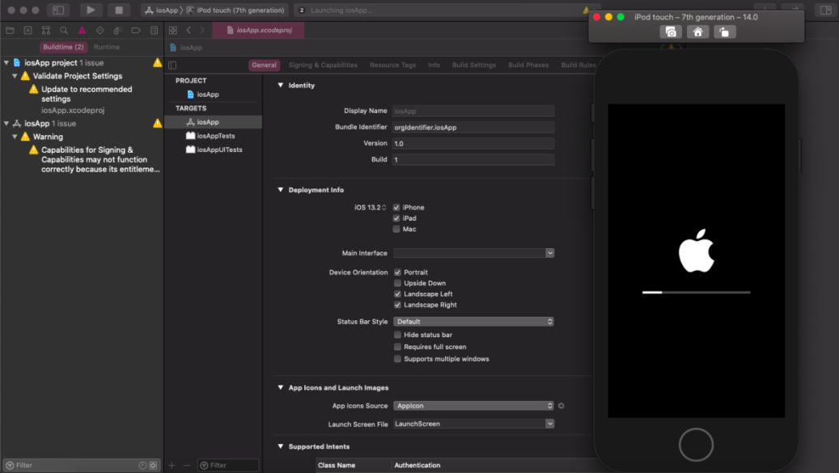
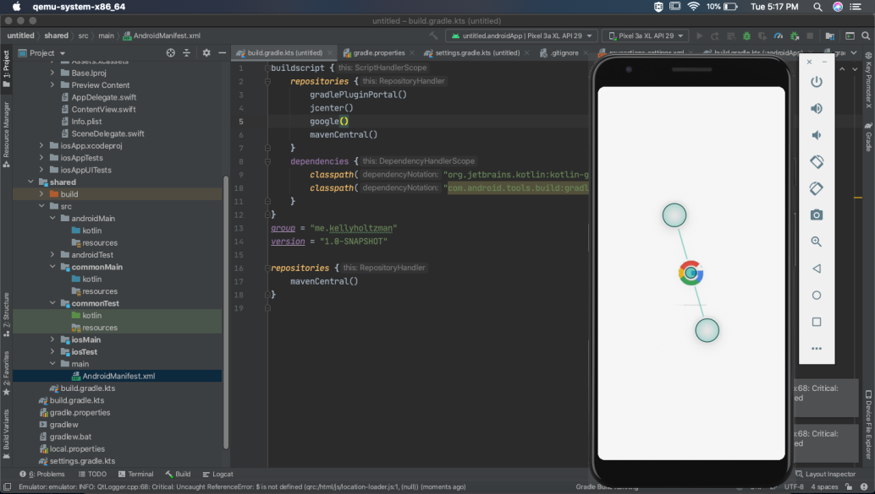
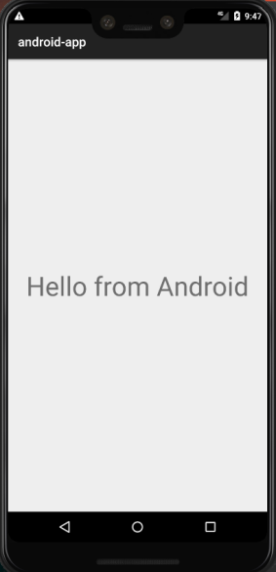
First steps towards Kotlin Multiplatform Mobile!
Achieves a basic app structure for both Android/iOS
Using IntelliJ and XCode IDEs in the images shown

Slide 6
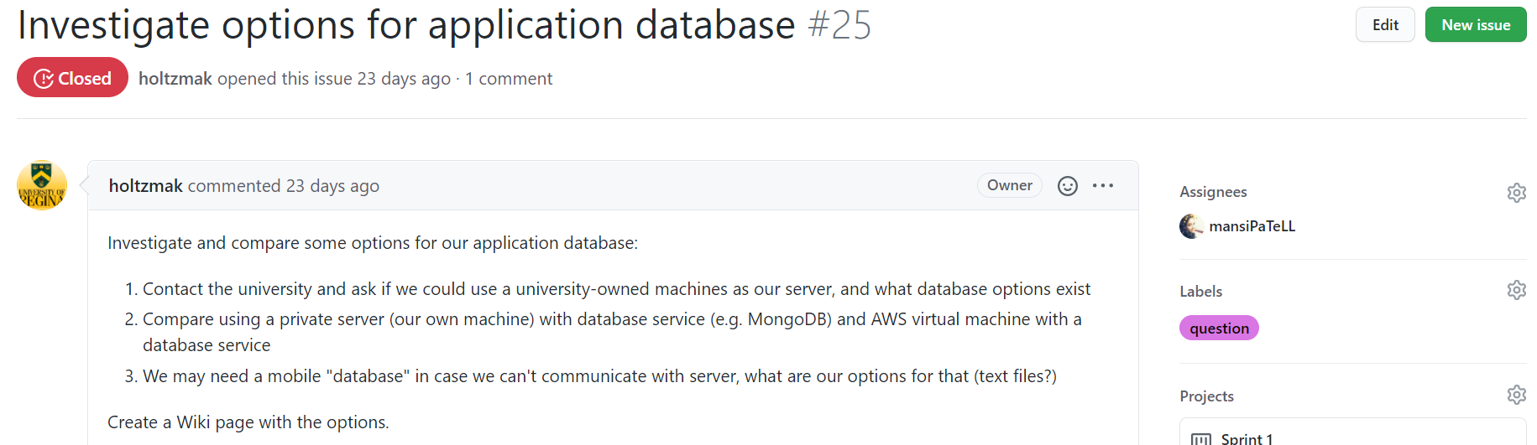
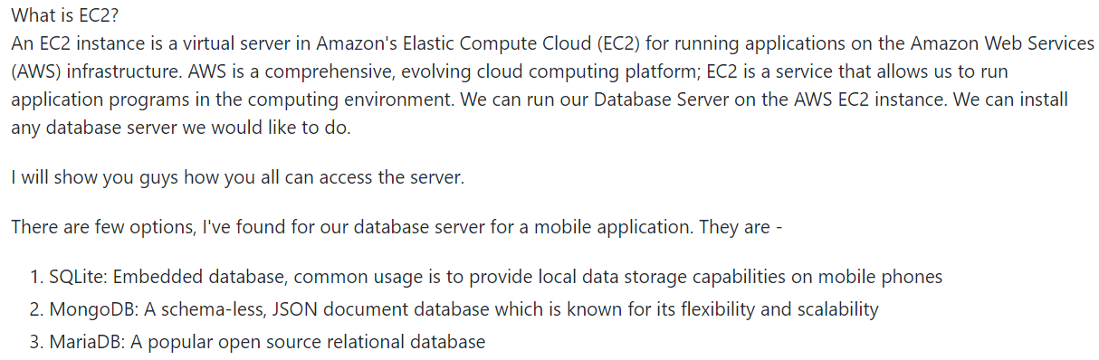
Database for App
Investigate available database options
Possible database setups with UofR

Slide 7
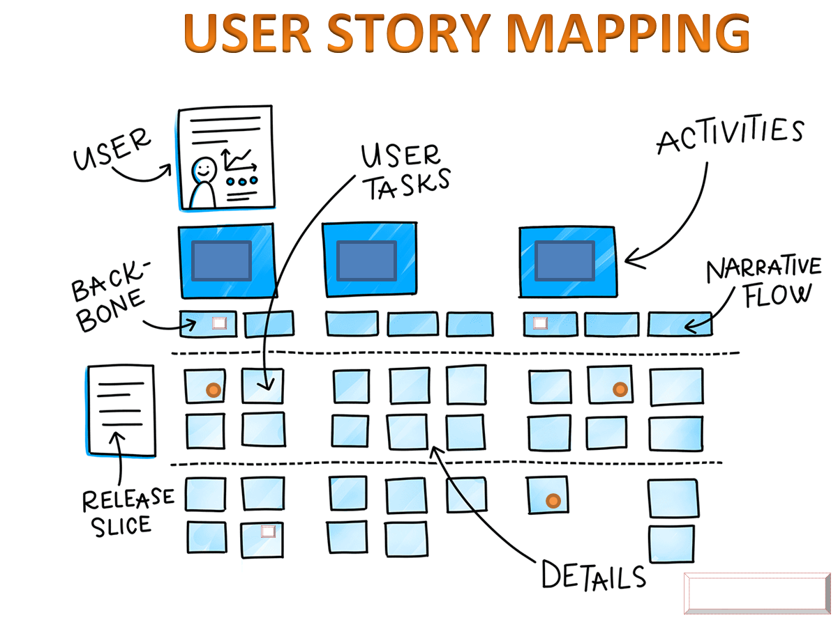

Work In Progress
Highlights:
Mega-form
User Story Mapping
Prototyping Structure

Slide 8
Group Reflection
Open discussion for the meeting
Does the team feel "on track"?
What barriers does the team feel is a current impediment to success?
What help does the team require to move positively forward?
Other questions or concerns?
?

Slide 9
Image References
CFIA Livestock Transport infographic. https://www.inspection.gc.ca/animal-health/humane-transport/livestock-transport-in-canada/eng/1363748532198/1363748620219
User Story Mapping. https://medium.com/@priyank.it/user-story-mapping-product-backlog-creation-7ea9a54f7f0e
Prototyping. https://www.invisionapp.com/inside-design/low-fi-vs-hi-fi-prototyping/
Sprint 1 image captures dated October 25, 2020. https://github.com/holtzmak/Humane-Transport/projects/2

