Slide 1
ENSE 400 Bi-Weekly Scrum Report-Out
Humane Transport
Clark Inocalla, Kelly Holtzman, Mansi Patel, Sana Khan
November 23, 2020

Slide 2
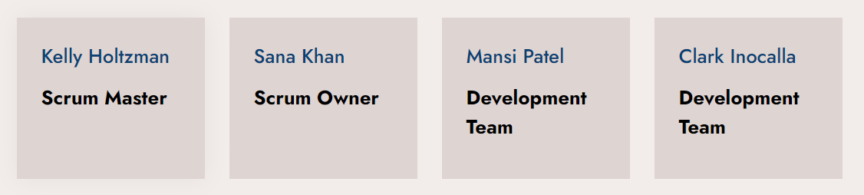
Team Member Responsibilities

Slide 3


Project
Details
We’re designing and developing a proof-of-concept mobile application to replace present Canadian animal transportation records.
The existing manifests are in part controlled by the CFIA.
We’re not affiliated with nor endorsed by the CFIA.

Slide 4
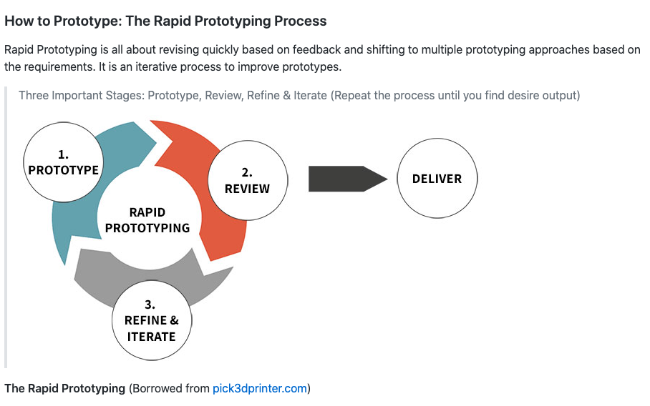
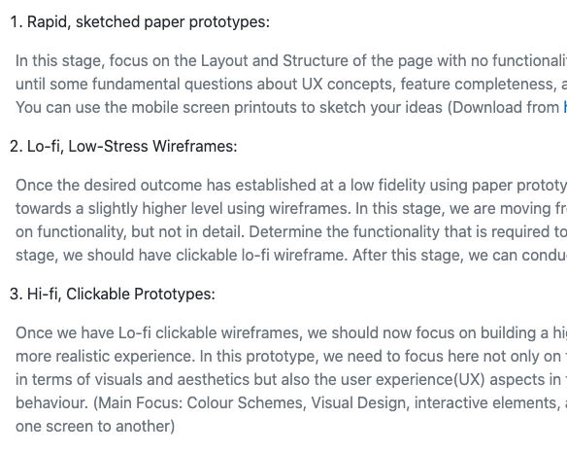
GUI Prototyping
Lo-Fi, Mid-Fi, Hi-Fi
Rapid Prototyping
Process

Slide 5
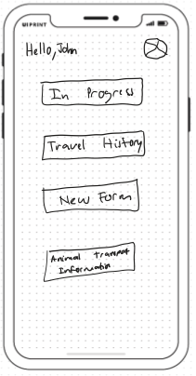
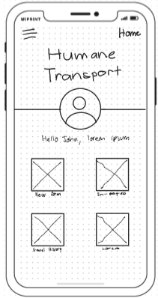
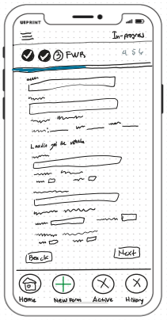
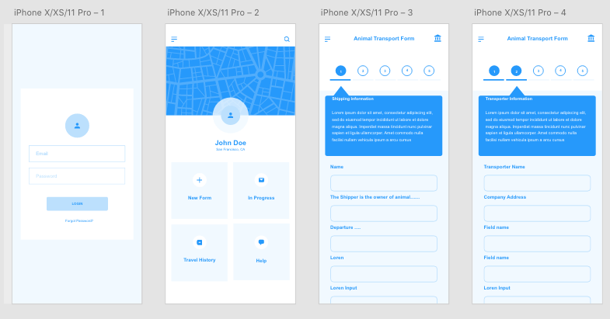
Lo-Fi and Mid-Fi Generation
Clickable Lo-Fi Prototype (Mid-Fi)
Lo-Fi Paper Prototype

Slide 6
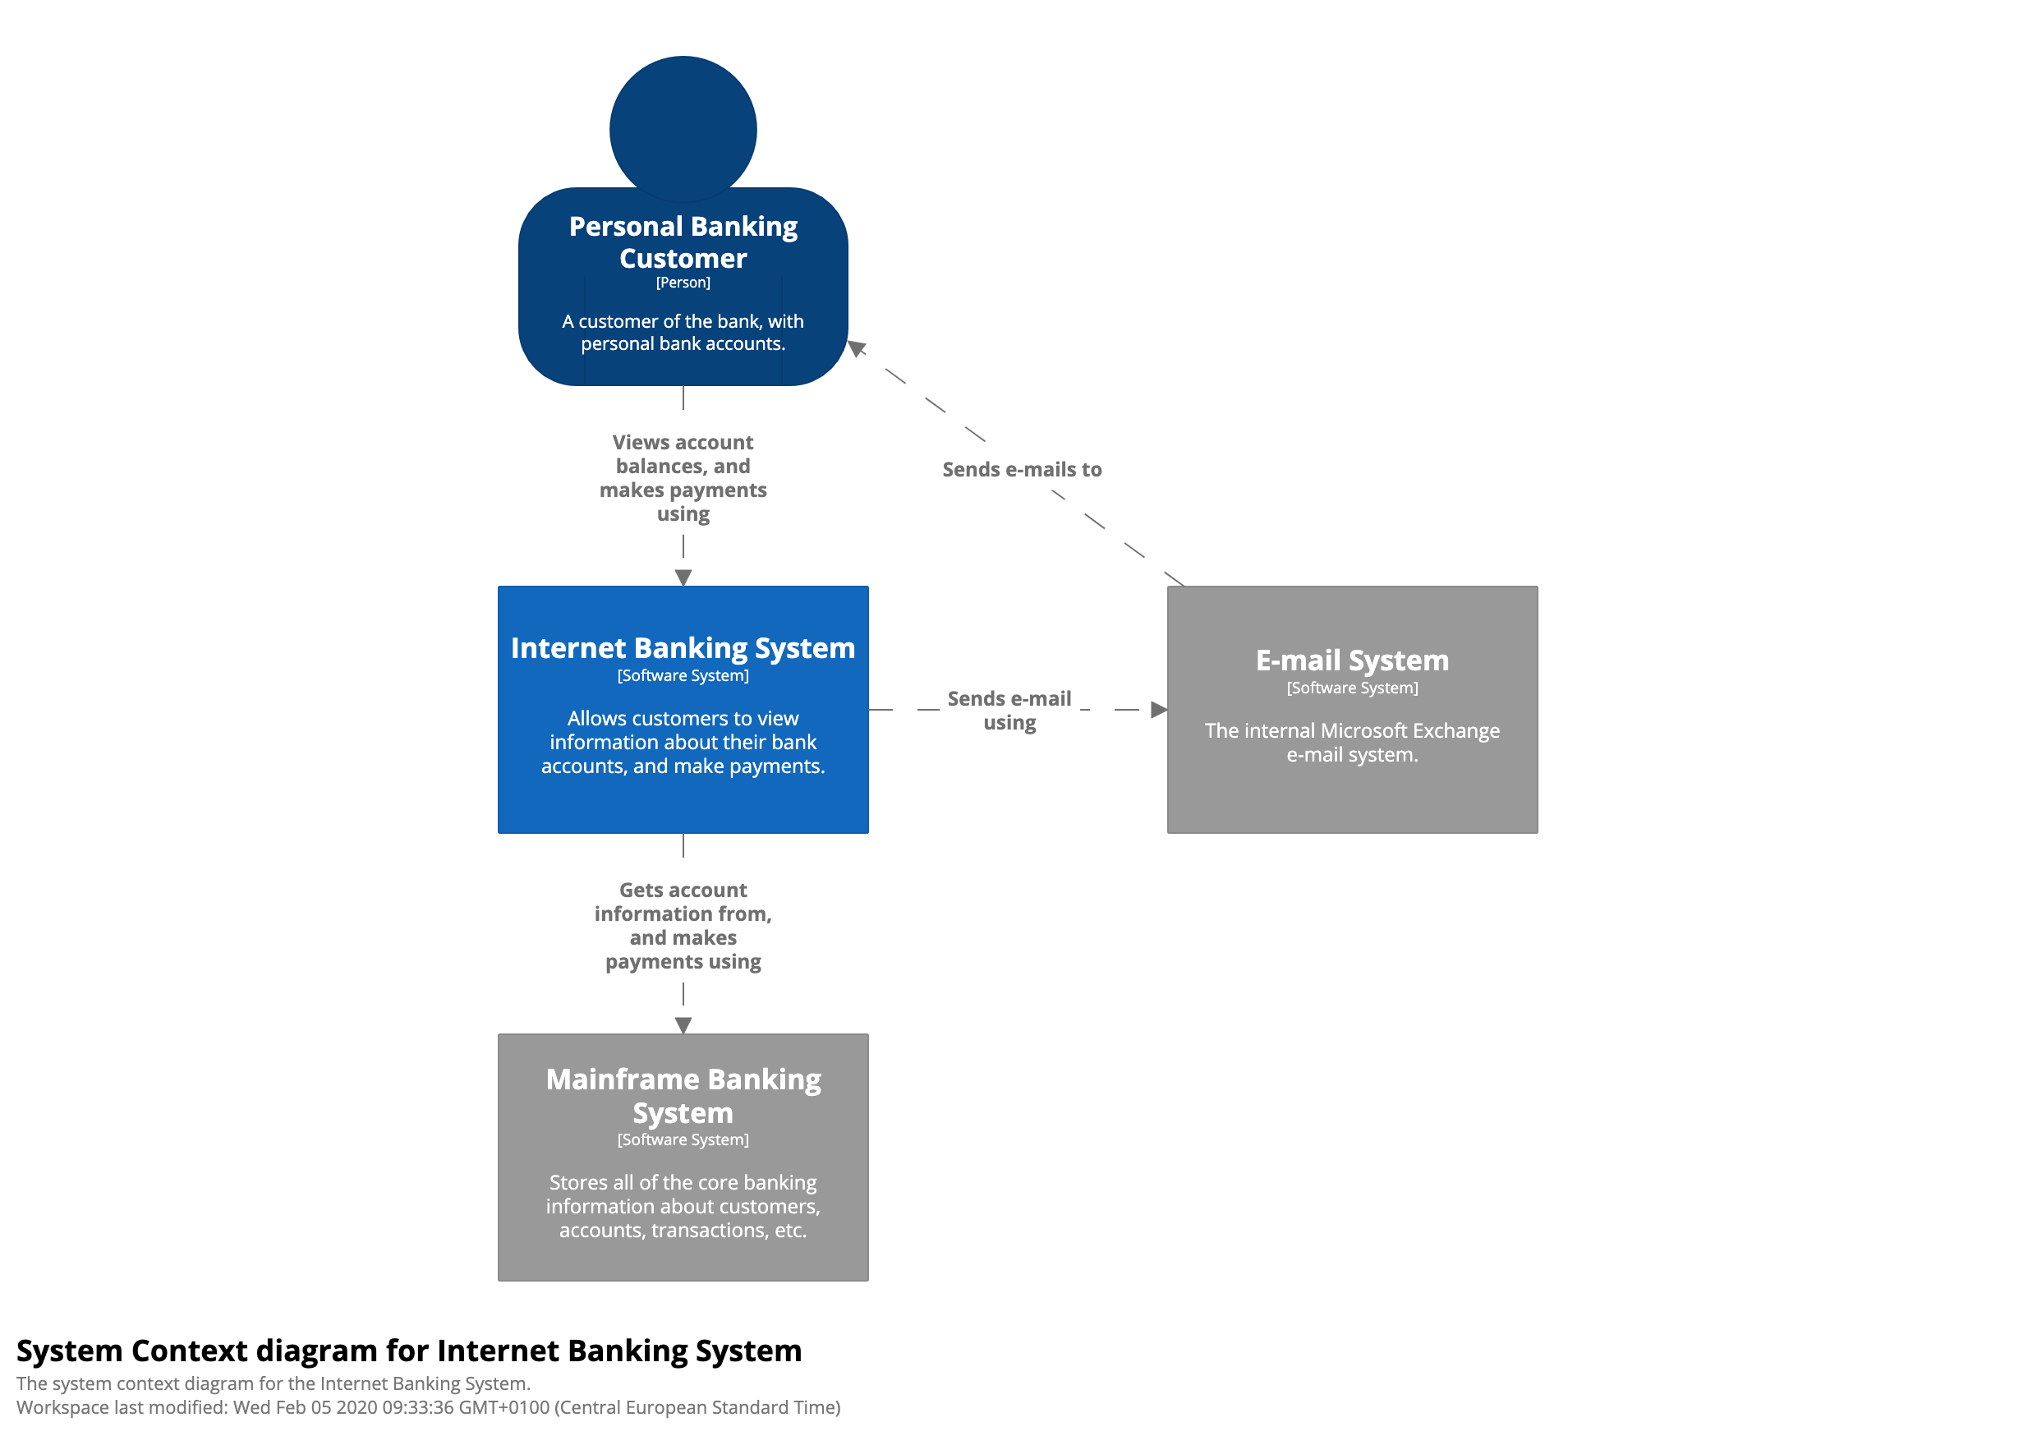
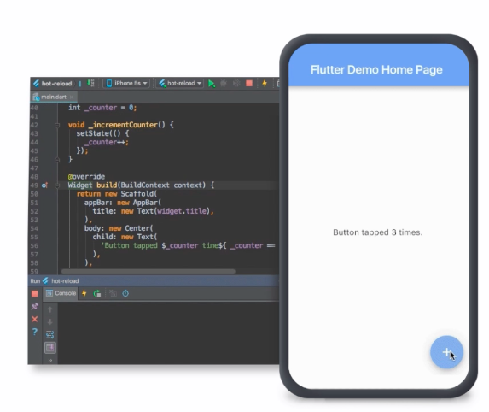
Semester Outlook
Ends Dec 8, 2020
Generating GUI prototypes: LoFi, MidFi, and HiFi
Prototype testing with the client
Designing Client-Server and Database architectures
Possibly implementing Client-Server and Database architectures*
*May include GUI-side programming if ready
Designing
Developing

Slide 7
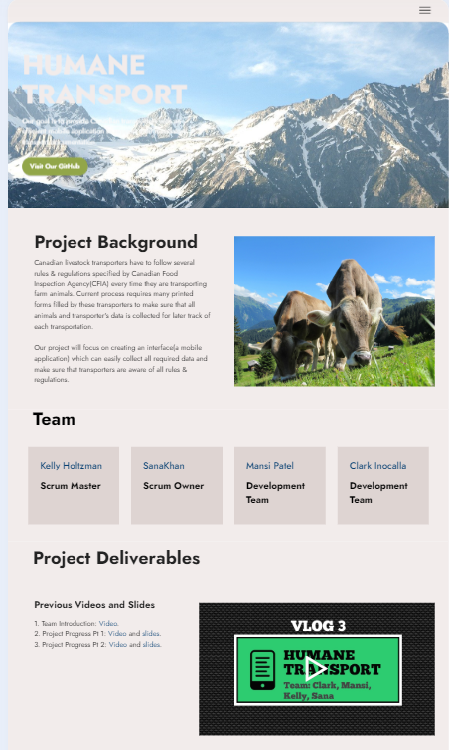
Website Revision and Future
Client Meetings
Meeting with testers: we are looking forward to get lo-fis and mid-fis tested from real users(transporters)
Meeting with Livestock Services of Saskatchewan(LSS): They have similar documentation issues and are interested to see our application performance as well as future opportunities of introducing their forms to our app.
Site Link

Slide 8
Group Reflection
Open discussion for the meeting
Does the team feel "on track"?
What progress does the team particularly feel good about?
What barriers does the team feel is a current impediment to success?
What help does the team require to move positively forward?
Other questions or concerns?
?

Slide 9
Image References
CFIA Livestock Transport infographic. https://www.inspection.gc.ca/animal-health/humane-transport/livestock-transport-in-canada/eng/1363748532198/1363748620219
C4 Model. https://c4model.com/
Flutter. https://flutter.dev/

