Slide 1
ENSE 477 Bi-Weekly Scrum Report-Out
Humane Transport
Clark Inocalla, Kelly Holtzman, Mansi Patel, Sana Khan
March 4, 2021

Slide 2

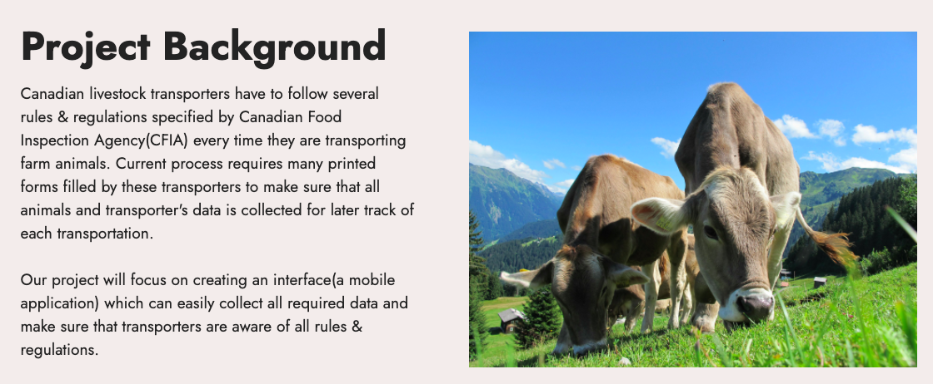

Slide 3
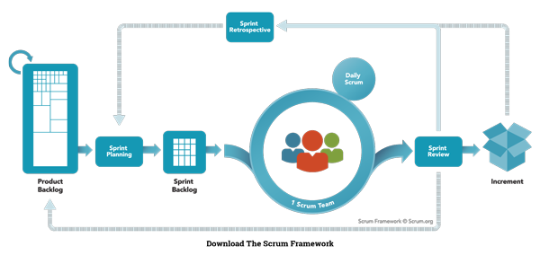
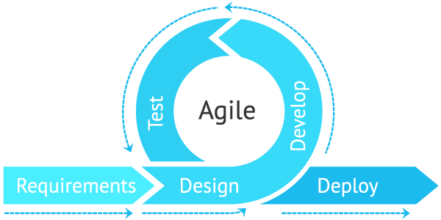
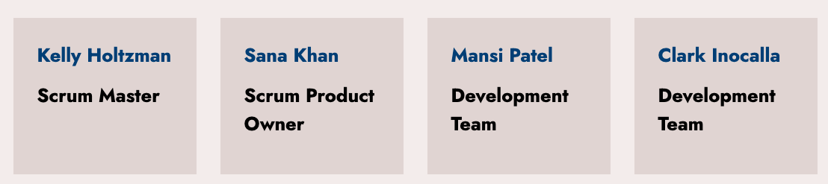
Agile Scrum Team Responsibilities

Slide 4
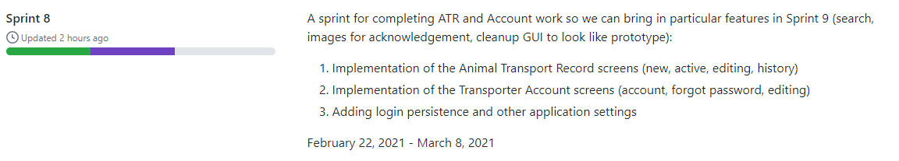
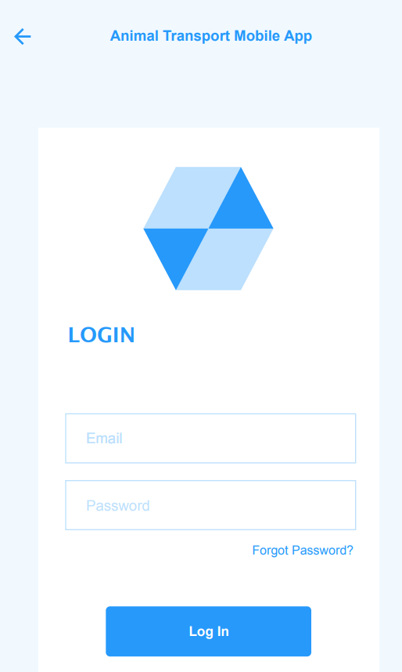
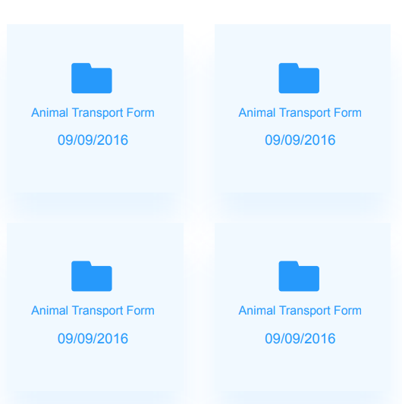
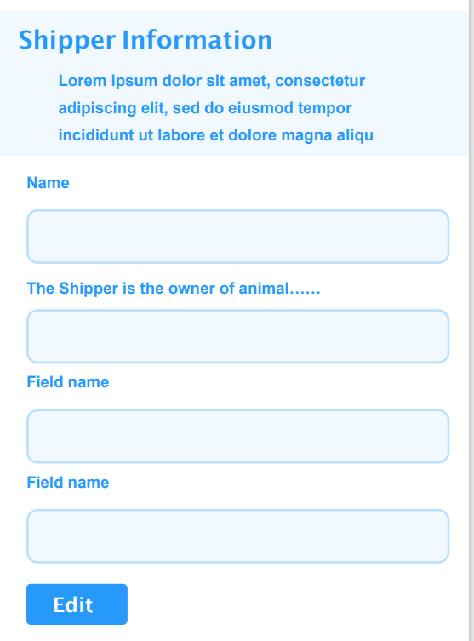
Sprint 8 So Far...
Feb 22, 2021 - Mar 8, 2021
Editing Screen
Database Communication
Login Screen

Slide 5

Project Status Description
and Project Issues (No Changes)
Our project status is greener.
The delays we’re experiencing are:
Still no transporter feedback.
We’ve decided to move on with the most approved design so far
Slowness as the semester picks up
Just need to continue the flow until delivery!

Slide 6
Application Demo

Slide 7
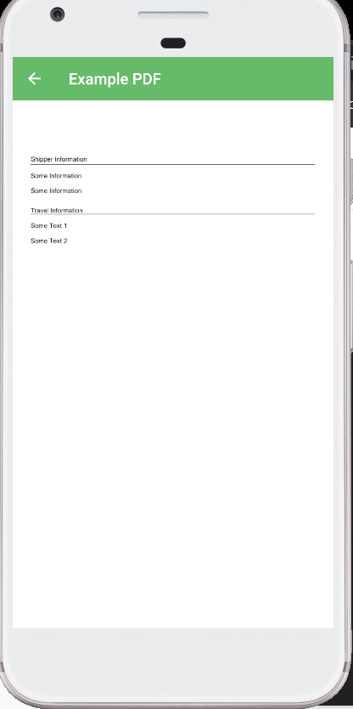
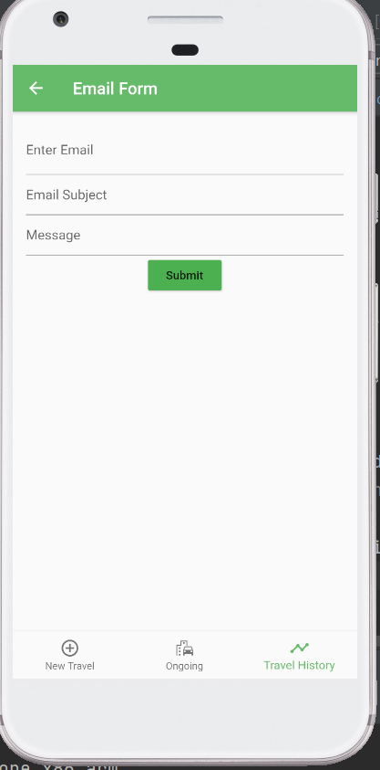
Sprint 9 Outlook
Starts Mar 8, 2021, ends Mar 22, 2021
This Sprint will consist of cleanup!
Adding the ability to use image acks
Bringing back PDF and email
Adding form validation
Our last Sprint focuses on:
Adding remaining useful features (search)
Making the GUI look like the prototypes
Cleanup of tests, etc.

Slide 8
Group Reflection
Open discussion for the meeting
Does the team feel "on track"?
What progress does the team particularly feel good about?
What barriers does the team feel is a current impediment to success?
What help does the team require to move positively forward?
Other questions or concerns?
?

Slide 9
Questions, Suggestions?

Slide 10
Image References
Agile Scrum Framework. https://www.scrum.org/resources/what-is-scrum
Stoplight. http://clipart-library.com/traffic-light-cliparts.html

