Slide 1
ENSE 477 Project Progress Vlog 4
Humane Transport
Clark Inocalla, Kelly Holtzman, Mansi Patel, Sana Khan
February 4, 2021

Slide 2
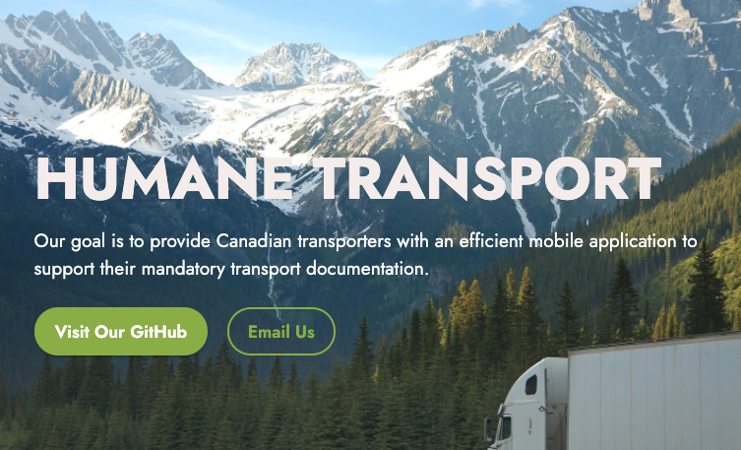
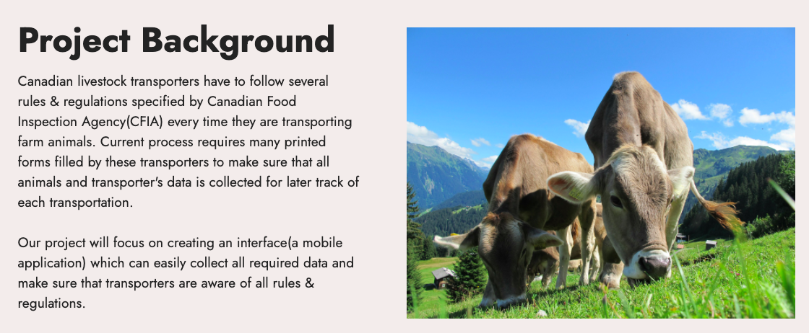

Slide 3
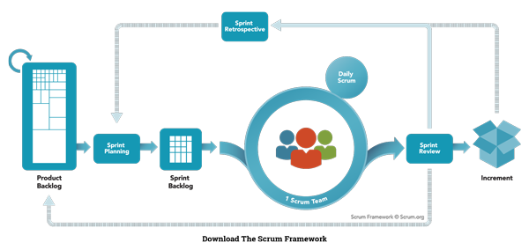
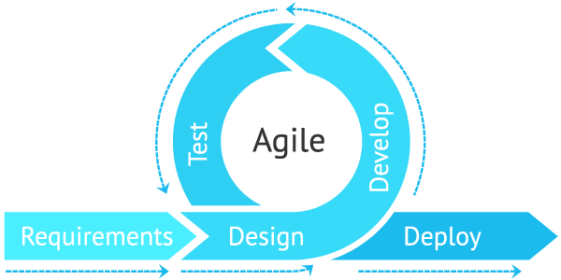
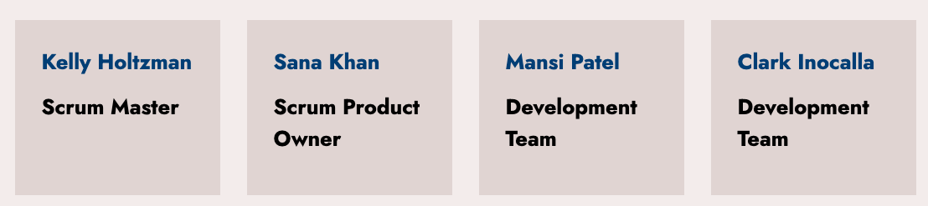
Agile Scrum Team Responsibilities

Slide 4
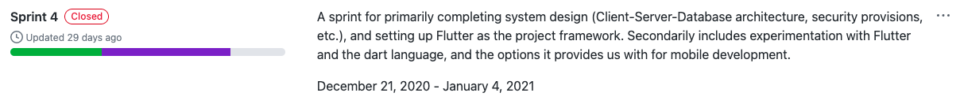
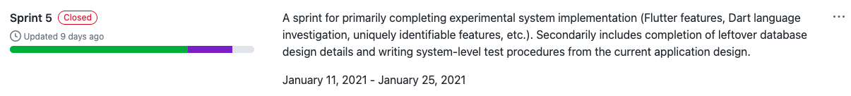
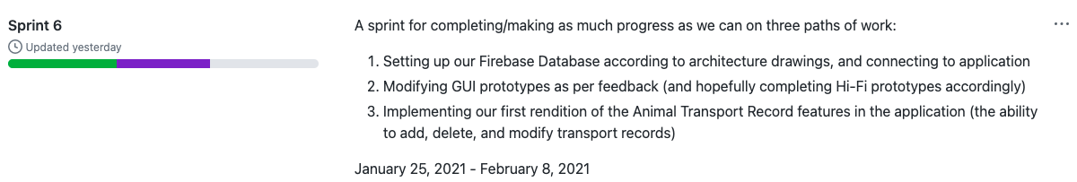
Sprints Overview
Since last progress vlog Dec 14, 2020

Slide 5

Project Status Description
and Project Issues (No Changes)
Our project status is green!
Sprint 6 and Sprint 7 are expected to overlap.
The only possible delays we expect are:
The continued delay of Transporter feedback on prototypes (due to slow business)
Slow to build database structure (we’ve expected this work to continue into Sprint 7)

Slide 6
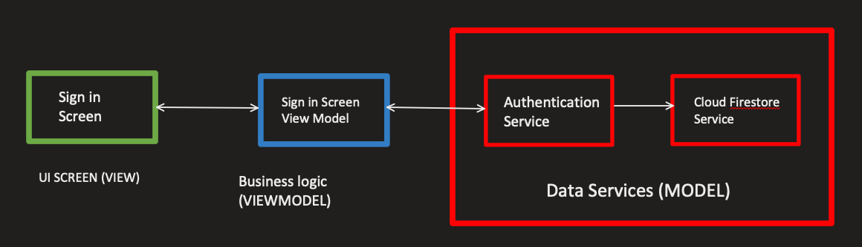
MVVM Architecture

Slide 7
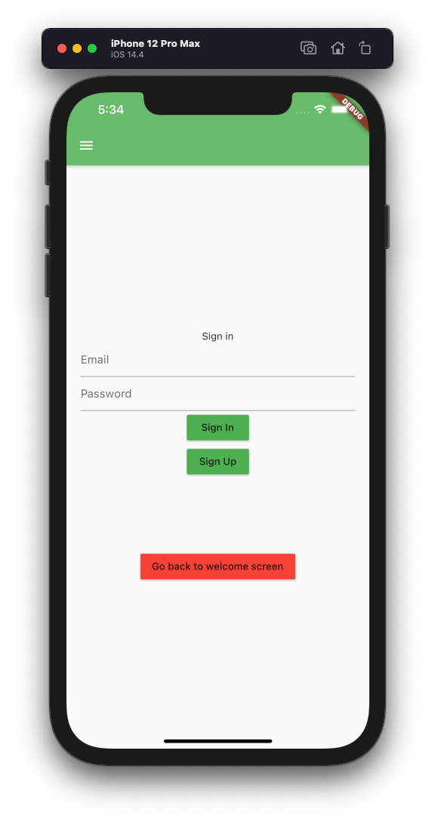
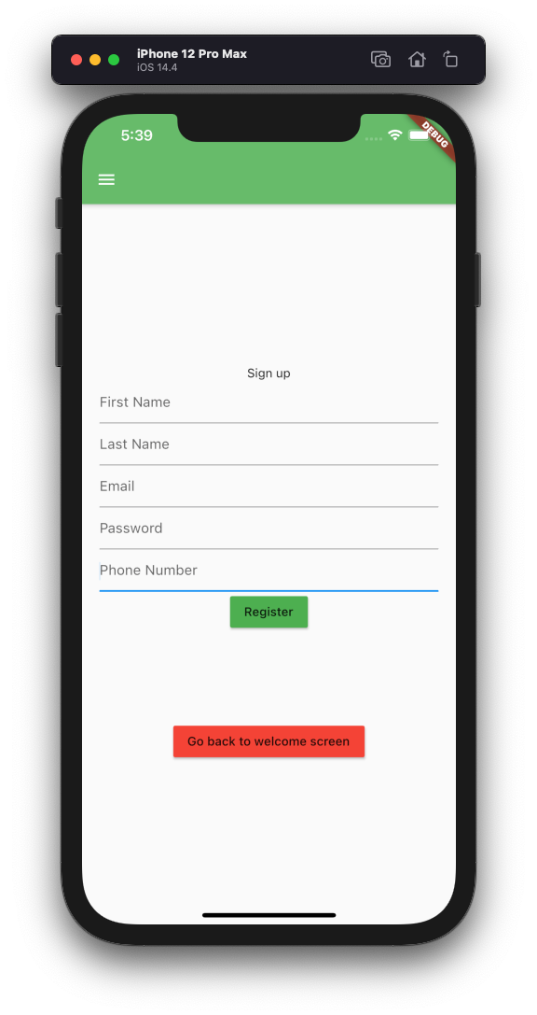
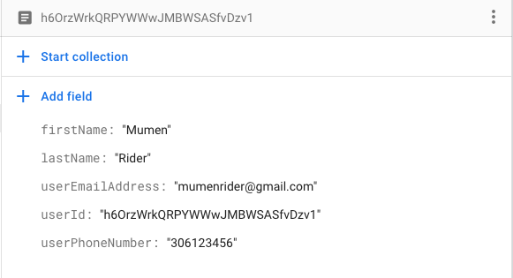
Firestore Experimentation

Slide 8
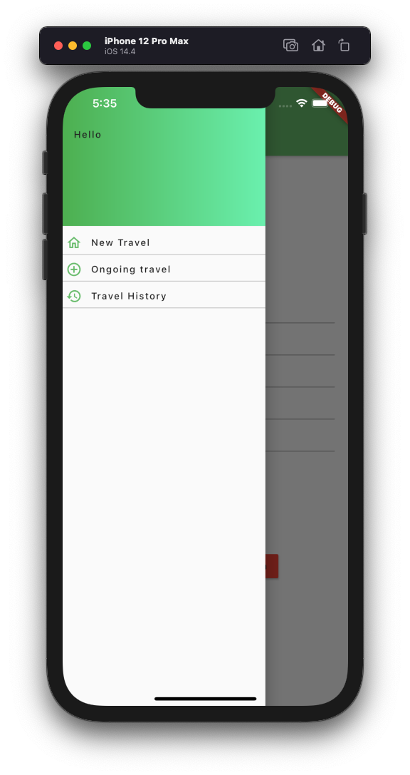

Navigation Interface

Slide 9
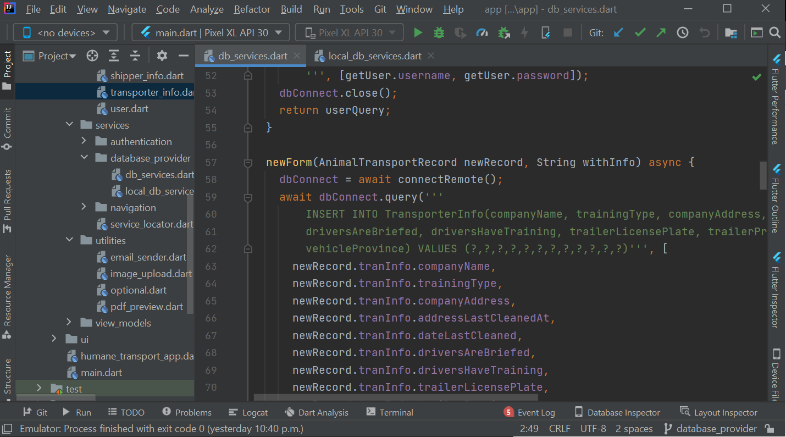
Database Interface
First draft of database interface focusing on sql
Functions will remain similar when making interface for other database providers like firestore
Uses plugin to ensure network connection and allow local database when no internet.

Slide 10

Generate PDF
File & Share
via Email
Feature
With these features, the Transporter can:
Can generate PDF file out of ATR data
Can able to send PDF file via Email

Slide 11
Upload Image
Feature
With this feature, the Transporter can:
Can able to upload their profile picture
Can able to capture image and upload it into the ATR form

Slide 12
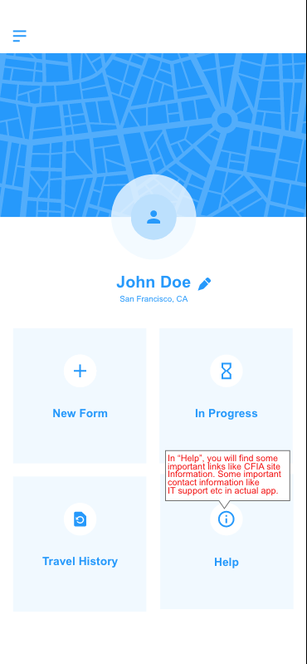
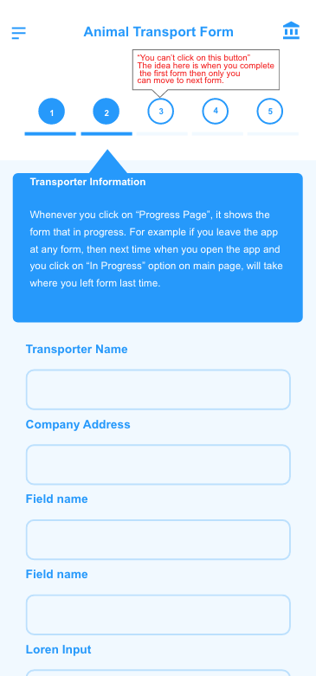
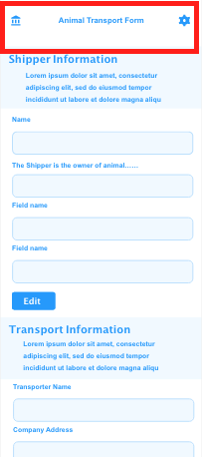
Refactoring our Mid-Fis into Hi-Fis
Refactoring Mid-Fis based on Feedbacks:
Added Tooltip for non clickable feature to guide transporter just for prototype testing purposes
Home button to left hand side instead of right hand

Slide 13
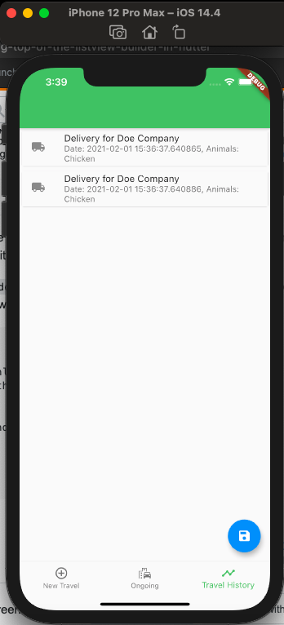
Animal Transport Record
History Screen
With this screen, the Transporter can:
See their completed records
Choose a record to see all of its information
They will eventually also:
Be able to search for particular records
Select records to email out
Not Final

Slide 14
History
Screen
Integration
Test
Our tests are: 1. Fully automated
2. Can be run without a phone
3. See our GitHub Wiki for more procedures

Slide 15
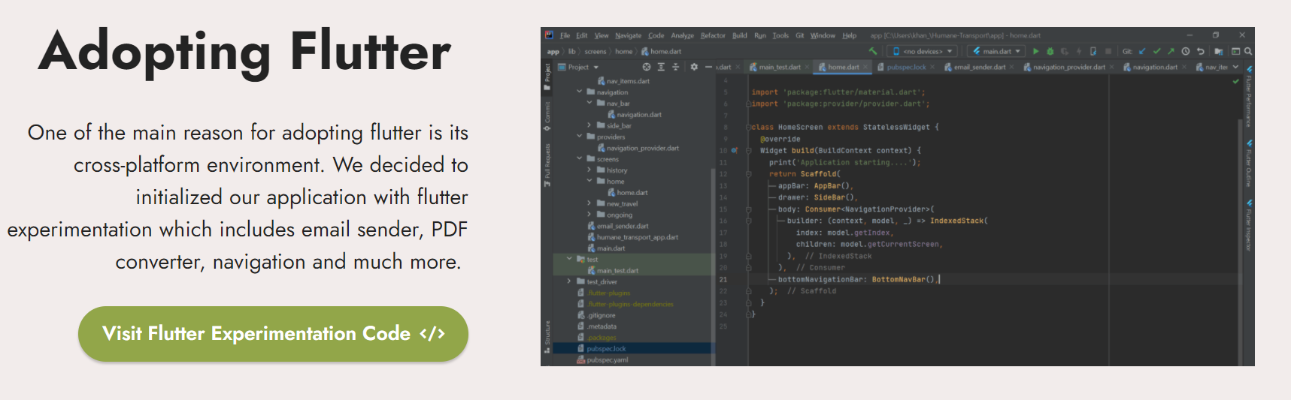

Website Update and Application Icon
App Icon under progress
Website update
more information on application code
client server architecture
upcoming updates and important dates to look out for

Slide 16
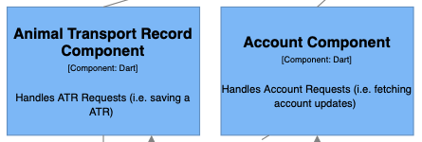
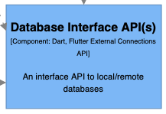
Sprint 7 Outlook
Starts Feb 8, 2021
This Sprint will consist of:
Completing ATR screens
Completing ATR features (like search)
Completing ATR and database integration
Completing Transporter account and database integration

Slide 17
Group Reflection
Open discussion for the meeting
Does the team feel "on track"?
What progress does the team particularly feel good about?
What barriers does the team feel is a current impediment to success?
What help does the team require to move positively forward?
Other questions or concerns?
?

Slide 18
Image References
Agile Scrum Framework. https://www.scrum.org/resources/what-is-scrum
Stoplight. http://clipart-library.com/traffic-light-cliparts.html

