Slide 1
ENSE 400 Project Progress Vlog
Humane Transport
Clark Inocalla, Kelly Holtzman, Mansi Patel, Sana Khan
October 19, 2020

Slide 2

Team Member Responsibilities
Clark Inocalla
Kelly
Holtzman
Mansi Patel
Sana
Khan

Slide 3


Project
Details
We’re designing and developing a proof-of-concept mobile application to replace present Canadian animal transportation records.
The existing manifests are in part controlled by the CFIA.
We’re not affiliated with nor endorsed by the CFIA.

Slide 4
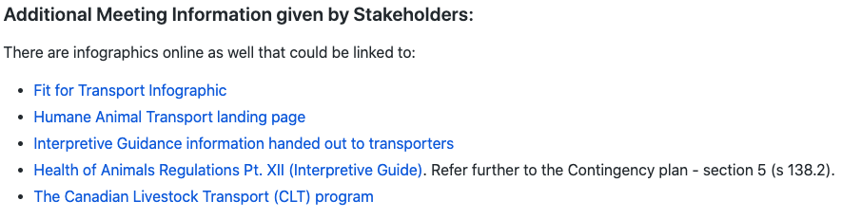
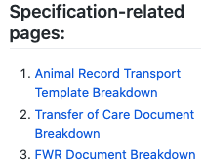
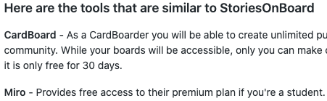
Sprint 1 Review
Ends Oct 26, 2020
Had a client meeting at start of Sprint...
… which turned into breaking down animal transport record regulations!
Investigated documentation and development tools for best first implementation

Slide 5
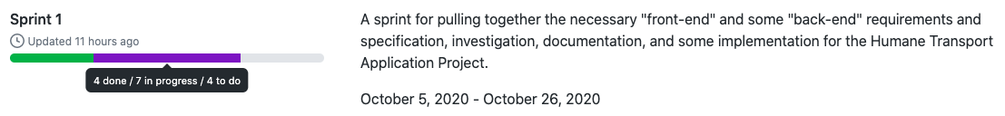
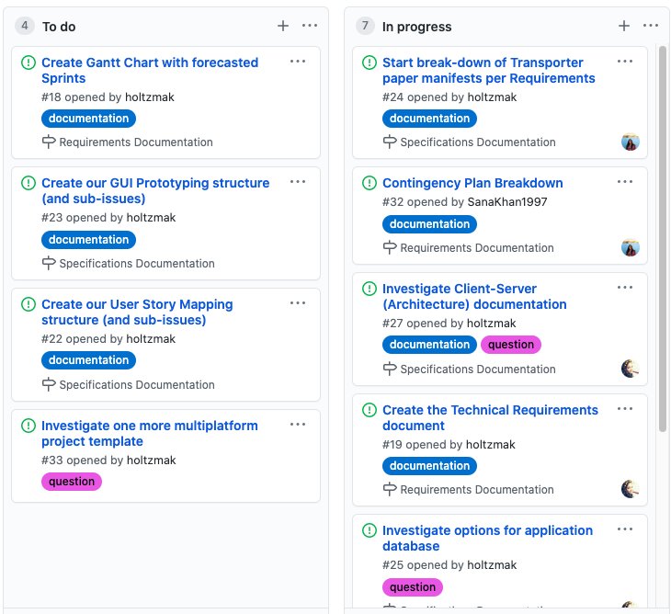
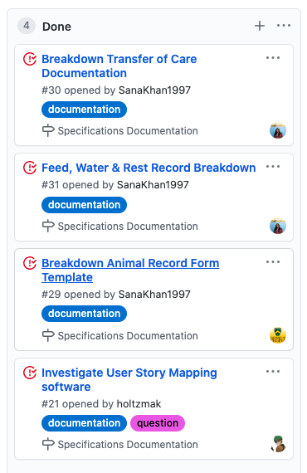
Sprint 1 Review
There are several ongoing investigations:
Database for mobile app
Final requirements gathering
Multiplatform Project base!

Slide 6
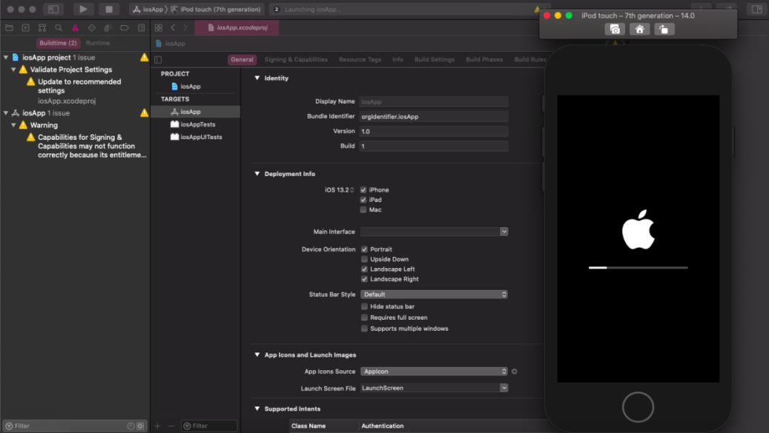
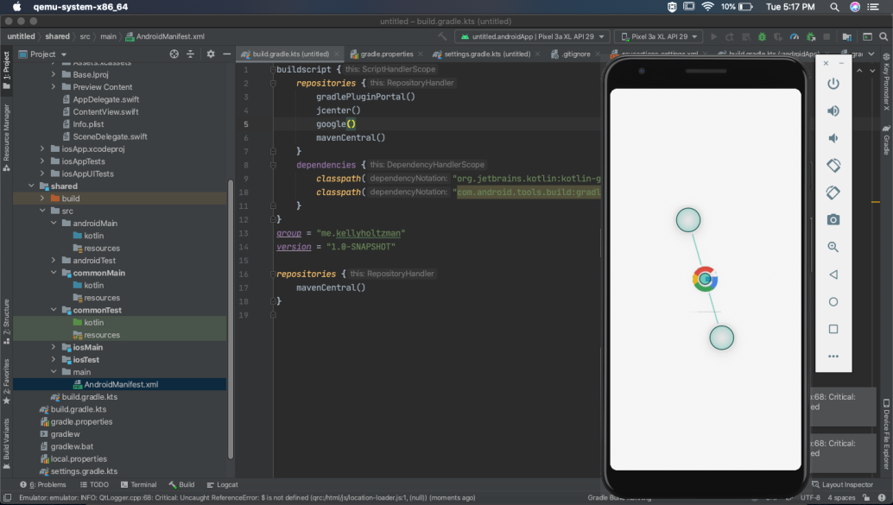
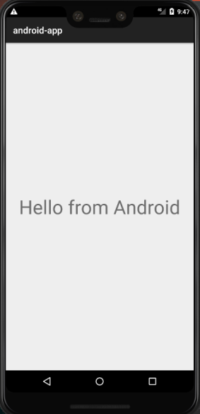
First steps towards Kotlin Multiplatform Mobile!
Achieves a basic app structure for both Android/iOS
Using IntelliJ and XCode IDEs in the images shown

Slide 7
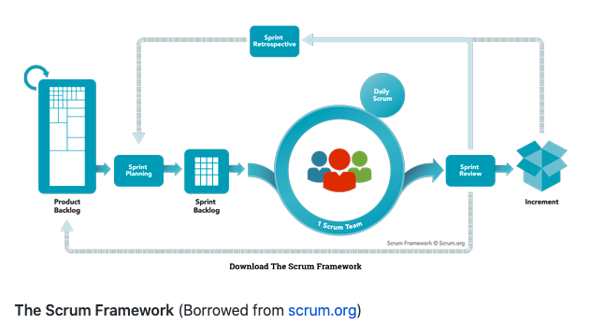
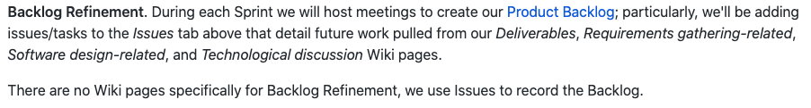
Future Sprints?
Start of Sprint 2+
We’ll be doing backlog refinement:
Steps towards GUI prototype, using USM
Prototype testing with the client
Investigating tools to help us develop what the client wants!
Foresee a backlog refinement in the next week or two, while working on completing Sprint 1

Slide 8
Group Reflection
Open discussion for the meeting
Does the team feel "on track"?
What progress does the team particularly feel good about?
What barriers does the team feel is a current impediment to success?
What help does the team require to move positively forward?
Other questions or concerns?
?

Slide 9
Image References
CFIA Livestock Transport infographic. https://www.inspection.gc.ca/animal-health/humane-transport/livestock-transport-in-canada/eng/1363748532198/1363748620219
Agile Scrum Framework. https://www.scrum.org/resources/what-is-scrum
Sprint 1 image captures dated October 16, 2020. https://github.com/holtzmak/Humane-Transport/projects/2

