Slide 1
ENSE 477 Project Bazaar Day 1
Humane Transport
Clark Inocalla, Kelly Holtzman, Mansi Patel, Sana Khan
February 25, 2021

Slide 2

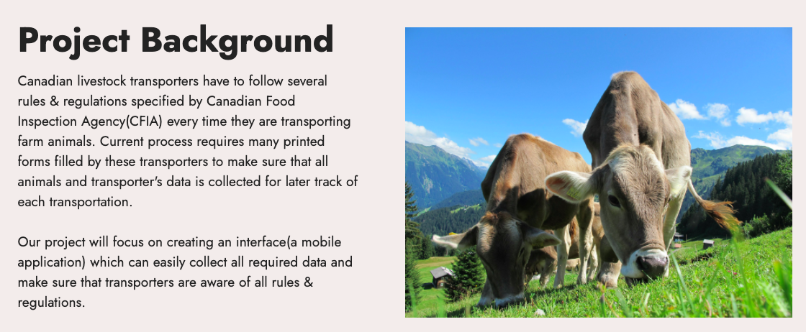

Slide 3
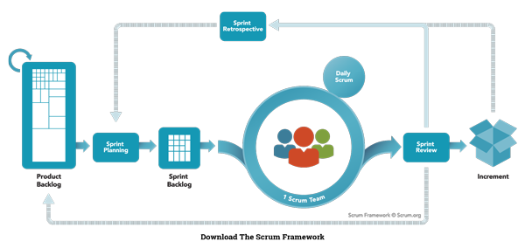
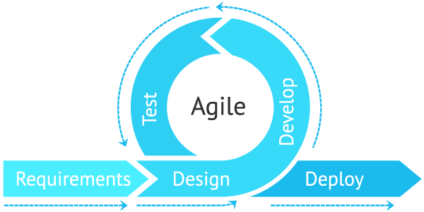
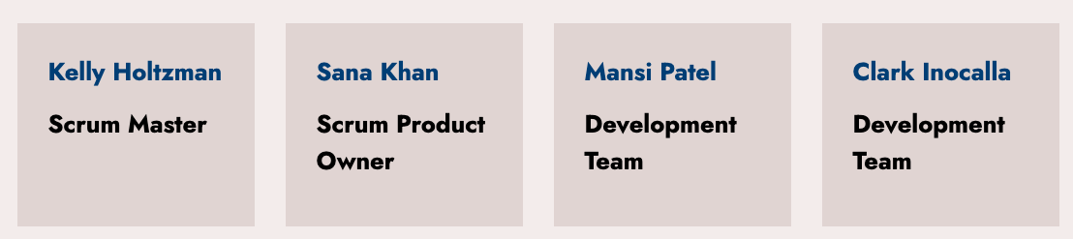
Agile Scrum Team Responsibilities

Slide 4
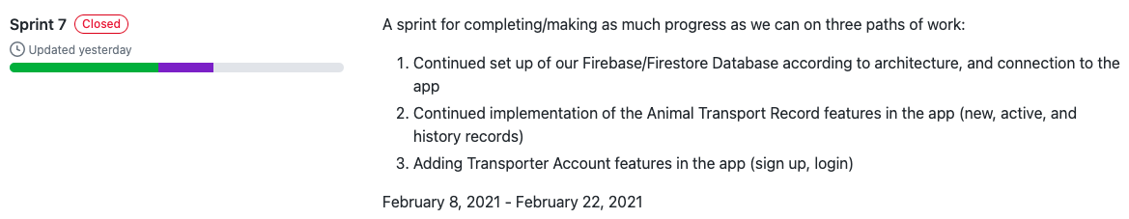
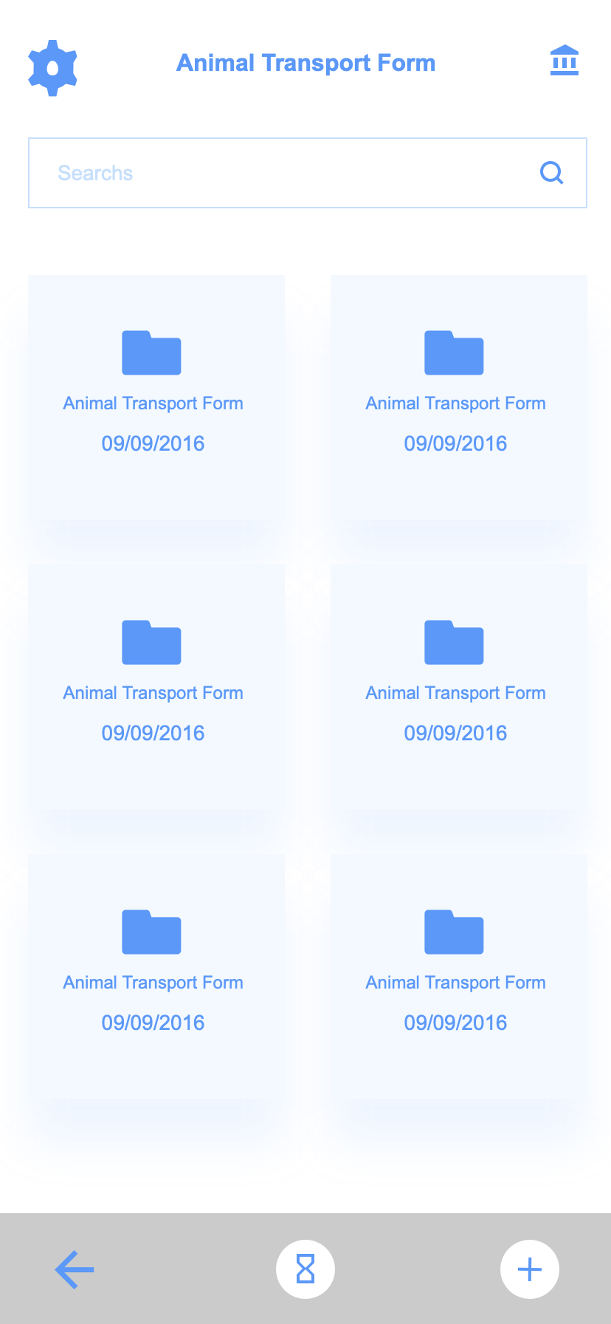
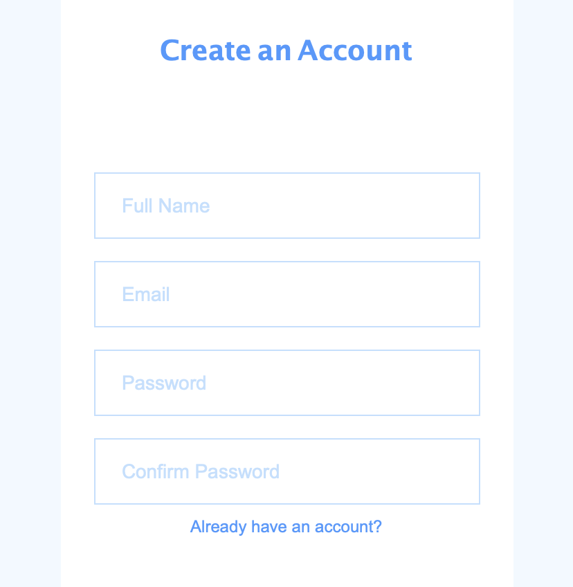
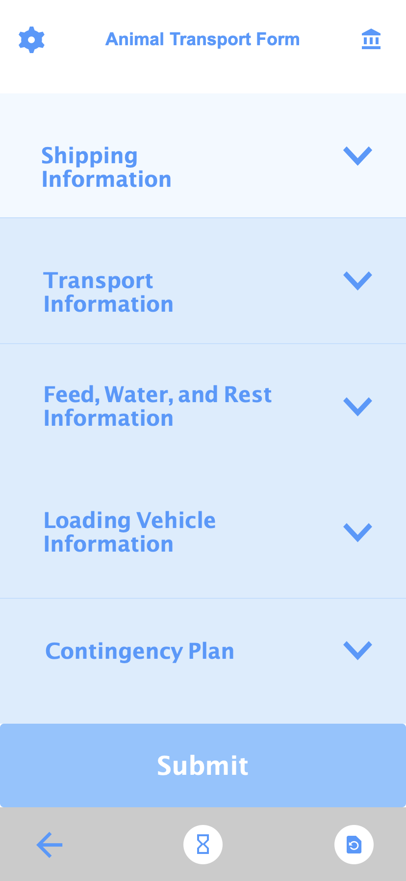
Sprint 7 Overview
Feb 8, 2021 - Feb 22, 2021
Sign-In Screen
Animal Transport Form Screens
Database Config

Slide 5

Project Status Description
and Project Issues (No Changes)
Our project status is green-yellow.
The delays we’re experiencing are:
The continued delay of Transporter feedback on prototypes (due to slow business)
Slowness as the semester picks up
Slowness due to learning curve of more complex programming concepts

Slide 6
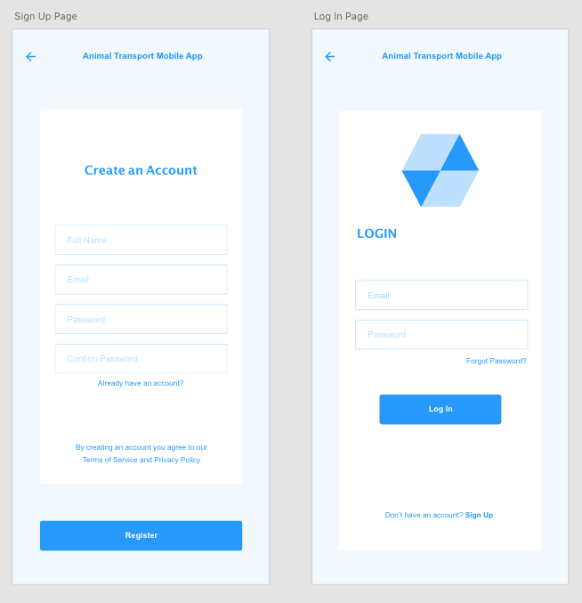

Signup and Login Screens Demo
From our prototypes
to implementation

Slide 7
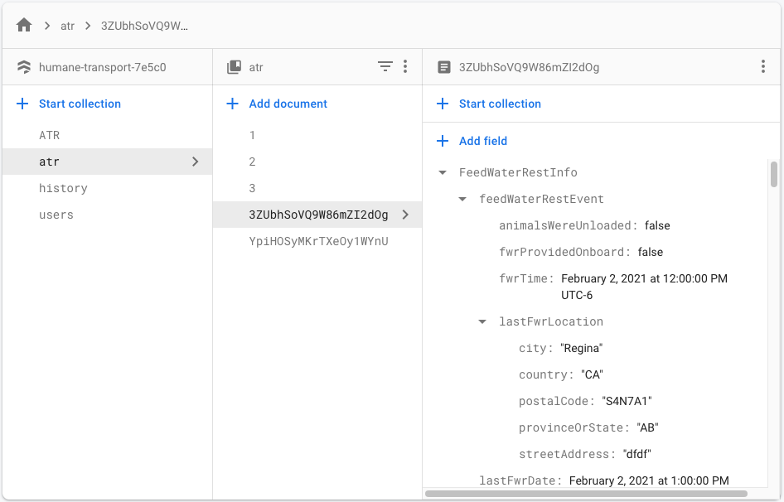
Database Interface Demo
Demo Link:
https://youtu.be/Vhsj-HXmsc4

Slide 8
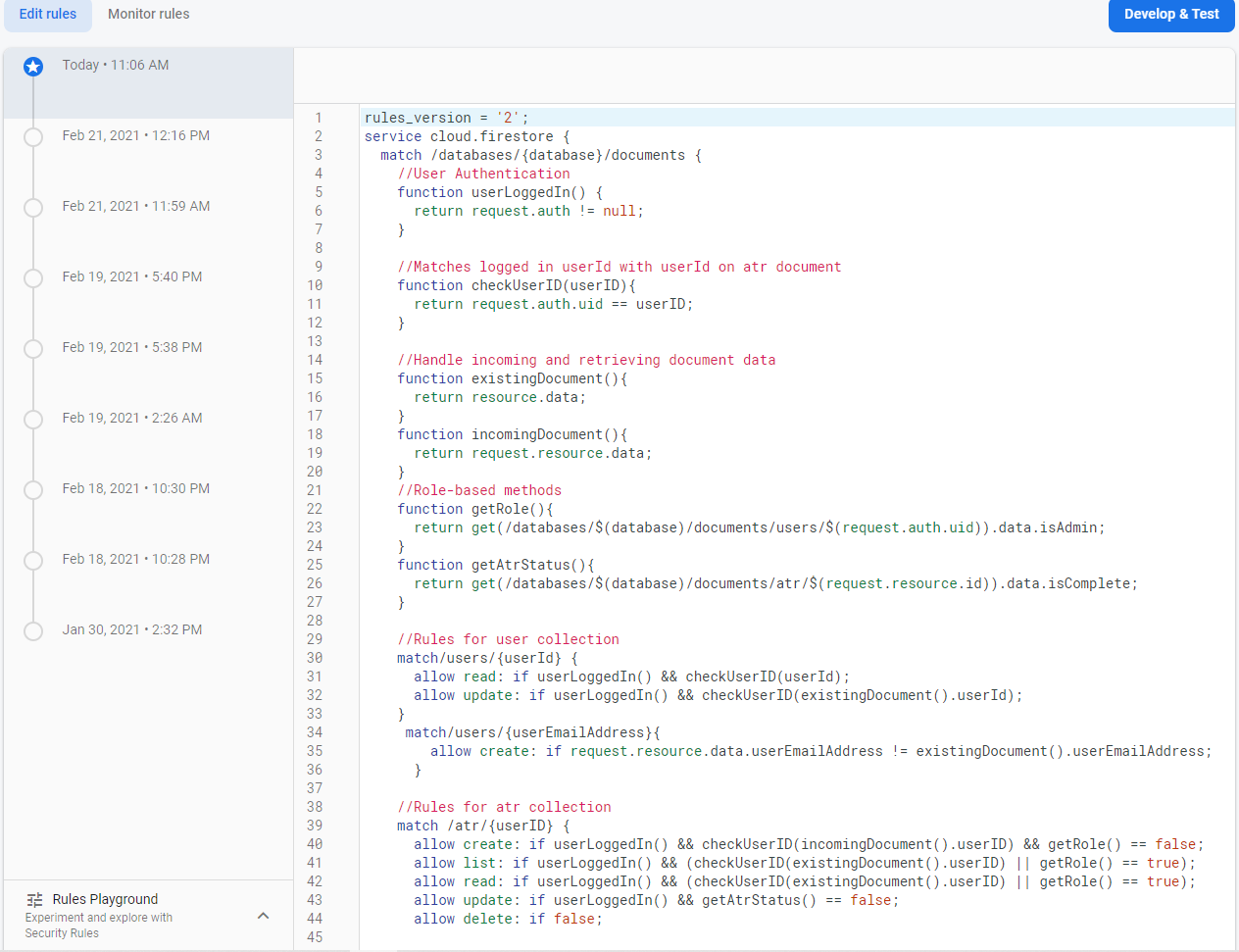
Database Security Rules and Demo
Demo Link
https://youtu.be/9rN6Dky0f2g

Slide 9
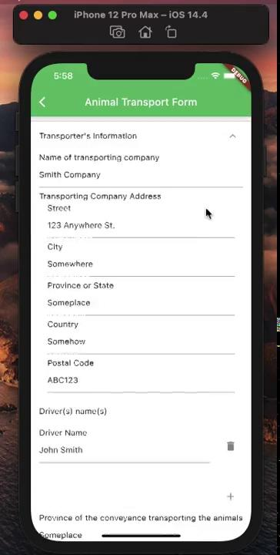
Animal Transport Record Screens Demo
From our prototypes
to implementation

Slide 10
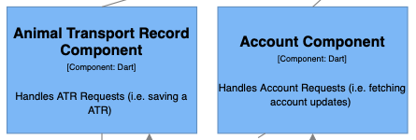
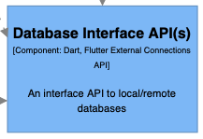
Sprint 8 Outlook
Started Feb 22, 2021, ends Mar 8, 2021
This Sprint will consist of:
Completing Account screens
Completing ATR Editing screen
Completion of the Database Interface
Create Login Persistence
Our last few Sprints focus on:
Adding remaining useful features (like search)
Making the GUI look like the prototypes
Cleanup of tests, etc.

Slide 11
Group Reflection
Open discussion for the meeting
Does the team feel "on track"?
What progress does the team particularly feel good about?
What barriers does the team feel is a current impediment to success?
What help does the team require to move positively forward?
Other questions or concerns?
?

Slide 12
Questions, Suggestions?

Slide 13
Image References
Agile Scrum Framework. https://www.scrum.org/resources/what-is-scrum
Stoplight. http://clipart-library.com/traffic-light-cliparts.html

