Slide 1
ENSE 477 Bi-Weekly Scrum Report-Out
Humane Transport
Clark Inocalla, Kelly Holtzman, Mansi Patel, Sana Khan
January 21, 2020

Slide 2



Slide 3
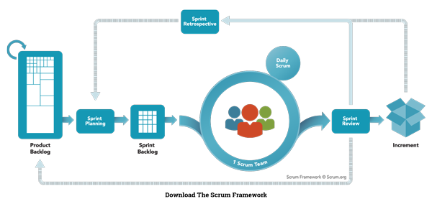
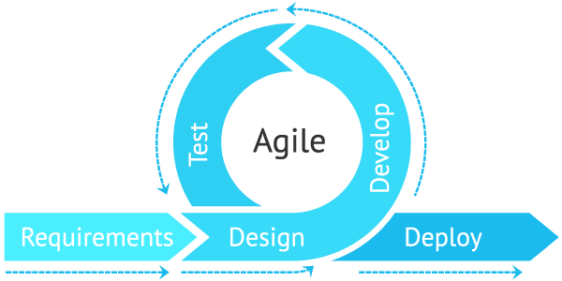
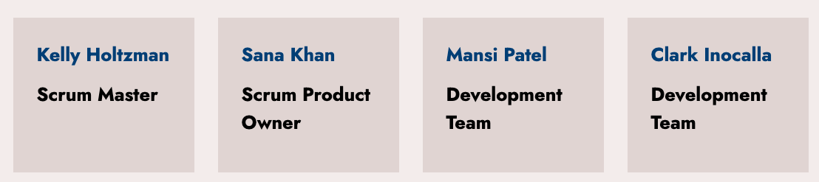
Agile Scrum Team Responsibilities

Slide 4
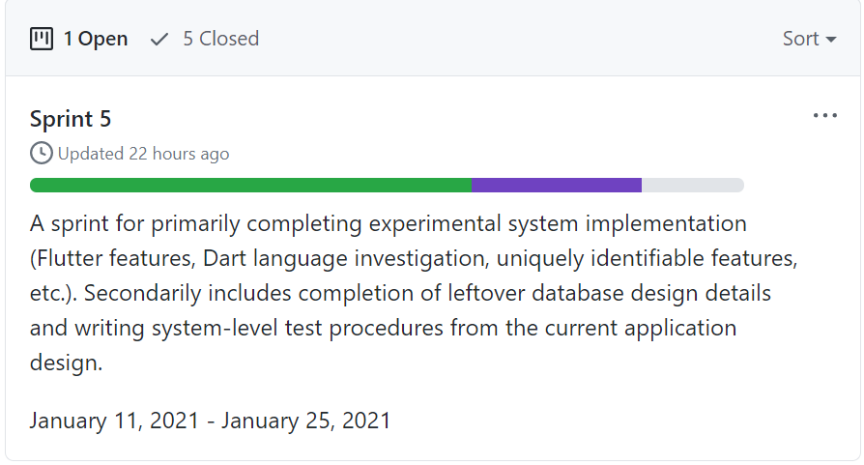
Progress since Sprint 3
Flutter Setup on GitHub
Project Experimentation Code
Testing Setup
Firebase Research
Role based access and security provision

Slide 5
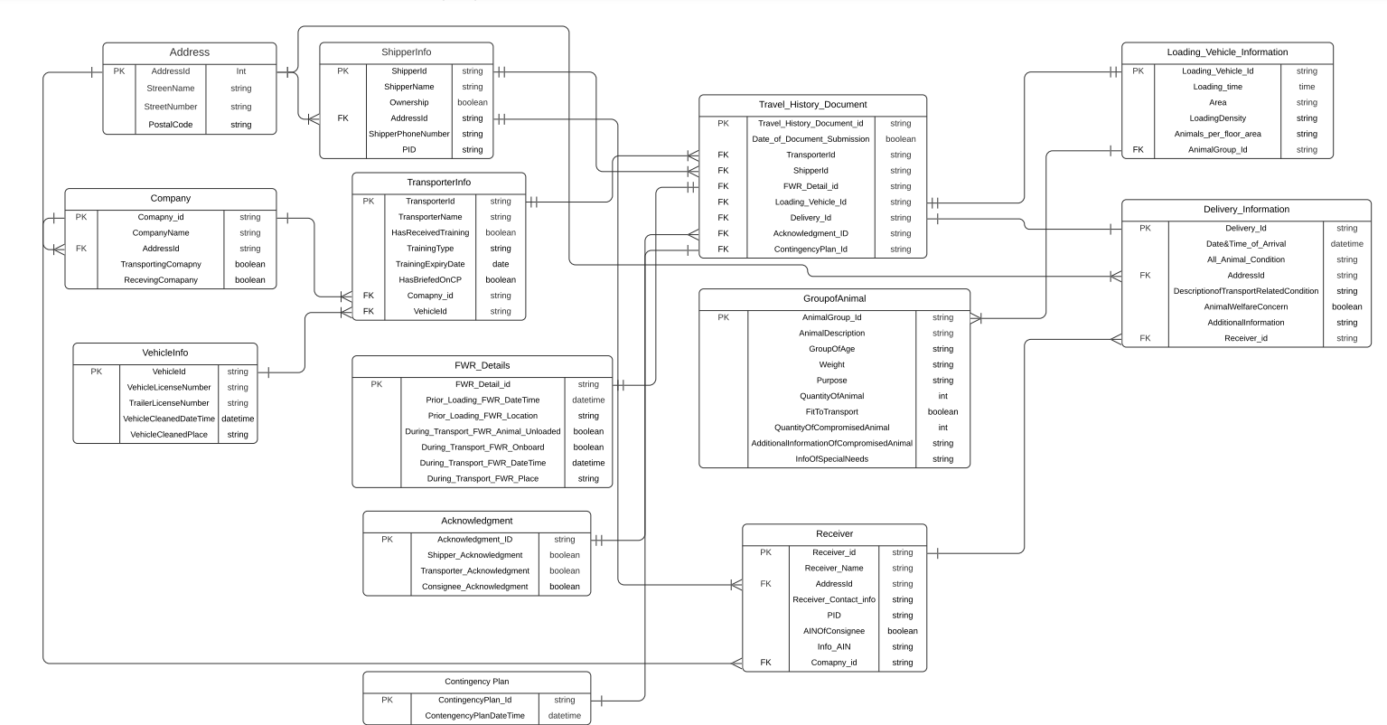
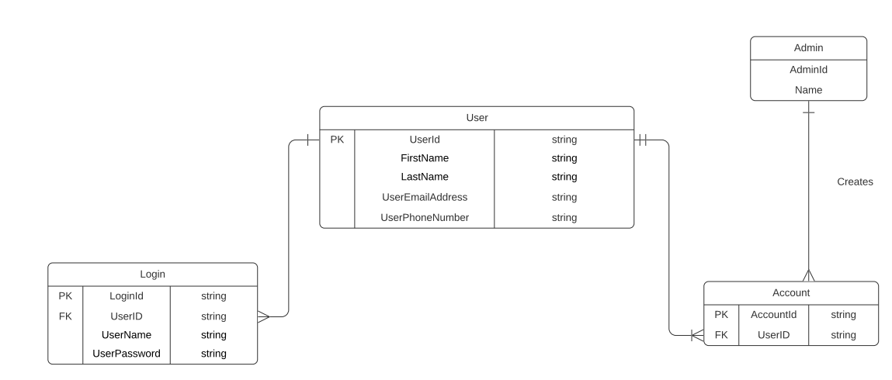
Database Design Documentation
Animal Transport Record System ER Diagram
Data Models
Transporter Login ER Diagram

Slide 6
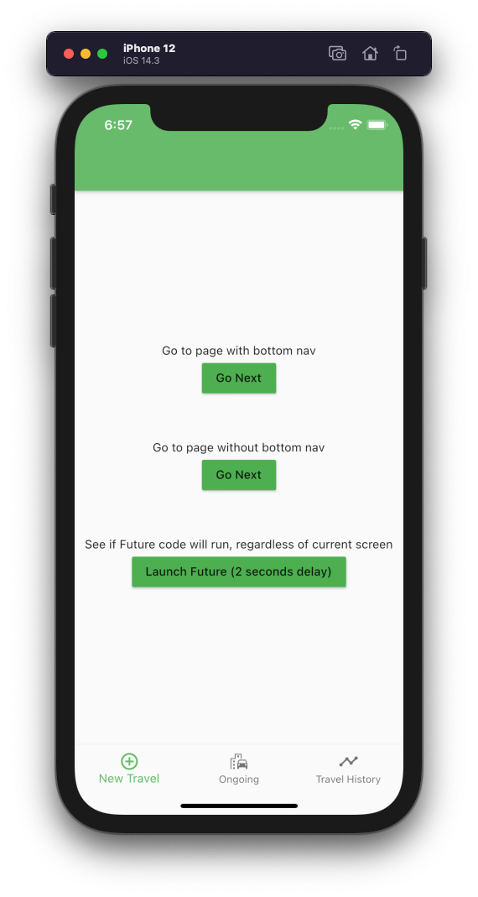
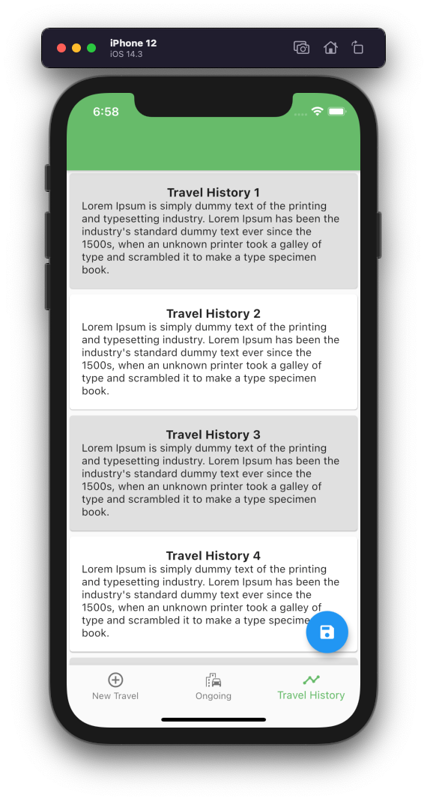
Flutter GUI Experimentation
Explored the following:
Widgets available to us
Customize Widgets
Navigation and Routing
Demo at the end!

Slide 7
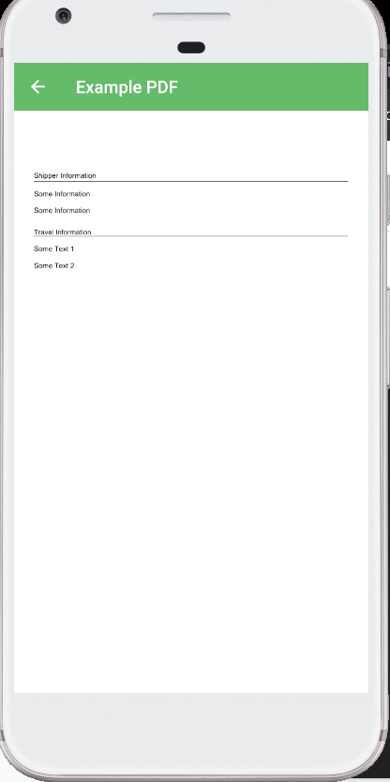
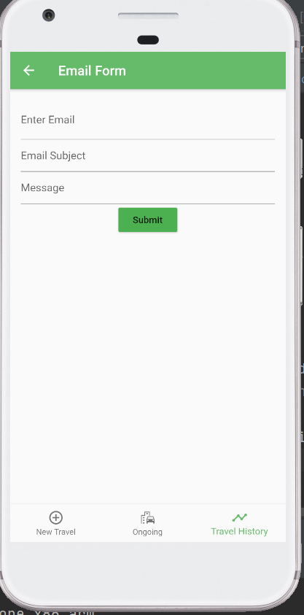
Flutter Email and PDF Experimentation
PDF converter to generate PDF copy of ATR form
Email Sender to send form receipt to receivers and CFIA Inspectors

Slide 8

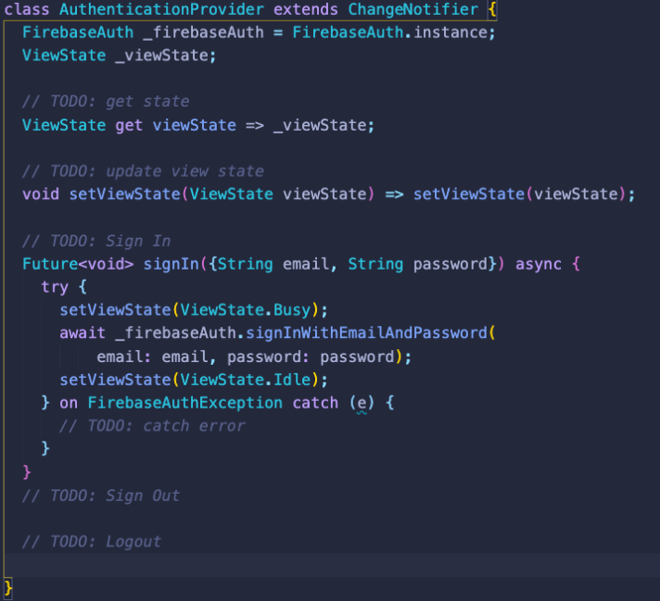
Flutter and Firebase Integration
Initially planned to use AWS cloud services but it requires AWS Flutter Amplify (Still in Developer Review)
Major Benefits
Firebase databases are optimize for offline (When no network available)
To secure data, it allows the security rules
We have already started setting up Firebase in our project!

Slide 9
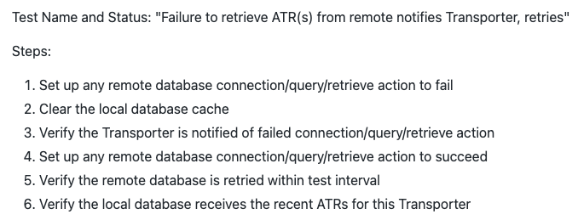
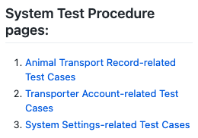
System Test Cases and Implementation
We’ve written system-level tests with expectations for Animal Transport Records, Transporter Accounts, and App Settings

Slide 10
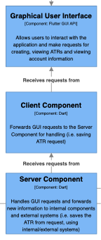


Sprint 6 Outlook
Next Sprint, we’ll be doing:
Hi-Fis based on prototype feedback
Completing setup of our database(s)
(already in progress!)
Implementing our first MVP - Animal Transport Records
(those labelled ATR in architecture drawings)

Slide 11
Group Reflection
Does the team feel "on track"?
What progress does the team particularly feel good about?
What barriers does the team feel is a current impediment to success?
What help does the team require to move positively forward?
Other questions or concerns?
?

Slide 12
Experimentation Demo

Slide 13
Image References
Agile Scrum Framework. https://www.scrum.org/resources/what-is-scrum
Flutter & Firebase Symbol. https://levelup.gitconnected.com/firebase-authentication-and-keeping-users-logged-in-with-provider-in-flutter-f1c66cdb1bc7

