Slide 1
ENSE 400 Bi-Weekly Scrum Report-Out
Humane Transport https://sanakhan1997.github.io/Capstone-Project/
Clark Inocalla, Kelly Holtzman, Mansi Patel, Sana Khan
September 28, 2020

Slide 2

Project
Details
We’re designing and developing a proof-of-concept mobile application to replace present Canadian animal transportation manifests.
The existing manifests are in part controlled by the Canadian Food Inspection Agency (CFIA).
We’re not affiliated with nor endorsed by the CFIA.

Slide 3
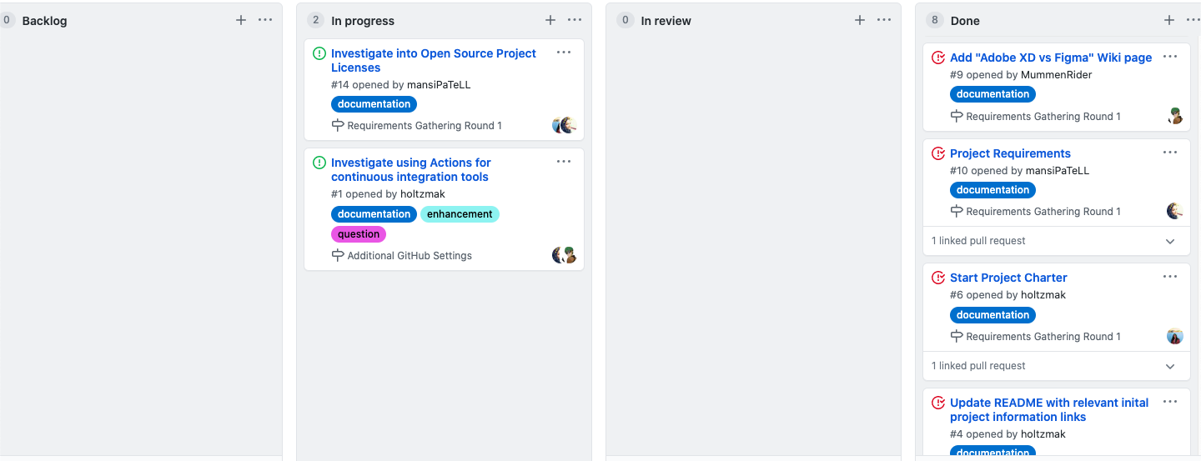
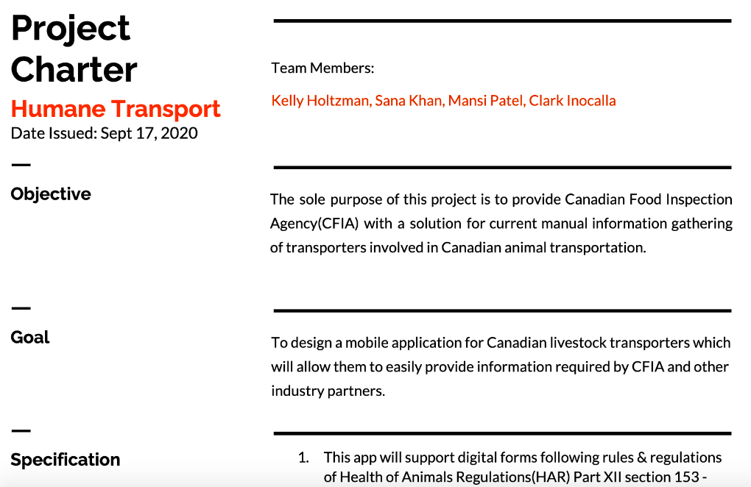
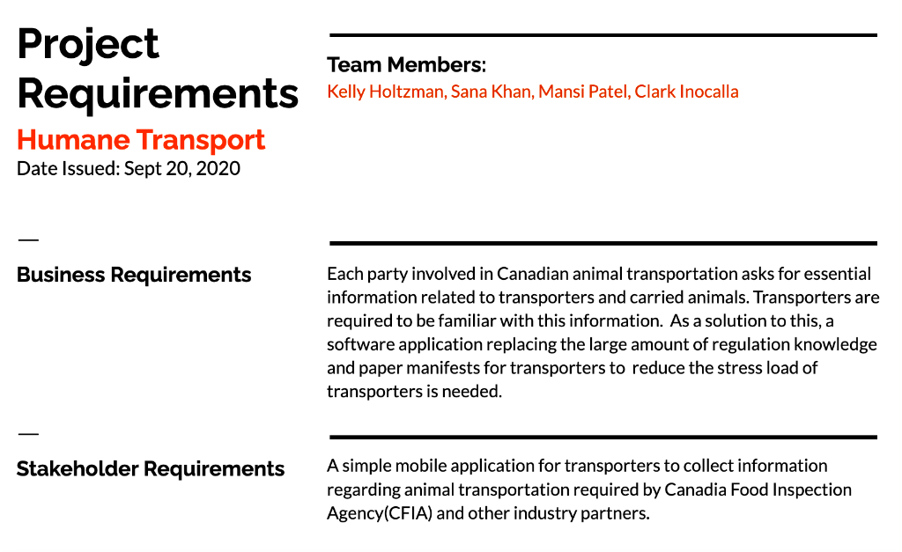
Project
Documentation
Review
End of Sprint 0
Sprint 0 ends September 29, 2020
We’ve begun initial
Project Requirements documentation

Slide 4
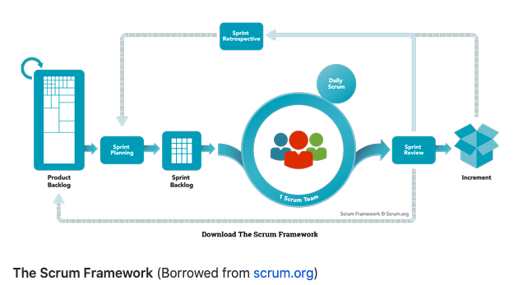
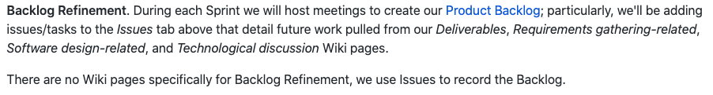
Project
Documentation
Review
Start of Sprint 1
We’ll be needing backlog refinement:
Further initial documentation
Front-end/GUI Requirements/Prototyping
Back-end/Server Requirements
Possibly 1 week refinement, 3 week Sprint for Sprint 1

Slide 5
Group Reflection
Open discussion for the meeting
Do we feel we are on track?
Do we feel there are barriers to our success (if any)?
Do we need any help going forward?
Any other questions or concerns?
?

