Slide 1
ENSE 400 Project Progress Vlog 2
Humane Transport
Clark Inocalla, Kelly Holtzman, Mansi Patel, Sana Khan
November 16, 2020

Slide 2

Team Member Responsibilities
Clark Inocalla
Kelly
Holtzman
Mansi Patel
Sana
Khan

Slide 3


Project
Details
We’re designing and developing a proof-of-concept mobile application to replace present Canadian animal transportation records.
The existing manifests are in part controlled by the CFIA.
We’re not affiliated with nor endorsed by the CFIA.

Slide 4
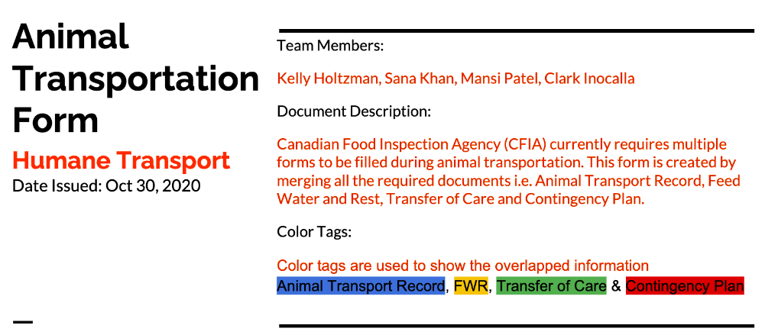
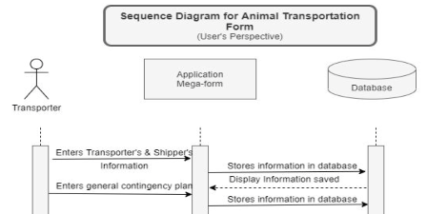
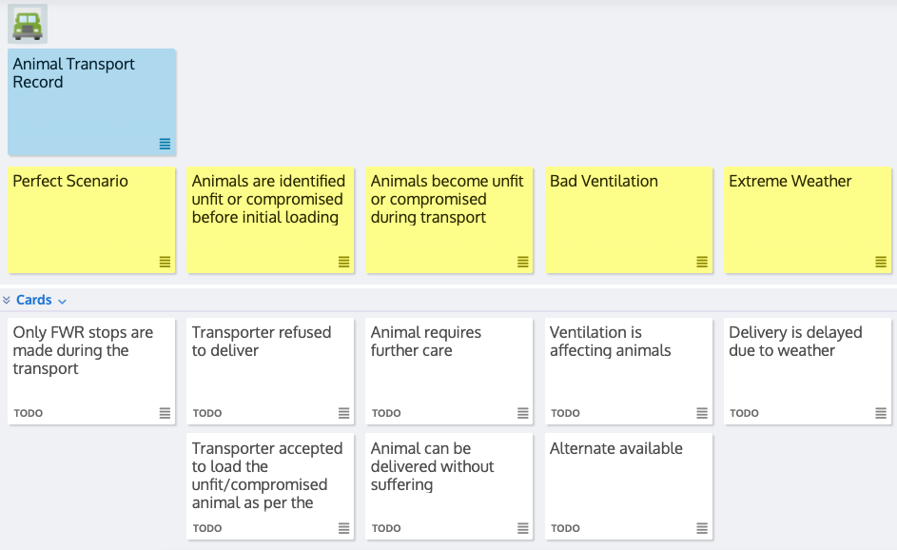
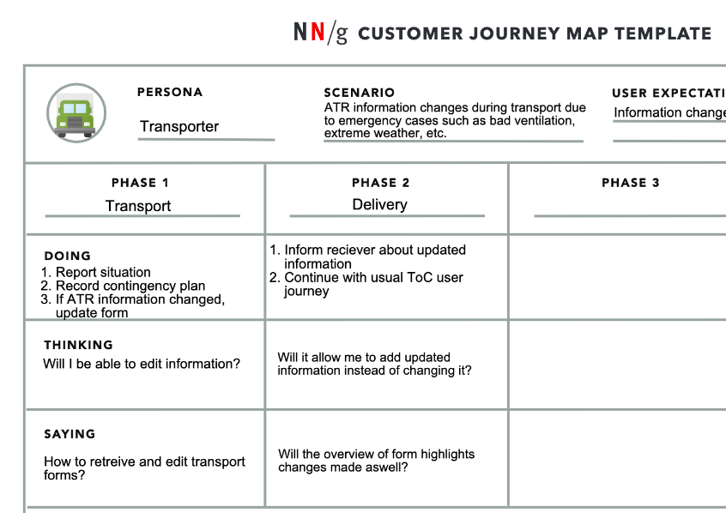
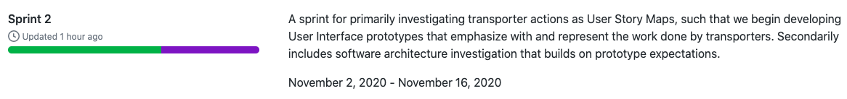
Sprint 2 Overview
Ends Nov 16, 2020
The team pushed forwards to GUI prototyping and testing (front-end design)
Continued back-end design investigation

Slide 5
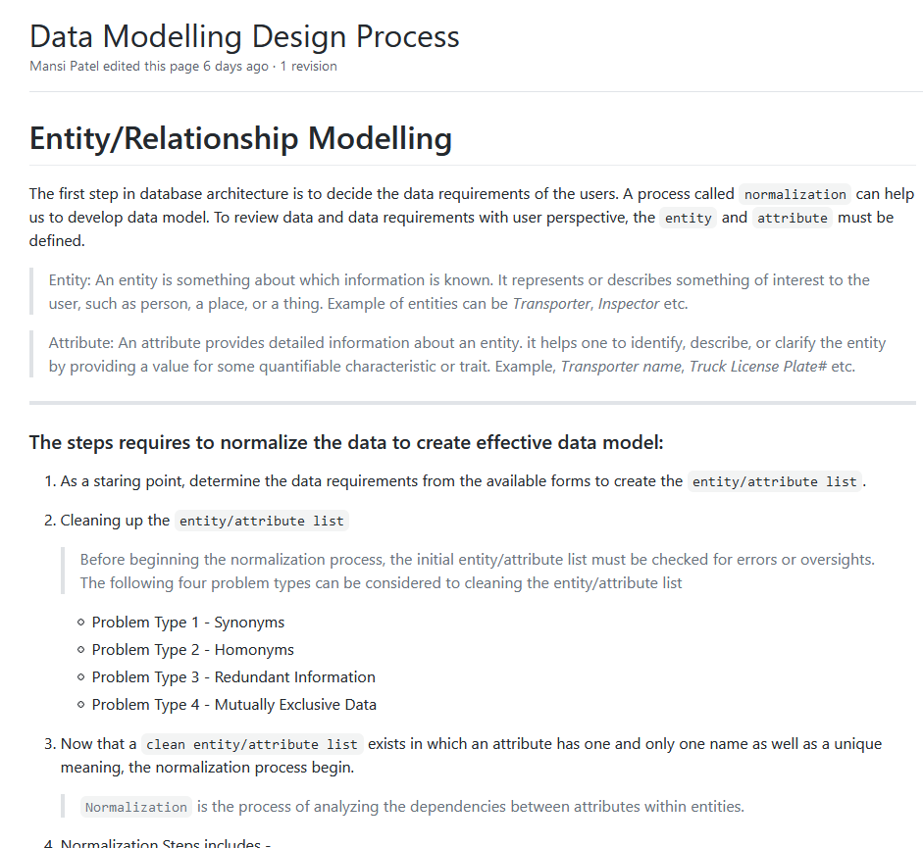
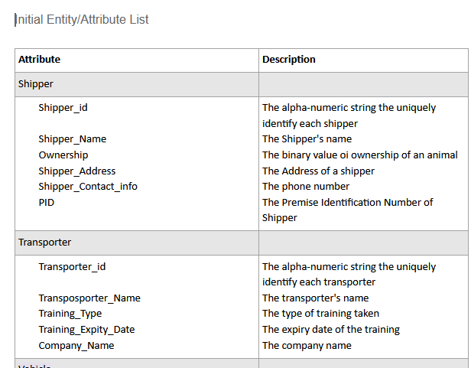
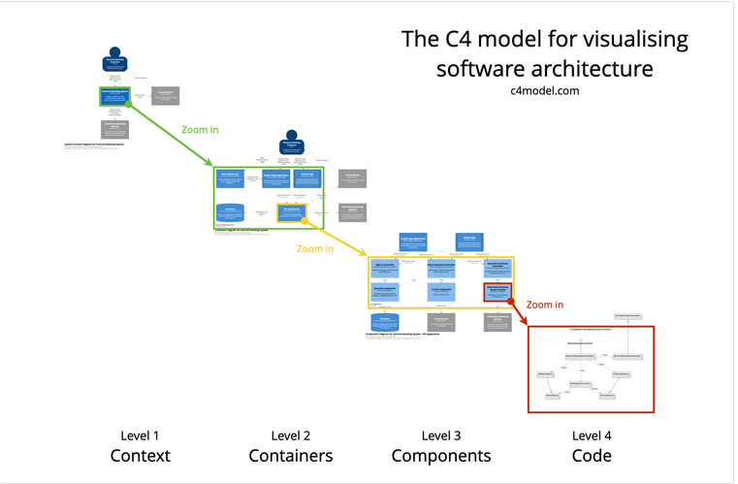
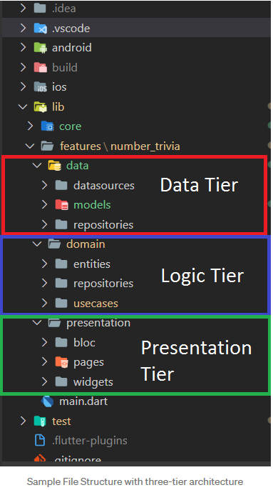
Client-Server & Database-Server Architecture Documentation
Client-Server
Database Architecture
3-tier Database Architecture includes:
Presentation tier
Application Tier
Data Tier

Slide 6
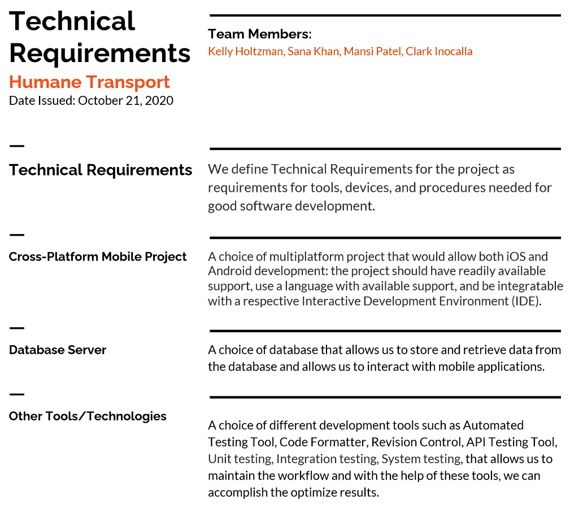
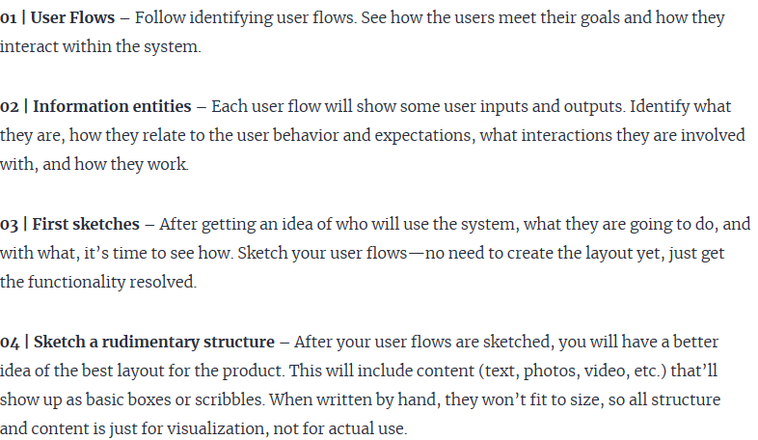
Technical Requirement Document / GUI Prototyping/Testing Structure
Things to consider before creating Prototype:

Slide 7

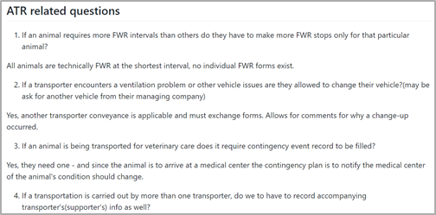
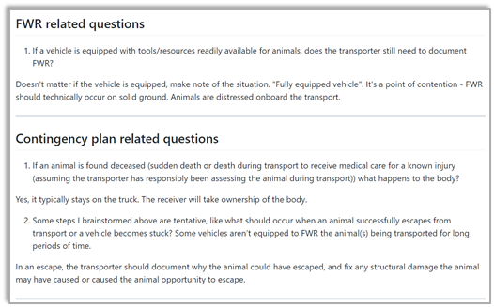
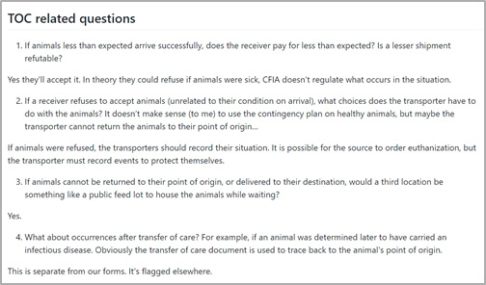
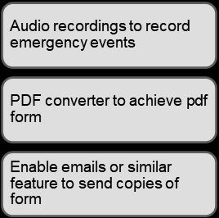
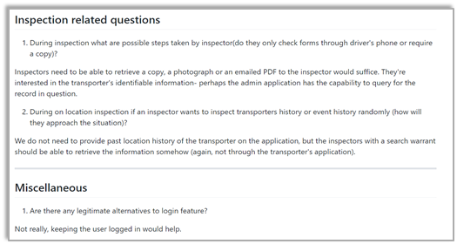
Discussion with Client and Future MVPs
Wiki Page Link

Slide 8
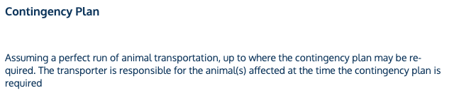
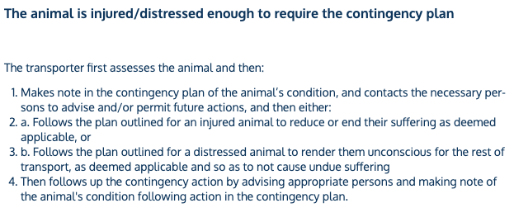
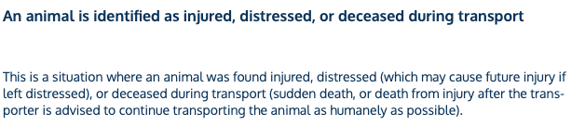
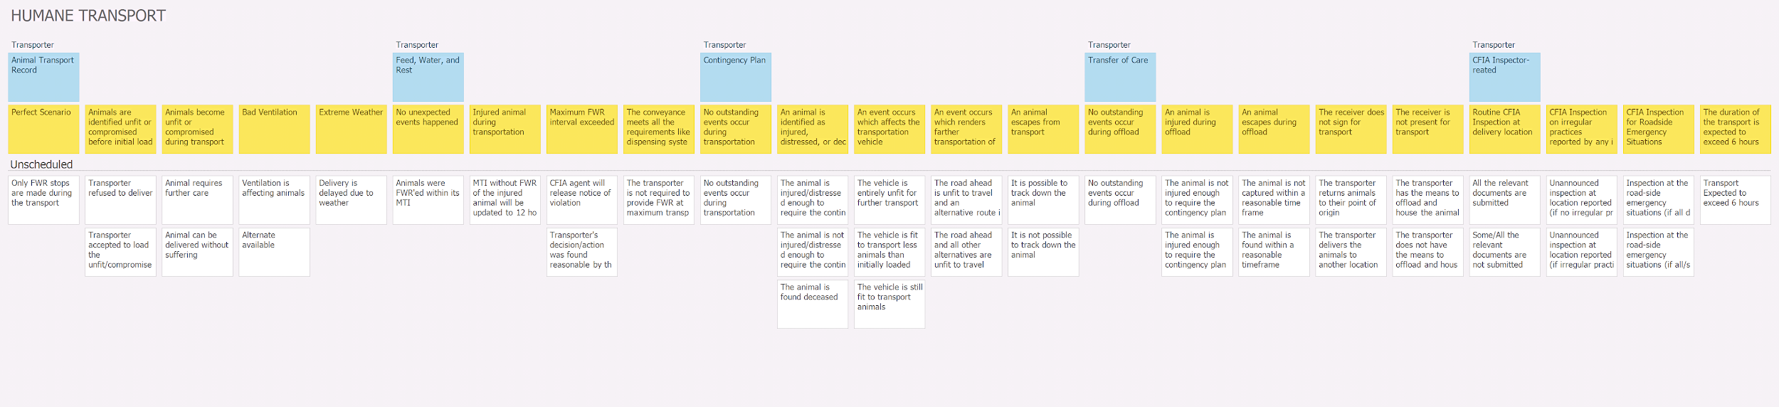
User Story Mapping towards GUI Prototypes
Epics
Steps
Stories
We investigated events in the Animal Transport Record, Feed, Water, and Rest, Contingency Plan, Transfer of Care, and outstanding occurrences

Slide 9
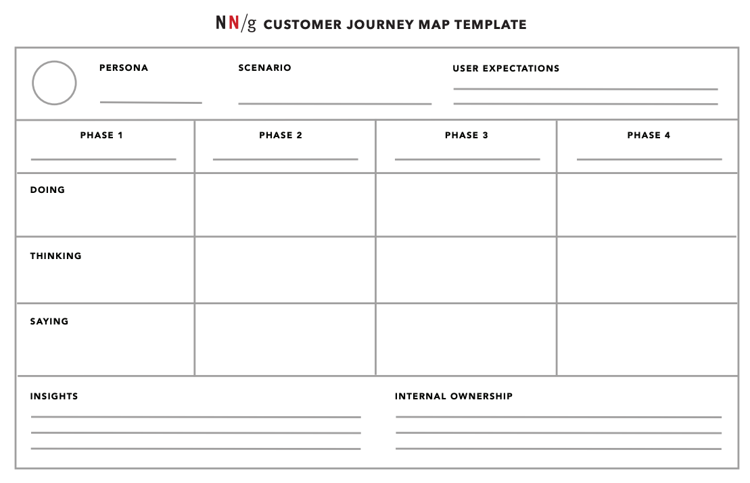
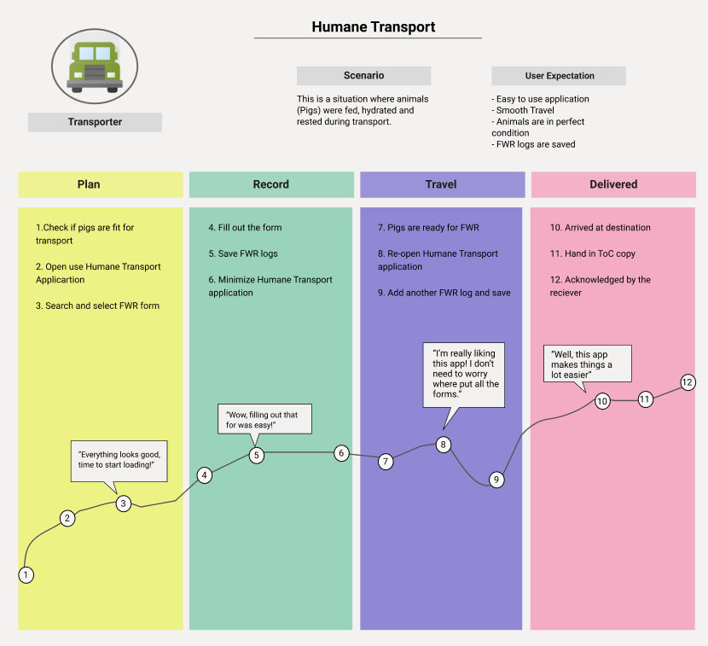
User Journey Mapping towards GUI Prototypes
Why is UJM important? It is a strategic approach to a better understanding customer’s expectations
and a key for better User Experience.

Slide 10
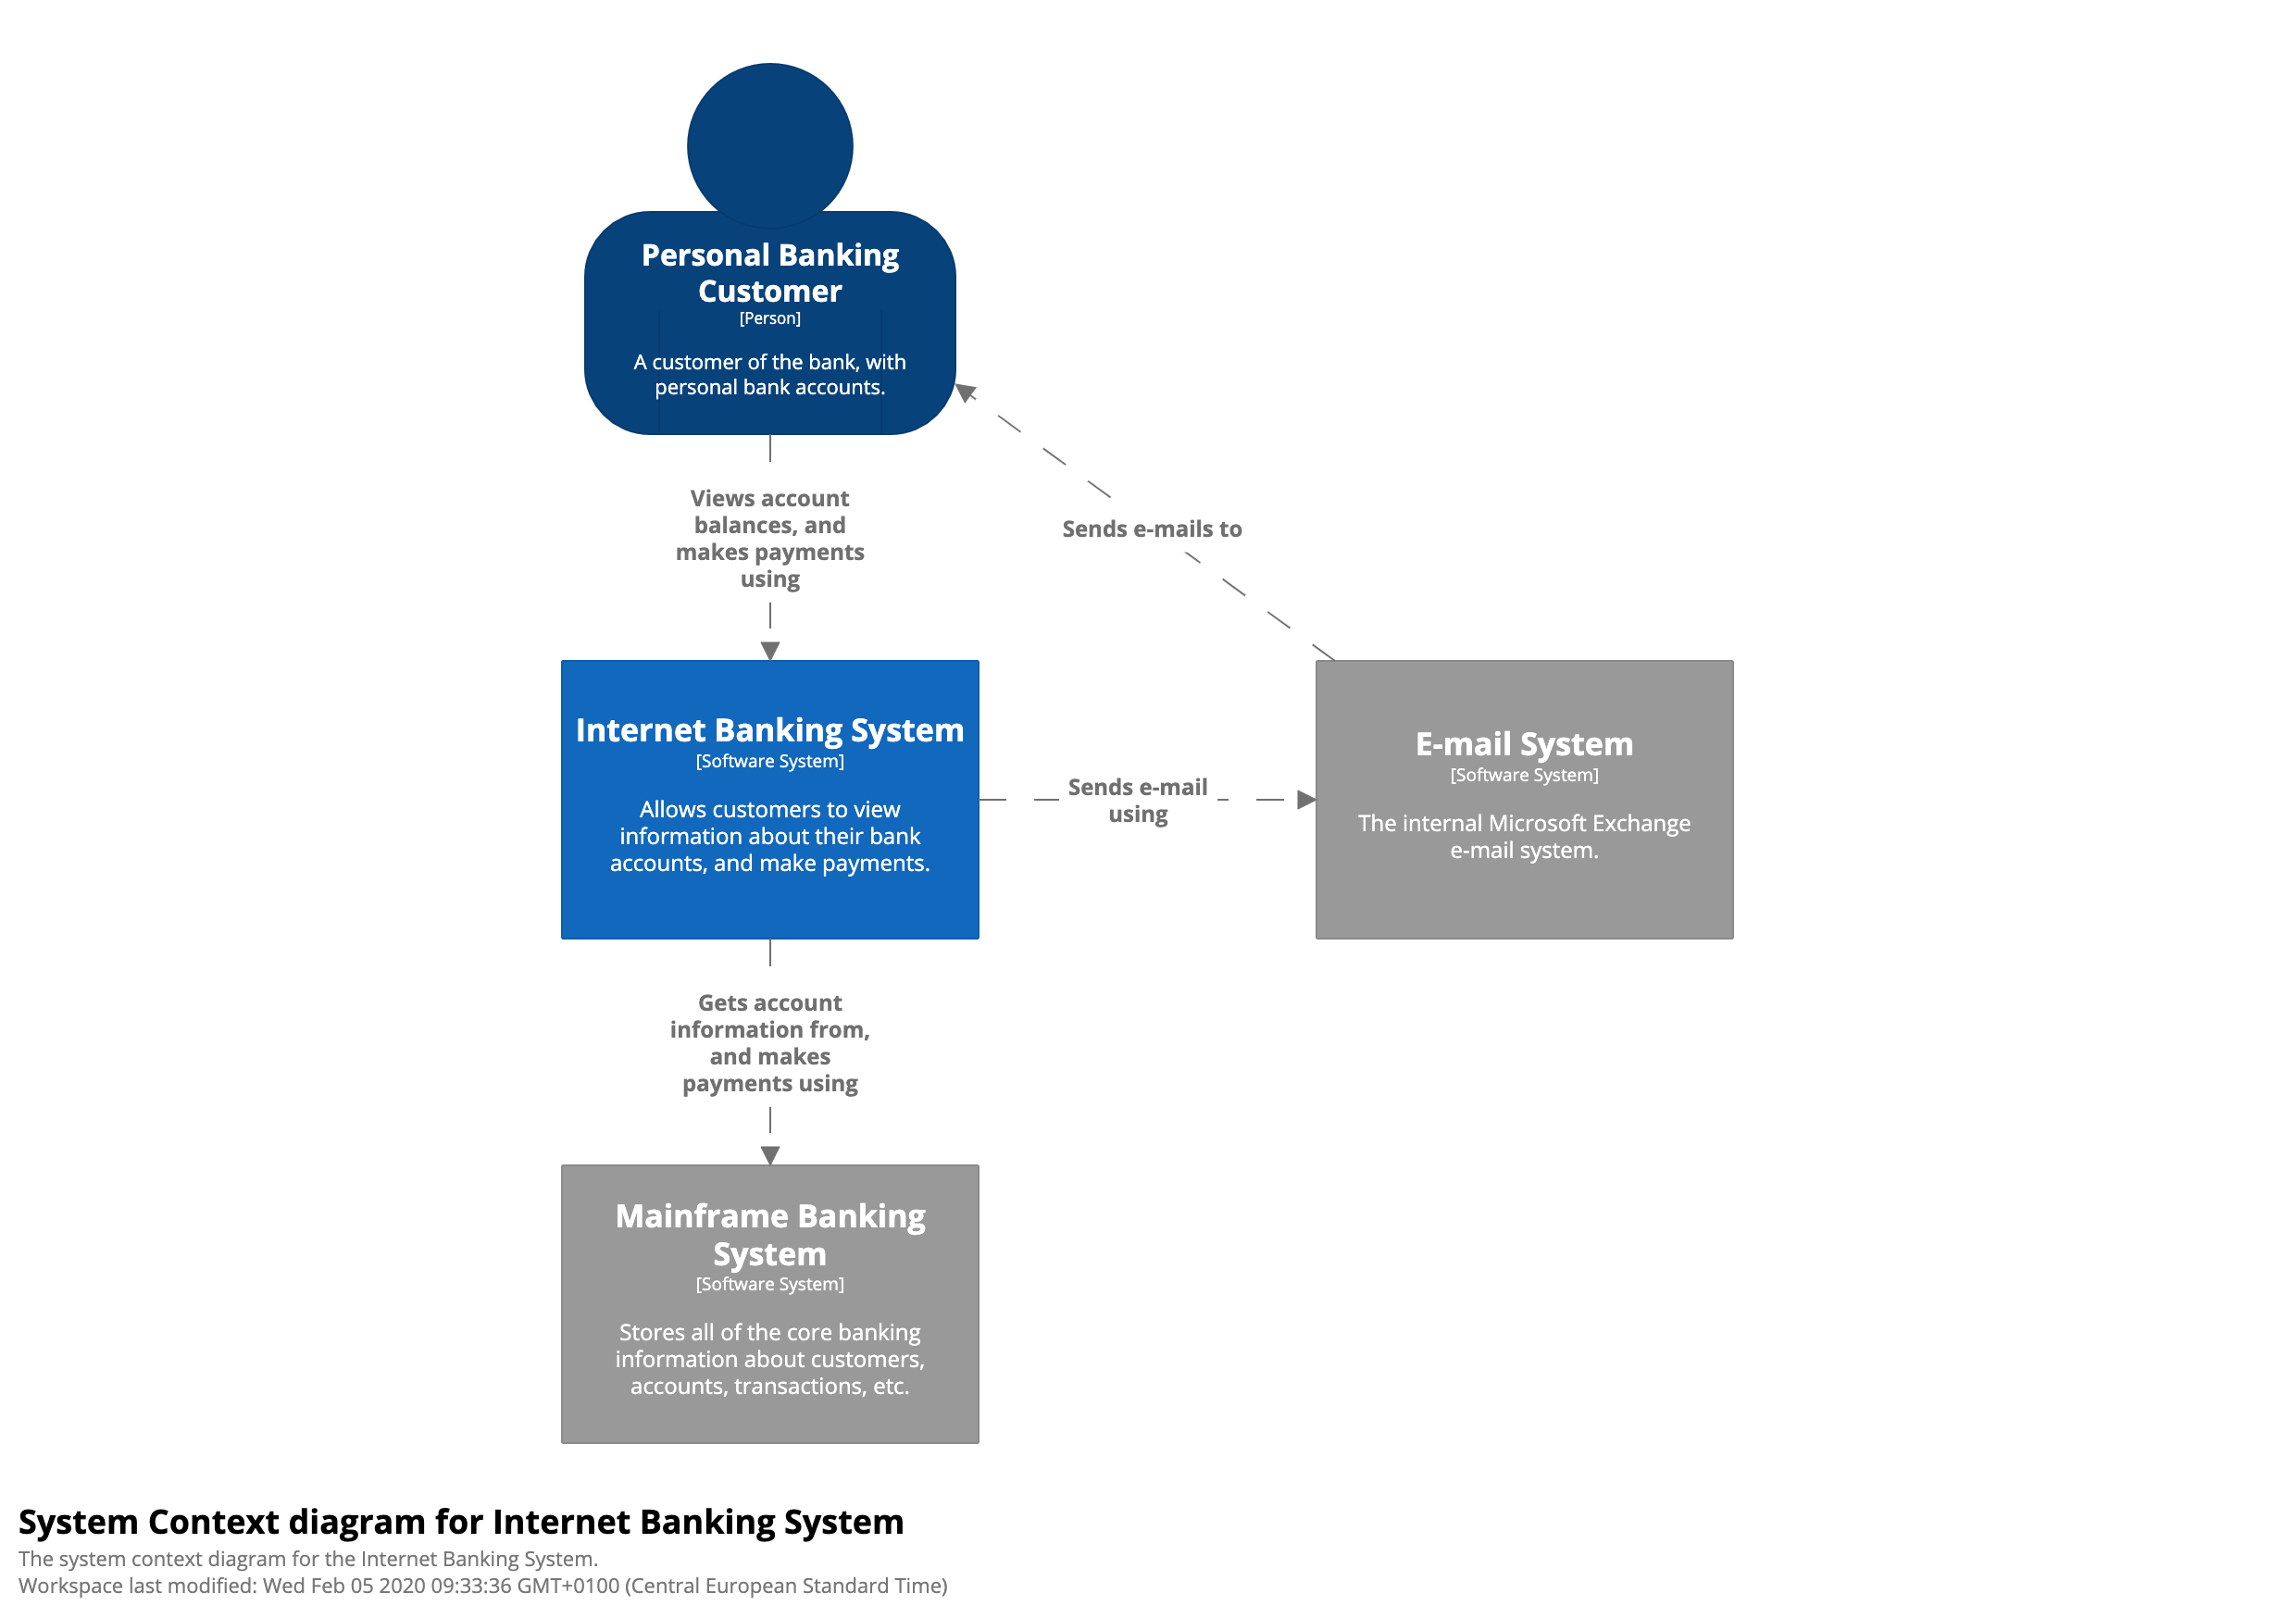
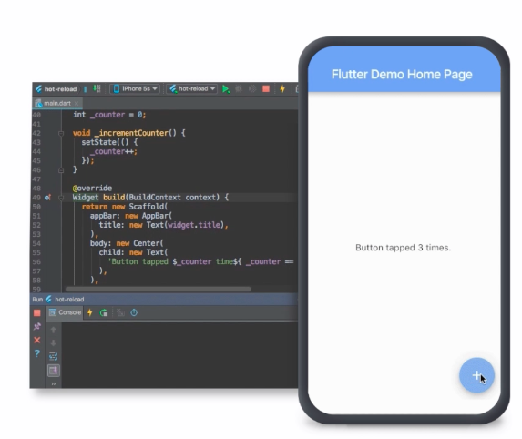
Sprint 3 Outlook
Starts Nov 23, 2020
Generate GUI prototypes: LoFi, MidFi, and HiFi
Prototype testing with the client
Designing Client-Server and Database architectures
Implementing Client-Server and Database architectures*
*May include GUI-side programming if ready
First Design...
...then Development!

Slide 11
Group Reflection
Open discussion for the meeting
Does the team feel "on track"?
What progress does the team particularly feel good about?
What barriers does the team feel is a current impediment to success?
What help does the team require to move positively forward?
Other questions or concerns?
?

Slide 12
Image References
CFIA Livestock Transport infographic. https://www.inspection.gc.ca/animal-health/humane-transport/livestock-transport-in-canada/eng/1363748532198/1363748620219
Sprint 2 Screenshots. https://github.com/holtzmak/Humane-Transport/projects/3
MVPs. https://oyelabs.com/mvp-app-development-company/
C4 Model. https://c4model.com/
Flutter. https://flutter.dev/

