Slide 1
ENSE 477 Project Bazaar Day 2
Humane Transport
Clark Inocalla, Kelly Holtzman, Mansi Patel, Sana Khan
March 25, 2021

Slide 2
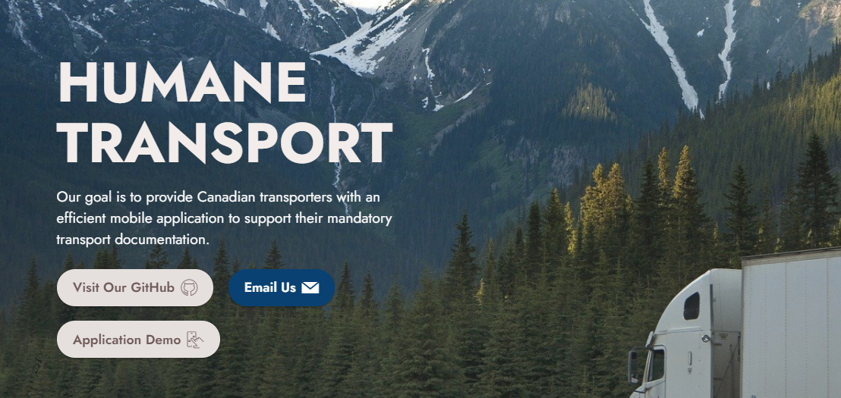
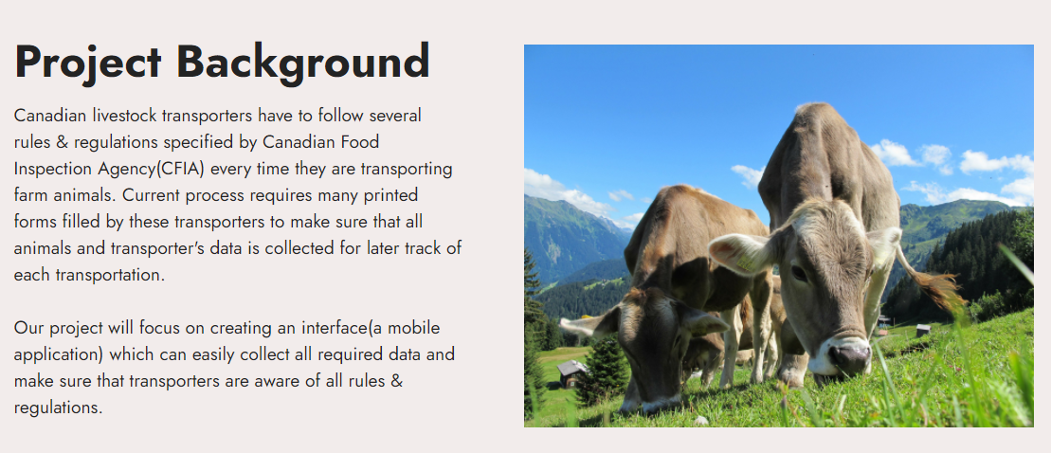

Slide 3
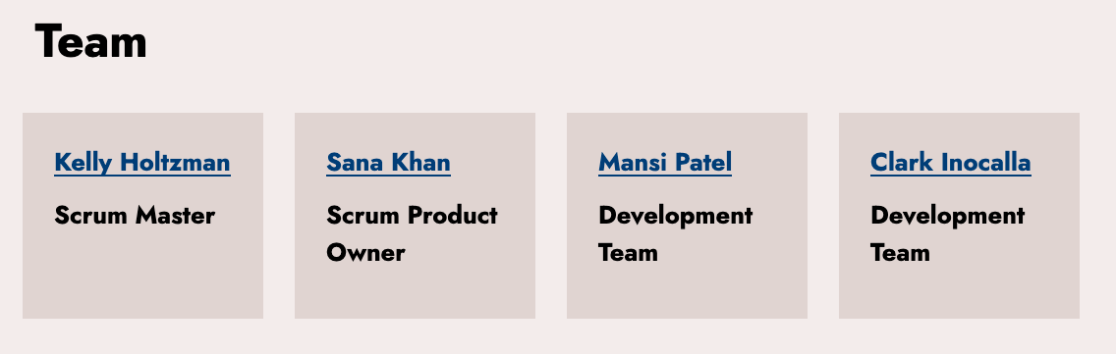

Slide 4
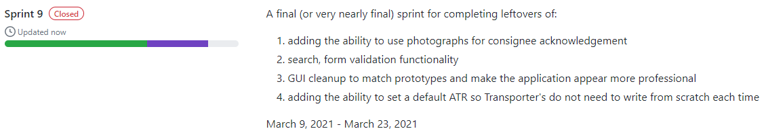
Sprint 9 Overview
Mar 9, 2021 - Mar 23, 2021
Colour scheme update!
Images in the application!
Quality of life improvements!

Slide 5
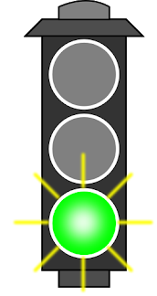
Project Status Description
and Project Issues (No Changes)
Our project status is green.
This application could be delivered as-is.
There is still no transporter feedback.
We’re not likely to receive it in time.
Our future recommendations for the app include user testing with a group of willing Transporters.

Slide 6
Application Demo

Slide 7


Sprint 10 Outlook
Fun facts about the project so far!
Starts Mar 23, 2021, ends Apr 10, 2021
The project closing Sprint:
Remaining minor implementation and appearance updates
Closing documentation
Project poster
Project commercial
Project presentation
(Unit and Integration Tests)
The test and format run is ~5 minutes
The full build of android and iOS is ~33 minutes
(without cache)

Slide 8
Group Reflection
Open discussion for the meeting
Does the team feel "on track"?
What progress does the team particularly feel good about?
What barriers does the team feel is a current impediment to success?
What help does the team require to move positively forward?
Other questions or concerns?
?

Slide 9
Questions, Suggestions?

Slide 10
Image References
Stoplight. http://clipart-library.com/traffic-light-cliparts.html

