Slide 1
Data Visualization

Slide 2
Superhero U: Fostering Youth Innovation
🌟 Superhero U Event Empowering youth with innovation - Superhero U: where young minds create superheroes to tackle real-world issues guided by UN's SDGs.
🚀 Inspiring Tomorrow's Heroes Equal educational opportunities for imaginative youth, encouraging solutions for global challenges.
🏆 Showcasing Brilliance Three rounds of competition from Aug 2020 to Apr 2021. High school and college students showcased their ingenuity. 🔗 Learn More
Visit Superhero U’s website for details. Let's inspire tomorrow's superheroes! 🌟

Slide 3
Analyzing Facebook Ad Data
🌟 Project: We analyze data from Marketing team's Facebook ad campaigns for the Superhero U event. The goal: help identify a campaign for discontinuation, optimizing costs. Then, create compelling data visualizations.
🚀 The Challenge
Analyze Marketing data from August 2020 to April 2021 to pinpoint a campaign for cost-cutting without compromising Superhero U's mission.
🔍 Our Mission
Identify areas where we can optimize ad spending, creating a win-win situation for Superhero U and their budget.

Slide 4
Overview of Superhero U Ad Campaigns
📊 Challenge: Identify campaigns to cut costs while preserving Superhero U's mission.
📈 Campaigns: Analyzing 11 campaigns SHU_6(Educators and Principals)
, SHU3_Students Apart from India and US), SHU_Students from various regions).
Campaign 1: SHU_6 (Educators and Principals)
Campaign 2: SHU3_ (Students Apart from India and US)
Campaign 3 :SHU_Students(Australia)
Campaign 4: SHU_Students (Canada)
Campaign 5: SHU_Students(Ghana)
Campaign 6: SHU_Students (India)
Campaign 7: SHU_Students(Nepal)
Campaign 8: SHU_Students (Nigeria)
Campaign 9: SHU_Students(UAE)
Campaign 10: SHU_Students(UK)
Campaign 11: SHU_Students (USA)

Slide 5
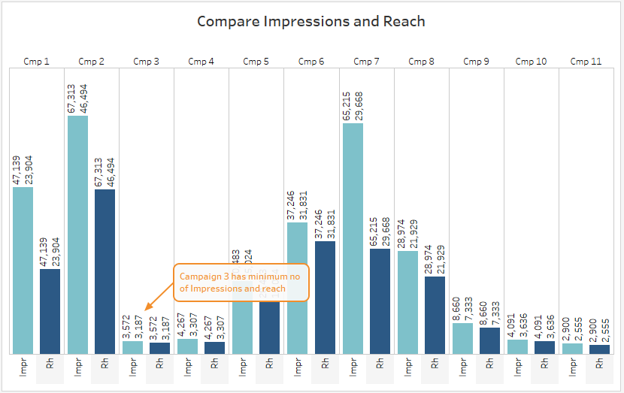
Based on Reach and Impressions: Compared to the reach, impressions for different campaigns resulted in the least performance for campaign 3 and campaign 11.

Slide 6
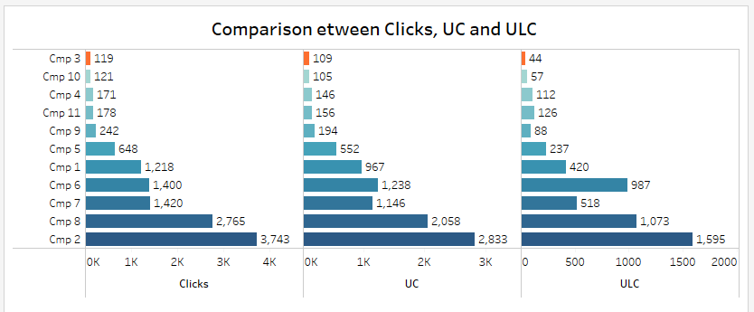
Comparison between Clicks, Unique Clicks and Link Clicks: Comparing all campaigns, we will see that the least number of clicks gained by campaign 3, the clicks are only 119 where UC and ULC are 109 and 44 respectively. Over all the performance of campaign 3 is the lowest of all the others.

Slide 7
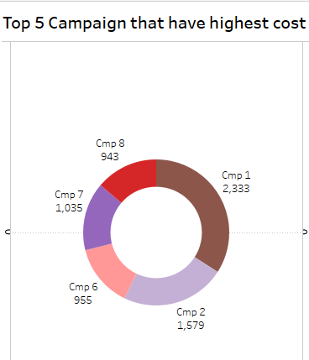
Top 5 Campaigns that have Highest Cost: Though Campaign 3 spent low amount than the other campaigns but it still performing low

Slide 8
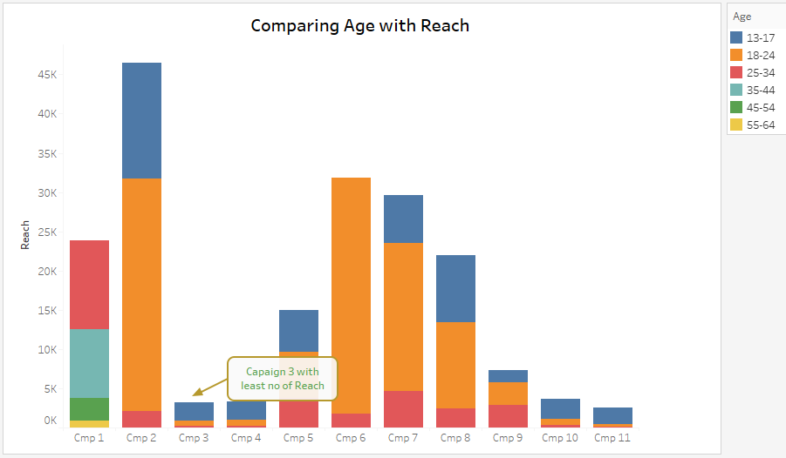
Comparing Age with Reach: In this campaign 3 has also lowest Reach

Slide 9
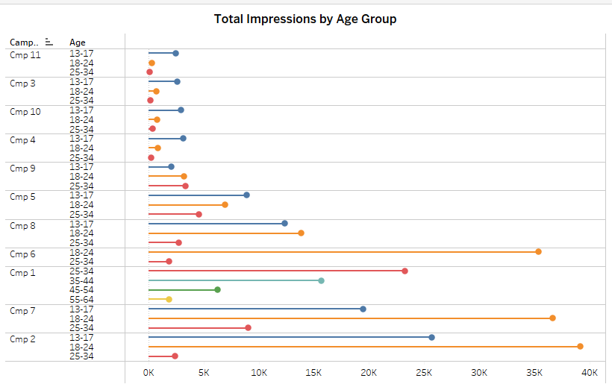
Total Impressions by Age Group: Compare the age group with impressions to analyze campaigns more deeply

Slide 10
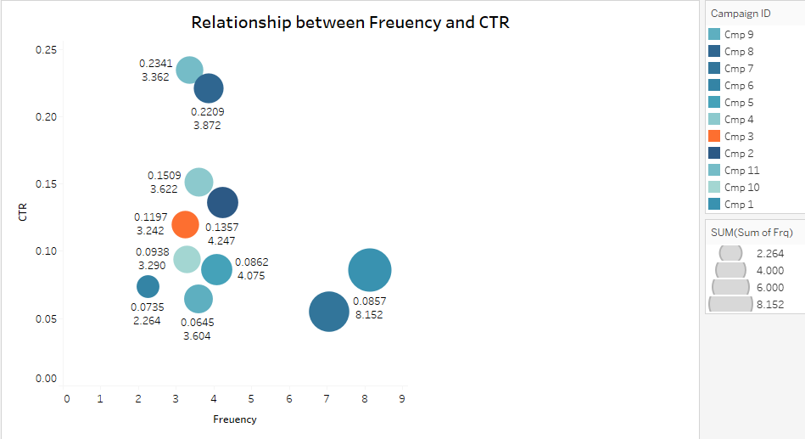
Relationship between Frequency and Click Through Rate (CTR): As we see from the size of the bubble that campaign 3 is one of the lowest campaign that has least CPC and CPR.

Slide 11
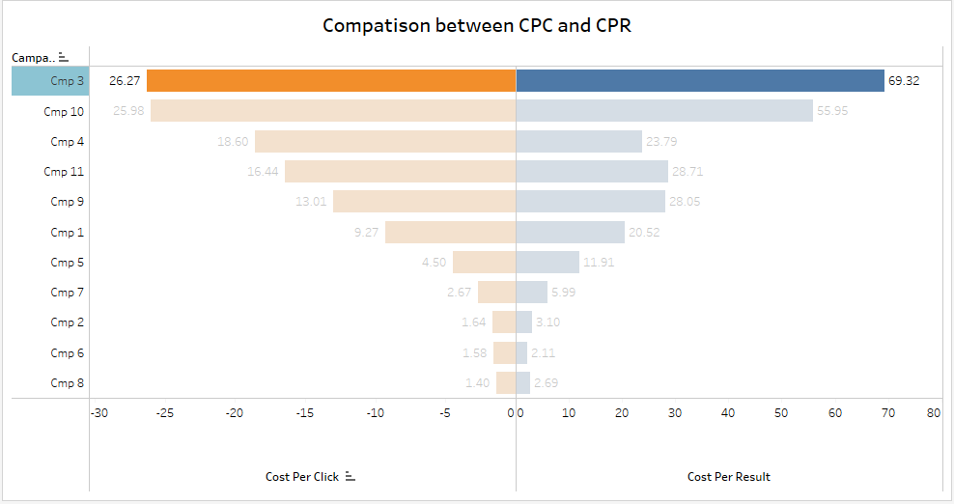
Based on Cost Per Click (CPC) and Cost Per Result (CPR): In both comparisons, campaign 3 with the highest CPC and CPR can be considered for discontinuation.

Slide 12
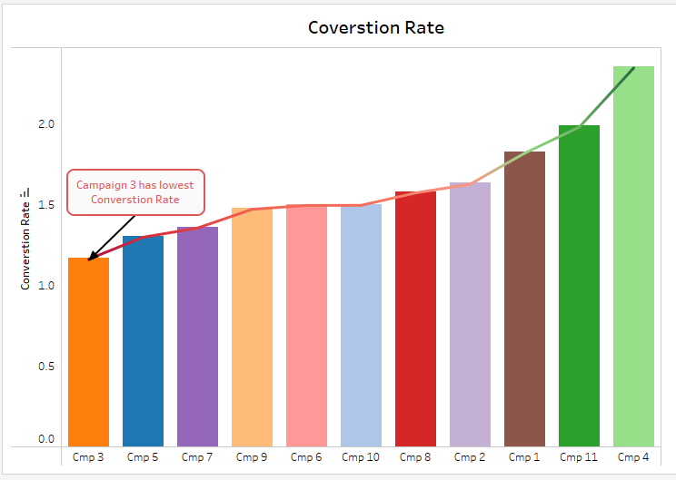
Conversion Rate As we clearly seen that the campaign 3 has least conversion rate

Slide 13
Conclusion:
Though Campaign 3 spent low amount than the other campaigns, according to the campaign's visual analysis, however depending on the other characteristics include
lower reach and impressions
poor performance
Higher CPC and CPR
the campaign isn't doing well. The campaign's influence and reach are at their lowest levels, cost per click and cost per result highest

