Slide 1
Project Management

Slide 2
Team Name:
سناء محمد عبدالوهاب احمد
سلسبيل سيد كمال سيد
سلمي محمد سعدالدين محمد
شروق احمد عبدالباسط بيومي
سهيله حمدي عبدالعال محمد

Slide 3
The first and main objective of this project:
It is to spread awareness and culture among all people.
Provides the electronic library.
Provides its readers with all books and novels pdf.
Help readers find the nearest library.
Provides the same audiobooks for those who cannot read such as
blind children and illiterate people.
It allows to access the books in the least time, effort and money
as well.
]

Slide 4
How does the team handle the work?
We defined sub-goals.
assigned tasks to team members.
started implementation immediately.
divided the time to complete a part of a part of the project and set the final time for it .

Slide 5
Project Deliverables:
Website
Application
EBooks offline
International and local books
Buy and borrow books

Slide 6
Project Assumptions:
This app will be universal in the world and very many users
will use it.
It will provide all books, whether read or audio.
This application will be the most effective.

Slide 7
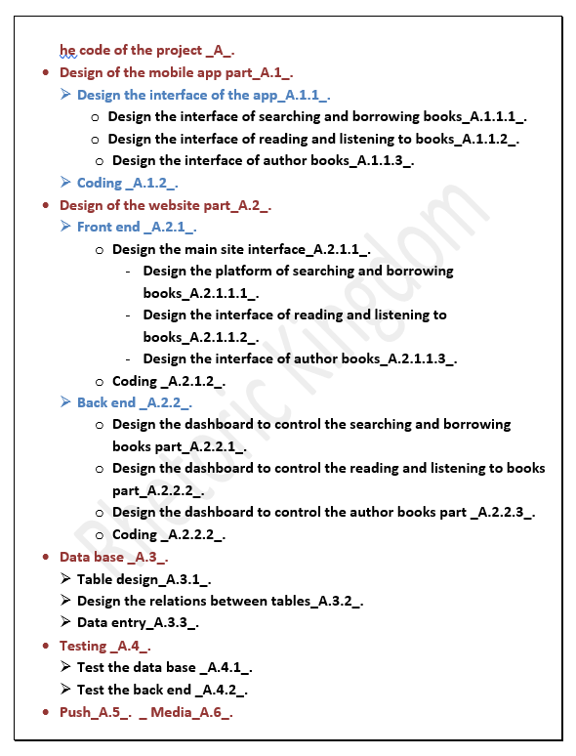
The WBS :

Slide 8
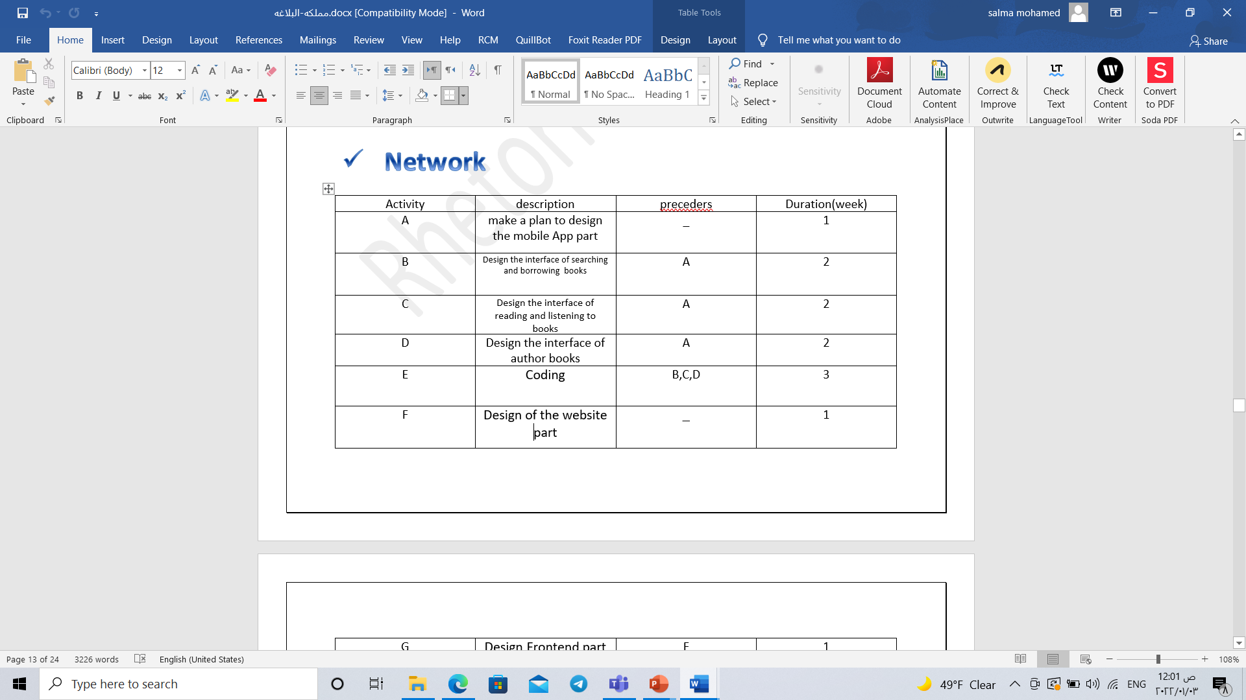
_{Network}

Slide 9
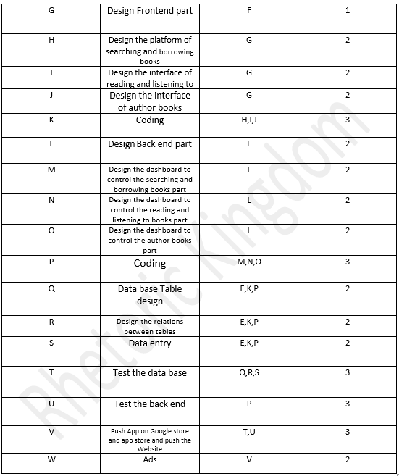

Slide 10
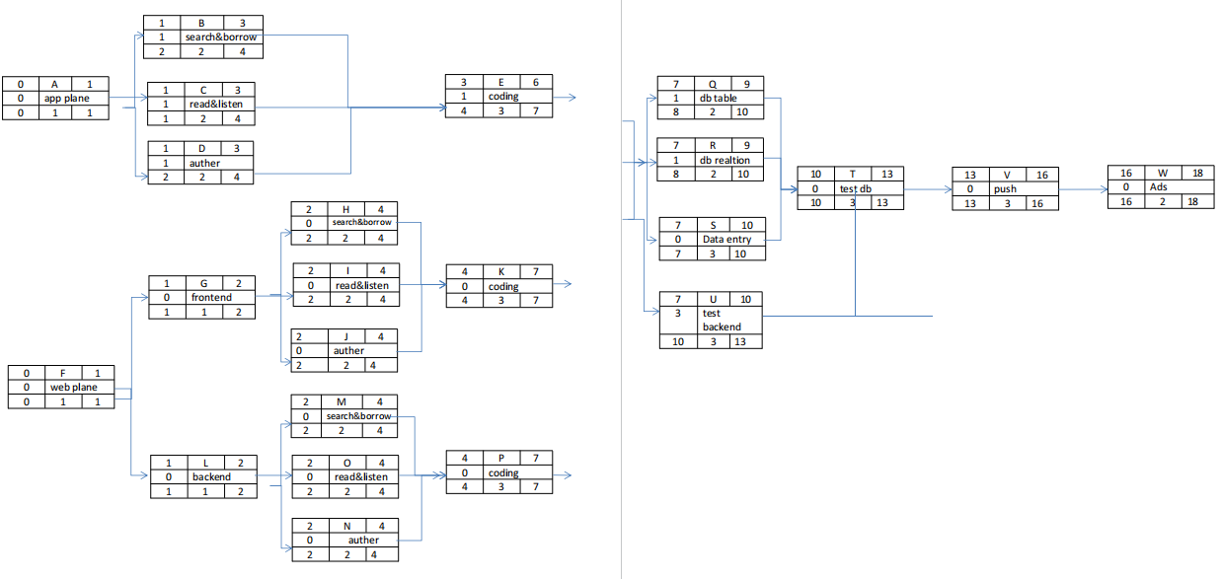

Slide 11
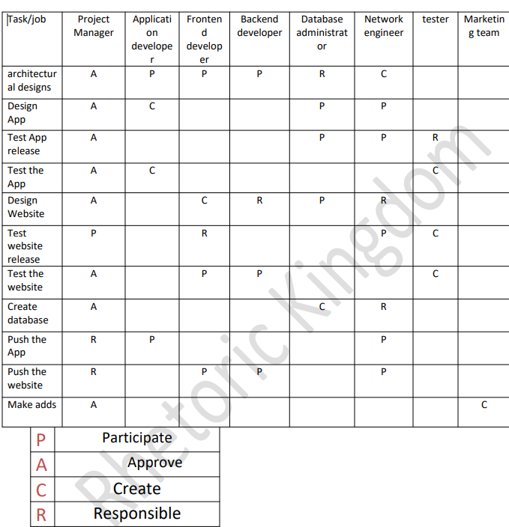
The Matrix Responsibilities

Slide 12
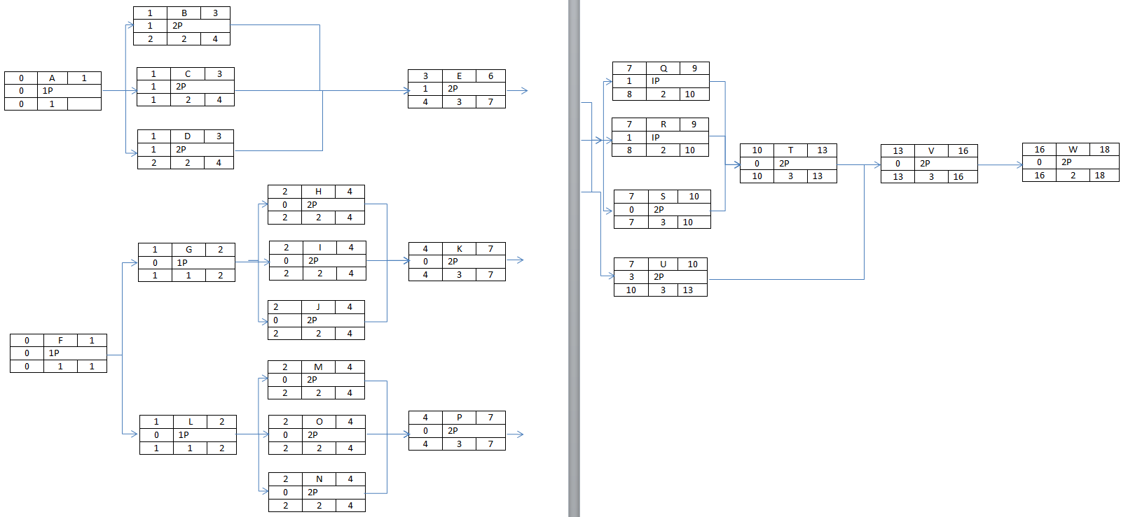
Resource

Slide 13
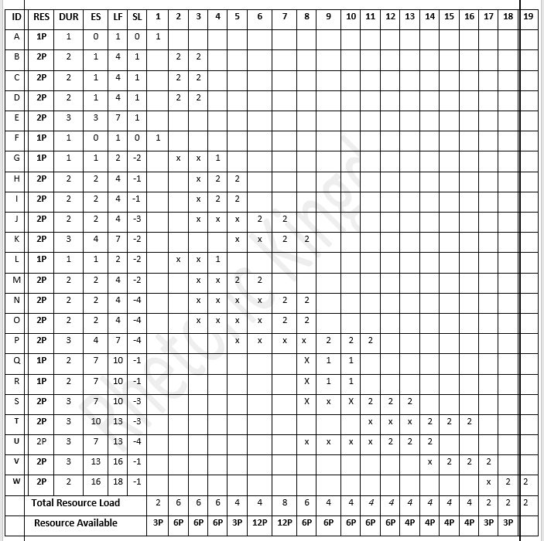

Slide 14
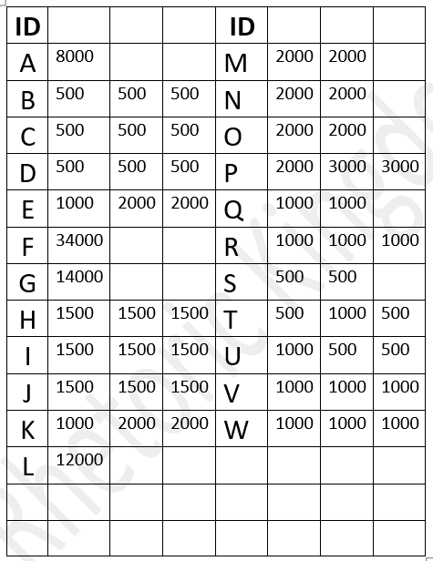
Budget

Slide 15
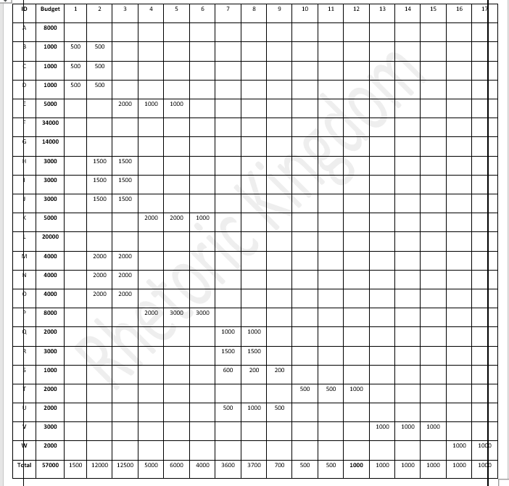
Baseline Budget

Slide 16
Project Features:
Providing all kinds of books, articles, novels and stories.
Providing these same audio books for people who cannot read.
Easy access to books with minimal effort.
Easy access to rare books.
Save time You don't have to go to the library as long as you have the Internet, it is available 24 hours a day.

Slide 17
Project defects:
The application cannot be accessed without the Internet.
The application does not accept cash payments, electronic
payment must be made when purchasing any book.

