Slide 1

Open Sensor Networks
Platform improvements
Alejandro Andreu Isábal
alejandro.andreu01@estudiant.upf.edu

Slide 2
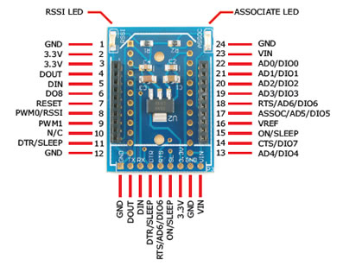
Xbee Direct I/O
Cheaper design
Less energy consumption
Packet encapsulation
Complex

Slide 3
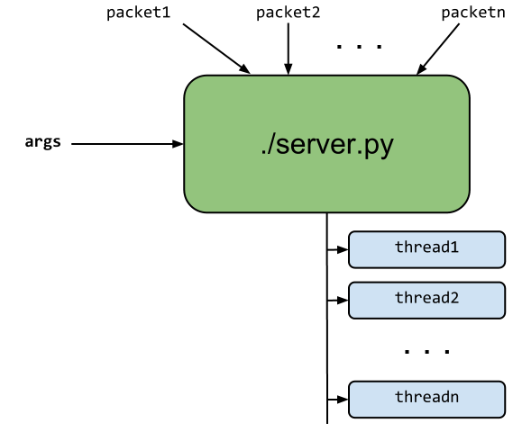
Overview

