Slide 1

Open Sensor Networks
P2P communication and Cosm
Alejandro Andreu Isábal
alejandro.andreu01@estudiant.upf.edu

Slide 2
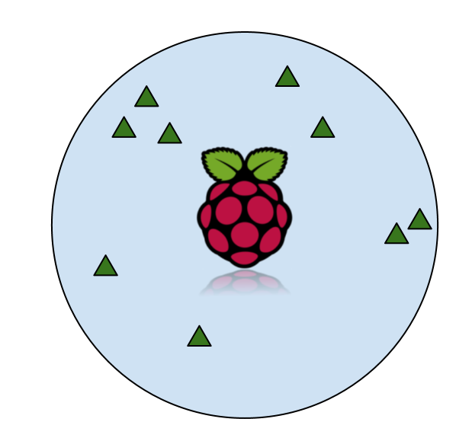
Arquitecture design
Arduino
  Easy to work with
  Not powerful enough
  No Internet capabilities
Need for an external device
  Raspberry Pi

Slide 3

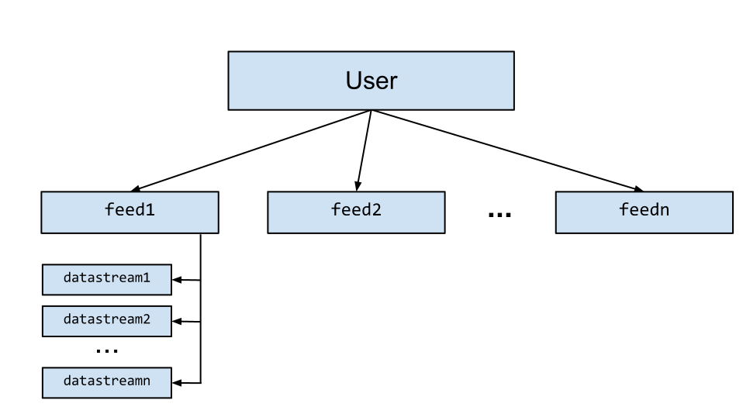
Data uploading

Slide 4
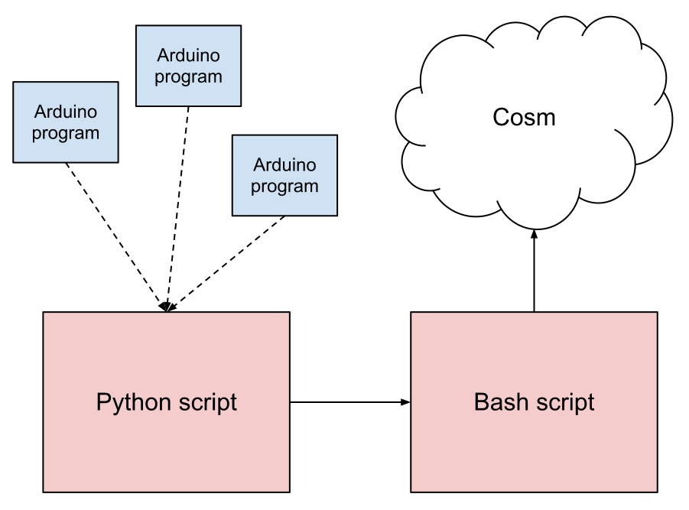
Overview

