Slide 1

Correlating Factors of House Sale Prices
Author: Sanabu Washizuka

Slide 2
Introduction
Method
This project is an analysis of what factors of a house's build and features are correlated with its sale price and an exploration of which factors will build a prediction model of the highest accuracy to predict these values. The general approach is to find features that are most correlated with the sale price through statistical functions, and fitting the data of those features into a prediction model.

Slide 3
Introduction
Workflow Model
Data Exploration Initial exploration of size and characteristics of data
Data Preparation Removal of invalid data and confirming correct representation of data to the subject matter context
Correlation Calculations Calculate correlation coefficients of dependent variables to determine which variables to use for the prediction model
Prediction Model Creation Create and test 3 prediction models
Model Performance Analysis Determine which model performs best
Test Verification Verify performance on test data

Slide 4
Introduction
Data Science Processes
The data science problems in this analysis is the decision of what features to use to fit the prediction model on to and how to ensure clean data. One measure of possible prediction ability is the correlation of these features with the sale price, represented by their correlation coefficients. This will serve as the main marker for candidacy of which features to use in the model.
Visual analysis through the use of error histograms and correlation scatterplots will also be utilized as secondary indicators of model performance.

Slide 5
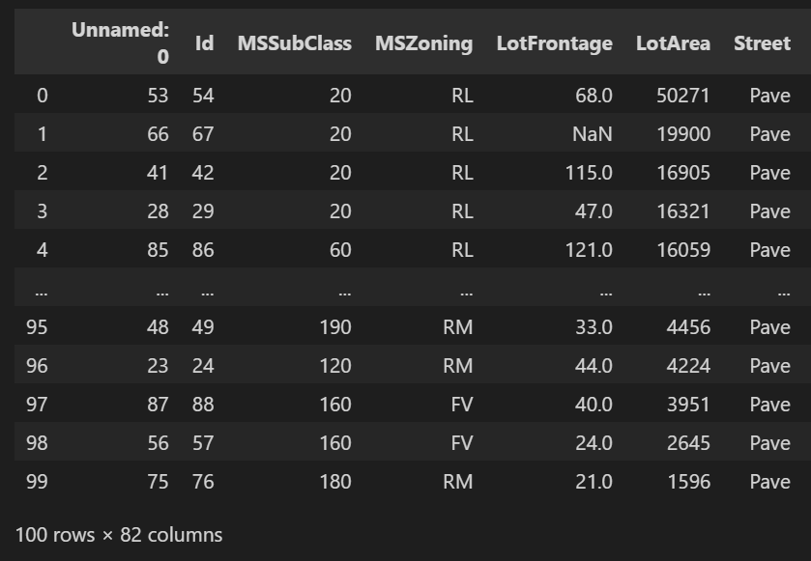
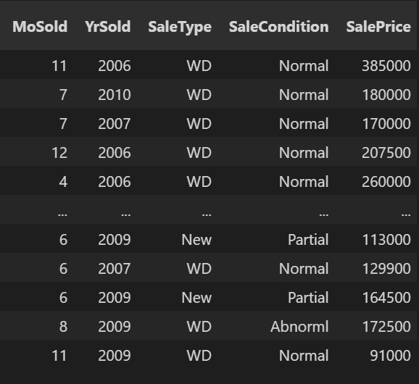
The Data
The training data consisted of 100 records and 81 features.
*Unnamed: 0 was an artifact of loading the data

Slide 6
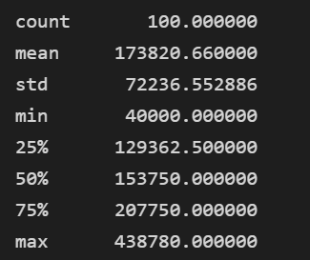
The Data
Descriptive statistics of the sale price with the following critical statistics:
Mean: 17,3820
Standard Deviation: 72,237

Slide 7
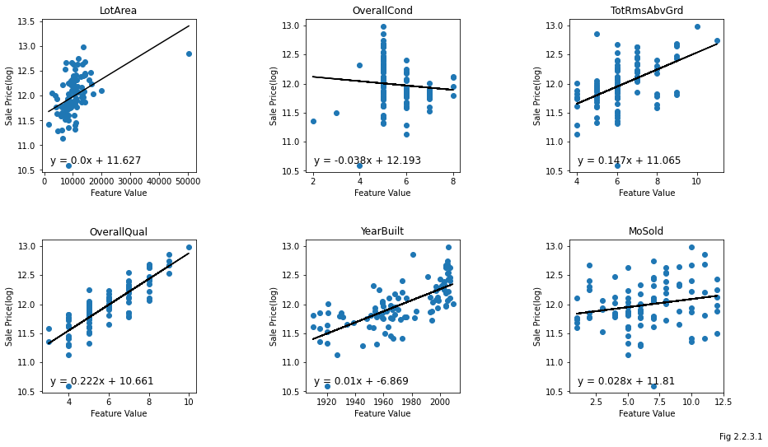
The Data
Data Exploration
6 arbitrarily chosen features were chosen for simple visual analysis of correlation.

Slide 8
The Data
Data Exploration
LotArea: Appears to be correlated, however it is difficult to tell with the outlier in the upper right extremity of the graph.
OverallCond: Several data points appear at rating 5 and seem to taper to a point as the rating gets higher, implying this feature may not be correlated with the sale price.
TotlRmsAbvGrd: Though there is significant variance, there seems to be a positive correlation with the sales price.
OverallQual: A tight correlation seems to exist for this feature, making it a strong candidate to be a feature to test on.
YearBuilt: A moderate and positive correlation seems to exist for this feature.
MoSold: As many data points are dispersed in an oblong shape across the graph, a poor correlation seems to exist for this feature.

Slide 9
The Data
Data Preparation
Removal of features that did not contextually have anything to do with the sales price, Id and Unnnamed: 0.
Columns with more than 40% of its values as null values were removed. Any remaining columns with null values were then evaluated if those values should be interpolated. LotFrontage and GarageYrBlt both contextually do not make sense if they do not have a value (houses are assumed to have a sidewalk in front of them and a garage must have been built at some point in time), and were given average values of the entire column. All features with any null values and '0' values were confirmed that any null or 0 values make sense conceptually within their context.

Slide 10
The Data
Data Preparation
A check of each numerical column in the data frame was made to ensure the context of the feature appropriately represented a measurement and not a categorical label. This was done by manually referencing the accompanying data description document. One feature that was of a numerical type in the data frame was in fact a categorical feature, and changed appropriately.
Once all categorical features were of the correct data type, one-hot encoding was applied using, resulting in the final cleaned data.

Slide 11
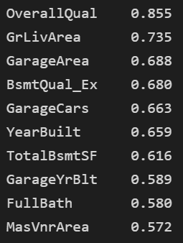
Correlation
The features with the top 10 highest correlation coefficients with the sales price:
Features deemed previously to have a good correlation, OverallQual and YearBuilt are included. The other 4 features, most of which were assessed to have poor correlation, are not.
The existence of a basement with "Excellent" height has a correlation of 0.68, a value relatively stronger than most of the other features.
A relatively large number of features related to a house's garage are included in this list. Out of 10 features, 3 are related to garages(GarageArea, GarageCars, GarageYrBlt)
A new set of variables will be chosen as the primary study for the regression model, comprised of this list of features with the top 10 highest correlations.

Slide 12
Project Description
The variables chosen for analysis had the highest correlation coefficients with SalePrice, implying a strong ability to predict SalePrice values.
This analysis improves upon the curriculum's demonstration with the inclusion of an additional number of features to fit onto the regression model. Additionally, in comparison to the study in the curriculum which did not include any categorical features, these categorical features were included in this analysis, one of which was within the top 10 correlation values.

Slide 13
Project Description
Workflow
Two other sets of contextually related features were also analyzed, in order to compare the relative reliability between models. One was a set of measures of area of various building features (e.g. square footage of the first floor), and a set of counts of different rooms (e.g. number of bedrooms). These sets were created from alternative hypotheses that more space or more rooms would cause the house to be sold at a higher price.
These will be applied to a linear regression model. The reason a linear regression model was chosen is because linear regressions are designed to predict continuous values (e.g. a sale price) as opposed to categorical values.

Slide 14
Project Description
Methods
The feature set with the highest R^2 value will be chosen as the set to fit the final model on. R^2 was chosen as it is a measure of how much the change in a variable is explained due to another variable or variables, and is a measure that is applicable to the selected model, a multiple linear regression model.
Additionally, visual features of plotted errors and correlations between the predictions and observations of sale prices will be conducted to find supporting evidence for which model will be the most reliable predictor.

Slide 15
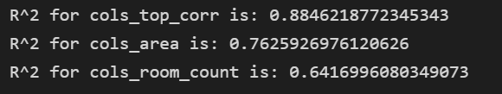
Analysis and Results
Observing the $R^2$ for each feature set, the feature set of top correlation coefficients(cols_corr_set) had the highest R^2 of 0.88. The set of square foot area measures(cols_area) produced an R^2 of 0.76, and the set of room counts(cols_room_count) produced a value of 0.64.

Slide 16
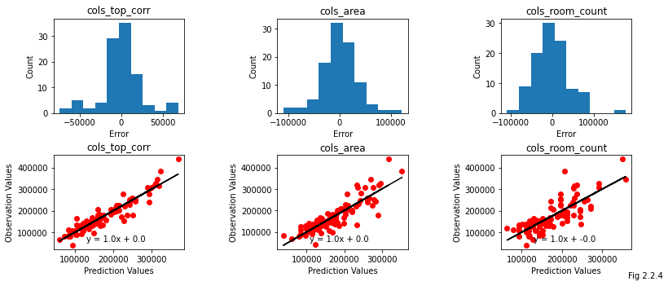
Analysis and Results
The high performance of the model with the top 10 correlated features can be observed through the error histograms and correlation scatter plots. The shape of the error histogram distribution for top_corr_set is relatively narrow compared to the other two models. For its scatter plot, a lower amount of spread of the data points can be observed around the regression line, especially when compared to the room_count_set feature set.

Slide 17
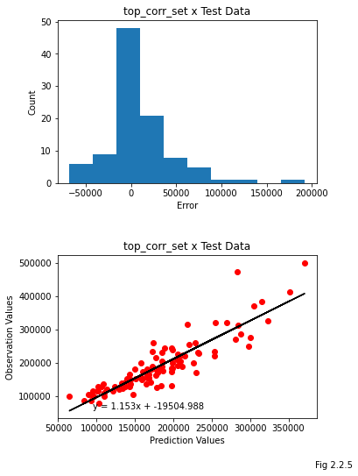
Verification
The model fit with the 10 highest correlations was then verified against test data that was not included in the training data the model was fit on.
This yielded an R^2 of 0.77, which is a drop in this value from that of testing against the trained data set, which is expected, and is still a relatively high R^2 value for testing on data unfamiliar to the model.

Slide 18

Conclusion
The feature set with the highest R^2 from the trained data was the set with the top 10 correlated features, at a value of 0.88.
Testing against the test data yielded a an R^2 0.77, implicating a reliable model.
Including as many well-correlated features as possible into the model can make for a reliable model.
Understanding context of the data is critical for interpreting null and 0 values, and to ensuring data integrity while also ensuring features were interpreted correctly by the regression model.

Slide 19
References
Frost, Jim. "Mean Squared Error (MSE)." Statistics By Jim. 2022. https://statisticsbyjim.com/regression/mean-squared-error-mse/ .
Frost, Jim. "How To Interpret R-squared in Regression Analysis." Statistics By Jim. 2022. https://statisticsbyjim.com/regression/interpret-r-squared-regression/ .
Glen, Stephanie. "Linear Regression: Simple Steps, Video. Find Equation, Coefficient, Slope." StatisticsHowTo.com: Elementary Statistics for the rest of us!. 2022. https://www.statisticshowto.com/probability-and-statistics/regression-analysis/find-a-linear-regression-equation/ .
Yang, Archer Yi. "An Example R Markdown." www.math.mcgill.ca. McGill University, 2017. https://www.math.mcgill.ca/yyang/regression/RMarkdown/example.html .
Ford, Clay. "Interpreting Log Transformations in a Linear Model." Research Data Services + Sciences. University of Virginia Library, 2018. https://data.library.virginia.edu/interpreting-log-transformations-in-a-linear-model/ .
illust image. DESIGNALIKIE, 2022. https://illustimage.com/ .

