Slide 1
Wiqaya: Wildfire Susceptibility Mapping and Alerts for the Forests of Northern Morocco
Wiame Kane · Sanae Belfrouh · Yassine Azmou · Mohammed Yassine Sof · Hajar Elouatiq
Team Wiqaya — Morocco
Arab Youth Space Hackathon 2026 · Proof of Concept
Theme: Climate & Disaster Resilience
October 2026 · github.com/SanaeBelfrouh/wiqayagit

Slide 2
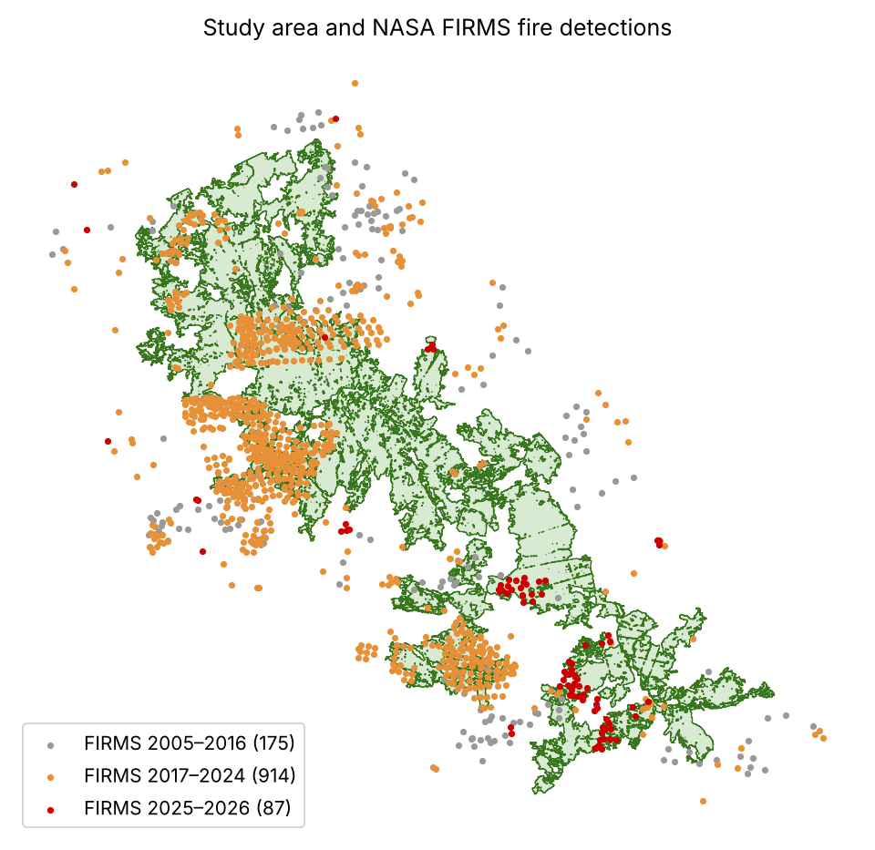

The western Rif burns almost every summer, and warnings arrive after ignition
Recent large fires: Bouhachem 2022 (> 7,500 ha), Larache 2022 (> 10,500 ha), Derdara 2021 and Bouhachem 2020 (~1,100 ha each), two fires in August 2025
Drivers: hot, dry chergui winds, steep slopes, villages (douars) inside the forest
Gap: danger bulletins are province-scale and satellite detections come after ignition; there is no daily, cell-level view of risk
Why satellite data: NASA FIRMS gives the only consistent 20-year fire record of these remote mountains (MODIS since 2005, VIIRS 375 m since 2017)
10,600
264,000
445
people living inside the forest
people within 10 km of it
FIRMS detections inside the forest since 2005
Fig. 1. Study area (25,900 ha) and NASA FIRMS detections by period. Population: WorldPop 2017.

Slide 3
Business use case: where to patrol today, and whether to warn residents
End users | Forest managers (national forestry agency, ANEF), Civil Protection, provinces and communes; residents of the villages in and around the forest
Decision supported | Each summer morning: where to send patrols and first-intervention teams, and whether the day is dangerous enough to warn residents and restrict burning
Current practice | Province-scale danger bulletins, field knowledge, and fire detections (FIRMS, EFFIS) that arrive after ignition; no alerts in Arabic and French
Contribution of Wiqaya | 250 m risk map with alert zones and a per-cell explanation, daily weather danger index, 20-year fire history, SMS / email alerts in three languages, open GeoJSON API
Business model | Subscription per protected area for institutions; free citizen alerts funded by these contracts or CSR partners; open data, so no imagery cost

Slide 4
Data: open Earth-observation and ancillary datasets
Dataset | Product and provider | Period | Use
Active fires | NASA FIRMS: MODIS C6.1 and VIIRS S-NPP 375 m | 2005–2026 (1,176 points) | Labels, fire history
Terrain | FABDEM V1-2, 30 m (Univ. of Bristol; Copernicus GLO-30) | 2023 release | Elevation, slope, aspect
Population | WorldPop mar_ppp_2017 (CC BY 4.0) | 2017 | Exposure per cell
Weather | Open-Meteo: ERA5 archive and forecast (CC BY 4.0) | 2017–today | Weather danger index
Optical imagery * | Sentinel-2 L2A, Landsat C2 L2 (Planetary Computer) | 2005–2025 | NDVI, NDMI, NBR, dNBR
Land cover, OSM * | 2021 classification; OpenStreetMap 2022 | 2021–2022 | Fuel, human pressure
* Research notebook only. Hyperspectral data is not used in this proof of concept; EnMAP or Arab Satellite 813 scenes are planned to map live fuel moisture and vegetation species.

Slide 5
Approach: from satellite detections to alert zones
1. Inputs
FIRMS 2005–2026, DEM, WorldPop, forest boundaries
2. Grid and features
6,071 cells of 250 m; elevation, slope, aspect, population
3. Fire history
FIRMS within 375 m; years since last fire (no leakage)
4. Model selection
Logistic regression vs random forest, leave-one-year-out 2017–2024
5. Fuel rule
Risk 0 if burned < 1 year ago; × 0.5 if 1–5 years
6. Blind test
Retrain on 2017–2024; score the 2025 fires
7. Risk map
5 KMeans classes; alert = riskiest 20 % of cells
8. Weather danger
Max T, VPD, wind, min RH ranked vs 2017–2024 summers
Reproducible: notebooks/02_main_analysis.ipynb runs end to end in about 5 minutes from the committed sample inputs (fixed seeds, relative paths).

Slide 6
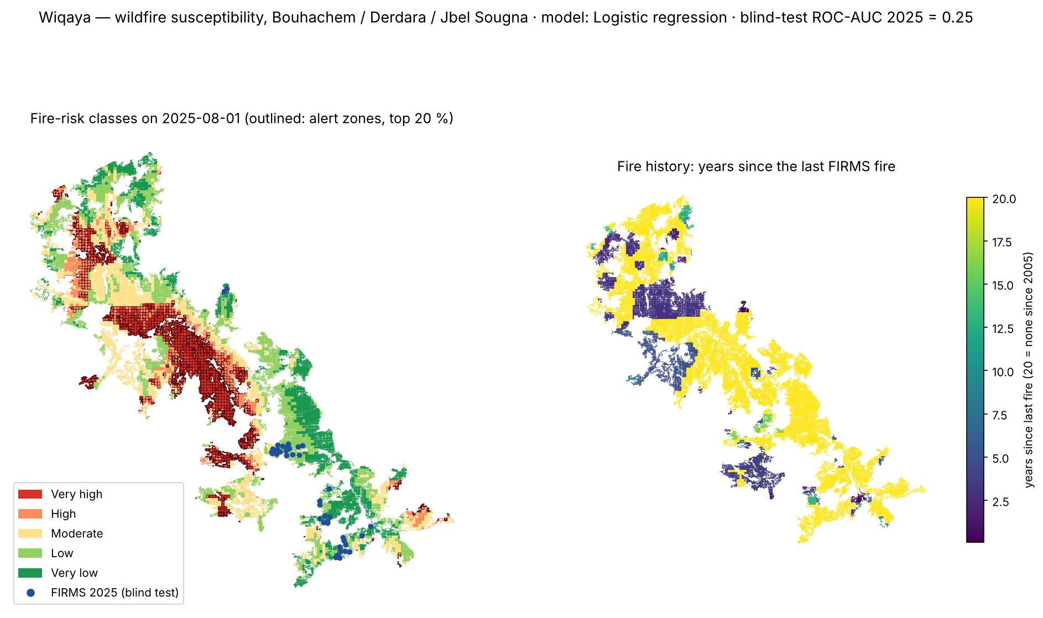
Risk classes on 1 August 2025: the 2025 fires fell outside the alert zones
Fig. 2. Left: five risk classes; outlined cells are alert zones (riskiest 20 %); blue points are the 2025 FIRMS fires (blind test). Right: years since the last FIRMS fire (20 = none since 2005). Notebook output results/example_output.png.

Slide 7
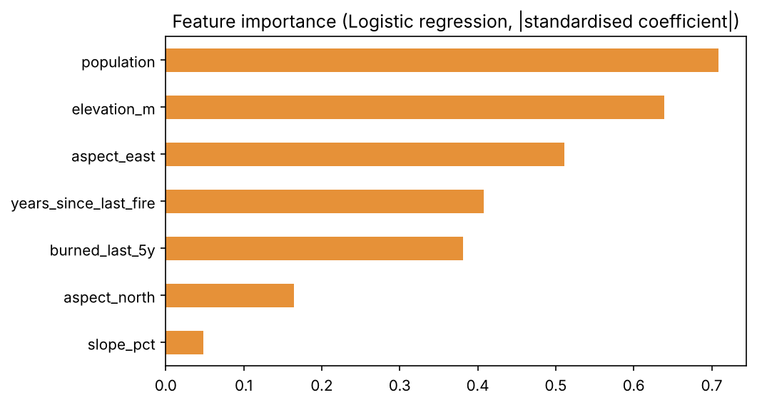
Population, terrain and fire history drive the selected model
Selected model: L2 logistic regression (C = 0.5, balanced classes)
Strongest predictors: population, elevation, east-facing aspect, then fire history (years since the last fire, burned in the last 5 years)
Weak predictor: slope
Missing drivers: vegetation dryness and human access, available only in the research notebook
Fig. 3. Absolute standardised coefficients of the logistic regression.

Slide 8
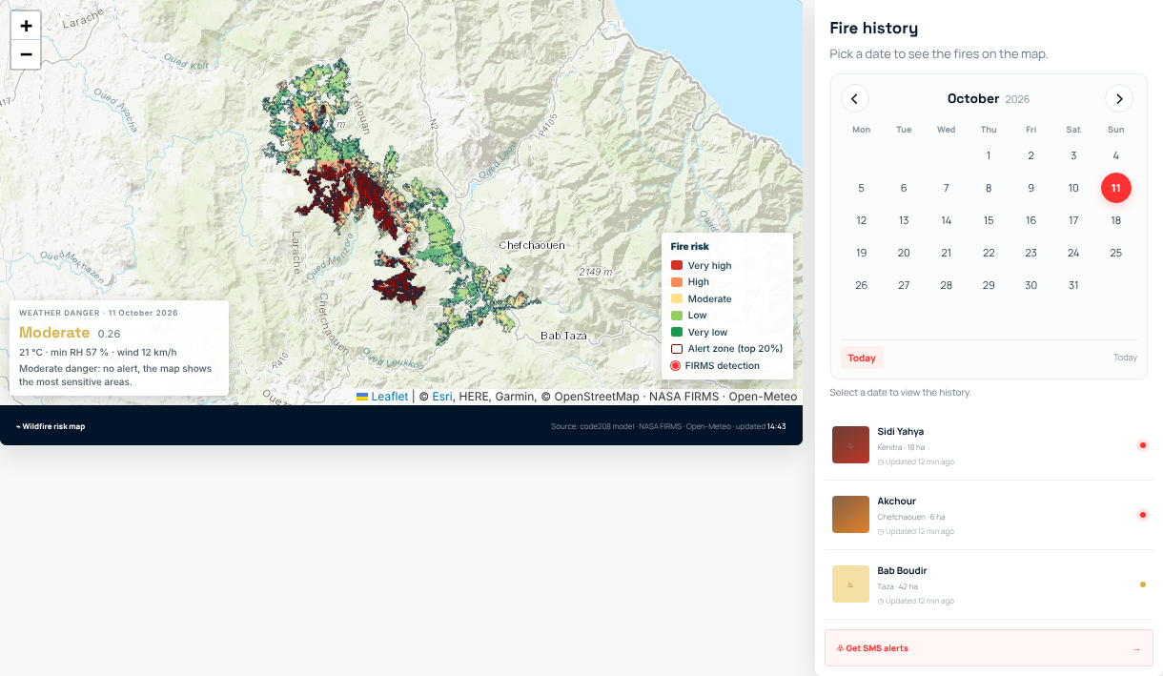
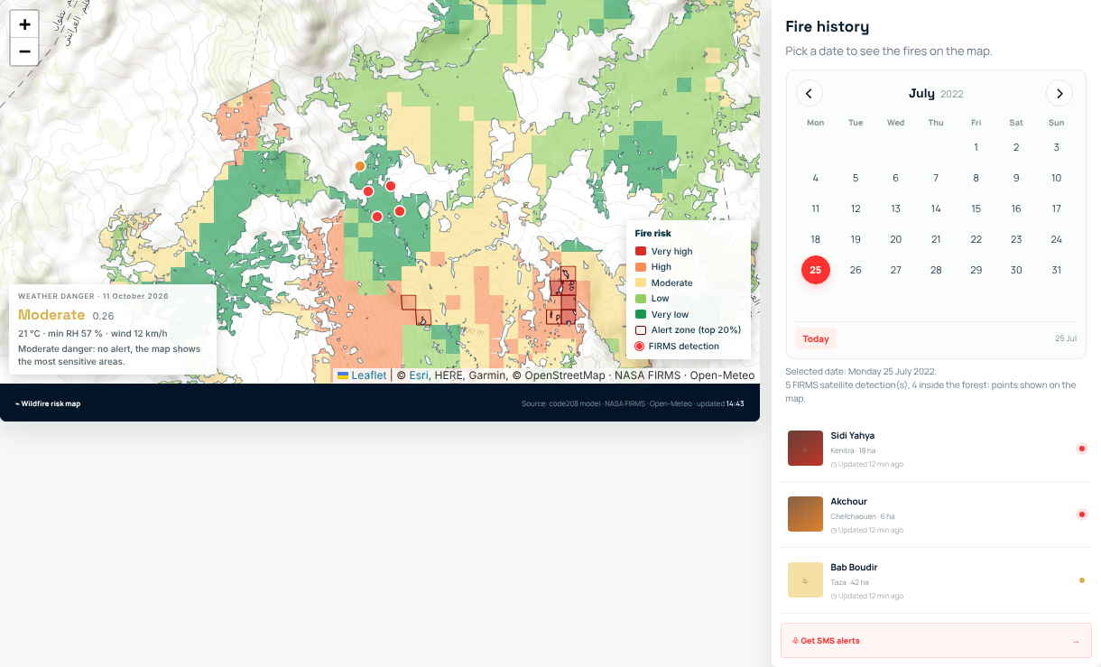
The same model is delivered to users through a web platform
Fig. 4. Daily risk map with the weather danger of the day and the five-class legend.
Fig. 5. Fire history: 25 July 2022, start of the Bouhachem fire; FIRMS shows 5 detections, 4 inside the forest.

Slide 9
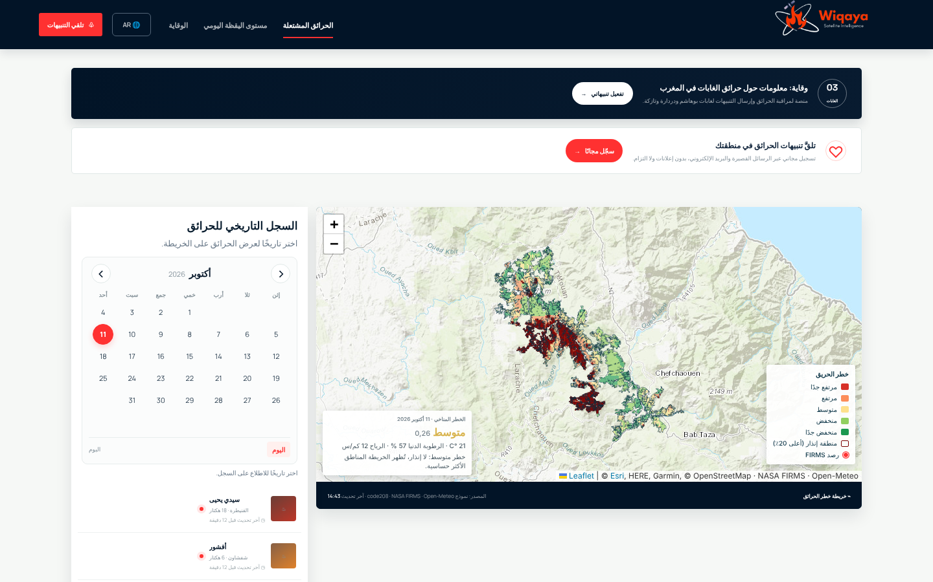
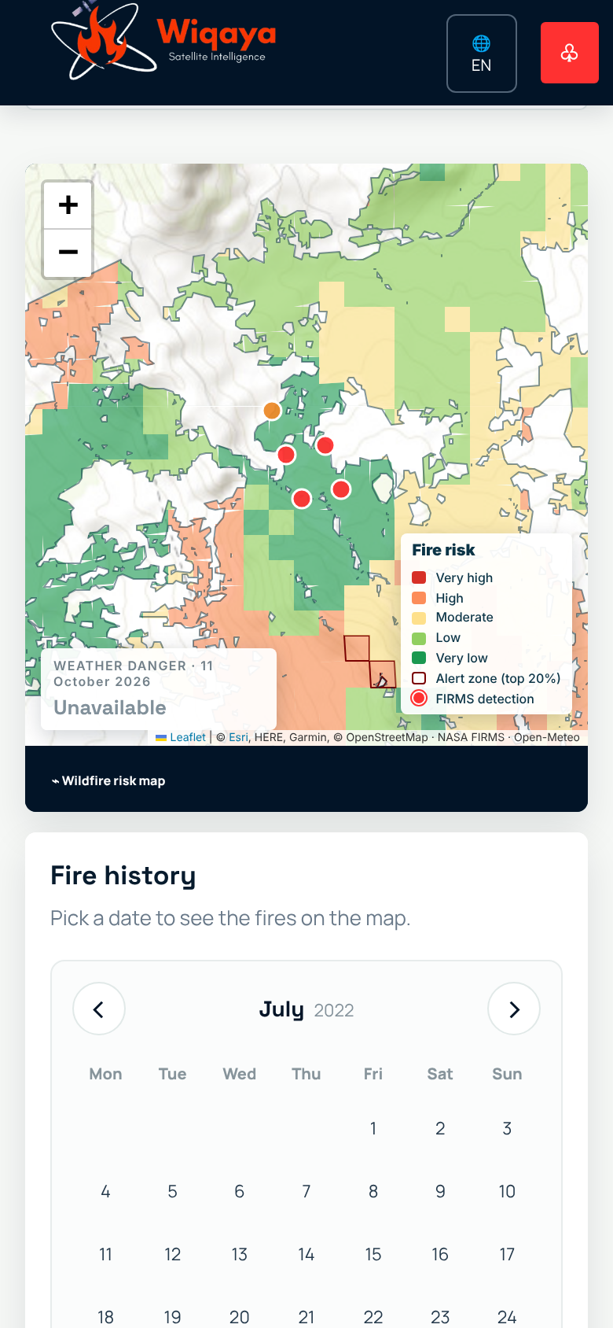
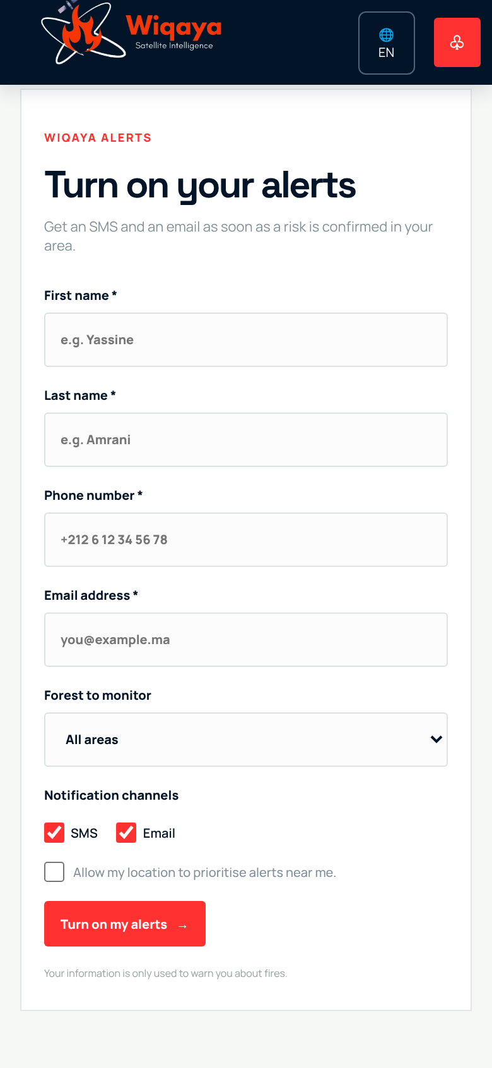
Access for residents: Arabic, French and English, on any phone
Fig. 7. Fire history and SMS / email alert sign-up on a phone.
Fig. 6. Right-to-left Arabic interface.

Slide 10
Validation: informative on large-fire years, but the 2025 blind test fails
Test | Result
Leave-one-year-out 2017–2024, logistic regression (selected) | Mean ROC-AUC per year 0.62; global 0.65; PR lift 1.64
Leave-one-year-out 2017–2024, random forest | Mean ROC-AUC per year 0.56; global 0.60
ROC-AUC per held-out year | 2018: 0.99 · 2019: 0.88 · 2020: 0.80 · 2021: 0.68 · 2023: 0.23 · 2024: 0.06
Blind test, 2025 fires (39 cells) | ROC-AUC 0.25; no fire cell in the alert zones
Works on the large fire years 2018–2021
Fails on 2023–2025: the 2025 fires started in cells rated low risk
Cause: predictors describe exposure, terrain and history, not vegetation dryness or human access
Few positives: 345 fire cell-years; per-year scores are unstable
No leakage: history strictly before each date; 2025 never used for training or selection

Slide 11
Expected impact and strategic alignment
Goal | Contribution
SDG 13 Climate action (13.1) | Resilience to heatwave- and wind-driven fire seasons
SDG 15 Life on land (15.1, 15.2) | Patrols and firebreak work targeted at the riskiest cells
SDG 11 Sustainable communities (11.5) | Early warning for ~10,600 people living inside the forest
Morocco: supports the strategy Forêts du Maroc 2020–2030, ANEF and Civil Protection
Arab region: open data only; replicable in Mediterranean forests of Algeria, Tunisia, Lebanon and Syria
Inclusion: Arabic-first interface; SMS for residents without smartphones

Slide 12
Next steps for incubation
Better predictors: land cover, OpenStreetMap distances and daily Sentinel-2 NDVI, NDMI, NBR
Hyperspectral: EnMAP / Arab Satellite 813 maps of live fuel moisture and species
Better reference data: validation on dNBR burned areas, not only FIRMS points
Operations: SMS gateway, daily batch processing, alert workflow with forest managers
Pilot: one fire season in Bouhachem, Derdara and Jbel Sougna, then other Mediterranean forests
Reproduce the headline result
github.com/SanaeBelfrouh/wiqayagit
pip install -r requirements.txt
jupyter lab notebooks/02_main_analysis.ipynb

Slide 13
References and data sources
Assali, F. et al. (2016). Forest-fire risk mapping in the Chefchaouen-Ouazzane region, Morocco (topoclimate index).
Hawker, L. et al. (2022). A 30 m global map of elevation with forests and buildings removed (FABDEM). Environ. Res. Lett., 17, 024016.
Hersbach, H. et al. (2020). The ERA5 global reanalysis. Q. J. R. Meteorol. Soc., 146, 1999–2049.
NASA FIRMS. MODIS Collection 6.1 and VIIRS S-NPP 375 m active fire detections. https://earthdata.nasa.gov/firms
WorldPop (2018). Morocco 2017 population counts (mar_ppp_2017). University of Southampton. CC BY 4.0.
Zippenfeld, P. Open-Meteo.com Weather API. CC BY 4.0. https://open-meteo.com
Copernicus Sentinel-2 L2A data (2015–2025) and USGS Landsat Collection 2 Level-2, accessed via Microsoft Planetary Computer.
© OpenStreetMap contributors (ODbL). Basemaps: Esri World Topo Map; OpenTopoMap (CC BY-SA).
Software: GeoPandas, Rasterio, rasterstats, scikit-learn, FastAPI, Leaflet. Code released under the MIT licence.

