Slide 1



DEPARTMENT OF COMPUTER SCIENCE AND ENGINEERING
Major Project (COM-811) Presentation
B.Tech CSE 8th | Batch 2021-2025
PROJECT TITLE: CrowdSense: A CV based framework
Team Members:
1. Sanam Bhardwaj (2021A1R105)
2. Aditya Sharma (2021A1R099)
Model Institute of Engineering & Technology (Autonomous)
Notes:
Presentation slide for courses, classes, lectures et al.

Slide 2

Table of Content
Introduction & Problem Statement
Project Objectives
Proposed Solution & Innovation
Methodology (Technology Stack)
System Architecture / Workflow
Implementation
Results / Outcomes
Conclusion
References

Slide 3
Introduction & Problem Statement
Introduction:
Large public gatherings can quickly turn dangerous due to crowd surges or stampedes.
Traditional crowd management relies on manual monitoring, which is prone to delays and human error.
Problem Statement:
Lack of real-time, automated systems for detecting high-density crowd patterns and predicting potential stampede risks.

Slide 4
Project Objectives
Detect and analyze crowd density in real-time using computer vision.
Classify risk levels (Low, Medium, High) based on detected crowd count.
Provide proactive alerts before a critical situation arises.
Enable reactive measures by identifying sudden crowd surges.

Slide 5
Proposed Solution & Innovation
A vision-based framework using YOLO (You Only Look Once) for people detection.
Real-time analysis of crowd density from live video feeds or CCTV footage.
Risk classification based on predefined thresholds.
Deep SORT is used for precise multi-object tracking to monitor individual movements and analyze crowd behavior effectively.
Potential for integration with surveillance systems.

Slide 6
Methodology (Technology Stack)
Technology Stack:
Programming Language: Python
Framework: DeepSort, YOLO
Libraries: OpenCV, NumPy, Matplotlib
Tools: VS Code, Virtual Environment
Deployment: Local system / CCTV integration
Approach:
Capture video frames.
Detect people using YOLO.
Count detected individuals per frame.
Determine risk level based on density.
Overlay visual alerts and display FPS.

Slide 7
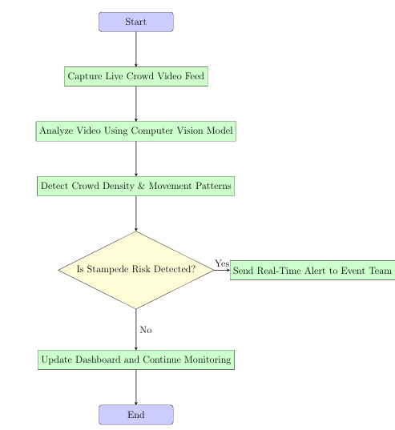
System Architecture / Workflow
Input Video Feed (Live/CCTV/Recorded)
Frame Extraction
Object Detection using YOLO
People Counting
Risk Level Determination
Overlay Results on Frame
Proactive/Reactive Alerts
Display Output

Slide 8
Implementation
Used YOLO model for lightweight, real-time detection.
Crowd count displayed dynamically on video.
FPS display to monitor system efficiency.
Configurable thresholds for flexible risk classification.

Slide 9
Result
Successful detection of people in video frames.
Accurate crowd counting with real-time FPS display.
Effective risk classification and visual alerts.

Slide 10
References
Zhan, B., Monekosso, D. N., Remagnino, P., Velastin, S. A., & Xu, L. Q. (2008). Crowd analysis: a survey. Machine Vision and Applications, 19(5-6), 345-357. https://doi.org/10.1007/s00138-008-0132-4
Birmohan Singh; Dalwinder Singh; Gurwinder Singh; Neeraj Sharma; Vicky Sib- bal “Motion detection for video surveillance”.
Ultralytics. YOLOv8 Documentation. https://docs.ultralytics.com
Zhan, B., Monekosso, D. N., Remagnino, P., Velastin, S. A., & Xu, L. Q. (2008). Crowd analysis: a survey. Machine Vision and Applications, 19(5-6), 345-357. https://doi.org/10.1007/s00138-008-0132-4
Redmon, J., & Farhadi, A. (2018). YOLOv3: An Incremental Improvement. arXiv preprint. https://arxiv.org/abs/1804.02767
Ultralytics Team. (2024). YOLOv8 Tutorials and Code Examples. Retrieved from: https://github.com/ultralytics/ultralytics
Python Software Foundation. (2024). Python 3.10 Documentation. Retrieved from: https://docs.python.org/3/
Chakraborty, T., & Banerjee, S. (2021). Real-time crowd monitoring and risk analysis using deep learning techniques: A review. International Journal of Information Management, 58, 102325. https://doi.org/10.1016/j.ijinfomgt.2020.102325
Chen et al. (2018). Deep Learning for Crowd Analysis, IEEE TCSVT.

Slide 11
Thank You

