Slide 1

Automata Formal Languages & Logic UE24CS243A
Introduction to the Course
Divyaprabha K N
Department of Computer Science & Engineering

Slide 2

Course Objectives
Understand different classes of languages and grammars
Analyze finite automata, PDA, and Turing Machines
Explore language properties and computability limits
Introduce logic-based reasoning and inference method

Slide 3
Why study AFLL? (APPLICATIONS)
Foundation for compiler design and language parsing
Applied in AI, NLP, network security, verification
Helps in understanding computability and logic
Boosts problem-solving and abstract reasoning skills
Etc…………………………

Slide 4
Course Structure
Unit 1: Finite Automata and Regular Languages (14 hrs)
Unit 2: PDA and Context-Free Languages (14 hrs)
Unit 3: Turing Machines & CFG Properties (14 hrs)
Unit 4: Undecidability & Declarative Logic (14 hrs)

Slide 5
Unit 1 – Finite Automata
Mathematical Notations and Basic Concepts
Deterministic & Non-Deterministic Finite Accepters
State Reduction and Regular Expressions
Practical Regex usage and Regular Grammars

Slide 6
Unit 2 – PDA & Context-Free Languages
Closure Properties of Regular Languages
PDA: Deterministic and Non-Deterministic
Context-Free Grammars and their Applications

Slide 7
Unit 3 Overview – Turing Machines & CFG Properties
Ambiguity and Normal Forms of CFGs
Closure Properties and Pumping Lemma for CFLs
Turing Machines and Computability

Slide 8
Unit 4 Overview – Undecidability & Logic
Recursive Languages and the Chomsky Hierarchy
Rice’s Theorem and Proof Techniques
Propositional & First Order Logic and Inference

Slide 9
Tools Used
JFLAP: Automata simulation and visualization
PLY (Python Lex-Yacc): Lexical analysis & parsing
Optional: Python for regular expressions

Slide 10
Course Expectations
- Active participation and regular practice
- Bi-Weekly assignments
- ISA and final exam assessments
- Application-focused learning with logic and modeling

Slide 11
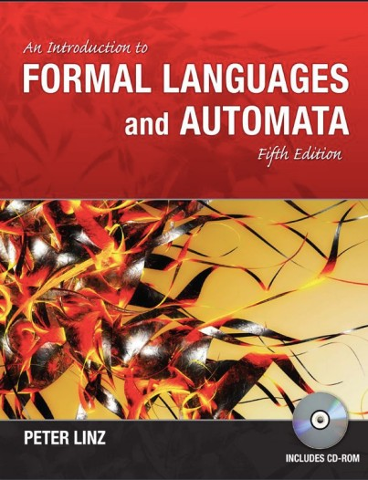
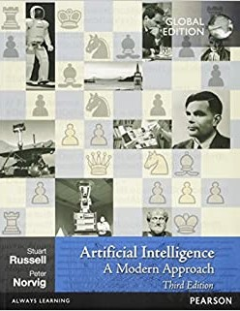
Text Books:
Text Book(s):
“An Introduction to Formal Languages and Automata”, Peter Linz, Jones and Bartlett, New Delhi, India, 5th Edition, 2011.
“Artificial Intelligence – A Modern Approach”, Stuart Russell and Peter Norvig, Pearson, 3rd Edition (Paperback), 2016
Reference Book(s):
“Theory of Computation”, Michael Sipser, Cengage Learning, New Delhi, India, 2008.
“Introduction to Automata Theory, Languages, and Computation”, John E Hopcroft, Rajeev Motwani, Jeffrey D Ullman, Pearson Education, New Delhi, India, 3rd Edition, 2009.
“Theory of Computation: A Problem–Solving Approach”, Kavi Mahesh, Wiley India, New Delhi, 2012.

Slide 12
Key Definitions
What is meant by Computations?
Computation is executing an algorithm (i.e.) it involves taking some inputs and performing required operation on it to produce an output.
Input x
Output y=f(x)
Computation is the sequence of steps that can be performed by computer.
The computer which performs computation is not actual computers they are “abstract machines”. It can be defined mathematically.
Examples of abstract machines
Turing Machine (Powerful as real Computers)
Finite Automata (Simple)
What is theory of computations?
The theory of computation is the branch that deals with how efficiently problems can be solved on a model of computation, using an algorithm. The field is divided into three major branches:
automata theory,
computability theory,
computational complexity theory

Slide 13
Key Definitions
What is Automata Theory?
Automata theory is the study of abstract machines (or abstract 'mathematical' machines or systems) and the computational problems that can be solved using these machines. These abstract machines are called automata.
Automata which means that something is doing something by itself. Automata theory is also closely related to formal language theory, as the automata are often classified by the class of formal languages they are able to recognize.
An automaton can be a finite representation of a formal language that may be an infinite set.
What is a formal language?
Language is a set of valid strings from some alphabet. The set may be empty, finite or infinite.
L(M) is the language defined by machine M and L(G) is the language defined by context free grammar.
The two notations for specifying formal languages are:
Grammar or regular expression (Generative approach)
Automaton (Recognition approach)

Slide 14
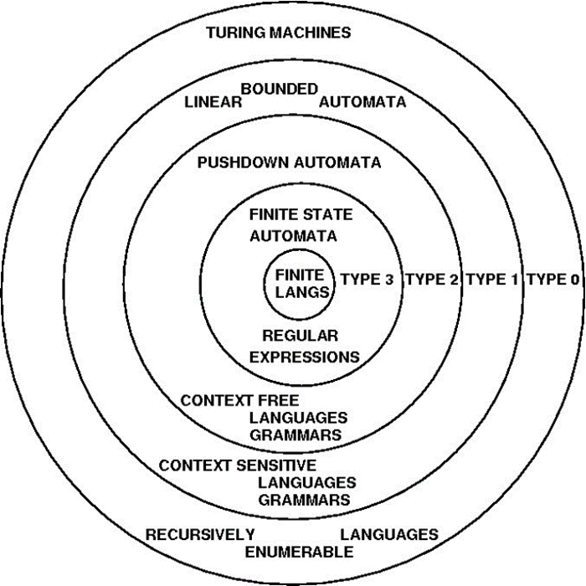
Key Definitions – Formal Languages/Grammar/
The Chomsky hierarchy in the fields of formal language theory, computer science, and linguistics, is a containment hierarchy of classes of formal grammars.

Slide 15
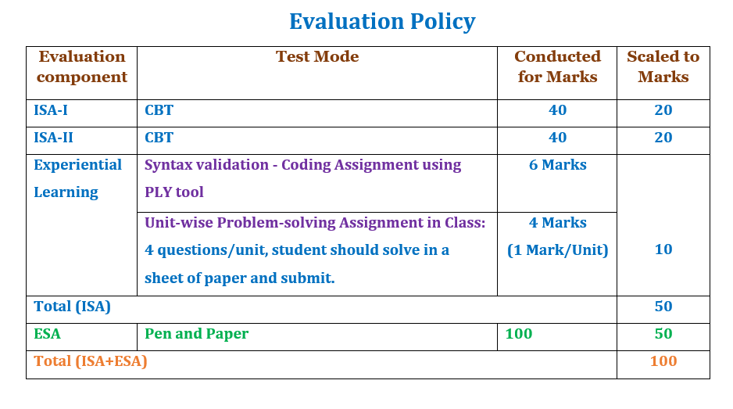
Course Evaluation Strategy

Slide 16
THANK YOU
Divyaprabha K N
Department of Computer Science & Engineering divyaprabha@pes.edu

