Slide 1

MATHEMATICS FOR COMPUTER SCIENCE ENGINEERS
Sampling Distribution
Mamatha.H.R
Department of Computer Science and
Engineering

Slide 2
MATHEMATICS FOR COMPUTER SCIENCE ENGINEERS
Sampling Distribution
Mamatha H R
Department of Computer Science and Engineering

Slide 3
MATHEMATICS FOR COMPUTER SCIENCE ENGINEERS
Sampling Distribution
In inferential statistics, we want to use characteristics of the sample (i.e. a statistic) to estimate the characteristics of the population (i.e. a parameter).
If we obtain a random sample and calculate a sample statistic from that sample, the sample statistic is a random variable .
The population parameters, however, are fixed. If the statistic is a random variable, can we find the distribution? The mean? The standard deviation?

Slide 4
MATHEMATICS FOR COMPUTER SCIENCE ENGINEERS
Sampling Distributions
The answer is yes! This is why we need to study the sampling distribution of statistics. So what is a sampling distribution?

Slide 5
MATHEMATICS FOR COMPUTER SCIENCE ENGINEERS
Sampling Distributions
The sampling distribution of a statistic is a probability distribution based on a large number of samples of size n from a given population.

Slide 6
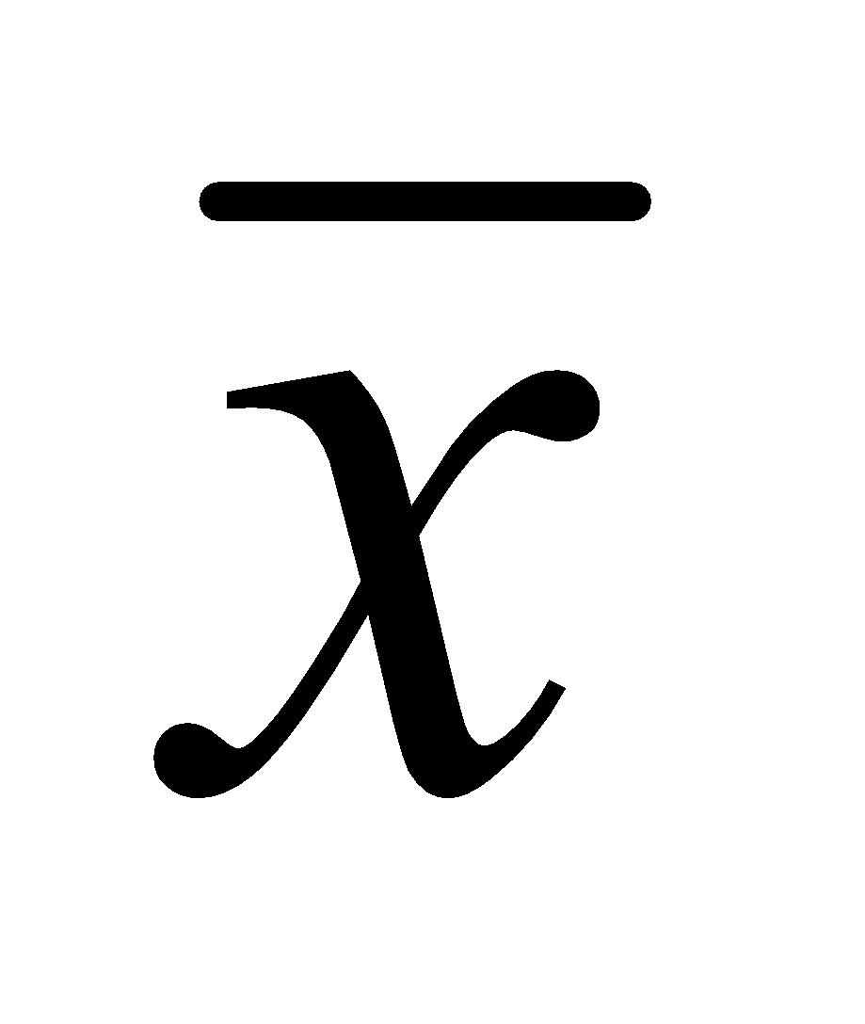
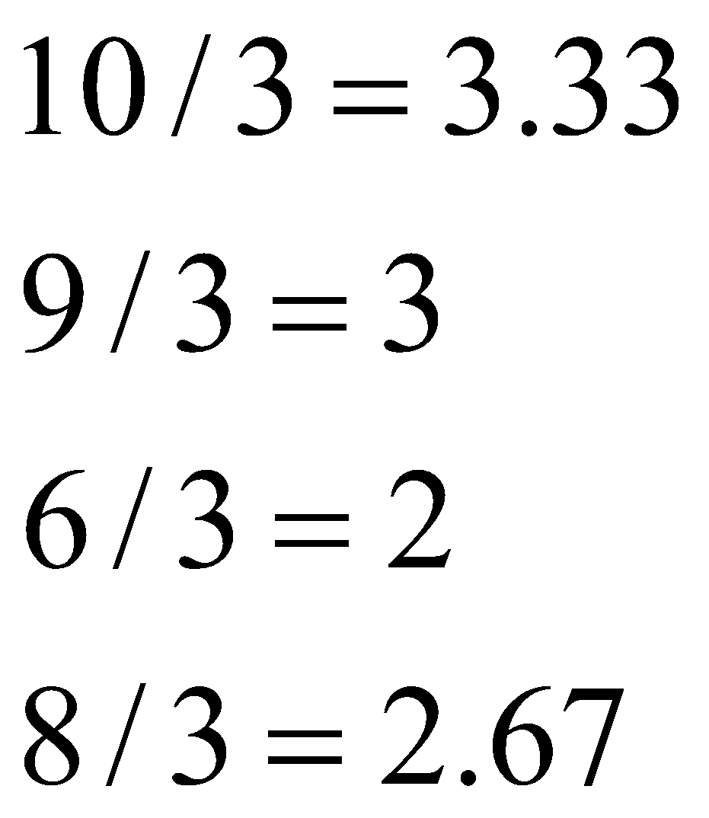
MATHEMATICS FOR COMPUTER SCIENCE ENGINEERS
Sampling Distributions
Population: 3, 5, 2, 1
Draw samples of size n = 3 without replacement
Possible samples
3, 5, 2
3, 5, 1
3, 2, 1
5, 2, 1
p(x)
1/4
Each value of x-bar is equally likely, with probability 1/4
x
2 3

Slide 7
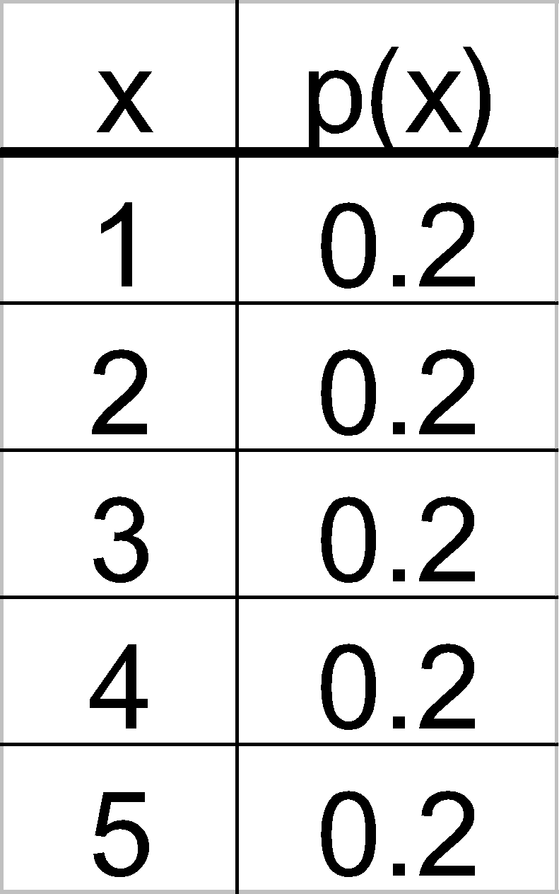
MATHEMATICS FOR COMPUTER SCIENCE ENGINEERS
Sampling Distributions
Consider a population that consists of the numbers 1, 2, 3, 4 and 5 generated in a manner that the probability of each of those values is 0.2 no matter what the previous selections were. This population could be described as the outcome associated with a spinner such as given below with the distribution next to it.

Slide 8
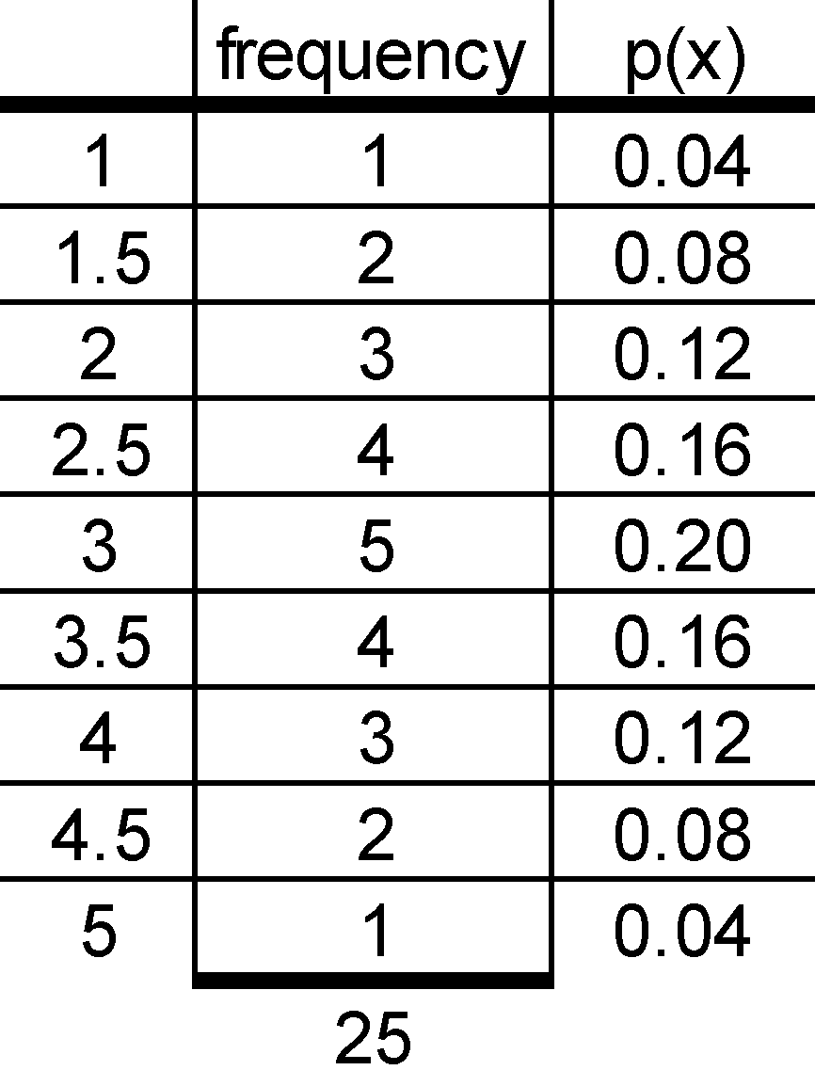
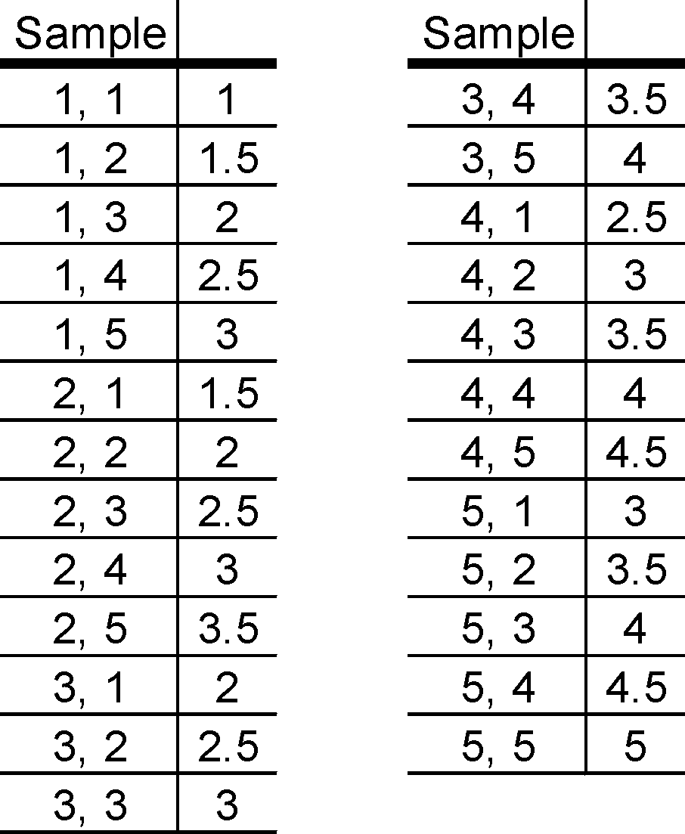
MATHEMATICS FOR COMPUTER SCIENCE ENGINEERS
Sampling Distributions
Population Mean
μ=E[X]=∑​k⋅P(X=k)=(1+2+3+4+5)⋅0.2=15⋅0.2=3
If the sampling distribution for the means of samples of size two is analyzed, it looks like

Slide 9
MATHEMATICS FOR COMPUTER SCIENCE ENGINEERS
Sampling Distributions
Find the statistic means
X=E[X]=∑​x⋅P(x)=1x0.4+1.5x.08+2x.12+2.5x0.16+3x0.2+3.5x.16+4x.12+4.5x0.08+5x0.04=3

Slide 10
MATHEMATICS FOR COMPUTER SCIENCE ENGINEERS
Sampling Distributions
The original distribution and the sampling distribution of means of samples with n=2 are given below.
1
2
3
4
5
1
2
3
4
5
Original distribution
Sampling distribution
n = 2

Slide 11
MATHEMATICS FOR COMPUTER SCIENCE ENGINEERS
Sampling Distributions
Sampling distributions for n=3 and n=4 were calculated and are illustrated below. The shape is getting closer and closer to the normal distribution.
1
2
3
4
5
Original distribution
1
2
3
4
5
Sampling distribution n = 2
1
2
3
4
5
1
2
3
4
5
Sampling distribution n = 3
Sampling distribution n = 4

Slide 12
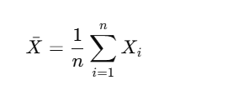
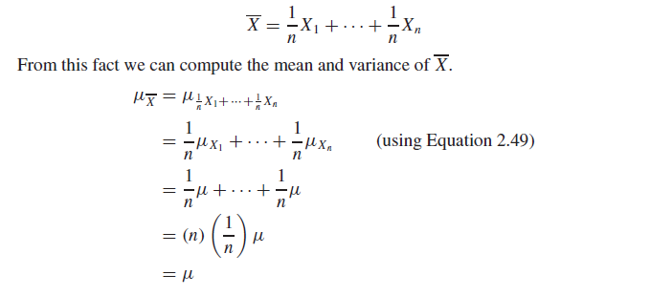
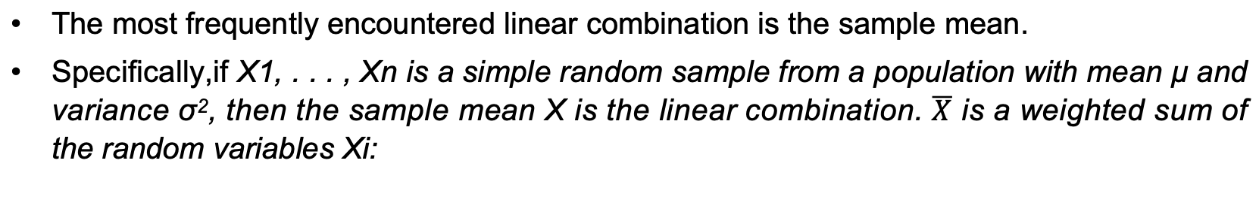
MATHEMATICS FOR COMPUTER SCIENCE ENGINEERS
The Mean and Variance of a Sample Mean
The most frequently encountered linear combination is the sample mean.
Specifically,if X1, . . . , Xn is a simple random sample from a population with mean μ and variance σ², then the sample mean X is the linear combination. $\overline{X}$ is a weighted sum of the random variables Xi​:
X_{i} are identically distributed, which means they have the same mean μ

Slide 13
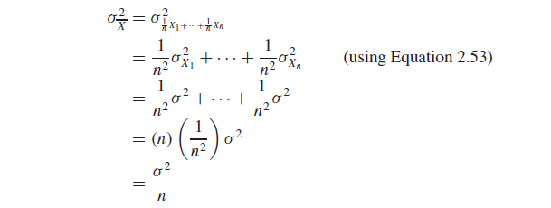
MATHEMATICS FOR COMPUTER SCIENCE ENGINEERS
The Variance of a Sample Mean
the items in a simple random sample may be treated as independent random variables. Therefore

Slide 14
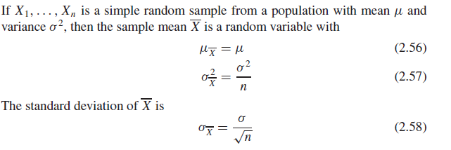
MATHEMATICS FOR COMPUTER SCIENCE ENGINEERS
The Mean and Variance of a Sample Mean

Slide 15
MATHEMATICS FOR COMPUTER SCIENCE ENGINEERS
Sampling Distribution-Example
A process that fill the plastic bottles with a beverage has a mean fill volume of 2.013L and a standard deviation of 0.005L. A case contains 24 bottles. Assuming that the bottles in a case are a simple random sample of bottles filled by this method. Find the mean and standard deviation of the average volume per bottle in a case.

Slide 16
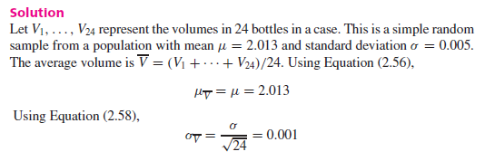
MATHEMATICS FOR COMPUTER SCIENCE ENGINEERS
Sampling Distribution-Example

Slide 17
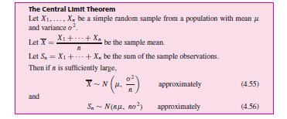

MATHEMATICS FOR COMPUTER SCIENCE ENGINEERS
The Central Limit Theorem

Slide 18
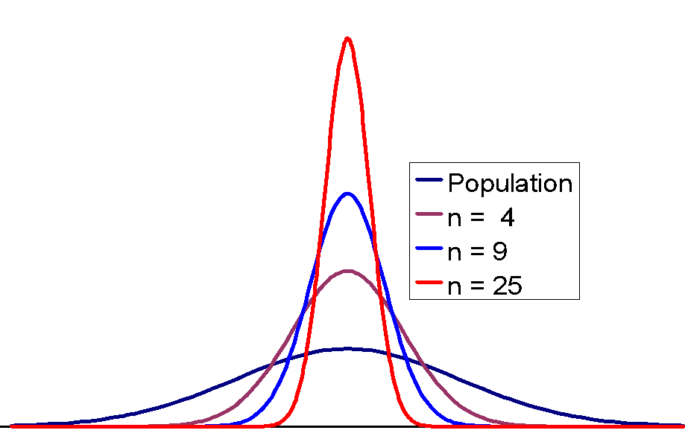
MATHEMATICS FOR COMPUTER SCIENCE ENGINEERS
Illustrations of Sampling Distributions
Symmetric normal like population

Slide 19
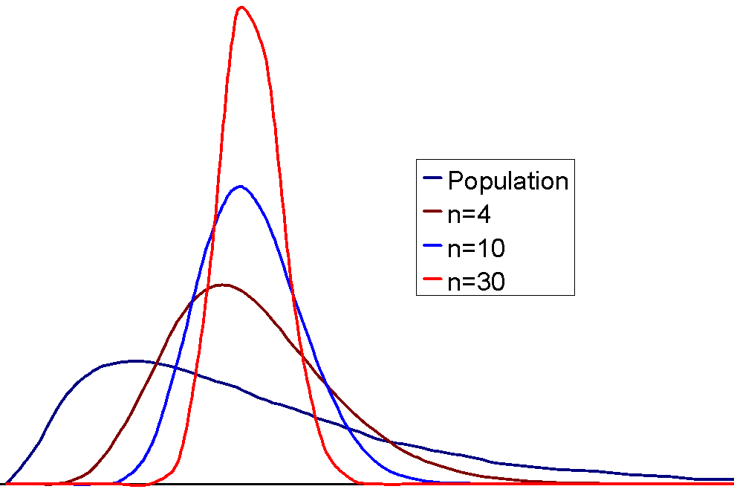
MATHEMATICS FOR COMPUTER SCIENCE ENGINEERS
Illustrations of Sampling Distributions
Skewed population

Slide 20
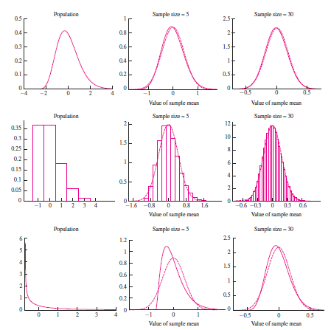
MATHEMATICS FOR COMPUTER SCIENCE ENGINEERS
Illustrations of Sampling Distributions

Slide 21
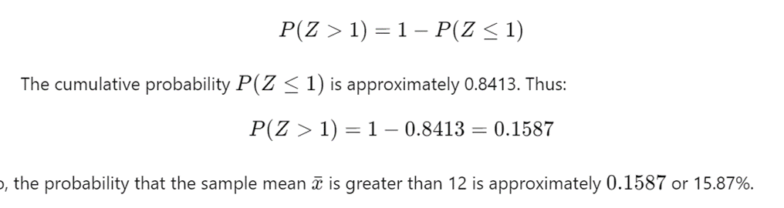
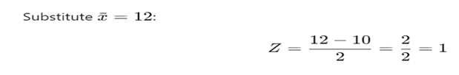
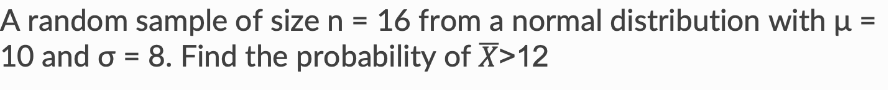
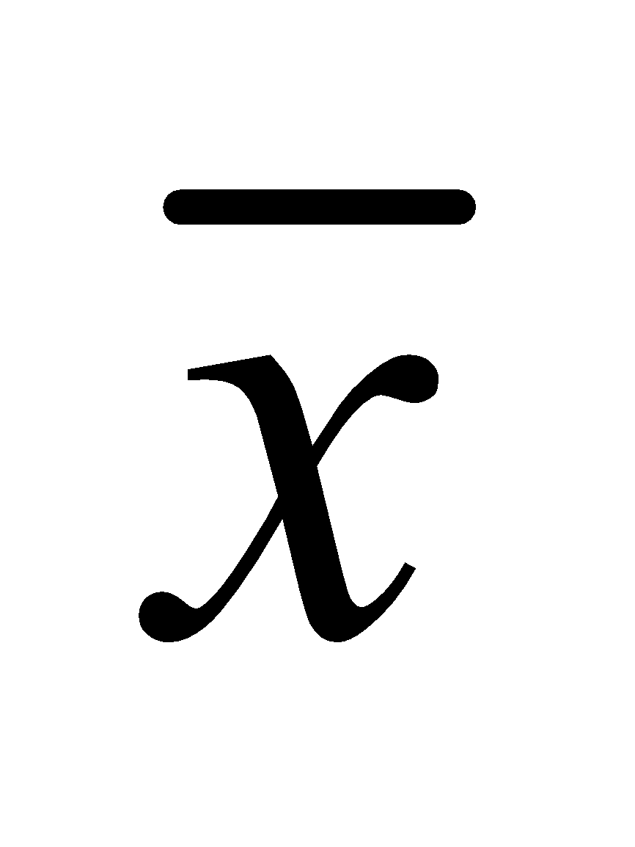
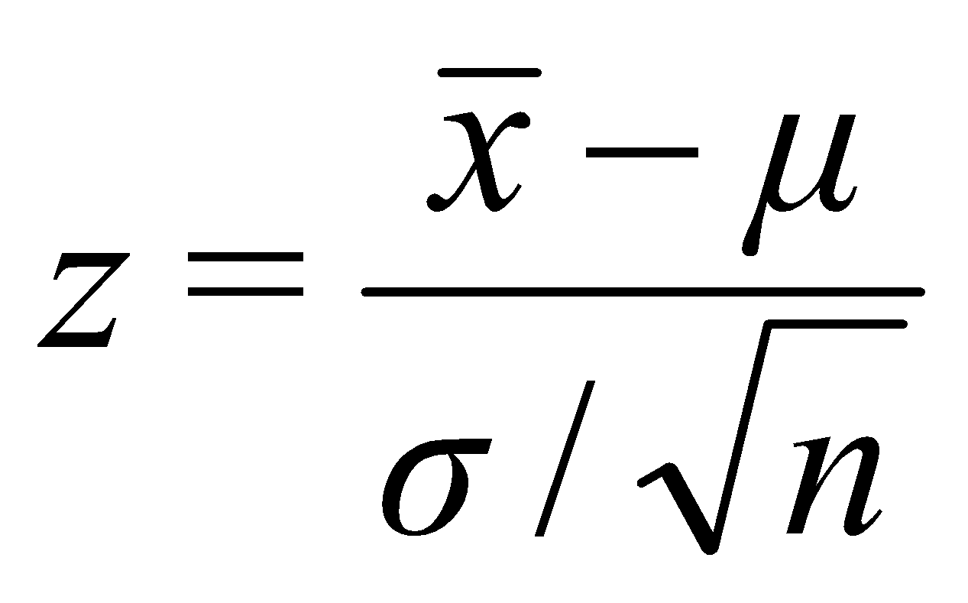
MATHEMATICS FOR COMPUTER SCIENCE ENGINEERS
Finding Probabilities for the Sample Mean
If the sampling distribution of is normal or approximately normal, standardize or rescale the interval of interest in terms of
Find the appropriate area using Table.
A random sample of size n = 16 from a normal distribution with μ = 10 and σ = 8. Find the probability of $\overline{X}$>12

Slide 22
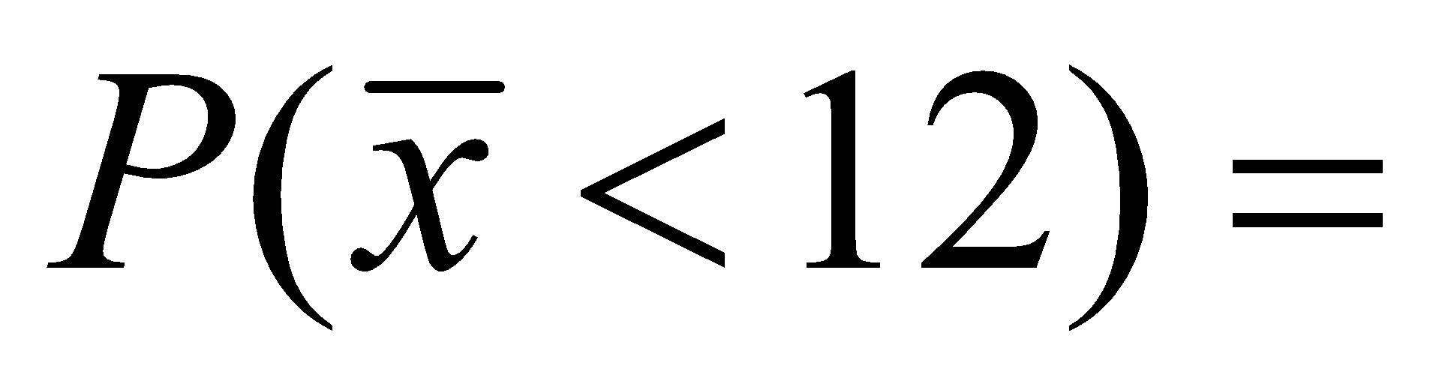
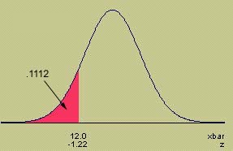
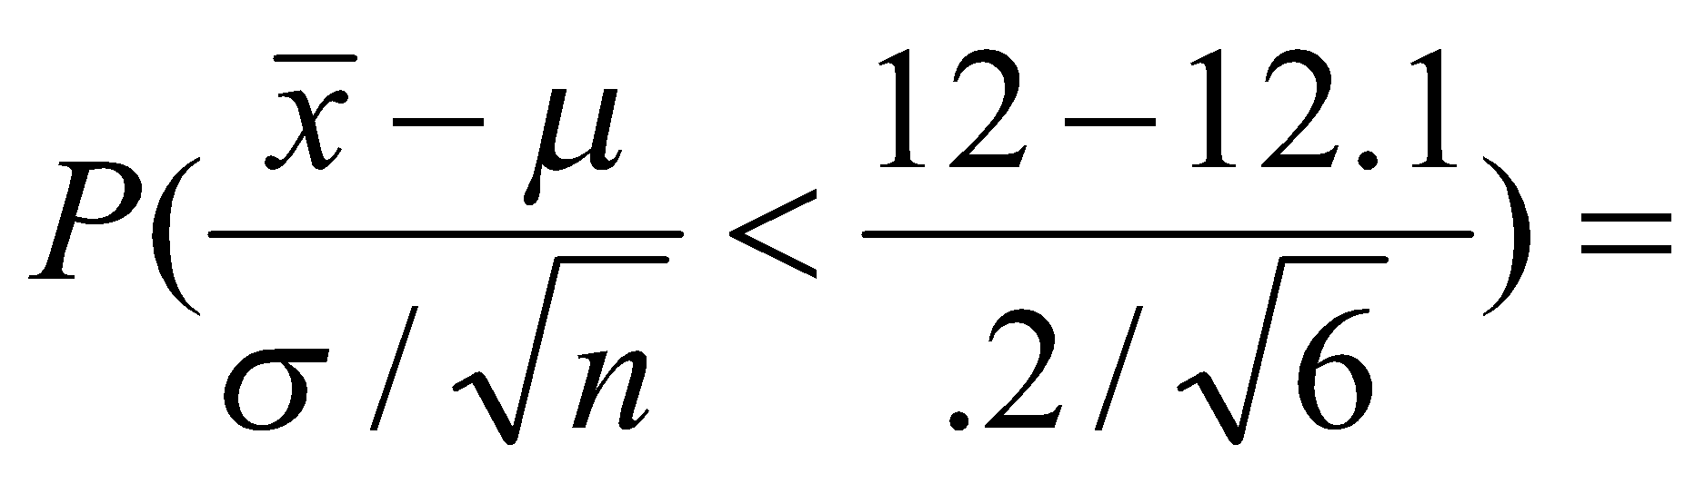
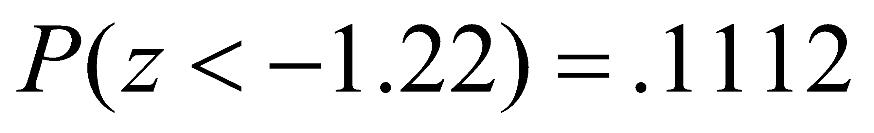
MATHEMATICS FOR COMPUTER SCIENCE ENGINEERS
Example
A soda filling machine is supposed to fill cans of soda with 12 fluid ounces. Suppose that the fills are actually normally distributed with a mean of 12.1 oz and a standard deviation of .2 oz.
What is the probability that the average fill for a 6-pack of soda is less than 12 oz?

Slide 23
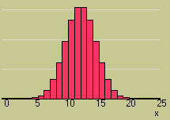
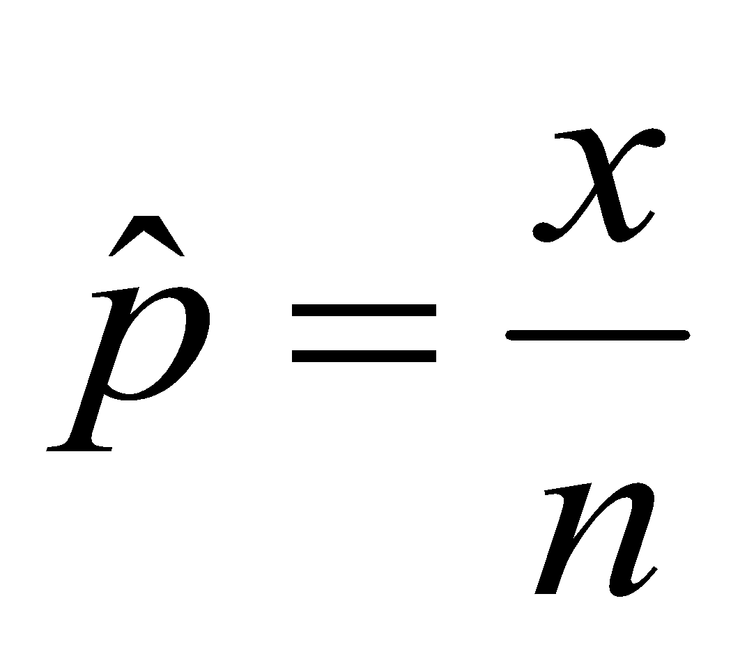
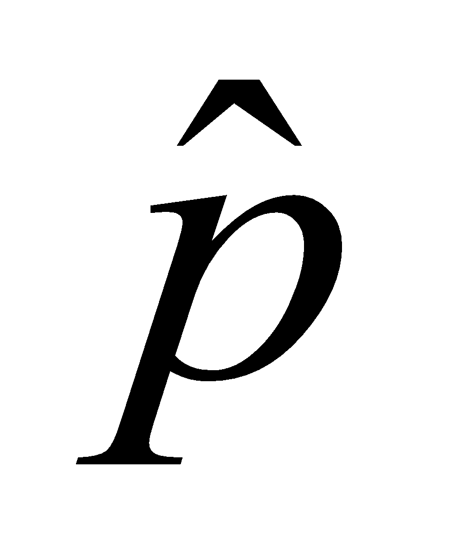
MATHEMATICS FOR COMPUTER SCIENCE ENGINEERS
The Sampling Distribution of the Sample Proportion
The Central Limit Theorem can be used to conclude that the binomial random variable x is approximately normal when n is large, with mean np and variance npq.
The sample proportion, is simply a rescaling of the binomial random variable x, dividing it by n.
From the Central Limit Theorem, the sampling distribution of will also be approximately normal, with a rescaled mean and standard deviation.

Slide 24
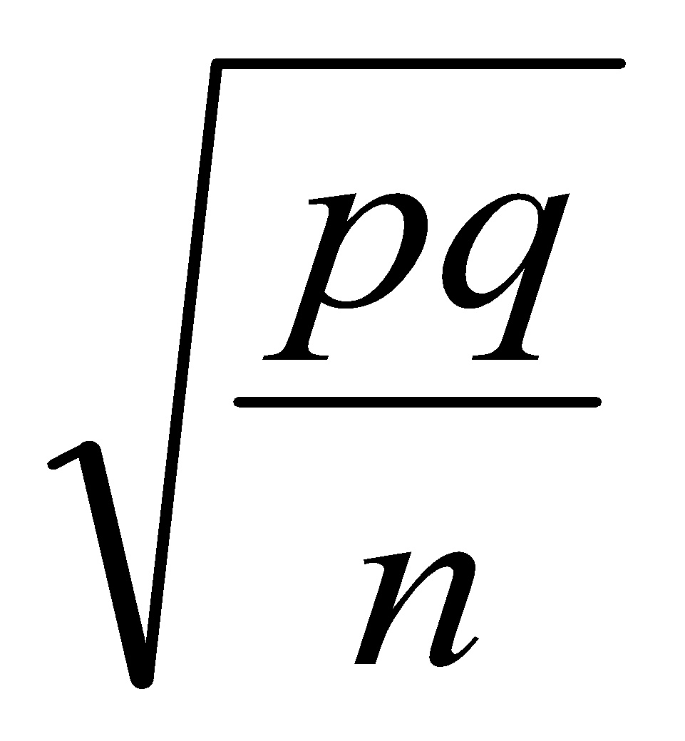
MATHEMATICS FOR COMPUTER SCIENCE ENGINEERS
The Sampling Distribution of the Sample Proportion
A random sample of size n is selected from a binomial population with parameter p.
Τhe sampling distribution of the sample proportion,
will have mean p and standard deviation
If n is large, and p is not too close to zero or one, the sampling distribution of will be approximately normal.
The standard deviation of p-hat is sometimes called the STANDARD ERROR (SE) of p-hat.

Slide 25
MATHEMATICS FOR COMPUTER SCIENCE ENGINEERS
The Sampling Distribution of the Sample Proportion
We define the sample proportion as:
p̂ = x / n where
x ~ Bin(n, p) (i.e., x follows a Binomial distribution with parameters n and p)
We know: μₓ = E[x] = np
σₓ² = Var(x) = np(1 - p)
Now, derive the expected value of the sample proportion:
E[p̂] = E[x / n]
= (1 / n) * E[x]
= (1 / n) * np
= p. Therefore, E[p̂] = p => μₚ̂ = p

Slide 26
MATHEMATICS FOR COMPUTER SCIENCE ENGINEERS
The Sampling Distribution of the Sample Proportion
Derivation of the Variance of the Sample Proportion
We know:
p̂ = x / n
Now, compute the variance:
σ²ₚ̂ = Var[p̂] = Var[x / n]
= (1 / n²) * Var[x]
= (1 / n²) * np(1 - p)
= p(1 - p) / n
Therefore,
σ²ₚ̂ = p(1 - p) / n
σₚ̂ = sqrt[p(1 - p) / n]

Slide 27
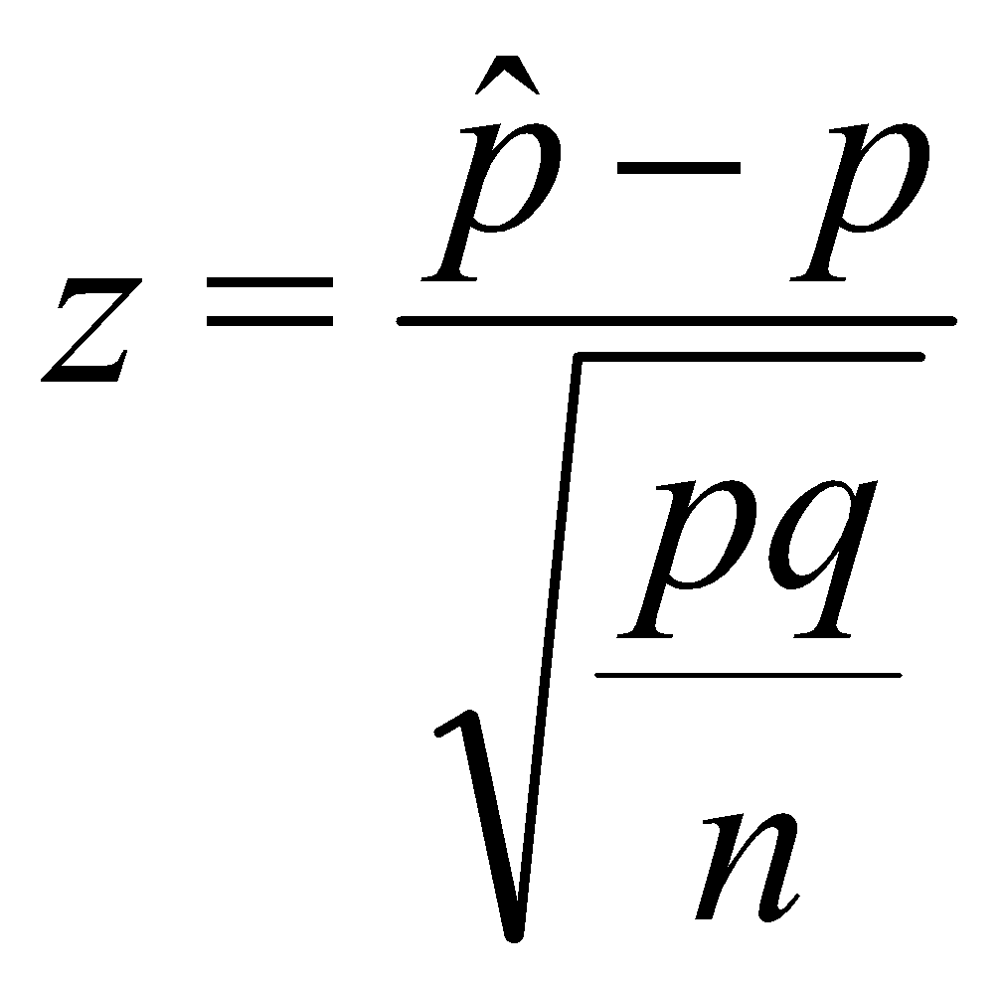
MATHEMATICS FOR COMPUTER SCIENCE ENGINEERS
Finding Probabilities for the Sample Proportion
If the sampling distribution of is normal or approximately normal, standardize or rescale the interval of interest in terms of
Find the appropriate area using Z Table .

Slide 28
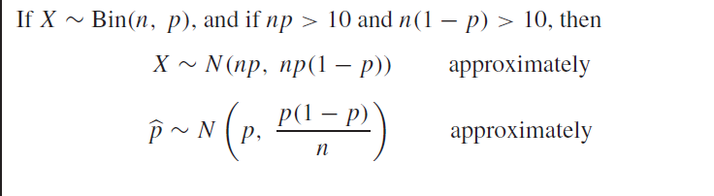
MATHEMATICS FOR COMPUTER SCIENCE ENGINEERS
Sampling Distributions

Slide 29
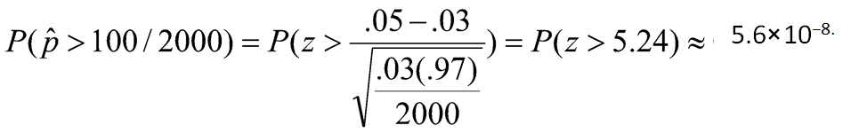

MATHEMATICS FOR COMPUTER SCIENCE ENGINEERS
Example
Suppose 3% of the people contacted by phone are receptive to a certain sales pitch and buy your product. If your sales staff contacts 2000 people, what is the probability that more than 100 of the people contacted will purchase your product?
OK to use the normal approximation
n=2000, p= 0.03, np=60, nq=1940,
This is practically zero.

Slide 30
MATHEMATICS FOR COMPUTER SCIENCE ENGINEERS
Example
Let X denote the number of flaws in a 1 in. length of copper wire. The probability mass function of X is presented in the following table.
x P(X = x)
0 0.48
1 0.39
2 0.12
3 0.01
One hundred wires are sampled from this population. What is the probability that the average number of flaws per wire in this sample is less than 0.5?

Slide 31
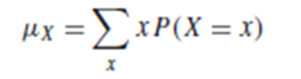
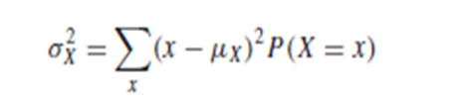
MATHEMATICS FOR COMPUTER SCIENCE ENGINEERS
Example
The population mean number of flaws is μ = 0.66, and the population variance is σ² = 0.5244
We need to find P( < 0.5).
sample size is n = 100,which is a large sample. It follows from the Central Limit Theorem
that ∼ N(0.66, 0.005244).
The z-score of 0.5 is therefore
z = (0.5 − 0.66) /√0.005244 = −2.21
From the z table, the area to the left of −2.21 is 0.0136.
Therefore P( < 0.5) =0.0136, so only 1.36% of samples of size 100 will have fewer than 0.5 flaws per wire.

Slide 32
MATHEMATICS FOR COMPUTER SCIENCE ENGINEERS
Example
At a large university, the mean age of the students is 22.3 years, and the standard deviation is 4 years. A random sample of 64 students is drawn. What is the probability that the average age of these students is greater than 23 years?

Slide 33
MATHEMATICS FOR COMPUTER SCIENCE ENGINEERS
Example
Let X1, . . . , X64 be the ages of the 64 students in the sample.
Find P( > 23).
Now the population from which the sample was drawn has mean
μ = 22.3 and variance σ² = 16.
The sample size is n = 64.
It follows from the Central Limit Theorem that ∼ N(22.3, 0.25).
The z-score for 23 is
z = 23 − 22.3 /√0.25= 1.40
From the z table, the area to the right of 1.40 is 0.0808.
Therefore P( > 23) =0.0808.

Slide 34
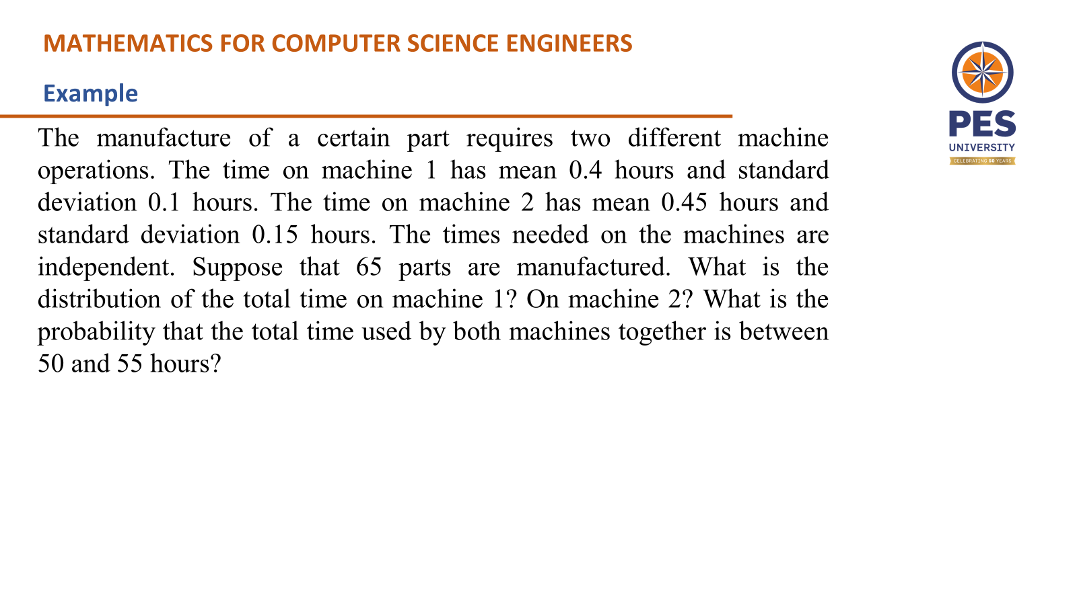

Slide 35
MATHEMATICS FOR COMPUTER SCIENCE ENGINEERS
Example

Slide 36
MATHEMATICS FOR COMPUTER SCIENCE ENGINEERS
Example
Let X1, . . . , X65 represent the times of the 65 parts on machine 1.
The population from which this sample was drawn has mean μ_{X} = 0.4 and standard deviation σ_{X} = 0.1.
Let S_{X} = X1 + ··· + X65 be the total time on machine 1.
It follows from the Central Limit Theorem that
S_{X} ∼ N(65μ_{X} , 65σ²_{X}) = N(26, 0.65)

Slide 37
MATHEMATICS FOR COMPUTER SCIENCE ENGINEERS
Example
Let Y1, . . . , Y65 represent the times of the 65 parts on machine 2.
The population from which this sample was drawn has mean μ_{Y} = 0.45 and standard deviation σ_{Y} = 0.15.
Let S_{Y} = Y1 + ··· + Y65 be the total time on machine 2.
It follows from the Central Limit Theorem that
S_{Y} ∼ N(65μ_{Y} , 65σ²_{Y}) = N(29.25, 1.4625)

Slide 38
MATHEMATICS FOR COMPUTER SCIENCE ENGINEERS
Example
let T = S_{X} + S_{Y} represent the total time on both machines.
Since
S_{X} ∼ N(26, 0.65), S_{Y} ∼ N(29.25, 1.4625), and S_{X} and S_{Y} are independent, it follows that
μ_{T} =26+29.25=55.25, σ²_{T}=0.65+1.4625=2.1125, and
T ∼ N(55.25, 2.1125)
To find P(50 < T < 55) we compute the z-scores of 50 and of 55.
z = (50 − 55.25) /√2.1125= −3.61
z = (55 − 55.25) /√2.1125= −0.17

Slide 39
MATHEMATICS FOR COMPUTER SCIENCE ENGINEERS
Example
The area to the left of z = −3.61 is 0.0002.
The area to the left of z = −0.17 is 0.4325.
The area between z = −3.61 and z = −0.17 is 0.4325 − 0.0002 = 0.4323.
The probability that the total time used by both machines together is between 50 and 55 hours is 0.4323

Slide 40
MATHEMATICS FOR COMPUTER SCIENCE ENGINEERS
Questions
According to the Central Limit Theorem, as sample size increases, the sampling distribution of the sample mean:
A) Becomes skewed B) Approaches a normal distribution C) Becomes uniform D) Becomes bimodal
2. Which of the following conditions is necessary for applying the Central Limit Theorem?
A) The population must be normally distributed B) The population must be finite C) The sample size must be large D) The population mean must be zero
3. If the sample size is increased, the standard error of the mean will:
A) Increase B) Remain the same C) Decrease D) Become zero

Slide 41
MATHEMATICS FOR COMPUTER SCIENCE ENGINEERS
Answers
C
C
C

Slide 42
THANK YOU
Dr.Mamatha H R
Department of Computer Science and Engineering

