Slide 1

DATA STRUCTURES AND ITS APPLICATIONS
Vandana M L
Department of Computer Science and Engineering

Slide 2
DATA STRUCTURES AND ITS APPLICATIONS
Introduction to Data Structures
Vandana M L
Department of Computer Science and Engineering

Slide 3
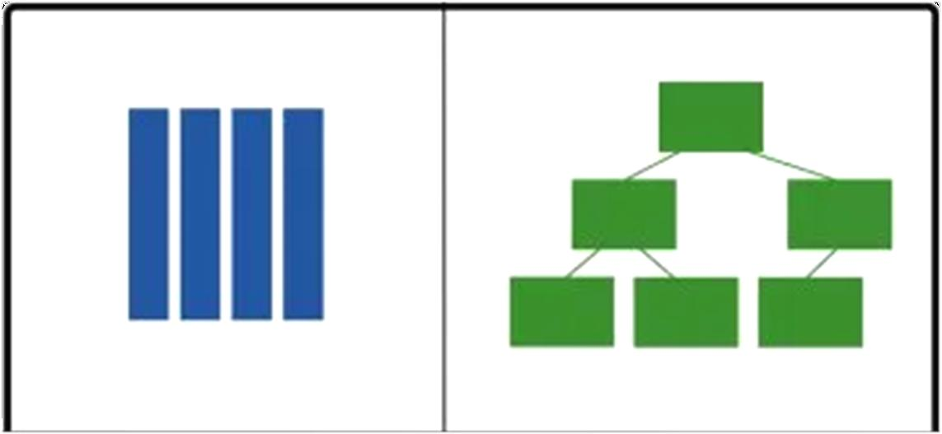
DATA STRUCTURES AND ITS APPLICATIONS
Introduction to Data Structures
Data Structure is a scheme of organizing data in the memory of the computer in such a way that various operations can be performed efficiently on this data

Slide 4
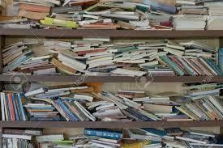

DATA STRUCTURES AND ITS APPLICATIONS
Introduction to Data Structures
Why Data Structure?

Slide 5


DATA STRUCTURES AND ITS APPLICATIONS
Introduction to Data Structures
Why Data Structures?
Computer systems deal with large amount of data ( text ,image, relational data etc.)
Hello!!!
I am Algorithm Lets Crack this problem together
Data is just the raw material for information, analytics, business intelligence, advertising, etc.
Hey !!!
I am Data Structure
The way data is organized in memory plays a key role in deciding the time complexity of the algorithms designed for solving the problems
Data Structures and algorithm go hand in hand

Slide 6
DATA STRUCTURES AND ITS APPLICATIONS
Introduction to Data Structures
Importance of Data Structures
Data Structures is most fundamental and building block concept in computer science
Good knowledge of Data Structures is required to build efficient software systems

Slide 7
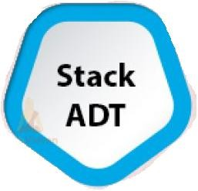
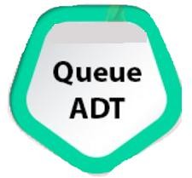


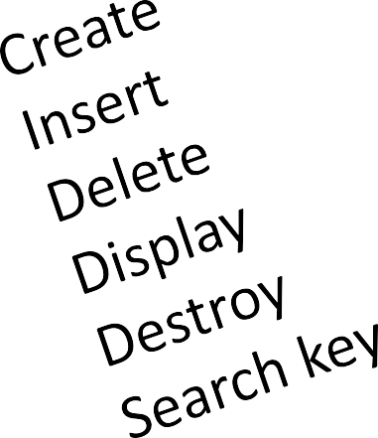

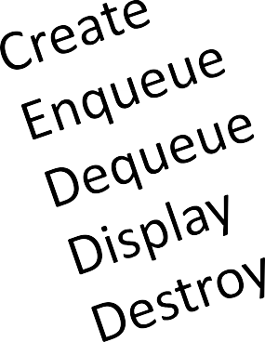

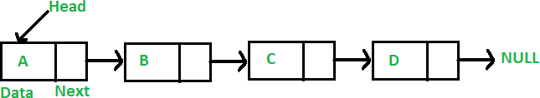

Data Structures and its Applications Abstract Data Type
Abstract Data Type is used to represent data and operations associated with an entity from the point of view of user irrespective of implementation
A. DT can be implemented using one or more Data Structures and
Algorithms

Slide 8
DATA STRUCTURES AND ITS APPLICATIONS
Classification of Data Structures
Linear Data Structures
Stack, Queue, Linked List
Non Linear Data Structures
Tree , Graph

Slide 9


DATA STRUCTURES AND ITS APPLICATIONS
Classification of Data Structures : Linear Data Structures
Stack Queue Linked List
Linear List using Array

Slide 10
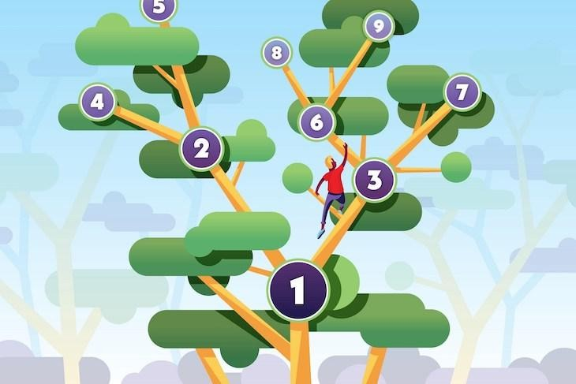
DATA STRUCTURES AND ITS APPLICATIONS
Classification of Data Structures : Non Linear Data Structures
Tree Graph

Slide 11
DATA STRUCTURES AND ITS APPLICATIONS
Few Applications of Linear Data Structures
Array
To implement other data structures
To store files in memory
Linked Lists
To implement other data structures
To manipulate large numbers
Stacks
Recursion
Infix to postfix conversion
Queues
Process Scheduling
Event handling

Slide 12
DATA STRUCTURES AND ITS APPLICATIONS
Few Applications of Non Linear Data Structures
Tree
Auto complete features (Trie)
Used by operating systems to maintain the structure of a file system
Heaps
Priority Queue implementation
Heap Sort
Graphs
Computer Networks
Shortest Path Problems

Slide 13
Data Structures and Applications Overview- Course Contents
Unit -1 : Linked List and Stacks
Review of C , Static and Dynamic Memory Allocation. Linked List: Doubly Linked List, Circular Linked List – Single and Double, Multilist: Introduction to sparse matrix (structure). Skip list Case study: Dictionary implementation using skip list Stacks: Basic structure of a Stack, Implementation of a Stack using Arrays & Linked list. Applications of Stack: Function execution, Nested functions, Recursion: Tower of Hanoi. Conversion & Evaluation of an expression: Infix to postfix, Infix to prefix, Evaluation of an Expression, Matching of Parenthesis.

Slide 14
Data Structures and Applications Overview- Course Contents
Unit -2 : Queues and Trees
Queues & Dequeue: Basic Structure of a Simple Queue, Circular Queue, Priority Queue, Dequeue and its implementation using Arrays and Linked List. Applications of Queue: Case Study – Josephus problem, CPU scheduling- Implementation using queue (simple /circular). General: N-ary trees, Binary Trees, Binary Search Trees (BST) and Forest: definition, properties, conversion of an N-ary tree and a Forest to a binary tree. Traversal of trees: Preorder, Inorder and Postorder.

Slide 15
Data Structures and Applications Overview- Course Contents
Unit -3 : Application of Trees and Introduction to Graphs
Implementation of BST using arrays and dynamic allocation: Insertion and deletion operations, Implementation of binary expression tree., Threaded binary search tree and its implementation. Heap: Implementation using arrays. Implementation of Priority Queue using heap - min and max heap. Applications of Trees and Heaps: Implementation of a dictionary / decision tree (Words with their meanings). Balanced Trees: definition, AVL Trees, Rotation, Splay Tree, Graphs: Introduction, Properties, Representation of graphs: Adjacency matrix, Adjacency list. Implementation of graphs using adjacency matrix and lists. Graph traversal methods: Depth first search, Breadth first search techniques. Application: Graph representation: Representation of computer network topology.

Slide 16
Data Structures and Applications Overview- Course Contents
Unit -4 : Applications of Graphs , B-Trees, Suffix Tree and Hashing
Application of BFS and DFS: Connectivity of graph, finding path in a network. Suffix Trees: Definition, Introduction of Trie Trees, Suffix trees. Implementations of TRIE trees, insert, delete and search operations. Hashing: Simple mapping / Hashing: hash function, hash table, Collision Handling: Separate Chaining & Open Addressing, Double Hashing, and Rehashing. Applications: URLs decoding, Word prediction using TRIE trees / Suffix Trees.

Slide 17
Data Structures and its Applications Overview- Course Contents
Text Book :
"Data Structures using C / C++", Langsum Yedidyah, Moshe J Augenstein, Aaron M Tenenbaum Pearson Education Inc, 2nd edition,2015.
Reference Book:
"Data Structures and Program Design in C", Robert Kruse, Bruce Leung, C.L Tondo, Shashi Mogalla, Pearson, 2nd Edition, 2019

Slide 18
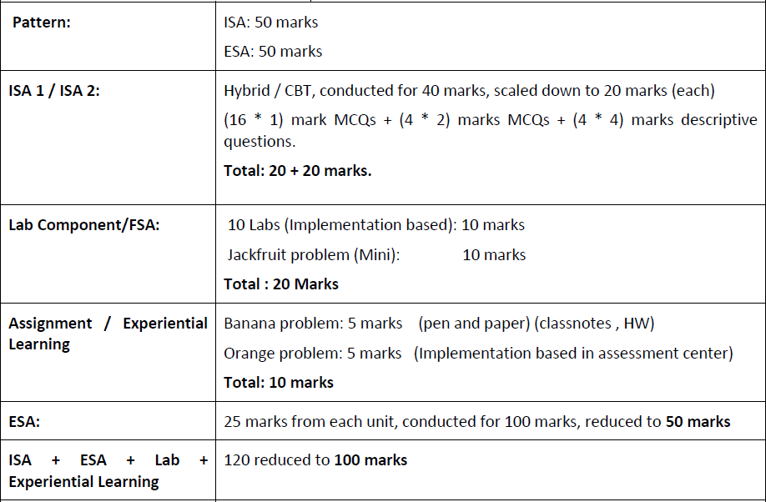
Data Structures and its Applications Evaluation Policy

Slide 19
THANK YOU
Vandana M L
Department of Computer Science & Engineering
vandanamd@pes.edu

