Slide 1

WEB TECHNOLOGIES
Introduction to WWW,
Web Protocols and URLs
Prof. Pavan A C
Department of Computer Science and Engineering
Acknowledgement:
Teaching Assistants(Samved Suresh Jain and Sathyajit P)

Slide 2
Introduction to WWW, Web Protocols and URLs
WWW
WWW stands for World Wide Web. A technical definition of the World Wide Web is − All the resources and users on the Internet that are using the Hypertext Transfer Protocol (HTTP).
In simple terms, The World Wide Web is an information system where documents and other web resources are identified by URLs, interconnected by hyperlinks and accessible via the internet.

Slide 3
Introduction to WWW, Web Protocols and URLs
Common Terms
Internet vs. Web
Web Browsers
URL
Web Server
DNS
HTTP Protocol
HTTPS

Slide 4

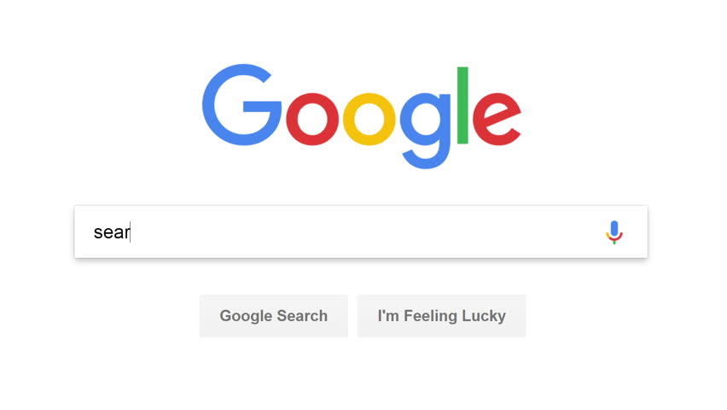
Introduction to WWW, Web Protocols and URLs
Internet vs. WWW
Internet is a network of interconnected computers and devices whereas WWW is a service that uses the internet infrastructure to transfer data
Notes:
The Internet is a global network of interconnected computers and servers that spans the entire globe. It is a massive infrastructure that allows various devices and networks to communicate with each other, enabling data exchange, communication, and information sharing. The Internet operates using a set of protocols, such as TCP/IP (Transmission Control Protocol/Internet Protocol), which govern the way data is transmitted and received between devices.
The World Wide Web, commonly known as the Web, is a subset of the Internet. It is a system of interconnected hypertext documents and resources that are accessed through the Internet using web browsers. The Web was invented by Sir Tim Berners-Lee in 1989 as a means to share and access information more efficiently.
the Internet is the underlying infrastructure, a vast global network of interconnected devices, while the World Wide Web is a specific application that runs on top of the Internet, allowing users to access and navigate web pages through hyperlinks and web browsers. The Web is just one of many services that operate on the Internet. Other services, like email, online gaming, and video conferencing, also rely on the Internet to function.

Slide 5
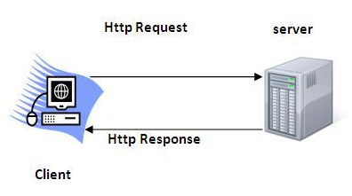
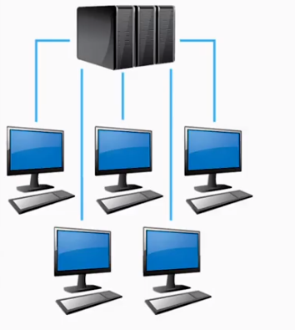
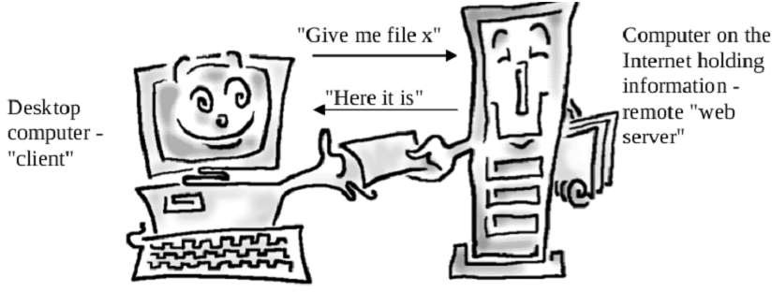
Introduction to WWW, Web Protocols and URLs
How does WWW work?
1. Client/Server Architecture
2. Request/Response Pattern

Slide 6
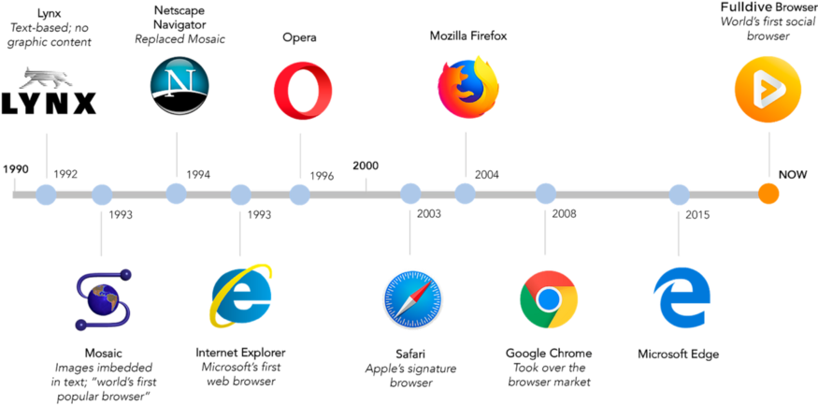

Introduction to WWW, Web Protocols and URLs
History of Web Browsers
2020
Microsoft Edge Based on chromium

Slide 7
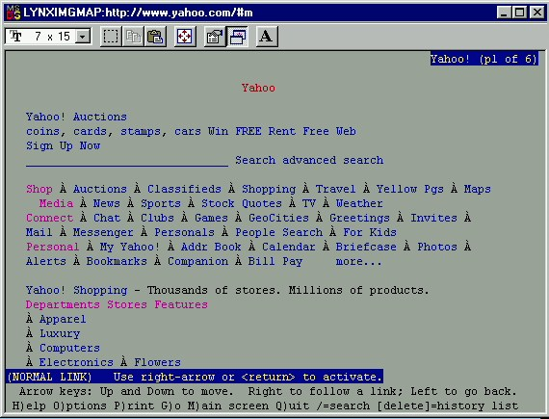
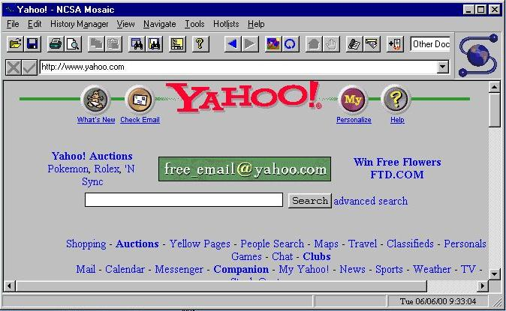
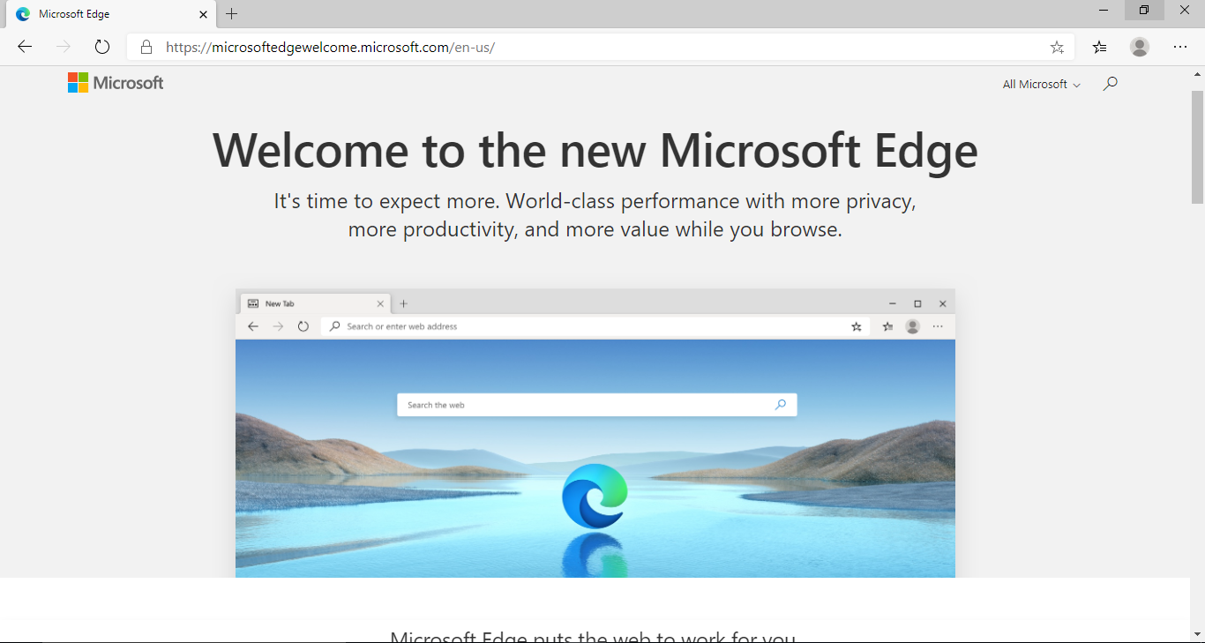
Introduction to WWW, Web Protocols and URLs
Browser Evolution
Lynx – A text based browser
Mosaic – the first graphical browser

Slide 8
Introduction to WWW, Web Protocols and URLs
URLs
URL stands for Uniform Resource Locator
In theory, each valid URL points to a unique resource on the internet, such as web pages, images etc.
It consists of a protocol/scheme, domain name and path to the resource
For example,
In https://www.example.com/page.html,
Notes:
Uniform Resource Locators (URLs): Each resource on the Web is identified by a unique address called a URL. URLs help users locate and access specific web pages or resources.
URL stands for "Uniform Resource Locator," and URI stands for "Uniform Resource Identifier." While these terms are often used interchangeably, there is a subtle difference between them:
URI (Uniform Resource Identifier): A URI is a broader term that encompasses both URLs and URNs (Uniform Resource Names). URIs are used to identify resources on the internet or any other system, and they provide a way to uniquely identify a resource. URIs consist of a string of characters that serve as a reference to a resource.
URL (Uniform Resource Locator): A URL is a specific type of URI that not only identifies a resource's location but also provides a means to locate and retrieve that resource. In other words, a URL includes information about how to access the resource, such as the protocol (e.g., HTTP, HTTPS), the domain name (or IP address), the port number, and the path to the resource.
Here's an example to illustrate the difference between a URL and a URI:
URI: urn:isbn:0451450523 This is a URI in the form of a URN (Uniform Resource Name). It uniquely identifies a resource as an ISBN (International Standard Book Number) and provides information about the format of the identifier.
URL: https://www.example.com/images/pic.jpg This is a URL that points to an image file. It includes the protocol (HTTP), the domain name (www.example.com), the path to the resource (/images/pic.jpg), and potentially additional components like query parameters or fragments.
In summary, all URLs are URIs, but not all URIs are URLs. URIs serve as a general concept for identifying resources, while URLs are a specific subset of URIs that provide information on how to access those resources.
URI (Uniform Resource Identifier): A URI is a string of characters that identifies a resource, whether it's a web page, a file, or any other item that can be accessed over a network. URIs are further divided into two subcategories: URLs and URNs.
URL (Uniform Resource Locator): A URL is a specific type of URI that not only identifies a resource but also provides a means to locate the resource by describing its address. URLs include information about the protocol to be used (e.g., HTTP, HTTPS, FTP), the domain or IP address, the port number (if necessary), the path to the resource, and potentially query parameters or fragments.
Here's a brief comparison:
URI:
A broader concept that includes both URLs and URNs.
Focuses on identifying a resource.
May or may not include information about how to access the resource.
Examples of URIs: isbn:0451450523 (URN), mailto:john@example.com (URL with 'mailto' scheme), tel:+123456789 (URL with 'tel' scheme).
URL:
A specific subset of URIs.
Not only identifies a resource but also includes information to locate and retrieve it.
Contains details like the protocol, domain, port, path, query parameters, and fragments.
Examples of URLs: https://www.example.com/page.html, ftp://ftp.example.com/file.zip, file:///path/to/local/file.txt.
In summary, while all URLs are URIs, not all URIs are URLs. URIs encompass a broader range of resource identifiers, including URLs for resource location and URNs for resource naming. URLs provide additional information beyond identification, detailing how to access the resource.
URL:
A specific subset of URIs.
Not only identifies a resource but also includes information to locate and retrieve it.
Contains details like the protocol, domain, port, path, query parameters, and fragments.
Examples of URLs: https://www.example.com/page.html, ftp://ftp.example.com/file.zip, file:///path/to/local/file.txt.
In summary, while all URLs are URIs, not all URIs are URLs. URIs encompass a broader range of resource identifiers, including URLs for resource location and URNs for resource naming. URLs provide additional information beyond identification, detailing how to access the resource.

Slide 9
Introduction to WWW, Web Protocols and URLs
URLs (cntd.)
The protocol indicates the method used to access the resource(i.e., http,https)
The domain name identifies the specific server hosting the resource(www.example.com)
The path specifies the location of the resource on the server(i.e., /page.html)

Slide 10
Introduction to WWW, Web Protocols and URLs
Web Servers
On the hardware side, a web server is a computer that stores a website's component files (for example, HTML,CSS and Javascript files). It connects to the Internet and supports physical data interchange with other devices connected to the web.
On the software side, a web server includes several parts that control how web users access hosted files. At a minimum, this is a HTTP server. A HTTP server is a software that understands URLs and HTTP which can be accessed through the domain names of the websites it stores and it delivers the content of these hosted websites to the end user's device.

Slide 11
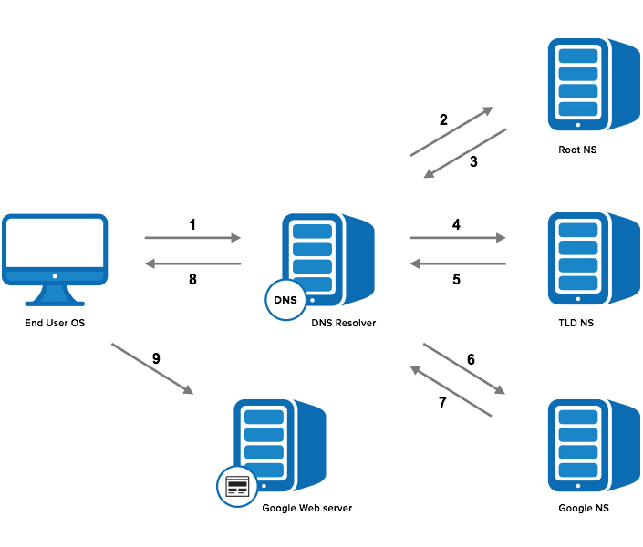
Introduction to WWW, Web Protocols and URLs
Domain Name Service
Step 1: OS Recursive Query to DNS Resolver
Step 2: DNS Resolver Iterative Query to the Root Server
Step 3: Root Server Response
Step 4: DNS Resolver Iterative Query to the TLD Server
Step 5: TLD Server Response
Step 6: DNS Resolver Iterative Query to the Google.com NS
Step 7: Google.com NS Response
Step 8: DNS Resolver Response to OS
Step 9: Browser Starts TCP Handshake

Slide 12
Introduction to WWW, Web Protocols and URLs
How to get your own website?
Steps:
1. Choose a domain name
2. Register a domain and sign up with web hosting
3. Set up a website using WordPress/Name cheap/Go Daddy (through web host)
4. Customize your website design and structure
5. Add pages and content to your website

Slide 13
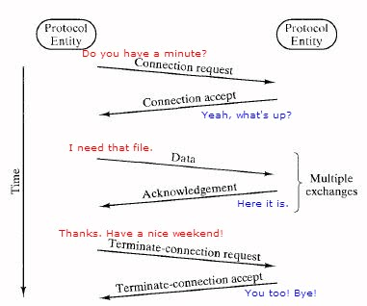
Introduction to Web Protocols and HTTP
What is a Protocol?
A protocol is a set of rules and guidelines for communicating data.
Different applications use different protocols
The web, in particular, uses multiple protocols to communicate.
The most important and visible protocols are HTTP and HTTPS.

Slide 14


Introduction to Web Protocols and HTTP
HTTP Overview
HTTP: HyperText Transfer Protocol
A protocol for fetching resources such as HTML documents
Foundation of any data exchange on the web and is a client-server protocol
Client/Server model
Client: browser that requests, receives, and “displays” Web Objects
Server: Web server sends Web Objects (using HTTP protocol) in response to requests
server
running
Apache Web
server
HTTP request
PC running
Firefox browser
HTTP response
HTTP request
HTTP response
iphone running
Safari browser

Slide 15
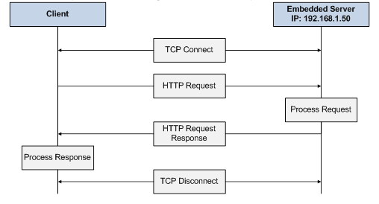
Introduction to Web Protocols and HTTP
HTTP Overview…(cntd.)
uses TCP:
client initiates TCP connection (creates socket) to server, port 80
server accepts TCP connection from client
HTTP messages (application-layer protocol messages) exchanged between browser (HTTP client) and Web server (HTTP server)
TCP connection closed
HTTP is “stateless”
server maintains no information about past client requests

Slide 16
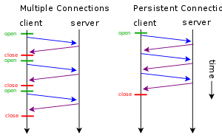
Introduction to Web Protocols and HTTP
HTTP Connections
non-persistent HTTP
at most one object sent over TCP connection
connection is then closed
downloading multiple objects required multiple connections
persistent HTTP
multiple objects can be sent over single TCP connection between client, server

Slide 17
Introduction to Web Protocols and HTTP
HTTP Requests
HTTP request is a request line, followed by zero or more request headers
Request line: <method> <uri> <version>
<version> is HTTP version of request
(HTTP/1.0 or HTTP/1.1)
<uri> is typically URL for proxies, URL suffix for servers.
<method> is either GET, POST, OPTIONS, HEAD, PUT, DELETE, or TRACE.
Request Header
Blank line (CRLF)
Message Body
GET /test.html HTTP/1.1
Accept: */*
Accept-Language: en-us
Accept-Encoding: gzip, deflate
User-Agent: Mozilla/4.0 (compatible; MSIE 4.01; Windows 98)
Host: euro.ecom.cmu.edu
Connection: Keep-Alive
CRLF (\r\n)

Slide 18
Introduction to Web Protocols and HTTP
HTTP Request Methods
HTTP methods:
GET: Retrieve static or dynamic content
POST: Send content to server through request body
OPTIONS: Get server or file attributes
HEAD: Fetches only header field without any response body
PUT: Write a file to the server
DELETE: Delete a file on the server

Slide 19
Introduction to Web Protocols and HTTP
HTTP Response
HTTP response is a response line followed by zero
or more response headers.
Response line:
<version> <status code> <status msg>
<version> is HTTP version of the response.
<status code> is numeric status.
<status msg> is a short description of the
status code
Response headers:
<header name>: <header data>
Provides additional information about response
Content-Type: MIME type of content in response body.
Content-Length: Length of content in response body.
HTTP/1.1 200 OK
Date: Thu, 22 Jul 1999 04:02:15 GMT
Server: Apache/1.3.3 Ben-SSL/1.28 (Unix)
Last-Modified: Thu, 22 Jul 1999 03:33:21 GMT
ETag: "48bb2-4f-37969101"
Accept-Ranges: bytes
Content-Length: 79
Keep-Alive: timeout=15, max=100
Connection: Keep-Alive
Content-Type: text/html
CRLF
<html>
<head><title>Test page</title></head>
<body>
<h1>Test page</h1>
</html>

Slide 20
Introduction to Web Protocols and HTTP
HTTP Response : Status Codes
Three-digit number; first digit specifies the general status
1 => Informational
2 => Success
3 => Redirection
4 => Client error
5 => Server error
<status msg> is corresponding English text.
200 OK => Request was handled without error
403 Forbidden => Client lacks permission to access file
404 Not found => Server couldn’t find the file.

Slide 21
Introduction to Web Protocols and HTTP
HTTP Secure (HTTPS)
An encrypted version of the HTTP protocol
It uses TLS(Transport Layer Security) to encrypt all communication between a client and server
This secure connection allows clients to safely exchange sensitive data with a server, such as when performing banking activities or online shopping
It protects against man-in-the-middle attacks, a popular example being eavesdropping, in which the attacker makes independent connections with the victims and relays messages between them to make them believe they are talking directly to each other over a private connection, when in fact the entire conversation is controlled by the attacker.

Slide 22
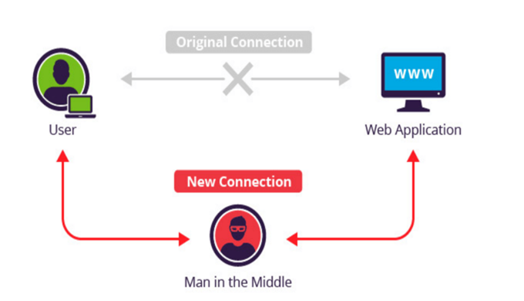
Introduction to Web Protocols and HTTP
HTTPS (cntd.)

Slide 23
Introduction to Web Protocols and HTTP
MCQ
What is the primary difference between the Internet and the World Wide Web? a) The Internet is a global network of interconnected computers, while the WWW is a subset of the Internet used for accessing hypertext documents. b)The WWW is a global network of interconnected computers, while the Internet is a subset of the WWW. c)The Internet uses HTTP, while the WWW uses TCP/IP.
d)There is no difference; the terms are interchangeable. Answer: a)

Slide 24
Introduction to Web Protocols and HTTP
MCQ
2. Which of the following best describes a URL? a)A broad term for identifying resources on the internet, including URLs and URNs. b)A specific type of URI that identifies a resource's location and provides a means to retrieve it.
c)A string of characters that serves as a reference to a resource, but does not provide access information. d) A protocol used for fetching resources such as HTML documents. Answer: b)

Slide 25
Introduction to Web Protocols and HTTP
MCQ
3. What is the main purpose of HTTPS? a) To speed up data transfer between a client and a server. b) To enable non-persistent HTTP connections. c) To encrypt all communication between a client and server using TLS for secure data exchange. d) To define the method used to access a resource. Answer: c)

Slide 26
THANK YOU
Prof. Pavan A C
Department of Computer Science and Engineering

