Slide 1

DIGITAL DESIGN AND
COMPUTER ORGANIZATION
Introduction
Team DDCO
Department of Computer Science and Engineering

Slide 2
Digital Design And Computer Organisation
Faculty Team:
RR Campus:
Dr.Chaitra N
Prof. Jayashree S
Prof.Rajeshwari CN
Prof.Shwetha Mugalihal
Dr.Suresh Babu Doarswamy
Dr.Chetana Srinivas
Ms. Sonali Kalekar K
Prof.Vivek Kashyap
Prof.Bharathi DS
Prof.Arpitha K
EC Campus:
Dr. Prajwala T R Prof. Deepti C Prof. Swati Priya Prof. Swetha Patil Dr. Monika Prof. Lenish

Slide 3
Digital Design And Computer Organisation
Course Code :UE24CS251A
Prerequisites :Basic Electronics, Programming in C

Slide 4
DIGITAL DESIGN AND COMPUTER ORGANIZATION
Course Objective
The objectives of this course are to provide a sound understanding of:
Fundamental (combinational and sequential) building blocks of digital logic circuits.
Design of more complex logic circuits such as adders, multipliers and register files.
Design of Finite State Machines based on problem specification.
Construction, using above logic circuits, of a microprocessor, and its functioning at the clock cycle level.
Tools to implement: iVerilog

Slide 5
DIGITAL DESIGN AND COMPUTER ORGANIZATION
Syllabus
Unit 1: Gate-Level Minimization and Combinational logic-1
Introduction, The map method Four variable K-map, Product of Sums simplification, Don’t Care conditions, NAND and NOR implementation, Combinational circuits, Analysis procedure Design Procedure, Combinational logic-1: Binary Combinational logic: Adder- Subtractor, Decimal Adder, Binary multiplier, Magnitude comparator Decoders Encoders, Multiplexers.
14 Hours
Unit 2: Synchronous Sequential Logic-I
Synchronous Sequential Logic: Introduction, Sequential circuits, Storage elements: Latches, Flip flops, Analysis of clocked sequential circuits, State reduction and assignment, Design procedure Registers and counters: Registers, Shift register, Ripple counters, Synchronous counters Other counters.
14 Hours

Slide 6
DIGITAL DESIGN AND COMPUTER ORGANIZATION
Syllabus
Unit 3: Basic structure of computers, Standard I/O interface, Interrupts, Memory System
Computer Types, Functional Units: Input Unit, Memory Unit, ALU, Output Unit, Control Unit, Basic operational concepts, Number representation and arithmetic Operations, Character representation, Memory locations and addresses, Memory Operations, Instruction and instruction sequencing , Addressing modes, Assembly Languages, Accessing I/O Devices, Interrupts, Standard I/O Interfaces. Semiconductor RAM memories.
14 Hours
Unit 4: Arithmetic Processing Unit and Control Unit Design Arithmetic:
Multiplication of Positive numbers, Signed operand Multiplication, Fast multiplication, Integer division, floating point numbers operation and Architecture, Some fundamental concepts, Execution of a complete instruction, Multiple Bus Organization, Hardwired control ,Micro programmed control
14 Hours

Slide 7
DIGITAL DESIGN AND COMPUTER ORGANIZATION
Syllabus
Textbook(s):
“Digital Design”, M Morris Mano, Michael D Ciletti, Pearson, 5th Edition, 2012.
“Computer Organization”, Carl Hamacher, Zvonko Vranesic, Safwat Zaky, McGraw Hill, 5th Edition,2002
References:
Digital Design & Computer Architecture, David Money Harris, Sarah L. Harris, 2nd Edition, Elsevier, 2013
Computer Organization and Design, David A. Patterson, John L. Hennessey 5th Edition, Elsevier,2013

Slide 8
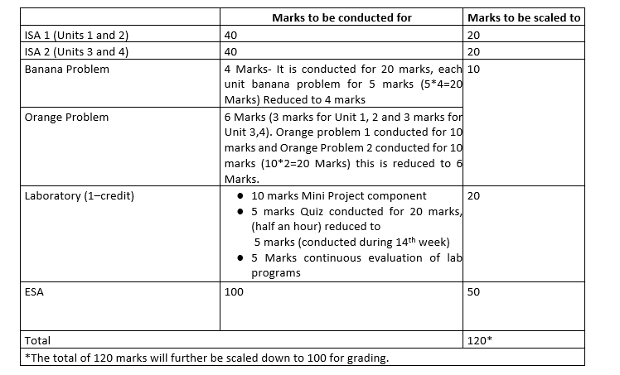
DIGITAL DESIGN AND COMPUTER ORGANIZATION
Evaluation Policy

Slide 9
DIGITAL DESIGN AND COMPUTER ORGANIZATION
What is Engineering?
Engineering
From latin ingenium: innate talent/capacity/intelligence
To design and build structures and machines (with skill/art/expertise/ingenuity)
Objective of Engineering?
Optimize fundamental physical quantities of time, space and energy
In current course, increase logic circuit speed, decrease logic resources required and
decrease power consumed

Slide 10
Perquisites-DDCO
Basic Electronics- the unit 3 of Basic electronics
Digital Electronics: Basic gates(review), Boolean Algebra, Boolean laws and theorems, Simplification of Boolean expressions, Universal gates – NAND and NOR- This is the basics for solving K maps and representing them in circuits in Unit 1 of DDCO.
Arithmetic building blocks – Half and Full Adder, Multiplexers, Demultiplexers, RS Flip-Flop – Basic idea, NAND Gate latch, Clocked RS and D Flip-Flops. – This is used in sequential Logic design of circuits in unit2 of DDCO
Using this knowledge the data path and control path of ALU is designed
Basics of C programming is desired knowledge for Lab-The Verilog language used in created of simple circuits like adders, multiplexers decoders and design of ALU has syntax similar to the C programming language.

Slide 11
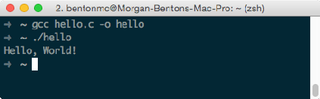
DIGITAL DESIGN AND COMPUTER ORGANIZATION
What is the course about?
Digital Design and Computer Organization: What is the course about?
You have learnt programming in C
Compile hello_world.c
Running program outputs “Hello World!”
From starting a program to the time it displays output What goes on inside your computer?
That in a nutshell is what DDCO is about
Design, organization and operation of various components in your computer at different levels of abstractions

Slide 12
DIGITAL DESIGN AND COMPUTER ORGANIZATION
Course Flow
BASIC ELECTRONICS
(1ST SEMESTER)
DIGITAL DESIGN AND COMPUTER ORGANISATION
(3RD SEMESTER)
COMPUTER NETWORKS (5TH SEMESTER)
INTRODUCTION TO OPERATING SYSTEMS (5TH SEMESTER)
MACHINE LEARNING (5TH SEMESTER)
COMPUTER GRAPHICS AND VISUALIZATION (5TH SEMESTER)
COMPILER DESIGN (6TH SEMESTER)
HIGH PERFORMANCE COMPUTING ARCHITECTURE (6TH SEMESTER)
PARALLEL COMPUTING (6TH SEMESTER)
DIGITAL IMAGE PROCESSING (6TH SEMESTER)
COMPUTER VISION (7TH SEMESTER)
INFORMATION SECURITY (7TH SEMESTER)
COMPUTER SYSTEMS PERFORMANCE ANALYSIS (7TH SEMESTER)
MICROPROCESSOR AND COMPUTER ARCHITECTURE
(4TH SEMESTER)

Slide 13
DIGITAL DESIGN AND COMPUTER ORGANIZATION Computer Organization & Computer Architecture

Slide 14
DIGITAL DESIGN AND COMPUTER ORGANIZATION Computer Organization & Computer Architecture
Why Digital Design and Computer Organization?
Foundational to Computing Systems
Forms the basis of understanding how computers work — from gates to systems.
Essential to bridge hardware and software design.
Hardware Understanding Aids Better Software Design
Enables efficient coding by understanding memory, cache, instruction cycles.
Crucial for embedded systems, real-time systems, and OS development.
Drives performance-aware programming (e.g., low-latency apps, game engines).
Write Smarter, Faster Software
Good software is not just about code — it’s about knowing the machine you’re coding for.
Learn how memory, CPU, and I/O work → write efficient code.
Understand why some programs are faster than others.

Slide 15
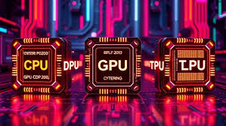

DIGITAL DESIGN AND COMPUTER ORGANIZATION Computer Organization & Computer Architecture
Why Digital Design and Computer Organization?
CPU Alone is Not Enough Anymore
Modern computing = GPU + TPU + custom hardware.
Needed for Machine Learning, Gaming, AR/VR, Data Centers.
helps you understand why and how these accelerators work.
Understand the Cloud & Networking Backbones
Ever wondered how YouTube streams, or ML runs on the cloud?
Concepts like pipelining, caching, and buses matter in networking, cloud, and IoT.
Helps in designing scalable, efficient systems.
What Top Tech Leaders Say
“To be a good programmer, understand how computers work." – Steve Jobs
"Programming without understanding hardware is like flying blind." – Linus Torvalds

Slide 16
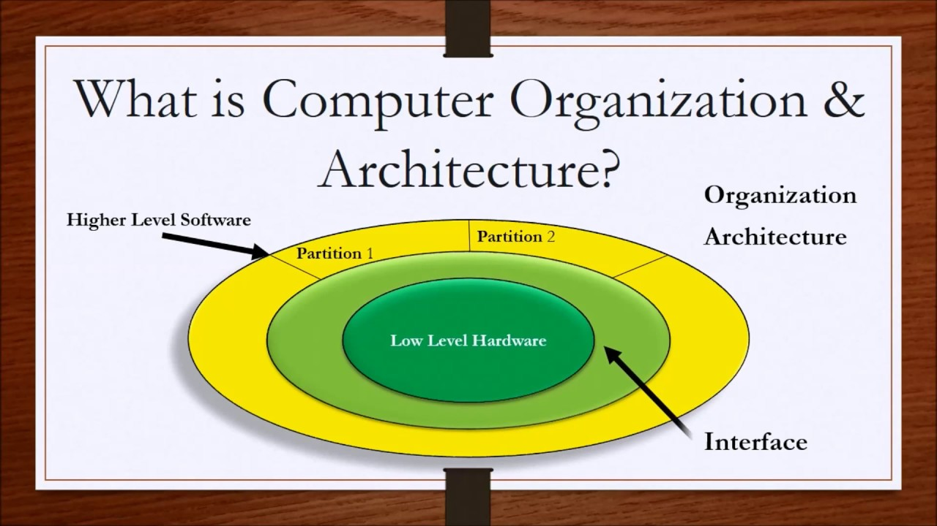
What is Computer Organization ?

Slide 17
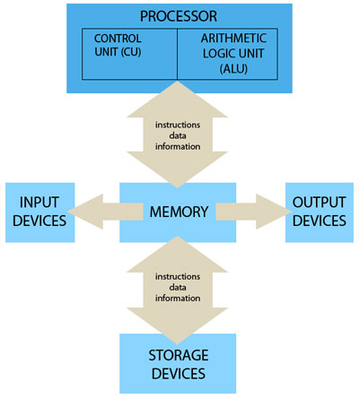
DIGITAL DESIGN AND COMPUTER ORGANIZATION Computer Organization & Computer Architecture
Computer Organization refers to the Operational Units and their interconnections that realize or recognize the specifications of Computer Architecture.
Organizational attributes includes Hardware details transparent to the programmer such as control signals , Interface between computers and peripherals and the memory technology used.

Slide 18

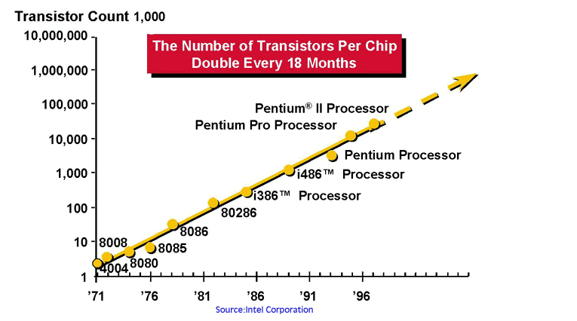
Moore’s Law
Moore’s Law Every 18 months or so:
Number of transistors (per unit chip area) doubles
Transistor speed doubles
Transistor power consumption halves
Moore’s Law is slowing down: Different computer companies show that the term is not very popular but the rule is still
Source: umsl.edu

Slide 19
Moore’s Law
For Example:
Moore's Law means ever-more powerful personal computers for less and less money.
A computer chip that contained 2,000 transistors and cost $1,000 in 1970, $500 in 1972, $250 in 1974, and $0.97 in 1990 costs less than $0.02 to manufacture today.
Moore's Law effectively means that approximately every two years personal computers and other electronic devices can do twice as many new, innovative, and unexpected things than before

Slide 20
Moore’s Law
Why Moore's Law is slowing down?
Moore's Law predicted that the number of transistors on a chip would double every two years, leading to faster and cheaper computers.
But today, we are reaching the physical limits of how small we can make transistors.
As components get smaller and packed more tightly, they produce more heat, which can damage or melt the chip.
Also, shrinking them further becomes extremely expensive and complex.
So, we can’t keep doubling performance just by making things smaller anymore — and that’s why Moore’s Law is slowing down.

Slide 21

DIGITAL DESIGN AND COMPUTER ORGANIZATION
Job Description
Position | Company | Job Profile | Job Requirement
CPU Design Engineer - Hardware | Nvidia Corporation | Design and implementation of modules. Come up with micro-architecture, implement in RTL, and deliver a fully verified, synthesis/timing clean design | Good understanding of ASIC design flow ,logic synthesis.
Logic Design Engineer | Intel Bengaluru, Karnataka | Will be responsible for design and development of Graphics, Media and Display IPs as well as discrete Graphics SoCs (GPUs), targeting both Client Device and Datacenter markets. | Good knowledge of digital logic design IP/ SoC architecture and microarchitecture.

Slide 22
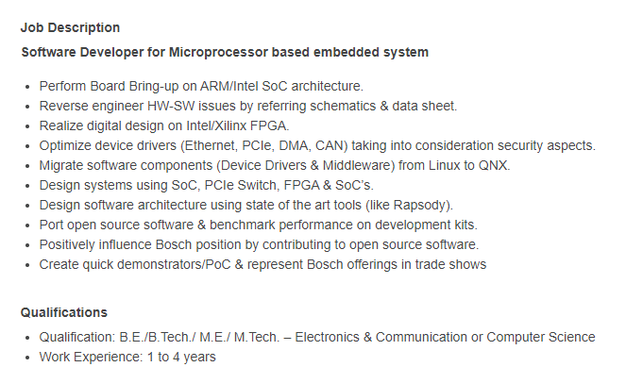

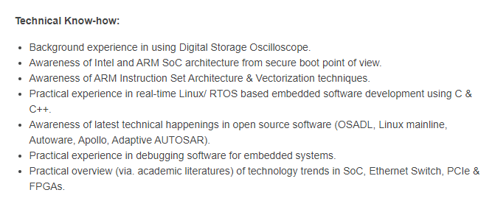
Job Description 1

Slide 23
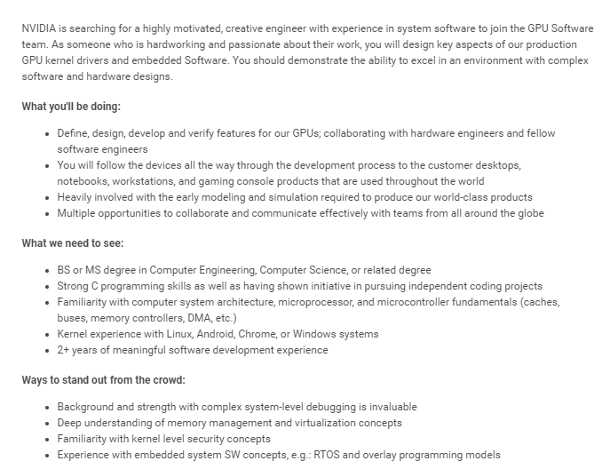

Job Description 2
System Software Engineer,
GPU Tools Development

Slide 24

Job Description 3
Role Description (Role & Responsibilities) 1. Mandatory skills 16bit 32bit Microcontroller Microprocessor
2. Embedded systems Firmware Device driver development experience Programming Strong in C
3. Communication protocols UART CAN SPI Ethernet Modbus TCP IP IDE usage
4. Code composer studio IAR workbench Code warrior RTOS VxWorks FreeRTOS Ti RTOS Bootloader
5. Multi threading concepts Preferred skills Strong in Cplusplus Assembly language experience
Capgemini
Firmware Developer
Mobiveil: CPU Processor Design
Job Summary: Bachelors or Masters degree in Computer Science or Electrical/Computer Engineering.
Understanding of general purpose CPU micro architecture, including knowledge of areas such as processor pipelines, caches, memory hierarchy, and multi-processor systems.
Knowledge and or Experience in RTL Design hardware development using Verilog, ideally block design in a CPU design project or similar high performance project.
Understanding of CPU instruction set architecture and assembly language.
Familiarity with ARM architecture and micro-architecture for current ARM CPU cores is helpful but not required.
Software development skills and/ or experience is helpful (C/C++, Python/Perl, Shell scripting) Experience modelling microprocessors using higher-level languages, like C/C++, is helpful but not required Effective communication skills and the ability to collaborate with a team

Slide 25
DIGITAL DESIGN AND COMPUTER ORGANIZATION
Course Structure
Digital Design
Combinational logic design
Sequential logic design
Computer Organization
Architecture (microprocessor instruction set)
Microarchitecture (microprocessor operation)

Slide 26
THANK YOU
Team DDCO
Department of Computer Science

