Slide 1


1
Parametric uncertainty estimation-based adaptive loss optimization in
DAB dc-dc converter
Sanat Agrawal
June 14, 2024
Power Electronics and Control Engineering (PEACE) Laboratory

Slide 2
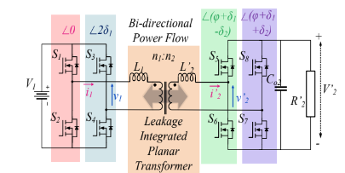
Background of the DAB Converter Topology
Applications:
for battery systems, renewable energy, solid-state transformers, and low- to medium-voltage grid applications.
Such as distributed renewable energy systems (PV or wind, residential loads, battery storage), EV charging (dc or ac grid, HV battery, LV battery/vehicle load), space power supply
Project Target:
Estimation of various Parameters of DAB
Optimize the Power loss by using the estimated parameter and predicting optimal point of operation
Power Electronics and Control Engineering (PEACE) Laboratory
2

Slide 3
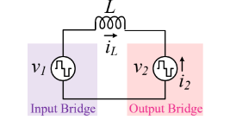
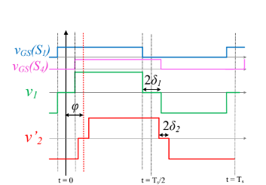
Background of the DAB Converter Topology
Equivalent Lossless model
Power Electronics and Control Engineering (PEACE) Laboratory
3

Slide 4
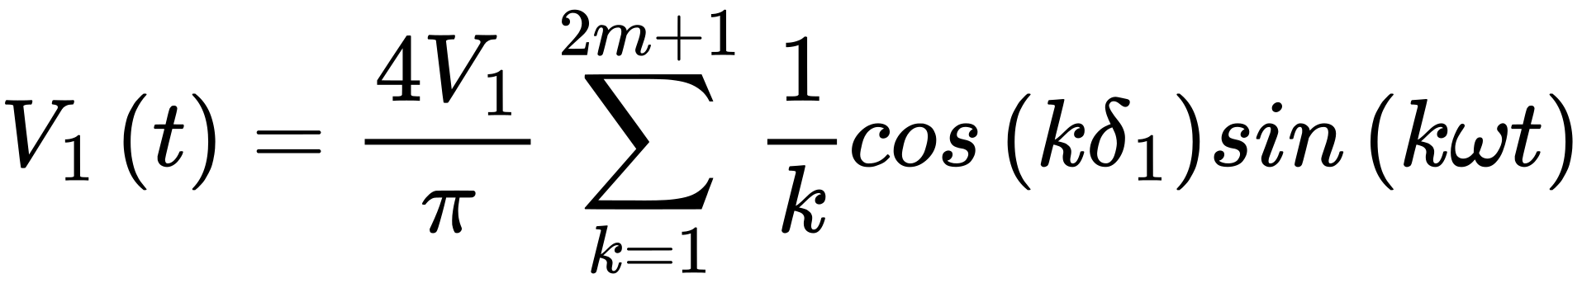
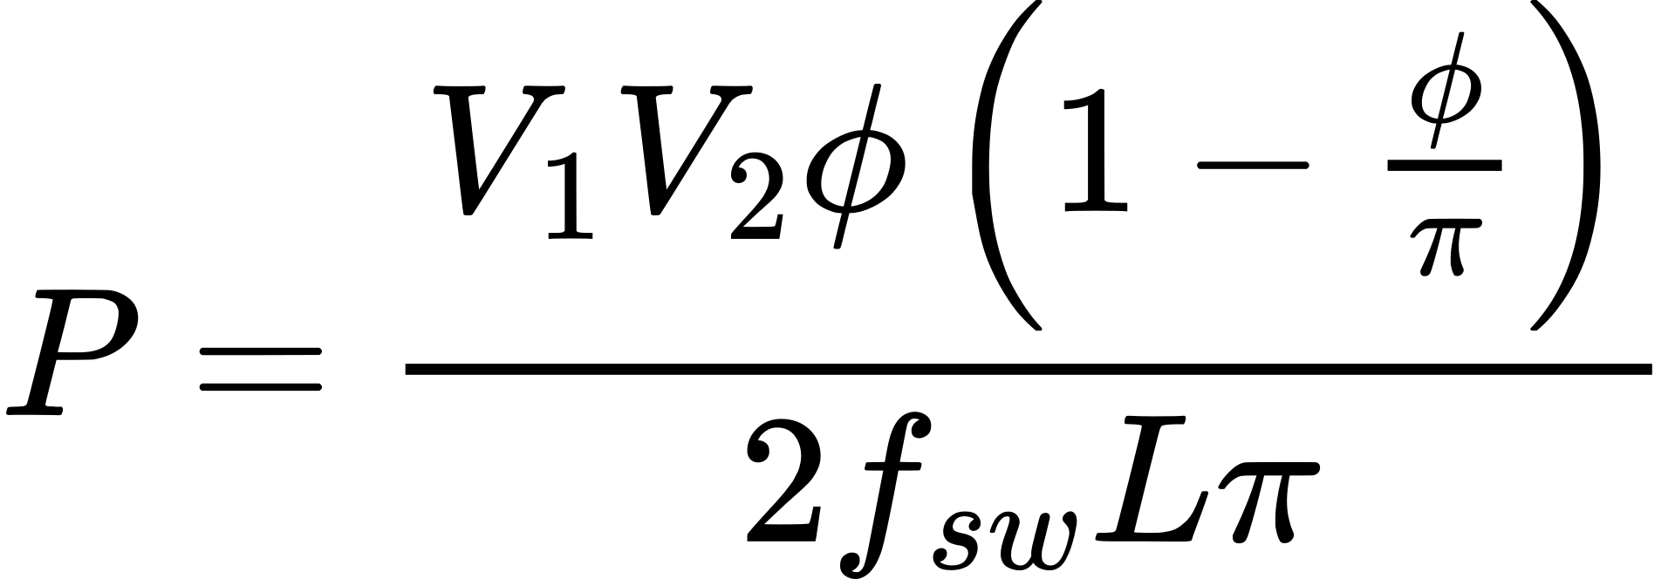
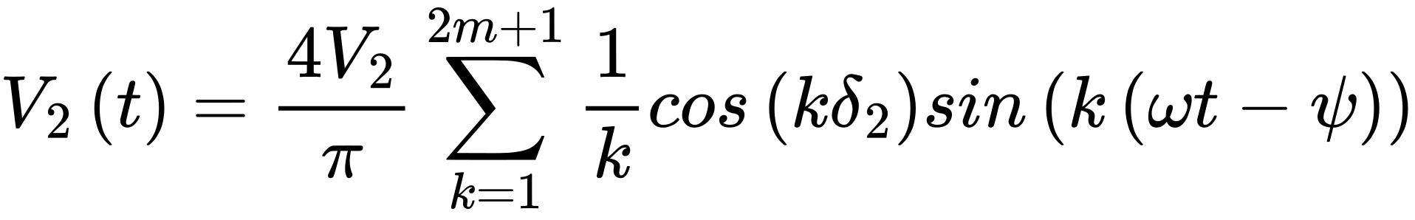
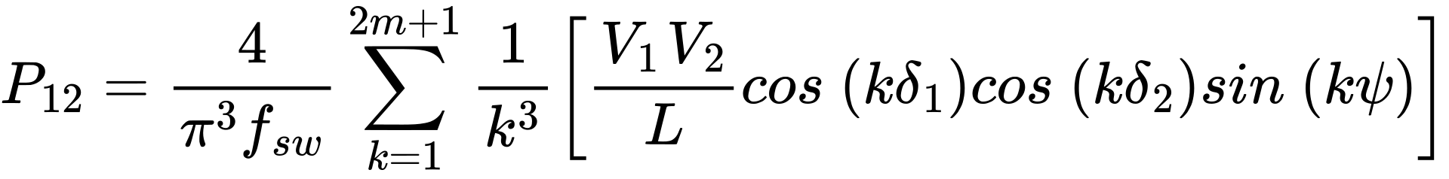
DAB Modeling
Output Power Derivation using Lossless Models
Frequency Domain
Time Domain
Power out in SPS control
Power Electronics and Control Engineering (PEACE) Laboratory
4

Slide 5
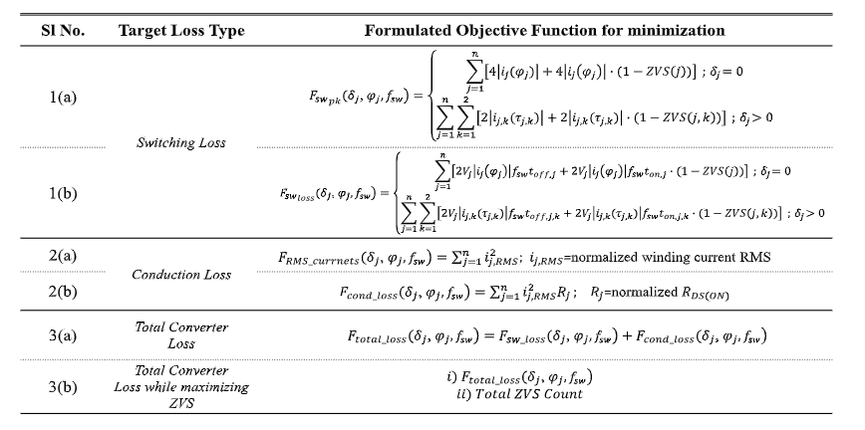
Problems in current scenario
Assumption that the converters
L,C s are constant
and does not change with time
2. All Losses cant be modelled accurately
Solving Various Power Loss equations to get a optimal Operating point
Power Electronics and Control Engineering (PEACE) Laboratory
5

Slide 6
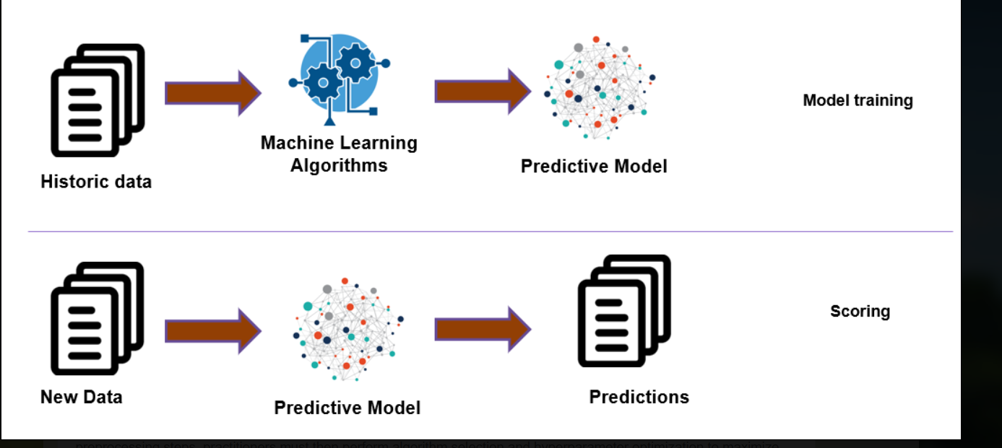


A Possible Solution
ML based adaptive loss optimization
Using Machine Learning for parametric estimation
Power Electronics and Control Engineering (PEACE) Laboratory
6

Slide 7


Machine Learning
Inputs
Phi
current(I1,I2)
Voltage(V1,V2)
Outputs
L
Rds
C
ML MODEL
Ways of Data Collection:-
Hardware Setup
Simulation Model
Mathematical solution
Power Electronics and Control Engineering (PEACE) Laboratory
6

Slide 8
COMPARISON OF SETUPS
Method
Pros
Cons
Accurate values of V,I,L
changing L -> Huge time
Hardware Setup
Some what
Accurate values
Varying all parameter
will take days of time
Simulation Model
Faster Data
Collection
Mathematical solution
Less Accurate as Losses
are not Modelled
Power Electronics and Control Engineering (PEACE) Laboratory
6

Slide 9
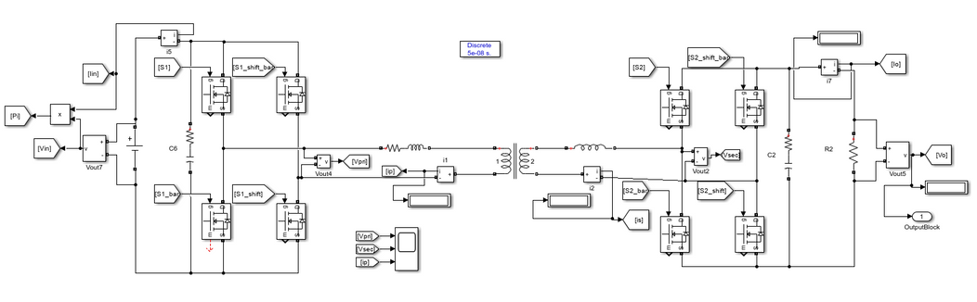
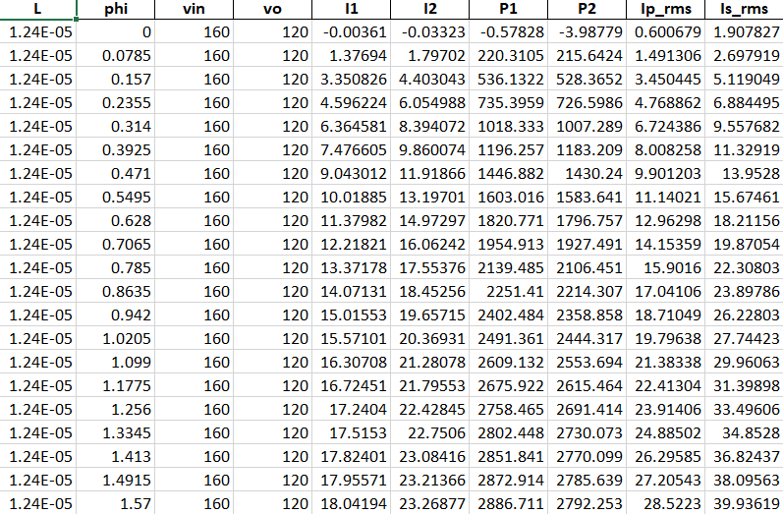

MATLAB MODEL
DATA Collection
DAB model in MATLAB
ML MODEL
Estimated L value
Power Electronics and Control Engineering (PEACE) Laboratory
6

Slide 10
MATLAB MODEL
Phi
current(I1,I2)
Voltage(V1,V2)
L
ML MODEL
DATA Collection No.
L ( +-5% in steps of 1%) 11
Phi(0 to 1.5 in steps of 0.07) 21
Total = 21*11= 231 data
Power Electronics and Control Engineering (PEACE) Laboratory
6

Slide 11
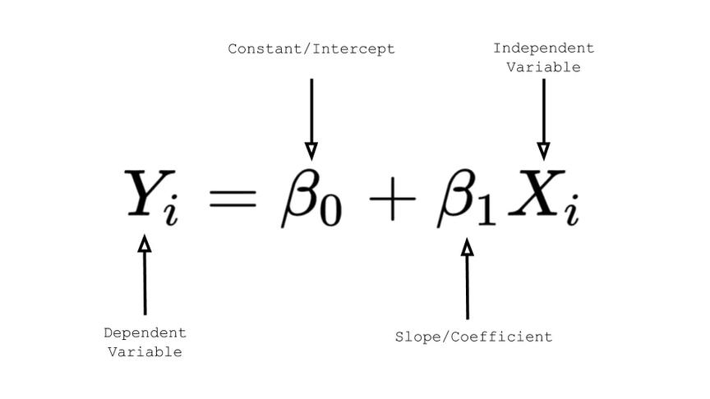

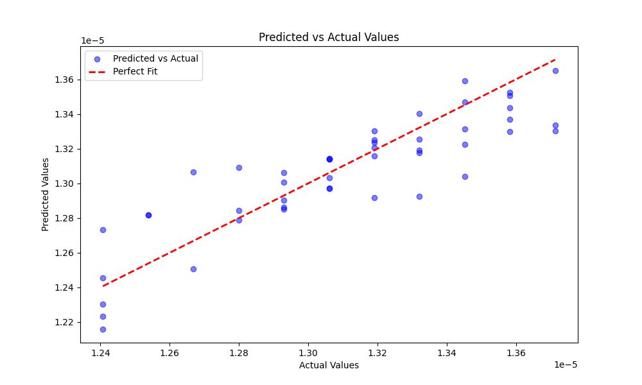

MODEL - 1 (LINEAR REGRESSION)
Average Error :
1.16%
Power Electronics and Control Engineering (PEACE) Laboratory
6

Slide 12
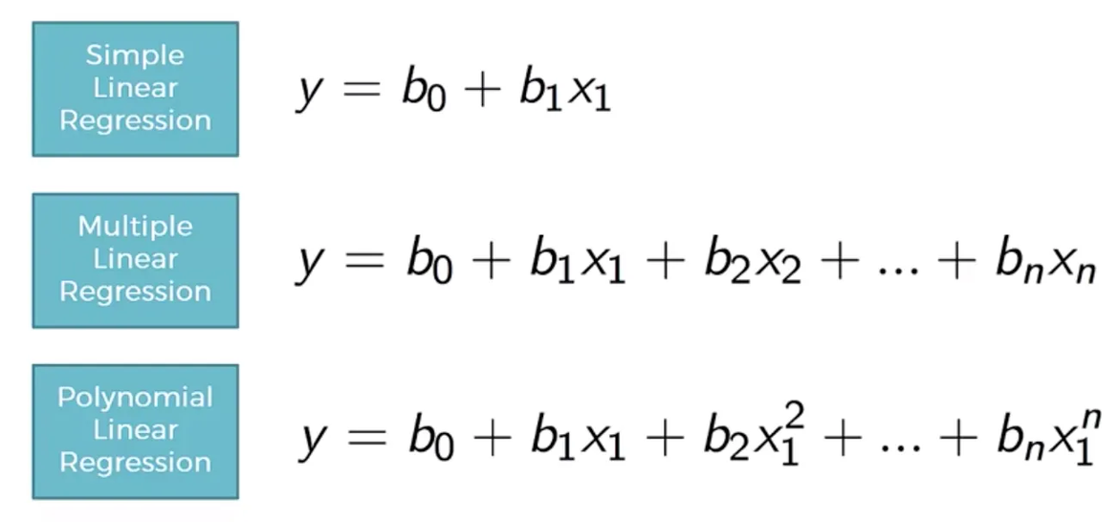
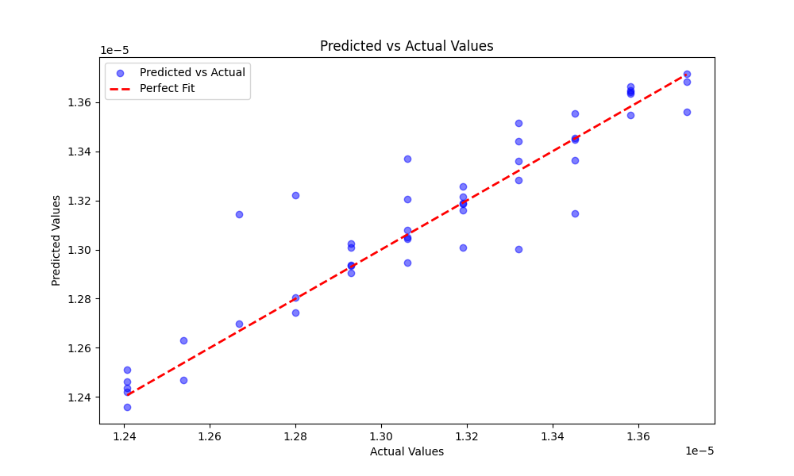

MODEL - 2 (POLYNOMIAL REGRESSION)
Degree 5 Polynomial
Average Error :
0.69%
Power Electronics and Control Engineering (PEACE) Laboratory
6

Slide 13
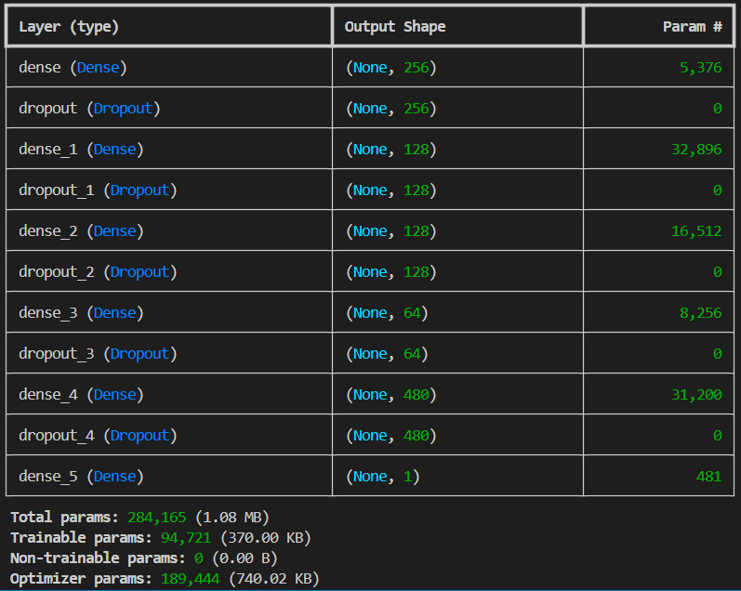
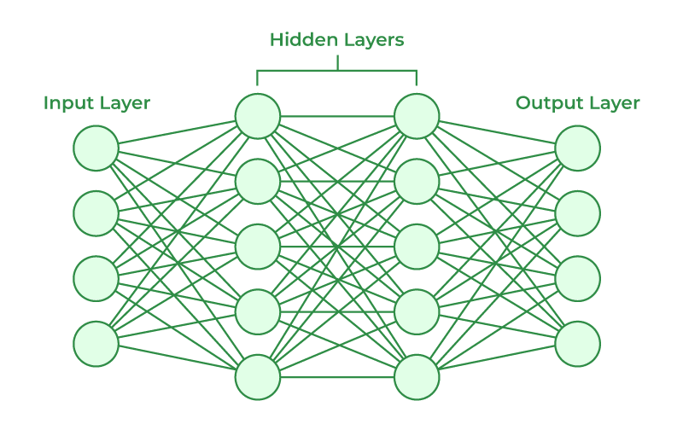
MODEL - 3 (Neural Network)
Power Electronics and Control Engineering (PEACE) Laboratory
6

Slide 14
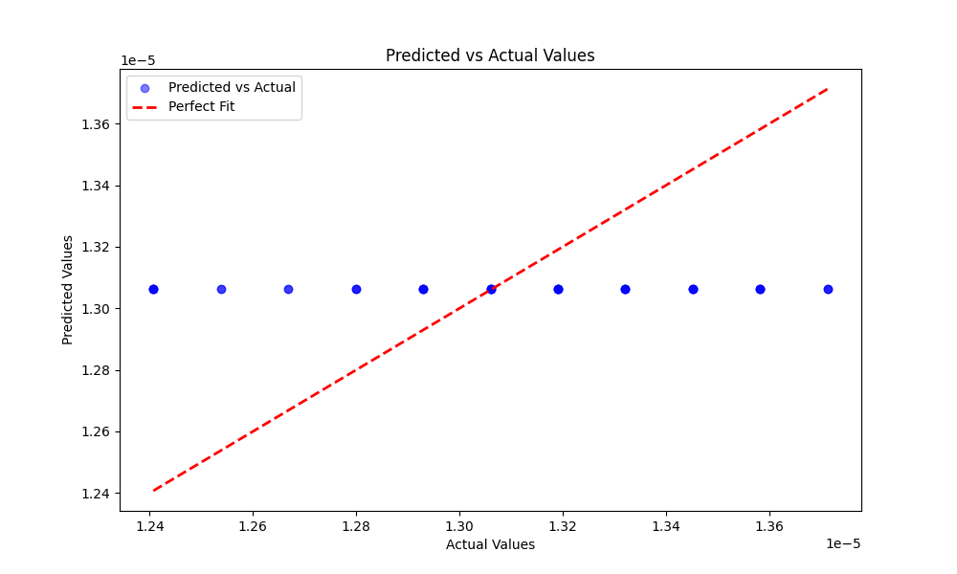

MODEL - 3 (Neural Network)
Average Error :
2.48%
Power Electronics and Control Engineering (PEACE) Laboratory
6

Slide 15
COMPARISON OF MODELS
 | 1.16%
 | 0.69%
 | 2.48%
1.Linear Regression
2.Polynomial Regression
3. Simple Neural Network
Power Electronics and Control Engineering (PEACE) Laboratory
6

Slide 16

PROBLEMS FACED
Very Slow DATA Collection i.e (230 points in ~ 4hr)
2. Simple Models gives good results due to lack of data
3. Less data leads to Poor training of Model
Solution
Using other software for DATA collection (PLECS with parallel computing )
2. USE of Other Models with Bigger DATA
6000 points in ~ 3 hr
Power Electronics and Control Engineering (PEACE) Laboratory
6

Slide 17
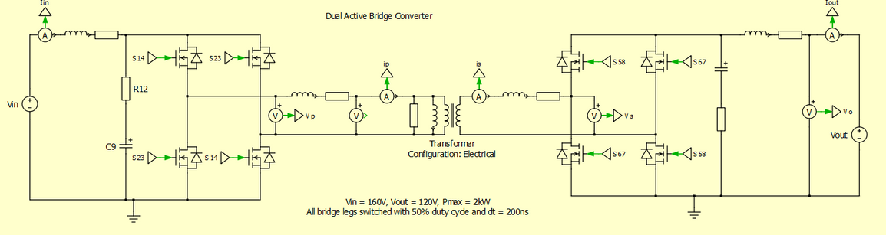
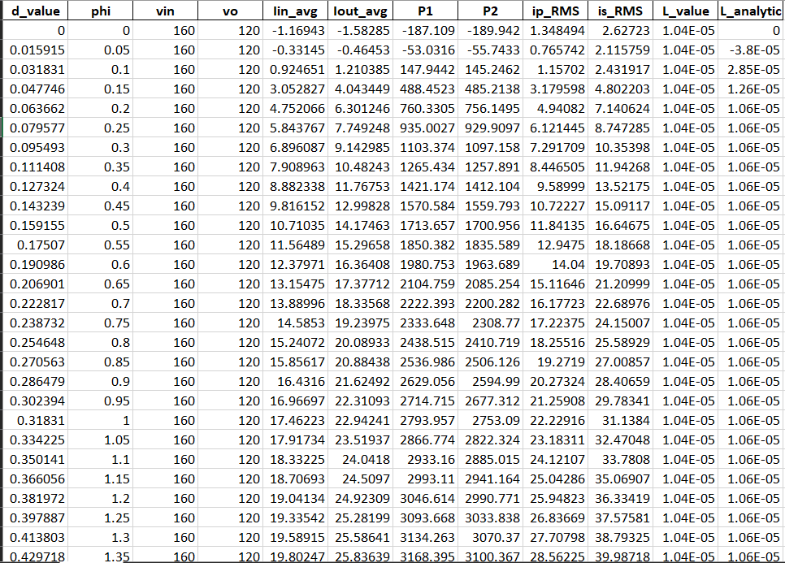
PLECS MODEL
DATA Collection
via Parallelization
DAB model in PLECS
ML MODEL
Estimated L value
Power Electronics and Control Engineering (PEACE) Laboratory
6

Slide 18
PLECS MODEL
Phi
current(I1,I2)
Voltage(V1,V2)
L
ML MODEL
DATA Collection No.
L ( +-20% in steps of 0.2%) 201
Phi(0 to 1.5 in steps of 0.05) 31
Total = 201*31= 6231 data
Power Electronics and Control Engineering (PEACE) Laboratory
6

Slide 19
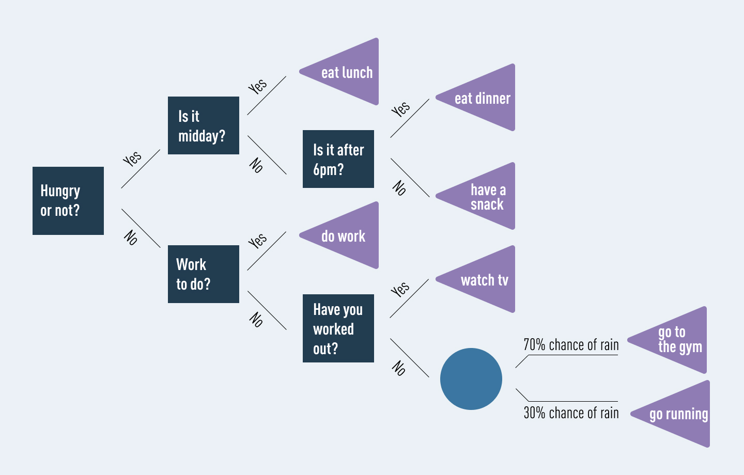
DECISION TREE
Power Electronics and Control Engineering (PEACE) Laboratory
6

Slide 20
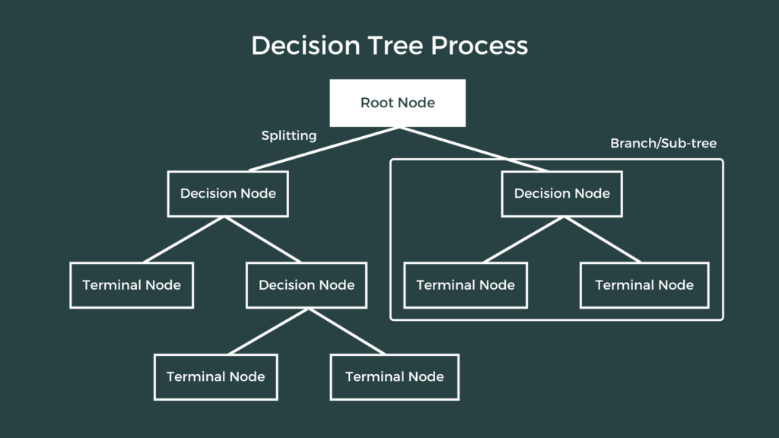
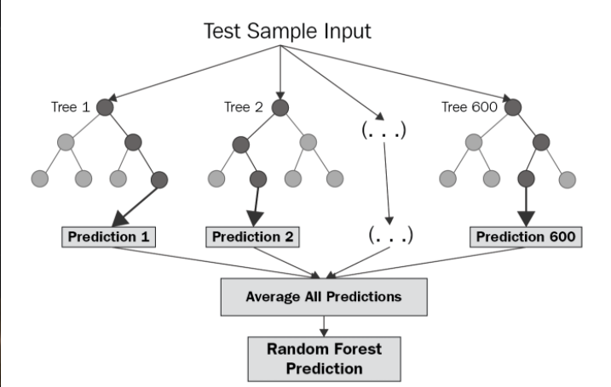
MODEL -1 (RANDOM FOREST )
RANDOM FOREST
A TREE
1. Prone To overfitting
2. Poor Generalization
Power Electronics and Control Engineering (PEACE) Laboratory
6

Slide 21
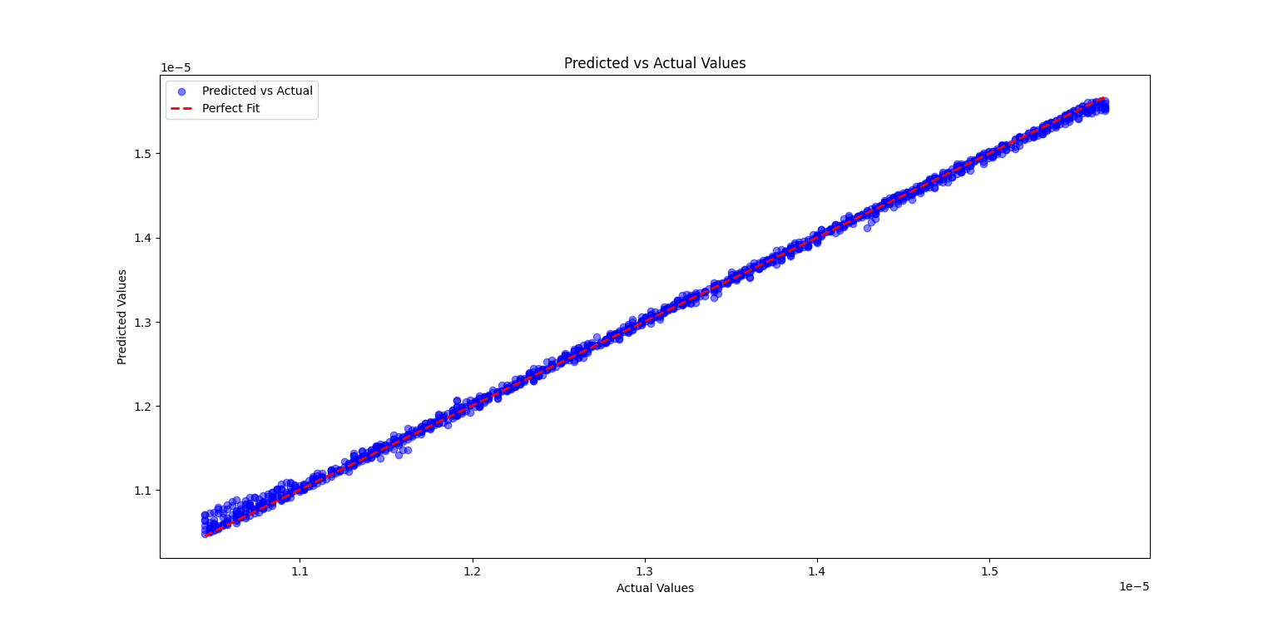

MODEL -1 (RANDOM FOREST )
0.33%
Power Electronics and Control Engineering (PEACE) Laboratory
6

Slide 22
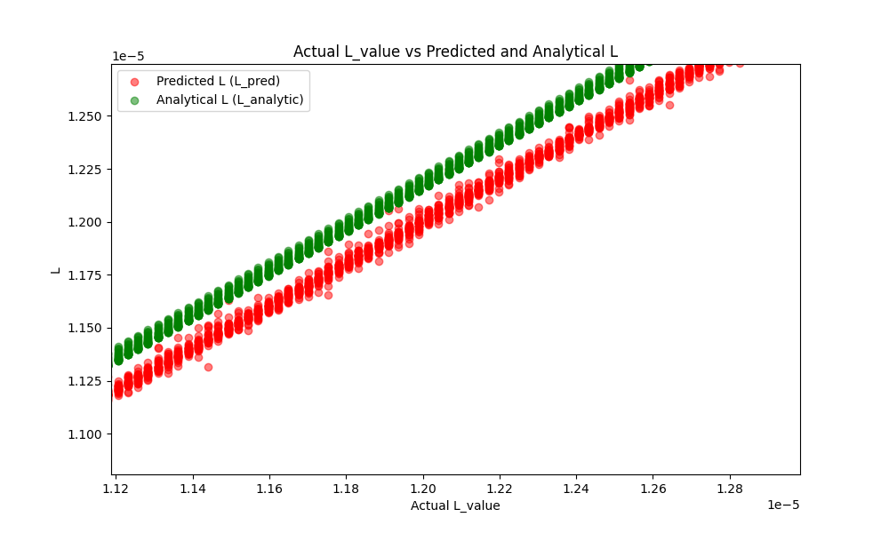
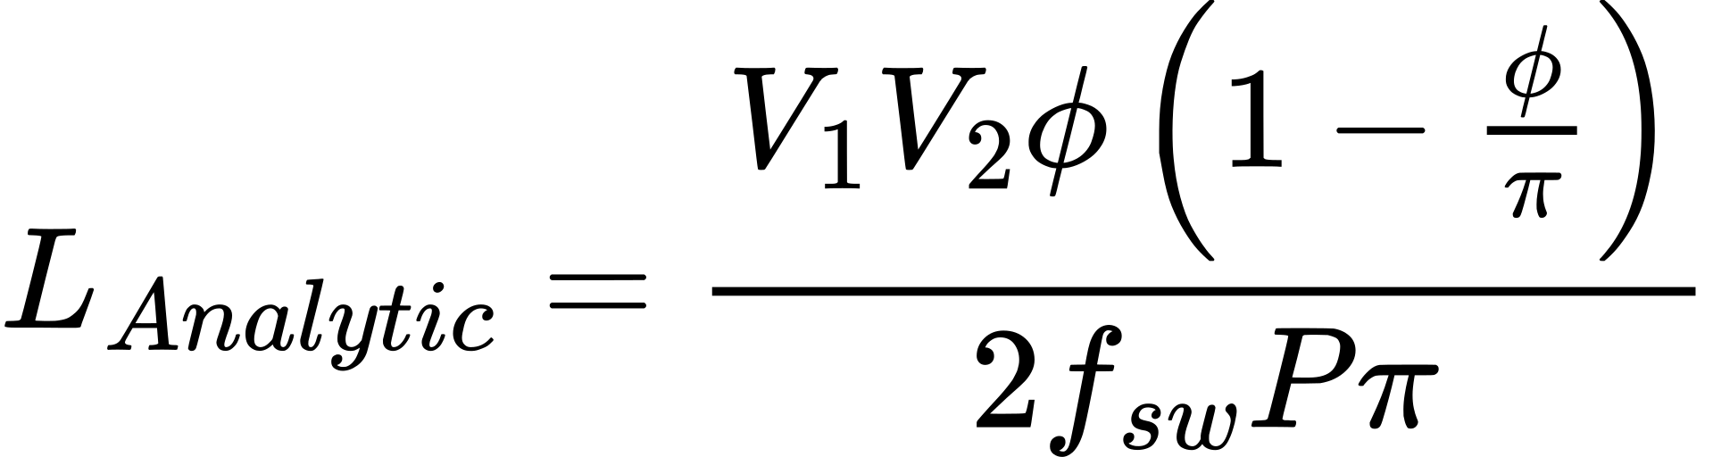
MODEL -1 (RANDOM FOREST )
Lossless
L(Analytic) should be
greater than
L(Actual & Prediction)
Average: 3%
Power Electronics and Control Engineering (PEACE) Laboratory
6

Slide 23
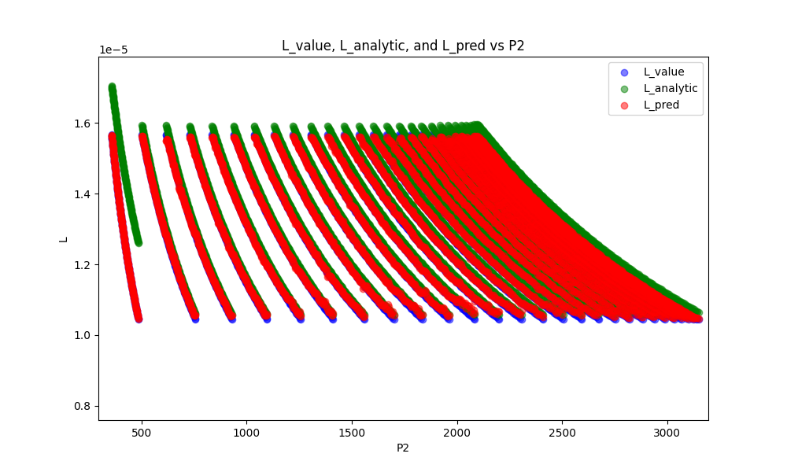

MODEL -1 (RANDOM FOREST )
L vs POWER
Power increases with increase in Phi for a fixed L
0.1 to 1.5
Phi Variation
Power Electronics and Control Engineering (PEACE) Laboratory
6

Slide 24
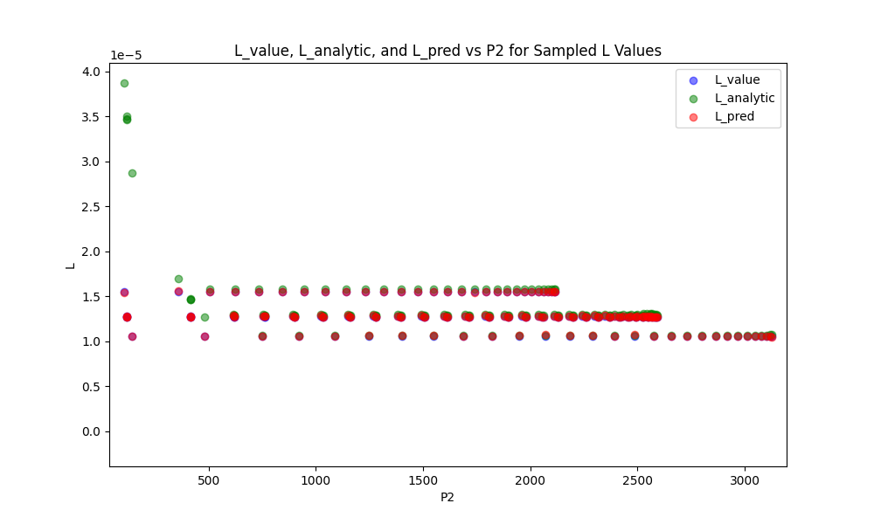
MODEL -1 (RANDOM FOREST )
L vs POWER
Power increases with increase in Phi for a fixed L
0.1 to 1.5
Phi Variation
Power Electronics and Control Engineering (PEACE) Laboratory
6

Slide 25
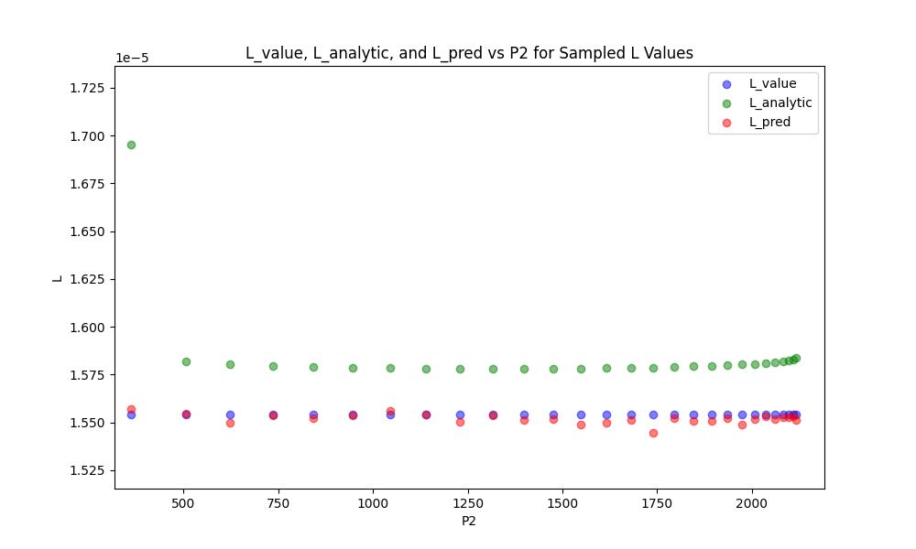
MODEL -1 (RANDOM FOREST )
L vs POWER
Phi Variation
Power increases with increase in Phi for a fixed L
0.1 to 1.5
Power Electronics and Control Engineering (PEACE) Laboratory
6

Slide 26
FURTHER PLANS
=>Collect data with more parameters(deltas)
using simulation and mathematical models
=>Using Physics constraints as loss in MODEL
=> Find a model which require Less data
and gives satisfactory results
Power Electronics and Control Engineering (PEACE) Laboratory
6

Slide 27
PLECS MODEL
DATA Collection No.
L ( +-20% in steps of 0.8%) 51
Phi(0 to 1.5 in steps of 0.1) 16
del1 (0 to 1.4 in steps of 0.2) 8
del2 (0 to 1.4 in steps of 0.2) 8
Total = 51*16*8*8= 27000 data
Power Electronics and Control Engineering (PEACE) Laboratory
6

Slide 28
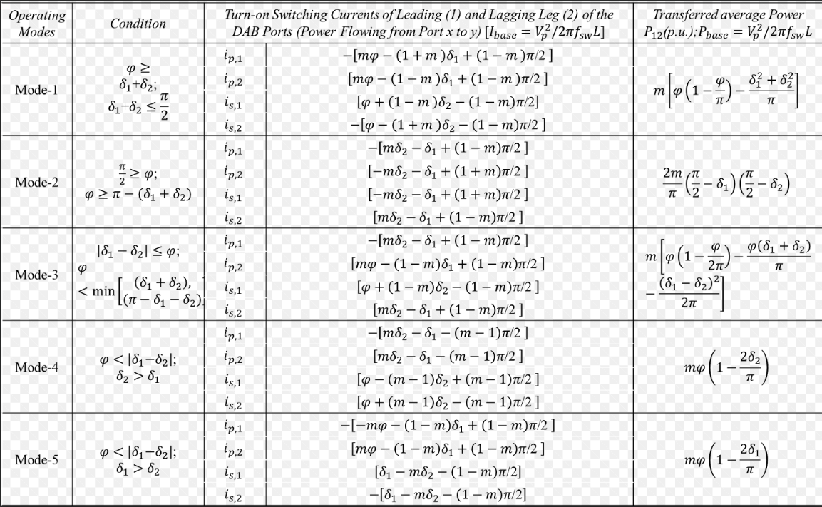
DERIVED FEATURE
L_Analytical
loss
Power Electronics and Control Engineering (PEACE) Laboratory
6

Slide 29
ML MODEL
Phi,del1,del2
current(I1,I2)
Voltage(V1,V2)
L_Analytical
loss(P1-P2)
L
ML MODEL
Power Electronics and Control Engineering (PEACE) Laboratory
6

Slide 30
MODEL -1 (RANDOM FOREST )
RANDOM FOREST
A TREE
1. Prone To overfitting
2. Poor Generalization
Power Electronics and Control Engineering (PEACE) Laboratory
6

Slide 31
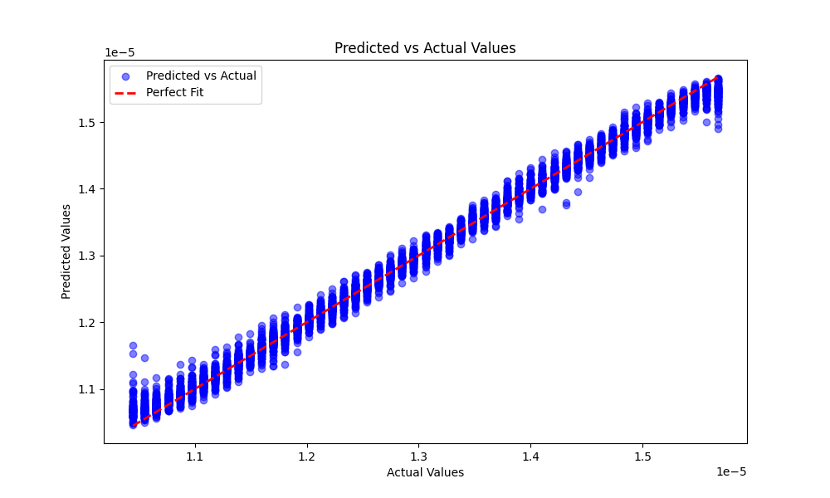
MODEL -1 (RANDOM FOREST )
Average Error :
0.6%
Power Electronics and Control Engineering (PEACE) Laboratory
6

Slide 32
MODEL - 2 (Neural Network)
5 Layers
16 nodes
sigmoid
Power Electronics and Control Engineering (PEACE) Laboratory
6

Slide 33
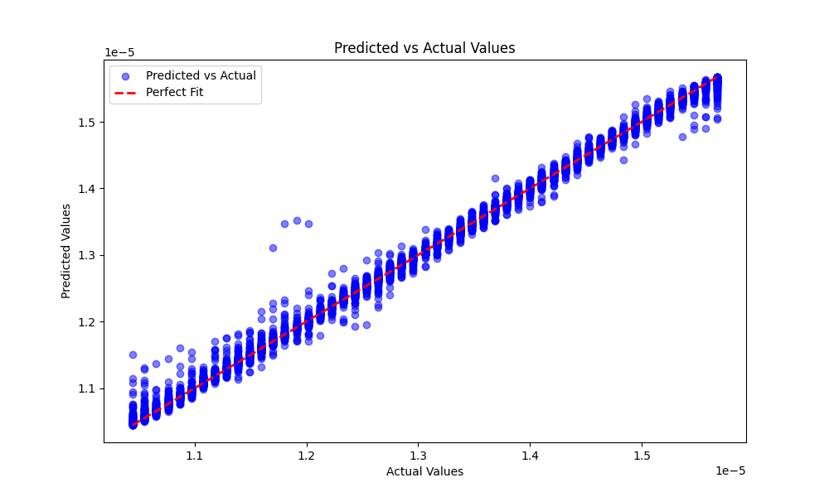
MODEL - 2 (Neural Network)
Average Error :
0.7%
Power Electronics and Control Engineering (PEACE) Laboratory
6

Slide 34

New architecture
Phi
current(I1,I2)
Voltage(V1,V2)
L_Analytical
loss(P1-P2)
L
ML MODEL
P_Emp
Physics
(P_out - P_empherical)
Power Electronics and Control Engineering (PEACE) Laboratory
6

Slide 35

New architecture
, For Now
Power Electronics and Control Engineering (PEACE) Laboratory
6

Slide 36
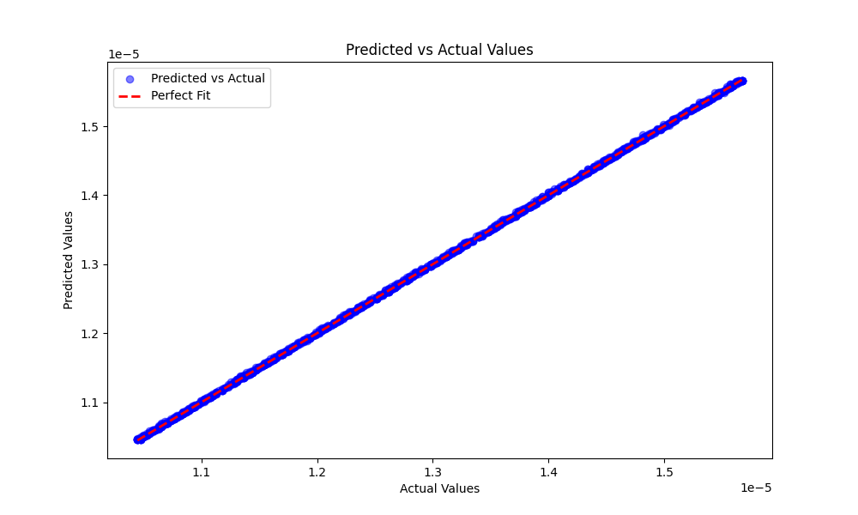
MODEL -1 (RANDOM FOREST +PI )
Average Error :
0.2%
phi only
Power Electronics and Control Engineering (PEACE) Laboratory
6

Slide 37
MODEL -1 (RANDOM FOREST +PI )
Average Error :
0.6%
phi +del
Power Electronics and Control Engineering (PEACE) Laboratory
6

Slide 38
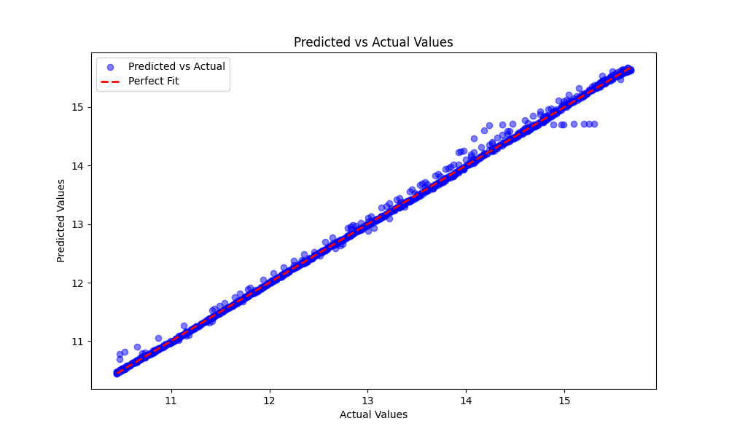
MODEL -2 ( PINN )
Average Error :
0.22%
phi only
Power Electronics and Control Engineering (PEACE) Laboratory
6

Slide 39
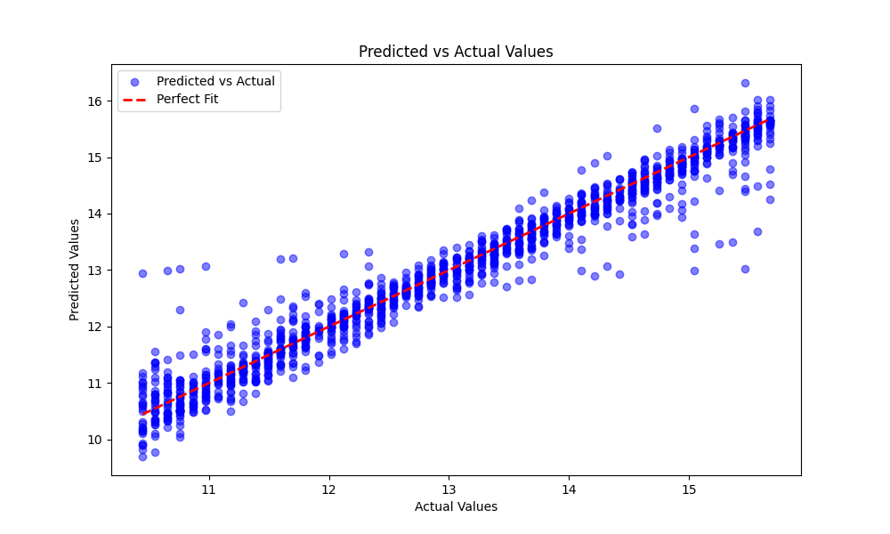
MODEL -2 ( PINN )
Average Error :
0.5%
phi +del
Power Electronics and Control Engineering (PEACE) Laboratory
6

Slide 40
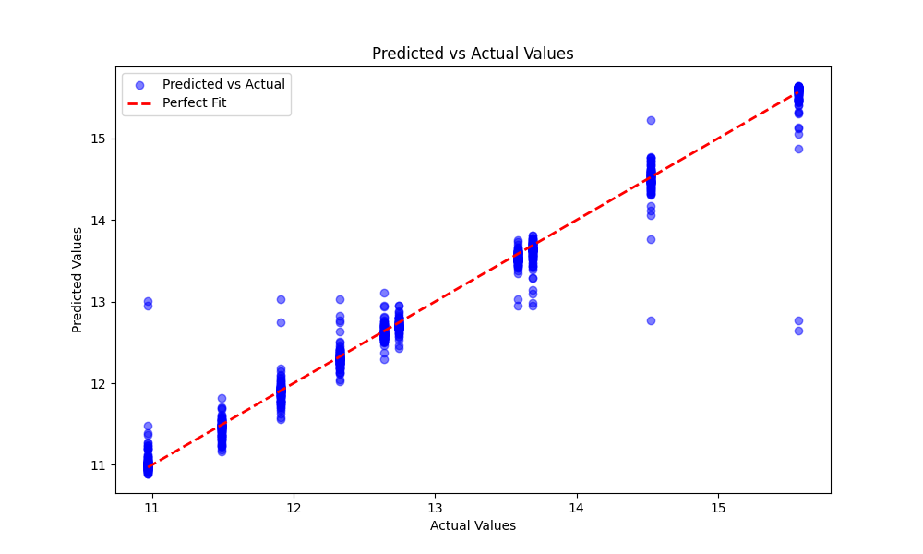
MODEL -2 ( NN )
Average Error :
0.72%
10 values of L
Power Electronics and Control Engineering (PEACE) Laboratory
6

Slide 41
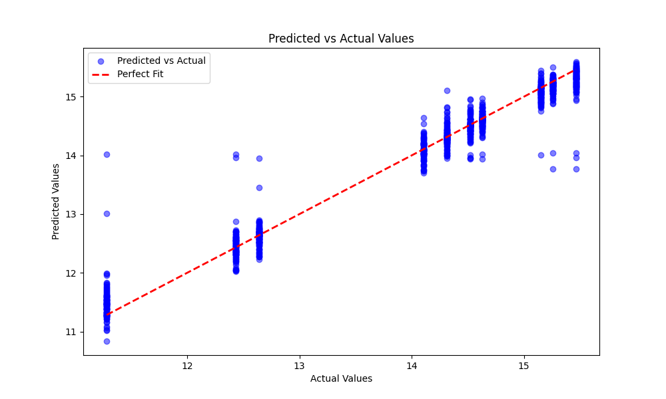
MODEL -2 ( PINN )
Average Error :
0.71%
10 values of L
Power Electronics and Control Engineering (PEACE) Laboratory
6

Slide 42
COMPARISON OF MODELS
Average error
RF
0.6%
Physics uses 1/2 of data
RF+Physics
0.6%
NN
(5,16,sig)
0.7%
PINN
(3,16,sig)
0.5%
NN(10 L)
(5,32,sig)
0.72%
PINN(10 L)
(3,32,sig)
0.71%
Power Electronics and Control Engineering (PEACE) Laboratory
6

Slide 43
PROBLEMS FACED
Very Slow Training of Model ( 3~ 4hr)
Ideal Model cant be tuned(nodes,layers,Lambda)
Solution
Using better systems to train data(Cloud ,Lab PC)
Re-Code from scratch to make it faster
Power Electronics and Control Engineering (PEACE) Laboratory
6

Slide 44
FURTHER PLANS
=> Find a better Tuned Model
=> Implement new parameters
=> validate with Hardware data
Power Electronics and Control Engineering (PEACE) Laboratory
6

Slide 45
ML MODEL
Phi,del1,del2
current(I1,I2)
Voltage(V1,V2)
L_Analytical
loss(P1-P2)
L1
L2
Ron1
Ron2
ML MODEL
Power Electronics and Control Engineering (PEACE) Laboratory
6

Slide 46
PROBLEM
Parameters
Phi
del1
del2
L1
L2
Ron1
Ron2
10 points per parameter =>10e7 points
Not possible to collect data from Hardware
Power Electronics and Control Engineering (PEACE) Laboratory
6

Slide 47
SOLUTION
Make a Math Model that simulates the hardware and generate data from it.
Steps:
Make a math model
Collect few Data from hardware
Tune the model accordingly
Test on hardware data Again
Power Electronics and Control Engineering (PEACE) Laboratory
6

Slide 48
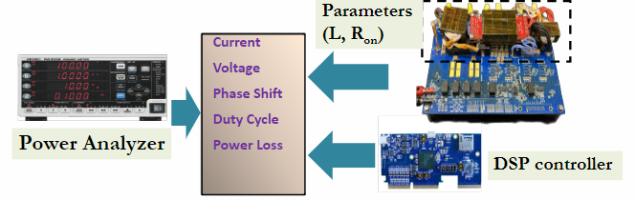
DATA COLLECTION
12 points
Hardware Data
Power Electronics and Control Engineering (PEACE) Laboratory
6

Slide 49
DATA GENERATION
Parameters No.
Phi 9
del1 8
del2 8
L1 6
L2 6
Ron1 6
Ron2 6
720000 data points
Power Electronics and Control Engineering (PEACE) Laboratory
6

Slide 50
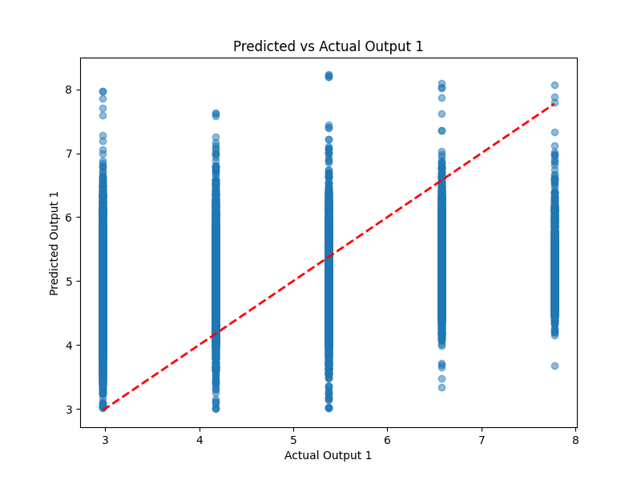
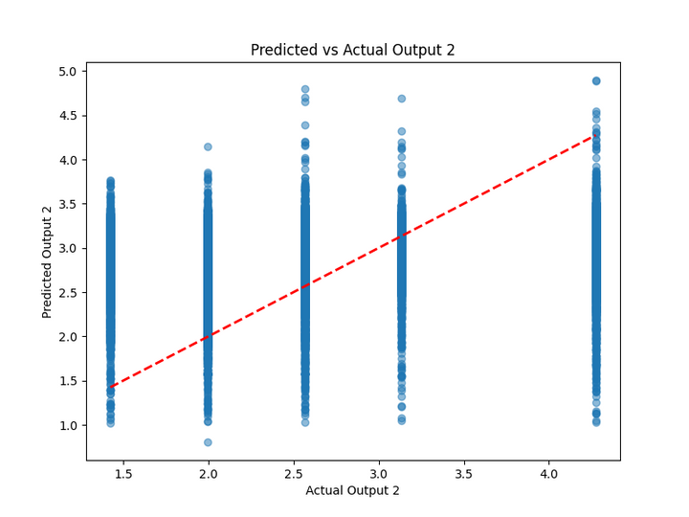
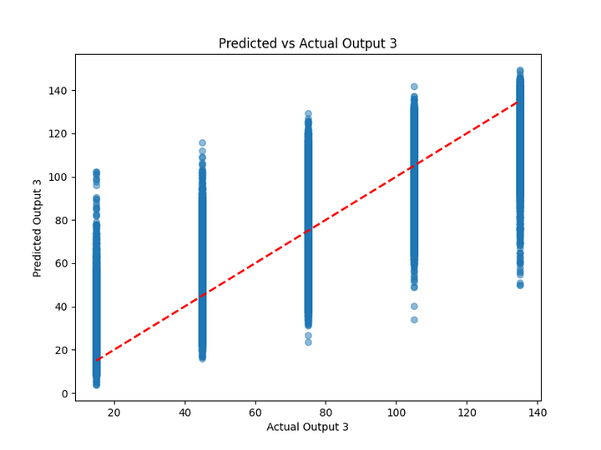
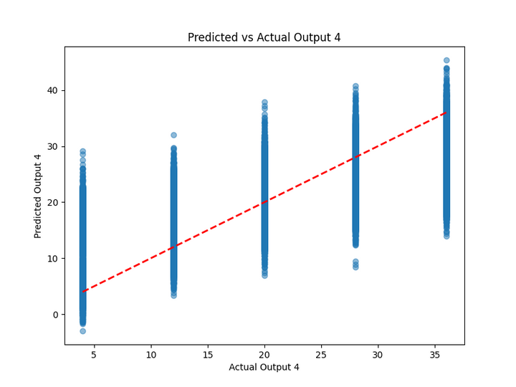
MODEL -1( NN )
Average Error :
25%
26%
22%
41%
4 Layers 16 Nodes
Power Electronics and Control Engineering (PEACE) Laboratory
6

Slide 51
FEATURE ENGINEERING
Old feature
Lanalytical
Power loss
New Features
cos(del1)
cos(del2)
sin(phi)
Power Electronics and Control Engineering (PEACE) Laboratory
6

Slide 52
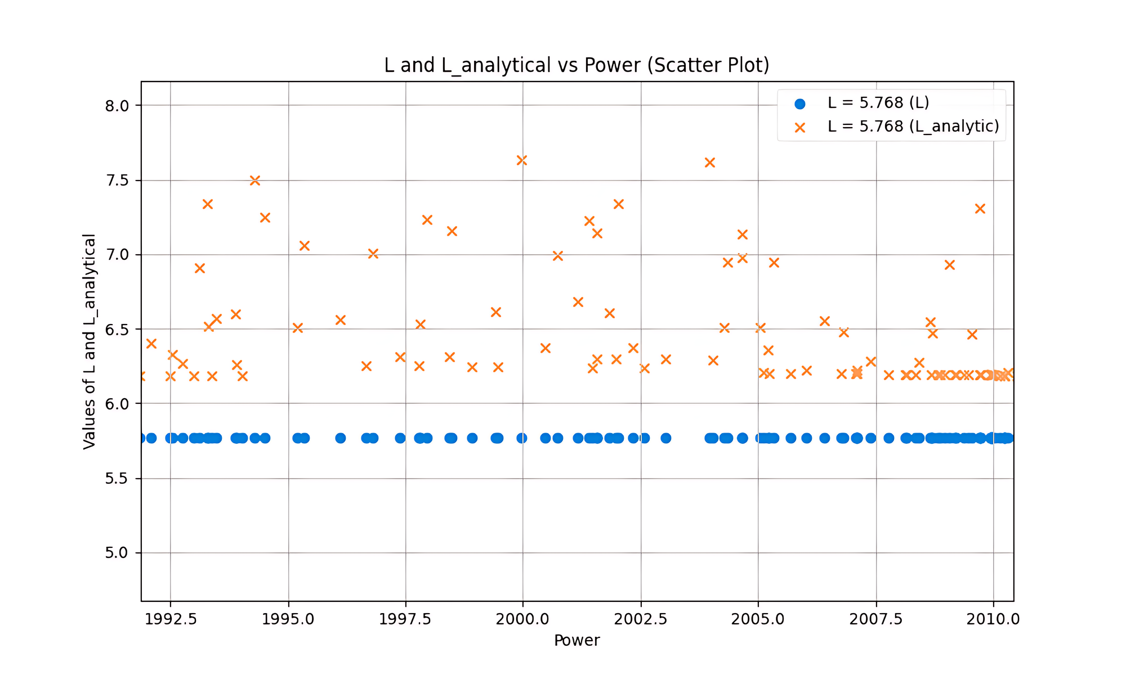
FEATURE ENGINEERING
Using Lossless Power equations
at different modes
of operation
Power Electronics and Control Engineering (PEACE) Laboratory
6

Slide 53
MODEL -1( NN )
Average Error :
20%
19%
19%
38%
4 Layers 32 Nodes
Power Electronics and Control Engineering (PEACE) Laboratory
6

Slide 54
POSSIBLE REASONS
1. Data closer to actual value ; NN cannot fit it
2. More number of outputs (complex)
3. Large Data for single output i.e Less variation in L
4. stuck at Local Minima
Power Electronics and Control Engineering (PEACE) Laboratory
6

Slide 55
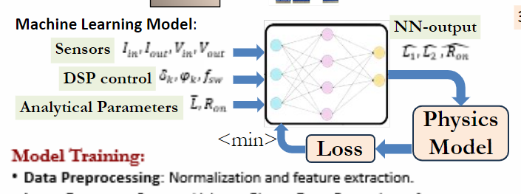
PINN
Power Electronics and Control Engineering (PEACE) Laboratory
6

Slide 56
PINN
Implementation Problem
Default Libraries uses tensors to calculate y_pred
Converted the power func to operate over tensors
2. Converted func cant be integrated with NN
System crashes due to complexity of code/errors
Solution
code from scratch without libraries
read tensor documents to integrate
Power Electronics and Control Engineering (PEACE) Laboratory
6

Slide 57
POSSIBLE SOLUTION
Train Different NN for different outputs
Average Error :
4%
4%
1. L1 and L2
(2 Layer 32 Nodes)
19%
37%
2. Ron1 and Ron2
(3 Layer 64 Nodes)
Power Electronics and Control Engineering (PEACE) Laboratory
6

Slide 58
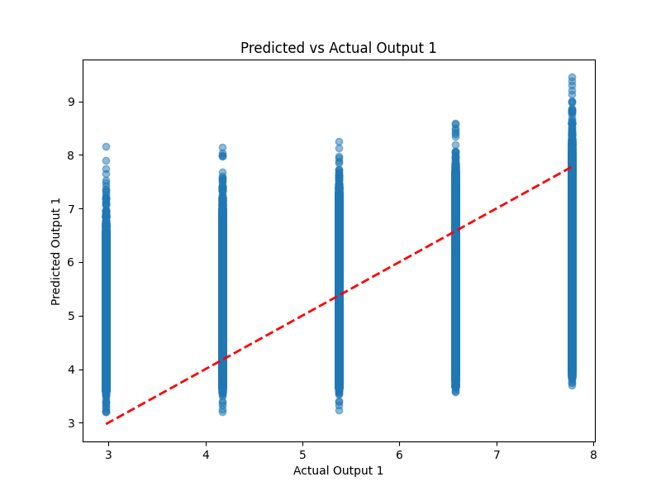
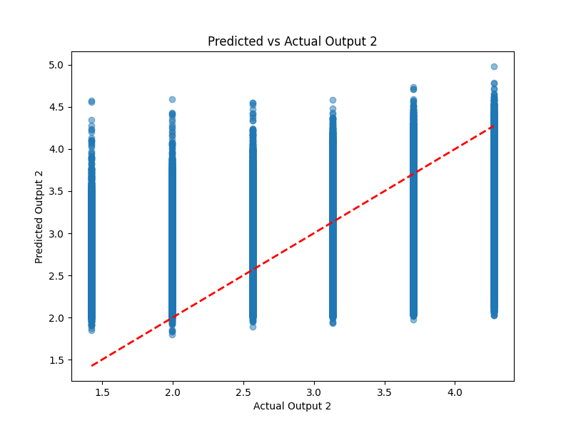
POSSIBLE SOLUTION
L1 and L2 (2 Layer 32 Nodes)
Power Electronics and Control Engineering (PEACE) Laboratory
6

Slide 59
COMPARISION
NN 4 Layers 16 Nodes
Average Error :
25%, 26%, 22%, 41%
NN 4 Layers 32 Nodes
(more features)
Average Error :
20%, 19%, 19%, 38%
Average Error :
4%, 4%
L1 and L2 (2 Layer 32 Nodes)
Ron1 and Ron2 (3 Layer 64 Nodes)
Average Error :
19%, 37%
Power Electronics and Control Engineering (PEACE) Laboratory
6

Slide 60
FUTURE WORK
Implement PINN
Try Genetic Algorithm for best weights
Implement it on Hardware
Power Electronics and Control Engineering (PEACE) Laboratory
6

