Slide 1
Normalization of social media text for better translation accuracy
By Sanat Deshpande and Lionel Eisenberg

Slide 2
The problem
Text is increasingly informal (Politics done over tweets, censorship through Facebook etc.)
More and more messaging takes place on social media where the focus is not on proper grammar, punctuation, formal words etc…
How do you translate the following? (real tweets)
“Do stdnts ever hve prblms readin assined stuff”
“wya boi we finna roll”
“nah im chillin w/ friends”

Slide 3
The solution
Beam Search Normalizer to transform social media text into something translatable, that resembles normal English.
”wya boi” → “where are you at boy” → “where are you at boy?”
“nah im chillin w/ friends” → “no i’m hanging with friends” →”no, I’m hanging with friends,”
Combine a beam search decoder and a combination of difference sentence transformers.
Apply a branching series of transformations, and prune based on a language models score at every step

Slide 4
Corpora/Datasets
Tweet Set
3.6M Tweets, made available with location information for another study
We could ignore the metadata
Small English Language Dataset
This was used for our simple language model, as a means of scoring hypotheses we produced
Dictionaries
Formal Word
Contractions
Interjections

Slide 5
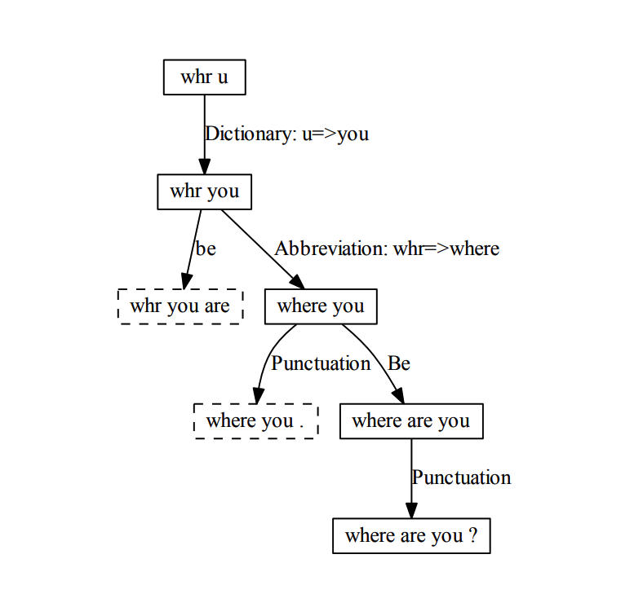
example from reference paper
After each branching point, a score is calculated based on the following
A language model score
The difference between the phrase and its predecessor
The number of informal words in the final phrase

Slide 6
Hypothesis Producers (some examples)
Interjection
Removing phrases like “Oh!”, “Shoot!”, “Wow!”
Time
“Meet me at 5” -> “Meet me at 5 o’ clock”
“It’s at 8pm” -> “It is at 8 PM”
Dictionary
“tbh that test was hard” -> “to be honest that test was hard”
Apostrophe
“Well talk later” -> “We’ll talk later”
“shed submitted the paper” -> “she’d submitted the paper”
Retonkenization
“ohh , cool .” -> “ohh, cool”
Punctuation
“where are you -> “where are you?”
Abbreviation (vowel omission)
“srsly” -> “seriously”
Prefix
“wanna grab din” -> “wanna grab dinner”

Slide 7
Findings
Average Language Model Improvement of -0.3201 (log prob)
Note this means our normalization rendered the text worse
Several Reasons
Language Model itself
Improvement through training on a larger corpus
Several Hypothesis producers like the dictionary had to be sourced by us
Access to more comprehensive dictionaries
Higher level statistical methods for correcting punctuation
Homophone Matching
The dataset posed the additional challenge of a high usage of slang, and mix of foreign words

