Slide 1

Lens

Slide 2
Problem statement
Develop an application that tracks and monitors facility equipment such as HVAC systems, elevators etc.
Prediction of future maintenance needs and potential failure using ML algorithms

Slide 3

OUR SOLUTION
Dashboard depicting historical, current and future metric of facility equipment.
Reactive and proactive notification system for upcoming services and faults
Machine Learning models to detect fault/ anomalies based on Sensor Data
Estimates of Average service and delay times optimized for urgency to ensure uninterrupted functioning
Room wise appliance status

Slide 4

ANOMALY DETECTION and analytics
Considered Sensor Data features such as:
Supply Air Temperature
Airflow Rate
Relative Humidity
Zone Temperature Carbon Dioxide (CO2) Concentration
Temperature Setpoints
Humidity Setpoints
Outdoor Temperature
Outdoor Humidity
Performed anomaly detection and predicted the occurrence of anomalies
Using maintenance records and the provided fictitious dataset, average time interval between consecutive services and leeway times after detection of fault were predicted
This can be filtered against asset type, manufacturer or other relevant filters present on the intuitive UI to tailor it to business needs

Slide 5
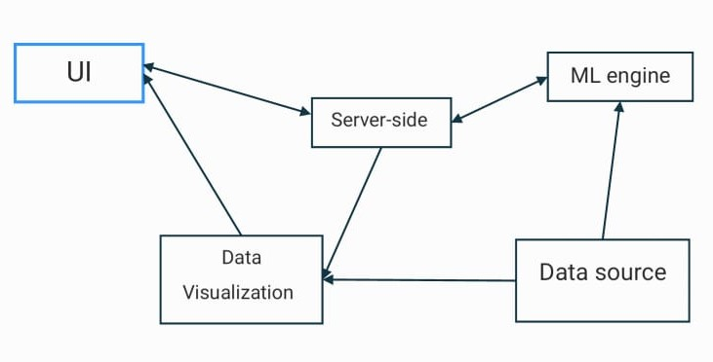
Workflow

Slide 6
TECH USED
Python (SciKitLearn)
Linear Regression
DBScan
Python
Isolation Forest
HTML, CSS, JS
Bootstrap
Sensor Data
Maintenance Data
Tableau

Slide 7
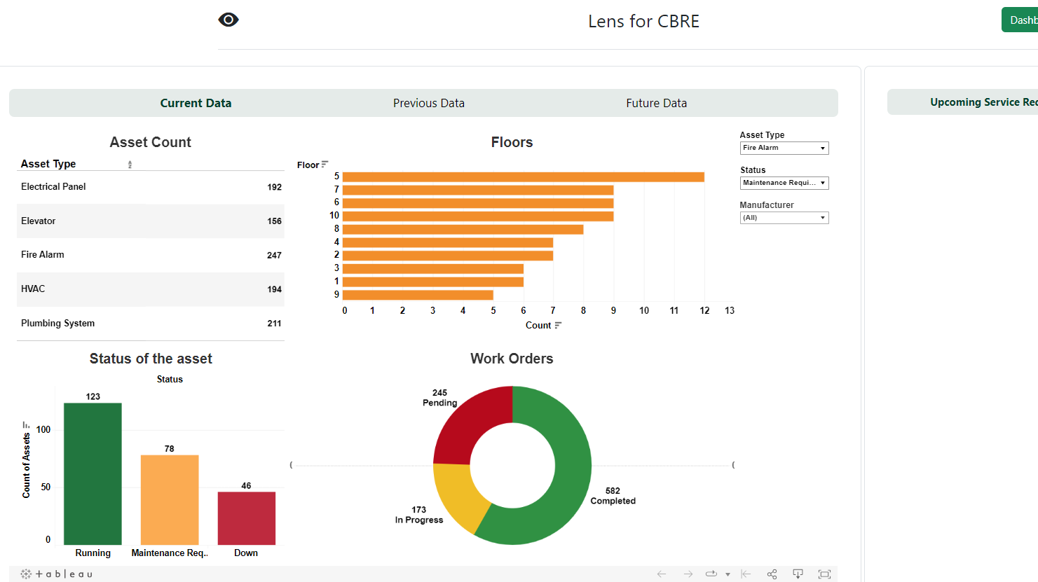
DEMO

Slide 8
Recommendations
Average Service Interval Insights: -better understand the typical maintenance frequency required for each asset type
Fault Patterns and Anomaly Detection:- identify common patterns of anomalies that precede equipment faults
Service Time Optimization:
Facilities can prioritize urgent service requests and allocate resources efficiently to ensure uninterrupted equipment functioning.
Equipment-Specific Maintenance Needs:

Slide 9
Future work
Incorporation of real-world datasets
Onboarding of new assets
Performance Benchmarking
Compliance and Reporting

Slide 10

THANK YOU!
Questions?

