Slide 1
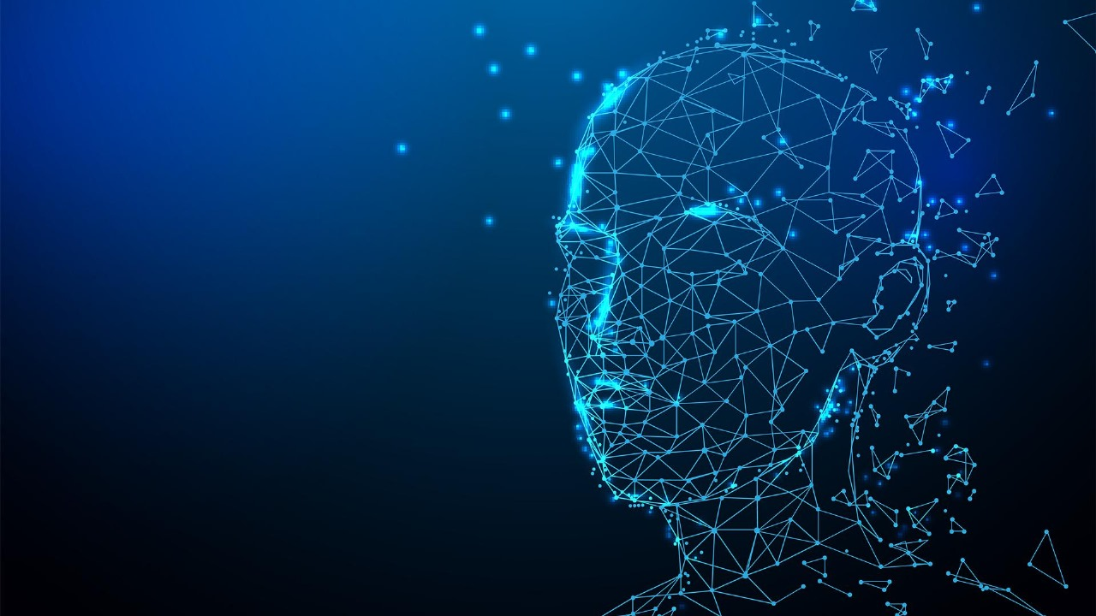
Personalized Intelligent Assistant.
M.Sanath 1602-21-737-171
K.Shashank Goud 1602-21-737-174
C.Shreya Sree 1602-21-737-177

Slide 2
Motivation:
This Personalized intelligent Assistant is very helpful for the people who are very busy in their daily chores and have less time to complete their project work within time so in this case intelligence assistant is very helpful. This reduces the work time on a particular task. By using the assistant we can minimize work time. This also helps the students to access web easily and search the items they want.

Slide 3

Problem Statement:
Develop a personal intelligent assistant application capable of understanding natural language commands, accessing and processing information from various sources, and performing automated tasks to improve user efficiency and provide a personalized experience.

Slide 4

Abstract:
This abstract introduces an innovative intelligent project management assistant that seamlessly integrates image recognition, voice commands, and real-time query support. Users can upload images, which the assistant analyzes to annotate the data. Additionally, users can interact with the assistant using natural language commands and queries, facilitating hands-free operation. The assistant also offers real-time responses to project-related questions, leveraging a comprehensive knowledge base.

Slide 5

Existing System:
The existing systems for intelligent assistants, such as Siri, Google Assistant, and Alexa, are built on artificial intelligence (AI) and machine learning (ML) technologies. These systems use natural language processing (NLP) algorithms to understand and respond to user commands and queries. They can perform various tasks like answering questions, providing information.
Proposed Solutions:
In addition to the existing features mentioned above we're also adding extra feature by incorporating code input, the assistant will directly assist students in efficiently annotating objects within the image. This functionality differentiates our assistant from current offerings like Google Assistant, Siri, and Alexa, which primarily focus on web searches and task completion.

Slide 6
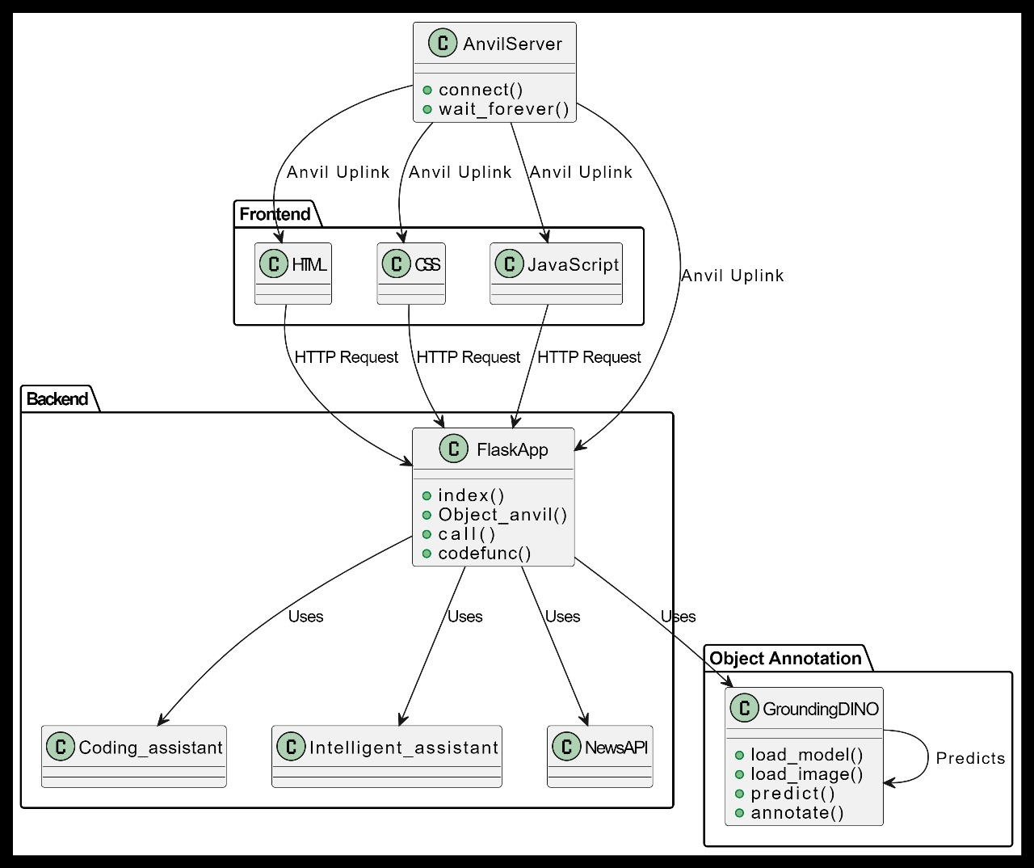
System Architecture

Slide 7
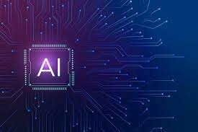
Technology Stack
Software Requirements :
Language : Python
Dataset : COCO
Libraries in python:
Speaker recognition
Anvil
gtts
Pygame
request
Supervision
API Calls
Gemini api
Custom search V1
News api

Slide 8
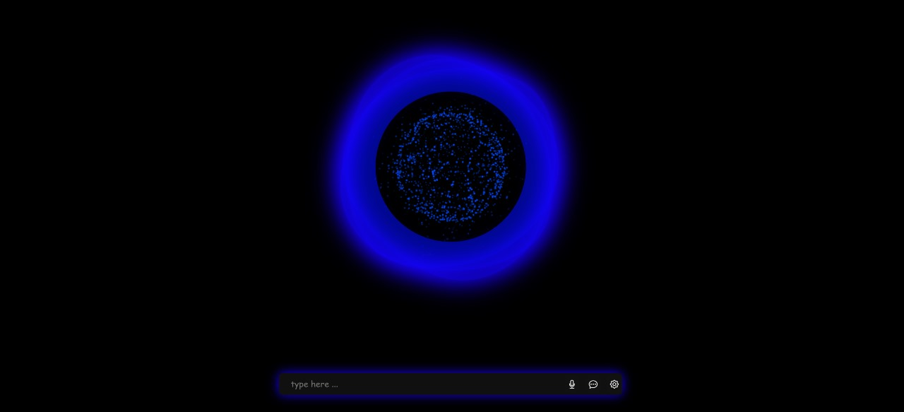
Result and Screenshots

Slide 9
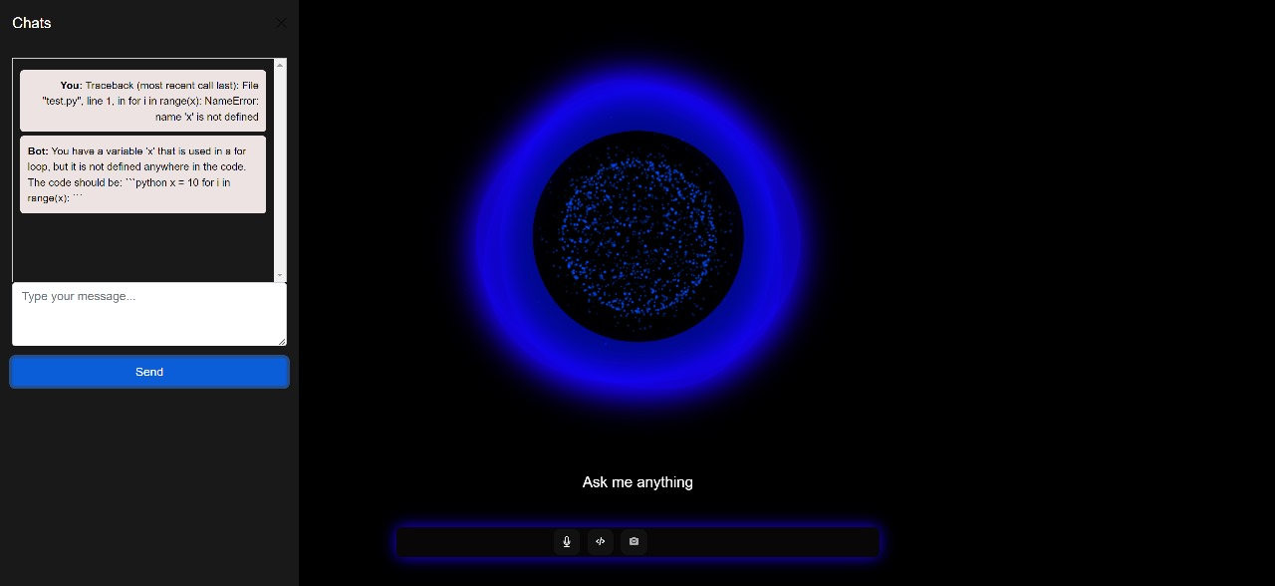

Slide 10
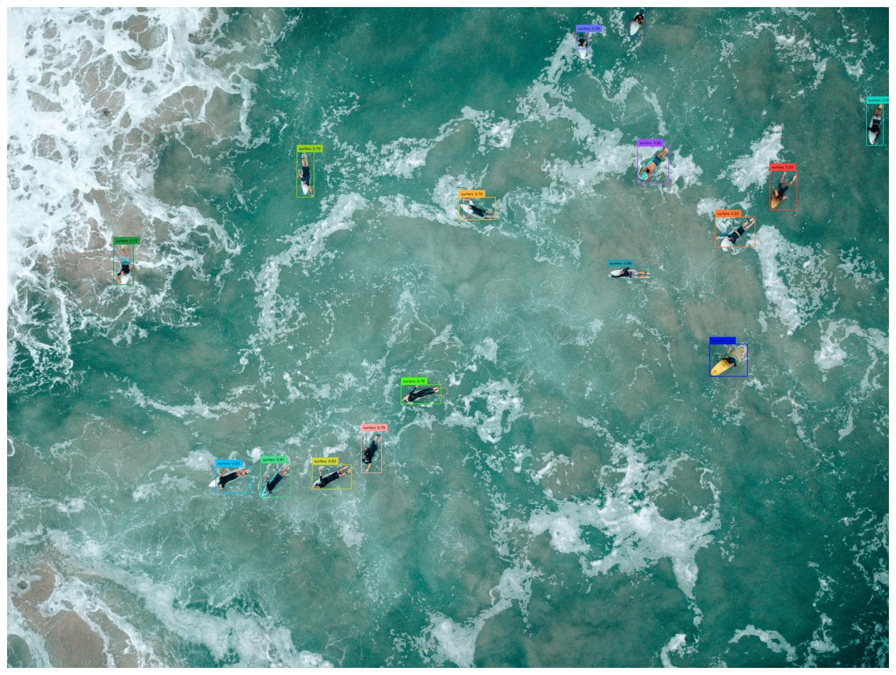

Slide 11
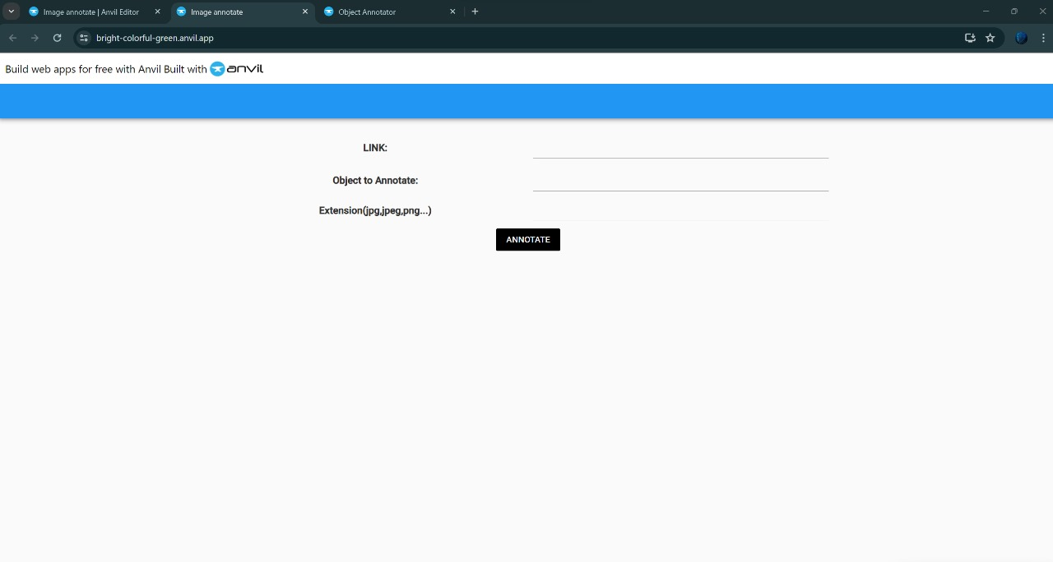

Slide 12
Conclusion:
This project has successfully developed a novel intelligent assistant that bridges the gap between image understanding and student learning. By leveraging the Gemini API, custom search functionalities, and image processing techniques, the assistant empowers students to efficiently annotate objects within images based on prompts. This innovative approach sets it apart from existing virtual assistants like Google Assistant, Siri, and Alexa, which primarily focus on web searches and task completion.

Slide 13
Future Scope:
Advanced Image Recognition: Move beyond basic object annotation. Integrate object property recognition (size, color, material) and scene understanding (actions, relationships between objects).
Multimodal Learning: Allow users to combine image input with voice prompts or text descriptions for richer annotations.
Subject-Specific Annotations: Tailor the annotation experience to different subjects (science, history, literature) by offering pre-defined annotation labels or integrating with educational databases.

Slide 14
References:
https://github.com/IDEA-Research/GroundingDINO
https://github.com/roboflow/notebooks
https://developers.google.com/custom-search/v1/overview
https://ai.google.dev/

Slide 15


