Slide 1
Securitysense
Information Security Dashboard
Copyright © 2014
Securitysense, www.securitysense.org
Confidential
1

Slide 2
Dashboard : Focus Area
Access Control
Change Control
System Update (Patch/Virus/Malware)
Security Incident Control
Awareness Effectiveness
Vulnerability Assessment
Backup Operations
Firewall / IPS Control
Compliance Effectiveness
Confidential
2

Slide 3
Dashboard : Access Control
Confidential
3

Slide 4
Dashboard : Change Control
4

Slide 5
Dashboard : Patch and Virus
5

Slide 6
Dashboard : Security Incident
6

Slide 7
Dashboard : Security Awareness
7

Slide 8
Dashboard : Vulnerability Assessment
Confidential
8

Slide 9
Dashboard : Backup Operation
9

Slide 10
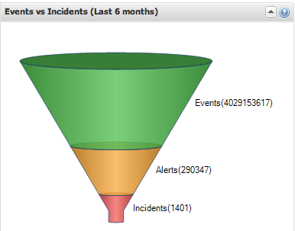
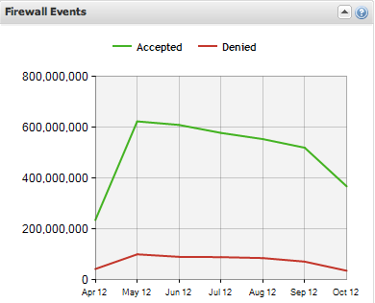
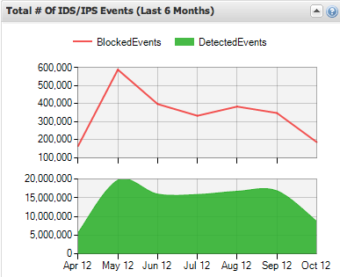
Dashboard : Firewall/IPS Control
10
Notes:
Information security event- An information security event indicates that the security of an information system, service, or network may have been breached or compromised. An information security event indicates that an information security policy may have been violated or a safeguard may have failed.
Information security incident- An information security incident is made up of one or more unwanted or unexpected information security events that could very likely compromise the security of information and weaken or impair business operations.

Slide 11
Dashboard : Compliance Effectiveness
Confidential
11

Slide 12
Dashboard : Office LAN Access
Confidential
12

Slide 13
Dashboard : Firewall & IPS
Access Control
Total Access | Unauthorized Attempt
2400 | 1000
Confidential
13

Slide 14
Dashboard : Software License Usage
* Additional 2 licenses will be adjusted under Oracle database consolidation project.
*SQL Server license need to re-evaluate.
*1000 E-Mail Archive License under procurement
Confidential
14

Slide 15
Dashboard : Sharefolder
Confidential
15

Slide 16
Security Does Matter
THANK YOU

