Slide 1
Linear Regression Project Presentation
Sanaz Salari

Slide 2
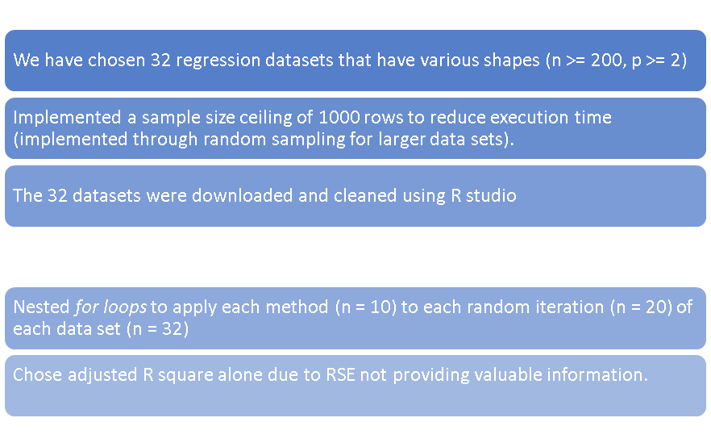
1) Project Approach & Setup
Also measured computation time.

Slide 3
Regression Methods
stats::lm() fitting linear methods for regression
rpart::rpart() recursive partitioning and decision trees
GLMnet
glmnet::glmnet() for ridge estimating coef. of regression for possible multicollinear predictors
glmnet::glmnet() for lasso enhance regression through shrinkage of variable selection and regularization
glmnet::glmnet() for elastic net attempts to combine penalties of lasso & ridge to regularize regression
Robust Regression
MASS::rlm() fit a linear model for robust regression through M-estimators
MASS::lqs() resistant regression to fit good points in a dataset; high breakdown point for estimator
Support Vector Machines
svm::svm() consider points within a decision boundary and develop a line of best fit
Ensemble
randomForest::randomForest() deep, independent ensemble regression, using multiple algorithms to fit the most accurate model
gbm::gbm() weak, shallow, successive trees form an ensemble committee to learn from previous and form an accurate model

Slide 4
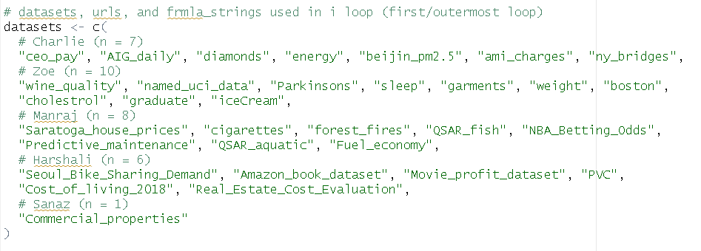
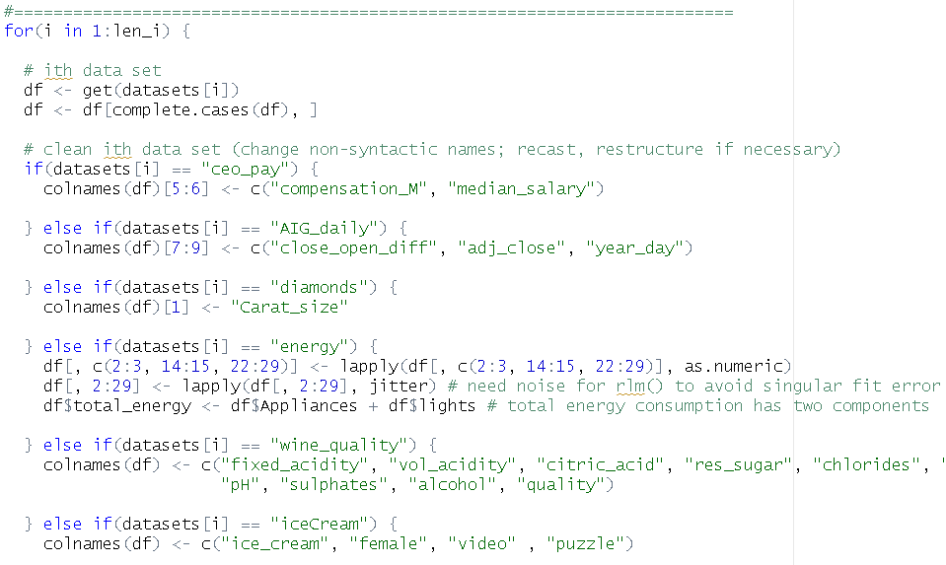
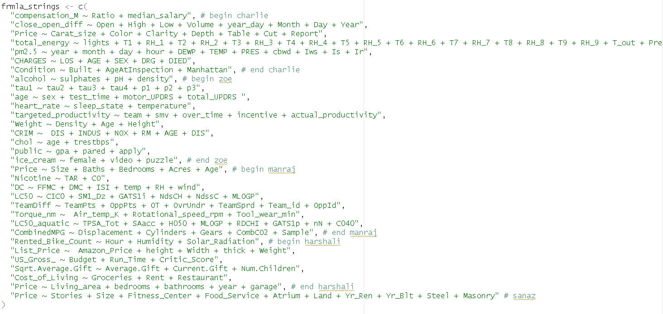
Dataset Cleaning & Manipulation
Above: Dataset nicknames; Bottom: Formula strings
Above: Snippet of data cleaning methodology

Slide 5
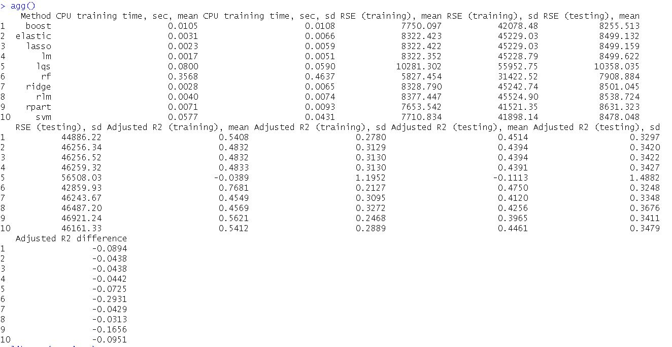
Aggregation of 20 Iterations

Slide 6
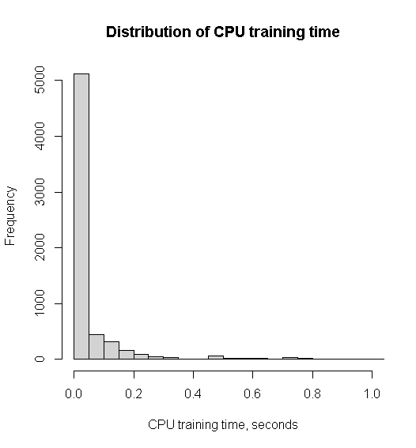
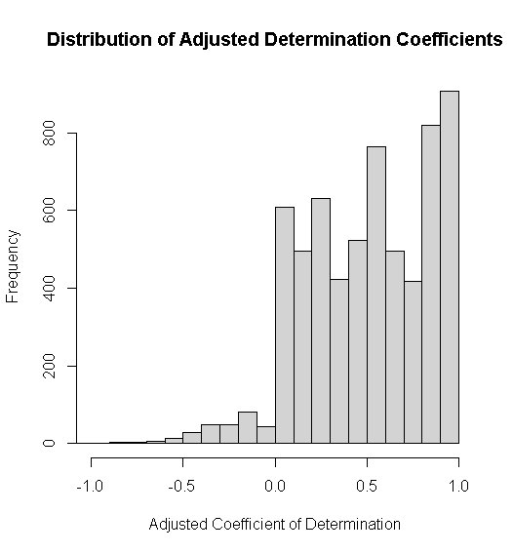
Performance metrics: distributions

Slide 7
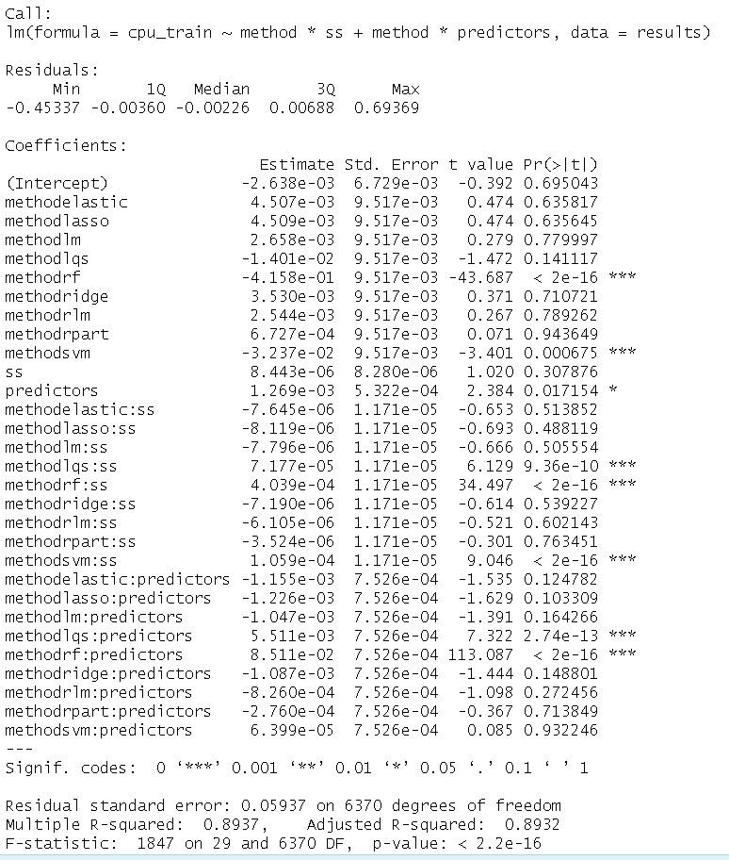
Computation Performance

Slide 8
Conclusion
Accuracy
Most methods had similar “out of the box” accuracy; exhibited minimal bias-variance trade-off
randomForest::randomForest()
Best training accuracy; greatest bias-variance trade-off
MASS::lqs()
Overall performed poorly
Computational cost
Tree methods took the longest
Random forest an outlier for computation time
Trivial at small scale, but could be problematic at larger scale
Data sets highly suggestive of linear relationships

